Slide 1

How to write a case study analysis

Slide 2

What is the case study model?
It is to prepare students to interpret and analyse real life situations in business.
All case studies are prepared in the form of a formal report.
The following format must be used.

Slide 3

Structure
Introduction (approximately 300 words)
Provide a summarised statement of the problem from the case study
Provide the aims and objectives of your research/report
Provide the structure of the rest of the report

Slide 4

Structure
Description of the Situation (Situation analysis) Approximately 300 words.
Provide an overview of the company with the description of the situation/problems that the company is facing based on your interpretation of the case study.

Slide 5

Structure
Problem Statement, Plan of analysis (Approx. 1000 words)
Provide a summarised statement of the problem (similar to the statement of the problem that you provided in the introduction) but with emphasis on major issues.
Based on the issues identified in the case, list and describe relevant functional areas, the issues relating to each functions and specific concepts / models / theories / resources / techniques that will help you to analyse the issues.

Slide 6
The table below can serve as an example:
S/N | Functional Area of Study | The Problem/Issue | The Theory to Use
1 | Strategic management | What are the strategic issues you identified? | What are the relevant strategic theories / concepts / models you will use to analyse the issue?
2 | Finance | What are the financial related issues you identified? | What are the relevant financial theories / concepts / models you will use to analyse the issue?
3 | Etc.

Slide 7
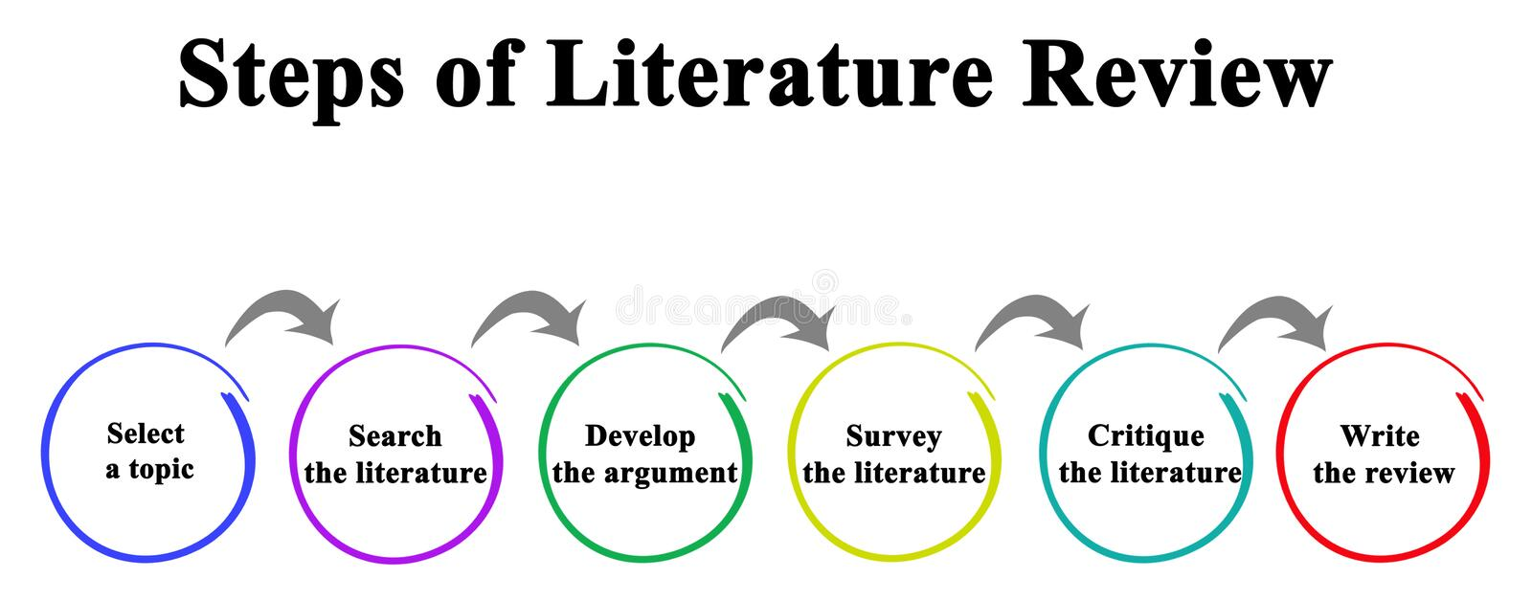
Structure
Conduct a literature review of the concepts, theories, models, resource and techniques you proposed in your plan of analysis.
(Your review should explain, analyse and evaluate the concepts, theories, models, resource and techniques). Citations are required.

Slide 8

Structure
Analysis & Findings (Approx. 800 words)
Assess / analyse the problems / issues / current positions facing the company using relevant concepts, theories, models, resource and techniques that you had reviewed in your literature review.
(Derived from applying the principles and practices of the concepts, theories and models referred to and discussed in section 3)

Slide 9

Structure
Proposed Solution to Problem (Approx. 600words)
Based on the problems and issues you identified and analysed, generate ideas or alternative solutions to the problems and issues.
Choose or suggest a “best fit” solution from any options you might have offered
b. Recommendations
Explain the limitations of the study and provide an action plan of addressing the limitations or scope for further research

Slide 10

Structure
Reference List
Appendices
This section will contain all the documentation, data, financial reports etc. used in the case analysis

