Slide 1
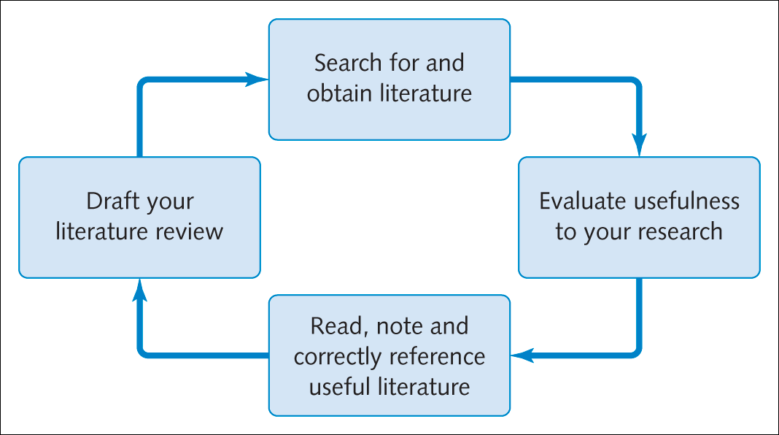
Figure 2.1 The process of reviewing the literature

Slide 2
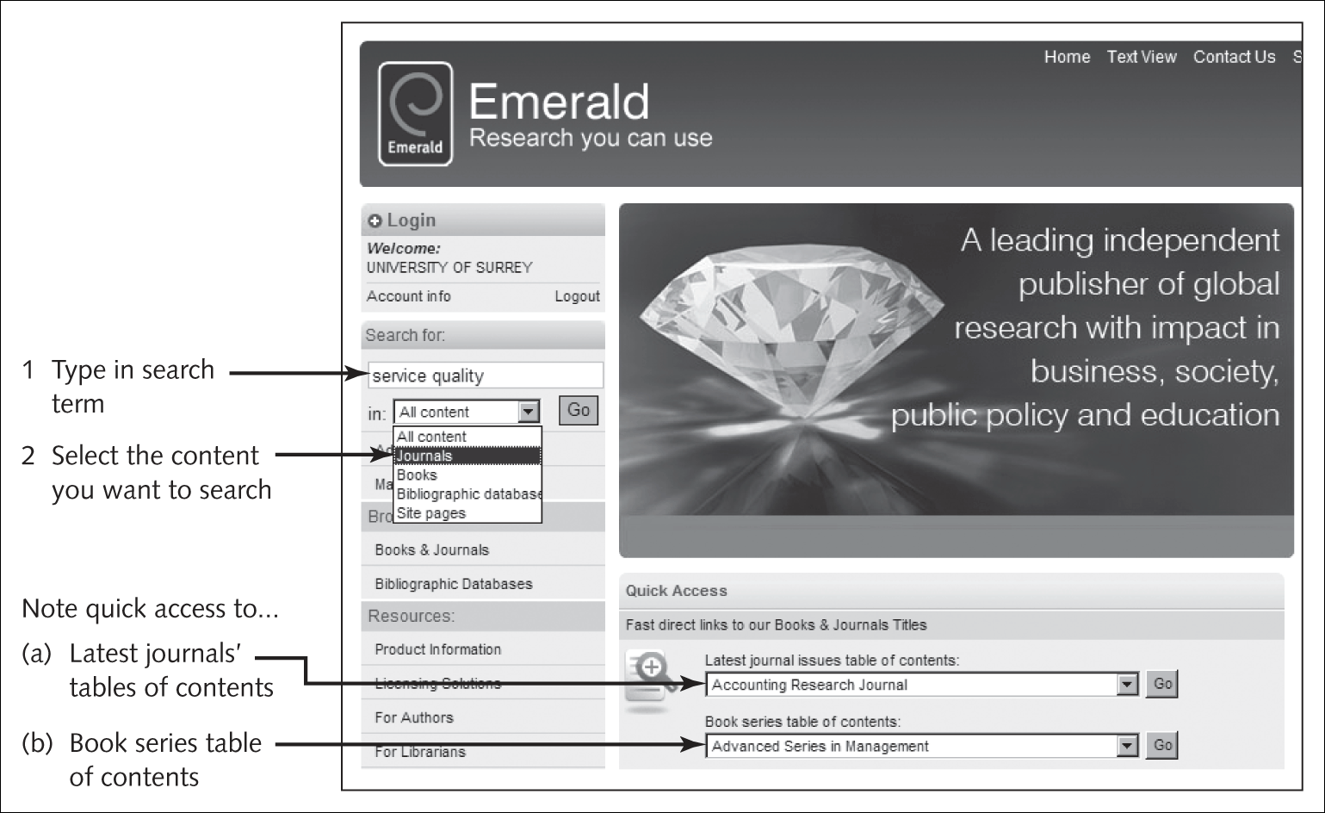
Figure 2.2 Quick search using Emerald
Source: Emerald, reproduced with permission

Slide 3
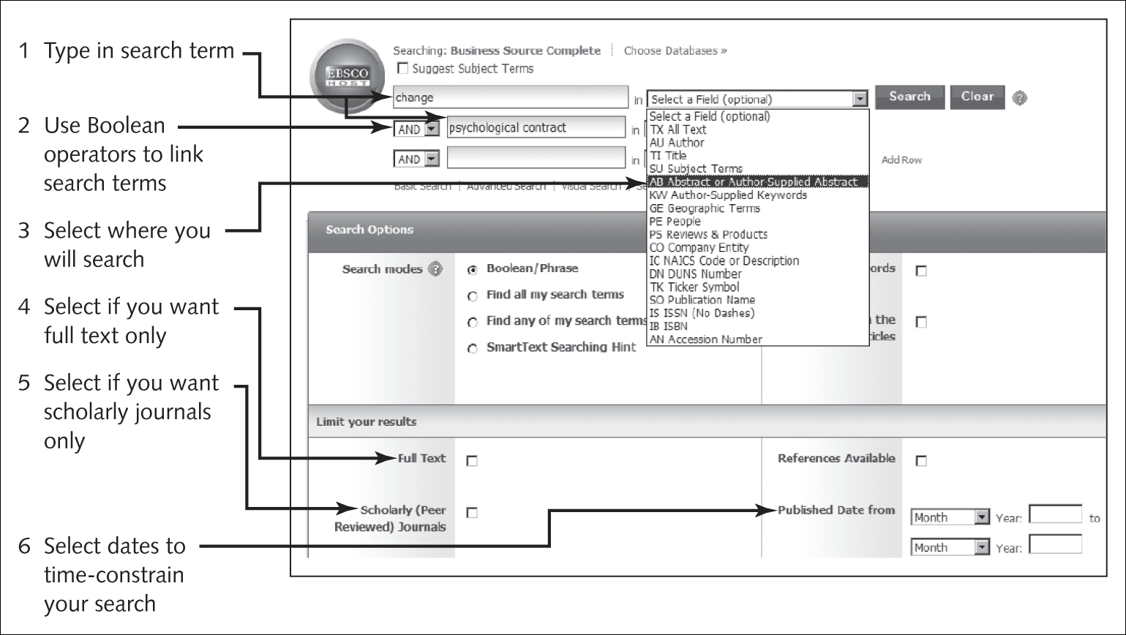
Figure 2.3 Advanced search using Business Source Complete
Source: EBSCO Information Services

Slide 4
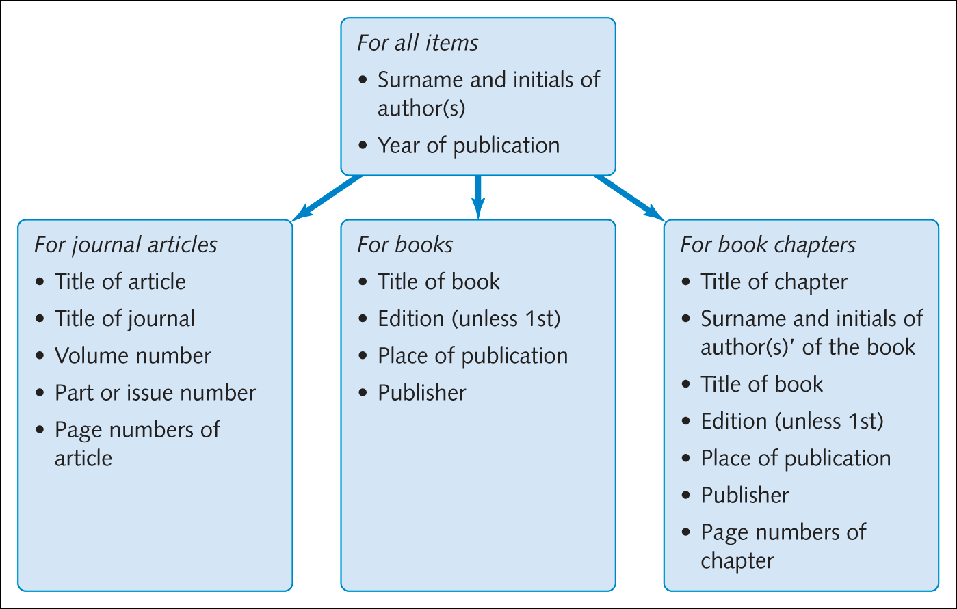
Figure 2.4 Information you need to reference items

Slide 5
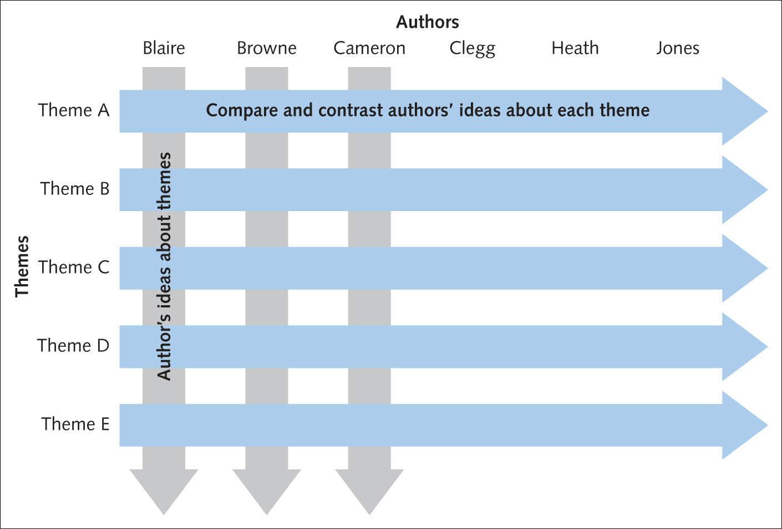
Figure 2.5 Structure of your literature review

