Slide 1
1: Introducing Strategy
Notes:
Need to change to 9th Edition and change title to Exploring Strategy – the rest is OK.

Slide 2
Learning outcomes
Summarise the strategy of an organisation in a ‘strategy statement’.
Identify key issues for an organisation’s strategy according to the Exploring Strategy model.
Distinguish between corporate, business and operational strategies.
Understand how different people contribute to strategy at work.
Appreciate the contributions of different academic disciplines and theoretical lenses to practical strategy analysis.

Slide 3
Definitions of strategy (1)
‘..the determination of the long-run goals and objectives of an enterprise and the adoption of courses of action and the allocation of resource necessary for carrying out these goals’
Alfred Chandler
‘Competitive strategy is about being different. It means deliberately choosing a different set of activities to deliver a unique mix of value’
Michael Porter
Sources:
A.D. Chandler, Strategy and Structure: Chapters in the History of American Enterprise, MIT Press, 1963, p. 13
M.E. Porter, ‘What is strategy?’, Harvard Business Review, 1996, November–December,
p. 60

Slide 4
Definitions of strategy (2)
‘..a pattern in a stream of decisions’
Henry Mintzberg
‘..the long-term direction of an organisation’
Exploring Strategy
Sources:
H. Mintzberg, Tracking Strategy: Toward a General Theory, Oxford University Press, 2007, p. 3

Slide 5
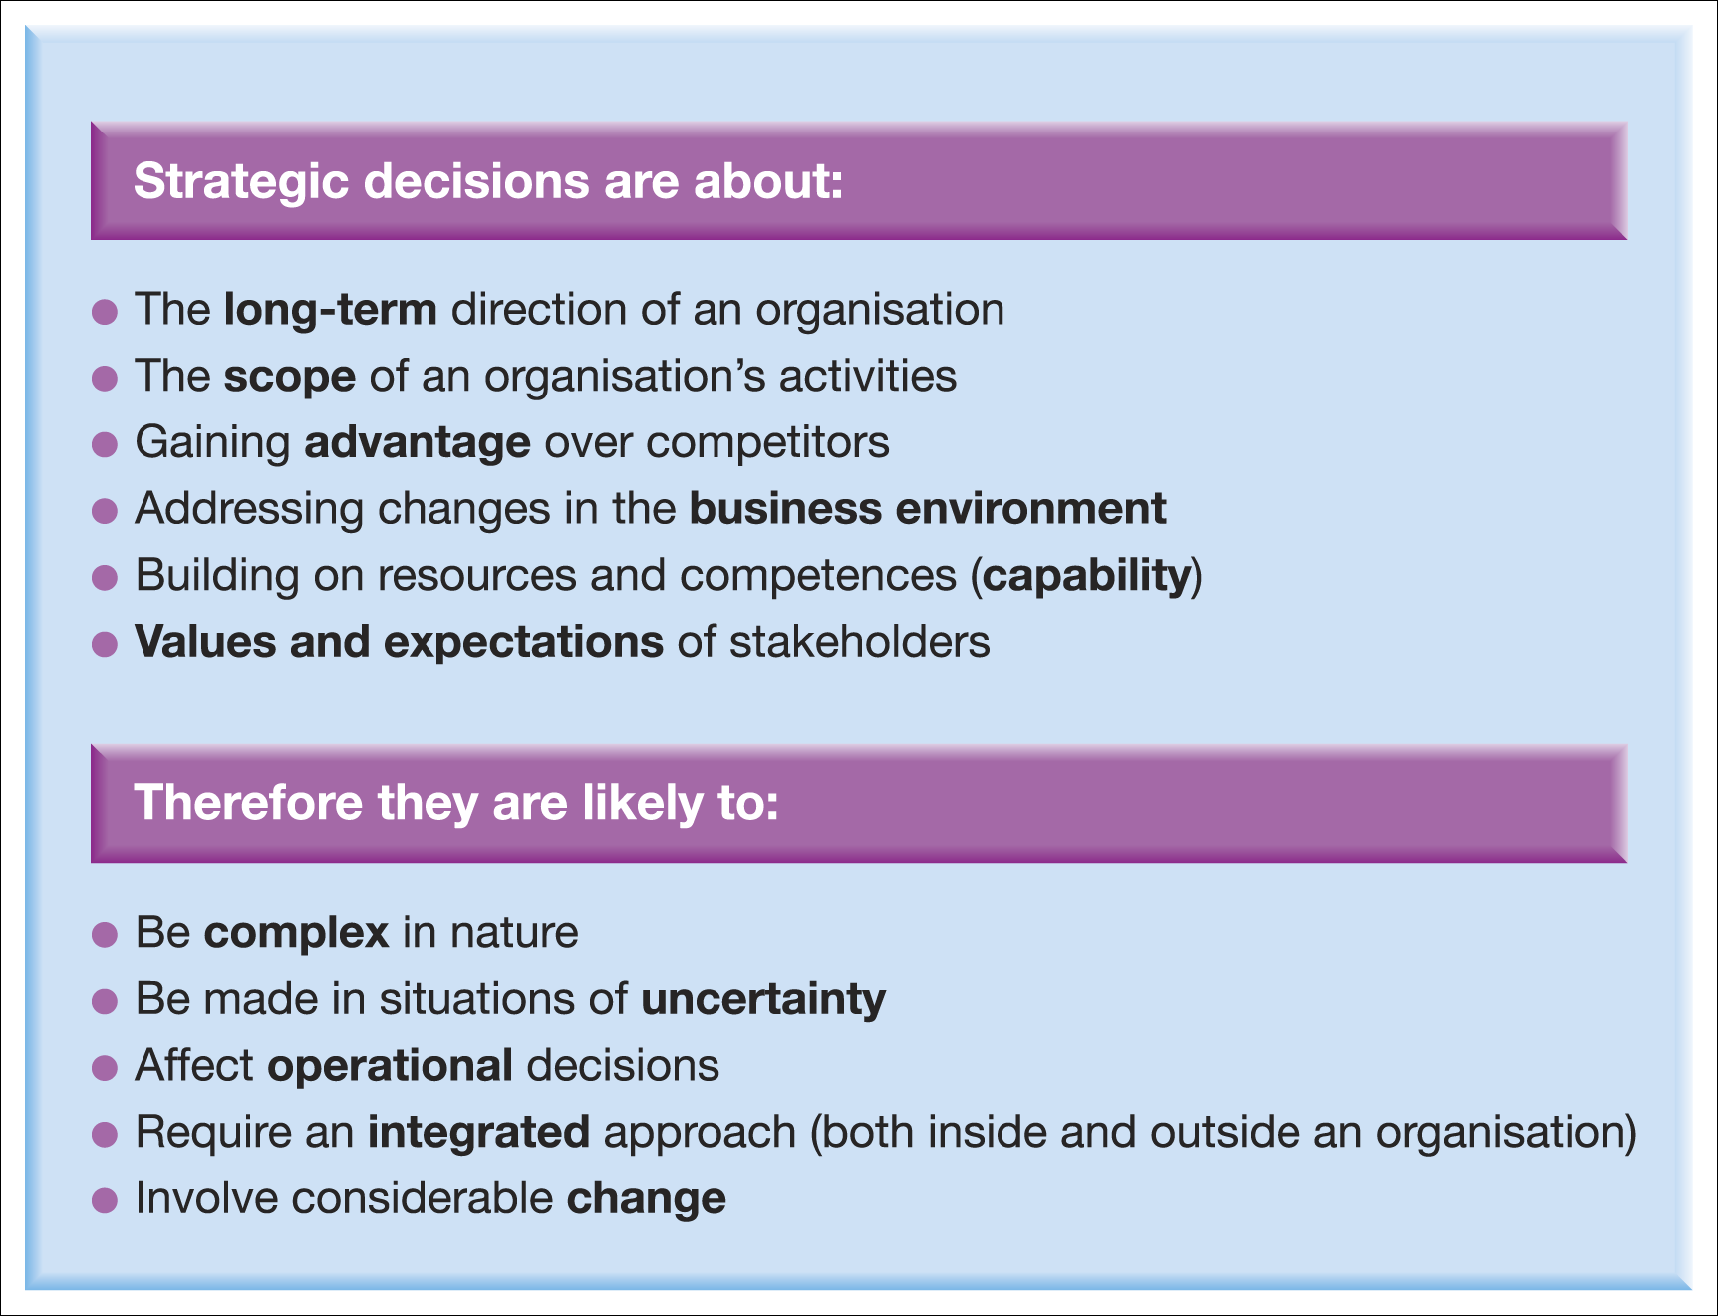
Strategic decisions

Slide 6
Three horizons for strategy (1)
Horizon 1 :
Extend and defend core business.
Horizon 2 :
Build emerging businesses.
Horizon 3 :
Create viable options.

Slide 7
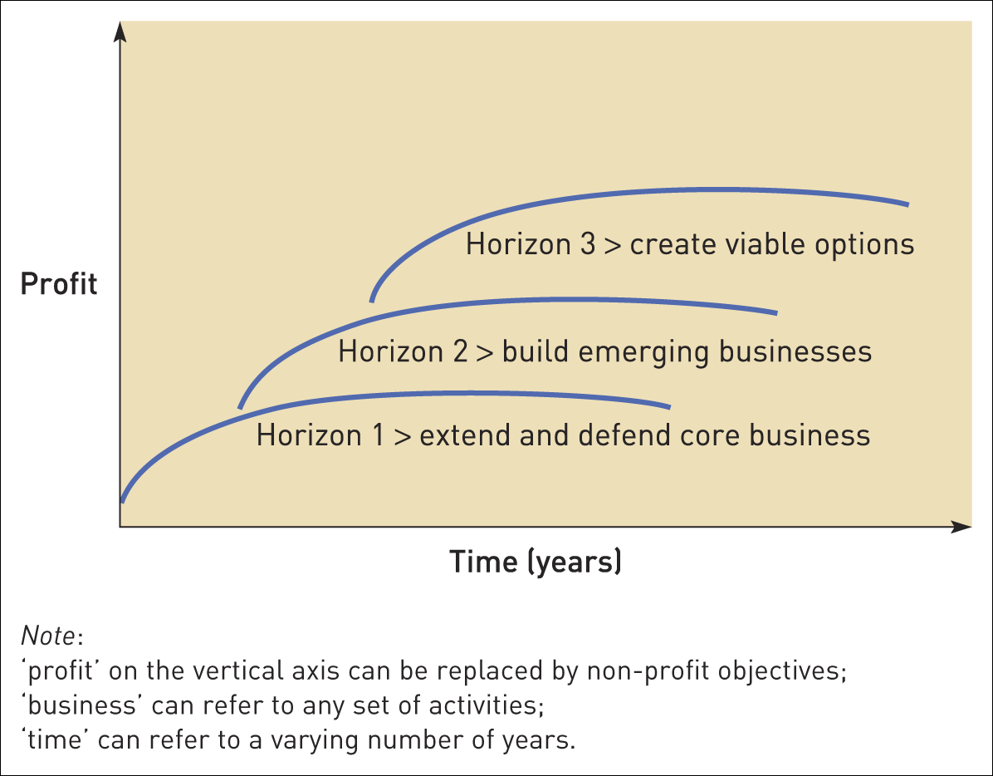
Three horizons for strategy (2)
Figure 1.2 Three horizons for strategy
Source: M. Baghai, S. Coley and D. While, The Alchemy of Growth, 2000, Texere Publishers: Figure 1.1, p. 5

Slide 8
Stakeholders
Stakeholders are those individuals or groups that depend on an organisation to fulfil their own goals and on whom, in turn, the organisation depends.

Slide 9
Levels of strategy (1)
Corporate-
level
strategy
News Corporation diversifying from print journalism into social networking.
Business-level
strategy
Website and marketing improvements at My Space to attract more users.
Operational strategy
MySpace engineers increasing processing
Capacity.

Slide 10
Levels of strategy (2)
Corporate-Level Strategy is concerned with the overall purpose and scope of an organisation and how to add value to business units.
Business-Level Strategy is concerned with the way a business seeks to compete successfully in its particular market.
Operational Level Strategy is concerned with how different parts of the organisation deliver the strategy in terms of managing resources, processes and people.

Slide 11

Strategy statements
Strategy statements should have three main themes:
the fundamental goals that the organisation seeks, which draw on the stated mission, vision and objectives
the scope or domain of the organisation’s activities
and the particular advantages or capabilities it has to deliver all these.

Slide 12
Working with strategy (1)
All managers are concerned with strategy:
Top managers frequently formulate and control strategy but may also involve others in the process.
Middle and lower level managers have to meet strategic objectives and deal with constraints.
All managers have to communicate strategy to their teams.
All managers can contribute to the formation of strategy through ideas and feedback.

Slide 13
Working with strategy (2)
Organisations may also use strategy specialists:
Many large organisations have in-house strategic planning or analyst roles.
Strategy consultants can be engaged from one of many general management consulting firms (e.g. Accenture, IBM Consulting, PwC).
There are a growing number of specialist strategy consulting firms (e.g. McKinsey &Co, The Boston Consulting Group).

Slide 14
Strategy’s three branches (1)
CONTEXT – internal and external.
CONTENT – strategic options.
PROCESS – formation and implementation.

Slide 15
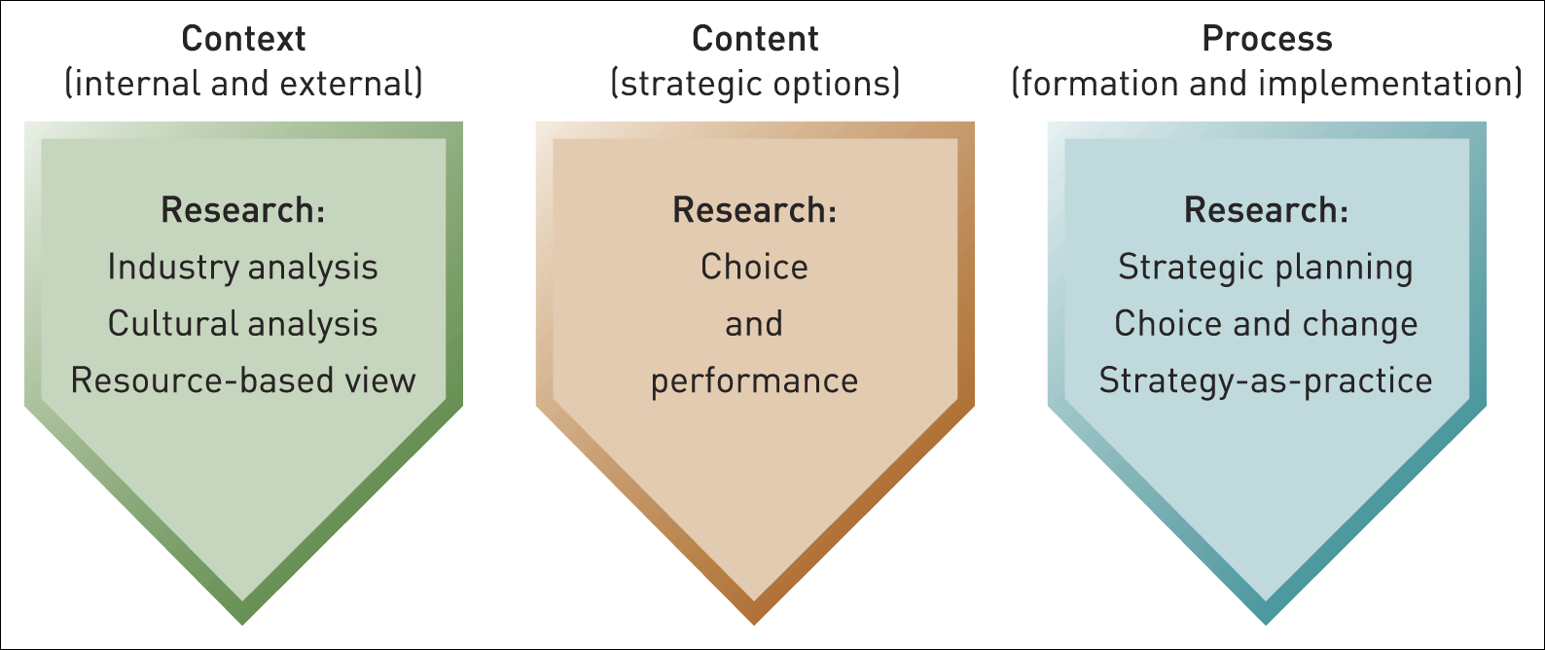
Strategy’s three branches (2)
Figure 1.3 Strategy’s three branches

Slide 16
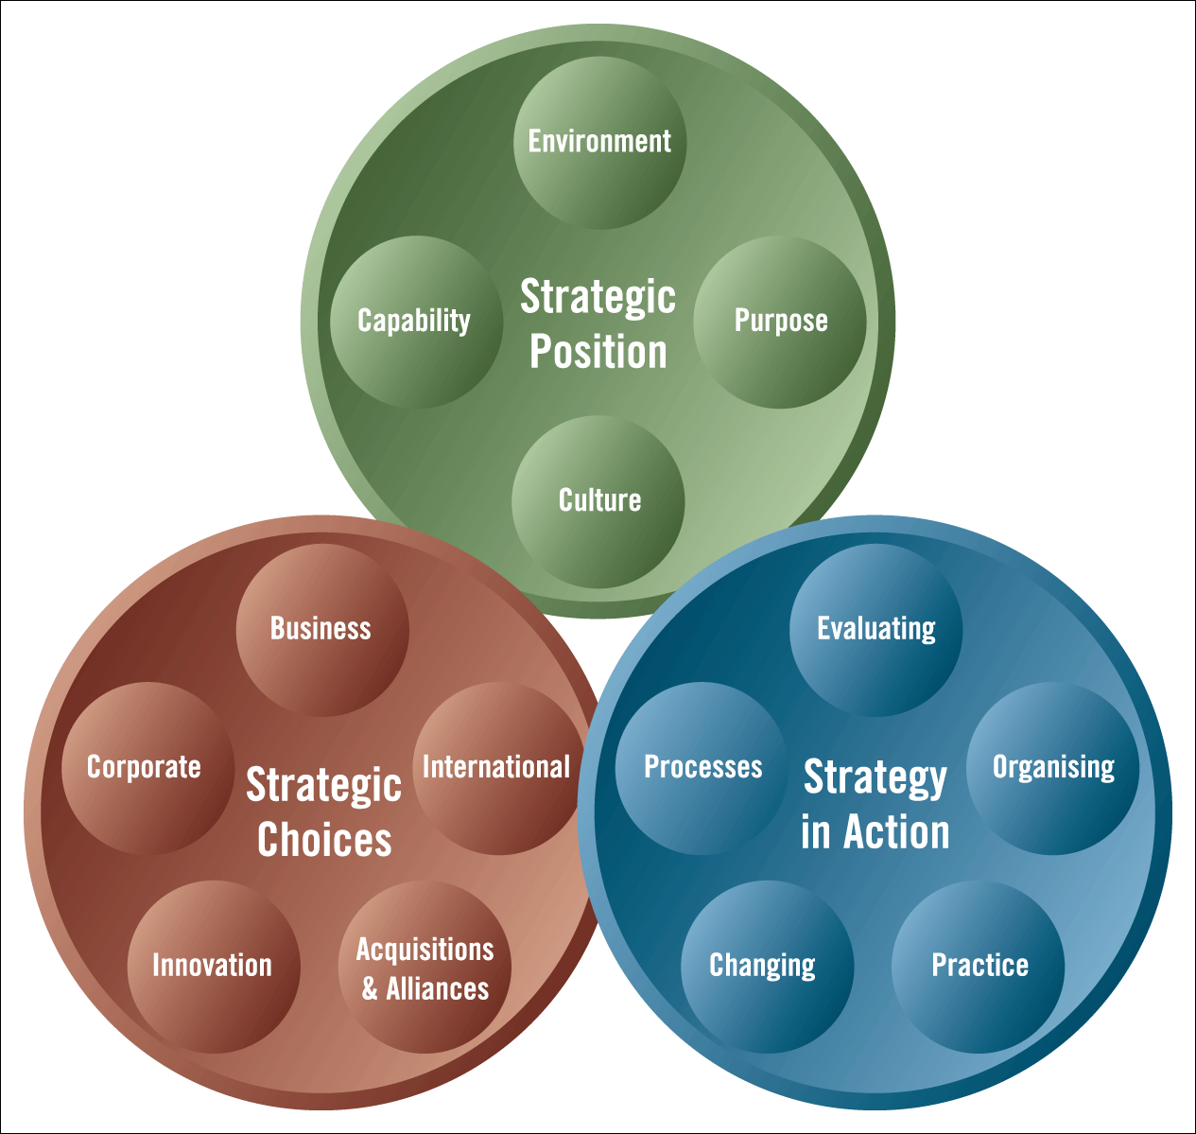
The exploring strategy model
Figure 1.4 The Exploring Strategy Model

Slide 17
Strategic position (1)
The strategic position is concerned with the impact on strategy of the external environment, the organisation’s strategic capability (resources and competences), the organisation’s goals and the organisation’s culture.

Slide 18
Strategic position (2)
The
Strategic
Position
Environment
Capability
Purpose
Culture

Slide 19
Strategic position (3)
Fundamental questions for Strategic Position:
• What are the environmental opportunities and threats?
• What are the organisation’s strengths and weaknesses?
• What is the basic purpose of the organisation?
• How does culture shape strategy?

Slide 20
Strategic choices (1)
Strategic choices involve the options for strategy in terms of both the directions in which strategy might move and the methods by which strategy might be pursued.

Slide 21
Strategic choices (2)
Strategic
Choices
Business-
level
Corporate-
level
International
Innovation
Acquisitions &
Alliances

Slide 22
Strategic choices (3)
Fundamental questions for Strategic Choice:
• How should business units compete?
• Which businesses to include in the portfolio?
• Where should the organisation compete
internationally?
• Is the organisation innovating appropriately?
• Should the organisation buy other companies, form alliances or go it alone?

Slide 23
Strategy in action (1)
Strategy in action is about how strategies are formed and how they are implemented.
The emphasis is on the practicalities of managing.

Slide 24
Strategy in action (2)
Strategy
in Action
Processes
Organising
Evaluating
Changing
Practice

Slide 25
Strategy in action (3)
Fundamental questions for Strategy in Action
• Which strategies are suitable, acceptable and feasible?
• What kind of strategy-making process is needed?
• What are the required organisation structures and systems?
• How should the organisation manage necessary changes?
• Who should do what in the strategy process?

Slide 26
Exploring strategy in different contexts
The Exploring Strategy Model can be applied in many contexts.
In each context the balance of strategic issues differs:
Small Businesses (e.g. Purpose and Growth issues)
Multinational Corporations (e.g. Geographical Scope and Structure/Control issues)
Public Sector Organisations (e.g. Service/Quality and Managing Change issues)
Not For Profit Organisations (e.g. Purpose and Funding issues)

Slide 27
The strategy lenses (1)
The strategy lenses are ways of looking at strategy issues differently in order to generate many insights. Looking at problems in different ways will raise new issues and new solutions.

Slide 28
The strategy lenses (2)
Strategy can be seen as:
Design
Experience
Variety (Ideas)
Discourse

Slide 29
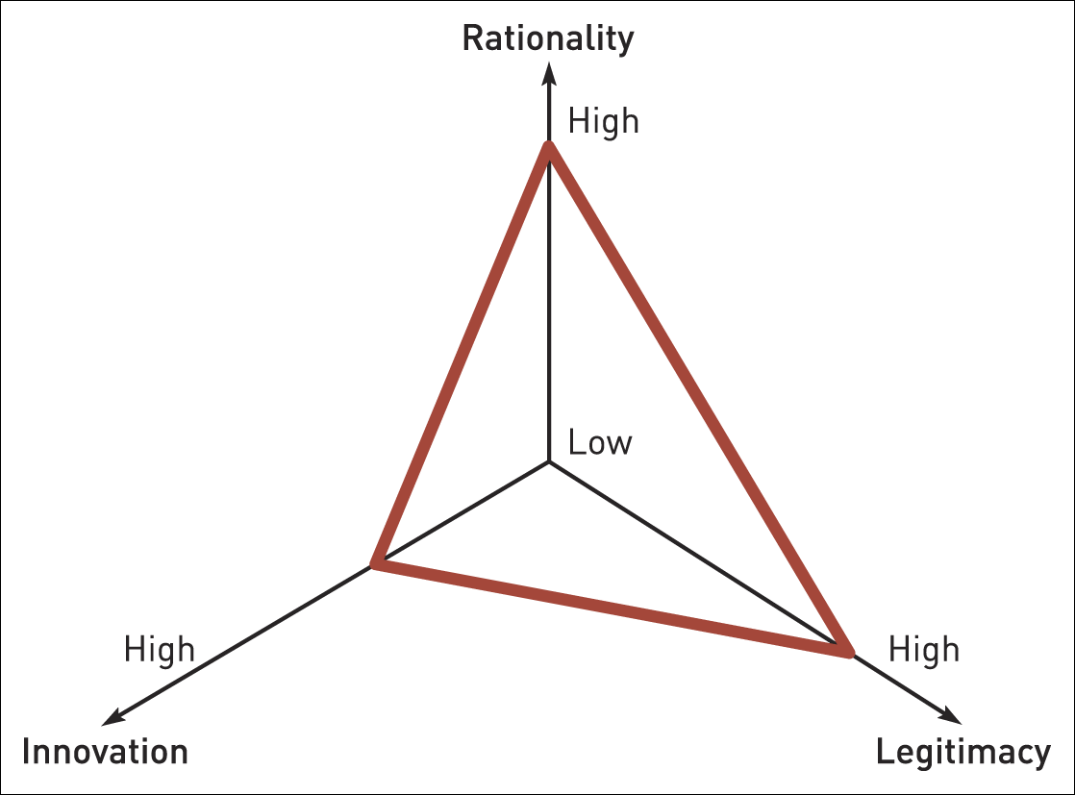
Strategy as design
Figure C.i Design lens

Slide 30
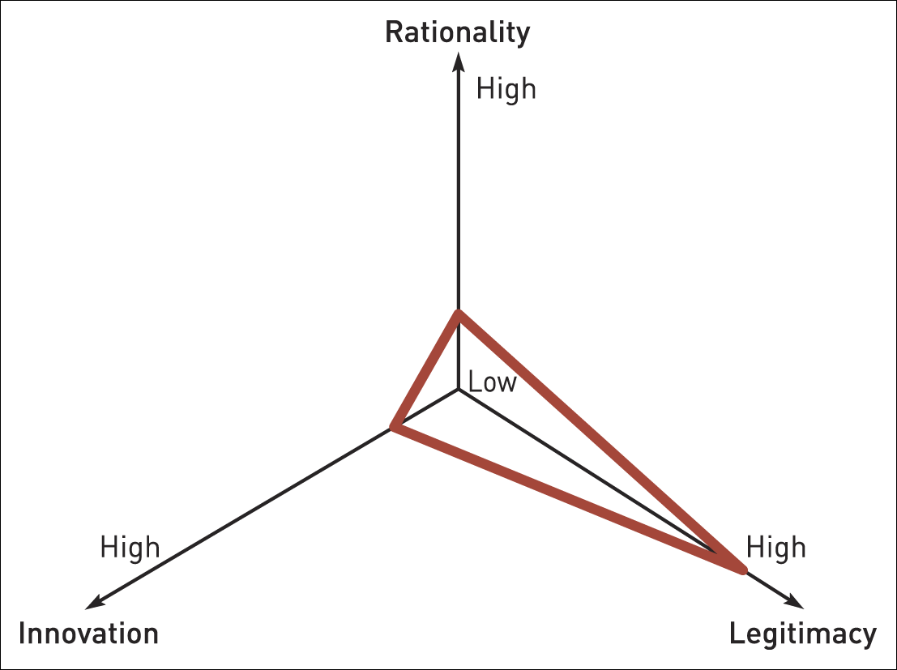
Strategy as experience
Figure C.ii Experience lens

Slide 31
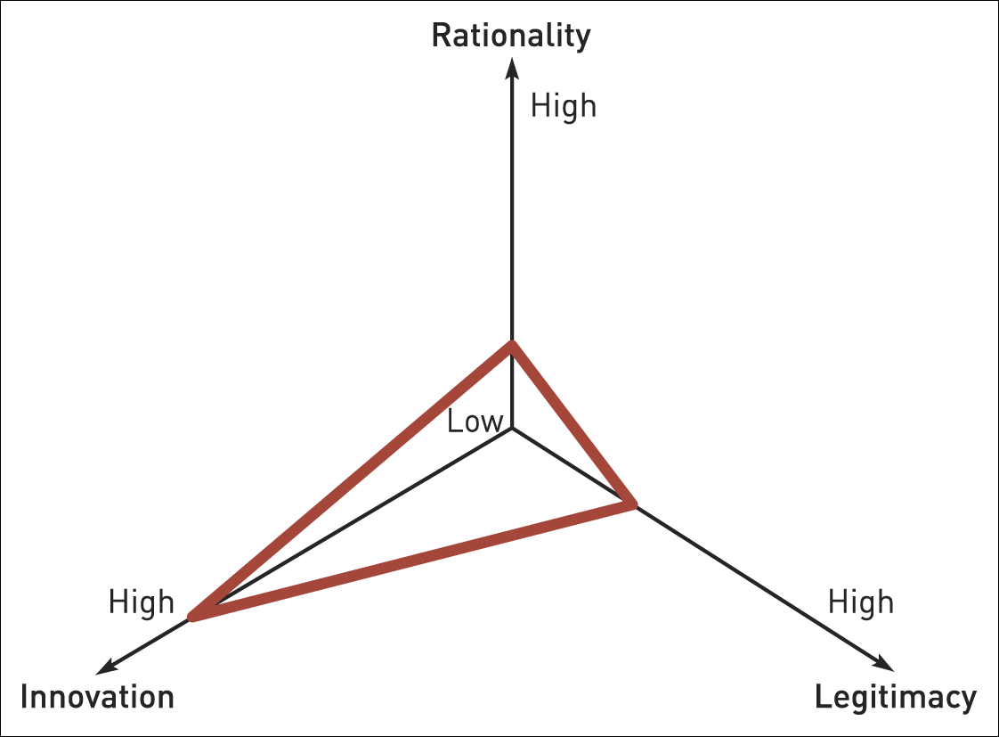
Strategy as variety
Figure C.iii Variety lens

Slide 32
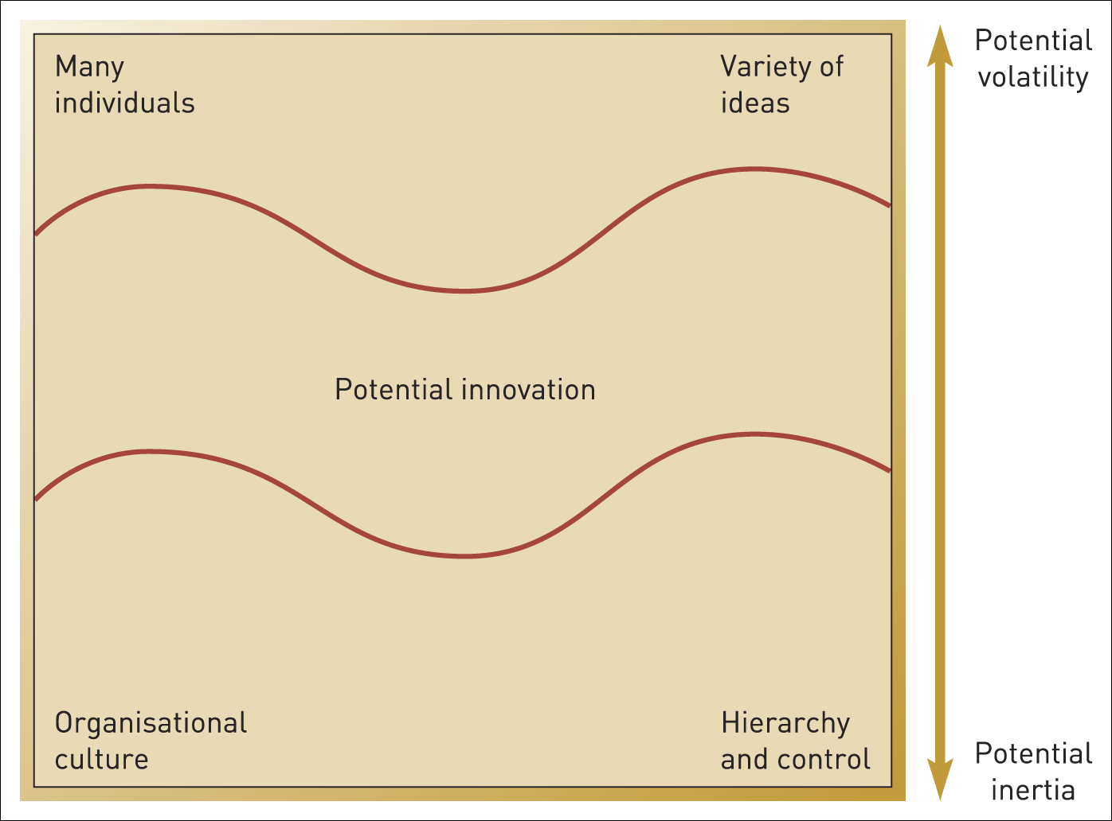
Strategy as discourse
Figure C.iv Adaptive tension

Slide 33
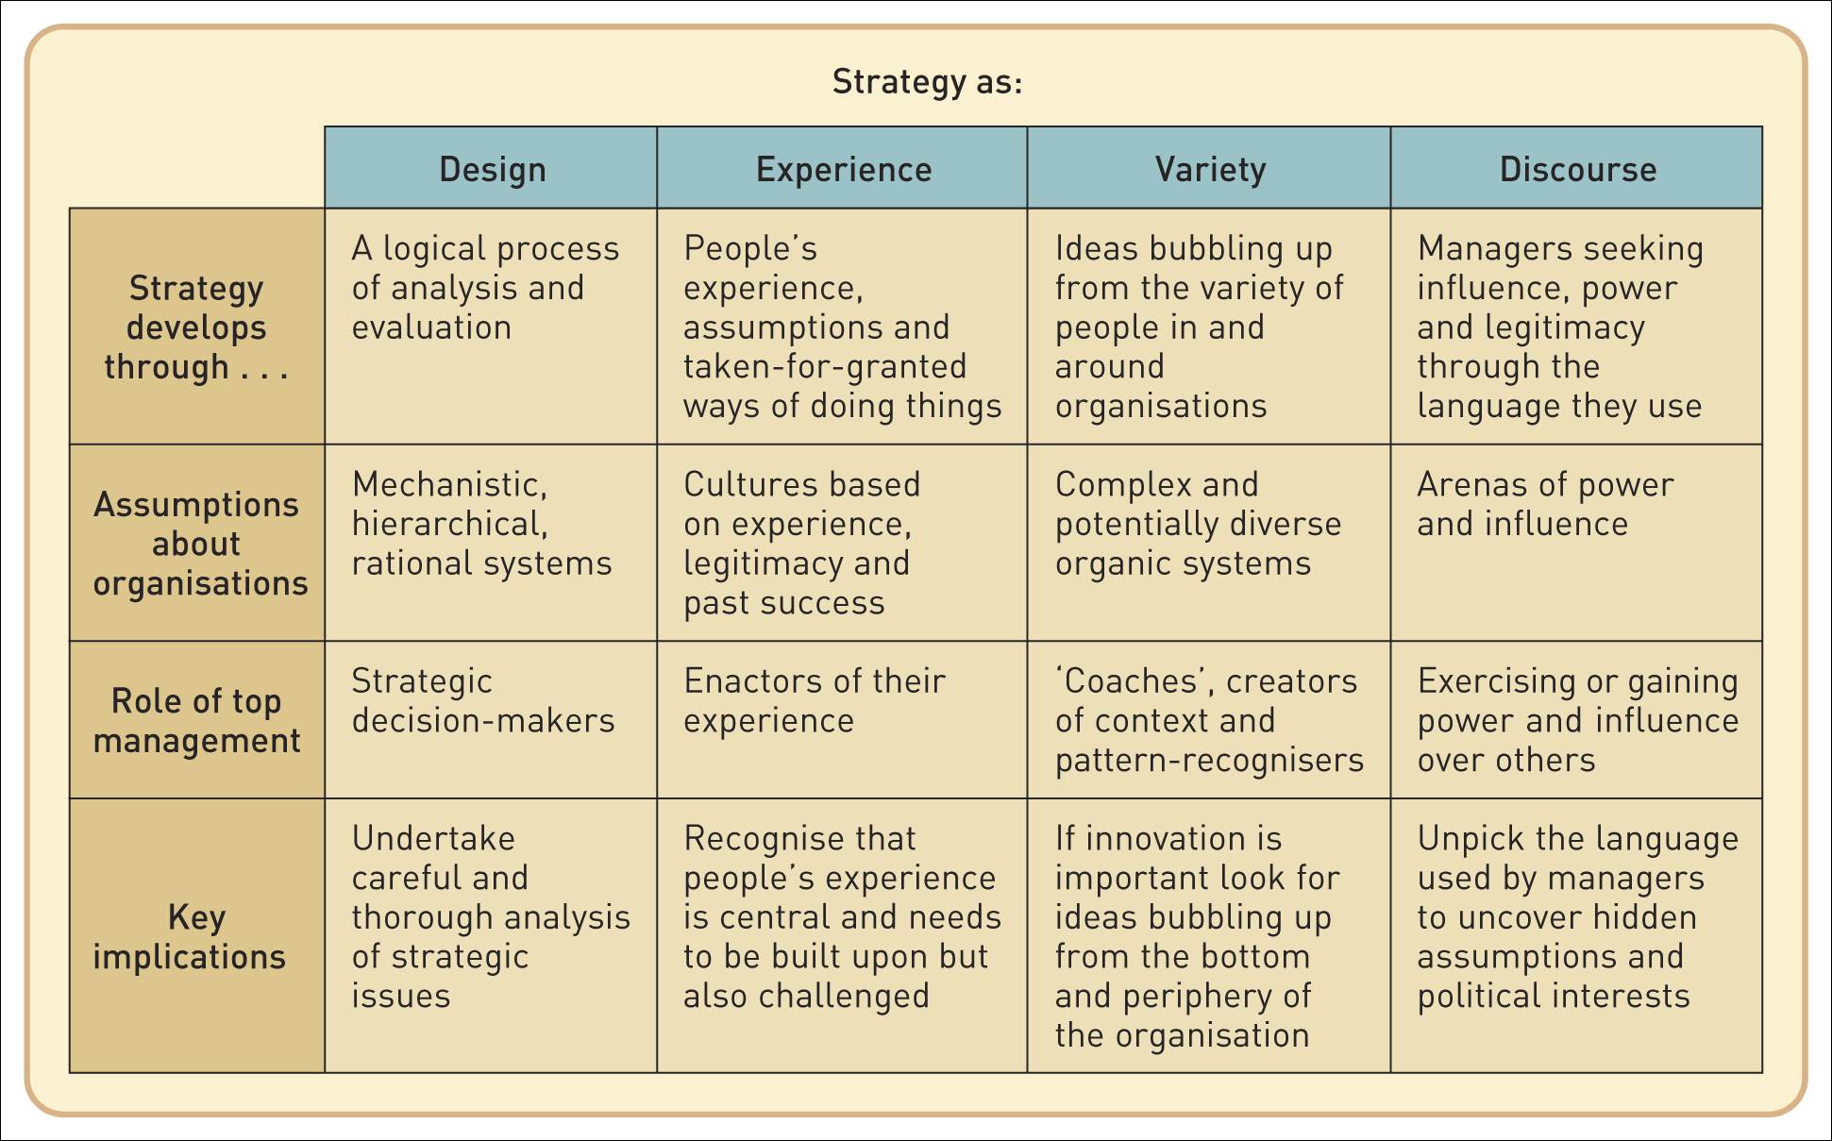
The strategy lenses summary
Table C.ii A summary of the strategy lenses

Slide 34
Chapter summary (1)
Strategy is the long-term direction of an organisation. A ‘strategy statement’ should cover the goals of an organisation, the scope of the organisation’s activities and the advantages or capabilities the organisation brings to these goals and activities.
Corporate-level strategy is concerned with an organisation’s overall scope; business-level strategy is concerned with how to compete; and operational strategy is concerned with how resources, processes and people deliver corporate- and business-level strategy.
Strategy work is done by managers throughout an organisation, as well as specialist strategic planners and strategy consultants.

Slide 35
Chapter summary (2)
Research on strategy context, content and process shows how the analytical perspectives of economics, sociology and psychology can all provide practical insights for approaching strategy issues
The Exploring Strategy Model has three major elements: understanding the strategic position, making strategic choices for the future and managing strategy-in-action.
Strategic issues are best seen from a variety of perspectives, as exemplified by the four strategy lenses of design, experience, variety and discourse.

