Slide 1
Part I:
The Strategic Position
Notes:
Change to 9th Edition and change title to Exploring Strategy. Update design

Slide 2
The Focus of part 1:
The strategic position
How to analyse an organisation’s position in the external environment.
How to analyse the determinants of strategic capability – resources, competences and the linkages between them.
How to understand an organisation’s purposes, taking into account corporate governance, stakeholder expectations and business ethics.
How to address the role of history and culture in determining an organisation’s position.

Slide 3
The Strategic Position
2: The Environment
Notes:
Update: Change to 9th edition and title to Exploring Strategy

Slide 4
Learning outcomes (1)
Analyse the broad macro-environment of organisations in terms of political, economic, social, technological, environmental (‘green’) and legal factors (PESTEL).
Identify key drivers in this macro-environment and use these key drivers to construct alternative scenarios with regard to environmental change.

Slide 5
Learning outcomes (2)
Use Porter’s five forces analysis in order to define the attractiveness of industries and sectors and to identify their potential for change.
Identify successful strategic groups, valuable market segments and attractive ‘Blue Oceans’ within industries.
Use these various concepts and techniques in order to recognise threats and opportunities in the marketplace.

Slide 6
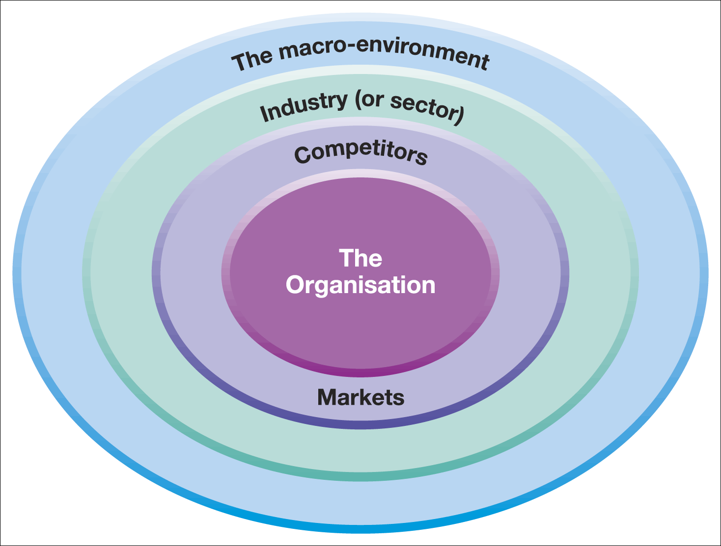
Layers of the business environment
Figure 2.1 Layers of the business environment

Slide 7

The PESTEL framework (1)
The PESTEL framework categorises environmental influences into six main types:
political, economic,
social, technological,
environmental legal
Thus PESTEL provides a comprehensive list of influences on the possible success or failure of particular strategies.

Slide 8
The PESTEL framework (2)
Political Factors: For example, Government policies, taxation changes, foreign trade regulations, political risk in foreign markets, changes in trade blocks (EU).
Economic Factors: For example, business cycles, interest rates, personal disposable income, exchange rates, unemployment rates, GDP trends.
Socio-cultural Factors: For example, population changes, income distribution, lifestyle changes, consumerism, changes in culture and fashion.

Slide 9
The PESTEL framework (3)
Technological Factors: For example, new discoveries and technology developments, ICT innovations, rates of obsolescence, increased spending on R&D.
Environmental (‘Green’) Factors: For example, environmental protection regulations, energy consumption, global warming, waste disposal and re-cycling.
Legal Factors: For example, competition laws, health and safety laws, employment laws, licensing laws, IPR laws.

Slide 10
Key drivers of change
Key drivers for change:
The environmental factors likely to have a high impact on the success or failure of strategy.
For example, the birth rate is a key driver for those planning nursery education provision in the public sector.
Typically key drivers vary by industry or sector.

Slide 11
Using the PESTEL framework
Apply selectively –identify specific factors which impact on the industry, market and organisation in question.
Identify factors which are important currently but also consider which will become more important in the next few years.
Use data to support the points and analyse trends using up to date information
Identify opportunities and threats – the main point of the exercise!

Slide 12
Scenarios
Scenarios are detailed and plausible views of how the environment of an organisation might develop in the future based on key drivers of change about which there is a high level of uncertainty.
Build on PESTEL analysis .
Do not offer a single forecast of how the environment will change.
An organisation should develop a few alternative scenarios (2–4) to analyse future strategic options.

Slide 13
Carrying out scenario analysis (1)
Identify the most relevant scope of the study – the relevant product/market and time span.
Identify key drivers of change – PESTEL factors that have the most impact in the future but have uncertain outcomes.
For each key driver select opposing outcomes where each leads to very different consequences.

Slide 14
Carrying out scenario analysis (2)
Develop scenario ‘stories’ - That is, coherent and plausible descriptions of the environment that result from opposing outcomes
Identify the impact of each scenario on the organisation and evaluate future strategies in the light of the anticipated scenarios.
Scenario analysis is used in industries with long planning horizons for example, the oil industry or airlines.

Slide 15
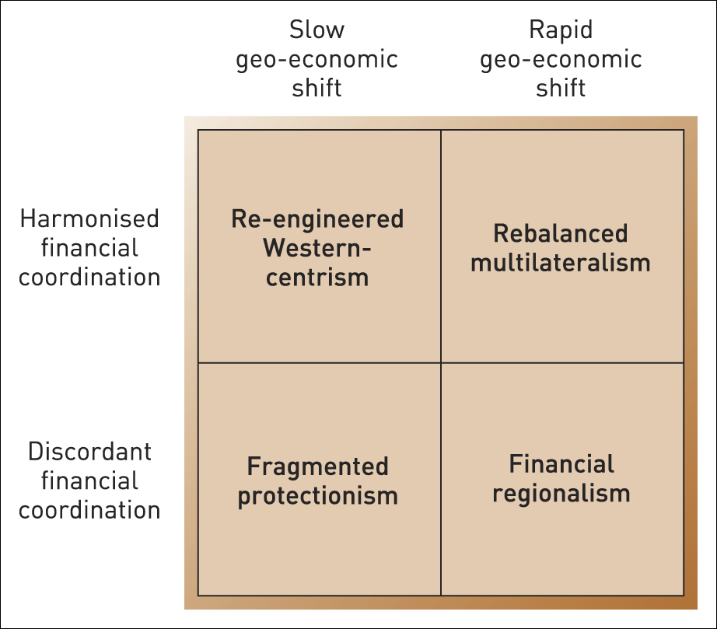
Scenarios for the global financial system, 2020
Illustration 2.2

Slide 16
Industries, markets and sectors
An industry is a group of firms producing products and services that are essentially the same. For example, automobile industry and airline industry.
A market is a group of customers for specific products or services that are essentially the same (e.g. the market for luxury cars in Germany).
A sector is a broad industry group (or a group of markets) especially in the public sector (e.g. the health sector)

Slide 17
Porter’s five forces framework
Porter’s five forces framework helps identify the attractiveness of an industry in terms of five competitive forces:
the threat of entry,
the threat of substitutes,
the bargaining power of buyers,
the bargaining power of suppliers and
the extent of rivalry between competitors.
The five forces constitute an industry’s ‘structure’.

Slide 18
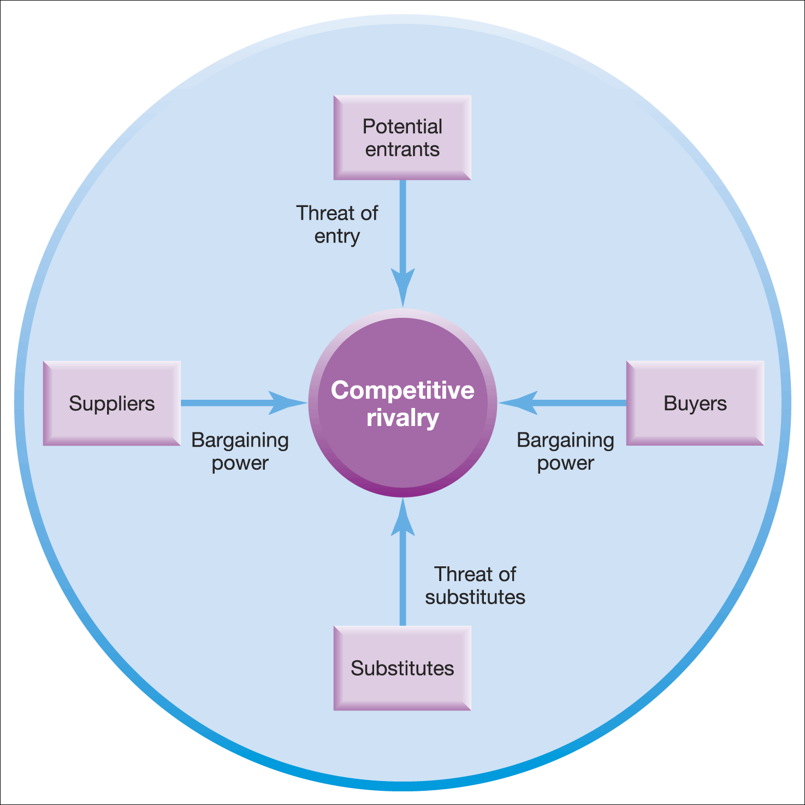
The five forces framework (1)
Figure 2.2 The five forces framework
Source: Adapted with the permission of The Free Press, a Division of Simon & Schuster Adult Publishing Group, from Competitive Strategy: Techniques for Analyzing Industries and Competitors by Michael E. Porter. Copyright © 1980, 1998 by The Free Press. All rights reserved

Slide 19
The five forces framework (2)
The Threat of Entry & Barriers to Entry
The threat of entry is low when the barriers to entry are high and vice versa.
The main barriers to entry are:
  Economies of scale/high fixed costs
  Experience and learning
  Access to supply and distribution channels
  Differentiation and market penetration costs
  Government restrictions (e.g. licensing)
Entrants must also consider the expected retaliation from organisations already in the market

Slide 20
The five forces framework (3)
Threat of Substitutes
Substitutes are products or services that offer a similar benefit to an industry’s products or services, but by a different process.
Customers will switch to alternatives (and thus the threat increases) if:
The price/performance ratio of the substitute is superior (e.g. aluminium maybe more expensive than steel but it is more cost efficient for some car parts)
The substitute benefits from an innovation that improves customer satisfaction (e.g. high speed trains can be quicker than airlines from city centre to city centre)

Slide 21
The five forces framework (4)
The bargaining power of buyers
Buyers are the organisation’s immediate customers, not necessarily the ultimate consumers.
If buyers are powerful, then they can demand cheap prices or product / service improvements to reduce profits .
Buyer power is likely to be high when:
  Buyers are concentrated
  Buyers have low switching costs
  Buyers can supply their own inputs (backward vertical integration)

Slide 22
The five forces framework (5)
The bargaining power of suppliers
Suppliers are those who supply what organisations need to produce the product or service. Powerful suppliers can eat into an organisation’s profits.
Supplier power is likely to be high when:
  The suppliers are concentrated (few of them).
  Suppliers provide a specialist or rare input.
  Switching costs are high (it is disruptive or expensive to change suppliers).
  Suppliers can integrate forwards (e.g. low cost airlines have cut out the use of travel agents).

Slide 23
The five forces framework (6)
Rivalry between competitors
Competitive rivals are organisations with similar products and services aimed at the same customer group and are direct competitors in the same industry/market (they are distinct from substitutes).
The degree of rivalry is increased when :
  Competitors are of roughly equal size
  Competitors are aggressive in seeking leadership
  The market is mature or declining
  There are high fixed costs
  The exit barriers are high
  There is a low level of differentiation

Slide 24
Implications of five forces analysis
Identifies the attractiveness of industries – which industries/markets to enter or leave.
Identifies strategies to influence the impact of the forces, for example, building barriers to entry by becoming more vertically integrated.
The forces may have a different impact on different organisations e.g. large firms can deal with barriers to entry more easily than small firms.

Slide 25
Issues in five forces analysis
Apply at the most appropriate level – not necessarily the whole industry. E.g. the European low cost airline industry rather than airlines globally.
Note the convergence of industries – particularly in the high tech sectors (e.g. digital industries - mobile phones/cameras/mp3 players).
Note the importance of complementary products and services (e.g. Microsoft windows and McAfee computer security systems are complements). This can almost be considered as a sixth force.

Slide 26
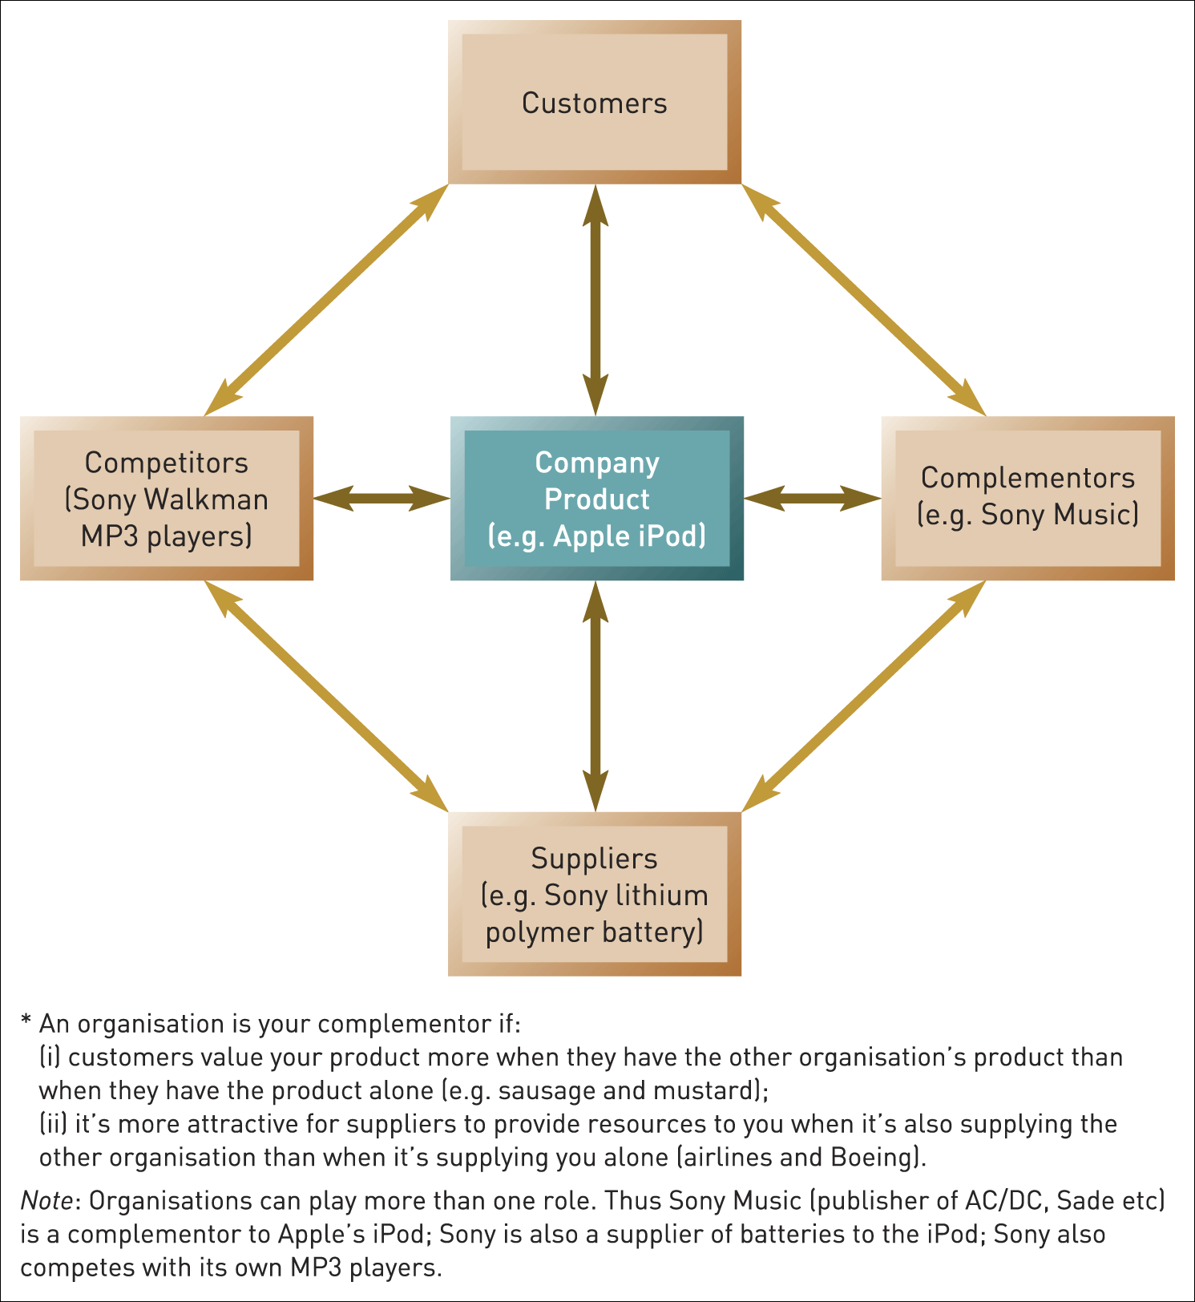
The value net
Figure 2.3 The value net
Reprinted by permission of Harvard Business Review. From ‘The Right Game’ by A. Brandenburger and B. Nalebuff, July–August 1996, pp. 57–64. Copyright © 1996 by the Harvard Business School Publishing Corporation. All rights reserved

Slide 27
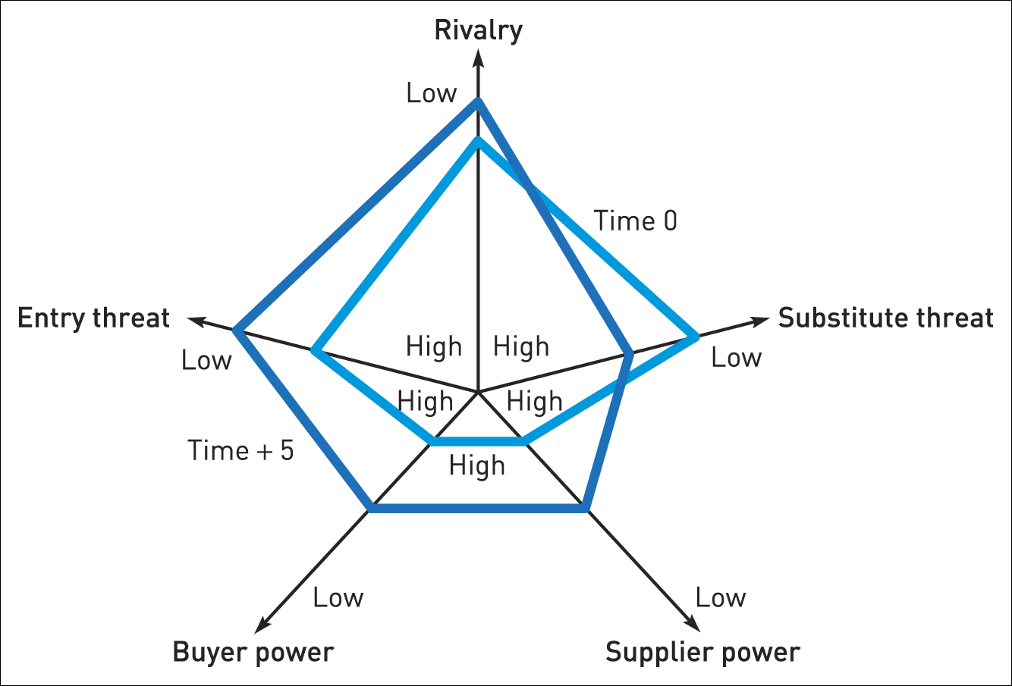
Comparative industry structure analysis
Figure 2.5 Comparative industry structure analysis

Slide 28
Types of industry (1)
Monopolistic industries - an industry with one firm and therefore no competitive rivalry. A firm has ‘monopoly power’ if it has a dominant position in the market. For example, BT in the UK fixed line telephone market.
Oligopolistic industries - an industry dominated by a few firms with limited rivalry and in which firms have power over buyers and suppliers.
Perfectly competitive industries - where barriers to entry are low, there are many equal rivals each with very similar products, and information about competitors is freely available. Few (if any) markets are ‘perfect’ but may have features of highly competitive markets, for example, mini-cabs in London.

Slide 29
Types of industry (2)
Hypercompetitive industries - where the frequency, boldness and aggression of competitor interactions accelerate to create a condition of constant disequilibrium and change.
Hypercompetition often breaks out in otherwise oligopolistic industries (e.g. mobile phones).
Organisations interact in a series of competitive moves in hypercompetition which often becomes extremely rapid and aggressive as firms vie for market leadership.

Slide 30
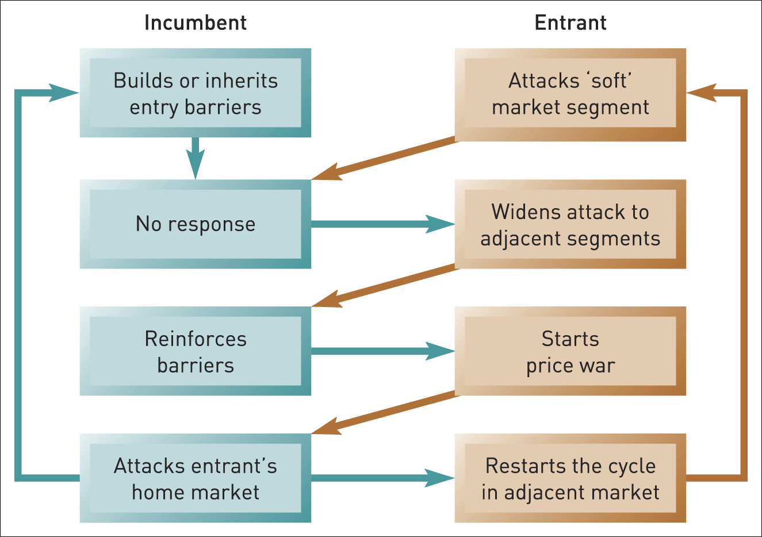
Cycles of competition
Figure 2.6 Cycles of competition
Source: Adapted with the permission of The Free Press, a Division of Simon & Schuster, Inc., from Hypercompetitive Rivalries: Competing in Highly Dynamic Environments by Richard A. D’Aveni with Robert Gunther. Copyright © 1994, 1995 by Richard A. D’Aveni. All rights reserved

Slide 31
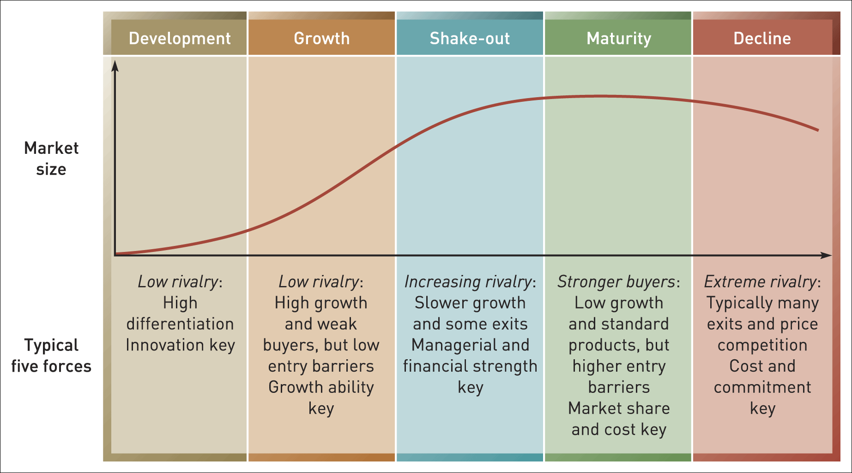
The industry life cycle
Figure 2.4 The industry life cycle

Slide 32
Strategic Groups
Strategic groups are organisations within an industry or sector with similar strategic characteristics, following similar strategies or competing on similar bases.
These characteristics are different from those in other strategic groups in the same industry or sector.
There are many different characteristics that distinguish between strategic groups.
Strategic groups can be mapped on to two dimensional charts – maps. These can be useful tools of analysis.

Slide 33
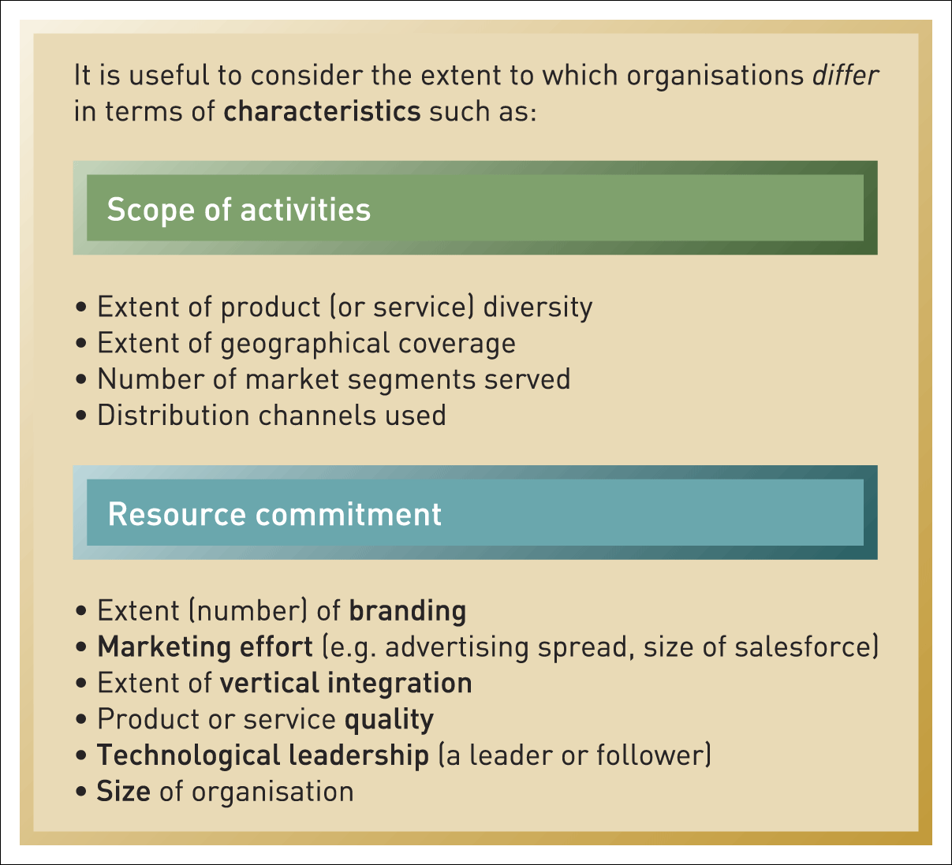
Characteristics for identifying strategic groups
Figure 2.7 Some characteristics for identifying strategic groups

Slide 34
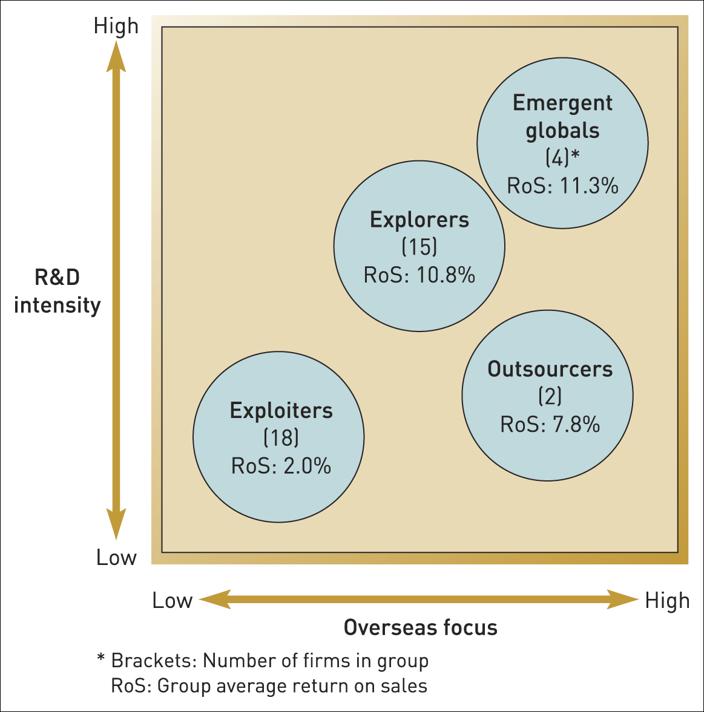
Strategic groups in the Indian pharmaceutical industry
Figure 2.8 Strategic groups in the Indian pharmaceutical industry
Source: Developed from R. Chittoor and S. Ray, ‘Internationalisation paths of Indian pharmaceutical firms: a strategic group analysis’, Journal of International Management, vol. 13 (2009), pp. 338–55

Slide 35
Uses of strategic group analysis
Understanding competition - enables focus on direct competitors within a strategic group, rather than the whole industry. (E.g. Tesco will focus on Sainsburys and Asda)
Analysis of strategic opportunities - helps identify attractive ‘strategic spaces’ within an industry.
Analysis of ‘mobility barriers’ i.e. obstacles to movement from one strategic group to another. These barriers can be overcome to enter more attractive groups. Barriers can be built to defend an attractive position in a strategic group.

Slide 36
Market segments
A market segment is a group of customers who have similar needs that are different from customer needs in other parts of the market.
Where these customer groups are relatively small, such market segments are called ‘niches’.
Customer needs vary. Focusing on customer needs that are highly distinctive is one means of building a secure segment strategy.
Customer needs vary for a variety of reasons -these factors can be used to identify distinct market segments.
Not all segments are attractive or viable market opportunities – evaluation is essential.

Slide 37
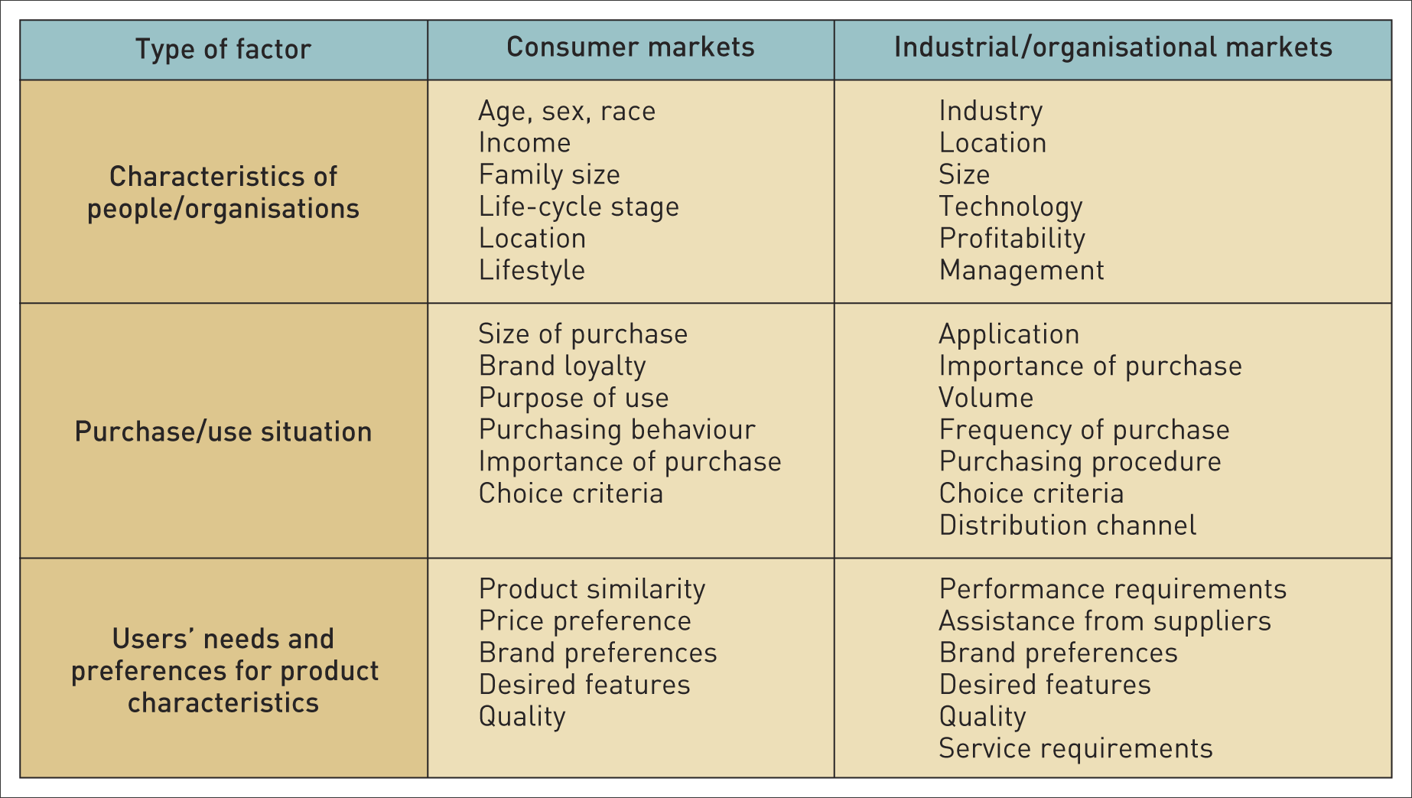
Bases of market segmentation (1)
Table 2.1 Some bases of market segmentation

Slide 38
Who are the strategic customers?
A strategic customer is the person(s) at whom the strategy is primarily addressed because they have the most influence over which goods or services are purchased.
Examples:
For a food manufacturer it is the multiple retailers (e.g. Tesco) that are the strategic customers not the ultimate consumer.
For a pharmaceutical manufacturer it is the health authorities and hospitals not the final patient.

Slide 39
Critical success factors (CSFs)
Critical success factors are those factors that are either particularly valued by customers or which provide a significant advantage in terms of cost.
Critical success factors are likely to be an important source of competitive advantage if an organisation has them (or a disadvantage if an organisation lacks them).
Different industries and markets will have different critical success factors (e.g. in low cost airlines the CSFs will be punctuality and value for money whereas in full service airlines it is all about quality of service).

Slide 40
Blue ocean thinking
‘Blue oceans’ are new market spaces where competition is minimised.
‘Red Oceans’ are where industries are already well defined and rivalry is intense.
Blue Ocean thinking encourages entrepreneurs and managers to be different by finding or creating market spaces that are not currently being served.
A ‘strategy canvas’ compares competitors according to their performance on key success factors in order to develop strategies based on creating new market spaces.

Slide 41
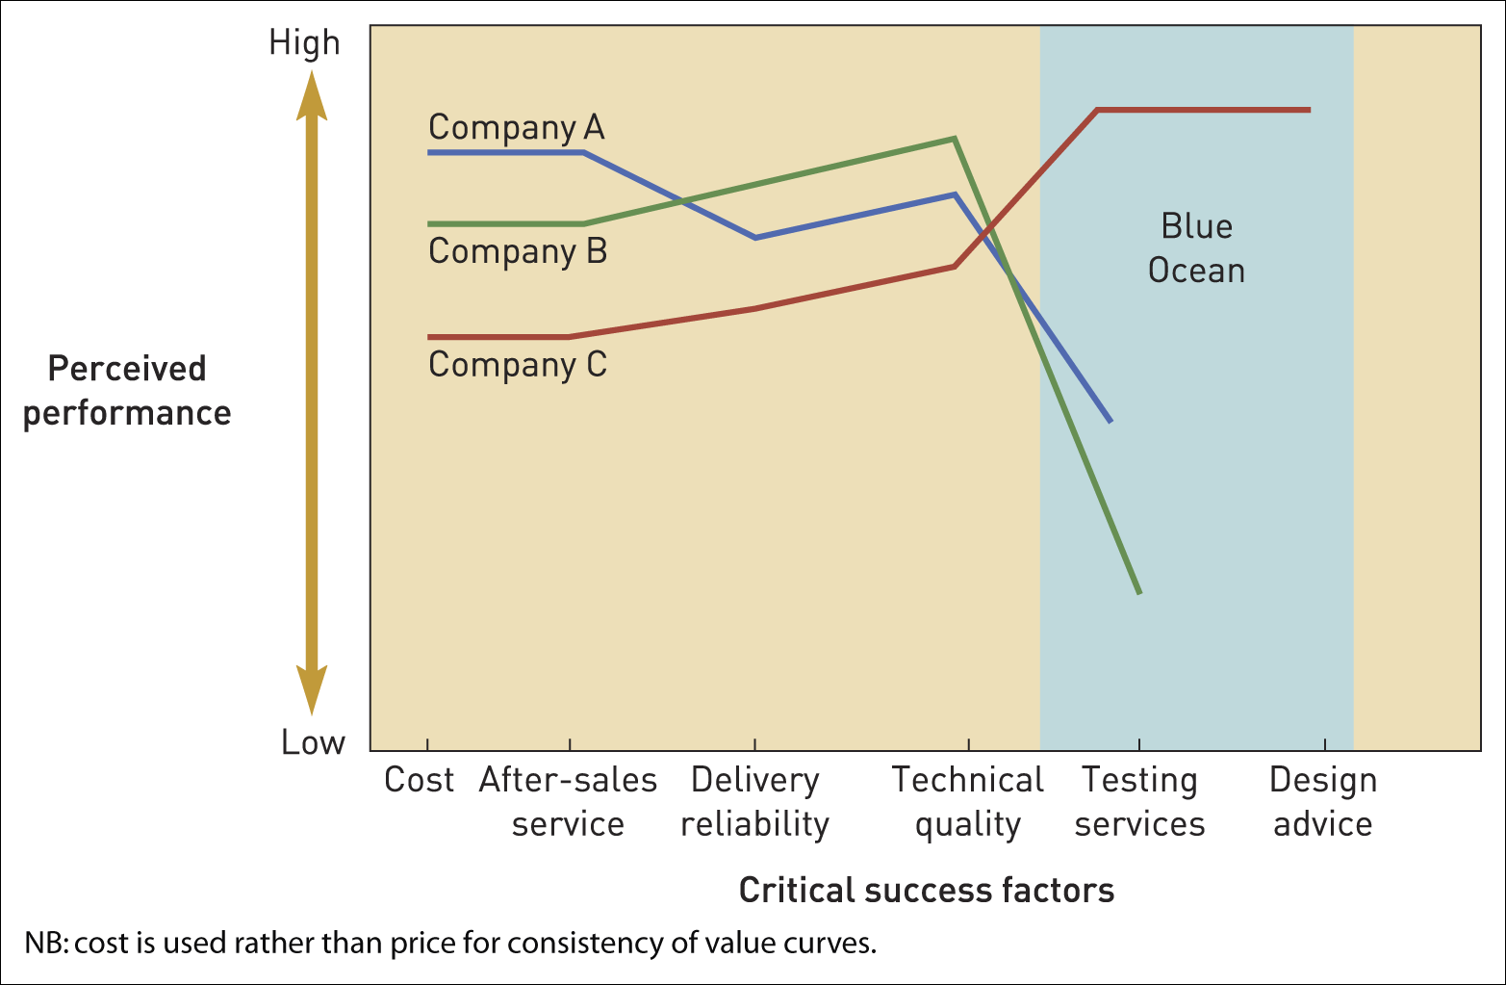
Strategy canvas
Figure 2.9 Strategy canvas for electrical components companies
Source: Developed from W.C. Kim and R. Mauborgne, Blue Ocean Strategy, 2005, Harvard Business School Press

Slide 42
Chapter summary (1)
Environmental influences can be thought of as layers around an organisation, with the outer layer making up the macro-environment, the middle layer making up the industry or sector and the inner layer strategic groups and market segments.
The macro-environment can be analysed in terms of the PESTEL factors, from which key drivers of change can be identified. Alternative scenarios about the future can be constructed according to how the key drivers develop.
Industries and sectors can be analysed in terms of Porter’s five forces – barriers to entry, substitutes, buyer power, supplier power and rivalry. Together, these determine industry or sector attractiveness.

Slide 43
Chapter summary (2)
Industries and sectors are dynamic, and their changes can be analysed in terms of the industry life cycle, comparative five forces radar plots and hypercompetitive cycles of competition.
In the inner layer of the environment, strategic group analysis, market segment analysis and the strategy canvas can help identify strategic gaps or opportunities.
Blue Ocean strategies characterised by low rivalry are likely to be better opportunities than Red Ocean strategies with many rivals.
The most important reason for environmental analysis is to identify OPPORTUNITIES AND THREATS

