Slide 1
The Strategic Position
3: Strategic Capabilities
Notes:
Update slide – change to 9th edition and title to Exploring Strategy

Slide 2
Learning outcomes
Identify what comprises strategic capabilities in terms of
organisational resources and competences and how these
relate to the strategies of organisations.
Analyse how strategic capabilities might provide sustainable competitive advantage on the basis of their value, rarity, inimitability and non-substitutability (VRIN).
Diagnose strategic capability by means of benchmarking, value chain analysis, activity mapping and SWOT analysis.
Consider how managers can develop strategic capabilities for their organisations.

Slide 3
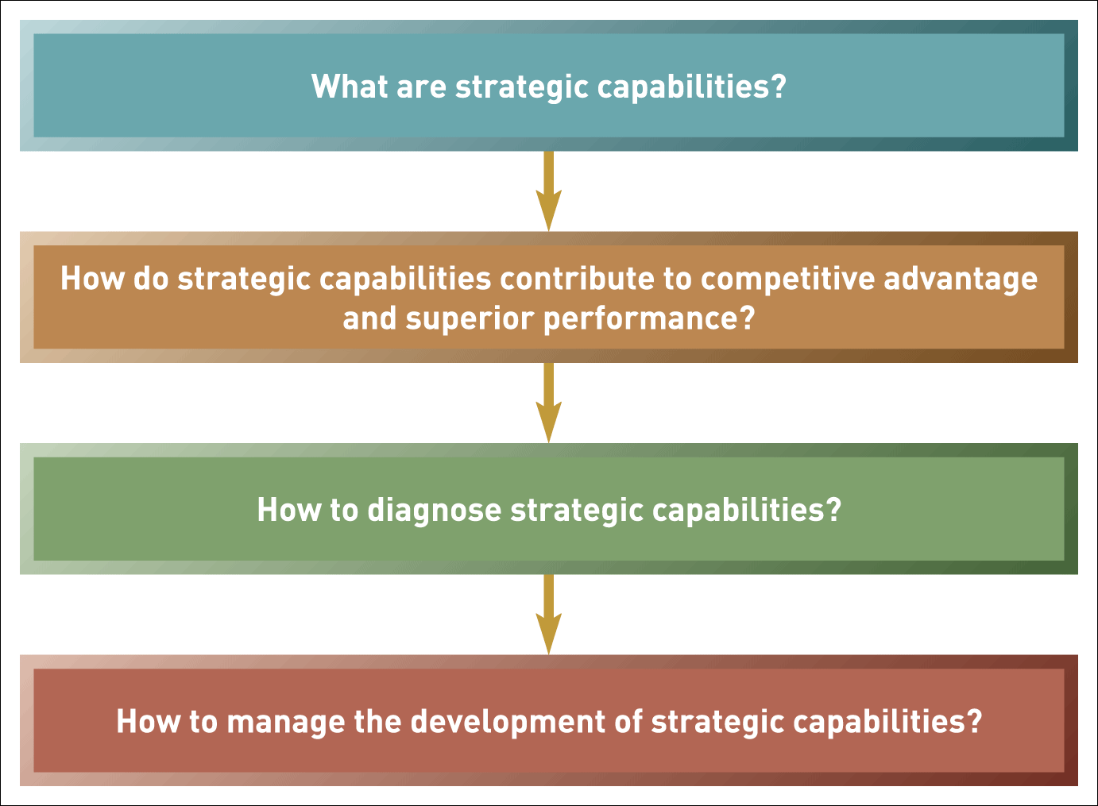
Strategic capabilities: the key issues
Figure 3.1 Strategic capabilities: the key issues

Slide 4

Resource-based strategy
The resource-based view (RBV) of strategy asserts that the competitive advantage and superior performance of an organisation is explained by the distinctiveness of its capabilities.

Slide 5
Resources and competences
Resources are the assets that organisations have or can call upon (e.g. from partners or suppliers),that is, ‘what we have’ .
Competences are the ways those assets are used or deployed effectively, that is, what we do well’.

Slide 6
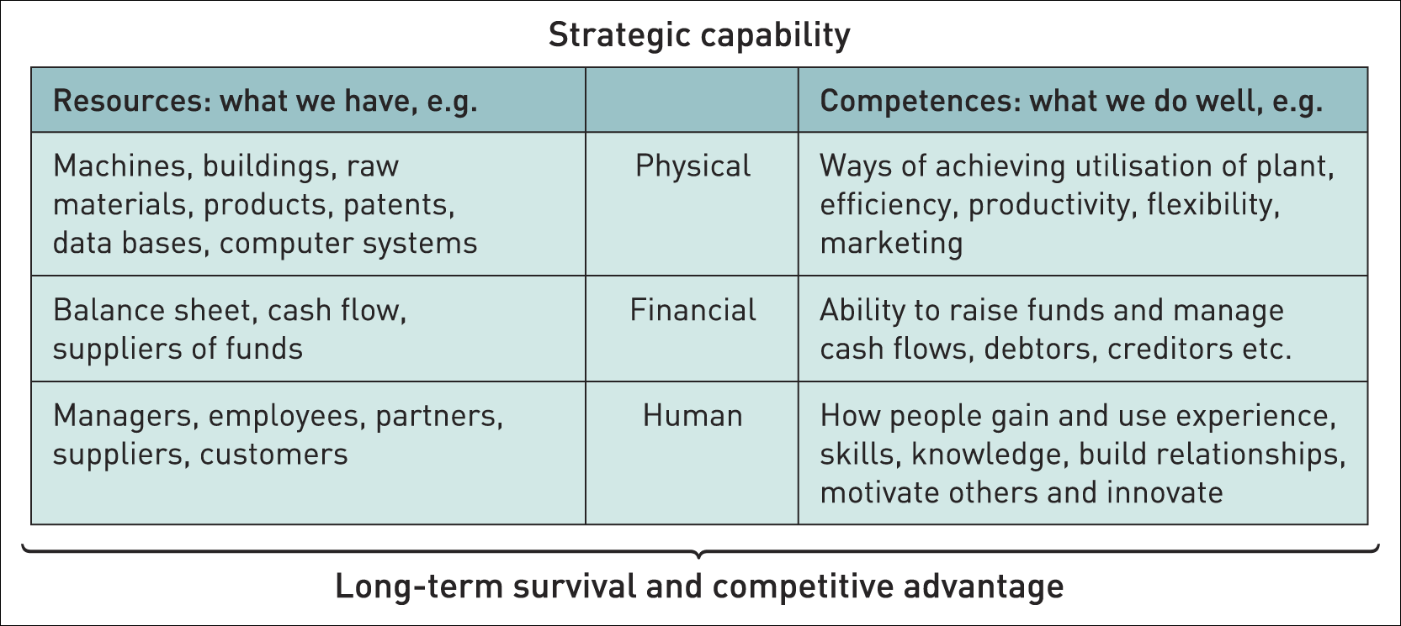
Components of strategic capabilities
Table 3.1 Components of strategic capabilities

Slide 7
Redundant capabilities
Capabilities, however effective in the past, can become less relevant as industries evolve and change.
Such ‘capabilities’ can become ‘rigidities’ that inhibit change and become a weakness.

Slide 8
Dynamic capabilities
Dynamic capability is the ability of an organisation to renew and recreate its strategic capabilities to meet the needs of changing environments.

Slide 9
Threshold and distinctive capabilities (1)
Threshold capabilities are those needed for an organisation to meet the necessary requirements to compete in a given market and achieve parity with competitors in that market – ‘qualifiers’.
Distinctive capabilities are those that critically underpin competitive advantage and that others cannot imitate or obtain – ‘winners’.

Slide 10
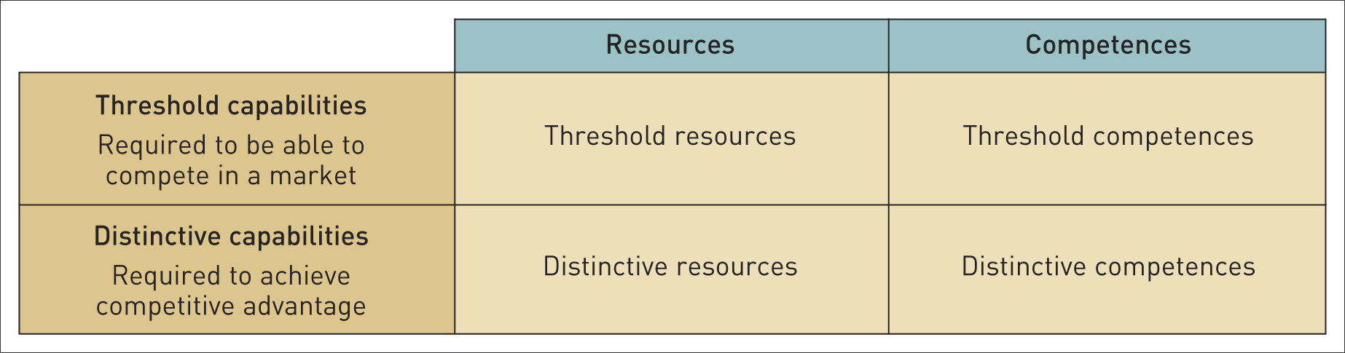
Threshold and distinctive capabilities
Table 3.2 Threshold and distinctive capabilities

Slide 11
Core competences
Core competences¹ are the linked set of skills, activities and resources that, together:
deliver customer value
differentiate a business from its competitors
potentially, can be extended and developed as markets change or new opportunities arise.
¹G. Hamel and C.K. Prahalad, ‘The core competence of the corporation’, Harvard Business Review, vol. 68, no. 3 (1990),
pp. 79–91.

Slide 12
Strategic capabilities and competitive advantage
The four key criteria by which capabilities can be assessed in terms of providing a basis for achieving sustainable competitive advantage are:
value,
rarity,
inimitability and
non-substitutability
1 Jay Barney: ‘Firm resources and sustained competitive advantage’, Journal of Management, vol. 17 (1991), no. 1, pp. 99–120.
VRIN¹

Slide 13
VRIN (1)
V – Value of strategic capabilities
Strategic capabilities are of value when they:
take advantage of opportunities and neutralise threats,
provide value to customers
provide potential competitive advantage
at a cost that allows an organisation to realise acceptable levels of return

Slide 14
VRIN (2)
R – Rarity
Rare capabilities are those possessed uniquely by one organisation or by a few others only. (E.g. a company may have patented products, have supremely talented people or a powerful brand.)
Rarity could be temporary.
(Eg: Patents expire, key individuals can leave or brands can be de-valued by adverse publicity.)

Slide 15
VRIN (3)
I – Inimitability
Inimitable capabilities are those that competitors find difficult to imitate or obtain.
Competitive advantage can be built on unique resources (a key individual or IT system) but these may not be sustainable (key people leave or others acquire the same systems).
Sustainable advantage is more often found in competences (the way resources are managed, developed and deployed) and the way competences are linked together and integrated.

Slide 16
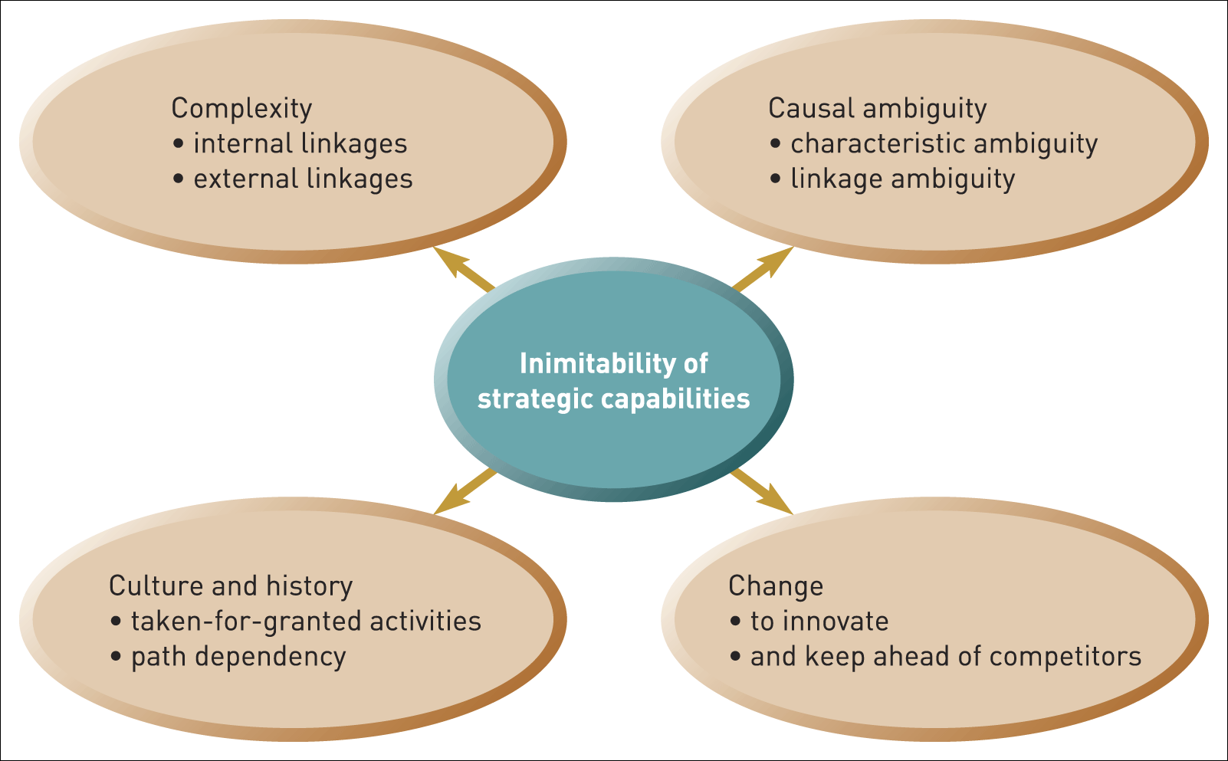
Criteria for the inimitability of strategic capabilities
Figure 3.2 Criteria for the inimitability of strategic capabilities

Slide 17
VRIN (4)
N - Non-substitutability
Competitive advantage may not be sustainable if there is a threat of substitution.
Product or service substitution from a different industry/market. For example, postal services partly substituted by e-mail.
Competence substitution. For example, a skill substituted by expert systems or IT solutions

Slide 18
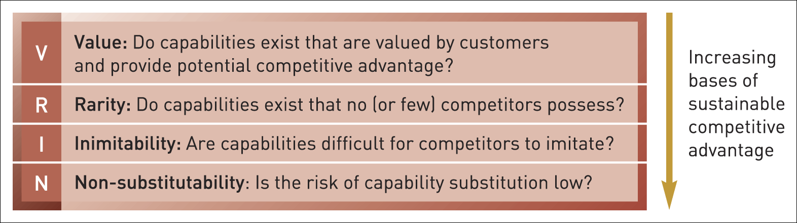
Criteria for the inimitability of strategic capabilities
Figure 3.3 VRIN

Slide 19
Organisational knowledge
Organisational knowledge is the collective intelligence, specific to an organisation, accumulated through both formal systems and the shared experience of people in that organisation.
Some of this knowledge is ‘Tacit’ knowledge that is, more personal, context-specific and hard to formalise and communicate – so it is difficult to imitate, for example, the knowledge and relationships in a top R&D team.

Slide 20
Benchmarking
Benchmarking is a means of understanding how an organisation compares with others – typically competitors.
Two approaches to benchmarking:
Industry/sector benchmarking - comparing performance against other organisations in the same industry/sector against a set of performance indicators.
Best-in-class benchmarking - comparing an organisation’s performance or capabilities against ‘best-in-class’ performance – wherever that is found even in a very different industry. (E.g. BA benchmarked its refuelling operations against Formula 1).

Slide 21
The value chain
The value chain describes the categories of activities within an organisation which, together, create a product or service.
The value chain invites the strategist to think of an organisation in terms of sets of activities – sources of competitive advantage can be analysed in any or all of these activities.

Slide 22
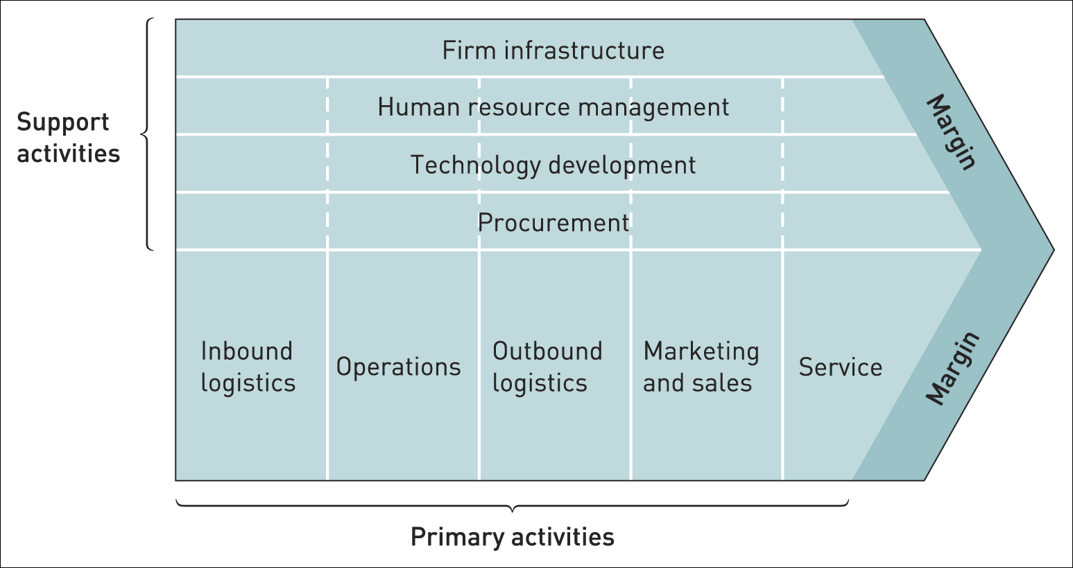
VRIN summary
Figure 3.4 The value chain within an organisation
Source: Adapted with the permission of The Free Press, a Division of Simon & Schuster, Inc., from Competitive Advantage: Creating and Sustaining Superior Performance
by Michael E. Porter. Copyright © 1985, 1998 by Michael E. Porter. All rights reserved

Slide 23
The value network
The value network comprises the set of inter-organisational links and relationships that are necessary to create a product or service.
Competitive advantage can be derived from linkages within the value network.

Slide 24
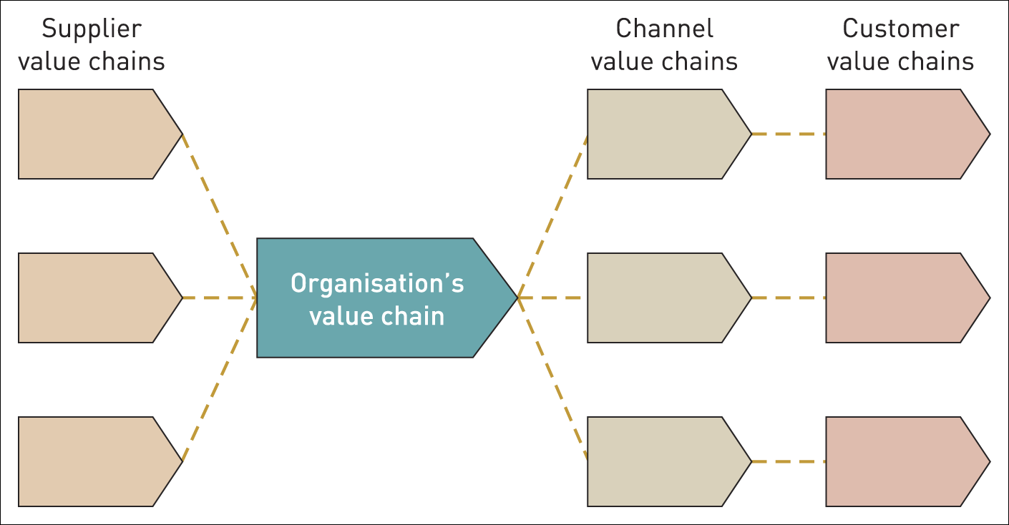
The value network
Figure 3.5 The value network
Source: Adapted with the permission of The Free Press, a Division of Simon & Schuster, Inc., from Competitive Advantage: Creating and Sustaining Superior Performance
by Michael E. Porter. Copyright © 1985, 1998 by Michael E. Porter. All rights reserved

Slide 25
Uses of the value chain
A generic description of activities – understanding the discrete activities and how they both contribute to consumer benefit and how they add to cost.
Identifying activities where the organisation has particular strengths or weaknesses
Analysing the competitive position of the organisation using the VRIN criteria – thus identifying sources of sustainable advantage.
Looking for ways to enhance value or decrease cost in value activities (e.g. outsourcing)

Slide 26
Uses of the value network
Understanding cost/price structures across the value network – analysing the best area of focus and the best business model .
Identifying ‘profit pools’ within the value network and seek to exploit these.
The ‘make or buy’ decision: deciding which activities to do ‘in-house’ and which to outsource.
Partnering and relationships – deciding who to work with and the nature of these relationships.

Slide 27
Mapping activity systems (1)
Identify ‘higher order strategic themes’ that is, how the organisation meets the critical success factors in the market.
Identify the clusters of activities that underpin these themes and how they fit together.
Map this in terms of how activity systems are interrelated.

Slide 28
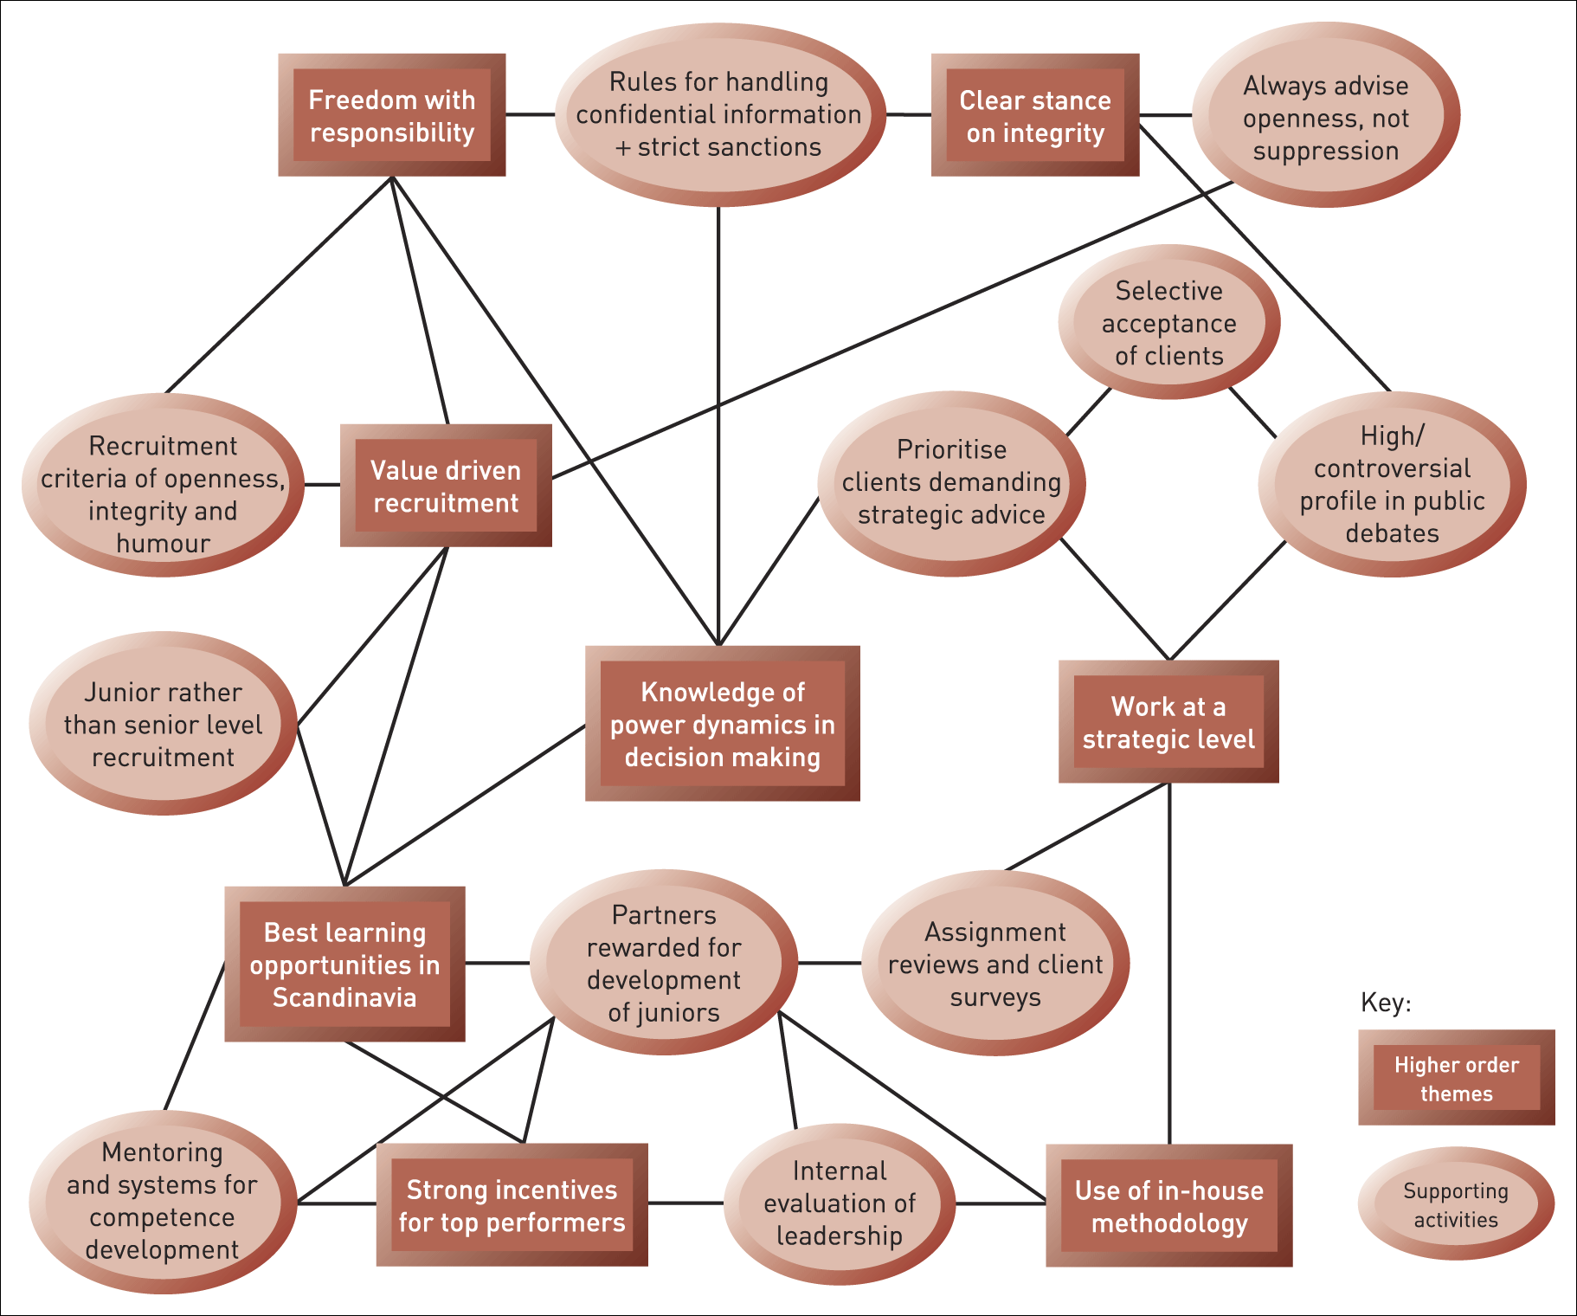
Mapping activity systems (2)
Illustration 3.5 Activity systems at Geelmuyden.Kiese

Slide 29
Using activity system maps
A means of identifying strategic capabilities in terms of linkages of activities
Internal and external links are identified (e.g. in terms of the needs of customers).
Therefore helps identify bases of competitive advantage.
And sustainable advantage for example, in terms of bases of inimitability.

Slide 30
SWOT analysis
SWOT summarises the strengths, weaknesses, opportunities and threats likely to impact on strategy development.
INTERNAL STRENGTHS WEAKNESSES
ANAYSIS
EXTERNAL OPPORTUNITIES THREATS
ANALYSIS

Slide 31
Uses of SWOT analysis
Key environmental impacts are identified using the analytical tools explained in Chapter 2.
Major strengths and weaknesses are identified using the analytic tools explained in Chapter 3.
Scoring (e.g. + 5 to - 5) can be used to assess the interrelationship between environmental impacts and the strengths and weaknesses.
SWOT can be used to examine strengths, weaknesses, opportunities and threats in relation to competitors.
SWOT can be used to generate strategic options– using a TOWS matrix.

Slide 32
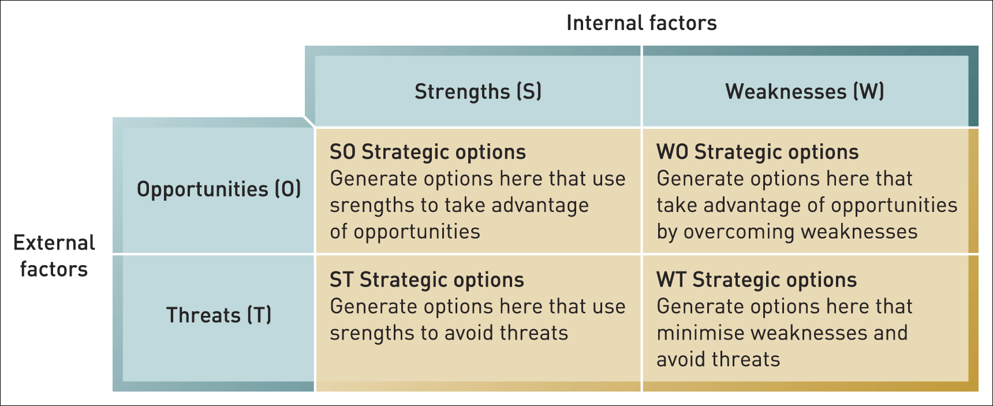
The TOWS matrix
Figure 3.6 The TOWS matrix

Slide 33
Dangers in a SWOT analysis
Long lists with no attempt at prioritisation.
Over generalisation – sweeping statements often based on biased and unsupported opinions.
SWOT is used as a substitute for analysis – it should result from detailed analysis using the frameworks in Chapters 2 and 3.
SWOT is not used to guide strategy – it is seen as an end in itself.

Slide 34
Developing strategic capabilities (1)
Internal capability development:
Leveraging capabilities – identifying capabilities in one part of the organisation and transferring them to other parts (sharing best practice).
Stretching capabilities - building new products or services out of existing capabilities.

Slide 35
Developing strategic capabilities (2)
External capability development – adding capabilities through mergers, acquisitions or alliances.
Ceasing activities – non-core activities can be stopped, outsourced or reduced in cost.
Monitor outputs and benefits – to understand sources of consumer benefit and enhance anything that contributes to this.
Managing the capabilities of people – training, development and organisation learning.

Slide 36
Chapter summary (1)
Strategic capabilities comprise both resources and competences.
The concept of dynamic capabilities highlights that strategic capabilities need to change as the market and environmental context of an organisation changes.
Sustainability of competitive advantage is likely to depend on an organisation’s capabilities being of at least threshold value in a market but also being valuable, relatively rare, intimable and non-substitutable.

Slide 37
Chapter summary (2)
Ways of diagnosing organisational capabilities include:
Benchmarking as a means of understanding the relative performance of organisations.
Analysing an organisation’s value chain and value network as a basis for understanding how value to a customer is created and can be developed.
Activity mapping as a means of identifying more detailed activities which underpin strategic capabilities.
SWOT analysis as a way of drawing together an understanding of strengths, weaknesses, opportunities and threats an organisation faces.

