Slide 1
The Strategic Position
4: Strategic Purpose
Notes:
Update

Slide 2
Learning outcomes
Consider appropriate ways to express the strategic purpose of
an organisation in terms of statements of purpose, values,
vision, mission or objectives.
Identify the components of the governance chain of an
organisation.
Understand differences in governance structures and the
advantages and disadvantages of these.
Identify differences in the corporate responsibility stances taken
by organisations and how ethical issues relate to strategic
purpose.
Undertake stakeholder analysis as a means of identifying the
influence of different stakeholder groups in terms of their
power and interest.

Slide 3
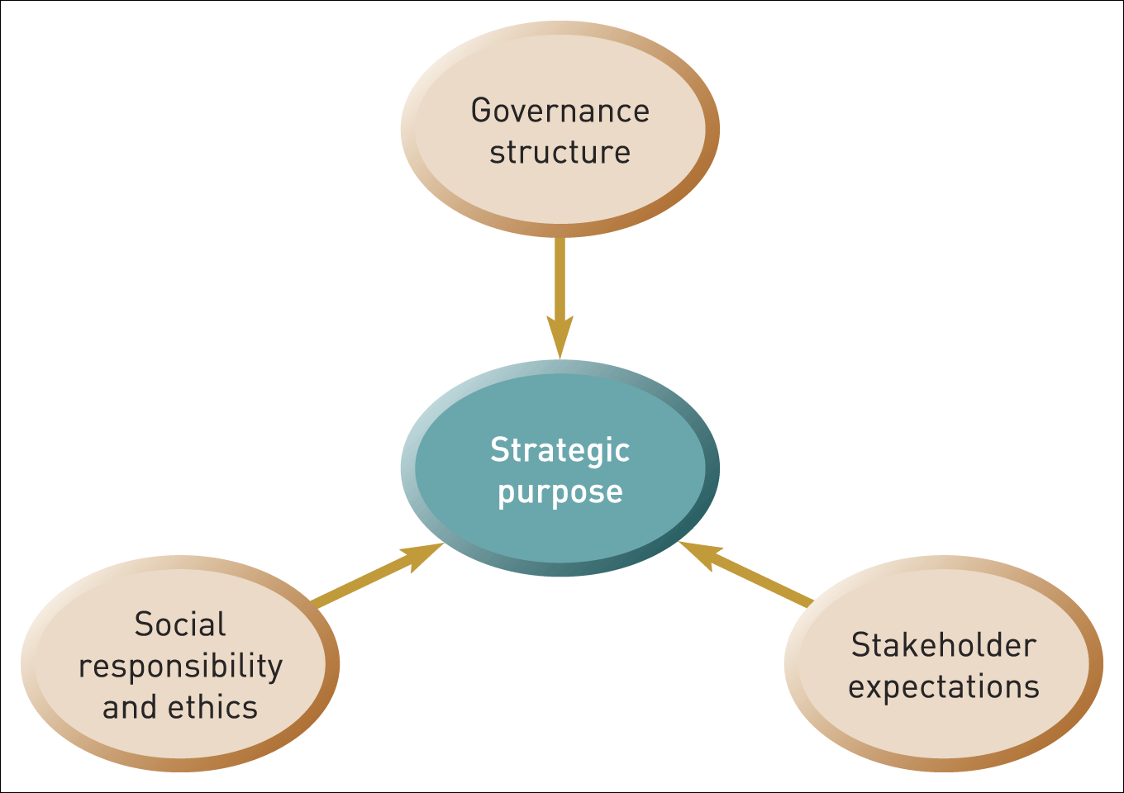
Influences on strategic purpose
Figure 4.1 Influences on strategic purpose

Slide 4
Who are the stakeholders?
Stakeholders are those individuals or groups who depend on an organisation to fulfil their own goals and on whom, in turn, the organisation depends.

Slide 5

Mission statements
A mission statement aims to provide employees and stakeholders with clarity about the overriding purpose of the organisation
A mission statement should answer the questions:
‘What business are we in?’
‘How do we make a difference?’
‘Why do we do this?’

Slide 6
Vision statements
A vision statement is concerned with the desired future state of the organisation; an aspiration that will enthuse, gain commitment and stretch performance.
A vision statement should answer the question :
‘What do we want to achieve?’

Slide 7
Statement of corporate values
A statement of corporate values should communicate the underlying and enduring core ‘principles’ that guide an organisation’s strategy and define the way that the organisation should operate.
Such core values should remain intact whatever the circumstances and constraints faced by the organisation.

Slide 8
Objectives
Objectives are statements of specific outcomes that are to be achieved.
Objectives are frequently expressed in: financial terms (e.g. desired profit levels)
market terms (e.g. desired market share)
and increasingly
social terms (e.g. corporate social
responsibility targets)

Slide 9
Issues in setting objectives
Do objectives need to be specific and quantified targets?
The need to identify core objectives that are crucial for survival.
The need for a hierarchy of objectives that cascade down the organisation and define specific objectives at each level.

Slide 10
Corporate governance
Corporate governance is concerned with the structures and systems of control by which managers are held accountable to those who have a legitimate stake in an organisation.

Slide 11
The growing importance of governance
The separation of ownership and management control – defining different roles in governance.
Corporate failures and scandals (e.g. Enron) – focussing attention on governance issues.
Increased accountability to wider stakeholder interests and the need for corporate social responsibility (e.g. green issues).

Slide 12
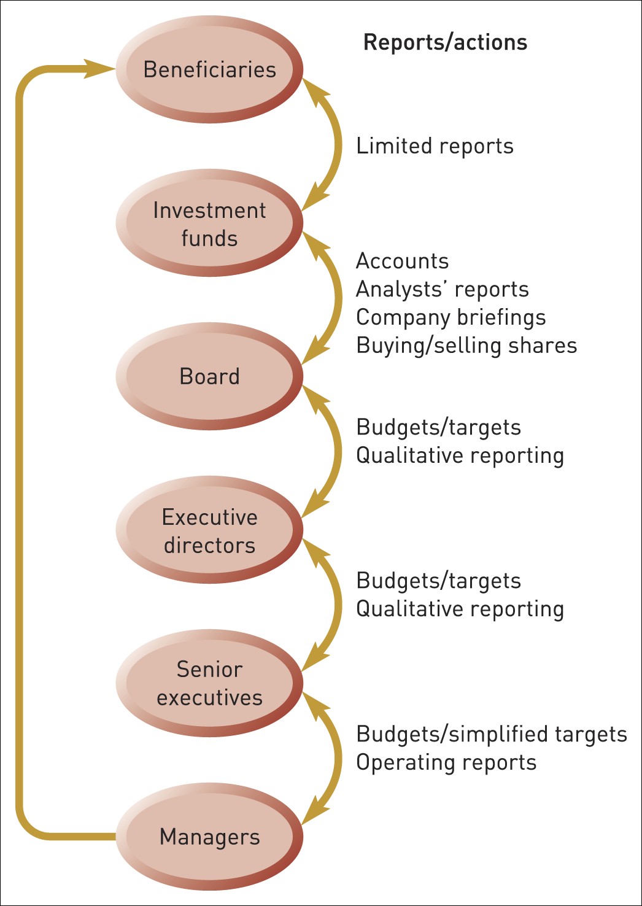
The governance chain
Figure 4.2 The chain of corporate governance: typical reporting structures
Source: Adapted from David Pitt-Watson, Hermes Fund Management

Slide 13
The principal-agent model
Governance can be seen in terms of the principal agent model
Principals pay agents to act on their behalf (e.g. beneficiaries/trustees pay investment managers to manage funds, Boards of Directors pay executives to run a company).
Agents may act in their own self interest.

Slide 14
Issues in governance (1)
The key challenge is to align the interests of agents with those of the principals.
Misalignment of incentives and control – e.g. beneficiaries may require long term growth but executives may be seeking short term profit.
Responsibility to whom – should executives pursue solely shareholder aims or serve a wider constituency of stakeholders?

Slide 15
Issues in governance (2)
Who are the shareholders – should boards respond to the demands of institutional investment managers or the needs of the ultimate beneficiaries?
The role of institutional investors – should they actively intervene in strategy?
Establishing the specific role of the board – in particular the role of non-executive directors.
Scrutiny and control – statutory requirements and voluntary codes to regulate boards.

Slide 16
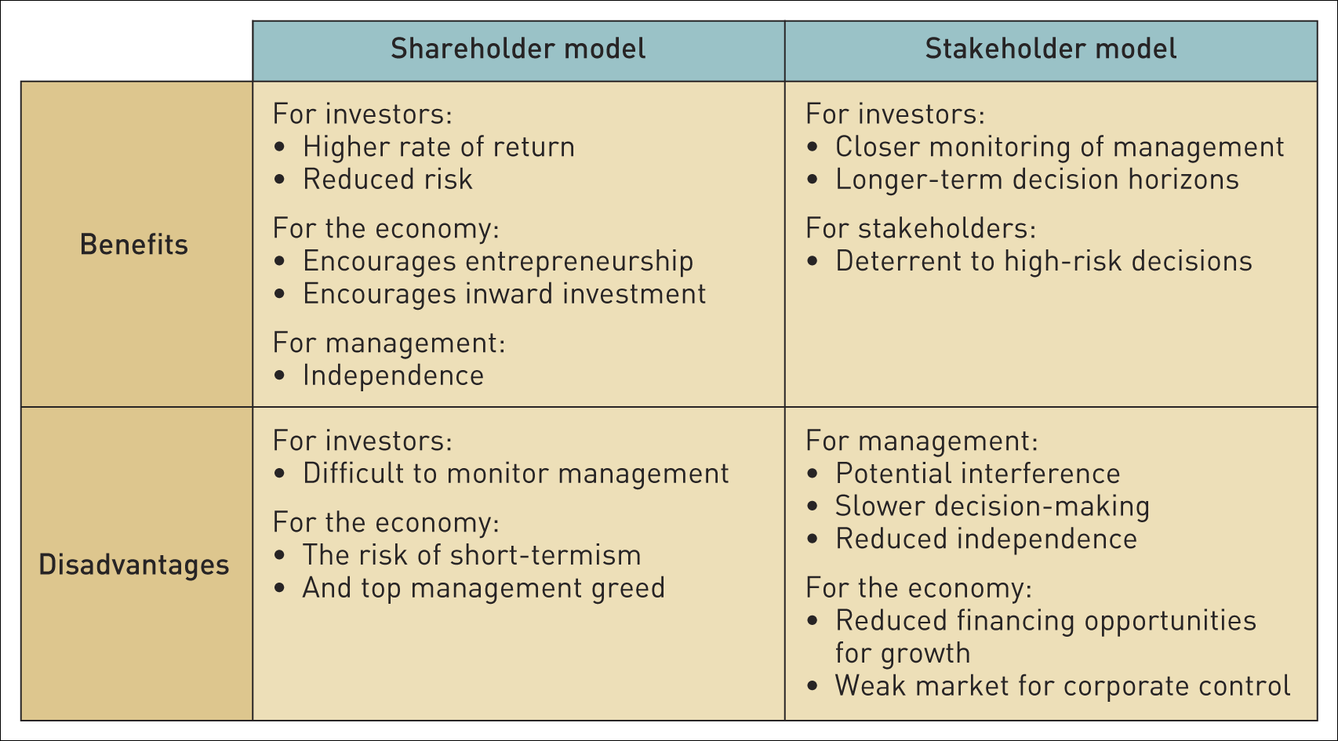
Different governance systems
Table 4.1 Benefits and disadvantages of governance systems

Slide 17
The role of boards
Operate ‘independently’ of the
management – the role of non-executives is crucial.
Be competent to scrutinise the activities of managers.
Have time to do their job properly.
Behave appropriately given expectations for trust, role fluidity, collective responsibility, and performance.

Slide 18
Corporate social responsibility
Corporate social responsibility (CSR) is the commitment by organisations to ‘behave ethically and contribute to economic development while improving the quality of life of the workforce and their families as well as the local community and society at large’.¹
¹ World Business Council for Sustainable Development.

Slide 19
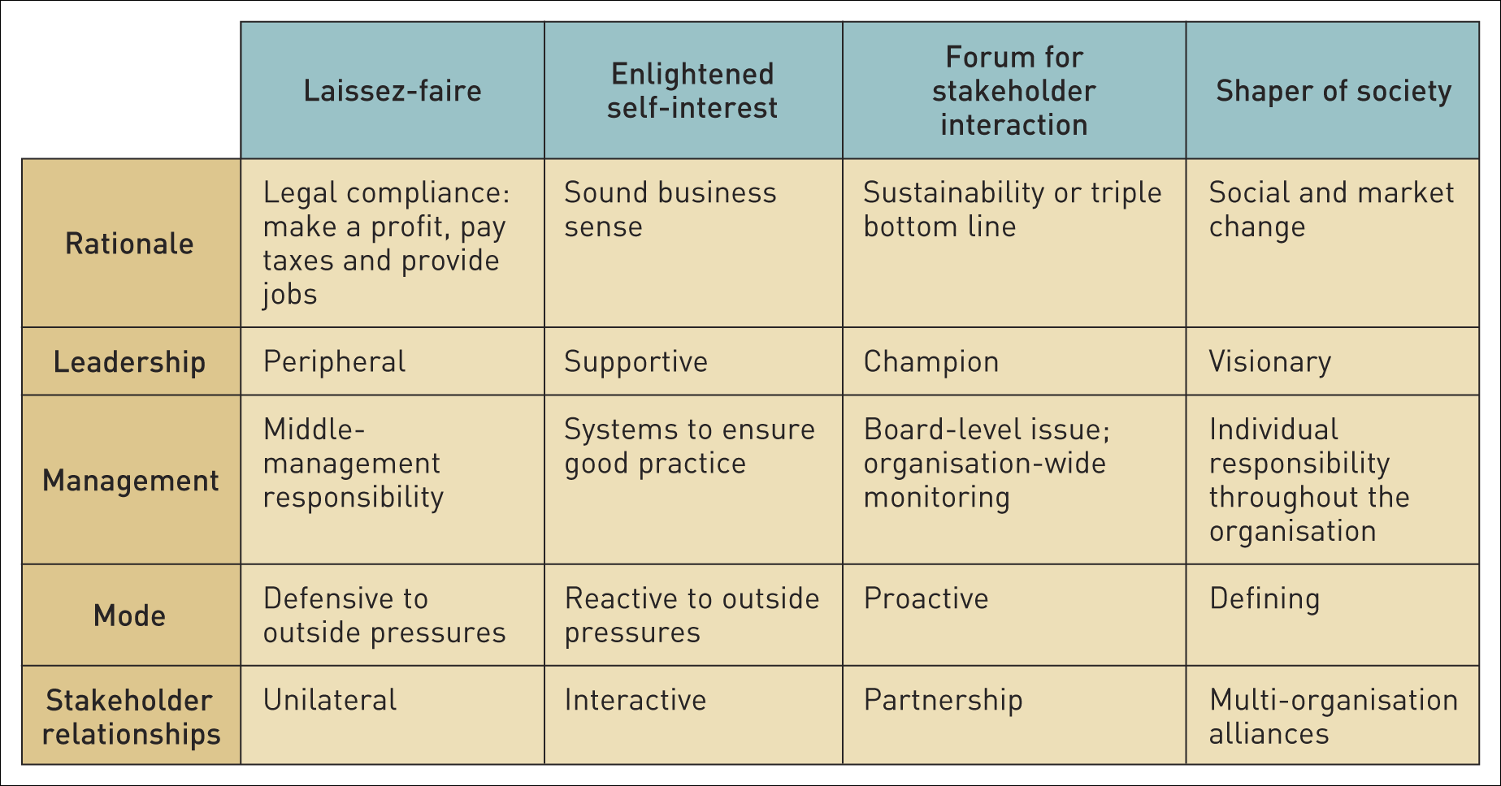
Corporate social responsibility stances
Table 4.2 Corporate social responsibility stances

Slide 20
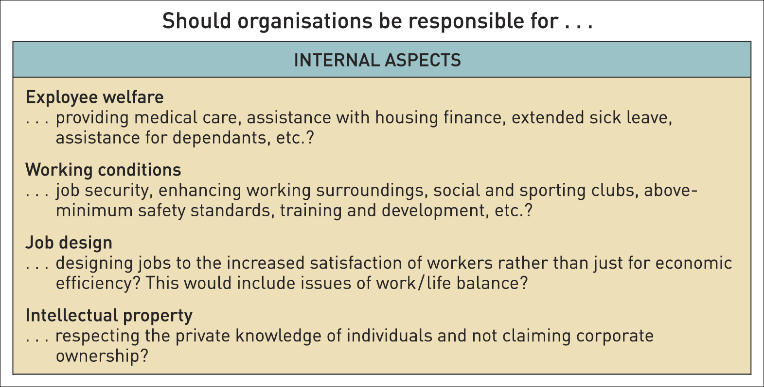
Questions of corporate social responsibility – internal aspects (1)
Table 4.3 Some questions of corporate social responsibility

Slide 21
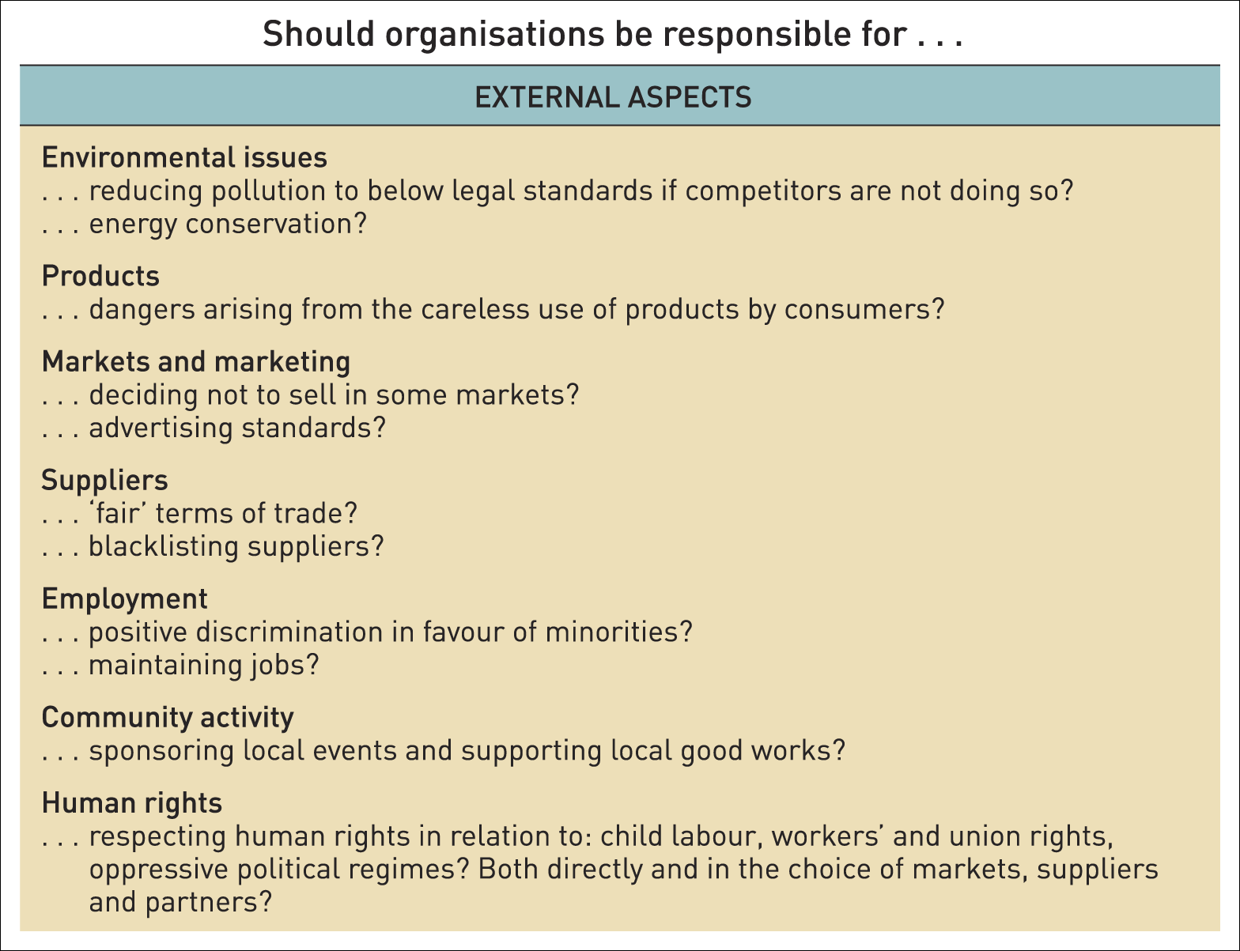
Questions of corporate social responsibility – external aspects (2)
Table 4.3 Some questions of corporate social responsibility (Continued)

Slide 22
The ethics of individuals and managers
Ethical issues have to be faced at the individual level :
The responsibility of an individual who believes that the strategy of the organisation is unethical – resign, ignore it or take action.
‘Whistle-blowing’ - divulging information to the authorities or media about an organisation if wrong doing is suspected.

Slide 23
Texas instruments’ guidelines
Is the action legal? . . . If no, stop immediately.
Does it comply with our values? . . . If it does not, stop.
If you do it would you feel bad? . . . Ask your own conscience if you can live with it.
How would this look in the newspaper? . . . Ask if this goes public tomorrow would you do it today?
If you know it’s wrong . . . don’t do it.
If you are not sure . . . ask; and keep asking until you get an answer.

Slide 24
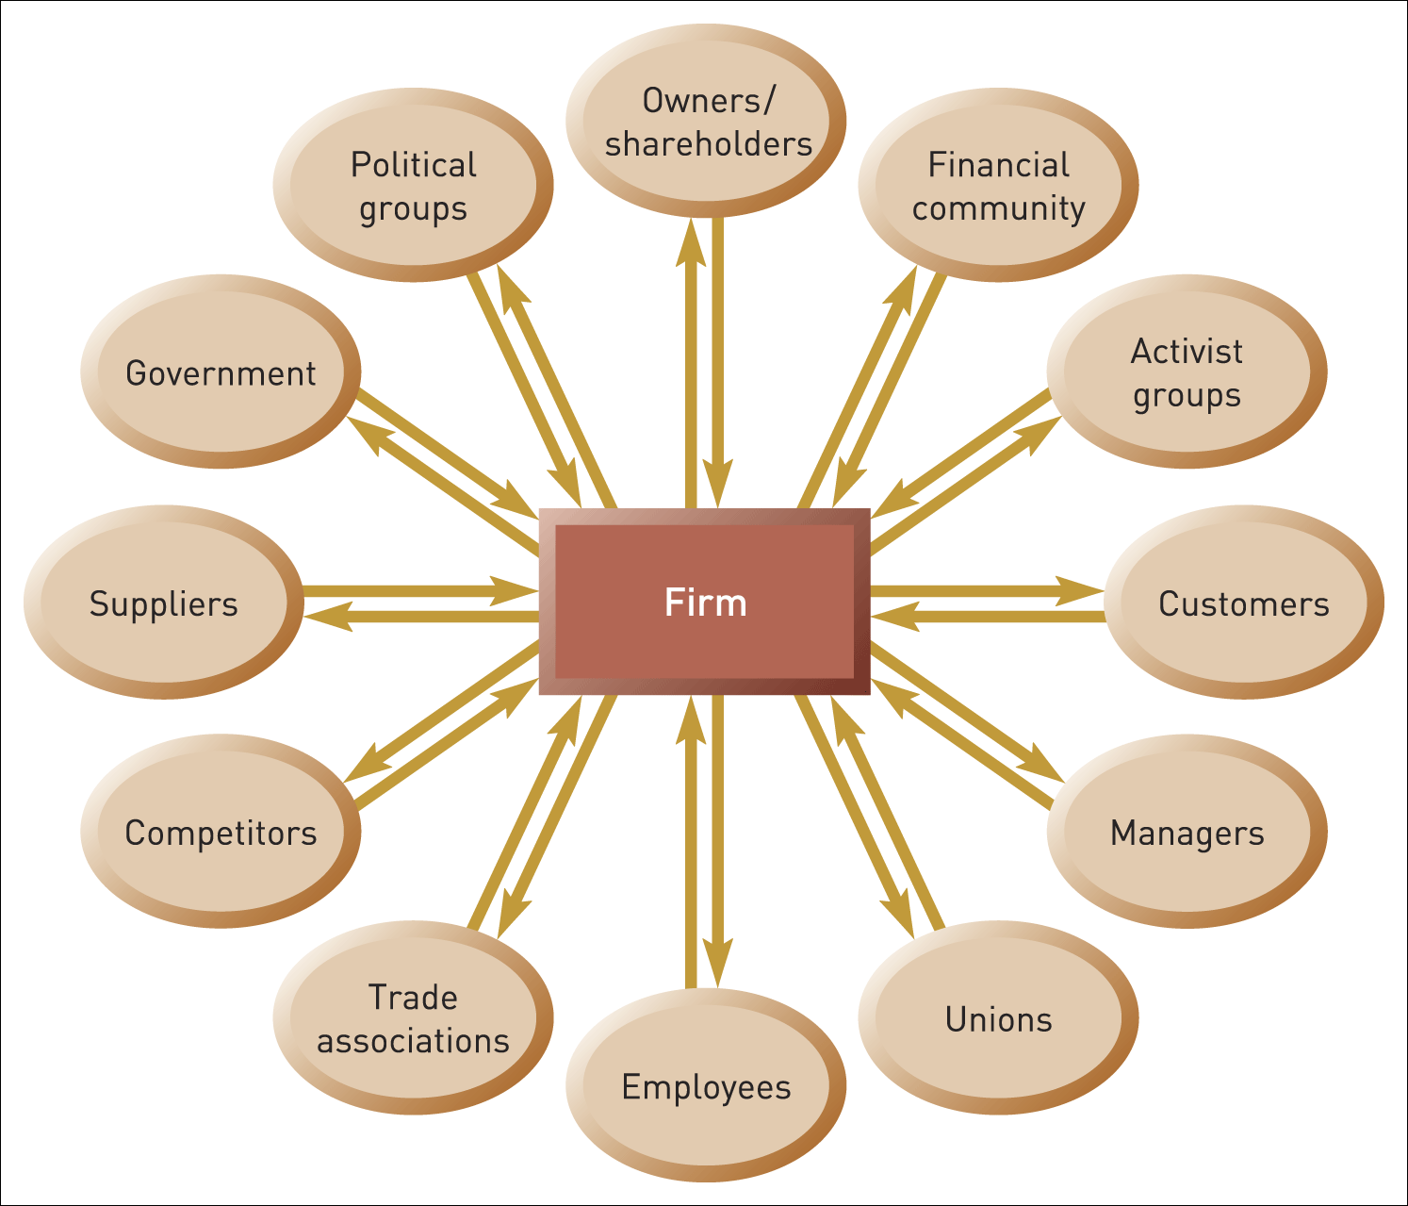
Stakeholders of a large organisation
Figure 4.3 Stakeholders of a large organisation
Source: Adapted from R.E. Freeman, Strategic Management: A Stakeholder Approach, Pitman, 1984. Copyright 1984 by R. Edward Freeman.

Slide 25
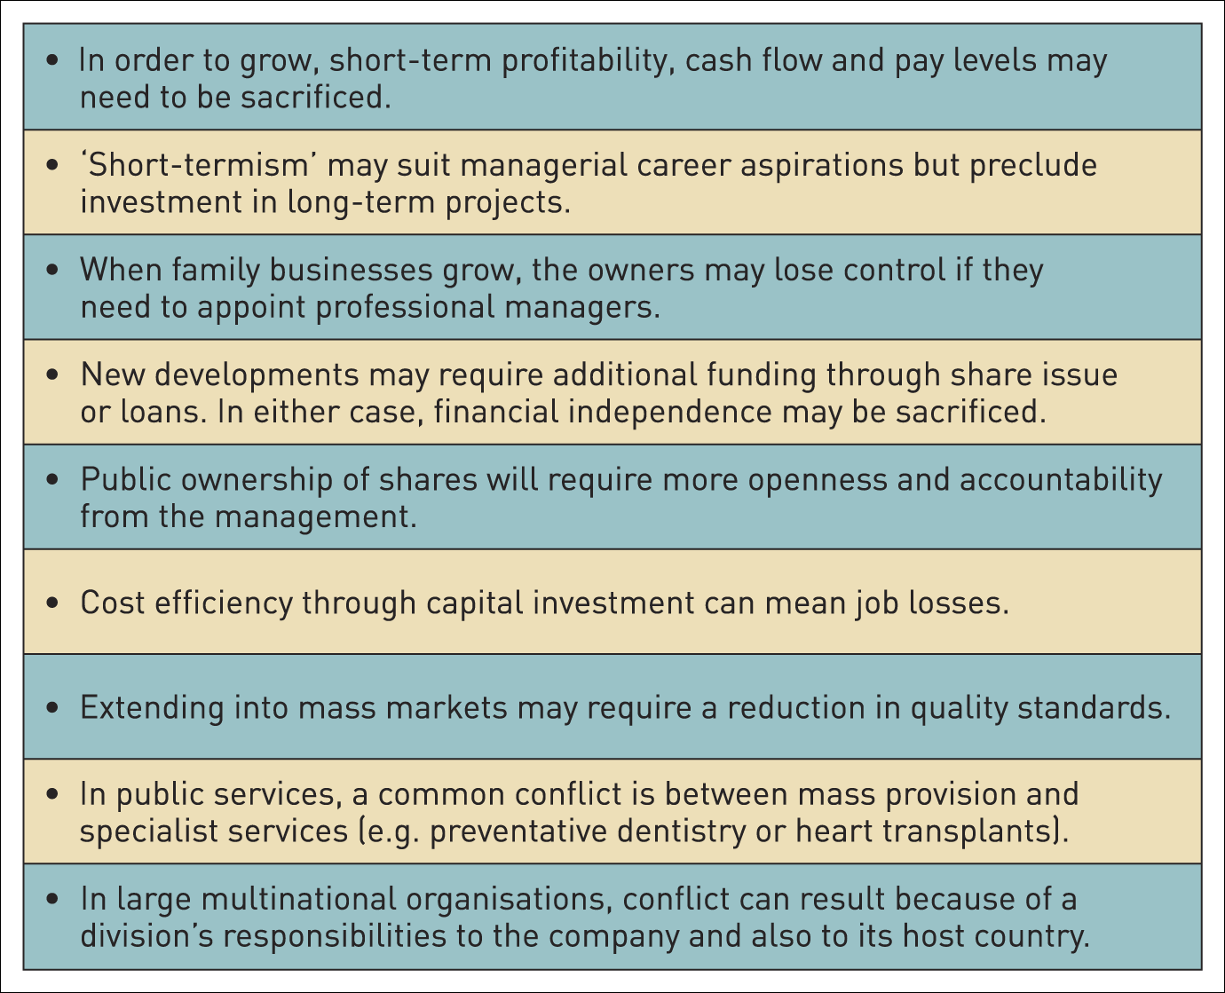
Stakeholder conflicts of expectations
Table 4.4 Some common conflicts of expectations

Slide 26
Stakeholder mapping
Stakeholder mapping identifies stakeholder expectations and power and helps in understanding political priorities.

Slide 27
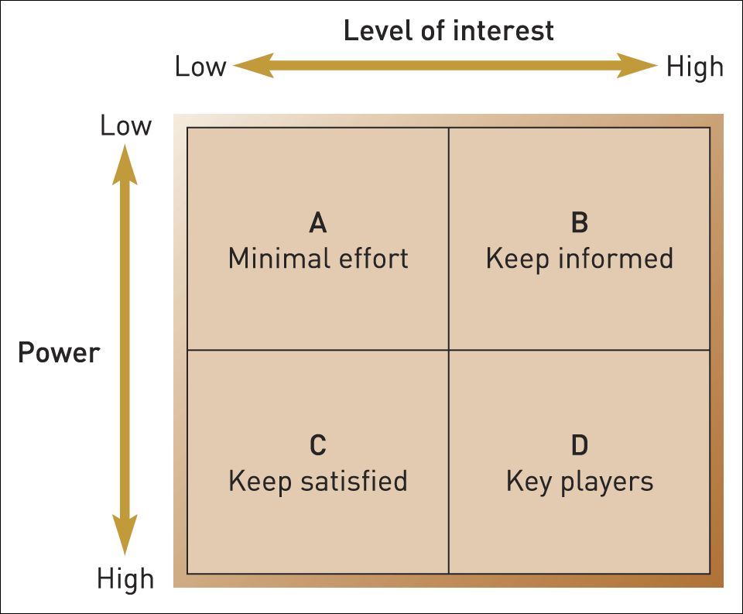
Stakeholder mapping: the power/interest matrix
Figure 4.4 Stakeholder mapping: the power/interest matrix
Source: Adapted from A. Mendelow, Proceedings of the Second International Conference on Information Systems, Cambridge, MA, 1986

Slide 28
Stakeholder mapping issues
Determining purpose and strategy – whose expectations need to be prioritised?
Do the actual levels of interest and power reflect the corporate governance framework?
Who are the key blockers and facilitators of strategy?
Is it desirable to try to reposition certain stakeholders?
Can the level of interest or power of key stakeholders be maintained?
Will stakeholder positions shift according to the issue/strategy being considered.

Slide 29
Power
Power is the ability of individuals or groups to persuade, induce or coerce others into following certain courses of action.

Slide 30
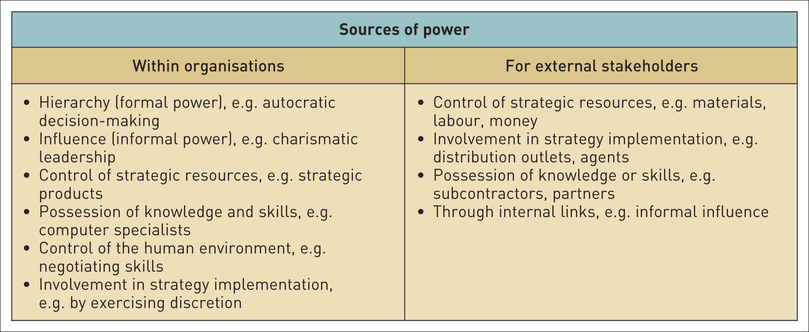
Sources of power
Table 4.5 Sources and indicators of power

Slide 31
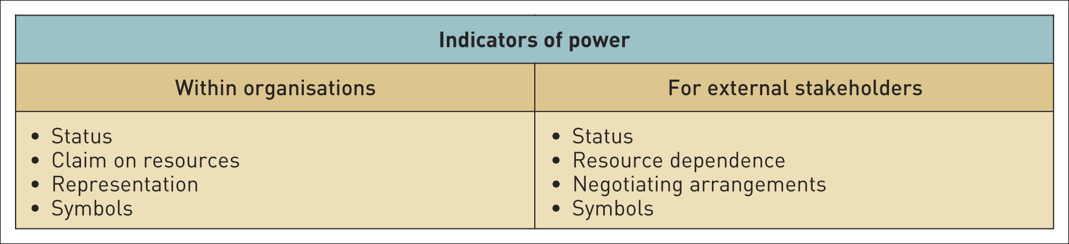
Indicators of power
Table 4.5 Sources and indicators of power (Continued)

Slide 32
Summary (1)
An important managerial task is to decide how the organisation should express its strategic purpose through statements of mission, vision, values or objectives.
The purpose of an organisation will be influenced by the expectations of its stakeholders.
The influence of some key stakeholders is represented formally within the governance structure of an organisation. This can be represented in terms of a governance chain, showing the links between ultimate beneficiaries and the managers of an organisation.

Slide 33
Summary (2)
There are two generic governance structures systems: the shareholder model and the stakeholder model though there are variations of these internationally.
Organisations adopt different stances on corporate social responsibility depending on how they perceive their role in society. Individual managers may face ethical dilemmas relating to the purpose of their organisation or actions it takes.
Different stakeholders exercise different influence on organisational purpose and strategy, dependent on the extent of their power and interest. Managers can assess the influence of different stakeholder groups through stakeholder analysis.

