Slide 1
The Strategic Position
5: Culture and Strategy
Notes:
Update slide – 9th edition and change to Exploring Strategy

Slide 2
Learning outcomes
Identify organisations that have experienced strategic drift and the symptoms of strategic drift.
Analyse how history influences the strategic position of organisations.
Analyse the influence of an organisation’s culture on its strategy using the cultural web.
Recognise the importance of strategists questioning the taken–for–granted aspects of a culture.

Slide 3
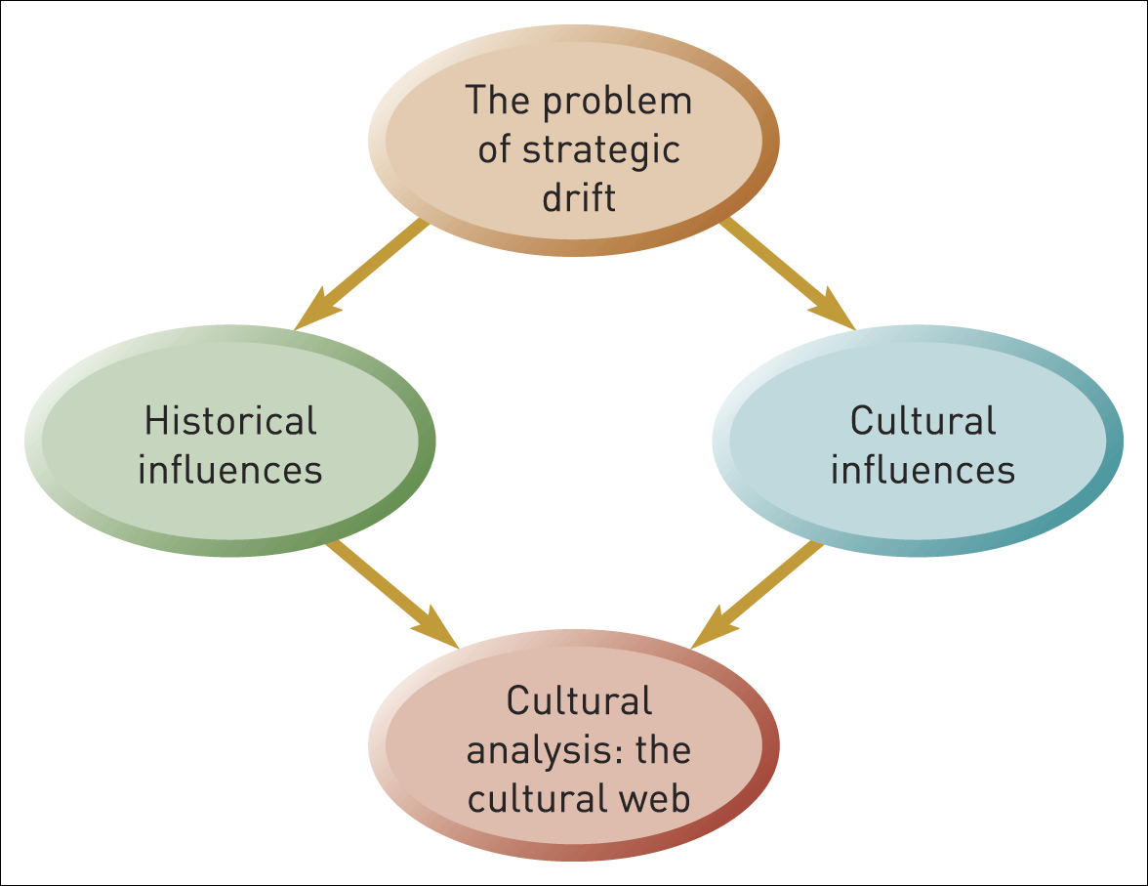
Culture and strategy – key issues
Figure 5.1 The influence of history and culture

Slide 4

Strategic drift
Strategic drift is the tendency for strategies to develop incrementally on the basis of historical and cultural influences but fail to keep pace with a changing environment.

Slide 5
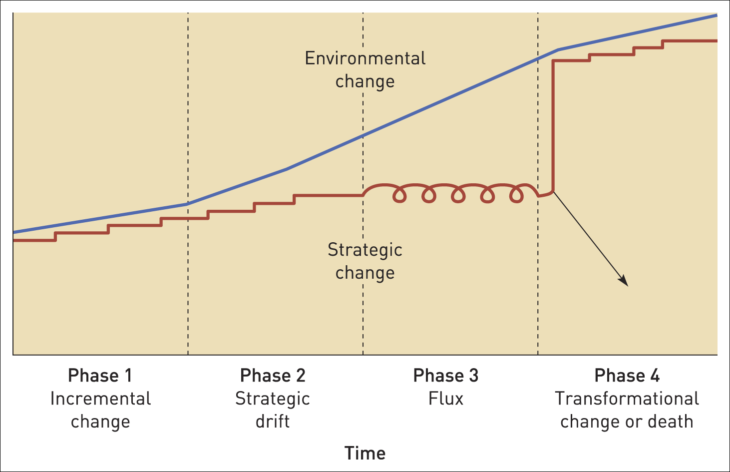
Strategic drift
Figure 5.2 Strategic drift

Slide 6
Incremental change to avoid strategic drift
Gradual change in alignment with environmental change.
Building on successful strategies used in the past (built around core competences)
Making changes based on experimentation around a theme (incremental change built on a successful formula)
This approach is called Logical Incrementalism

Slide 7
The tendency towards strategic drift (1)
Strategies fail to keep pace with environmental change because :
Steady as you go – reluctance to accept that change requires moving away from strategies that have been successful.
Building on the familiar – uncertainty of change is met with a tendency to stick to the familiar.
Core rigidities – capabilities that are taken for granted and deeply ingrained in routines are difficult to change even when they are no longer suitable.

Slide 8
The tendency towards strategic drift (2)
Relationships become shackles – organisations become reluctant to disturb relationships with customers, suppliers or the workforce even if they need to change.
Lagged performance effects – the financial performance of the organisation may hold up initially (e.g. due to loyal customers or cost cutting) masking the need for change.

Slide 9
A period of flux
As performance declines and the organisation loses track of the environment then a period of Flux occurs typified by:
Strategies that change, but in no clear direction.
Top management conflict and managerial changes.
Internal disagreement on the ‘right’ strategies.
Declining performance and morale.
Customers becoming alienated.

Slide 10
Transformational change or death
As performance continues to deteriorate the outcome is likely to be :
The organisation dies (e.g. goes bankrupt or into receivership).
The organisation is taken over (and perhaps radically changed by new owners).
The organisation implements transformational change – multiple, rapid and fundamental changes.

Slide 11
Why history is important
Recognising that organisational experience becomes deeply embedded in behaviour.
Avoiding recency bias – learning from the past.
Asking ‘what if’ questions based on past experience.
History as legitimisation – past success can be used as evidence to support specific strategies.
Innovation based on historic capabilities which can be adapted and transferred.

Slide 12
Path dependency
Path dependency is where early events and decisions establish ‘policy paths’ that have lasting effects on subsequent events and decisions.

Slide 13
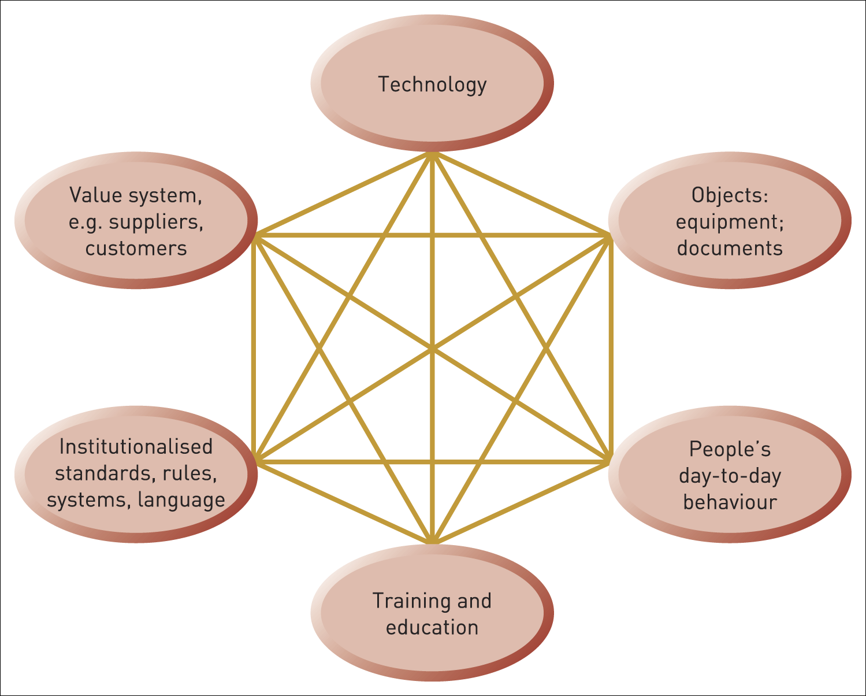
Path dependency and lock-in
Figure 5.3 Path dependency and lock-in

Slide 14
The impact of path dependency
Building strategy around the path-dependent capabilities that have been successful in the past.
Path creation – changing strategies in a way that is built on the past and acceptable to key players.
Management style may be rooted in and evolved from the early style adopted by the founder(s).

Slide 15
Methods of historical analysis
Chronological
analysis
Cyclical
influence
Anchor
points
Historical
narratives
Notes:
Use Marks and Spencer, start at 5:16 through 6:07 on benchmarking and analysis of profitability.

Slide 16
Organisational culture
Organisational culture is the taken-for-granted assumptions and behaviours that make sense of people’s organisational context

Slide 17
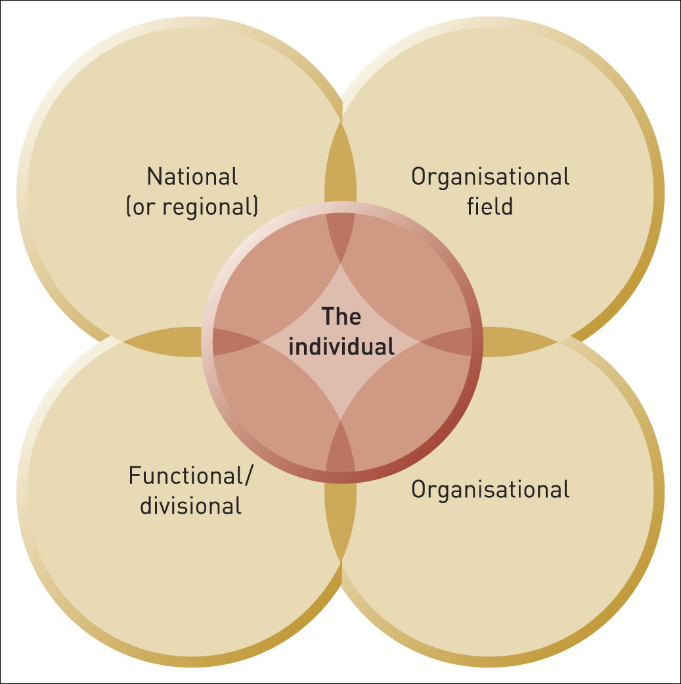
Cultural frames of reference
Figure 5.4 Cultural frames of reference

Slide 18
The organisational field
An organisational field is a community of organisations that interact more frequently with one another than with those outside the field and that have developed a shared meaning system.

Slide 19
Recipes
A recipe is a set of assumptions, norms and routines held in common within an organisational field about the appropriate purposes and strategies of field members.
In effect it is ‘shared wisdom’.

Slide 20
Legitimacy
Legitimacy is concerned with meeting the expectations within an organisational field in terms of assumptions, behaviours and strategies.
Strategies can be shaped by the need for legitimacy in several ways:
Regulation
Normative expectations
The recipe

Slide 21
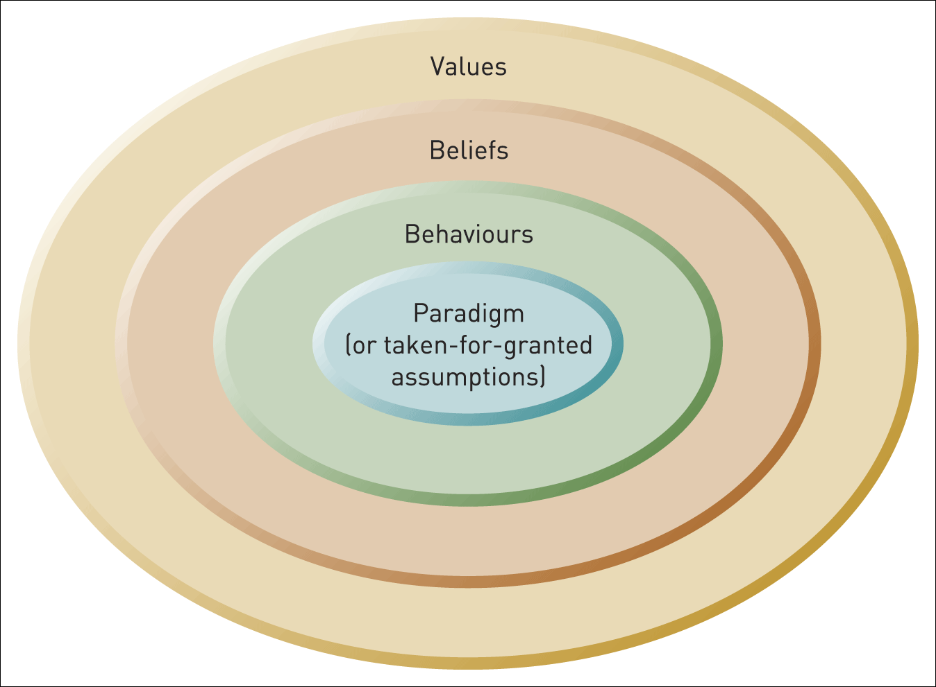
Culture in four layers
Figure 5.5 Culture in four layers

Slide 22
The paradigm
The paradigm is the set of assumptions held in common and taken for granted in an organisation.
The paradigm:
is built on collective experience
informs what people in the organisation do
influences how organisations respond to change.

Slide 23
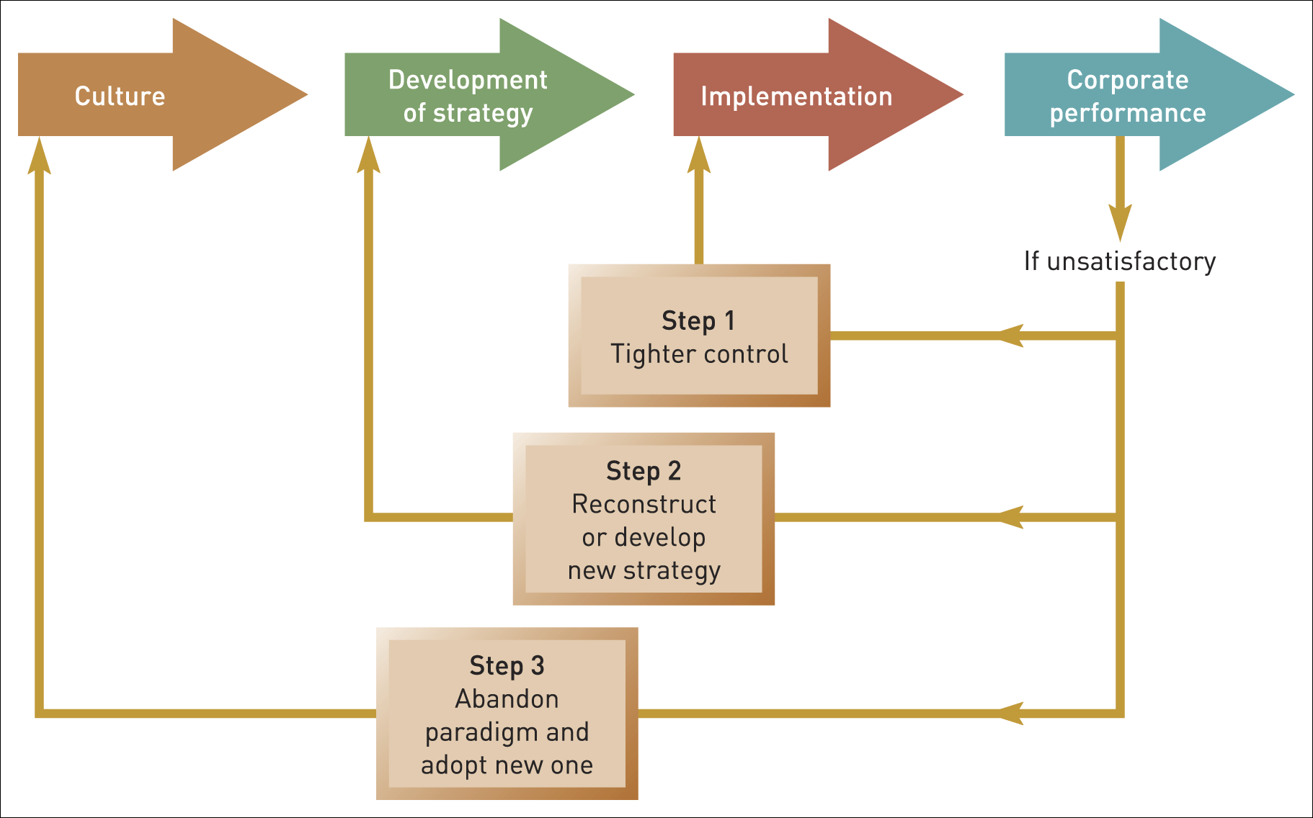
Culture’s influence on strategy development
Figure 5.6 Culture’s influence on strategy development
Source: Adapted from P. Gringer and J.-C. Spender, Turnaround: Managerial Recipes for Strategic Success, Associated Business Press, 1979, p. 203

Slide 24
The cultural web
The cultural web shows the behavioural, physical and symbolic manifestations of a culture that inform and are informed by the taken-for-granted assumptions, or paradigm, of an organisation

Slide 25
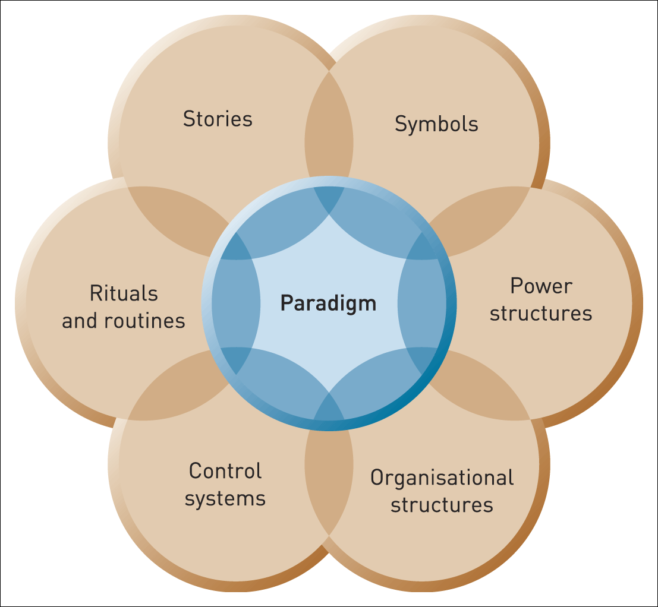
The cultural web of an organisation (1)
Figure 5.7 The cultural web of an organisation

Slide 26
The cultural web of an organisation (2) – stories
What core beliefs do the stories reflect?
What stories are commonly told e.g. to newcomers
How do these stories reflect core assumptions and beliefs?
What norms do the mavericks
deviate from?
Tend to be about heroes, villains
mavericks, successes and
disasters.
Stories
Paradigm
Notes:
The style/artwork can be tidied up here.

Slide 27
The cultural web of an organisation (3) – symbols
Symbols are objects, events, acts or people that convey, maintain or create meaning over and above their functional purpose.
What objects, people or events do people in the organisation particularly identify with?
What are these related to in the
history of the organisation?
What aspects of strategy are
highlighted in publicity?
Symbols
Paradigm

Slide 28
The cultural web of an organisation (4) – power structures
Where does power reside?
Who makes things happen?
Indicators include:
  status
  claim on resources
  symbols of power
Paradigm
Power
structures

Slide 29
The cultural web of an organisation
(5) – organisation structure
How formal/informal are the structures?
Do structures encourage collaboration or competition?
What types of power structure do they support?
Paradigm
Organisation
Structure

Slide 30
The cultural web of an organisation
(6) – control systems
What is most closely monitored/controlled?
Is emphasis on reward or punishment?
Are controls rooted in history or current strategies?
Are there many/few controls?
Paradigm
Control
systems

Slide 31
The cultural web of an organisation
(7) – routines and rituals
Which routines are emphasised?
Which are embedded in history?
What behaviour do routines encourage?
What are the key rituals?
What assumptions and core beliefs do they reflect?
What do training programmes
emphasise?
How easy are routines/rituals
to change?
Rituals/
routines
Paradigm

Slide 32
Summary (1)
The history and culture of an organisation may contribute to its strategic capabilities, but may also give rise to strategic drift as its strategy develops incrementally on the basis of such influences and fails to keep pace with a changing environment.
Historical, path-dependent processes play a significant part in the success or failure of an organisation and need to be understood by managers. There are historical analyses that can be conducted to help uncover these influences.

Slide 33
Summary (2)
Cultural and institutional influences both inform and constrain the strategic development of organisations.
Organisational culture is the basic assumptions and beliefs that are shared by members of an organisation, that operate unconsciously and define in a basic taken-for-granted fashion an organisation’s view of itself and its environment.
An understanding of the culture of an organisation and its relationship to organisational strategy can be gained by using the cultural web.

