Slide 1
Part II:
Strategic Choices

Slide 2
The focus of part 2: strategic choices
How organisations relate to competitors in terms of their competitive business strategies.
How broad and diverse organisations should be in terms of their corporate portfolios.
How far organisations should extend themselves internationally.
How organisations are creative and innovative.
How organisations pursue strategies through organic development, acquisitions or strategic alliances.

Slide 3
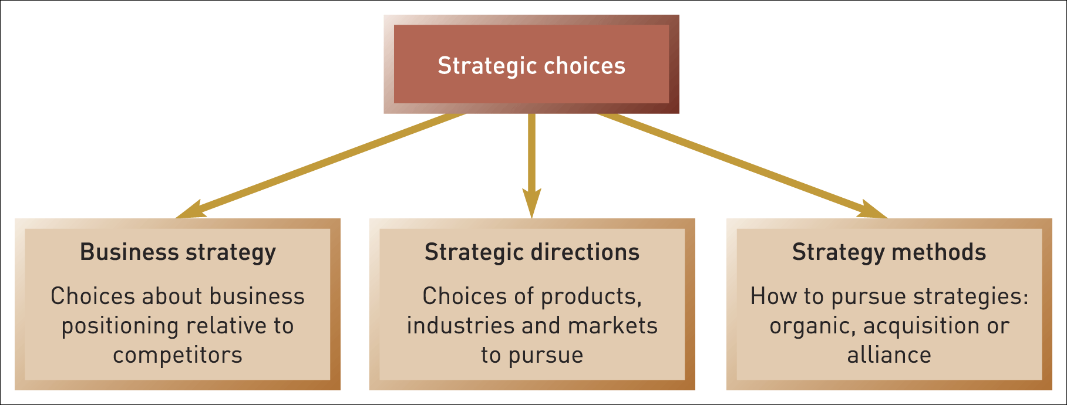
Strategic choices
Figure II.i Strategic choices

Slide 4
Strategic Choices
6: Business Strategy
Notes:
Update – 9th edition and new title (Exploring Strategy) and chapter title (Business Strategy)

Slide 5
Learning outcomes
Identify strategic business units (SBUs) in organisations.
Assess business strategy in terms of the generic strategies of cost leadership, differentiation and focus.
Identify business strategies suited to hypercompetitive conditions.
Assess the benefits of cooperation in business strategy.
Apply principles of game theory to business strategy.

Slide 6
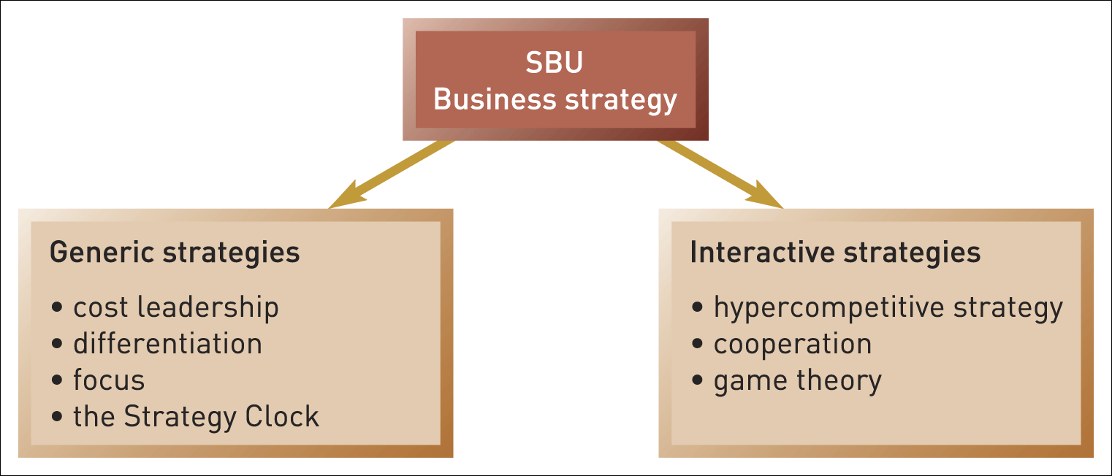
Business strategy
Figure 6.1 Business strategy

Slide 7

Strategic business units (SBUs)
A strategic business unit (SBU) supplies
goods or services for a distinct domain of activity.
A small business has just one SBU.
A large diversified corporation is made up of multiple businesses (SBUs).
SBUs can be called ‘divisions’ or ‘profit centres’
SBUs can be identified by:
  Market based criteria (similar customers, channels and competitors).
  Capability based criteria (similar strategic capabilities).

Slide 8
The purpose of SBUs
To decentralise initiative to smaller units within the corporation so SBUs can pursue their own distinct strategy.
To allow large corporations to vary their business strategies according to the different needs of external markets.
To encourage accountability – each SBU can be held responsible for its own costs, revenues and profits.

Slide 9
Generic strategies
Porter introduced the term ‘Generic Strategy’ to mean basic types of competitive strategy that hold across many kinds of business situations.
Competitive strategy is concerned with how a strategic business unit achieves competitive advantage in its domain of activity.
Competitive advantage is about how an SBU creates value for its users both greater than the costs of supplying them and superior to that of rival SBUs.

Slide 10
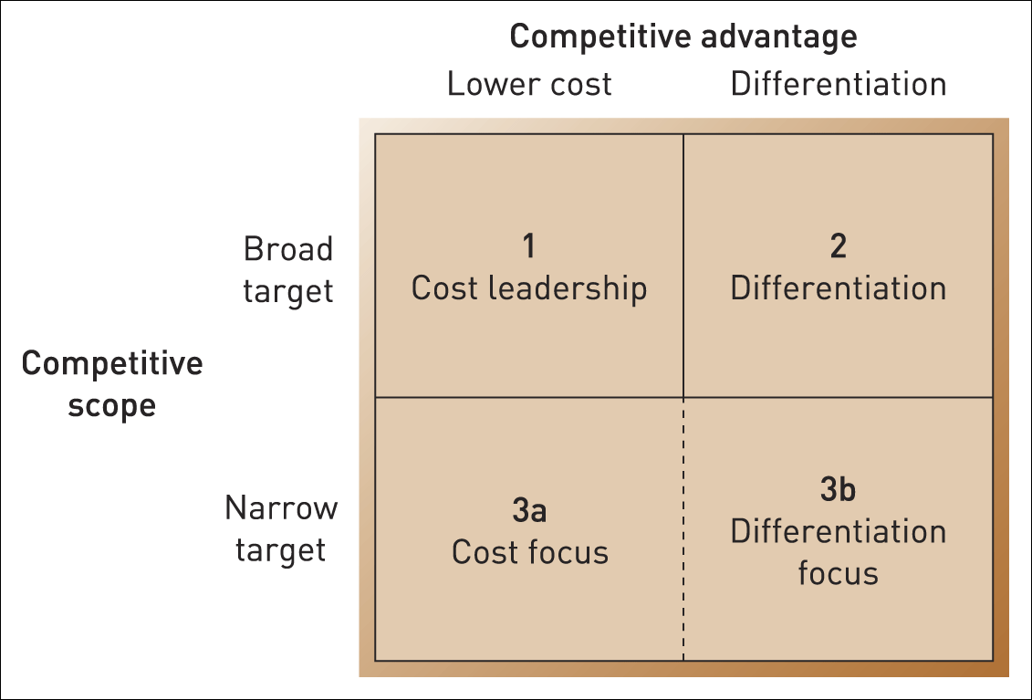
Three generic strategies
Figure 6.2 Three generic strategies
Source: Adapted with the permission of The Free Press, a Division of Simon & Schuster, Inc., from Competitive Advantage: Creating and Sustaining Superior Performance
by Michael E. Porter. Copyright © 1985, 1998 by Michael E. Porter. All rights reserved

Slide 11
Cost-leadership
Cost-leadership strategy involves becoming the lowest-cost organisation in a domain of activity.
Four key cost drivers that can help deliver cost leadership:
Lower input costs.
Economies of scale.
Experience.
Product process and design.

Slide 12
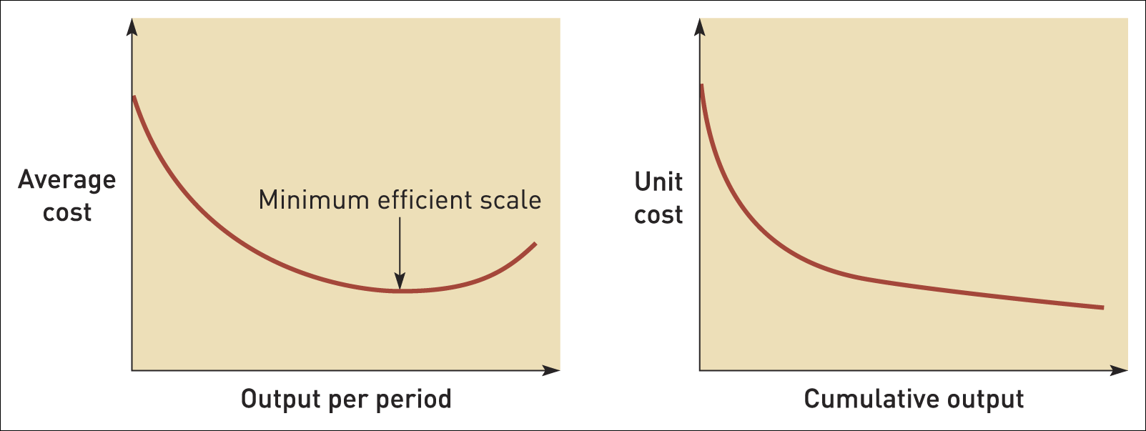
Economies of scale and the experience curve
Figure 6.3 Economies of scale and the experience curve

Slide 13
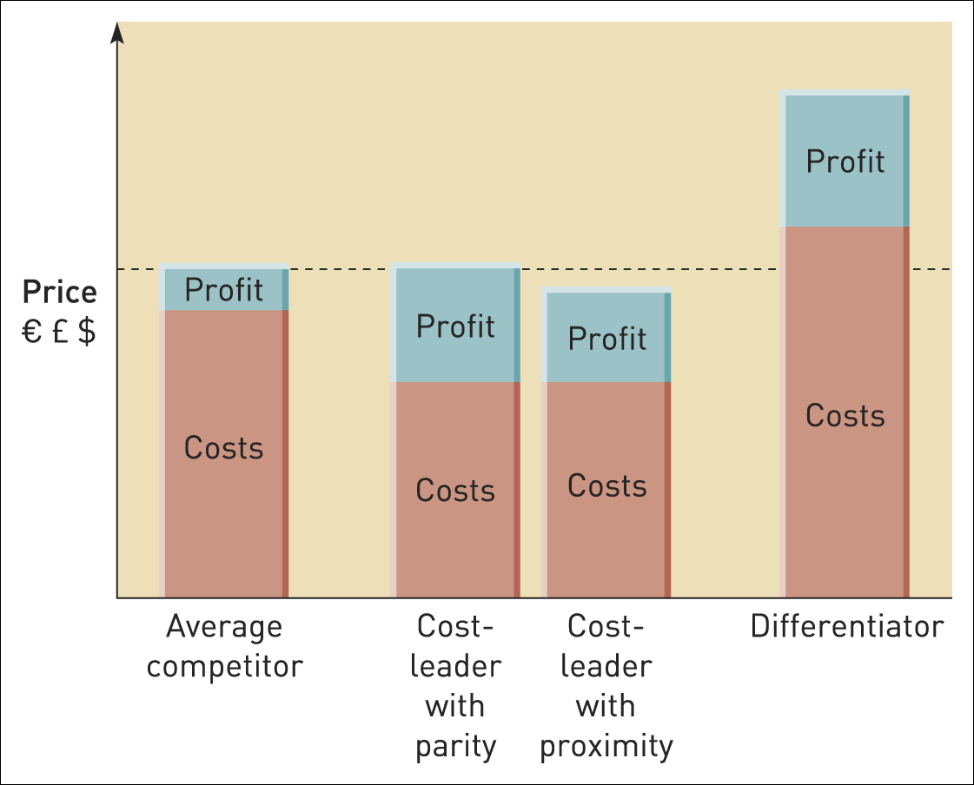
Costs, prices and profits for generic strategies
Figure 6.4 Costs, prices and profits for generic strategies

Slide 14
Differentiation strategies
Differentiation involves uniqueness along some dimension that is sufficiently valued by customers to allow a price premium.
Two key issues:
The strategic customer on whose needs the differentiation is based.
Key competitors – who are the rivals and who may become a rival.

Slide 15
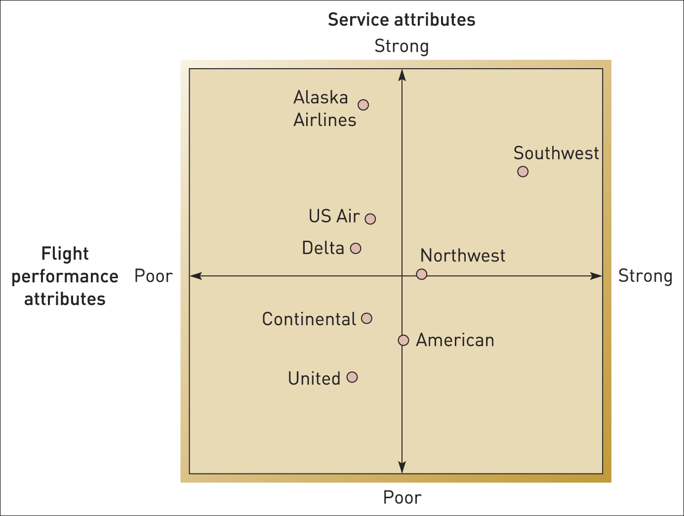
Differentiation in the US airline industry
Figure 6.5 Mapping differentiation in the US airline industry
Source: Simplified from Figure 1, in D. Gursoy, M. Chen and H. Kim (2005), ‘The US airlines relative positioning’, Tourism Management, 26, 5, 57–67: p. 62

Slide 16
Focus strategies (1)
A focus strategy targets a narrow segment of domain of an activity and tailors its products or services to the needs of that specific segment to the exclusion of others.
Two types of focus strategy:
cost-focus strategy (e.g. Ryanair).
differentiation focus strategy (e.g. Ecover).

Slide 17
Focus strategies (2)
Successful focus strategies depend on at least one of three key factors:
Distinct segment needs.
Distinct segment value chains.
Viable segment economics.

Slide 18
‘Stuck in the middle’?
Porter’s argues:
It is best to choose which generic strategy to adopt and then stick rigorously to it.
Failure to do this leads to a danger of being ‘stuck in the middle’ i.e. doing no strategy well.
The argument for pure generic strategies is controversial. Even Porter acknowledges that the strategies can be combined (e.g. if being unique costs nothing).

Slide 19
Combining generic strategies
A company can create separate strategic business units each pursuing different generic strategies and with different cost structures.
Technological or managerial innovations where both cost efficiency and quality are improved.
Competitive failures – if rivals are similarly ‘stuck in the middle’ or if there is no significant competition then ‘middle’ strategies may be OK.

Slide 20
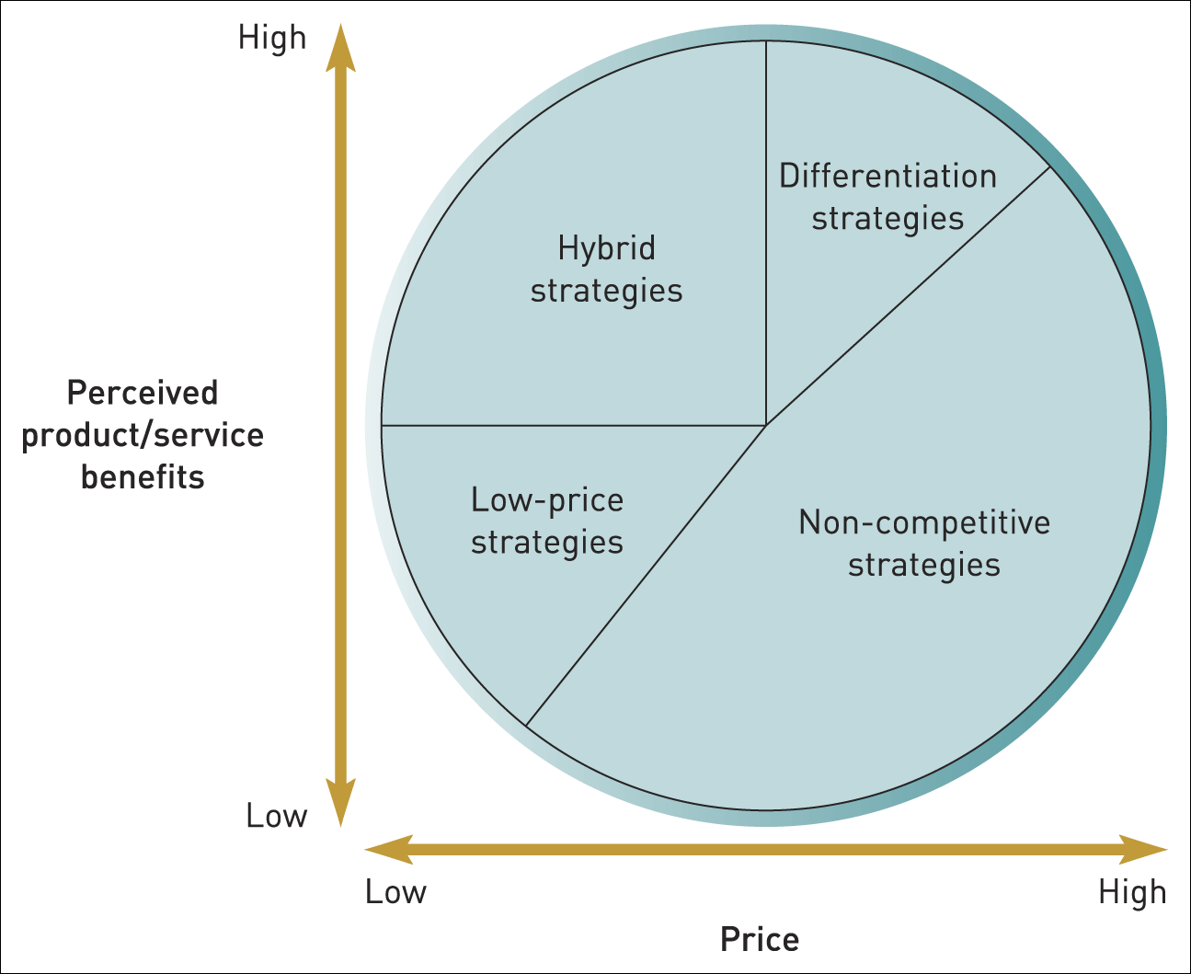
Strategy clock
Figure 6.6 The Strategy Clock
Source: Adapted from D. Faulkner and C. Bowman, The Essence of Competitive Strategy, Prentice Hall, 1995

Slide 21
Strategy clock - differentiation
Strategies in this zone seeks to provide products that offer benefits that differ from those offered by competitors.
A range of alternative strategies from:
  differentiation without price premium (12 o’clock) – used to increase market share.
  differentiation with price premium (1 o’clock) – used to increase profit margins.
  focused differentiation (2 o’clock) – used for customers that demand top quality and will pay a big premium.

Slide 22
Strategy clock – low price
Low price combined with:
  low perceived product benefits focusing on price sensitive market segments – a ‘no frills’ strategy typified by low cost airlines like Ryanair.
  lower price than competitors while offering similar product benefits – aimed at increasing market share typified by Asda /Walmart in grocery retailing.

Slide 23
Strategy clock - hybrid
Seeks to simultaneously achieve differentiation and low price relative to competitors.
Hybrid strategies can be used:
  to enter markets and build position quickly.
  as an aggressive attempt to win market share.
  to build volume sales and gain from mass production.

Slide 24
Strategy clock – non-competitive
Increased prices without increasing service/product benefits.
In competitive markets such strategies will be doomed to failure.
Only feasible where there is strategic ‘lock-in’ or a near monopoly position.

Slide 25
Strategic lock-in
Strategic lock-in is where users become dependent on a supplier and are unable to use another supplier without substantial switching costs.
Lock-in can be achieved in two main ways:
  Controlling complementary products or services. E.g. Cheap razors that only work with one type of blade.
  Creating a proprietary industry standard. E.g. Microsoft with its Windows operating system.

Slide 26
Establishing strategic lock-in
Size or market
dominance
First-mover
dominance
Self-reinforcing
commitment
Insistence on
preservation
of position

Slide 27
Hypercompetition
Hypercompetition describes markets with continuous disequilibrium and change e.g. popular music or consumer electronics.
Successful hypercompetition demands speed and initiative rather than defensiveness.

Slide 28
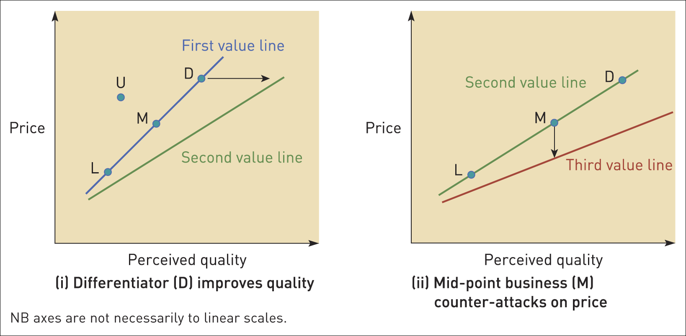
Interactive price and quality strategies
Figure 6.7 Interactive price and quality strategies
Source: Adapted with the permission of The Free Press, a Division of Simon & Schuster, Inc., from Hypercompetition: Managing the Dynamics of Strategic Manoeuvring by Richard D’Aveni with Robert Gunther. Copyright © 1994 by Richard D’Aveni. All rights reserved

Slide 29
Interactive strategies in hypercompetition
Four key principles:
  Cannibalise bases of success.
  A series of small moves rather than big moves.
  Be unpredictable.
  Mislead the competition.

Slide 30
Cooperating with rivals
Improved costs or benefits
reduces entry threat
Coordinated retaliation
Entrant
Industry
Rival A
Supplier
Buyer
Rival B
Increased supplier
power
Standardisation benefits
Increased
purchasing
power
Standardisation
benefits
Rival C
Improved
competitiveness
Substitute
Improved costs or benefits
reduces substitution threat
Figure 6.9 Cooperating with rivals
Source: Adapted with the permission of The Free Press, a Division of Simon & Schuster, Inc. from Competitive Strategy: Techniques for Analyzing Industries and Competitors by Michael E. Porter. Copyright © 1980, 1998 by The Free Press. All rights reserved

Slide 31
Game theory
Game theory encourages an organisation to consider competitors’ likely moves and the implications of these moves for its own strategy.

Slide 32
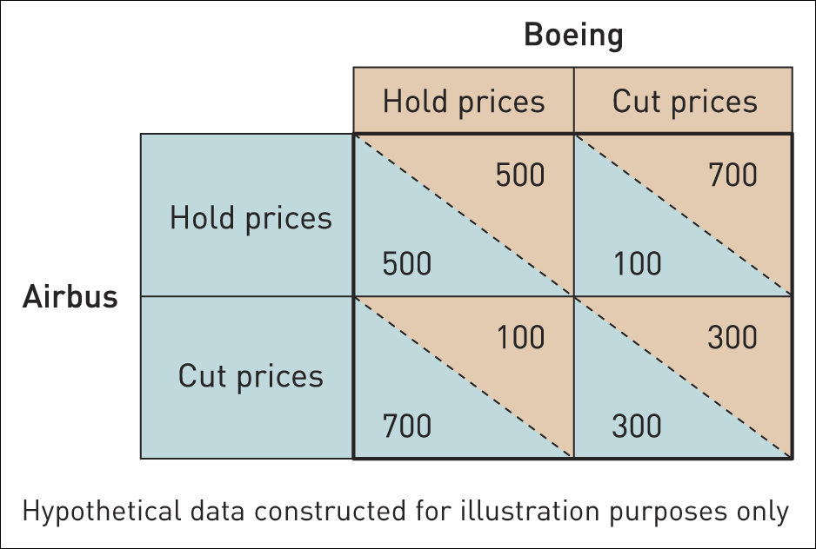
Prisoner’s dilemma
Figure 6.10 Prisoner’s dilemma game in aircraft manufacture

Slide 33
Lessons from game theory
Game theory encourages managers to consider how a ‘game’ can be transformed from ‘lose–lose’ competition to ‘win–win’ cooperation.
Four principles:
  Ensure repetition.
  Signalling.
  Deterrence.
  Commitment.

Slide 34
Summary (1)
Business strategy is concerned with seeking competitive advantage in markets at the business rather than corporate level.
Business strategy needs to be considered and defined in terms of strategic business units (SBUs).
Different generic strategies can be defined in terms of cost-leadership, differentiation and focus.
Managers need to consider how business strategies can be sustained through strategic capabilities and/or the ability to achieve a ‘lock-in’ position with buyers.

Slide 35
Summary (2)
In hypercompetitive conditions sustainable competitive advantage is difficult to achieve. Competitors need to be able to cannibalise, make small moves, be unpredictable and mislead their rivals.
Cooperative strategies may offer alternatives to competitive strategies or may run in parallel.
Game theory encourages managers to get in the mind of competitors and think forwards and reason backwards.

