Slide 1
Strategic Choices
7: Corporate Strategy and Diversification
Notes:
Update slide – 9th edition and new title Exploring Strategy

Slide 2
Learning outcomes (1)
Identify alternative strategy options, including market penetration, product development, market development and diversification.
Distinguish between different diversification strategies (related and conglomerate diversification) and evaluate diversification drivers.

Slide 3
Learning outcomes (2)
Assess the relative benefits of vertical integration and outsourcing.
Analyse the ways in which a corporate parent can add or destroy value for its portfolio of business units.
Analyse portfolios of business units and judge which to invest in and which to divest.

Slide 4
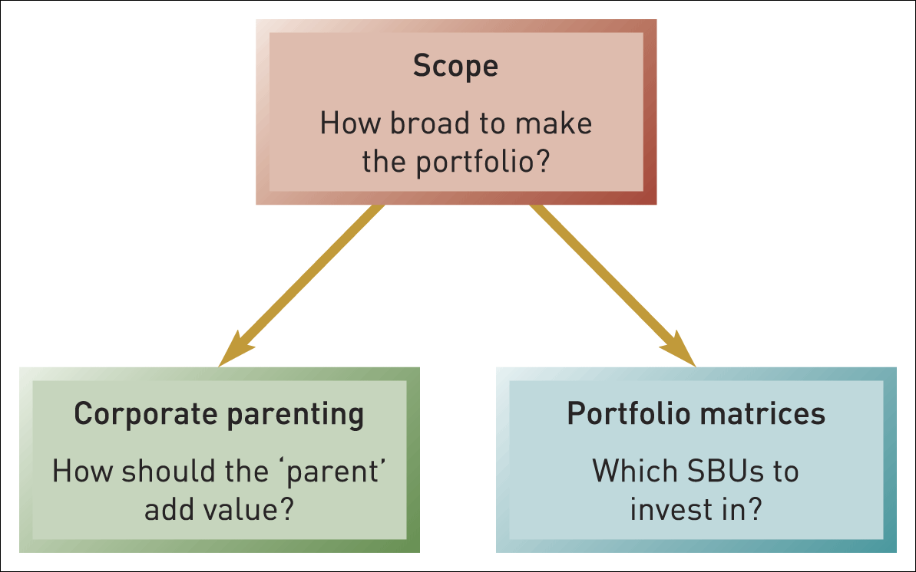
Strategic directions and corporate-level strategy
Figure 7.1 Strategic directions and corporate-level strategy

Slide 5

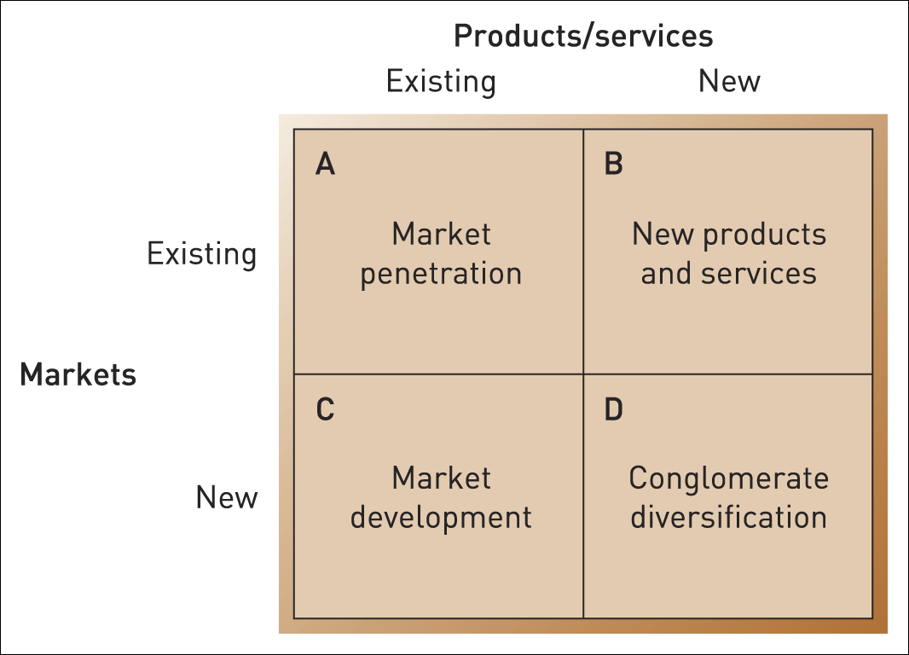
Corporate strategy directions
Figure 7.2 Corporate strategy directions
Source: Adapted from H.I. Ansoff, Corporate Strategy, Penguin, 1988, Chapter 6. Ansoff originally had a matrix with four separate boxes, but in practice strategic directions involve more continuous axes. The Ansoff matrix itself was later developed – see Reference 1

Slide 6
Diversification
Diversification involves increasing the range of products or markets served by an organisation.
Related diversification involves diversifying into products or services with relationships to the existing business.
Conglomerate (unrelated) diversification involves diversifying into products or services with no relationships to the existing businesses.

Slide 7
Market penetration
Market penetration refers to a strategy of increasing share of current markets with the current product range.
This strategy:
  strategic capabilities; builds on established
  scope is unchanged; means the organisation’s
  increased power; leads to greater market share and with buyers and suppliers;
  economies of scale; and provides greater and experience curve benefits.

Slide 8
Constraints of market penetration
Retaliation
from
competitors
Legal
constraints
Economic
Constraints
(recession or funding crisis)
Notes:
The artwork on this needs improving

Slide 9
Consolidation & retrenchment
Consolidation refers to a strategy by which an organisation focuses defensively on their current markets with current products.
Retrenchment refers to a strategy of withdrawal from marginal activities in order to concentrate on the most valuable segments and products within their existing business.

Slide 10
Product development
Product development refers to a strategy by which an organisation delivers modified or new products to existing markets.
This strategy :
  involves varying degrees of related diversification (in terms of products);
  can be an expensive and high risk
  may require new strategic capabilities
  typically involves project management risks.

Slide 11
Market development (1)
Market development refers to a strategy by which an organisation offers existing products to new markets

Slide 12
Market development (2)
This strategy involves varying degrees of related diversification (in terms of markets) it;
  may also entail some product development (e.g. new styling or packaging);
  can take the form of attracting new users (e.g. extending the use of aluminium to the automobile industry);
  can take the form of new geographies (e.g. extending the market covered to new areas – international markets being the most important);
  must meet the critical success factors of the new market if it is to succeed;
  may require new strategic capabilities especially in marketing.

Slide 13
Conglomerate diversification
Conglomerate (or unrelated) diversification takes the organisation beyond both its existing markets and its existing products and radically increases the organisation’s scope.

Slide 14
Drivers for diversification
Exploiting economies of scope – efficiency gains through applying the organisation’s existing resources or competences to new markets or services.
Stretching corporate management competences.
Exploiting superior internal processes.
Increasing market power.

Slide 15
Synergy
Synergy refers to the benefits gained where activities or assets complement each other so that their combined effect is greater than the sum of the parts.
N.B. Synergy is often referred to as the
‘2 + 2 = 5’ effect.

Slide 16
Value-destroying diversification drivers
Some drivers for diversification which may involve value destruction (negative synergies):
  Responding to market decline,
  Spreading risk and
  N.B. Despite these being common justifications for diversifying, finance theory suggests these are misguided.
  Managerial ambition.

Slide 17
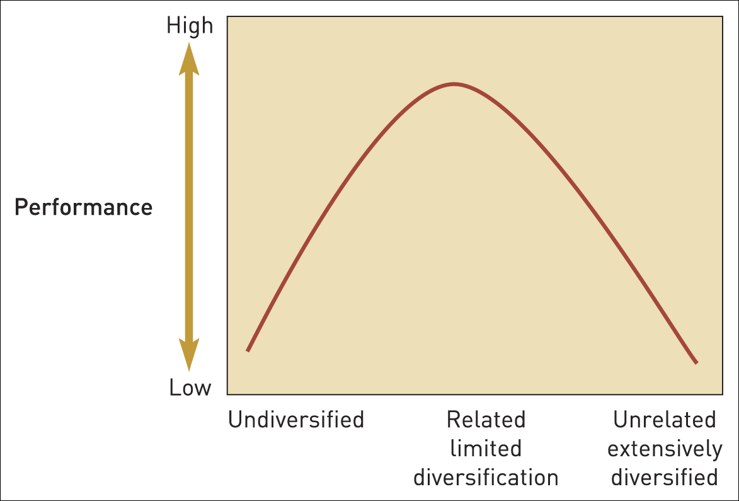
Diversification and performance
Figure 7.3 Diversity and performance

Slide 18
Vertical integration
Vertical integration describes entering activities where the organisation is its own supplier or customer.
Backward integration refers to development into activities concerned with the inputs into the company’s current business.
Forward integration refers to development into activities concerned with the outputs of a company’s current business.

Slide 19
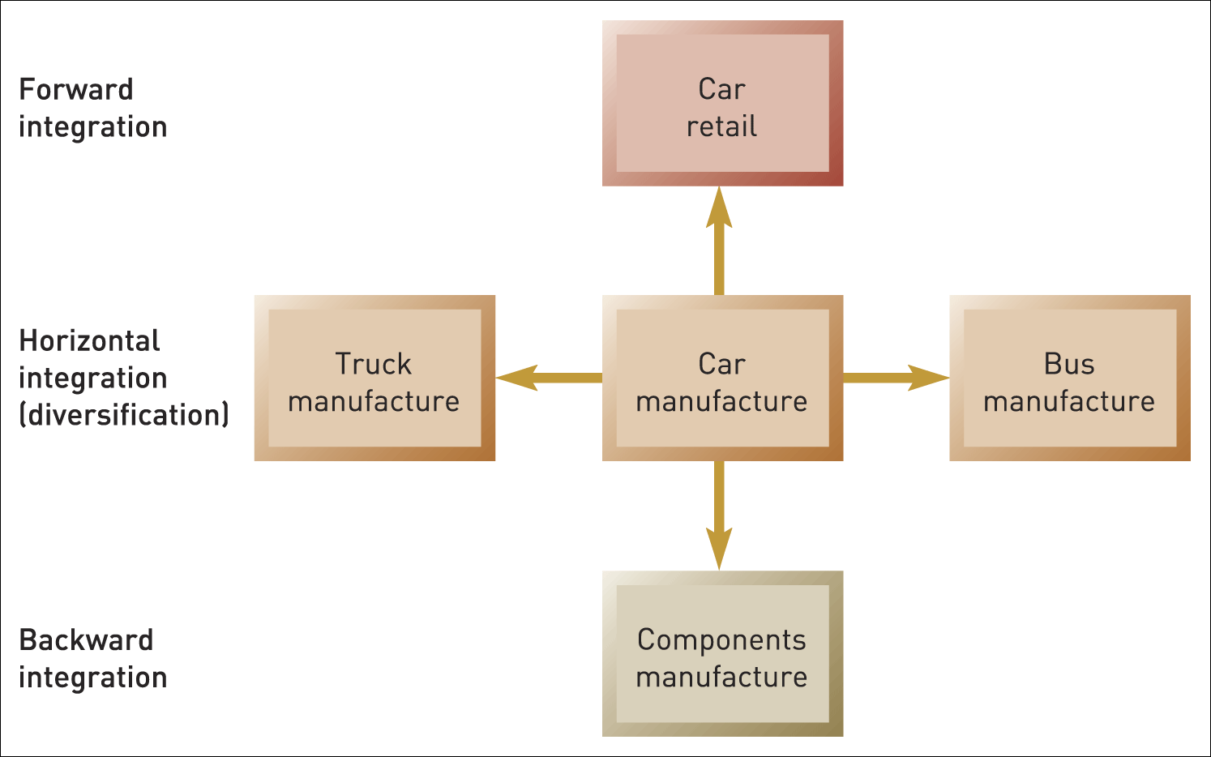
Diversification and integration options
Figure 7.4 Diversification and integration options: car manufacturer example

Slide 20
Outsourcing
Outsourcing is the process by which activities previously carried out internally are subcontracted to external suppliers.

Slide 21
To outsource or not?
The decision to integrate or subcontract rests on the balance between two distinct factors:
Relative strategic capabilities:
Does the subcontractor have the potential to do the work significantly better?
Risk of opportunism:
Is the subcontractor likely to take advantage of the relationship over time?

Slide 22
Value-adding activities
Envisioning
Coaching and
facilitating
Providing central
services and
resources
Intervening

Slide 23
Value-destroying activities
Adding management costs
Adding bureaucratic complexity
Obscuring financial performance

Slide 24
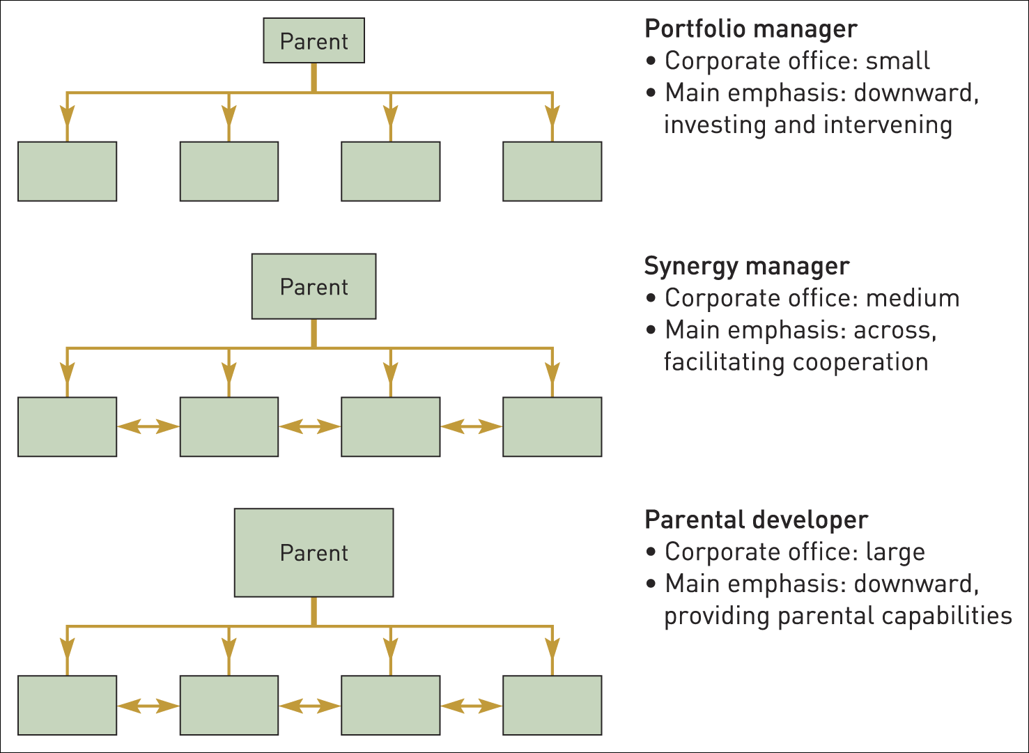
Corporate rationales (1)
Figure 7.5 Portfolio managers, synergy managers and parental developers
Source: Adapted from M. Goold, A. Campbell and M. Alexander, Corporate Level Strategy, Wiley, 1994

Slide 25
Corporate rationales (2)
The portfolio manager operates as an active investor in a way that shareholders in the stock market are either too dispersed or too inexpert to be able to do.
The synergy manager is a corporate parent seeking to enhance value for business units by managing synergies across business units.
The parental developer seeks to employ its own central capabilities to add value to its businesses.

Slide 26
Portfolio matrices
Growth/Share (BCG) Matrix
Directional Policy (GE-McKinsey) Matrix
Parenting Matrix

Slide 27
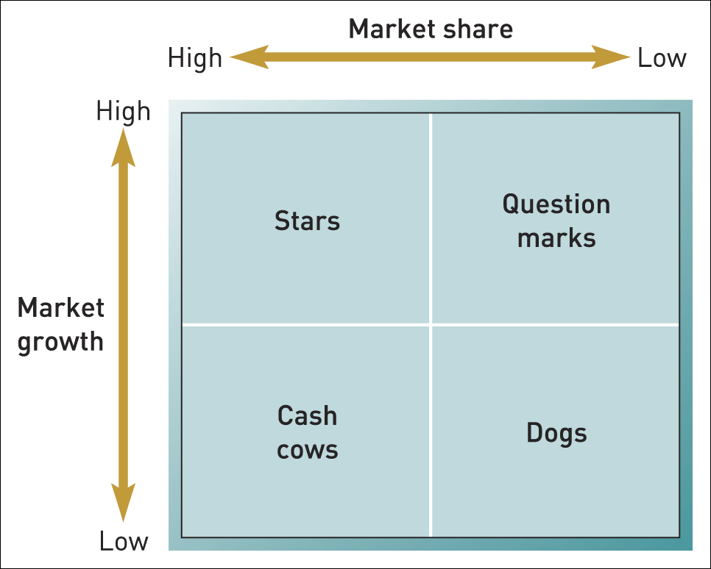
The growth share (or BCG) matrix (1)
Figure 7.6 The growth share (or BCG) matrix

Slide 28
The growth share (or BCG) matrix (2)
A star is a business unit which has a high market share in a growing market.
A question mark (or problem child) is a business unit in a growing market, but it does not have a high market share.
A cash cow is a business unit that has a high market share in a mature market.
A dog is a business unit that has a low market share in a static or declining market.

Slide 29
The growth share (or BCG) matrix (3)
Problems with the BCG matrix:
definitional vagueness,
capital market assumptions,
motivation problems,
self-fulfilling prophecies and
possible links to other business units.

Slide 30
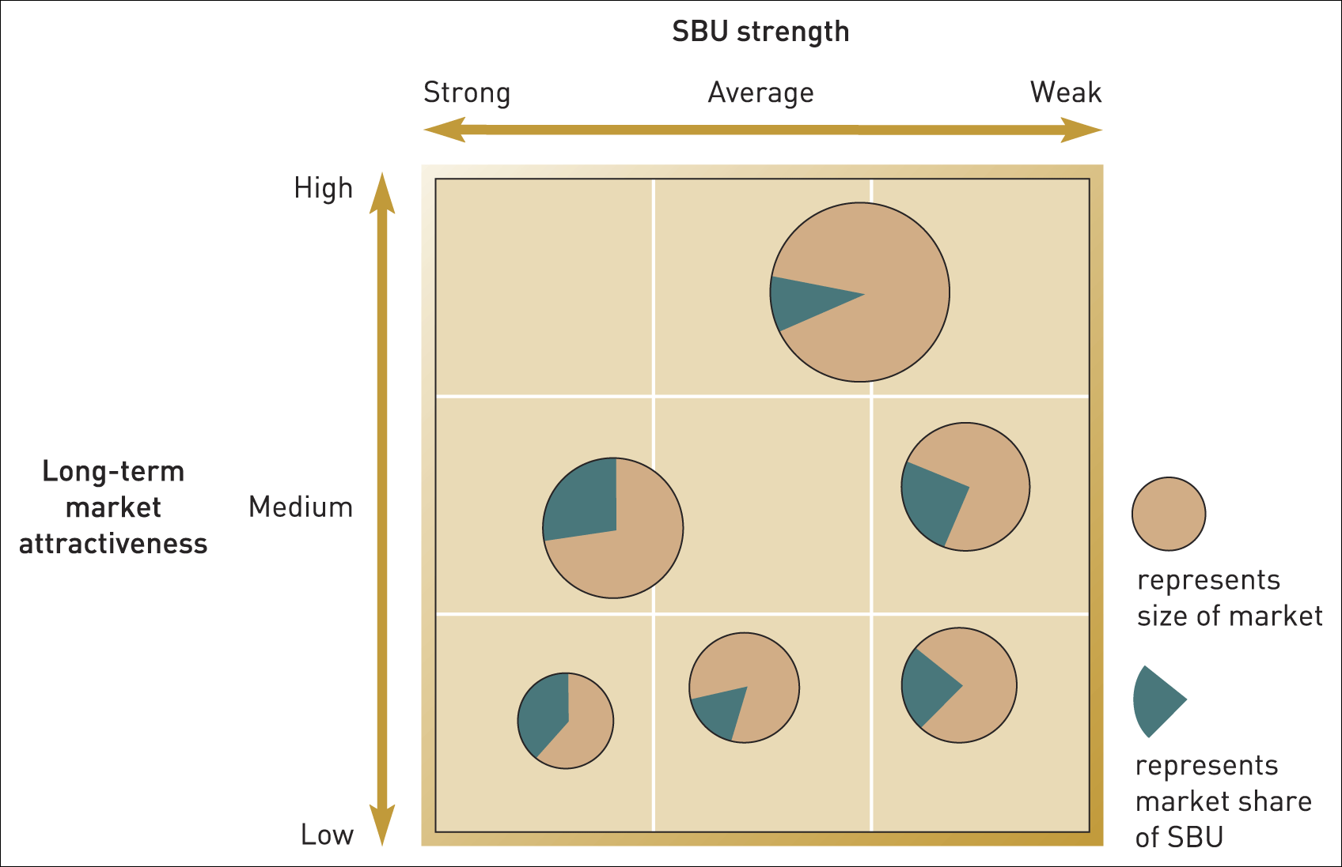
The directional policy
(GE–McKinsey) matrix (1)
Figure 7.7 Directional policy (GE–McKinsey) matrix

Slide 31
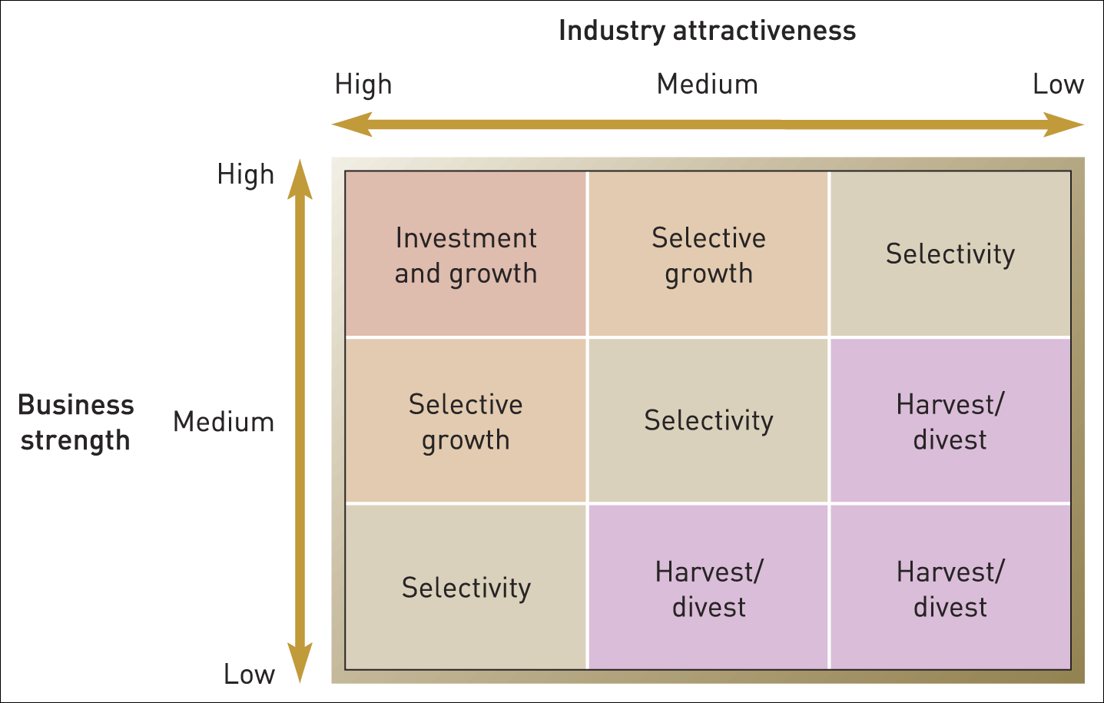
The directional policy
(GE–McKinsey) matrix (2)
Figure 7.8 Strategy guidelines based on the directional policy matrix

Slide 32
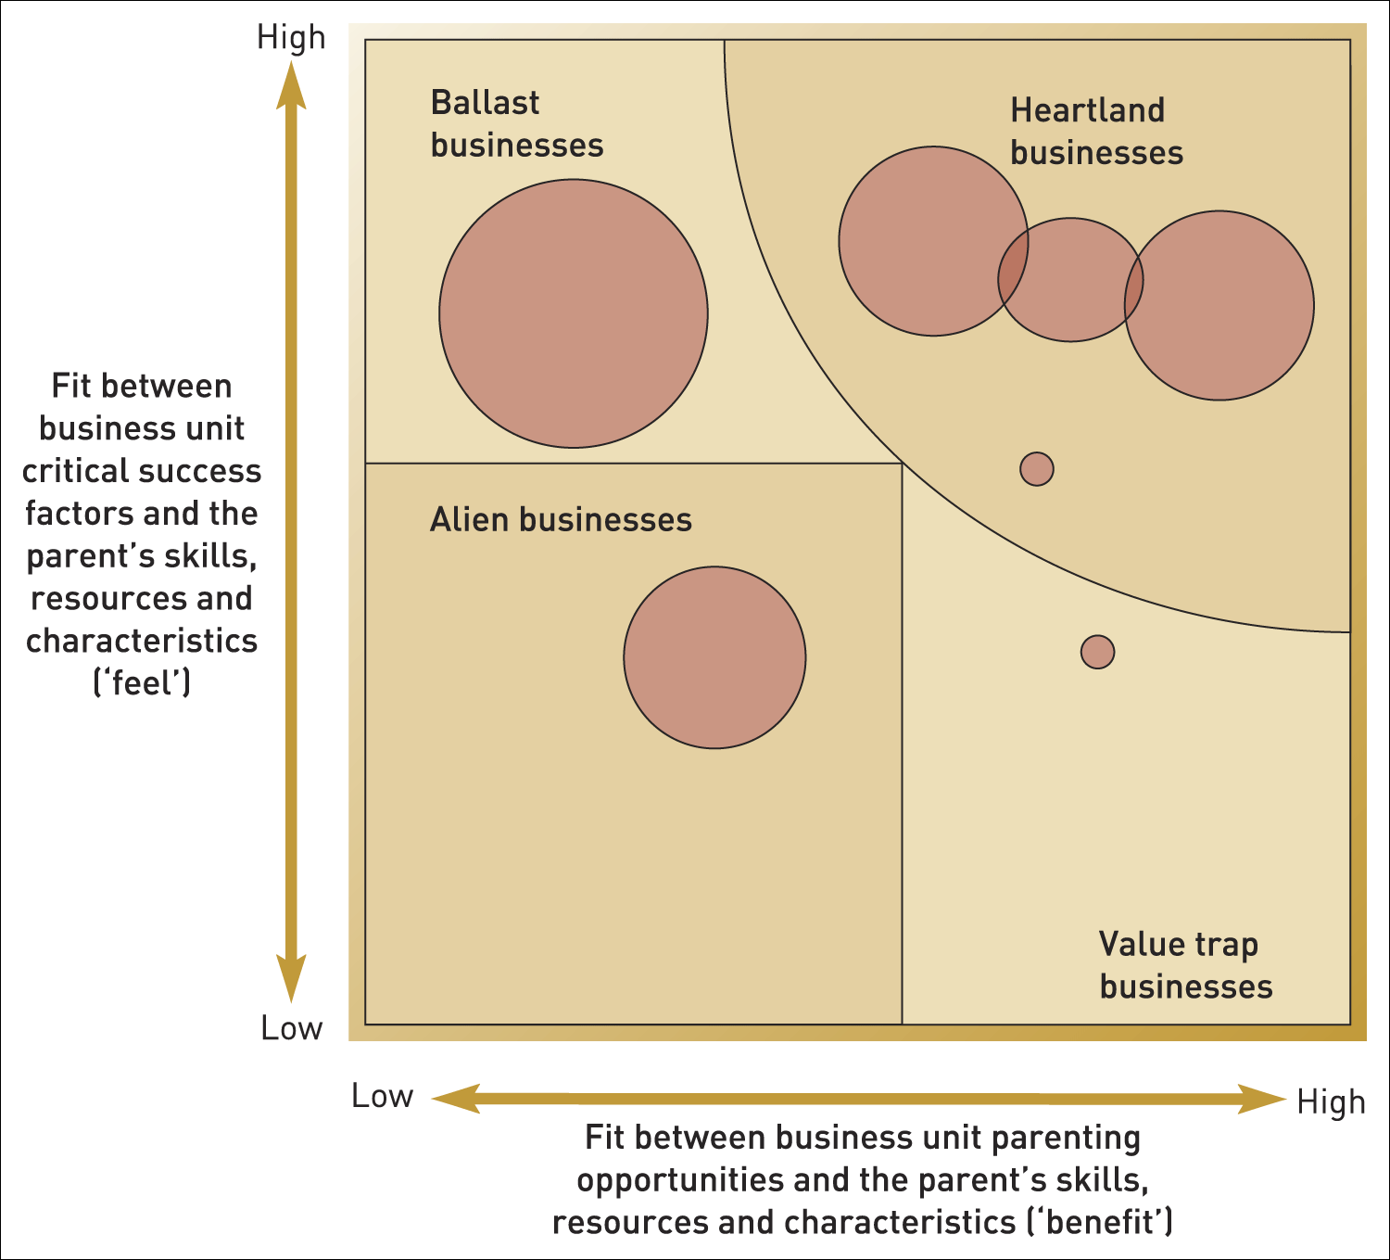
The parenting matrix (1)
Figure 7.9 The parenting matrix: the Ashridge Portfolio Display
Source: Adapted from M. Goold, A. Campbell and M. Alexander, Corporate Level Strategy, Wiley, 1994

Slide 33
The parenting matrix (2)
1. Heartland business units - the parent understands these well and can add value. The core of future strategy.
2. Ballast business units - the parent understands these well but can do little for them. They could be just as successful as independent companies.
If not divested, they should be spared corporate bureaucracy.
3. Value-trap business units are dangerous. There are attractive opportunities to add value but the parent’s lack of feel will result in more harm than good The parent needs new capabilities to move value-trap businesses into the heartland. It is easier to divest to another corporate parent which could add value.
4. Alien business units are misfits. They offer little opportunity to add value and the parent does not understand them. Exit is the best strategy.

Slide 34
Summary (1)
Many corporations comprise several, sometimes many business units. Decisions and activities above the level of business units are the concern of what in this chapter is called the corporate parent.
Organisational scope is considered in terms of related and unrelated diversification.
Corporate parents may seek to add value by adopting different parenting roles: the portfolio manager, the synergy manager or the parental developer.

Slide 35
Summary (2)
There are several portfolio models to help corporate parents manage their businesses, of which the most common are: the BCG matrix, the directional policy matrix and the parenting matrix.
Divestment and outsourcing should be considered as well as diversification, particularly in the light of relative strategic capabilities and the transaction costs of opportunism.

