Slide 1
Strategic Choices
8: International Strategy
Notes:
Update slide – 9th edition. Title – Exploring Strategy

Slide 2
Learning outcomes
Assess the internationalisation potential of different markets.
Identify sources of competitive advantage in international strategy, through both global sourcing and exploitation of local factors.
Distinguish between four main types of international strategy.
Rank markets for entry or expansion, taking into account attractiveness, cultural and other forms of distance and competitor retaliation threats.
Assess the relative merits of different market entry modes, including joint ventures, licensing and foreign direct investment.

Slide 3
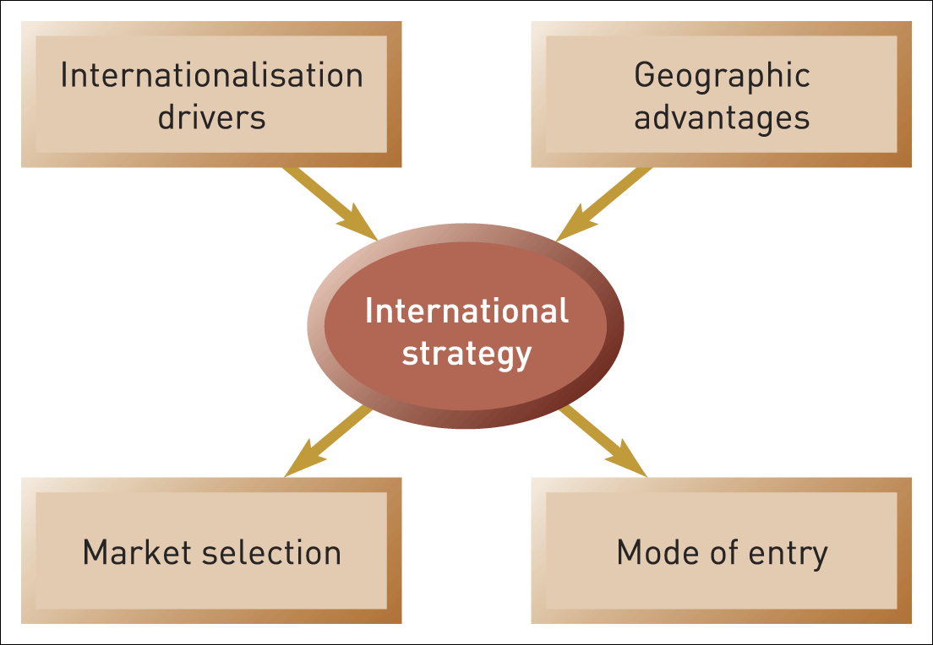
International strategy framework
Figure 8.1 International strategy framework

Slide 4
International v global strategy
International strategy refers to a range of options for operating outside an organisation’s country of origin.
Global strategy involves high coordination of extensive activities dispersed geographically in many countries around the world.
N.B. Global strategy is just one kind of international strategy.

Slide 5

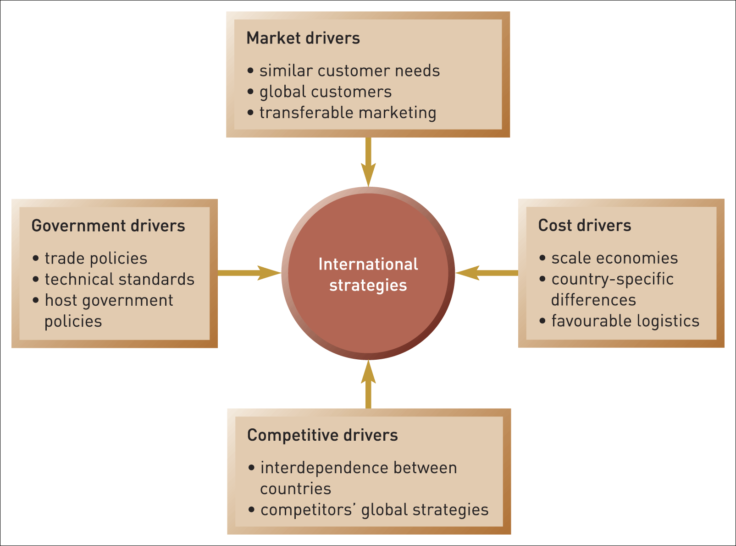
Internationalisation drivers
Figure 8.2 Drivers of internationalisation
Source: Adapted from G. Yip, Total Global Strategy II, Financial Times Prentice Hall, 2003, Chapter 2

Slide 6
Location advantages:
Porter’s diamond (1)
Porter’s Diamond – explains why some locations tend to produce firms with sustained competitive advantages in some industries more than others.
The four drivers in Porter’s Diamond stem from:
local factor conditions
local demand conditions
local related and supporting industries
local firm strategy structure and rivalry.

Slide 7
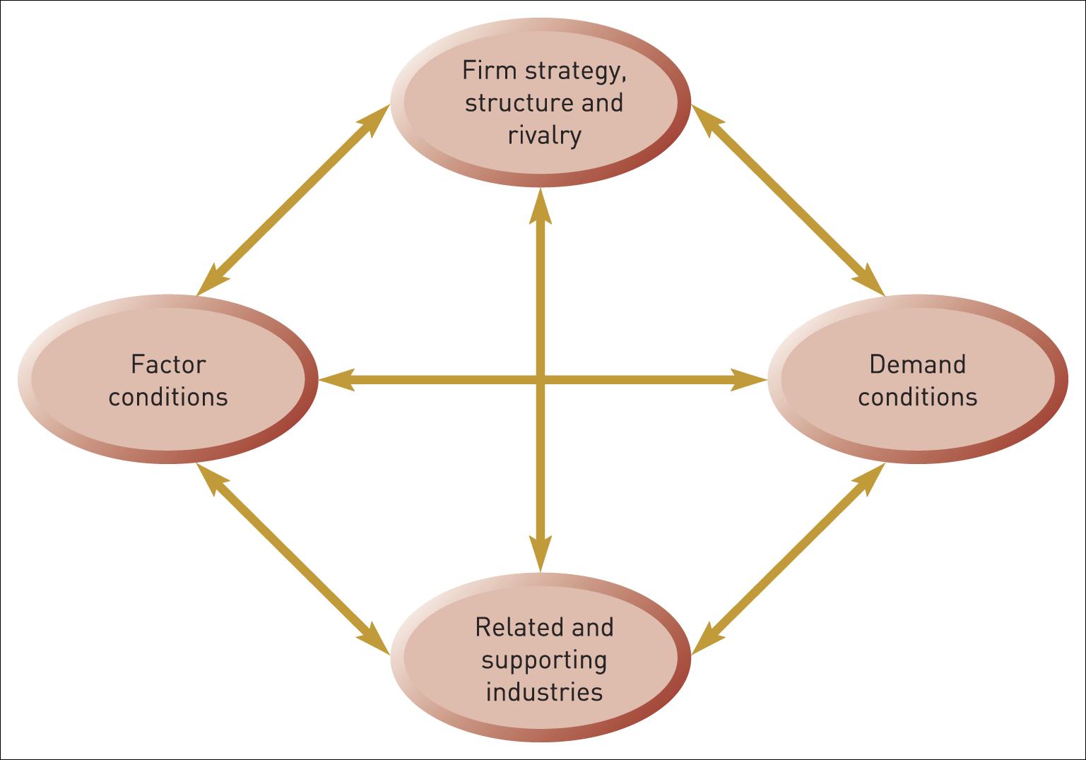
Location advantages:
Porter’s diamond (2)
Figure 8.3 Porter’s Diamond – the determinants of national advantages
Source: Adapted with permission of The Free Press, a Division of Simon & Schuster, Inc., from The Competitive Advantage of Nations by Michael E. Porter. Copyright © 1990, 1998 by Michael E. Porter. All rights reserved

Slide 8
Global sourcing
Global sourcing refers to purchasing services and components from the most appropriate suppliers around the world regardless of their location.
The advantages include:
Cost advantages include labour costs, transportation and communications costs, taxation and investment incentives.
Unique local capabilities.
National market characteristics and reputation.

Slide 9
The global–local dilemma
The global–local dilemma relates to the extent to which products and services may be standardised across national boundaries or need to be adapted to meet the requirements of specific national markets.

Slide 10
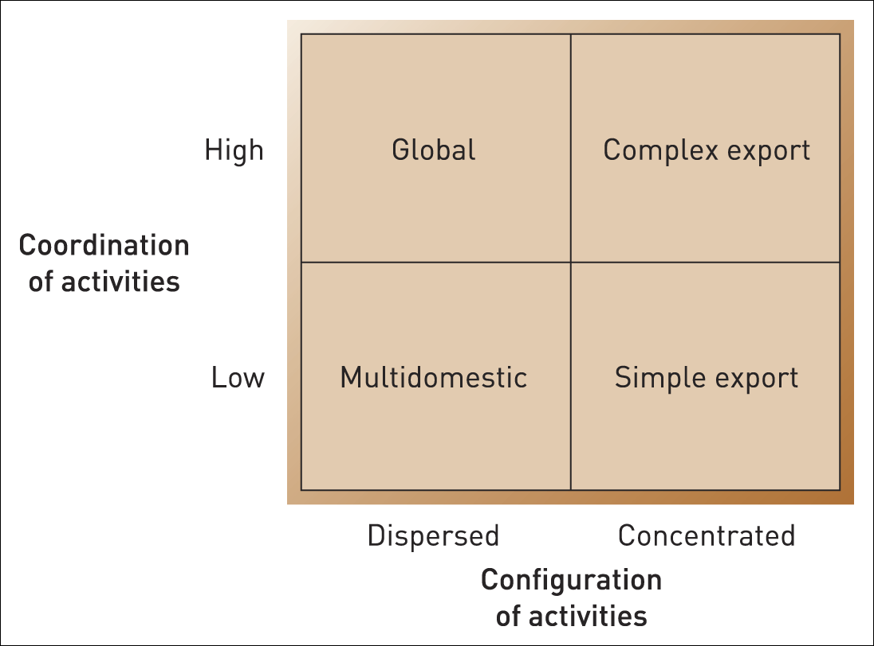
International strategies
Figure 8.4 Four international strategies
Source: Adapted ‘Changing patterns of international competition’, pp. 9–39, Figure 5 (Porter, M. 1987). Copyright © 1987, by The Regents of the University of California. Reprinted from the California Management Review, vol. 28, no. 2. By permission of The Regents. cmr berkeley.edu. All right reserved. This article is for personal viewing by individuals accessing this website. It is not to be copied, reproduced or otherwise disseminated without written permission from the California Management Review. By viewing this document, you here by agree to these terms. For permission or reprints, contact: cmr@haas. berkeley.edu electronic formats.

Slide 11
Market characteristics
Four elements of the PESTEL framework are particularly important in comparing countries for entry:
    Political. Political environments vary widely between countries and can alter rapidly.
    Economic. Key comparators are levels of Gross Domestic Product and disposable income which indicate the potential size of the market.
    Social. Factors like population characteristics and lifestyle as well as cultural differences.
    Legal. Countries vary widely in their legal regime.

Slide 12
The CAGE framework
Cultural
distance
Administrative and
political distance
Geographic
distance
Economic/ wealth
distance

Slide 13
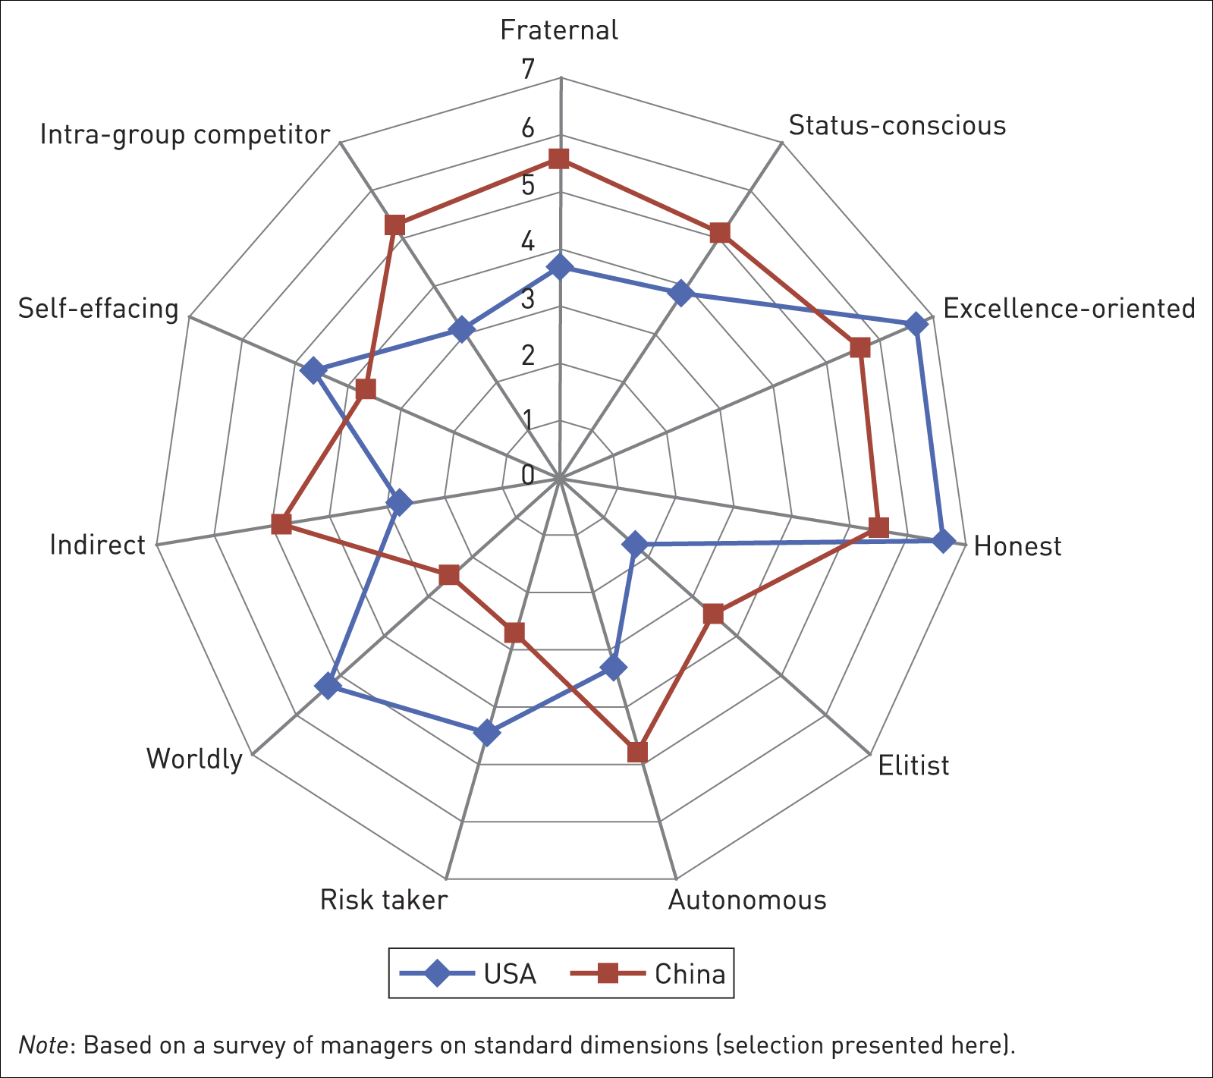
International cross-cultural comparison
Figure 8.5 International cross-cultural comparison
Source: M. Javidan, P. Dorman, M. de Luque and R. House, ‘In the eye of the beholder: cross-cultural lessons in leadership from Project GLOBE’, Academy of Management Perspectives, February 2006, pp. 67–90 (Figure 4: USA vs China, p. 82). (GLOBE stands for ‘Global Leadership and Organizational Behavior Effectiveness’.)

Slide 14
Assessing country markets
Country markets can be assessed according to three criteria:
    Market attractiveness to the new entrant
    The likelihood and extent of defenders’ reaction
    Defenders’ clout – the relative power of defenders to fight back.

Slide 15
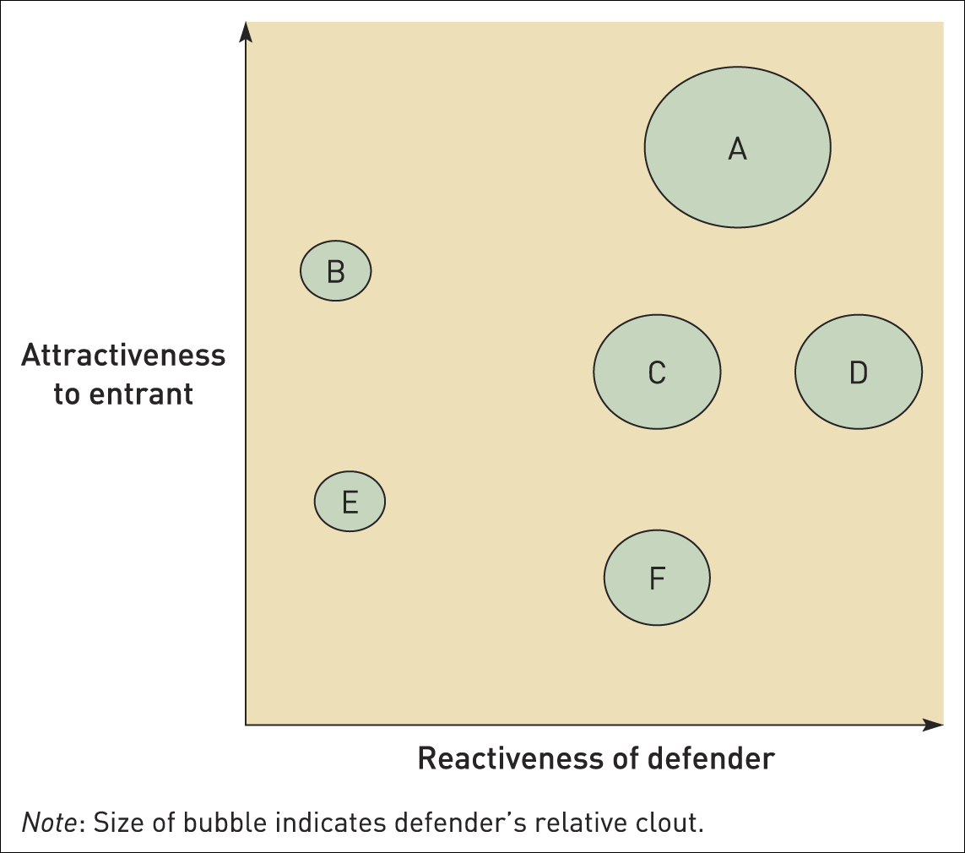
International competitor retaliation
Figure 8.6 International competitor retaliation
Source: Reprinted by permission of Harvard Business Review. Exhibit adapted from ‘Global gamesmanship’ by I. MacMillan, S. van Putter and R. McGrath, May 2003.
Copyright © 2003 by the Harvard Business School Publishing Corporation. All rights reserved

Slide 16
The staged international expansion model
The staged international expansion model proposes a sequential process whereby companies gradually increase their commitment to newly entered markets, as they build market knowledge and capabilities.
This is challenged by two phenomena:
  ‘Born-global’ firms - new small firms that internationalise rapidly (usually in new technologies)
  Emerging-country multinationals - building unique capabilities in the home market but exploiting them in international markets very quickly.

Slide 17
Modes of entry
Exporting
Joint ventures and alliances
Licensing
Foreign direct investment

Slide 18
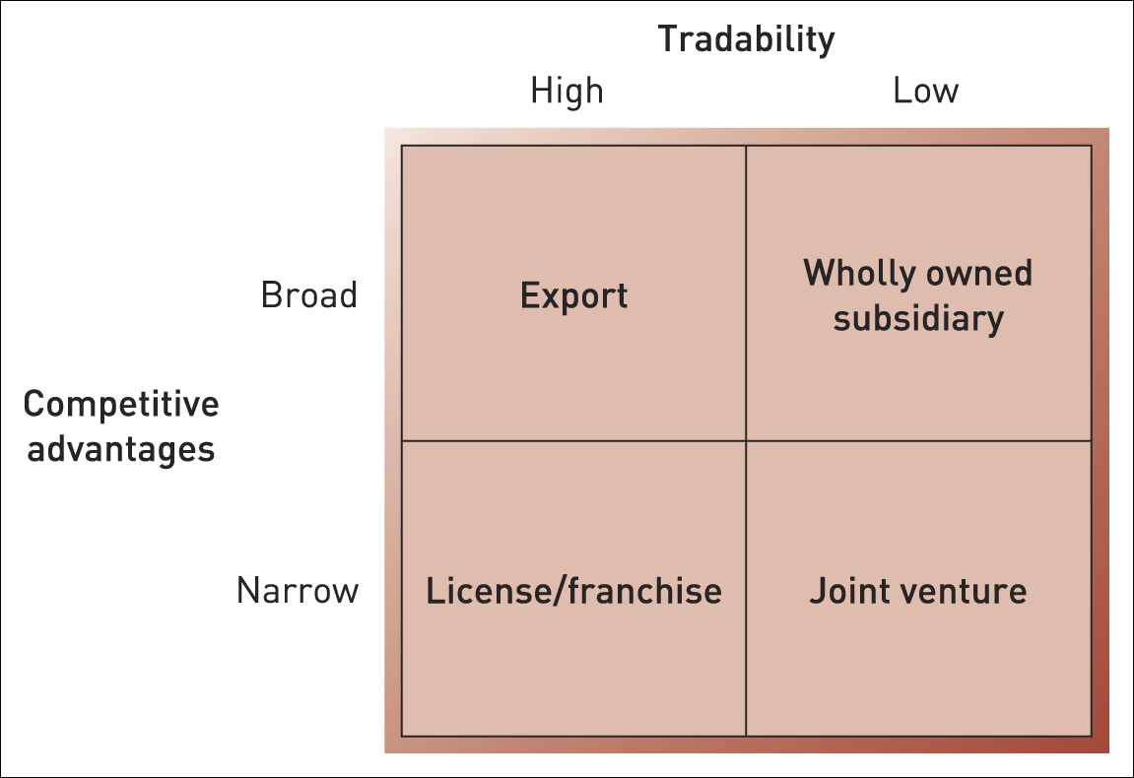
Modes of international market entry
Figure 8.7 Modes of international market entry

Slide 19
Exporting
Advantages
No need for operational facilities in host country
Economies of scale in the home country
Internet can facilitate exporting marketing opportunities
Disadvantages
Lose any location advantages in the host country
Dependence on export intermediaries
Exposure to trade barriers
Transportation costs

Slide 20
Joint ventures and alliances
Advantages
Shared investment risk
Complementary resources
Maybe required for market entry
Disadvantages
Difficult to find good partner
Relationship management
Loss of competitive advantage
Difficult to integrate and coordinate

Slide 21
Licensing
Advantages
Contractual source of income
Limited economic and financial exposure
Disadvantages
Difficult to identify good partner
Loss of competitive advantage
Limited benefits from host nation

Slide 22
Foreign direct investment
Advantages
Full control
Integration and coordination possible
Rapid market entry through acquisitions
Greenfield investments are possible and may be subsidised
Disadvantages
Substantial investment and commitment
Acquisitions may create integration/ coordination issues
Greenfield investments are time consuming and unpredictable

Slide 23
Internationalisation and performance
Inverted U-curve – complexity may erode
the advantages of internationalisation
Service sector disadvantages –
internationalisation may only work
well for manufacturing firms
Internationalisation and product diversity

Slide 24
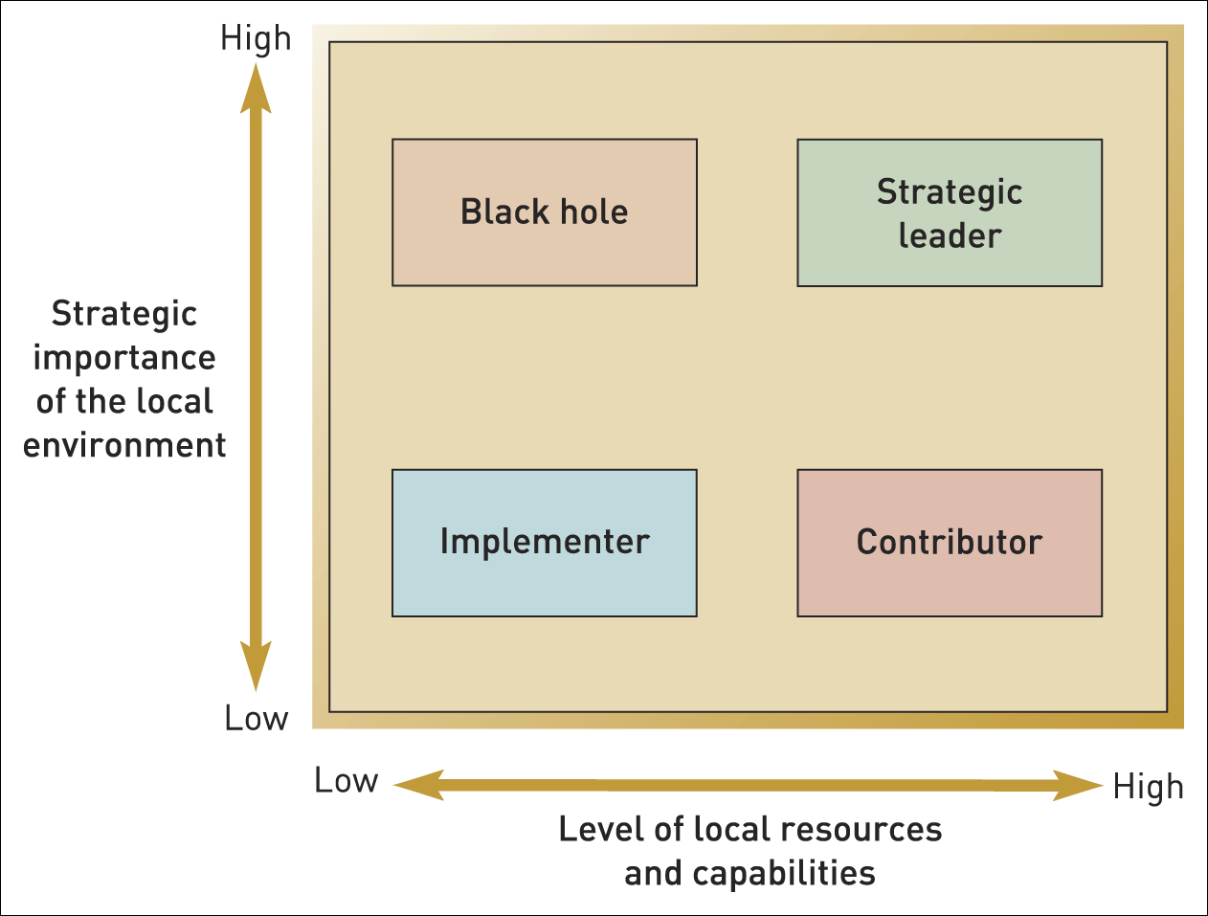
Roles in an international portfolio
Figure 8.8 Subsidiary roles in multinational firms
Source: Reprinted by premission of Harvard Business School Press. From Managing across Borders: The Transnational Solution by C.A. Bartlett and S. Ghoshal. Boston, MA 1989, pp. 105–11. Copyright © 1989 by the Harvard Business School Publishing Corporation. All rights reserved

Slide 25
Summary (1)
Internationalisation potential in any particular market is determined by Yip’s four drivers: market, cost, government and competitors’ strategies.
Sources of advantage in international strategy can be drawn from both global sourcing through the international value network and national sources of advantage, as captured in Porter’s Diamond.
There are four main types of international strategy, varying according to extent of coordination and geographical configuration: simple export, complex export, multidomestic and global.

Slide 26
Summary (2)
Market selection for international entry or expansion should be based on attractiveness, multidimensional measures of distance and expectations of competitor retaliation.
Modes of entry into new markets include export, licensing and franchising, joint ventures and overseas subsidiaries.
Internationalisation has an uncertain relationship to financial performance, with an inverted U-curve warning against over-internationalisation.
Subsidiaries in an international firm can be managed by portfolio methods just like businesses in a diversified firm.

