Slide 1
Part III:
Strategy in Action
Notes:
Update slide – 9th edition and new title

Slide 2
The focus of part 3: strategy in action
Criteria and techniques that can be used to evaluate possible strategic options.
How strategies develop in organisations; the processes that may give rise to intended strategies or to emergent strategies.
The way in which organisational structures and systems of control are important in organising for strategic success.
The leadership and management of strategic change.
Who strategists are and what they do in practice.

Slide 3
Strategy in Action
11: Evaluating Strategies
Notes:
Update slide – 9th edition and new title

Slide 4
Learning outcomes
Employ three success criteria for evaluating strategic options:
– Suitability: whether a strategy addresses the key issues relating to the opportunities and constraints an organisation faces.
– Acceptability: whether a strategy meets the expectations of stakeholders.
– Feasibility: whether a strategy could work in practice.
For each of these use a range of different techniques for evaluating strategic options, both financial and non-financial.

Slide 5
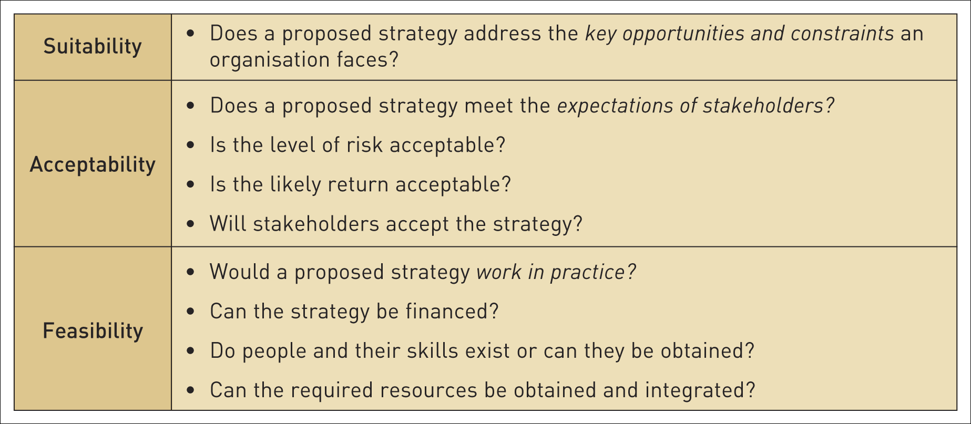
The SAFe criteria
Table 11.1 The SAFe criteria and techniques of evaluation

Slide 6
Suitability
Suitability is concerned with assessing which proposed strategies address the key opportunities & constraints an organisation faces, through an understanding of the strategic position of an organisation.
It is concerned with the overall rationale of the strategy:
Does it exploit the opportunities in the environment and avoid the threats?
Does it capitalise on the organisation’s strengths and strategic capabilities and avoid or remedy the weaknesses?

Slide 7
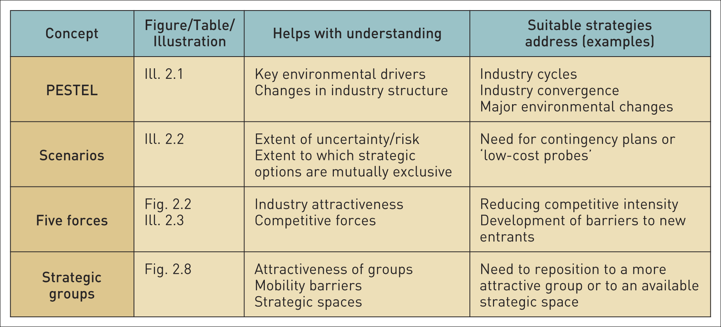
Suitability of strategic options in relation to strategic position (1)
Table 11.2 Suitability of strategic options in relation to strategic position

Slide 8
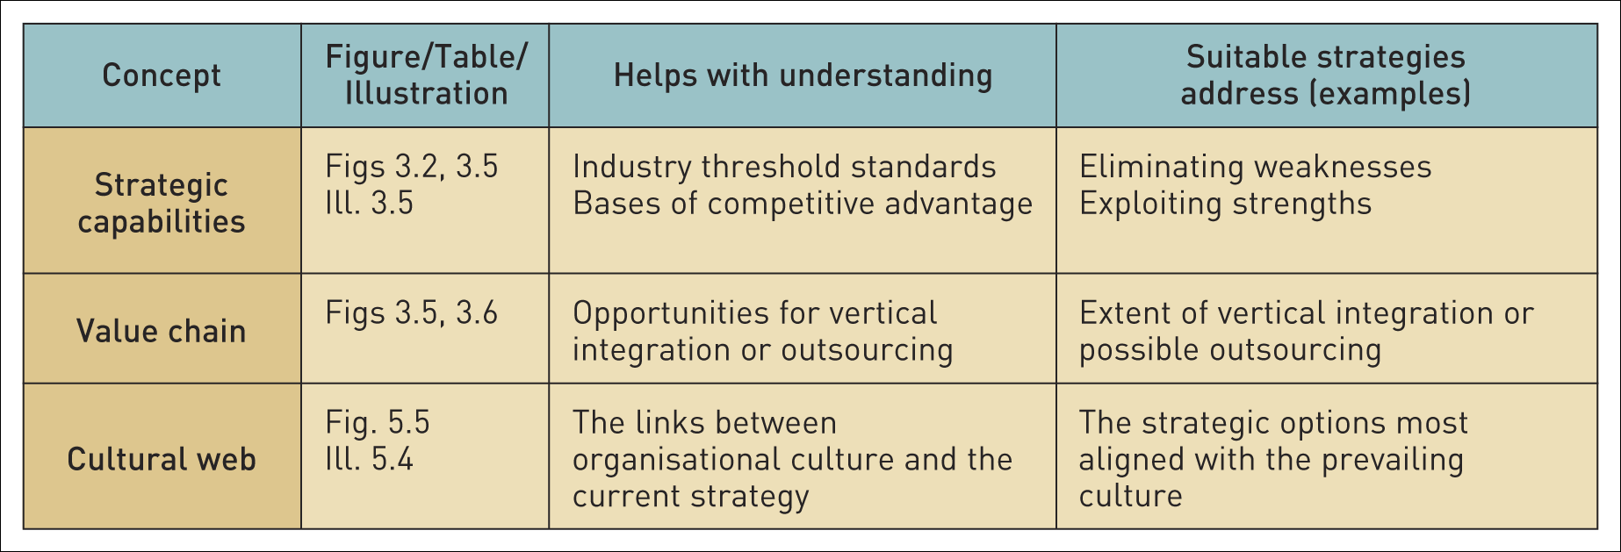
Suitability of strategic options in relation to strategic position (2)
Table 11.2 Suitability of strategic options in relation to strategic position (Continued)

Slide 9
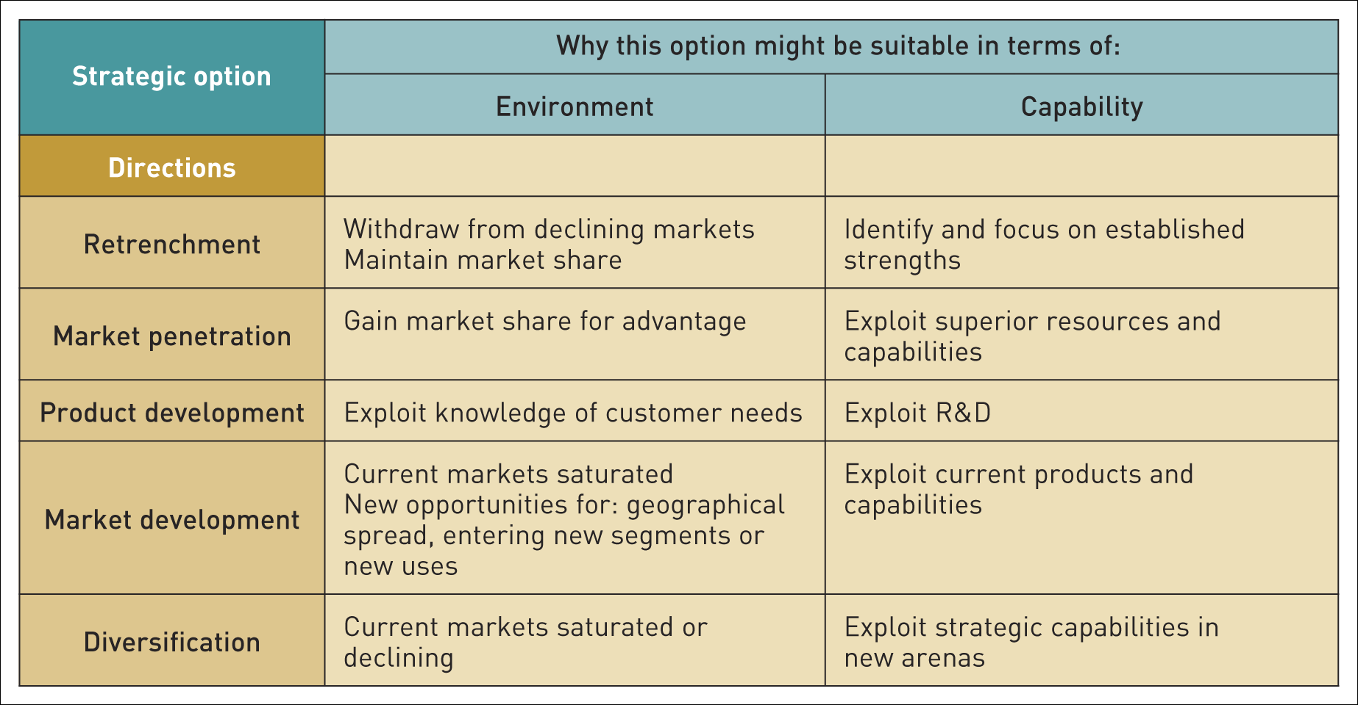
Some examples of suitability (1)
Table 11.3 Some examples of suitability

Slide 10
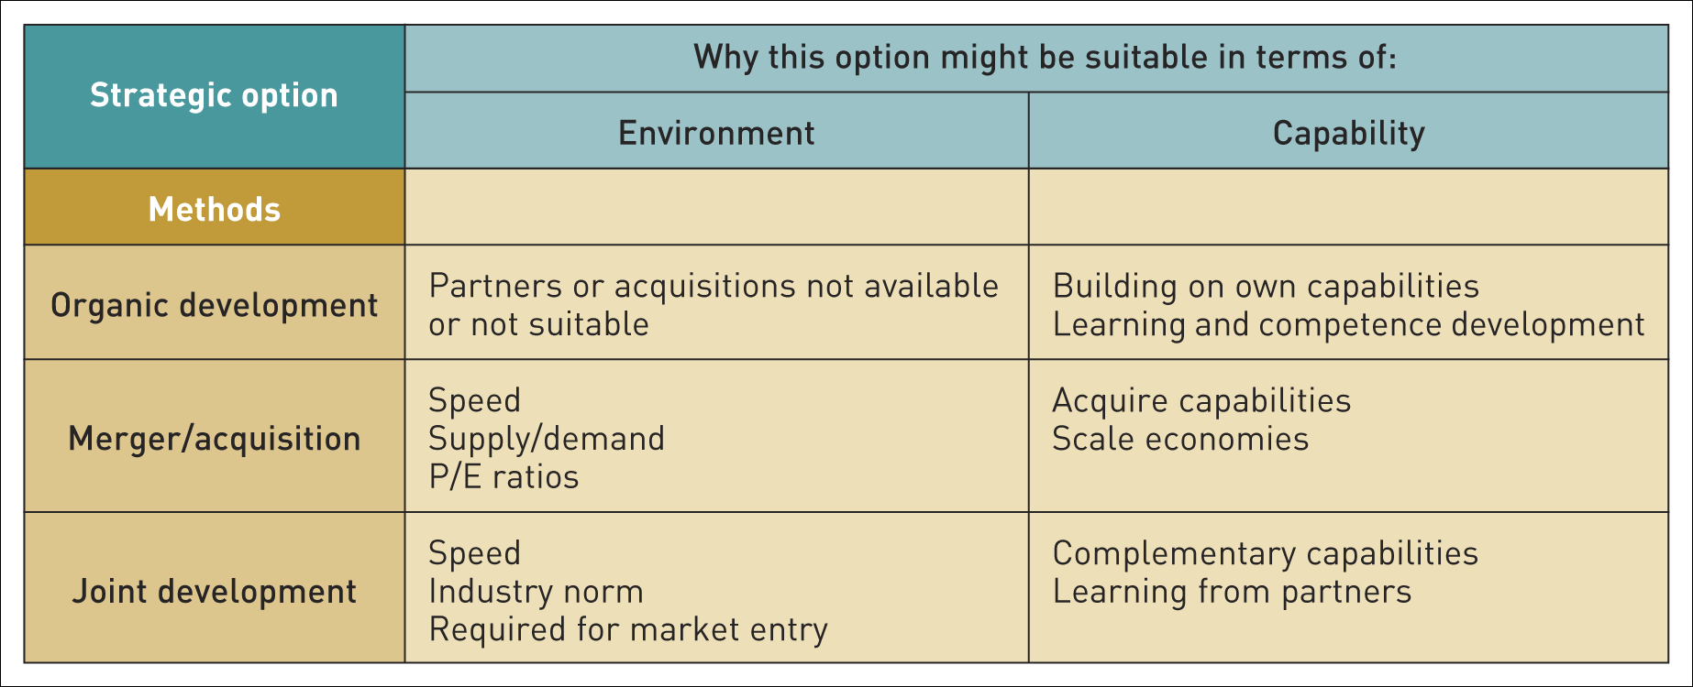
Some examples of suitability (2)
Table 11.3 Some examples of suitability (Continued)

Slide 11
Suitability – screening techniques
There are several useful techniques:
Ranking.
Using scenarios.
Screening for competitive advantage.
Decision trees.
Life cycle analysis.

Slide 12
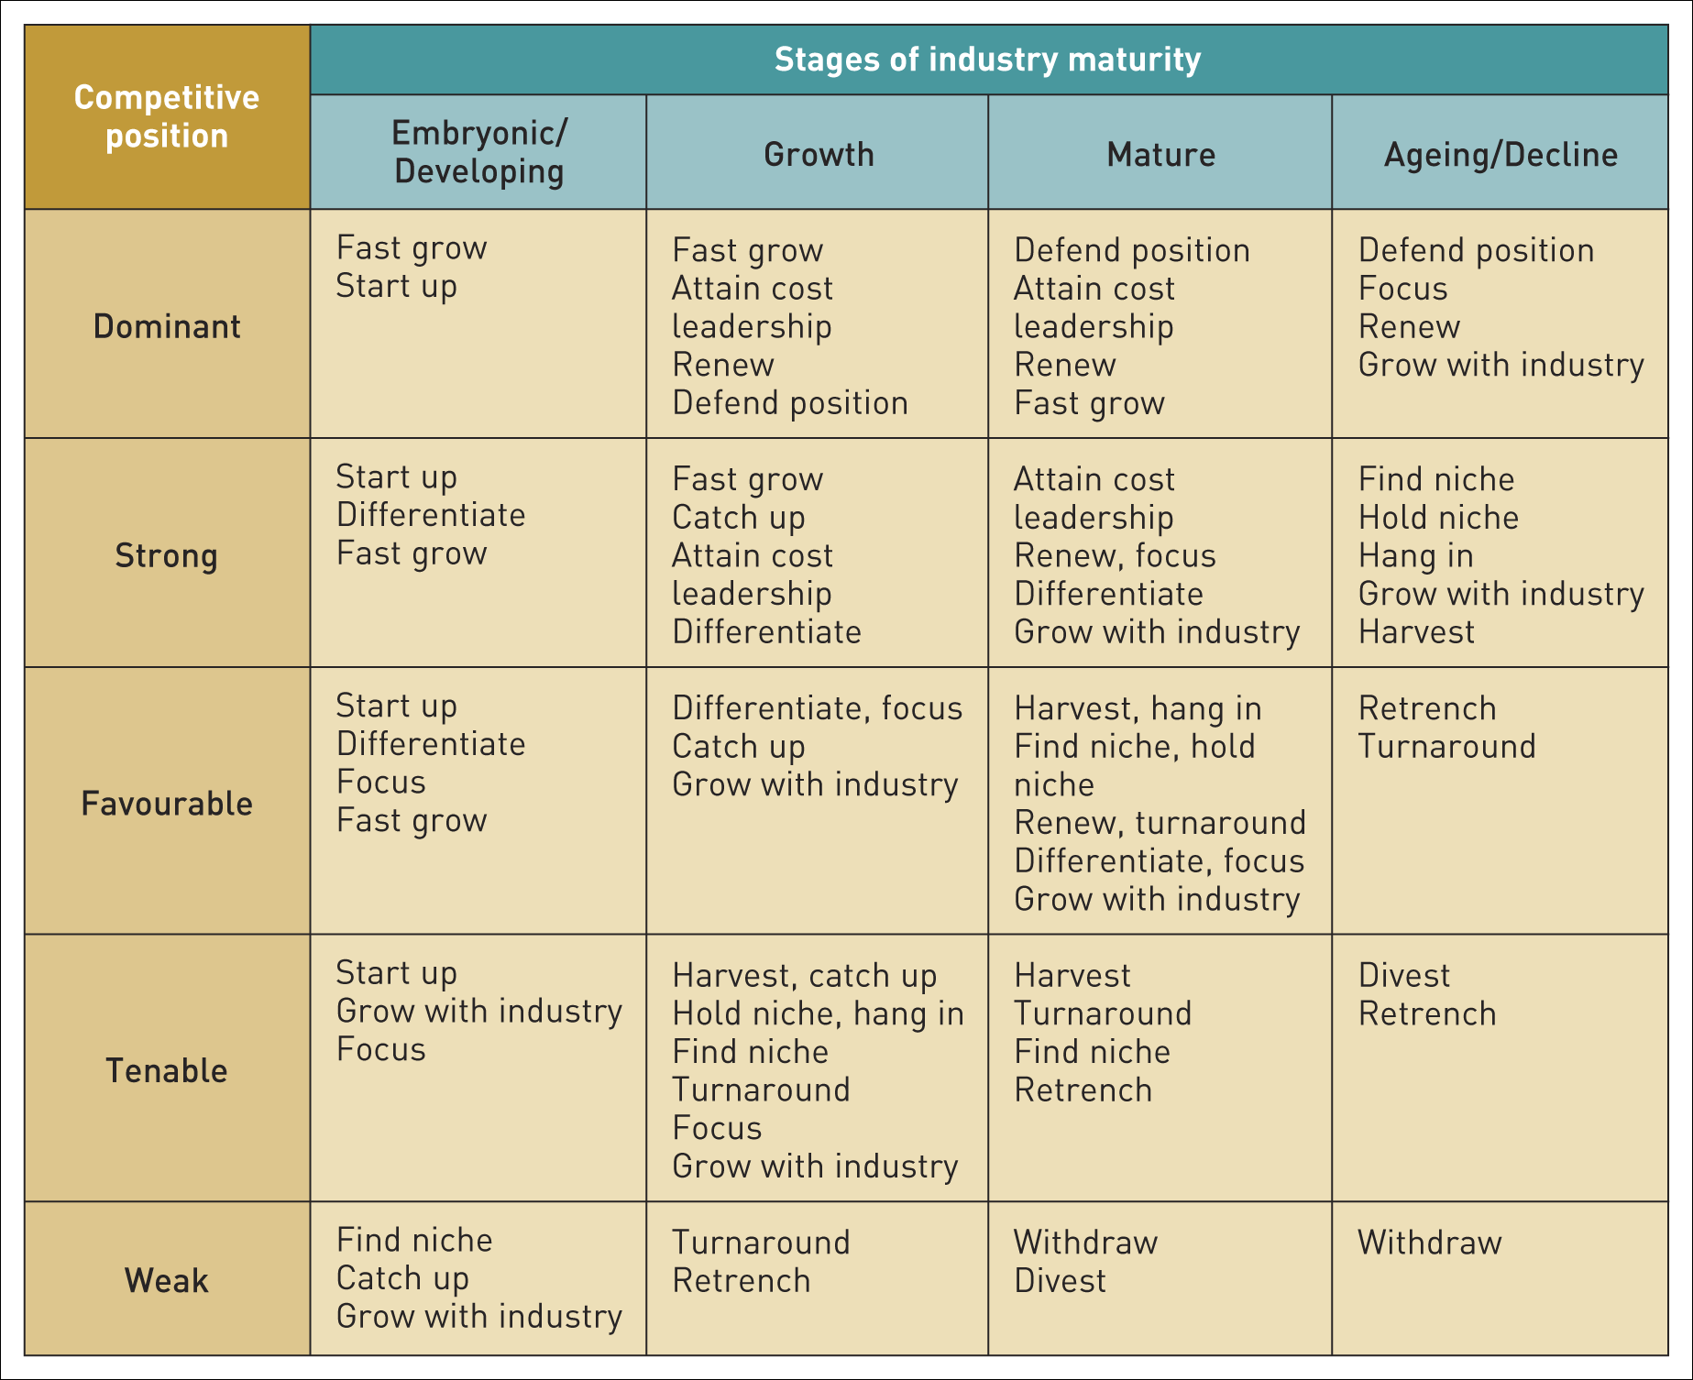
The life cycle/portfolio matrix
Table 11.5 The industry life cycle/portfolio matrix
Source: Arthur D. Little

Slide 13
Competitive position within an industry
Competitive position within an industry can be:
A dominant position which is rare in the private sector unless there is a quasi-monopoly position. In the public sector there can be a legalised monopoly status.
A strong position where organisations can follow strategies of their own choice without too much concern for competition.
A favourable position where no single competitor stands out, but leaders are better placed.
A tenable position can be maintained by specialisation or focus.
A weak position where competitors are too small to survive independently in the long run.

Slide 14
Acceptability (1)
Acceptability is concerned with whether the expected performance outcomes of a proposed strategy meet the expectations of stakeholders.

Slide 15
Acceptability (2)
There are three key aspects of acceptability - the ‘3 R’s’:
Risk.
Return.
Reactions (of stakeholders).

Slide 16
Risk
Risk concerns the extent to which the outcomes of a strategy can be predicted.
Risk can be assessed using:
  Sensitivity analysis.
  Financial ratios – e.g. gearing and liquidity.
  Break-even analysis.

Slide 17
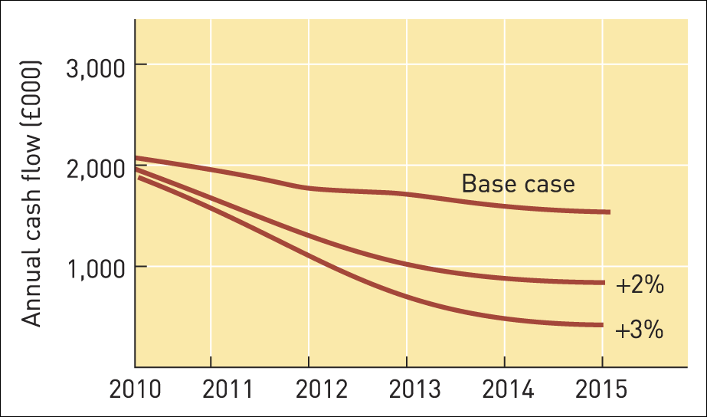
Sensitivity analysis
Illustration 11.3 A

Slide 18
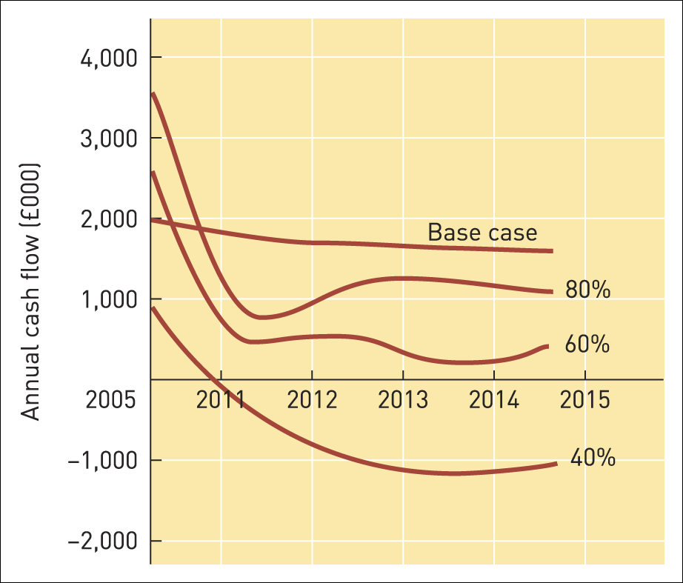
Sensitivity analysis (Continued)
Illustration 11.3 B

Slide 19
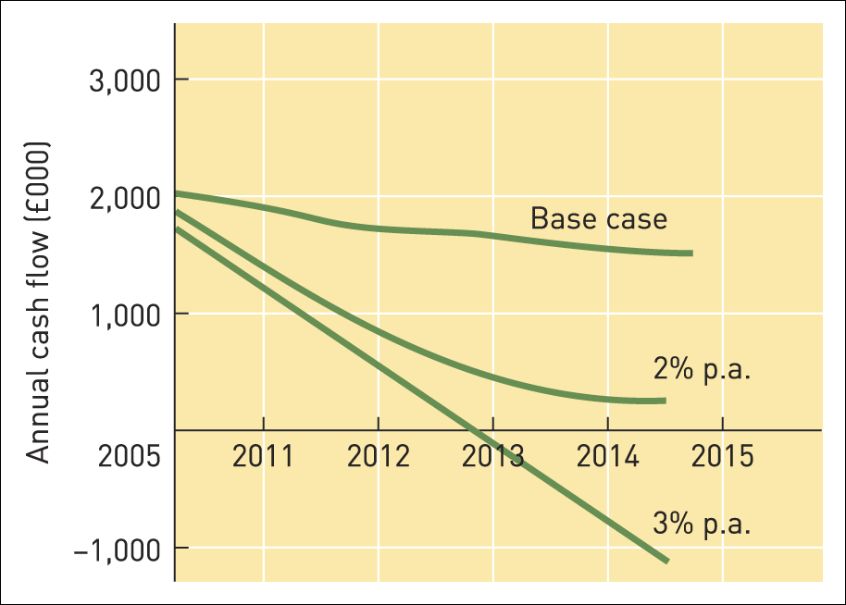
Sensitivity analysis (Continued)
Illustration 11.3 C

Slide 20
Return
Returns are the financial benefits which stakeholders are expected to receive from a strategy.
Different approaches to assessing return:
  Financial analysis.
  Shareholder value analysis.
  Cost–benefit analysis.
  Real options.

Slide 21
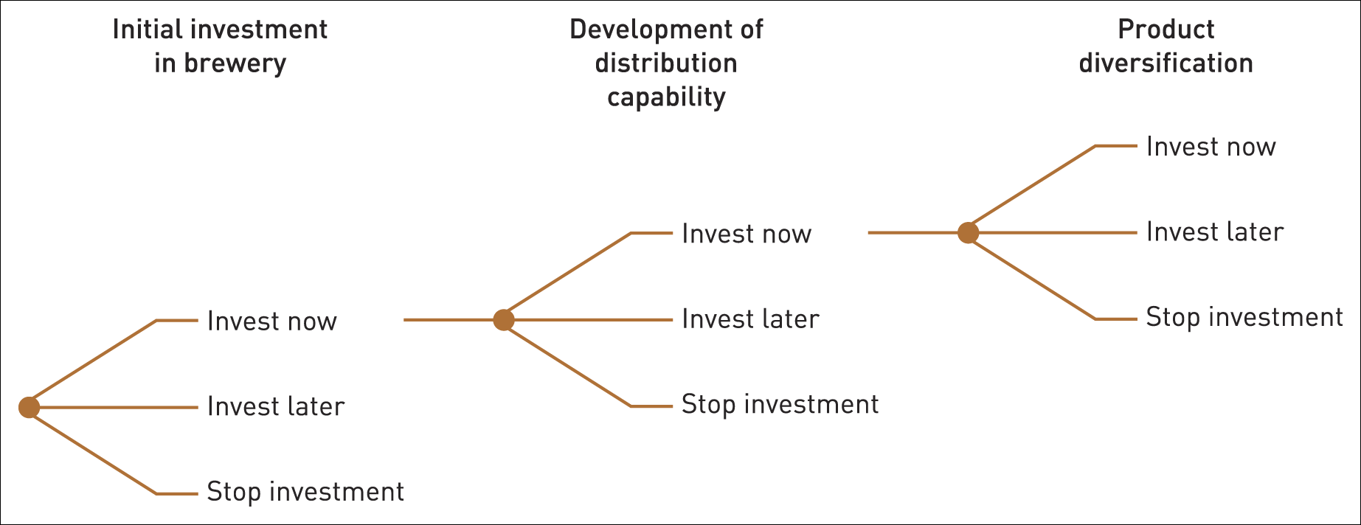
Real options evaluation
Illustration 11.6

Slide 22
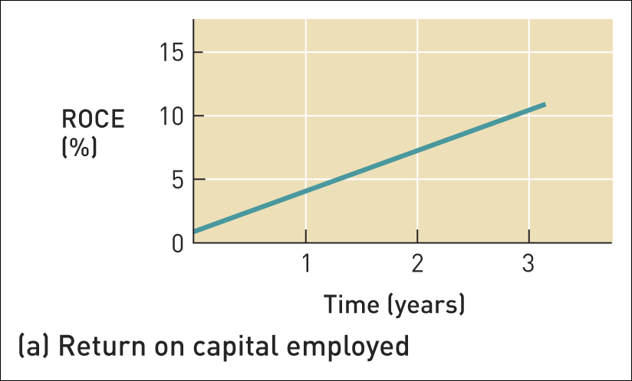
Assessing profitability (1)
Figure 11.1 Assessing profitability

Slide 23
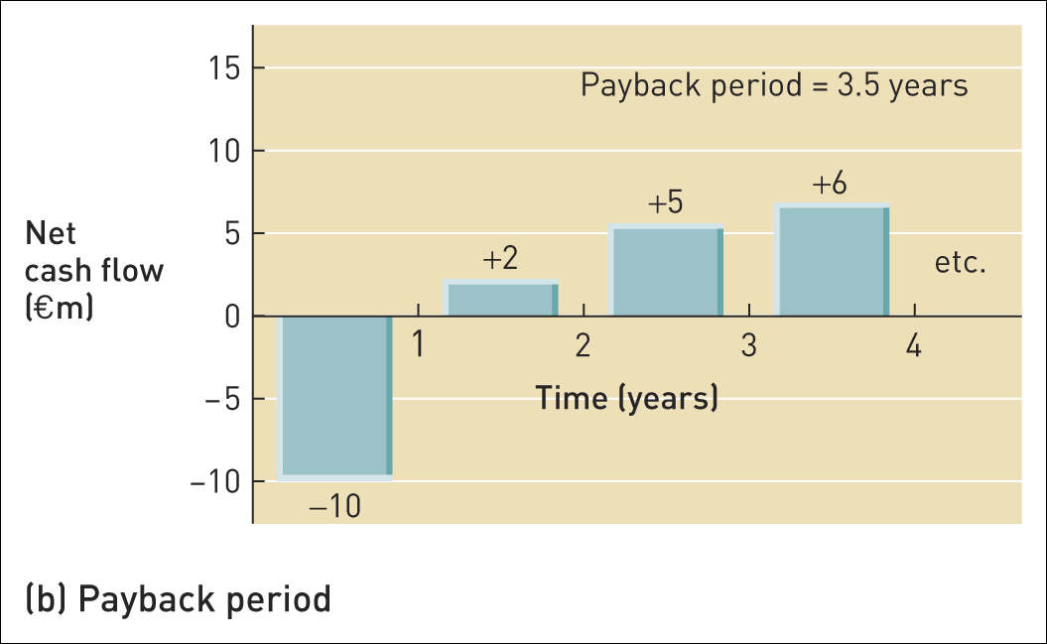
Assessing profitability (2)
Figure 11.1 Assessing profitability (Continued)

Slide 24
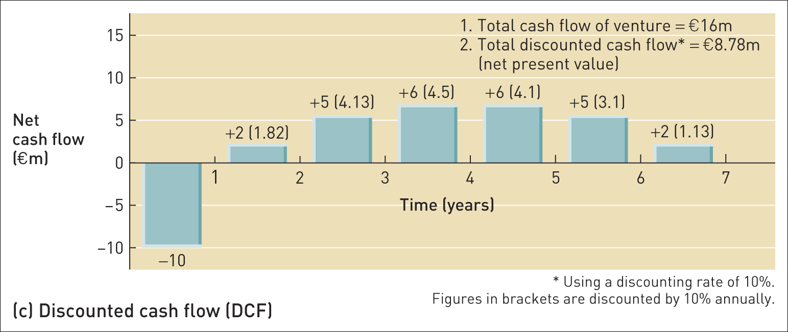
Assessing profitability (3)
Figure 11.1 Assessing profitability (Continued)

Slide 25
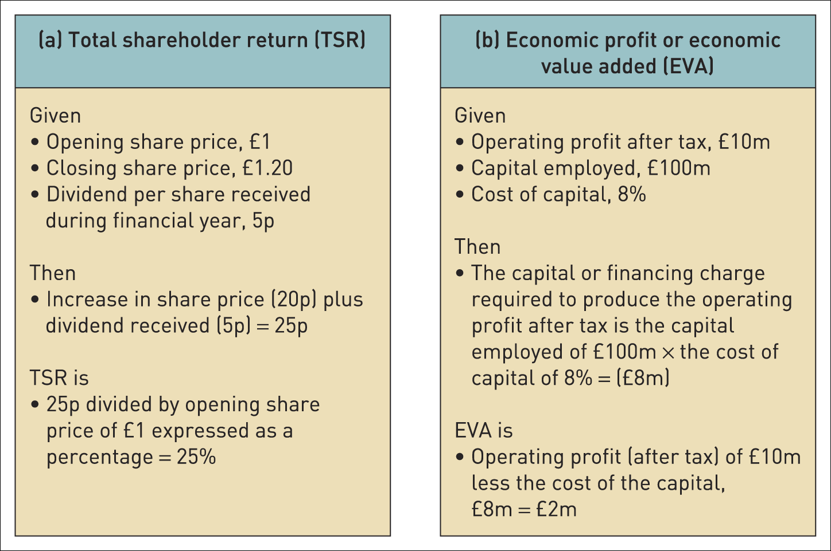
Measures of shareholder value
Table 11.6 Measures of shareholder value

Slide 26
Advantages of real options
There are four main benefits:
  Bringing strategic and financial evaluation closer together.
  Valuing emerging options.
  Coping with uncertainty.
  Offsetting conservatism.

Slide 27
Reaction of stakeholders
Stakeholder mapping and the power/interest matrix can be used to:
  understand the political context of strategies.
  understand the political agenda.
  gauge the likely reaction of stakeholders to specific strategies.
If key stakeholders find a strategy to be unacceptable then it is likely to fail

Slide 28
Feasibility
Feasibility is concerned with whether a strategy could work in practice i.e. whether an organisation has the capabilities to deliver a strategy
Two key questions:
Do the resources and competences currently exist to implement the strategy effectively?
If not, can they be obtained?

Slide 29
Financial feasibility
Need to consider:
  The funding required.
  Cash flow analysis and forecasting.
  Financial strategies needed for the different ‘phases’ of the life cycle of a business.

Slide 30
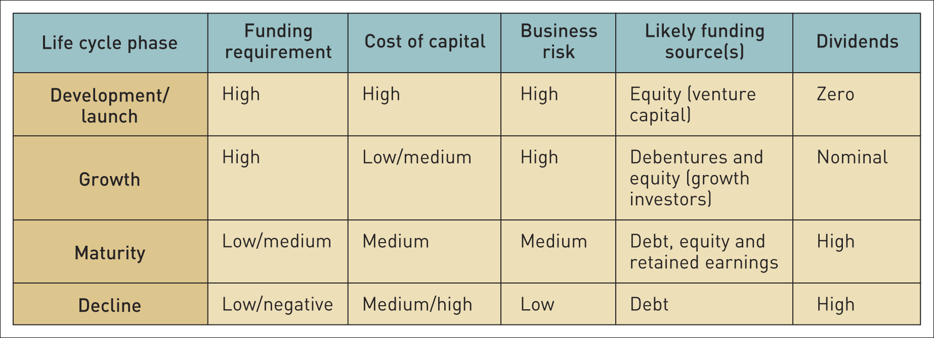
Financial strategy and the business life cycle
Table 11.7 Financial strategy and the business life cycle

Slide 31
People and skills (1)
Three questions arise:
Do people in the organisation currently have the competences to deliver a proposed strategy?
Are the systems to support those people fit for the strategy?
If not, can the competences be obtained or developed?

Slide 32
People and skills (2)
Critical issues that need to be considered:
  Work organisation – will this need to change?
  Rewards – are the incentives appropriate?
  Relationships – will people interact differently?
  Training and development – are current systems appropriate?
  Staffing – are the levels and skills of the staff appropriate?

Slide 33
Integrating resources
The success of a strategy depends on the management of many resource areas, for example:
  people,
  finance,
  physical resources,
  information,
  technology and
  resources provided by suppliers and partners.
It is essential to integrate resources – inside the organisation and in the wider value network.

Slide 34
Evaluation criteria
Four qualifications:
  Conflicting conclusions and the need for management judgement.
  Consistency between the different elements of a strategy is essential.
  The implementation and development of strategies might reveal unanticipated problems.
  Strategy development in practice – it isn’t always a logical or even rational process.

Slide 35

Summary
Proposed strategies may be evaluated using the three SAFe criteria:
Suitability is concerned with assessing which proposed strategies address the key opportunities and constraints an organisation faces. It is about the rationale of a strategy.
The acceptability of a strategy relates to three issues: the level of risk of a strategy, the expected return from a strategy and the likely reaction of stakeholders.
Feasibility is concerned with whether an organisation has or can obtain the capabilities to deliver a strategy.

