Slide 1
Strategy in Action
12: Strategy Development
Processes
Notes:
Update – 9th edition and new title

Slide 2
Learning outcomes
Explain what is meant by intended and emergent strategy development.
Identify intended processes of strategy development in organisations including: the role of strategic leadership, strategic planning systems and externally imposed strategy.
Identify processes that give rise to emergent strategy development such as: logical incrementalism, political processes, the influence of prior decisions and organisational systems.
Explain some of the challenges managers face in strategy development including: managing multiple strategy processes, strategy development in different contexts and managing intended and emergent strategy.

Slide 3
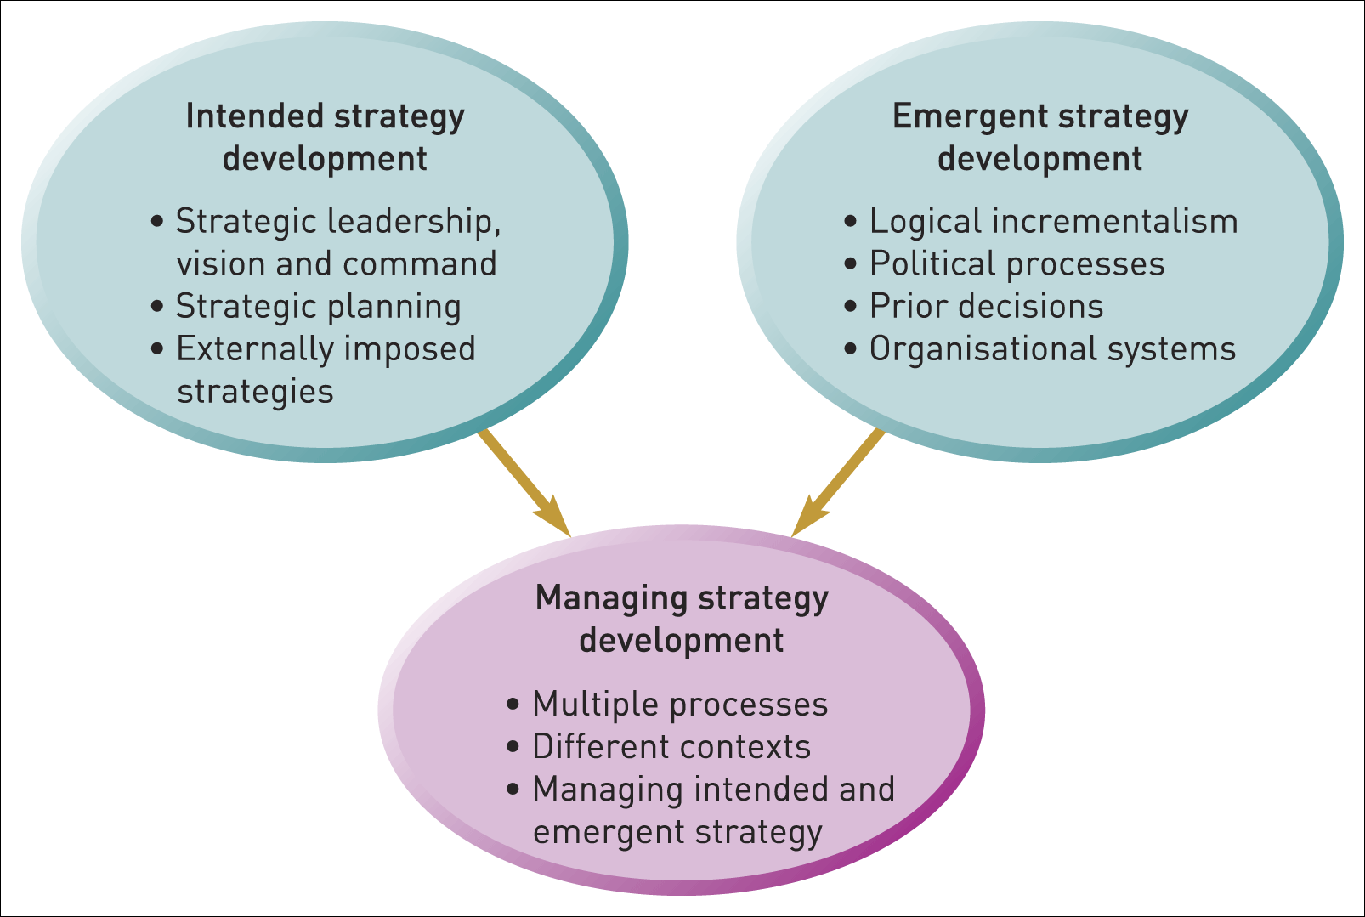
Strategy development processes
Figure 12.1 Strategy development process

Slide 4

Intended strategy
An intended strategy is deliberately formulated or planned by managers.
This may be the result of strategic leadership, strategic planning or the external imposition of strategy.

Slide 5
Strategic leadership
Strategy may be the deliberate intention of a leader. This may manifest itself in different ways:
  Strategic leadership as command.
  Strategic leadership as vision.
  Strategic leadership as decision-making.
  Strategic leadership as symbolic.

Slide 6
Strategic planning systems
Strategic planning systems take the form of systematised, step-by-step, procedures to develop an organisation’s strategy.

Slide 7
Stages of strategic planning
Initial guidelines from corporate centre
Business-level planning
Corporate-level integration of business plans
Financial and strategic targets agreed

Slide 8
The role of strategic planning
Strategic planning may play several roles within an organisation:
Formulating strategy: a means by which managers can understand strategic issues.
Learning – a means of questioning and challenging the taken-for-granted.
Co-ordinating business-level strategies within an overall corporate strategy.
Communicating intended strategy and providing agreed objectives or strategic milestones.

Slide 9
Benefits of planning
There are additional psychological benefits:
  can provide opportunities for involvement,
  leading to a sense of ownership,
  provides security to managers and
  re-assures managers that the strategy is ‘logical’.

Slide 10
Dangers associated with planning
Confusing strategy with the plan.
Detachment from reality.
Paralysis by analysis.
Lack of ownership.
Dampening of innovation.

Slide 11
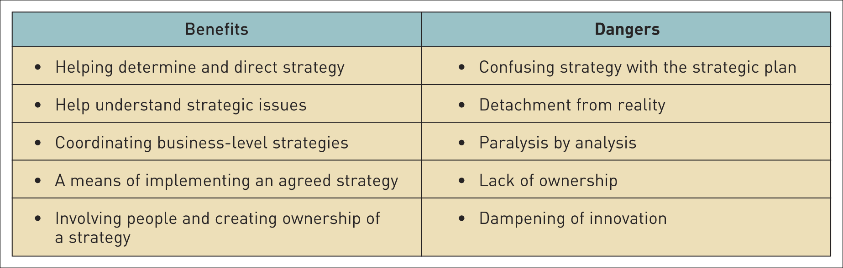
The potential benefits and dangers of strategic planning - summary
Table 12.1 The potential benefits and dangers of strategic planning

Slide 12
Externally imposed strategy
Strategies may be imposed by powerful external stakeholders:
  Government can determine strategy in public sector organisations (e.g. police).
  Government can shape strategy in regulated industries (e.g. utilities).
  Multinational companies may have elements of strategy imposed (e.g. forming local alliances).
  Business units may have their strategy imposed by head office (e.g. part of a global strategy).
  Venture capital firms may impose strategy on companies they buy into.

Slide 13
Emergent strategy
An emergent strategy comes about through a series of decisions - a pattern which becomes clear over time:
……not a ‘grand plan’, but a developing pattern in a stream of decisions.

Slide 14
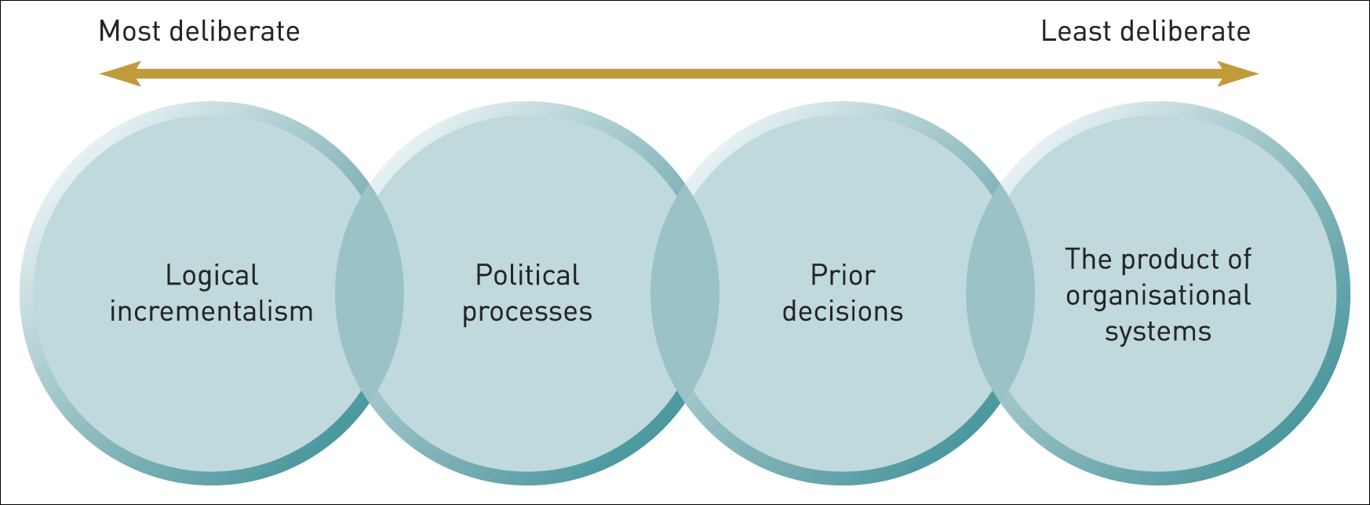
Emergent strategy development processes
Figure 12.2 A continuum of emergent strategy development processes

Slide 15
Logical incrementalism (1)
Logical incrementalism is the development of strategy by experimentation and learning – from partial commitments rather than through formulations of total strategies.

Slide 16
Logical incrementalism (2)
Four characteristics of logical incrementalism:
  Environmental uncertainty – constant scanning of the environment and adapting to change.
  General goals – avoiding too early commitment to specific goals.
  Experimentation – ‘side bet’ ventures to test out new strategies.
  Co-ordinating emergent strategies – drawing together an emerging pattern of strategy from subsystems.

Slide 17
Learning organisation
Learning organisation – an organisation that is capable of continual regeneration from the variety of knowledge, experience and skills within a culture that encourages questioning and challenge.

Slide 18
Strategy and political processes
The political view of strategy development is, that strategies develop as the outcome of bargaining and negotiation among powerful interest groups (or stakeholders).

Slide 19
Strategy continuity and prior decisions
Continuity is likely to be a feature of strategy because of:
  Emergent strategy as managed continuity – each strategic move is informed by the rationale of the previous move.
  Path-dependent strategy development – strategic decisions can be a result of historical pre-conditions.
  Organisation culture and strategy development – strategy is the outcome of the taken-for-granted assumptions, routines and behaviours in organisations.

Slide 20
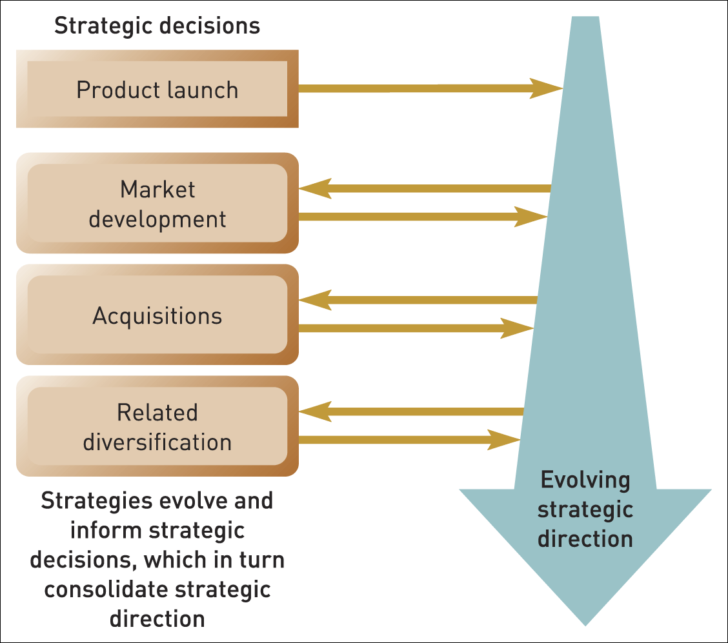
Strategic direction from prior decisions
Figure 12.3 Strategic direction from prior decisions

Slide 21
Strategy and organisational systems
Strategy development as the outcome of managers making sense of and dealing with strategic issues by applying established ways of doing things.
Strategy development is influenced by the systems and routines with which managers are familiar in their particular context.
Two useful explanations of how this occurs:
  The resource allocation process (RAP).
  The attention-based view (ABV).

Slide 22
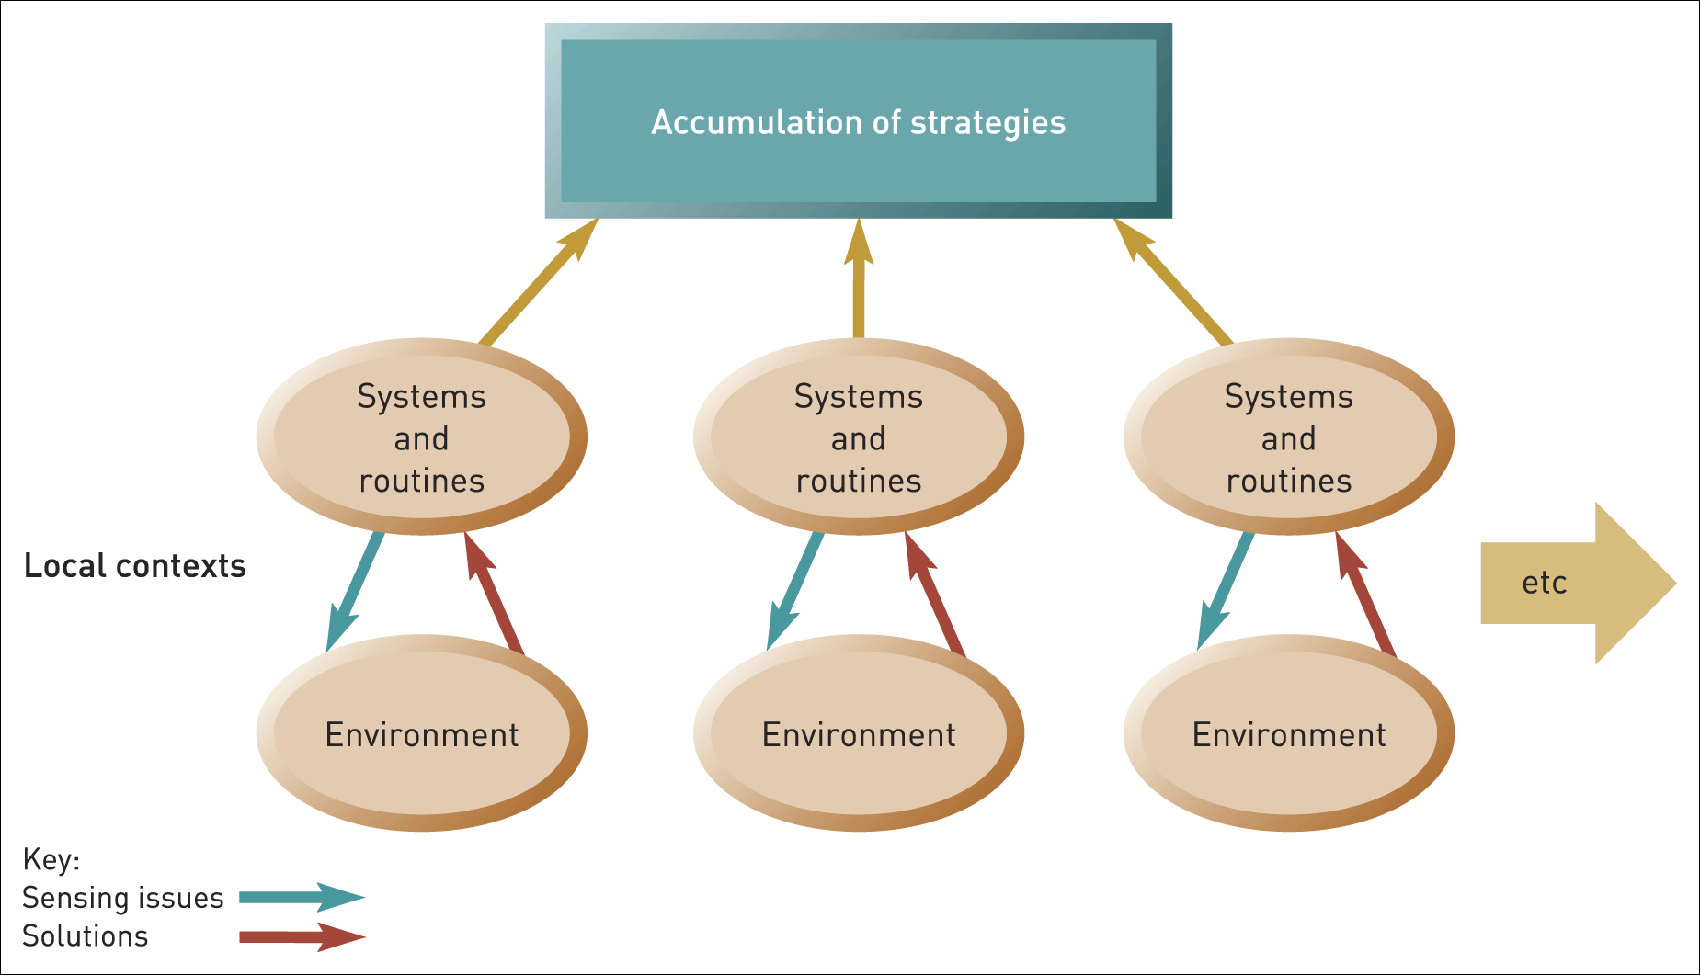
Strategy development as the product of structures, systems and routines
Figure 12.4 Strategy development as the product of structures, systems and routines

Slide 23
Challenges for managing strategy development
Multiple strategy development processes – most organisations will develop strategy involving several approaches.
There is no one right way to develop strategy but the context can be important.
Organisational ambidexterity – exploiting existing capabilities while exploring new capabilities.

Slide 24
Perceptions of strategy development
Perceptions of strategy development – strategy will be seen differently by different people:
  Senior executives see strategy in terms of intended, rational, analytic planned processes, whereas middle managers see strategy as the result of cultural and political processes.
  Managers in public-sector organisations see strategy as externally imposed because their organisations are answerable to government bodies.
  People who work in family businesses see more evidence of the influence of powerful individuals, who may be the owners of the businesses.

Slide 25
Strategy development and organisational context
Strategy development processes will differ according to context:
  Organisational characteristics differ – in size, technology and diversity.
  The nature of the environment differs – it may be stable or dynamic; simple or complex.
  Life cycle effects – development processes will evolve and change over the life cycle.

Slide 26
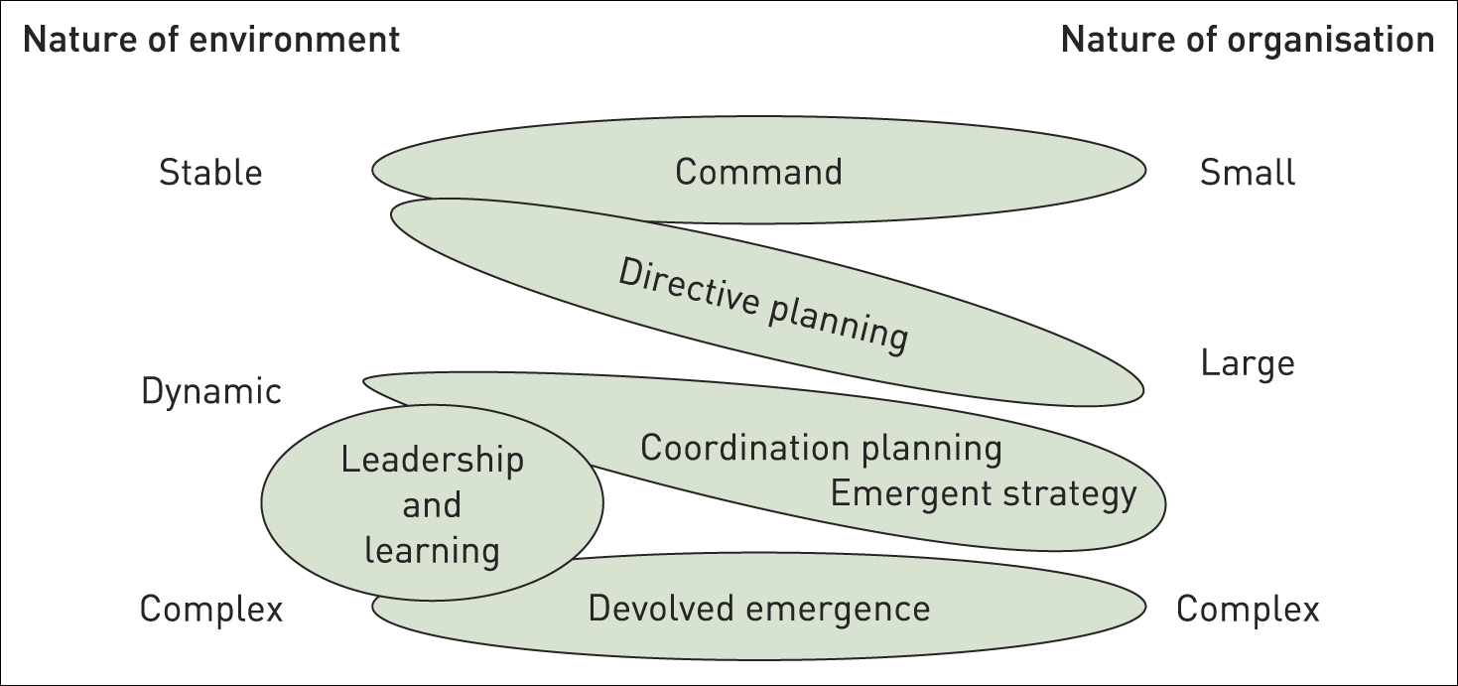
Strategy development contexts
Figure 12.5 Strategy development contexts

Slide 27
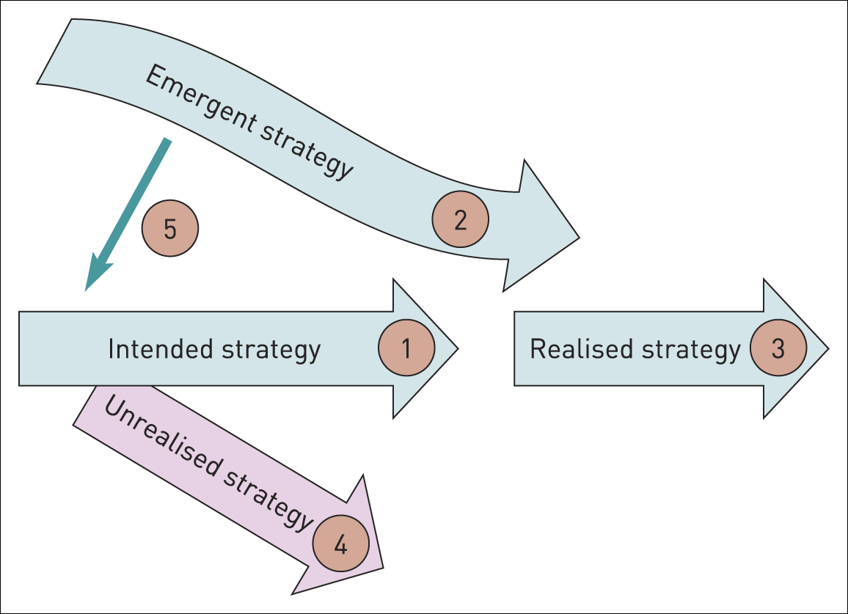
Strategy development routes
Figure 12.6 Strategy development routes

Slide 28
Managing intended and emergent strategy
There are four important implications:
  Awareness – is the intended strategy actually being realised?
  The role of strategic planning – needs to be clear (and it may be more about co-ordinating emergent strategies).
  Managing emergent strategy – even established routines and cultural norms can be managed.
  The challenge of strategic drift – recognising that strategy can come adrift and making the required changes in culture and the paradigm.

Slide 29
Summary: intended strategy
It is important to distinguish between intended strategy – the desired strategic direction deliberately planned by managers – and emergent strategy which may develop in a less deliberate way from the behaviours and activities inherent within an organisation.
Most often the process of strategy development is described in terms of intended strategy as a result of planning systems carried out objectively and dispassionately. There are benefits and disbenefits of formal strategic planning systems. However, there is evidence to show that such formal systems are not an adequate explanation of strategy development as it occurs in practice.
Intended strategy may also come about on the basis of central command, the vision of strategic leaders or the imposition of strategies by external stakeholders.

Slide 30
Summary: emergent strategy
Strategies may emerge from within organisations. This may be explained in terms of:
  How organisations may proactively try to cope through processes of logical incrementalism and organisational learning.
  The outcome of the bargaining associated with political activity resulting in a negotiated strategy.
  Strategy development on the basis of prior decisions, path dependency and the taken-for-granted elements of organisational culture that favour certain strategies.
  Strategies developing because organisational systems favour some strategy projects over others.

Slide 31
Summary: management challenges
In managing strategy development processes, managers face challenges including:
  Multiple processes of strategy development are likely to be needed if organisations are to achieve both the benefits of the exploitation of existing capabilities and the exploration for new ideas and capabilities (organisational ambidexterity).
  Recognising that different processes of strategy development may be needed at different times and in different contexts.
  Managing the processes that give rise to emergent strategy.

