Slide 1
Strategy in Action
13: Organising for Success
Notes:
Update slide – 9th edition and new title

Slide 2
Learning outcomes
Identify key challenges in organising for success, including ensuring control, managing knowledge, coping with change and responding to internationalisation.
Analyse main organisation structural types in terms of strengths and weaknesses.
Recognise key issues in designing organisational control systems (such as planning and performance targeting systems).
Recognise how the three strands of strategy, structure and systems should reinforce each other in organisational configurations and the managerial dilemmas involved.

Slide 3
Structures and systems
Structures give people formally defined roles, responsibilities and lines of reporting with regard to strategy.
Systems support and control people as they carry out structurally defined roles and responsibilities.
Configurations are the mutually supporting elements that make up an organisation’s design.

Slide 4
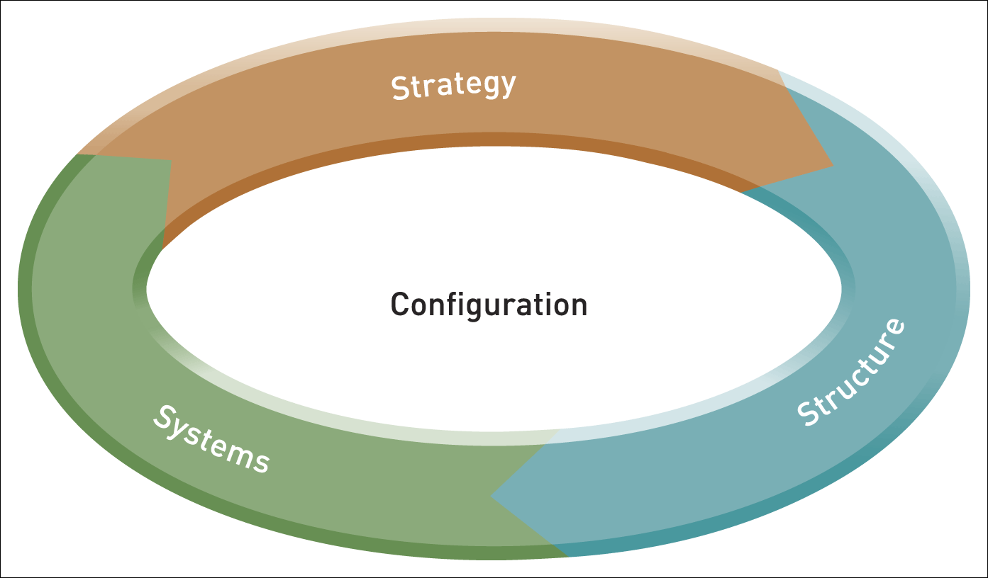
Organisational configurations
Figure 13.1 Organisational configurations: strategy, structure and systems

Slide 5

Structural types
Functional
Multidivisional
Matrix
Multinational/
Transnational
Project-based

Slide 6
The functional structure
The functional structure divides responsibilities according to the organisation’s primary specialist roles such as production, research and sales.

Slide 7
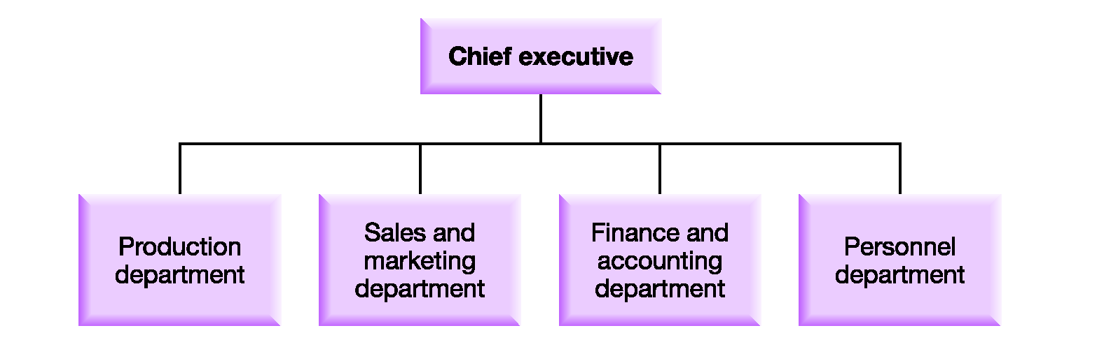
A functional structure

Slide 8
Functional structures
Advantages
Chief executive in touch with all operations.
Reduces/simplifies control mechanisms.
Clear definition of responsibilities.
Specialists at senior and middle management levels.
Disadvantages
Senior managers overburdened with routine matters.
Senior managers neglect strategic issues.
Difficult to cope with diversity.
Coordination between functions is difficult.
Failure to adapt.

Slide 9
The multidivisional structure
The multidivisional structure is built up of separate divisions on the basis of products, services or geographical areas.

Slide 10
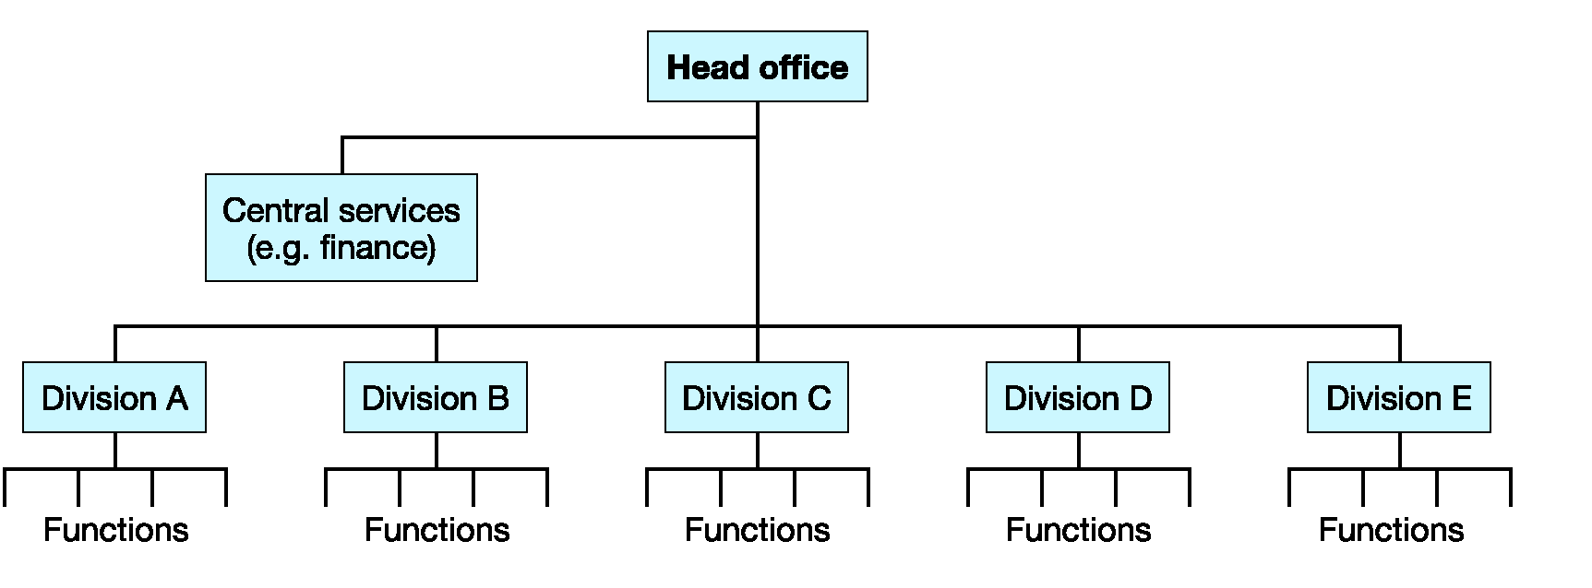
A multidivisional structure

Slide 11
Multidivisional structures
Advantages
Flexible (add or divest divisions).
Control by performance.
Ownership of strategy.
Specialisation of competences.
Training in strategic view.
Disadvantages
Duplication of central and divisional functions.
Fragmentation and non-cooperation.
Danger of loss of central control.

Slide 12
The matrix structure
The matrix structure combines different structural dimensions simultaneously, for example product divisions and geographical territories or product divisions and functional specialisms.

Slide 13
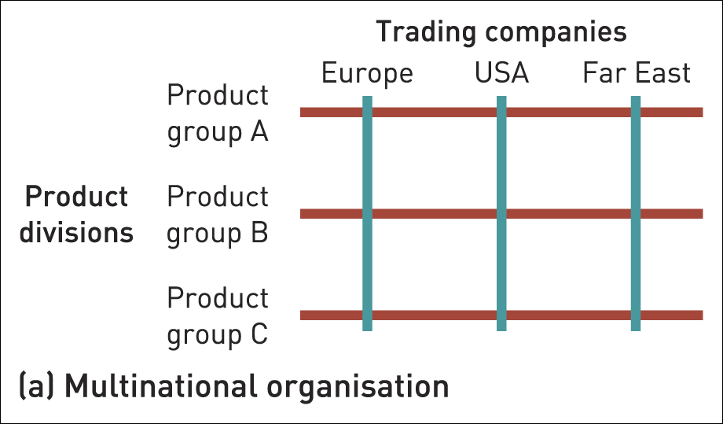
Matrix structures (1)
Figure 13.4 Two examples of matrix structures

Slide 14
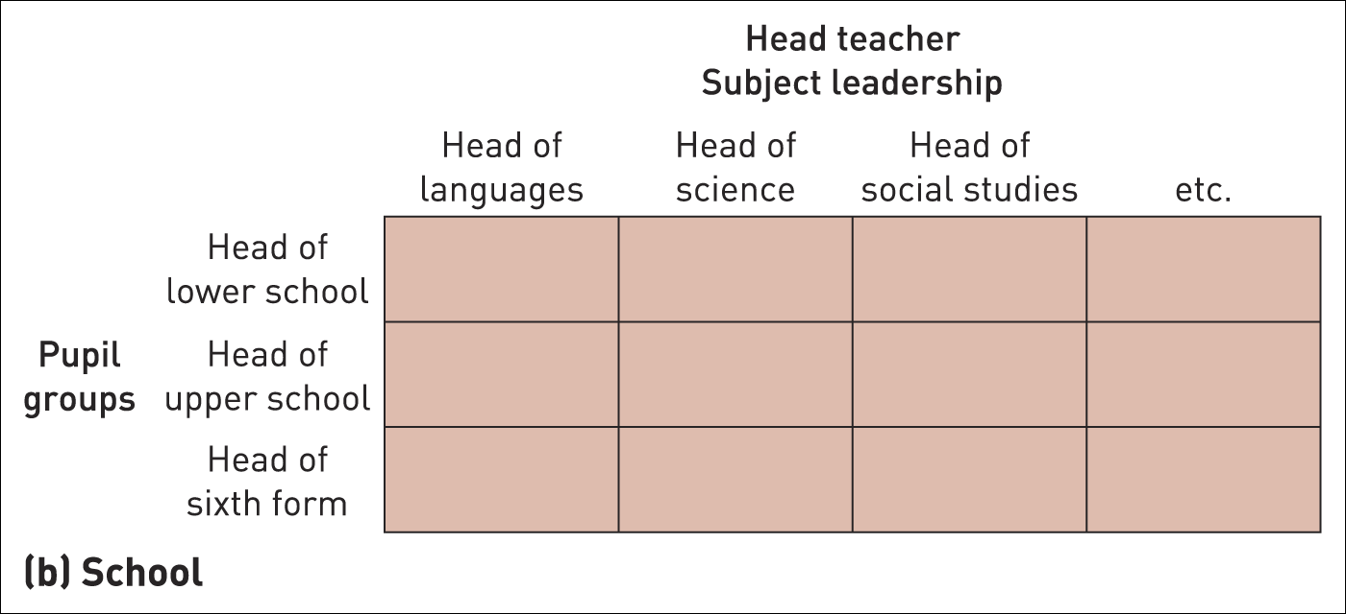
Matrix structures (2)
Figure 13.4 Two examples of matrix structures (Continued)

Slide 15
Matrix structures
Advantages
Integrated knowledge.
Flexible.
Allows for dual dimensions.
Disadvantages
Length of time to take decisions.
Unclear job and task responsibilities.
Unclear cost and profit responsibilities.
High degrees of conflict.

Slide 16
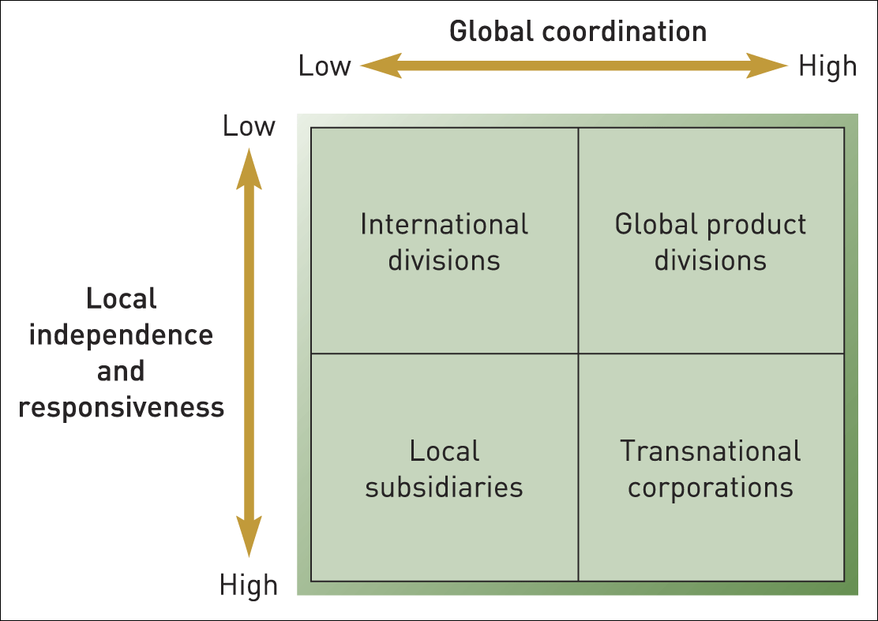
Multinational structures
Figure 13.5 Multinational structures
Source: Reprinted by permission of Harvard Business School Press. From Managing Across Borders: The Transnational Corporation, 2nd edition by C.A. Bartlett and S. Ghoshal, Boston, MA, 1998. Copyright © 1998 by the Harvard Business School Publishing Corporation. All rights reserved

Slide 17
Transnational structures
The transnational structure combines local responsiveness with high global coordination.
Key Advantages include:
  Knowledge-sharing.
  Specialisation.
  Network management.

Slide 18
Project-based structures
A project-based structure is one where teams are created, undertake the work (e.g. internal or external contracts) and are then dissolved.

Slide 19
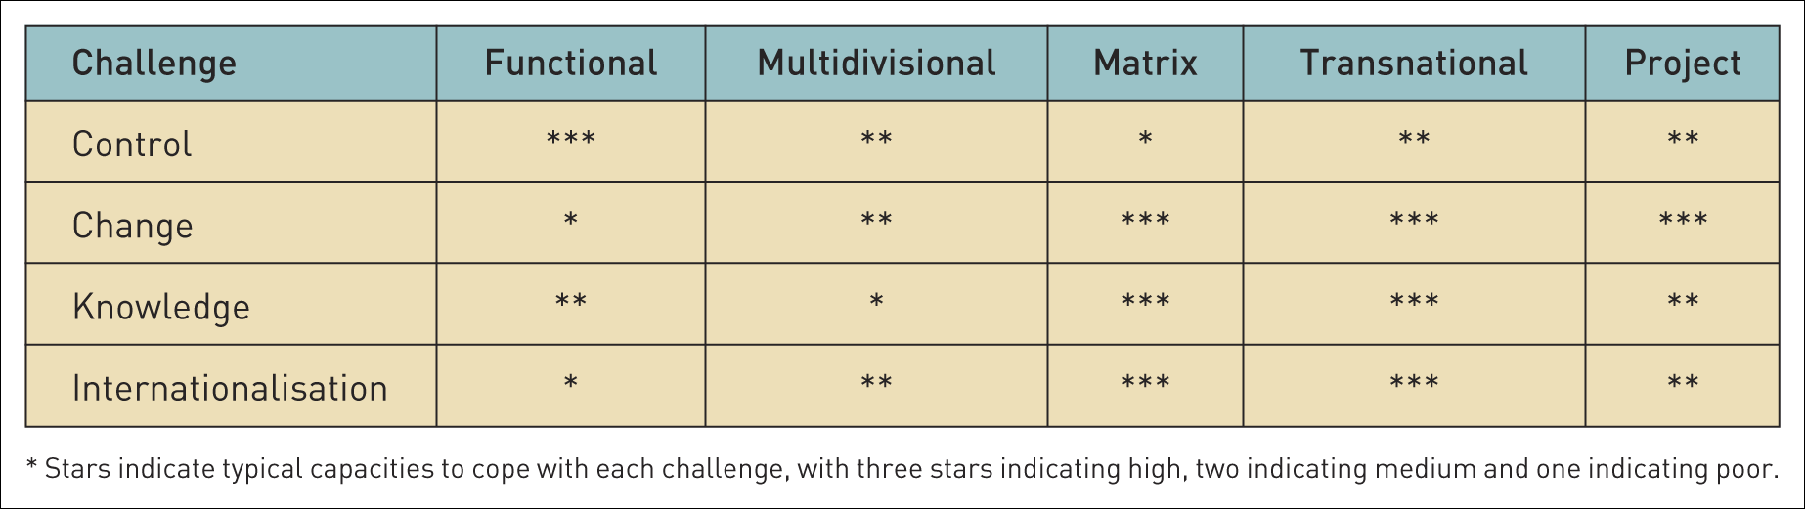
Comparison of structures
Table 13.1 Comparison of structures

Slide 20
Design tests for checking structural solutions
Market-Advantage.
Parenting Advantage.
People.
Feasibility.
Specialised Cultures.
Difficult Links.
Redundant Hierarchy.
Accountability.
Flexibility.

Slide 21
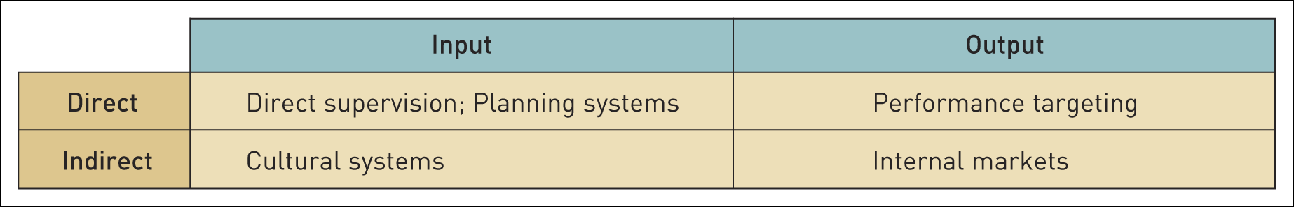
Types of control systems
Table 13.2 Types of control systems

Slide 22
Types of control systems
Direct supervision – direct control of strategic decisions by one or a few individuals, typically focused on the effort of employees.
Cultural systems aim to standardise norms of behaviour within an organisation in line with particular objectives.
Performance targets focus on the outputs of an organisation (or its parts) such as product quality, revenues or profits.
Internal market systems – a formal system of
a) ‘contracting’ for resources or inputs and b) for supplying outputs to other parts of an organisation.

Slide 23
Balanced scorecards
Balanced scorecards set performance targets according to a range of perspectives, not only financial.
Typically combine four specific perspectives:
  financial,
  customer,
  internal and
  innovation and learning.

Slide 24
Strategy maps
Strategy maps link different performance targets into a mutually supportive causal chain supporting strategic objectives.

Slide 25
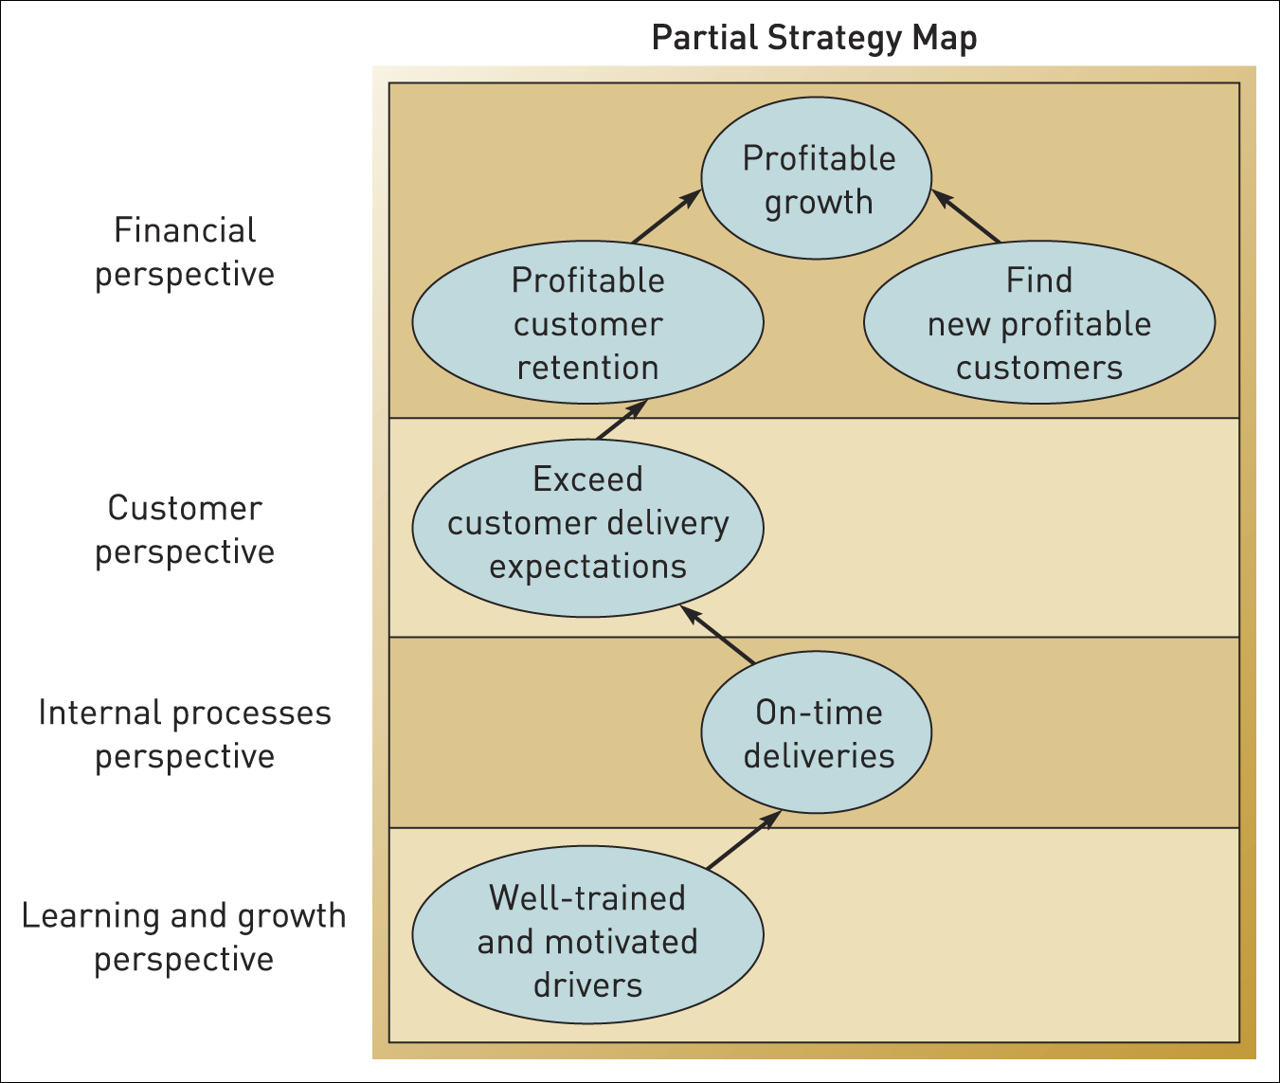
A strategy map
Figure 13.6 A strategy map
Source: Exhibit 1, R. Lawson, W. Stratton and T. Hatch (2005), ‘Achieving strategy with Scorecarding’, Journal of Corporate Accounting and Finance, March–April, 62–8: p. 64

Slide 26
Planning systems
Planning systems plan and control the allocation of resources and monitor their utilisation.

Slide 27
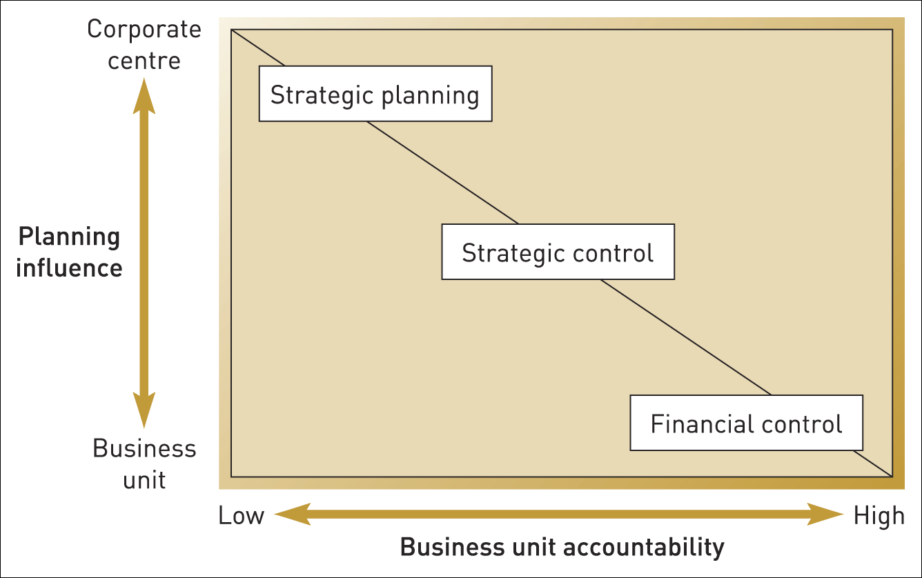
Strategy styles
Figure 13.7 Strategy styles
Source: Adapted from M. Goold and A. Campbell, Strategies and Styles, Blackwell, 1989, Figure 3.1, p. 39

Slide 28
Configurations
Configurations are the set of organisational design elements that interlink together in order to support the intended strategy.

Slide 29
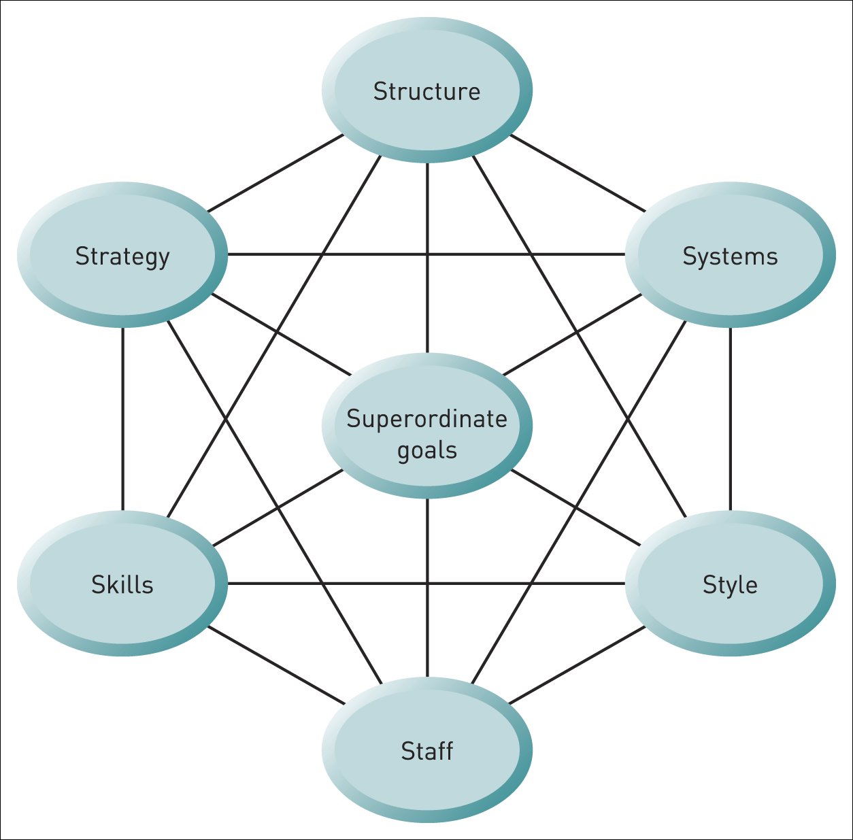
McKinsey 7-S framework
Figure 13.8 The McKinsey 7 Ss
Source: R. Waterman, T. Peters and J. Phillips, ‘Structure is not organization’, Business Horizons, June 1980, pp. 14–26: p. 18

Slide 30
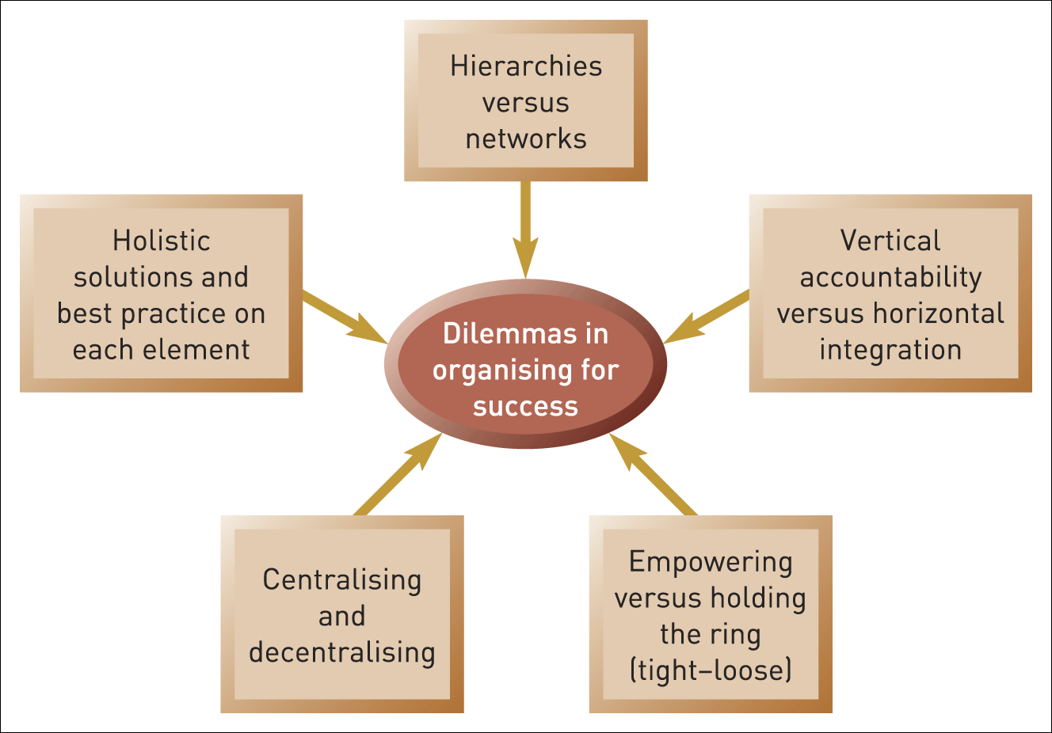
Configuration dilemmas
Figure 13.9 Some dilemmas in organising for success

Slide 31
Summary
Successful organising means responding to the key challenges facing the organisation. This chapter has stressed control, change, knowledge and internationalisation.
There are many structural types (e.g. functional, divisional, matrix, transnational and project). Each type has its own strengths and weaknesses and responds differently to the challenges of control, change, knowledge and internationalisation.
There is a range of different organisational systems to facilitate and control strategy. These focus on either inputs or outputs and can be direct or indirect.
The separate organisational elements, summarised in the McKinsey 7-S framework, should come together to form a coherent reinforcing configuration. But these reinforcing cycles also raise dilemmas that can be managed by subdividing, combining and reorganising.

