Slide 1
Strategy in Action
15: The Practice of Strategy
Notes:
Update slide – 9th edition and new title

Slide 2
Learning outcomes (1)
Identify key people involved in strategising, including top management, strategy consultants, strategic planners and middle managers.
Assess which people should be included in addressing different strategic issues.

Slide 3
Learning outcomes (2)
Evaluate different approaches to strategising, including analysis, issue selling, decision-making structures and communicationg.
Recognise key elements in methodologies used in strategising, including strategy workshops, projects, hypothesis testing and writing business cases and strategic plans.

Slide 4
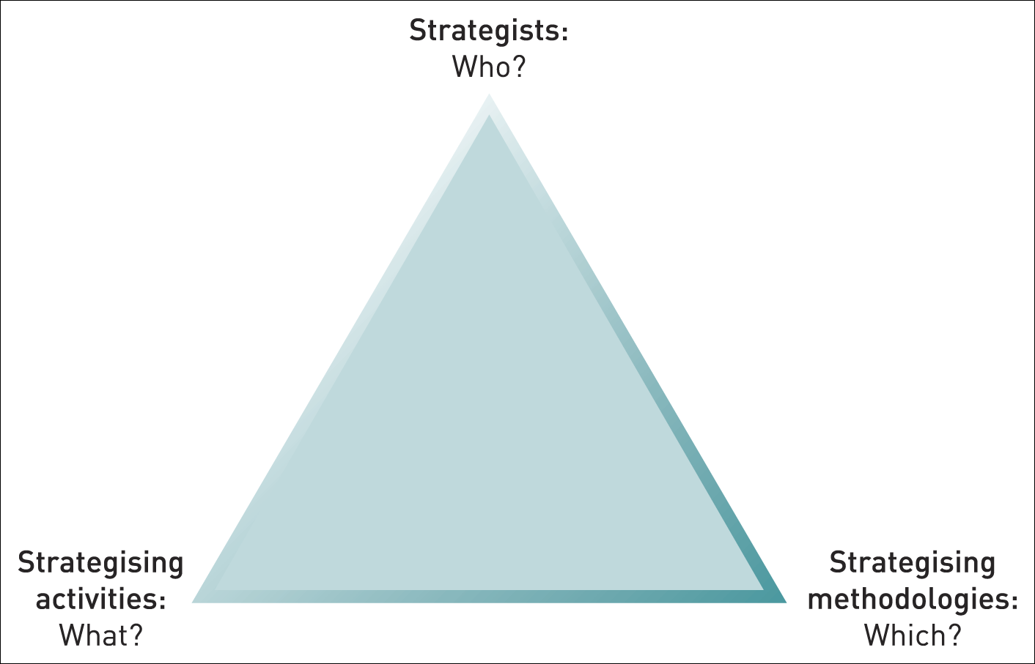
The pyramid of strategy practice
Figure 15.1 The pyramid of strategy practice

Slide 5
The strategists – top managers and directors
Chief Executive Officer
Top management team
Non-executive directors

Slide 6
Strategy skills
Three qualities senior managers need to contribute to high-level strategy-making:
  Mastery of analytical concepts and techniques;
  Social and influencing skills;
  Group acceptance as a player – respect.

Slide 7
The strategists – strategic planners
Strategic planners, sometimes known as strategy directors or corporate development managers are managers with a formal responsibility for co-ordinating the strategy process.

Slide 8
Tasks performed by strategic planners
Information and analysis
Managers of the strategy process
Special projects

Slide 9
The strategists – middle managers
Four roles middle managers have in relation to the management of strategy:
  Information source – knowledge and experience;
  ‘Sense-making’ of strategy – translating strategy into a message that is locally relevant;
  Reinterpretation and adjustment of strategic responses as events unfold;
  Champions of ideas that can be the foundation of new strategies.

Slide 10
Middle managers and strategy
Middle managers increase their influence on strategy when they have:
  Key organisational positions.
  Access to organisational networks.
  Access to the organisation’s ‘strategic conversation’.

Slide 11
The strategists – roles of strategy consultants
Analysing, prioritising,
and generating options
Transferring knowledge
Promoting strategic decisions
Implementing strategic change

Slide 12
Strategy consultants
Three ways to improve outcomes from strategy consulting:
  Professionalise purchasing of consulting services;
  Develop supervisory skills to manage consulting projects;
  Partner effectively – project teams should include a mix of consultants and managers from the client organisation.

Slide 13
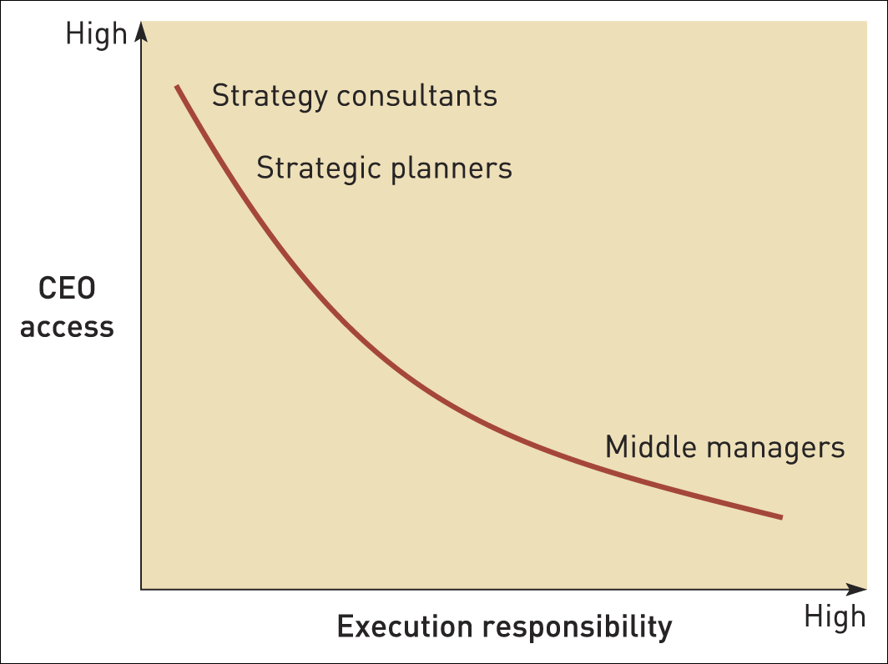
The access/execution paradox
Figure 15.2 The access/execution paradox

Slide 14
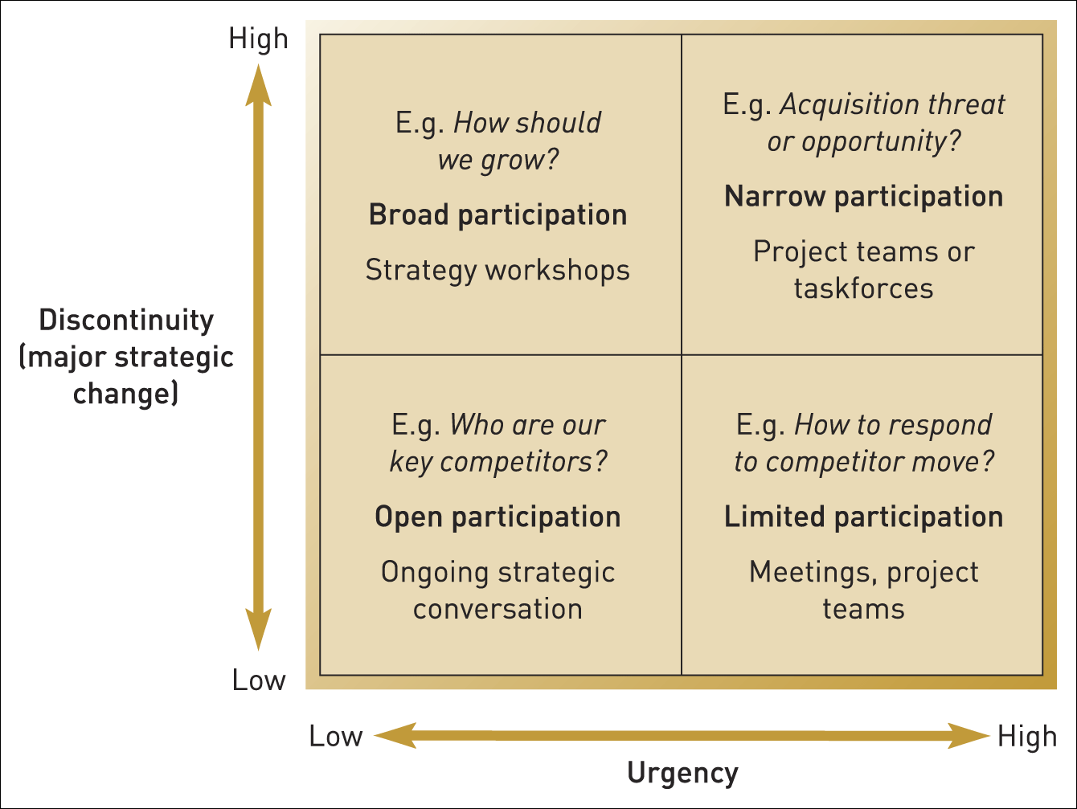
Who to include in strategy making?
Figure 15.3 Who to include in strategy making?

Slide 15
Strategic issue-selling
Strategic issue-selling is the process of gaining the attention and support of top management and other important stakeholders for strategic issues.

Slide 16
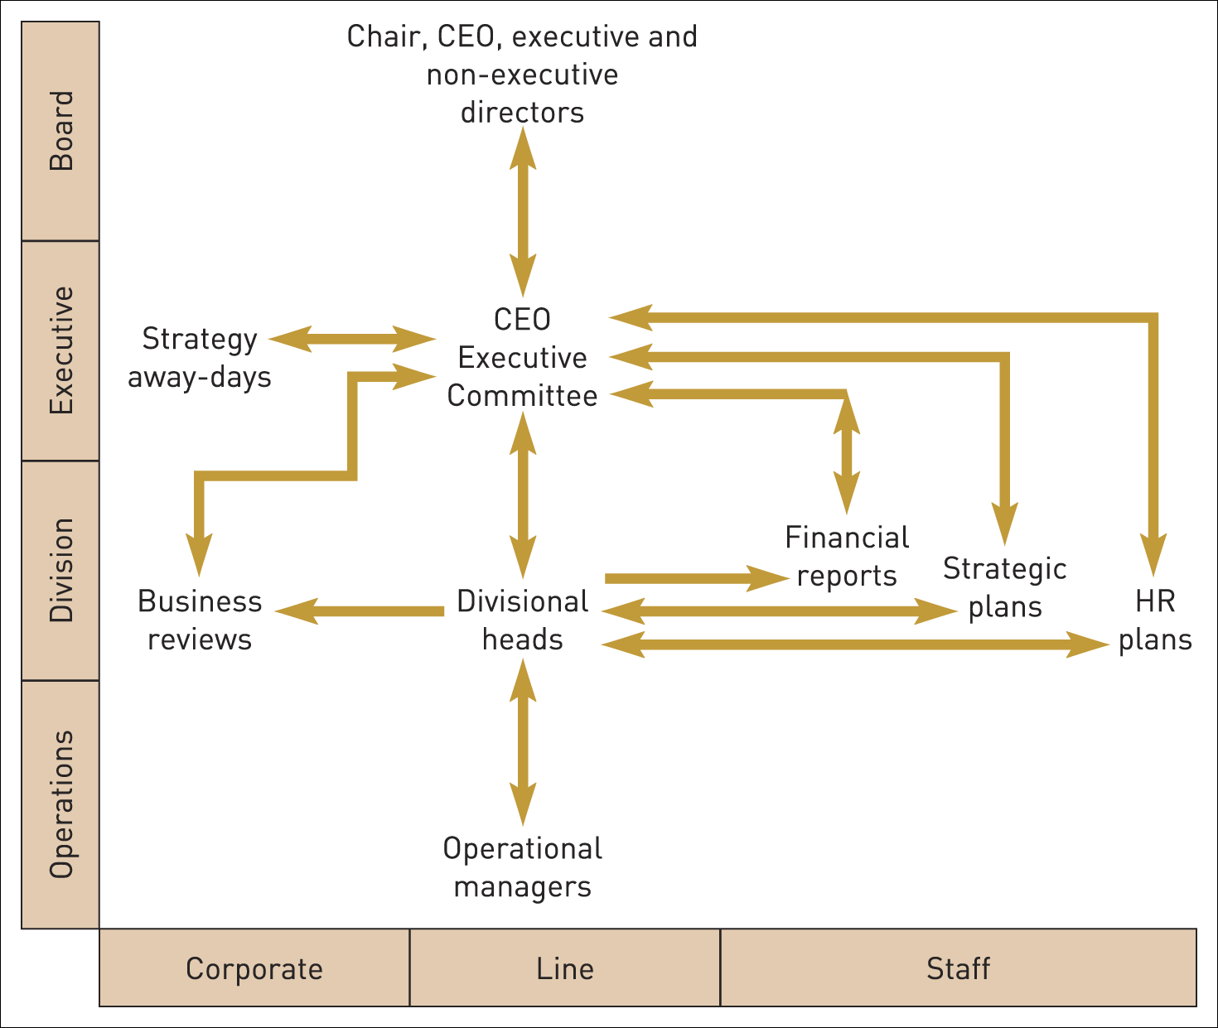
Strategic issue-selling
Figure 15.4 Formal channels for issue-selling
Source: Adapted from W. Ocasio and J. Joseph, ‘An attention-based theory of strategy formulation: linking micro and macro perspectives in strategy processes’, Advances in Strategic Management, vol. 22 (2005), pp. 39–62

Slide 17
Aspects of strategic issue-selling
Issue packaging
Formal or
informal channels
Sell alone
or in coalitions
Timing

Slide 18
Guidelines for strategic decision-making
Build multiple simultaneous alternatives
Track real-time information
Seek the views of trusted advisors
Aim for consensus, but not at any cost (challenge through conflict can be useful)
Harness intuition

Slide 19
Guidelines for developing intuitive capabilities
Recognise the importance of intuition (i.e. ‘open up the closet’)
Don’t mix up your ‘I’s (instinct, insight and intuition)
Elicit good feedback
Get a feel for your batting average – benchmark your intuitions
Use imagery not just words
Play devil’s advocate
Capture and validate your intuitions

Slide 20
Managing conflict
Rulebook – establish clear boundaries, encourage dissent, keep debate professional.
Referees – the leader must be open to differing views and enforce the rules.
Playing field – each side must have a chance to win, there must be a clear basis for resolution.
Gaps to exploit – each group should have a specific objective.
Relationships – individuals must deliver on their commitments and behave with integrity.
Energy levels – Ensure sufficient tension to promote useful debate, but monitor this. Leaders must understand what people care about.
Outcomes – Ensure leader gives bad news without damaging relationships. Ensure dignity in losing and risk-taking is rewarded.
Source: Adapted from S.A. Joni and D. Beyer, ‘How to pick a good fight’, Harvard Business Review, Dec. 2009, 48–57.

Slide 21
Elements of a communications strategy
Focus
Impact
Media
Employee
engagement

Slide 22
Strategy methodologies
Strategy workshops
Strategy projects
Hypothesis testing
Business cases and strategic plans

Slide 23
Strategy workshops
Strategy workshops (or strategy away-days) involve groups of executives working intensively for one or two days, often away from the office, on organisational strategy.

Slide 24
Strategy workshops
Workshops designed to question existing strategy or develop new strategy should:
  Employ strategy concepts and tools.
  Use a specialist facilitator to focus discussion and ensure participants contribute.
  Enjoy the visible support of the workshop sponsor (who may well be the CEO).
  Diminish everyday functional and hierarchical roles – to remove inhibitions and get away from normal routines.

Slide 25
Strategy workshops and action
If workshops are going to lead to effective action then there should be:
an agreed list of actions which are then widely circulated,
project groups established to follow up,
nesting of workshops in a series and
visible commitment by top management to workshop outcomes.

Slide 26
Strategy projects
Strategy projects involve teams of people assigned to work on particular strategic issues over a defined period of time.

Slide 27
Strategy projects – requirements
A clear brief or mandate
Top management commitment
Milestones and reviews
Appropriate resources

Slide 28
Hypothesis testing
Hypothesis testing is a methodology used particularly in strategy projects for setting priorities in investigating issues and options.

Slide 29
Business cases
A business case provides the data and argument in support of a particular strategy proposal, e.g. investment in new equipment.
A business case should:
  Focus on strategic needs.
  Be supported with key data.
  Provide a clear rationale.
  Demonstrate solutions and actions.
  Provide clear progress measures.

Slide 30
Strategic plans
A strategic plan provides the data and argument in support of a strategy for the whole organisation.
A strategic plan has the following elements:
  Mission, goals and objectives statement.
  Environmental analysis.
  Capability analysis.
  Proposed strategy.
  Resources required.
  Required changes in structures, systems and culture.

Slide 31
Summary (1)
The practice of strategy involves choices about
  who to involve in strategy,
  what to do in strategising activity and
  which strategising methodologies to use
Chief executive officers, senior managers, non-executive directors, strategic planners, strategy consultants and middle managers are all involved in strategising. Their degree of appropriate involvement should depend on the nature of strategic issues.

Slide 32
Summary (2)
Strategising activity can involve analysing, issue-selling, decision-making and communicating. Managers should not expect these activities to be fully rational or logical and can valuably appeal to the non-rational characteristics of the people they work with.
Practical methodologies to guide strategising activity include strategy workshops, strategy projects, hypothesis testing and creating business cases and strategic plans.

