Slide 1

LEADING PEOPLE

Slide 2
Module Descriptor
Students will learn about the importance of balancing leadership styles and models to develop teams and support people using coaching and mentoring approaches. They will assess their own leadership style and understand why and how they need to adapt this to different situations. You will understand organisational culture and the impact this has on leadership styles. You will review diversity management and employment law in this field and take actions to create an inclusive work culture. You will study high performance working and how this enhances business performance and develop and support others through coaching and mentoring.

Slide 3
Learning outcomes for today

Slide 4
Assessments

Slide 5


WHY DO WE NEED TO LEAD PEOPLE?

Slide 6
A RECENT MORI POLL IN USA … 70% OF PEOPLE ARE DISENGAGED AT WORK
TRUE IN OTHER COUNTRIES

Slide 7
LEADERSHIP AND MOTIVATION CENTRAL TO MANAGING PEOPLE

Slide 8
What is leadership ?
If I asked you to name some past or current leaders, I’m sure you could come up with a list as long as your arm
Politics
Military
Business
Religion
Sport
UK, USA, Russia, China, Nigeria etc

Slide 9
We suspect that at this point that:
“leadership is the characteristic of all organised human groups” (Bass, 1990, Handbook of Leadership”

Slide 10
SO WHAT IS LEADERSHIP?
It is a A___________ term
Perhaps easily recognised but difficult to define like
PEACE
FREEDOM
LOVE
LIGHT
DEMOCRACY

Slide 11
WHEN SOMETHING IS ABSTRACT, IT INVITES A LOT OF DEBATES
MANY HAVE WRITTEN ABOUT LEADERHIP
HISTORIANS
POLITICAL SCIENTISTS
INDUSTRIALISTS
JOURNALISTS
MANAGEMENT SCHOLARS
PSYCHOLOGISTS
etc

Slide 12

Hodge Podge of ideas

Slide 13
We end up with a “Leadership Safari”

Slide 14
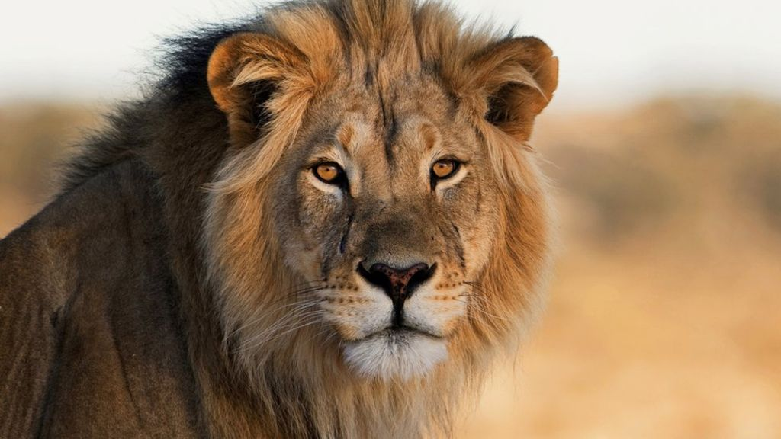

Slide 15
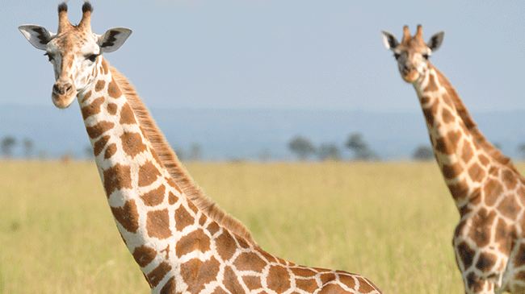

Slide 16
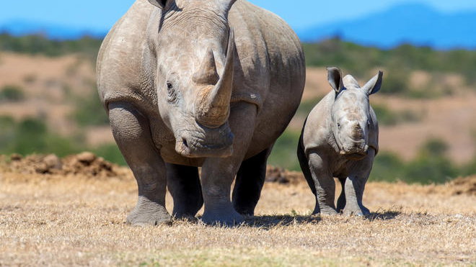

Slide 17
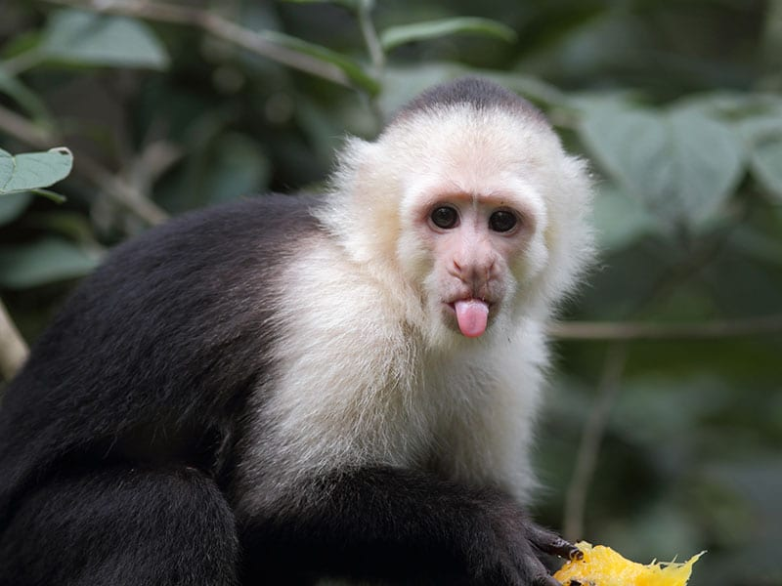

Slide 18
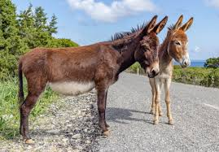
Trump

Slide 19
Since there are so many ideas about leadership, we need a method/basis to sort out them out…. classify them systematically

Slide 20
Video: Hannibal Battle of Cannae 215 BC

Slide 21
What are the reasons for the success of Hannibal?
Make 5 suggestions

Slide 22
Some quotations on leadership

Slide 23
Leadership is the most observed but least understood phenomenon on earth (Burns, 1978)

Slide 24
Stogdill (1948): “leadership may be considered as the process of influencing the activities of an organised group toward goal setting and goal achievement”
Lussier and Achua (2001): Leadership is the influencing process of leaders and followers to achive organisational objective through change”
Yulk (2010): “Leadership is the process of influencing others……..

Slide 25
Influence is a common view

Slide 26
What gives you the capacity to influence others?
P__________

Slide 27
Reward
Coercive
Technical
Position
Referent

Slide 28
Let’s try to classify the diverse ideas on leadership
Video: 10 leadership theories in 5 minutes

