Slide 1

LEADING PEOPLE LECTURE 2

Slide 2
ASSIGNMENT 1
ASSESSMENT
Completion of this work will satisfy the following learning outcomes from
module BMS411:
LO1 Evaluate a range of inclusive leadership styles and models
LO2 Assess the impact of leadership on organisational culture and
diversity management

Slide 3
Task:
“Leadership is about making others better as a result of your presence and making sure that impact lasts in your absence.” — Sheryl Sanberg, COO of Facebook

Slide 4
“I think it’s very important to have a feedback loop, where you’re constantly thinking about what you’ve done and how you could be doing it better. I think that’s the single best piece of advice: constantly think about how you could be doing things better and questioning yourself.” — Elon Musk, founder of PayPal and Tesla
Critically evaluate the above statements and apply these to various leadership styles and approaches that can be seen in today’s corporate world. Use a company of your choice as an exemplar to justify your stand by analysing its organisational culture and diversity policies. Compile your research and findings into a report.

Slide 5
VIDEO
MORNING STAR RADICAL MANAGEMENT

Slide 6
Great Man and Trait Approach
Great Man= Leaders are born (1920s)
Trait= Develops above by identifying personal characteristics of leaders

Slide 7
Alexander the Great on Leadership
I am more afraid of an army of s_________ led by a l___________ than an army of l__________ led by a s_______________

Slide 8
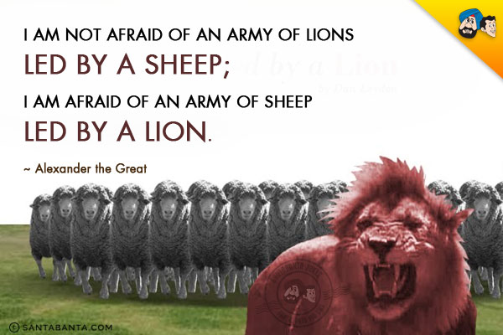

Slide 9
Refer to Battle of Cannae video

Slide 10
PHYSIOLOGICAL
DEMOGRAPHIC
PERSONALITY
INTELLECTIVE
ACHIEVEMENT

Slide 11
TOO MANY EXCEPTIONS TO THE RULE
JUSTIFICATION OF STATUS QUO
SOME TRAITS WOULD BE DIFFICULT TO IDENTIFY IN A PERSON
IGNORES THE NEEDS OF FOLLOWERS
IGNORES CONTEXT

Slide 12
Where do traits come from?
Nature
Nurture

Slide 13
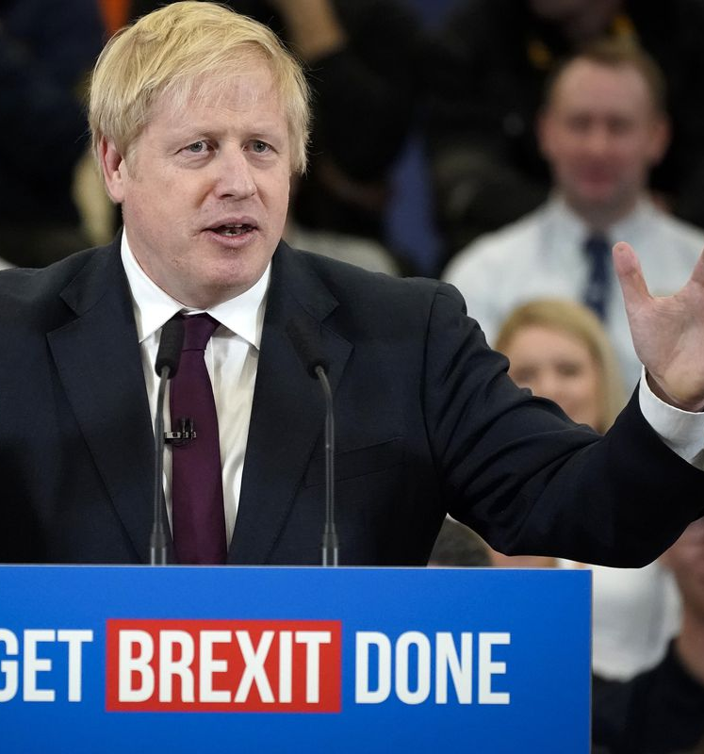
TRAITS?

Slide 15
Discredited for many years but revived in recent years in light of research on emotional intelligence.
Good leaders tend to have the following:

Slide 16
Common traits of leaders
Extraversion The tendency to be sociable and assertive and to have positive energy
Openness The tendency to be informed, creative, insightful, and curious
Agreeableness The tendency to be accepting, conforming, trusting, and nurturing
Conscientiousness The tendency to be thorough, organised, decisive

Slide 17
CONCLUSION:
Trait has some truth in it but not the whole truth!
Some traits could be useful in some circumstances

Slide 18
CASE STUDY
Sandra Coke is vice president for research and development at Great Lakes Foods (GLF), a large snack food company that has approximately 1,000 employees. As a result of a recent reorganization, Sandra must choose the new director of research. The director will report directly to Sandra and will be responsible for developing and testing new products. The research division of GLF employs about 200 people. The choice of directors is important because Sandra is receiving pressure from the president and board of GLF to improve the company’s overall growth and productivity. Sandra has identified three candidates for the position. Each candidate is at the same managerial level. She is having difficulty choosing one of them because each has very strong credentials. Alexa Smith is a long time employee of GLF who started part-time in the mailroom while in high school.

Slide 19
After finishing school, Alexa worked in as many as 10 different positions throughout the company to become manager of new product marketing. Performance reviews of Alexa’s work have repeatedly described her as being very creative and insightful. In her tenure at GLF, Alexa has developed and brought to market four new product lines. Alexa is also known throughout GLF as being very persistent about her work: When she starts a project, she stays with it until it is finished. It is probably this quality that accounts for the success of each of the four new products with which she has been involved. A second candidate for the new position is Kelsey Metts, who has been with GLF for 5 years and is manager of quality control for established products. Kelsey has a reputation of being very bright. Before joining GLF, she received her MBA at Harvard, graduating at the top of her class. People talk about Kelsey as the kind of person who will be president of her own company someday. Kelsey is also very personable. On all her performance reviews, she received extra-high scores on sociability and human relations. There isn’t a supervisor in the company who doesn’t have positive things to say about how comfortable

Slide 20
it is to work with Kelsey. Since joining GLF, Kelsey has been instrumental in bringing two new product lines to market. Thomas Santiago, the third candidate, has been with GLF for 10 years and is often consulted by upper management regarding strategic planning and corporate direction setting. Thomas has been very involved in establishing the vision for GLF and is a company person all the way. He believes in the values of GLF, and actively promotes its mission. The two qualities that stand out above the rest in Thomas’s performance reviews are his honesty and integrity. Employees who have worked under his supervision consistently report that they feel they can trust Thomas to be fair and consistent. Thomas is highly respected at GLF. In his tenure at the company, Thomas has been involved in some capacity with the development of three new product lines. The challenge confronting Sandra is to choose the best person for the newly established director’s position. Because of the pressure she feels from upper management, Sandra knows she must select the best leader for the new position.
Questions 1. Based on the information provided about the trait approach who would you select?

Slide 21
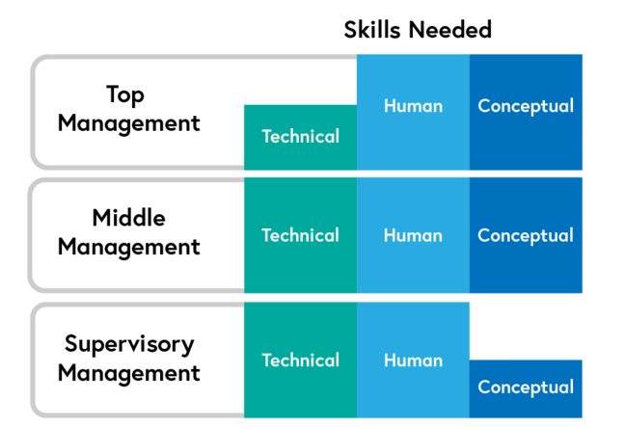
Skills-Based Approach

Slide 22
Technical deals with “things”
Eg Store Manager: good supply chain knowledge
Eg IT manager?
Eg Nurse Ward Manager?

Slide 23
Human concerns “people”
In what way?

Slide 24
Conceptual deals with “ideas”
Eg Big Picture= where is the company going to be next year? 5 years?

Slide 25
In the three-skill approach, effective leadership depends on three basic personal skills: technical, human, and conceptual. Although all three skills are important for leaders, the importance of each skill varies between management levels. At lower management levels, technical and human skills are most important. For middle managers, the three different skills are equally important. At upper management levels, conceptual and human skills are most important, and technical skills become less important. Leaders are more effective when their skills match their management level.
(Northhouse, p.48)

Slide 26
Behavioural School ( also called style)
Certain behaviours are associated with good and poor outcomes

Slide 27
Huneryager and Heckman (1960s):
Four behaviours:
Dictatorial
Autocratic
Democratic
Laissez-faire

Slide 28
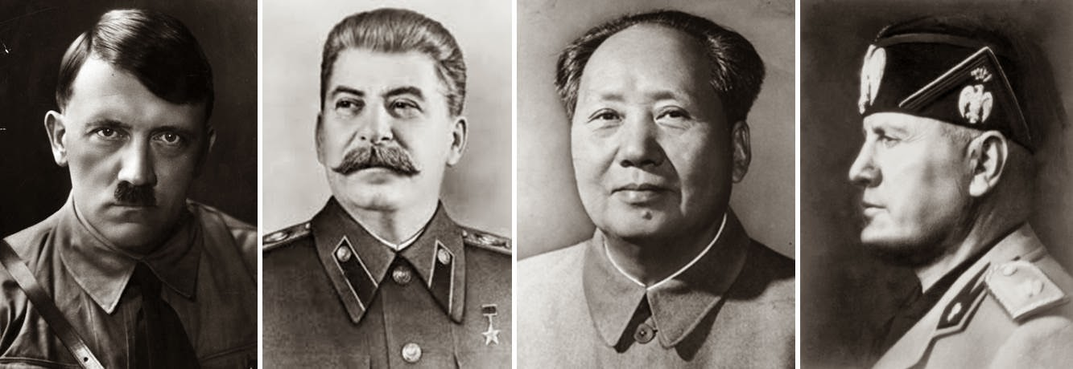

Slide 29
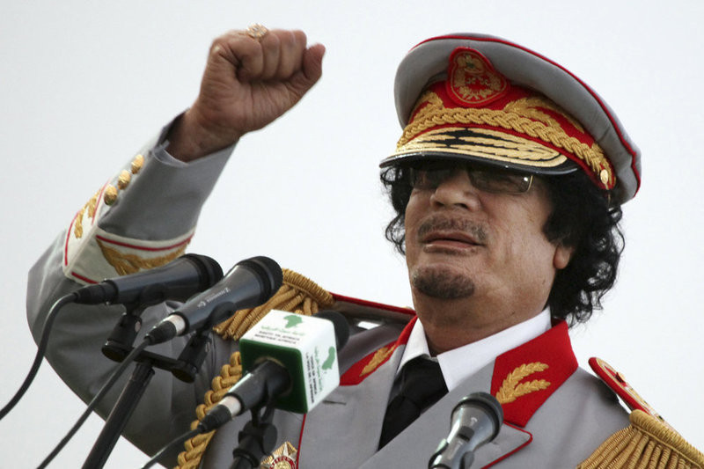

Slide 30
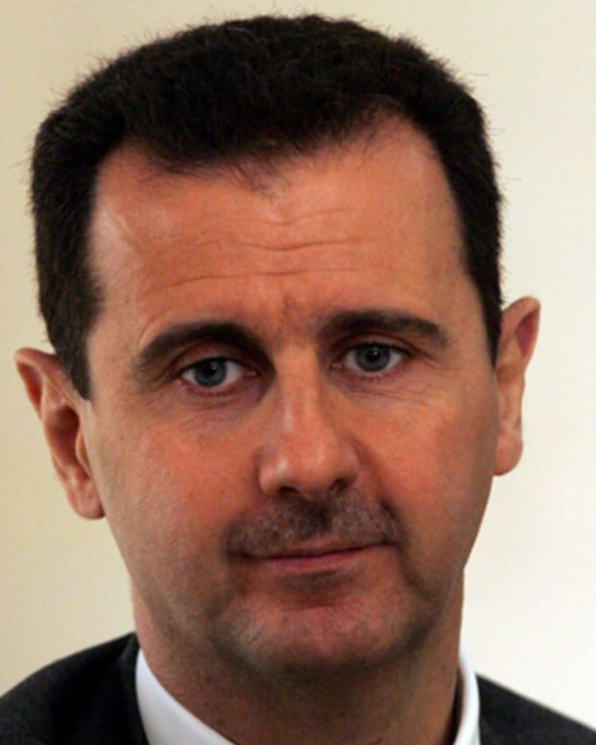

Slide 31
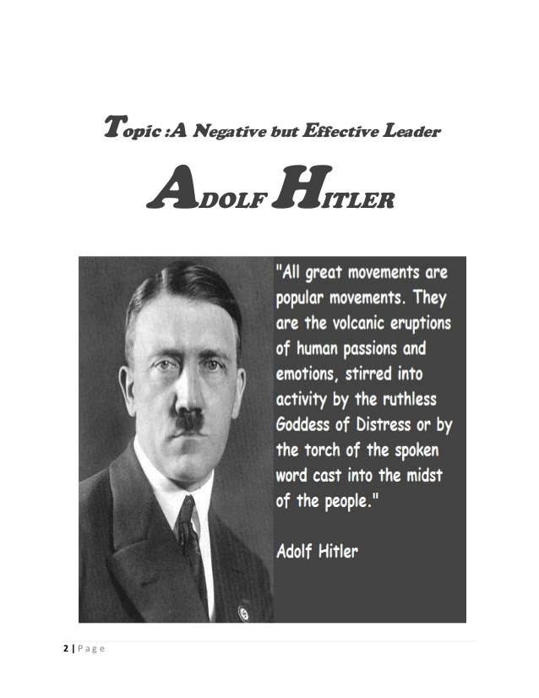

Slide 32
one death is a tragedy a million deaths is a statistic
Stalin

Slide 33
Power grows out of the barrel of a G___________?

Slide 34
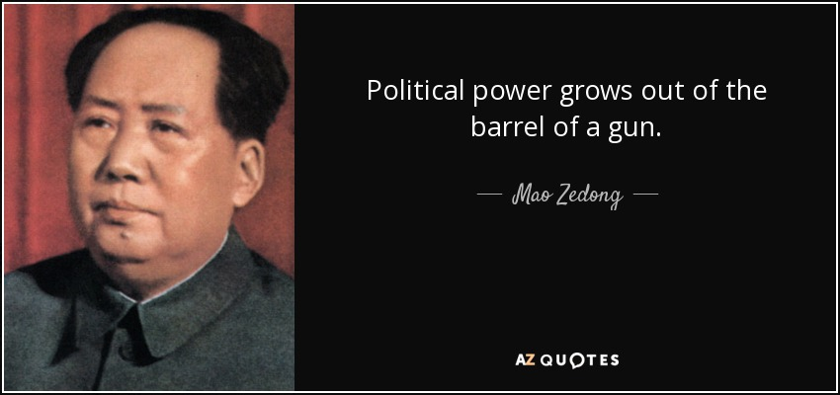

Slide 35
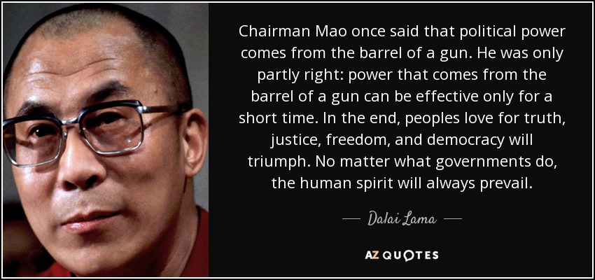

Slide 36
What ancient Greeks called
Dionysian versus the Apollonian tendencies

Slide 37
Dionysian=wild, irrational, undisciplined, emotional etc
Apollonian=rational, ordered, discipline, truth etc

Slide 39
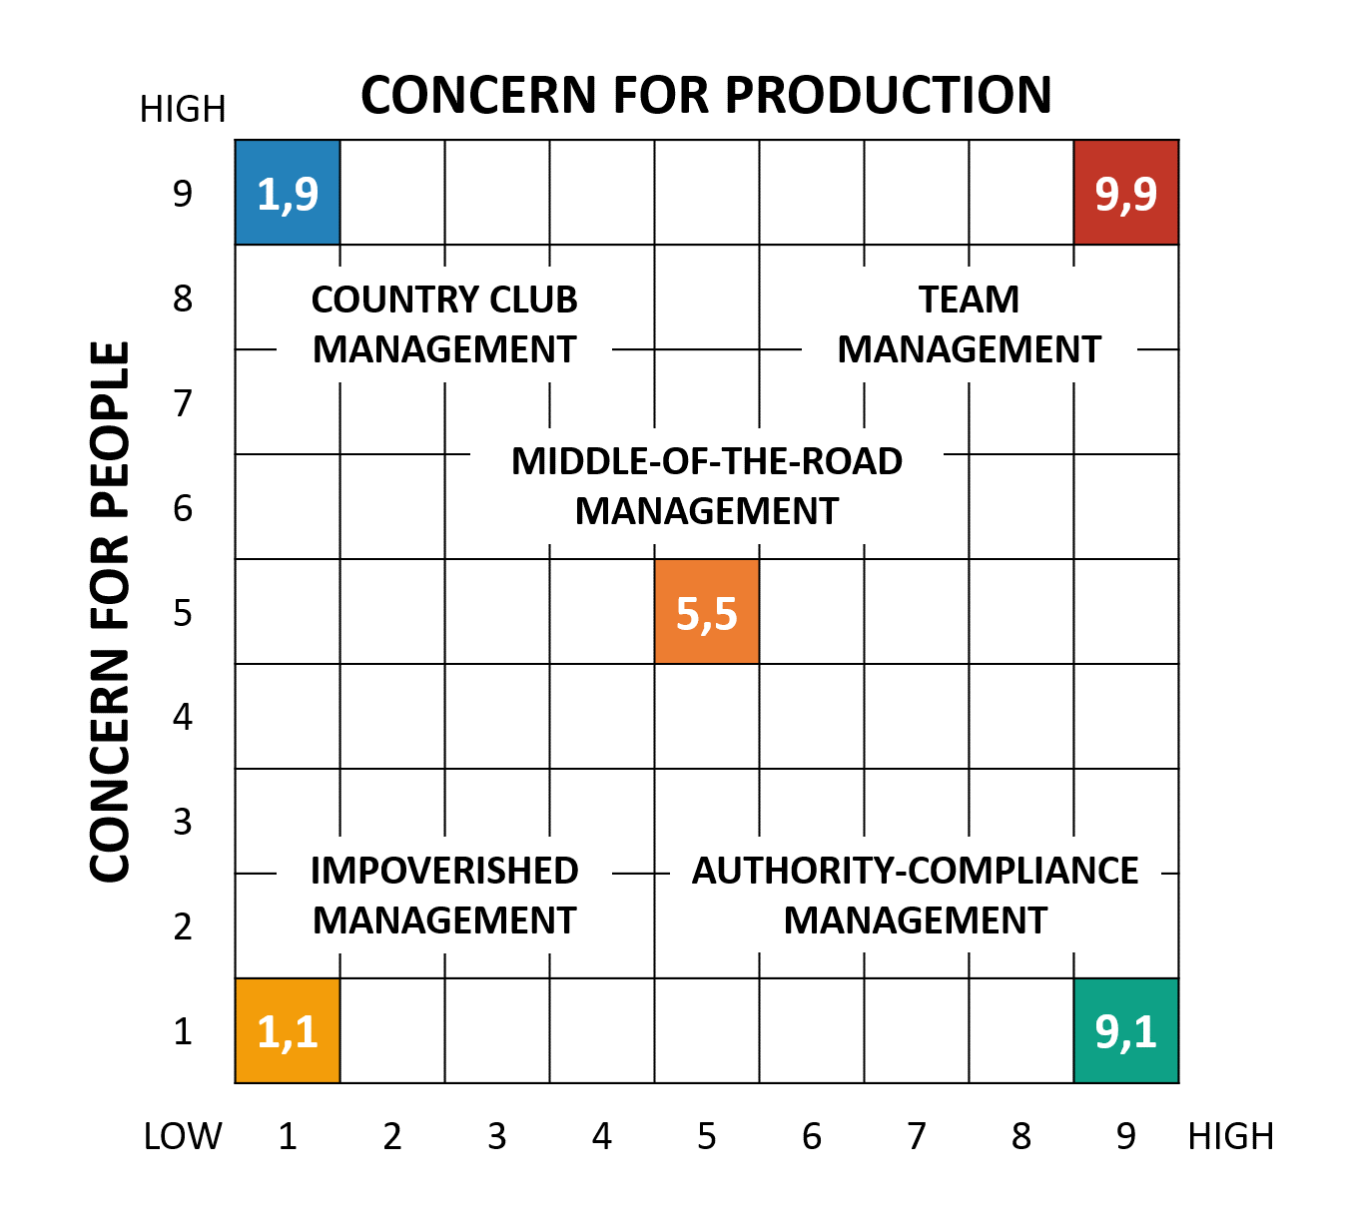
Blake and Mouton

