Slide 1
Lecture 3
Style Theories (continue)

Slide 2
An example may help explain how the style approach works.
Imagine two college classrooms on the first day of class and two professors with entirely different styles.

Slide 3


Slide 4
Professor Smith comes to class, introduces herself, takes attendance, goes over the syllabus, explains the first assignment, and dismisses the class.

Slide 5


Slide 6
Professor Jones comes to class and, after introducing herself and handing out the syllabus, tries to help the students to get to know one another by having each of the students describe a little about themselves, their majors, and their favourite non-academic activities.

Slide 7
Professor Smith =labelled task behaviour,
Professor Jones =relationship behaviour.
Depending on the response of the students to their style, the professors may want to change their behaviour to improve their teaching on the first day of class
Northouse, p.56

Slide 8
What are the theories that might shed more light on their styles?

Slide 9
Huneyager and Heckman (1965)
Blake and Mouton (1966)
McGregor (Theory X and Theory Y, 1960)
Simon Sinek (Golden Circles)
Theory Z (Ouchi)
Tannenbaum and Schimdt
Adair
Ohio and Michigan Studies

Slide 10
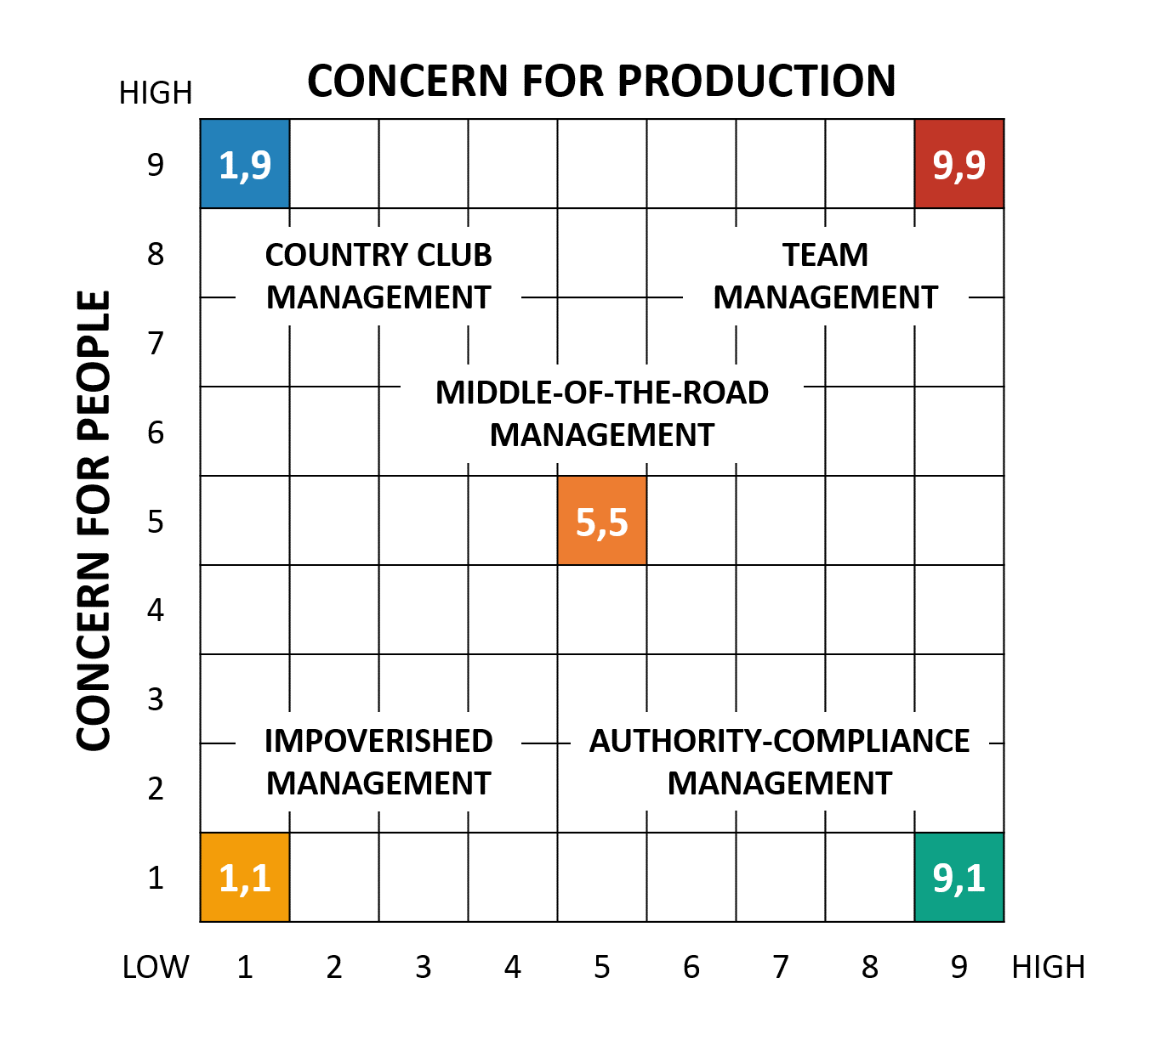
Blake and Mouton

Slide 11
The 1,1 style is representative of a leader who is unconcerned with both the task and interpersonal relationships

Slide 12
The 9,1 style of leadership places heavy emphasis on task and job requirements, and less emphasis on people, except to the extent that people are tools for getting the job done.
Similar to Storey’s Hard HRM

Slide 13
The 5,5 style describes leaders who are compromisers, who have an intermediate concern for the task and an intermediate concern for the people who do the task

Slide 14
The 9,9 style places a strong emphasis on both tasks and interpersonal relationships. It promotes a high degree of participation and teamwork in the organization and satisfies a basic need in employees to be involved and committed to their work

Slide 15
The 1,9 style represents a low concern for task accomplishment coupled with a high concern for interpersonal relationships.

Slide 16
Strengths
The style approach makes several positive contributions to our understanding of the leadership process.
No longer was the focus of leadership on the personal characteristics of leaders but on behaviours
Identified core of leadership processes: Task and Relationship
Can be used for training and development

Slide 17
Weaknesses
First, the research on styles has not adequately shown how leaders’ styles are associated with performance outcomes (Bryman, 1992; Yukl, 1994 in Northouse, p.57)

Slide 18
Secondly, it has failed to find a universal style of leadership that could be effective in almost every situation
Certain situations may require different leadership styles; some may be complex and require high-task behaviour, and others may be simple and require supportive behaviour

Slide 19
Eating Lunch Standing Up
Susan Parks is the part-owner and manager of Marathon Sports, an athletic equipment store that specializes in running shoes and accessories. The store employs about 10 people, most of whom are college students who work part-time during the week and full-time on weekends.
Marathon Sports is the only store of its kind in a college town with a population of 125,000. The annual sales figures for the store have shown 15% growth each year. Susan has a lot invested in the store, and she works very hard to make sure the store continues to maintain its reputation and pattern of growth. She works 50 hours a week at the store, where she wears many hats, including those of buyer, scheduler, trainer, planner, and salesperson. There is never a moment when Susan is not doing something. Rumour has it that she eats her lunch standing up.

Slide 20
Employees’ reactions to Susan are strong and varied. Some people like her style, and others do not. Those who like her style talk about how organized and efficient the store is when she is in charge. Susan makes the tasks and goals for everyone very clear. She keeps everyone busy; when they go home at night, they feel as if they have accomplished something. They like to work for Susan because she knows what she is doing.
Those who do not like her style complain that she is too driven. It seems that her sole purpose for being at the store is to get the job done. She seldom, if ever, takes a break or just hangs out with the staff. These people say Susan is pretty hard to relate to, and as a result it is not much fun working at Marathon Sports. Susan is beginning to sense that employees have a mixed reaction to her leadership style. This bothers her, but she does not know what to do about it. In addition to her work at the store, Susan struggles hard to be a good spouse and mother of three children.

Slide 21
1. According to the style approach, how would you describe Susan’s leadership?
2. Why does her leadership style create such a pronounced reaction from her subordinates?
3. Do you think she should change her style?
4. Would she be effective if she changed?

Slide 22
Mc Gregor: Theory X and Theory Y
X assumes that people are have a natural tendency to avoid responsibility
Y assumes that people welcome and look for responsibility at work

Slide 23


Slide 24
