Slide 1
Mentoring

Slide 2
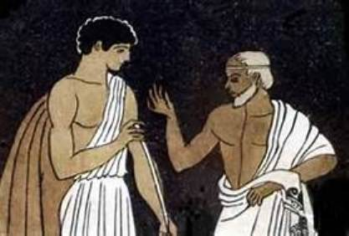

Slide 3
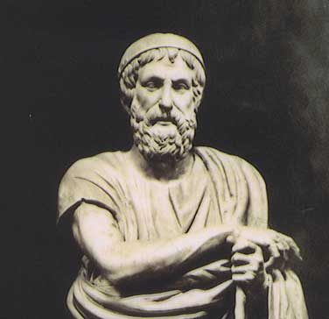
1. A wise and trusted counsellor or teacher.
2. Mentor Greek Mythology Odysseus's trusted counsellor, in whose guise Athena became the guardian and teacher of Telemachus.

Slide 4


Slide 5
What is Mentoring? Mentoring is essentially about helping people to develop more effectively. It is a relationship designed to build confidence and support the mentee so they are able to take control of their own development and work.

Slide 6
Definition
off-line help by one person to another in making significant transactions in knowledge, working or thinking (Clutterbuck & Megginson 1995)
Off-line means an individual who is not the mentee’s direct line manager

Slide 7


Slide 8
When to use Mentoring
• Induction for a new starter.
• Individuals working towards promotion.
• Staff who have changed roles in the department or across the organisation.
• Changes to job roles for example following a restructure.
• Continuous Professional Development (CPD).

Slide 9
What is a Mentor? A mentor is defined in the Oxford Dictionary as an “experienced and trusted adviser”. : • Listen
• Ask questions to help develop your and the mentee’s understanding of a situation or problem
• Provide information and knowledge and share informal networks • Provide advice on career development
• Offer different perspectives
• Provide support and encouragement
• Provide an insight into your work and career
• Offer guidance and advice in regards to qualifications
• Be a sounding board
• Be a critical friend • Encourage self reflection • Help mentees identify areas for development

Slide 10
Example Career Sidelines

Slide 11
Loyalty and Trust Dilemma

Slide 12
Why Mentoring?
It has flexibility – mentoring can happen in so many ways and under lots of different circumstances
• Is an off line activity- it is not a role carried out by the mentee’s line manager
• It relates to work and the job
• It is individual – each relationship will be unique to those two individuals involved
• It provides a feedback system- feedback is central to mentoring and is a great tool to enhance and embed learning
• It is not exclusive – but actually complements other methods of learning

Slide 13
The benefits of Mentoring

Slide 14
For Mentor
Job satisfaction from seeing others develop
• Increased recognition from peers
• Challenge and stimulation
• Satisfaction at the success of the mentee
• Recognition of your mentoring skills
• Motivation from self development and responsibility

Slide 15
Mentee
Increased self confidence and motivation
• Support and challenge in formulating a clear sense of personal direction
• An opportunity to develop skills by observing others
• A source of knowledge and experience to tap into
• A sounding board to discuss ideas and approaches before action is taken
• An opportunity to think about things in a different way

Slide 16
For the Organisation= HIGH PERFORMANCE CULTURE
Increased levels of motivation from those involved
• Employees who have a clear direction and clear objectives
• Improved communication at all levels and across levels
• Sharing of knowledge and experiences and best practice as standard working practice
• Tangible and measurable gains if work tasks and projects are used as a development tool
• Innovation and continuous improvement in the way that employees approach their work

