Slide 1
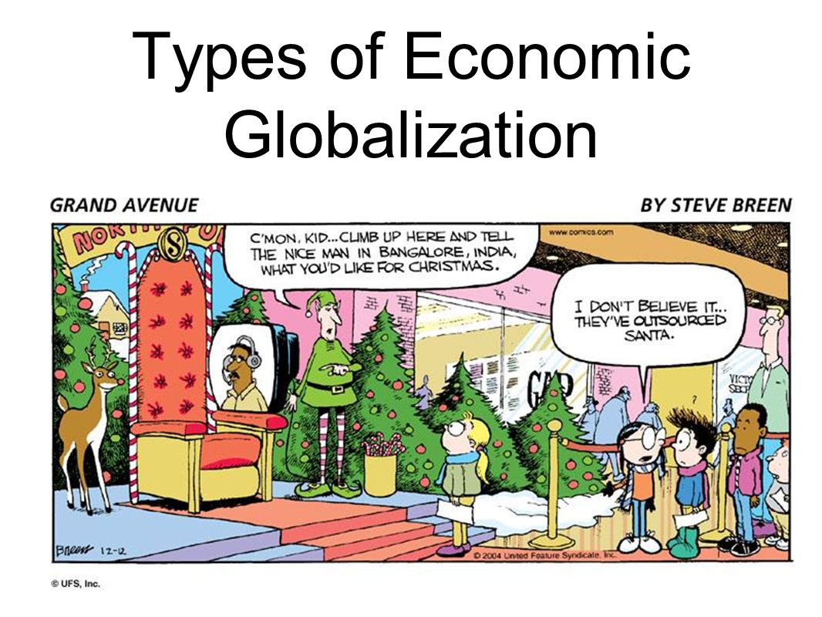
Globalisation

Slide 2
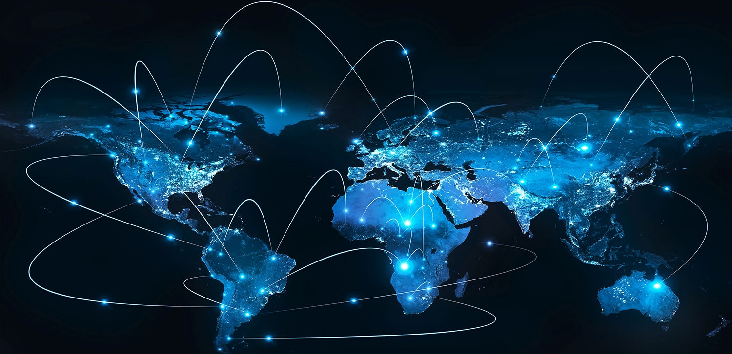
GLOBALISATION
'Globalisation' is commonly used as a shorthand way of describing the spread and connectedness of production, communication and technologies across the world. That spread has involved the interlacing of economic and cultural activity.

Slide 3

Certain new perspectives
Manuel Castells (1996):
A new brand of capitalism that has three fundamental features:
Productivity and competitiveness are, by and large, a function of knowledge generation and information processing;
firms and territories are organised in networks of production, management and distribution;
the core economic activities are global - that is, they have the capacity to work as a unit in real time, or chosen time, on a planetary scale.

Slide 4
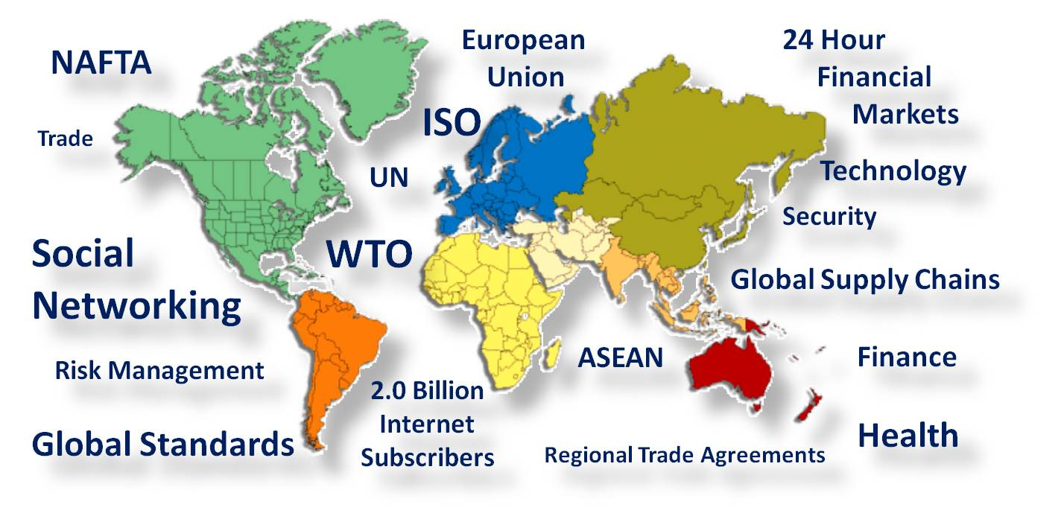
Globalisation and de-localisation:
There has been a significant de-localisation in social and economic exchanges. Activities and relationships have been uprooted from local origins and cultures (Gray 1999: 57).
Increasingly people have to deal with distant systems in order that they may live their lives.
What happens in local neighbourhoods
is increasingly influenced by the
activities of people and systems
operating many miles away.

Slide 5
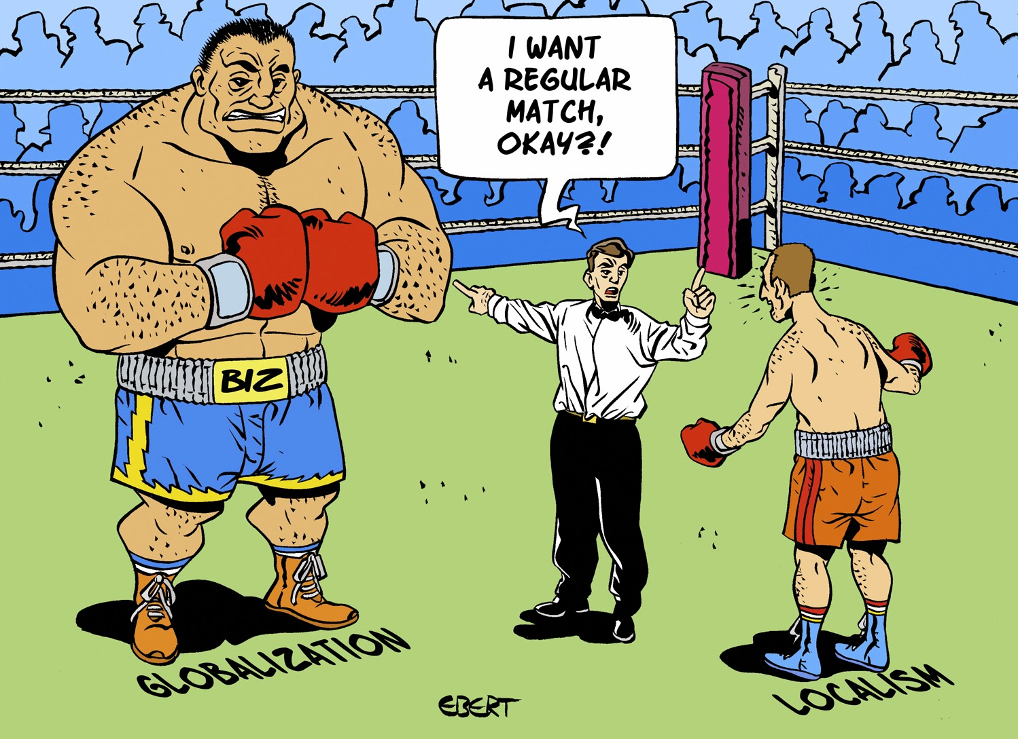
Globalisation and the decline in power of national governments
There has been a decline in the power of national governments to direct and influence their economies
The internationalisation of financial markets,
of technology and of some manufacturing and
services bring with them a new set of
limitations upon the freedom of action of
nation states.

Slide 6


Risk, technological innovation and globalisation
The interaction of extraordinary technological innovation combined with world-wide reach that gives today's change its particular complexion (Hutton and Giddens 2001)
Developments in the life sciences, and in digital technology and the like, have opened up vast, new possibilities for production and exchange.
Innovations like the internet have made it possible to access information and resources across the world - and to coordinate activities in real time.

Slide 7


Globalisation and the knowledge economy
For countries in the vanguard of the world economy, the balance between knowledge and resources has shifted so far towards the former that knowledge has become perhaps the most important factor determining the standard of living - more than land, than tools, than labour. Today's most technologically advanced economies are truly knowledge-based. (World Bank 1998)
Economists have been challenged to look beyond labour and capital as the central factors of production.
There is already a gaping divide between rich and poor nations - and this appears to be accelerating under 'knowledge capitalism'.

Slide 8
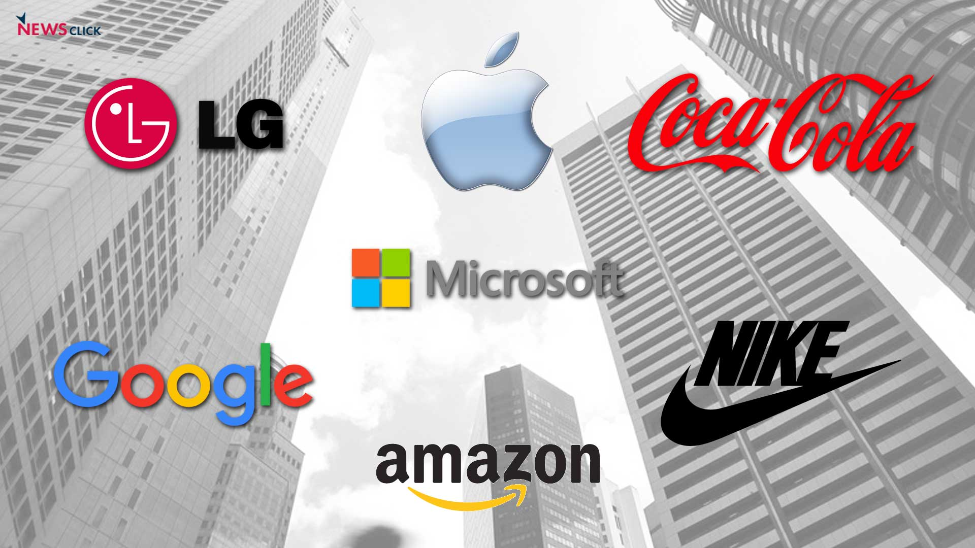
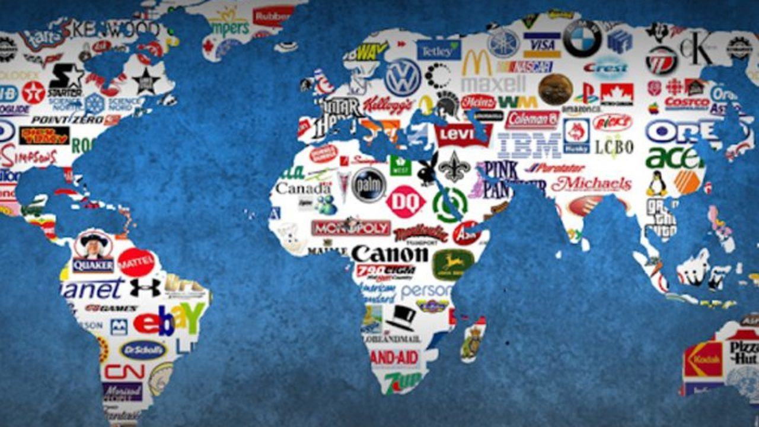
Globalisation and the rise of multinational corporations and branding
A further, crucial aspect of globalisation is the nature and power of multinational corporations. Such companies now account for over 33 per cent of world output, and 66 per cent of world trade
While full globalisation in this organisational sense may not have occurred on a large scale,
these large multinational
corporations still have
considerable economic and cultural
power

Slide 9

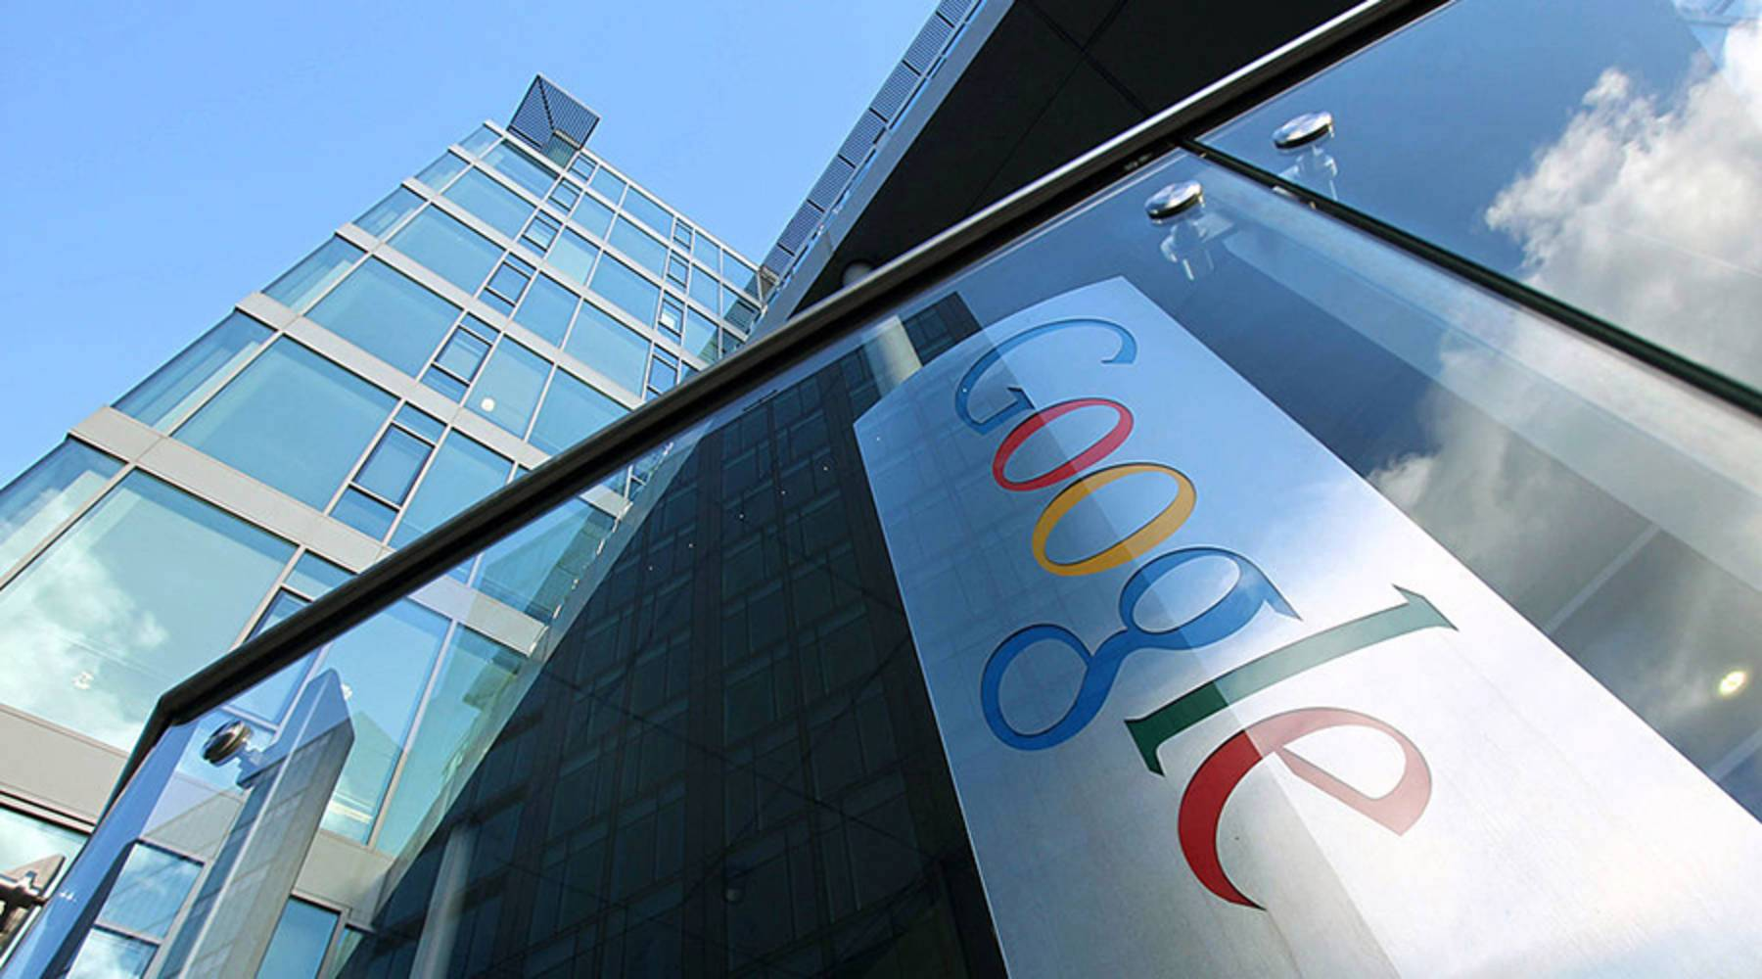
They look to establish or contract operations (production, service and sales) in countries and regions where they can exploit cheaper labour and resources
Can also mean large scale unemployment in those communities where those industries were previously located.
The wages paid in the new settings can be minimal, and worker's rights and conditions poor (survey of special economic zones in China showed that manufacturers for companies like Ralph Lauren, Adidas and Nike were paying as little as 13 cents per hour)

Slide 10
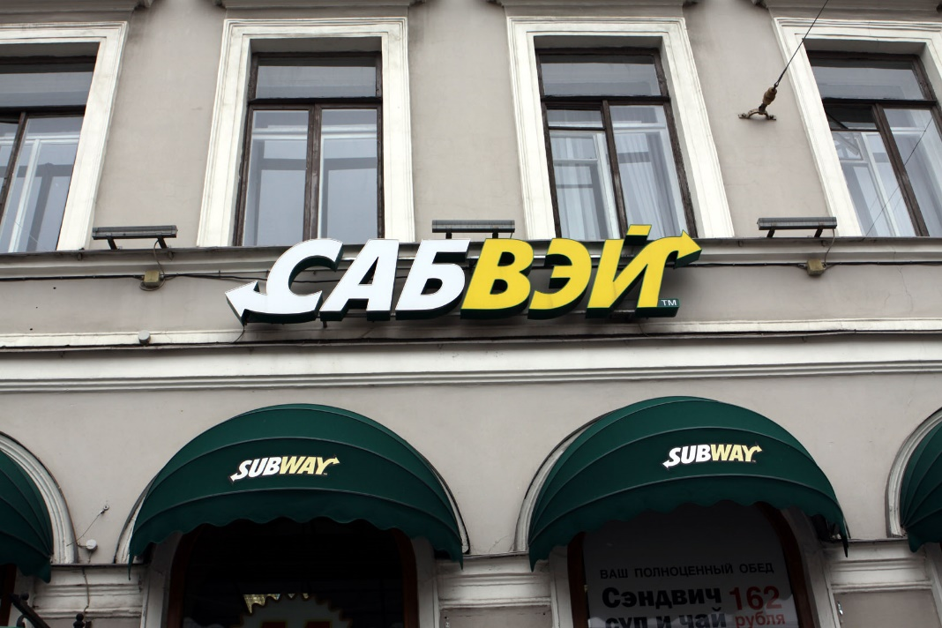
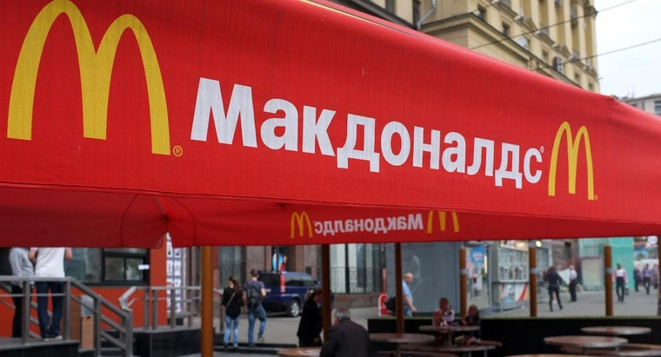
Multinationals constantly seek out new or under-exploited markets (often by trying to create new needs among different target groups)
The erosion of public space by corporate activities (privatised, commercialised activity)
Multinational companies can also have significant influence with regard to policy formation in many national governments and in transnational bodies

Slide 11


Naomi Klein (2001: 196) has suggested, 'brand builders are the new primary producers in our so-called knowledge economy‘
One strategy is to try and establish particular brands as an integral part of the way people understand, or would like to see, themselves
The focus on brand rather than the
inherent qualities of the product
as well as advantaging
multinationals in terms of market
development also has an Achilles heel

Slide 12
