Slide 1


Slide 2

International Business
An Introduction

Slide 3
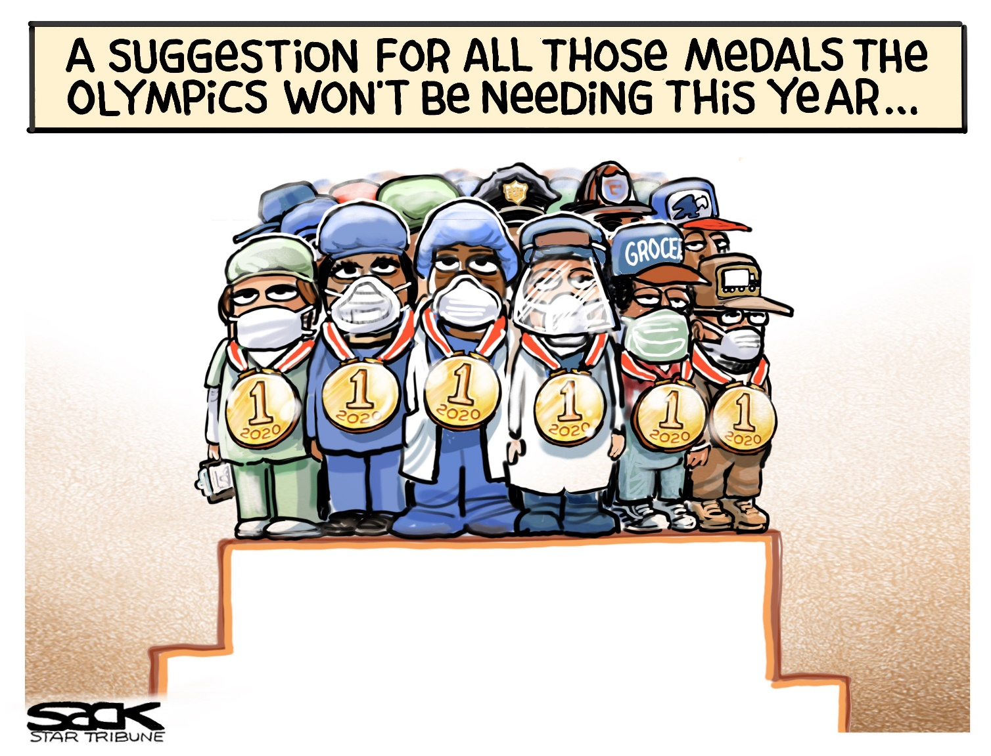
Question 1:
Why do businesses go overseas?

Slide 4
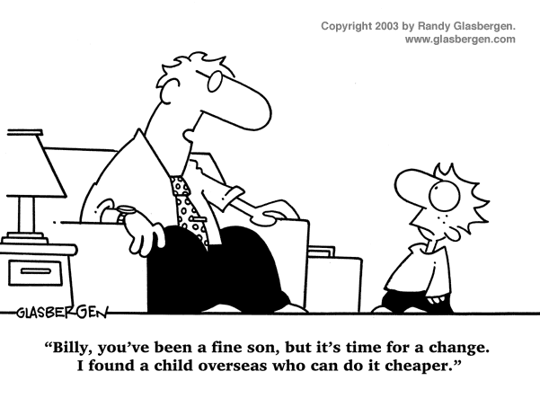

Slide 5

Question 2:
How do businesses go overseas?
What are the entry methods adopted by businesses to go to overseas markets?

Slide 6
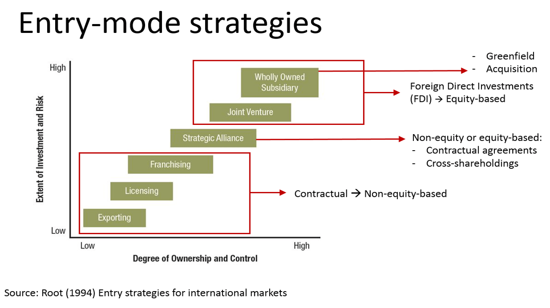
Entry Methods
Exporting
Licensing/Franchising
Joint Ventures
Mergers & Acquisitions (M & A)
Start-up Operation

Slide 7

Question 3:
How do businesses decide which overseas market to enter?
What is the criteria they use to decide which market to target?

Slide 8
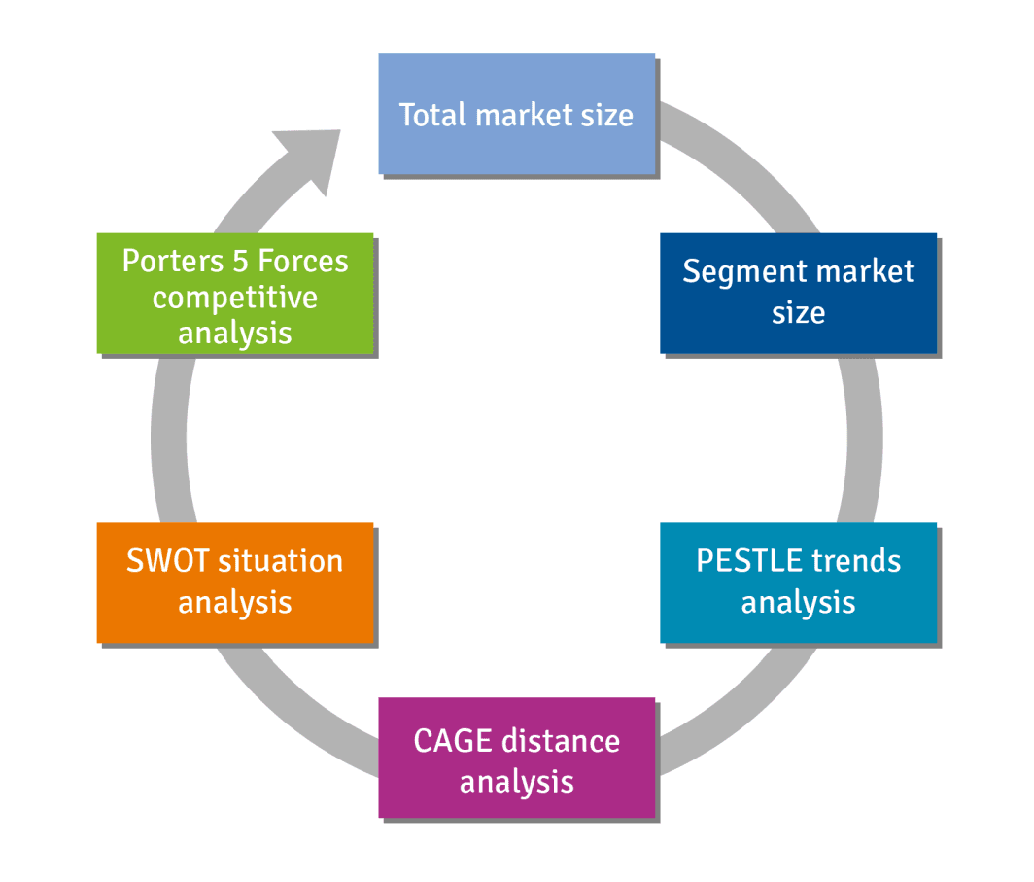
Criteria for selection
Political Factors
Economic Factors
Socio-Cultural Factors
Technological Factors
Legal Factors
Environmental Factors

Slide 9
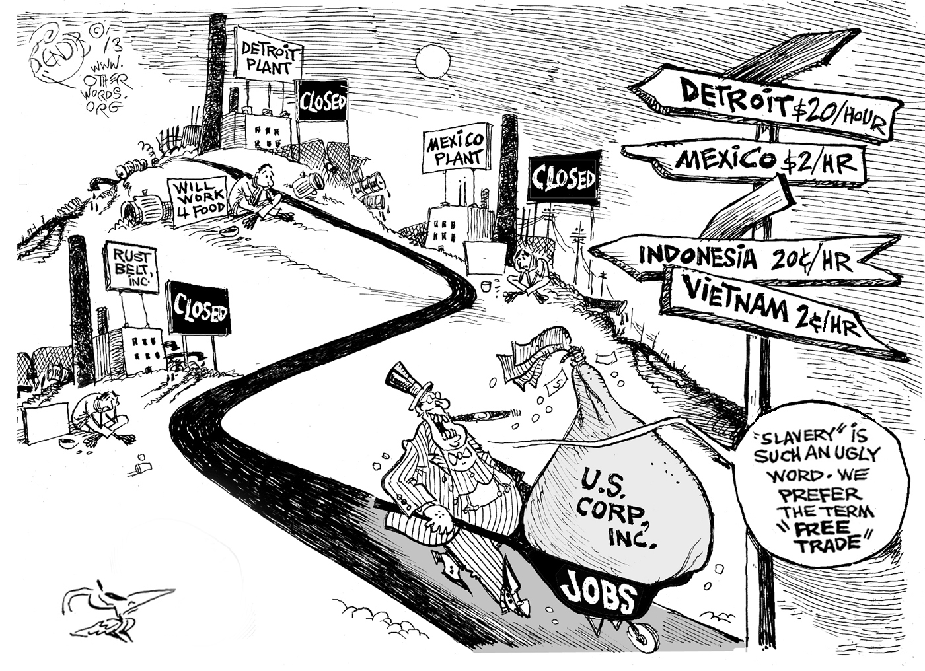

Slide 10
