Slide 1


Contemporary Social Issues in UK Healthcare Sector
Week 2
(LSC London)
FdSc Supporting Innovation in
Health and Social Care
Level 4

Slide 2

Module lecturer-Tayo Alebiosu
Health and Social Care
Contact me: tayo.alebiosu@lsclondon.co.uk

Slide 3
Recap of last session
Students :
Explored the definition of contemporary issues
Discussed varieties of contemporary issues impacting health and social care in the 21st century
Used Covid 19 and Brexit as issues impacting health and social care in the 21st century

Slide 4
Contemporary issues affecting the UK healthcare sector
There are two major contemporary issues affecting the UK healthcare sector in the 21st namely;
Covid 19
Brexit

Slide 5

Assessment guide
Open the assessment guide in word document

Slide 6
Learning outcomes of today’s lesson-(Week two)
Discuss the impacts of Brexit and the end of the transition period on health care systems in the UK.
Explain the impacts of Brexit on the health and care system’s international workforce
Describe the impacts of Brexit on Supply of medicines and medical devices
EU-analysis of the impact on NHS finances of the UK leaving the European Union

Slide 7
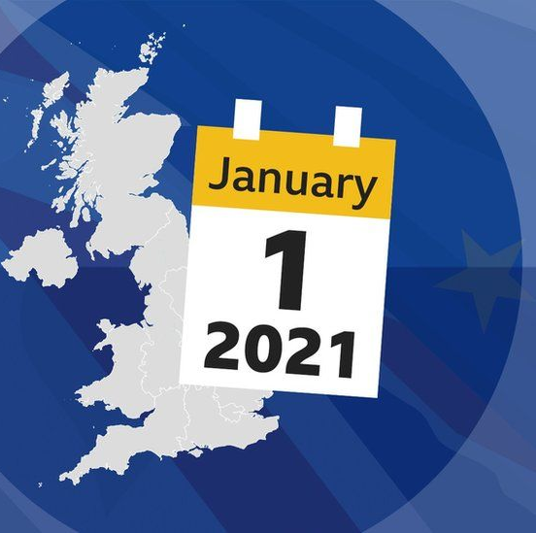
What is Brexit?
Brexit refers to the withdrawal of the United Kingdom from the European Union and the European Atomic Energy Community at the end of 31 January 2020

Slide 8

Brexit and the end of the transition period: what does it mean for the health and care system?
A Review of Brexit and post Brexit agenda.
Created by Tayo Alebiosu

Slide 9

(10 minutes)
Individually, research the UK-EU withdrawal agreement and its implication on UK health system.
Feedback by explaining your findings

Slide 10

Withdrawal Agreement
The Withdrawal Agreement saw the UK formally leave the EU on 31 January 2020 and begin an 11-month transition period. During this time the UK adhered to EU rules and remained a member of the single market and customs union, while negotiating a new long-term trading relationship with the EU.
Accordingly, a new EU-UK trade and co-operation deal was agreed on Christmas Eve 2020, to take effect from 1 January 2021
While the new agreement provides some welcome certainty, effectively removing the prospect of an immediate ‘no-deal’ cliff edge, it does introduce a wide range of changes that will have implications for health and care organisations, the public, and manufacturers of medicines and medical devices as well as the scientific research community, both now and in years to come.

Slide 11

Border system
Now that the UK is outside the EU’s customs union, new checks, customs declarations and paperwork will be needed to import and export goods to and from the EEA.
To prepare for this change the UK government developed a new Border Operating Model in 2020. From 1 January 2021, it will be implemented in three stages, which include an initial six-month window to complete declarations and pay VAT. From 1 July 2021 traders will have to make declarations at the point of entry.
The Border Operating Model is not yet fully implemented, and the risk of supply-chain disruption remains. However, the UK government remains confident that any future disruption to the supply of medicine will be temporary.
This, however, depends on the new border operating systems between Great Britain and EEA nations operating effectively, particularly at either side of the short strait crossing between Dover and Calais as three-quarters of medicine imported to the UK enters via that route.

Slide 12

LO1-Actvity 15 mins
Identify the impacts of Brexit on NHS from this Video Presentation;
https://youtu.be/EnJ9Xo4Axcg.
Feedback To The class.

Slide 13
Impact of Brexit on UK healthcare
Workforce and immigration
The NHS and the social care sector would not be able to function without their international workforce.
In the short term, the current workforce shortfall in the NHS is so severe that it will require at least 5,000 more nurses a year to be recruited from overseas while measures to increase domestic training capacity take effect.
The government recognises that international recruitment is key to increasing NHS staff headcount and has committed to recruiting an additional 12,000 nurses from overseas by 2024/25.
(Brexit and the end of the transition period, 2021)

Slide 14

LO2 Activity -10 mins
Class Discussion
Explain the impacts of Brexit on the health and care system’s international workforce

Slide 15

Immigration: the health and care system’s international workforce
Leaving the EU’s single market means that there will no longer be free movement of labour between the UK and European Economic Area (EEA) countries.
As it stands, 13.1 per cent of staff working in the NHS have a non-British nationality – 5.6 per cent are from EEA countries and 7.5 per cent are from non-EEA countries. In adult social care 16 per cent of the workforce is non-British – 7 per cent are from EEA countries and 9 per cent are from non-EEA countries.
In the short term, the current workforce shortfall in the NHS is so severe that it will require at least 5,000 more nurses a year to be recruited from overseas while measures to increase domestic training capacity take effect. The government recognises that international recruitment is key to increasing NHS staff headcount and has committed to recruiting an additional 12,000 nurses from overseas by 2024/25.

Slide 16


10 minutes break

Slide 17
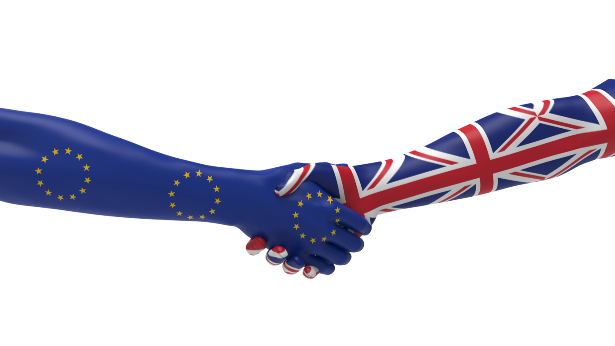
Mutual recognition of professional qualifications
The Mutual Recognition of Professional Qualifications Directive is an EU-wide directive that allows professional regulators in all member states to automatically recognise professional qualifications gained in other member states and grants entry to all relevant professional registers, including medical and social work registers.
Implications
With current transitional arrangements set to remain in place, little will change for UK-based employers until new arrangements are decided and implemented in 2023. This uncertainty may hinder the government’s efforts to attract more international staff to work in health and care.
The greater change is for those with health and care professional qualifications gained in the UK. They will no longer be automatically accepted on EEA states’ professional registers and therefore will face new barriers to taking up roles in those nations. Arrangements and processes for those with UK qualifications being accepted onto professional registers will differ between member states.
Brexit and the end of the transition period, 2021)

Slide 18

Reciprocal health care
EEA citizens are entitled to a European Health Insurance Card (EHIC) that provides them with access to medically necessary, state-provided health care during a temporary stay in any EEA country. While under current EU rules, people who move from one EEA country to live in another are given access to health care on the same basis as nationals of that country.
Implications
The arrangements for access to health care for people who move from the UK to live in an EEA state, or for EEA nationals who move to the UK, will differ between each member state. In many cases it is likely that additional requirements and bureaucracy, such as providing proof of residency, will be in place for UK citizens resident in the EEA.
(Brexit and the end of the transition period, 2021)

Slide 19
Supply of medicines and medical devices
The United Kingdom is a net importer of medicines and medical devices from the EEA.
Implications
In principle the key change for traders of medical products is that, from 1 January 2021, manufacturers will need to get a licence from the MHRA rather than the EMA to sell a medicine or medical device in the United Kingdom.
The government and the MHRA have prepared guidance to explain what manufacturers must do to register and market their products in Great Britain and how the requirements differ in Northern Ireland..
(Brexit and the end of the transition period, 2021)

Slide 20

Supply of medicines and medical devices
The United Kingdom is a net importer of medicines and medical devices from the EEA.
Implications
In principle the key change for traders of medical products is that, from 1 January 2021, manufacturers will need to get a licence from the MHRA rather than the EMA to sell a medicine or medical device in the United Kingdom.
The government and the MHRA have prepared guidance to explain what manufacturers must do to register and market their products
in Great Britain and how the requirements differ in Northern Ireland..
(Brexit and the end of the transition period, 2021)

Slide 21
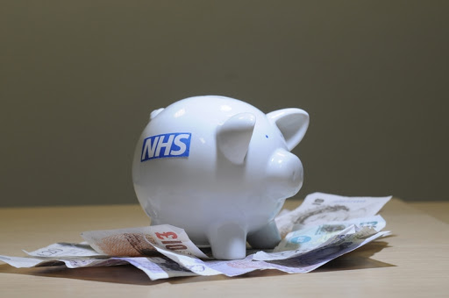
NHS finances outside the EU: Analysis of the impact on NHS finances of the UK leaving the European Union
The NHS in England is already facing its worst ever financial challenge, following an unprecedented squeeze on funding for health and social care. At the end of the last financial year, health care providers reported a £2.5bn deficit, as 65% struggled to balance their books.
Factors including an ageing population and an increase in prevalence of chronic conditions mean that funding pressures are set to rise by around 4% a year over the next decade.
The Health Foundation projects that the NHS will face a funding shortfall of at least £16bn by 2030/31, even before considering the impact of leaving the EU.
This pose significant risks to NHS funding.
(NHS finances outside the EU | The Health Foundation, 2021)

Slide 22

UK leaving the EU what it mean for funding of the NHS in England
Leading economists are almost unanimous in concluding that leaving the EU will have a negative effect on the UK economy, which in turn will impact on public spending. This report concludes that it is difficult to see how the NHS can escape the consequences.
The NHS budget could be £2.8bn lower than currently planned in 2019/20, if the government aims to balance the books overall. In the longer term, the NHS funding shortfall could be at least £19bn by 2030/31– equivalent to £365m a week – assuming the UK is able to join the European Economic Area. If this is not the case, the shortfall will potentially be as high as £28bn – which is £540m a week.
(NHS finances outside the EU | The Health Foundation, 2021).

Slide 23

Cont.….
There has been much discussion of additional funding for the NHS as a result of the UK leaving the EU.
The Health Foundation’s analysis finds that if economic growth slows as predicted, funding no longer being paid to the EU would be more than cancelled out by the negative economic consequences of leaving.
Therefore if the NHS were to receive an extra £100m a week from 2019/20, this would require: increased taxation of around 1p on the rate of income tax; adding £5.2bn to the expected public finance deficit; or making further cuts to other areas of public spending.
(NHS finances outside the EU | The Health Foundation, 2021)

Slide 24

Assessment guide
Open the assessment guide in word document

Slide 25

Reference The King's Fund. 2021. Brexit And The End Of The Transition Period. [online] Available at: <https://www.kingsfund.org.uk/publications/articles/brexit-end-of-transition-period-impact-health-care-system> [Accessed 21 January 2021]. The Health Foundation. 2021. COVID-19: Five Dimensions Of Impact | The Health Foundation. [online] Available at: <https://www.health.org.uk/news-and-comment/blogs/covid-19-five-dimensions-of-impact> [Accessed 21 January 2021]. https://www.kingsfund.org.uk/publications/articles/brexit-end-of-transition-period-impact-health-care-system#people. The Health Foundation. 2021. NHS finances outside the EU | The Health Foundation. [online] Available at: <https://www.health.org.uk/publications/nhs-finances-outside-the-eu> [Accessed 29 January 2021].

