Slide 1

Contemporary Issues (Week 3)
(LSC London)
FdSc Supporting Innovation in
Health and Social Care
Level 4

Slide 2

Module lecturer-Tayo Alebiosu
Health and Social Care
Contact me: tayo.alebiosu@lsclondon.co.uk

Slide 3
Today’s topic: Big issues in Health and Social Care
Aim:
To explore the Big issues in Health and social Care .

Slide 4
Learning outcomes
At end of this session, students will be able to ;
1
1-Identify four Big issues in Health and Social Care .
2
2-Explain the impacts of Covid 19 on Health and Social Care in UK.
3

Slide 5
Lo1 Activity. Individual Research -15 mins.
Conduct an individual Research by ;
1-Identifying Big issues in health and social care

Slide 6

The Nation’s Health
A healthy population is one of the nation’s most important assets. It is valuable in its own right and also creates value for society. It allows people to participate in family life, the community and the workplace.
Long-term improvements in life expectancy and mortality in the UK have stalled and are falling behind other high-income countries.
At the same time the difference between the health of people living in the best- and worst-off communities is widening.
Action is needed across the whole of government to address these trends.

Slide 7
Social Determinants of Health
https://youtu.be/_11xLlwKgWc
Individually/ working in pairs with extracts from the video clip,
Identify the inequalities which exist between the health of people living in the best- and- worst-off communities in the UK.
Feedback to the class

Slide 8
The Nation’s Health – Cont…
Investment needs to be directed towards areas of public spending that create the right conditions for people to lead healthy lives.
Stronger measures are needed to ensure that government is held to account for the health of the population. This should include adopting a legislative framework, along the lines of the Welsh Wellbeing of Future Generations Act to encourage long-term action across government to promote good health.
It should also include establishing an independent body to track and analyse trends in mortality and morbidity.

Slide 9
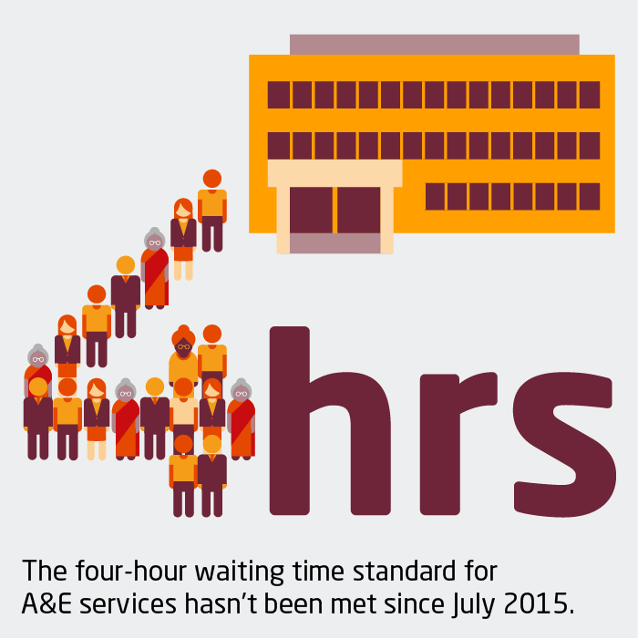
NHS performance and waiting times
Essential parts of the NHS in England are experiencing the worst performance against waiting times targets since the targets were set.
This includes the highest proportion of people waiting more than four hours in A&E departments since 2004, and the highest proportion of people waiting over 18 weeks for non-urgent (but essential) hospital treatment since 2008.
The target for treating cancer patients within 62 days of urgent GP referral has not been met for over 5 years, and survey evidence suggests more people are experiencing lengthening delays in getting GP appointments.

Slide 10

NHS performance and waiting times (Cont.…)
Longer waits are a symptom of more people needing treatment than the NHS has the capacity to deliver. This reflects a decade of much lower-than-average funding growth for the NHS and workforce shortages, coupled with growing and changing population health needs.
These pressures are exacerbated by cuts to social care and public health budgets, which make it harder to keep people healthy outside hospitals.

Slide 11

Health and social care funding
UK health spending has grown by 1.6% a year over the last 4 years. This is much less than half the historical average growth rate.
Compared to similar countries, the UK’s day-to-day spending on health is around average, but capital investment is notably low.
In England, the strategy for the NHS – the NHS long term plan – is underpinned by a funding settlement up to 2023/24, with average annual increases of 3.3% a year, starting this year.
But this is against a backdrop of significant hospital deficits, a maintenance backlog and workforce shortages – all flowing from previous inadequate investment.

Slide 12

Health and social care funding cont.…
The funding settlement doesn’t cover the full budget for the NHS in England. Budgets for workforce education and training, public health and capital continue to have neither a plan nor long-term funding.
Without further investment in these areas, quality and access to care are at risk of deteriorating further. As things stand, the total health budget will increase by just 2.9% a year to 2023/24.

Slide 13

Health and Social Care Workforce
The number of people employed by NHS providers in England this decade has grown at just half the rate of the 2000s, despite growing need. As a result, the NHS reports a workforce shortage of around 100,000 staff. The issues in social care are even greater and the outlook is concerning. Workforce shortages stand at around 122,000, with a quarter of staff on a zero-hours contract.
Our projections, with the King’s Fund and the Nuffield Trust, suggest that without concerted policy action and dedicated investment, NHS shortages could grow to up to 200,000 by 2023/24, and at least 250,000 by 2030. Nursing remains the key area of shortage (of over 40,000) – and this could double by 2023/24 and grow to over 100,000 by 2028/29.

Slide 14
Health and social care workforce (Cont.…)
One consequence of the failure to train and retain staff is that the UK is heavily reliant on international recruitment. This needs to continue at least 5,000 nurses sourced from abroad a year need to be recruited until 2023/24 to reduce shortages.
In 2017/18, the latest data available, just 1,600 nurses from overseas joined English NHS trusts. We do know how many overseas nurses are registered in the UK and therefore potentially available to work in the NHS. There are 33,000 EEA nurses on the register. In 2018/19, 3,400 more nurses came to the UK from outside the EU than in 2017/18. This follows an 85% fall in the number coming to the UK from the EU in recent years.

Slide 15

Health and social are workforce (Cont.…)
The social care sector employs a quarter of a million people from beyond the UK. Some areas of the country are particularly reliant; 40% of social care staff in London are from overseas. International recruitment is vitally important for social care and a restrictive immigration policy will make this harder.
As a major employer, typically providing better pay, terms and conditions, and career progression than social care can afford, the NHS has a significant impact on the social care workforce. More must be done to support social care – for instance, matching pay increases in the NHS would cost £1.7bn by 2023/24.

Slide 16

LO2 Activity – Class discussion (10 mins)
Explain the impacts of Covid 19 on Health and social care section in UK.

Slide 17
What does 'coronavirus' mean?
Coronavirus disease (COVID-19) is an infectious disease caused by a newly discovered coronavirus. Most people infected with the COVID-19 virus will experience mild to moderate respiratory illness and recover without requiring special treatment.
The main symptoms of coronavirus (COVID-19) are a high temperature, a new, continuous cough and a loss or change to your sense of smell or taste.

Slide 18
A sector poorly prepared for the pandemic.
The COVID-19 pandemic has taken a grim toll on social care in England. In terms of preparation, we heard that the years of underfunding had left the sector without the equipment and estates necessary to manage the crisis.
For instance, we heard that many care homes had insufficient space to safely isolate people who had caught COVID-19 and contain the spread. Local supplies of personal protective equipment (PPE) were low, or non-existent in some places as late as the end of March 2020, which left many care workers exposed to the virus.
In workshops with care managers, commissioners and managers as part of our COVID-19 work, we were told on many occasions that social care felt like it was not a priority, guidance was initially inaccurate and late, and support for funding insufficient and slow to arrive.

Slide 19
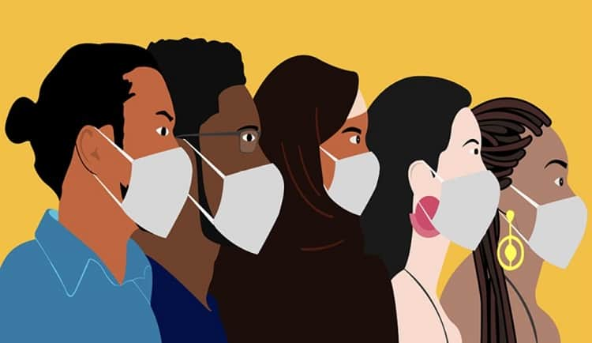
Inequalities Exposed
The crisis also had the impact of exposing the deep levels of inequalities which exist in society, with evidence telling us that Black, Asian and minority ethnic (BAME) communities, adults with learning disabilities, and those on the lowest incomes, have been disproportionately affected.
As we reset and rebuild social care, it is vital that we proactively tackle historic inequalities and injustices, whilst ensuring that the new models of care that are nurtured and developed as a result of the reforms are equally relevant, accessible and vital to all groups.

Slide 20
A fragmented and disconnected sector
The social care system is complex and fragmented, with care being provided by around 18,500 organisations working in 39,000 locations across England.
Whilst seen as a strength, the diversity of the sector provided, in some cases, a hindrance in terms of coordinating a response. Good practice being developed in one part of the care sector is difficult to share easily with another part.
Data on care home residents, workers and supplies was often incomplete or difficult to pull together.
In our interviews and surveys with commissioners, social workers, care home managers and care workers to inform our COVID-19 work, we heard a common theme that the sector was very fragmented, and that data wasn’t joined up.
Many of those we engaged told us that the scale and complexity of the sector posed significant practical and logistical challenges in organising effective responses.
For example:, in ensuring that providers have access to sufficient PPE, coordinating safe hospital discharges, and testing staff and residents in a timely manner.

Slide 21

Delayed local response
During the first few weeks of the pandemic, people who use services and carers told us that they often felt very isolated and frightened.
Whilst some local authorities were good at contacting people quickly, in other areas people didn’t hear from their key workers for many days. Information on websites about, for instance direct payments, was often slow to be updated.
Although many local authorities were praised for the support they gave to providers, others were criticised for being slow and inflexible, for instance, not passing on funding quickly to struggling providers.

Slide 22

Low morale amongst workers
We heard from contributors that we face a growing emergency about the morale of staff working in social care.
Despite many in the workforce showing immense resilience overall, morale is low in adult social care, and care staff have felt undervalued compared with their healthcare counterparts.
This has also played out in practical terms, for example, in care workers not having priority access when shopping for their clients.
We were told about registered managers of adult social care services suffering from burn out and extreme anxiety.

Slide 23

Low morale amongst workers
Access to high-quality and trauma-informed support to managers and frontline staff to help them recover was seen as essential in the future.
In our engagement with our social workers, commissioners and care workers for Department of Health and Social Care-funded work on COVID-19, we were consistently told that many felt isolated and experienced very low morale during the first period of the pandemic.
In response, SCIE, along with other sector bodies like Skills for Care, established national forums and ‘meetup’ meetings which proved hugely popular, and we call on national bodies to continue putting on such groups.

Slide 24
Reference List
The Health Foundation. 2021. Top line facts on the big issues in health and social care | The Health Foundation. [online] Available at: <https://www.health.org.uk/news-and-comment/newsletter-features/top-line-facts-on-the-big-issues-in-health-and-social-care> [Accessed 3 February 2021].
providers, C., (COVID-19), C., COVID-19, B., care, F. and impacts, N., 2021. Beyond COVID-19: Negative impacts of COVID-19 on social care. [online] Social Care Institute for Excellence (SCIE). Available at: <https://www.scie.org.uk/care-providers/coronavirus-covid-19/beyond/adult-social-care/negative-impacts> [Accessed 5 February 2021].

Slide 25
Assessment Details
Prepare Presentation slides and Presentation Notes
Maximum 10 PowerPoint slides
AND
1500 words Presentation Notes
Weighting % of final mark: 100%

Slide 26

Assessment Details
Maximum 10 PowerPoint Slides + 1500 words Presentation Notes 100%
Tasks to be completed –
Choose a specific area within the area of health and social care that aligns with your career interests.
Explore a variety of contemporary issues (focus on the 21st century) within that specified area that are currently being discussed by practitioners and writers.
Pick a specific perspective within that framework and evaluate its impact on care delivery.
Based on your analysis, put forward recommendations as to how the chosen issue can be implemented in such a way that it achieves the most appropriate results possible and yet minimises disruptions to services provided.

Slide 27
Assessment Details (Cont.….)
You are required to do the following:
Create a maximum 10 power point slides with key points of the summary of the findings.
Prepare 1500 words presentation notes by elaborating and supporting the key points that you are emphasising in your power point slides.
Submit both in a single file (either in Word or PDF)
Online submission will take place on Turnitin

Slide 28
How to complete this task
Create a maximum 10 power point slides with key points of the summary of the findings.
Prepare 1500 words presentation notes by elaborating and supporting the key points that you are emphasising in your power point slides.
Submit both in a single file (either in Word or PDF)
Online submission will take place on Turnitin

Slide 29
ASSESSMENT SUBMISSION
Date assignment set | 04/01/2021
Submission deadline date | 29/03/2021
Return date to students | 26/04/2021
All assignment will be submitted in electronic format and uploaded to LSC Portal on Turnitin

