Slide 1
LECTURE: 6
INTELLECTUAL PROPERTY

Slide 2
Intellectual Property : An Overview
Intellectual property in an intangible property which is usually resulted from a Mental effort or creativity.
Simply put, it is any product of someone's intellect that has commercial value
Intellectual property rights are protected by both statutory and common law.
The Patent Office in the UK is responsible for the administrative processes regarding these rights
Intellectual property may be disposed if by its owner through sale, will or gift.

Slide 3
Intellectual Property : An Overview
Owners are entitled to take legal action against infringement of their rights by third parties
Intellectual property rights are heavily influenced by EC Law and international treaties:
Intellectual property rights include:
  Patents
  Copyrights
  Trademarks
  Designs
    The Design Right
    Registered Designs

Slide 4
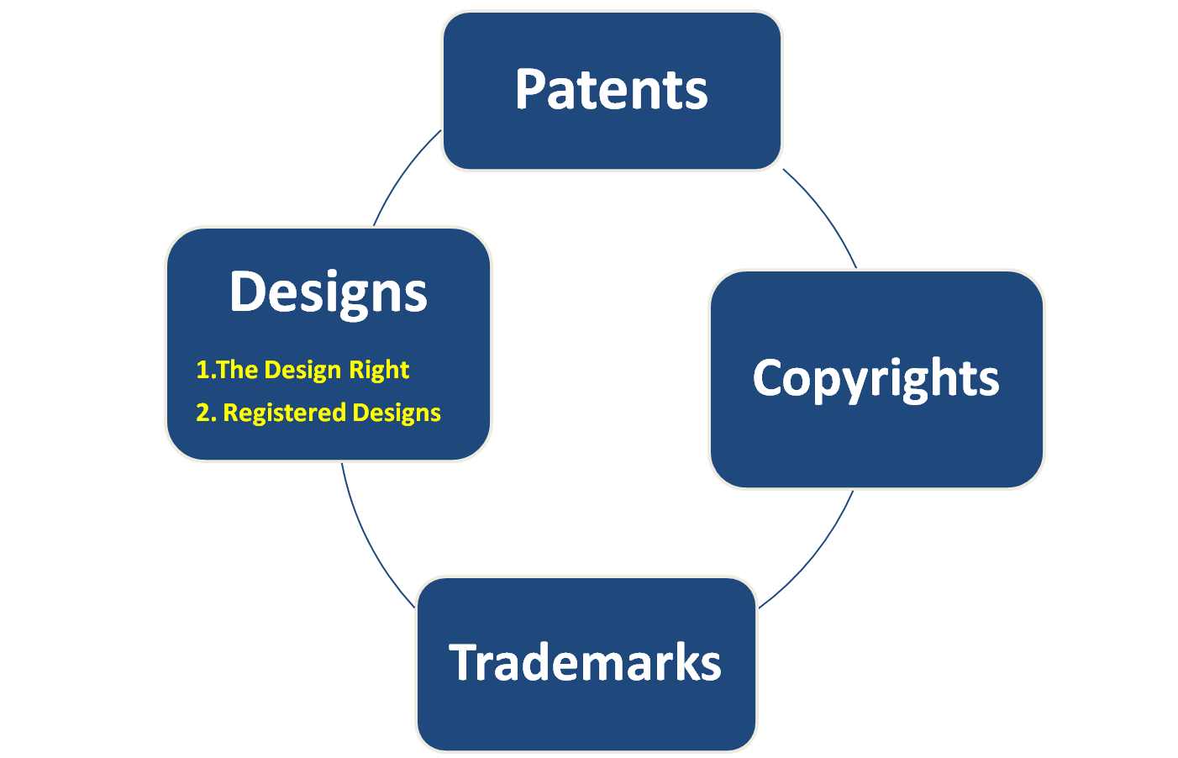
Intellectual Property Rights

Slide 5
Copyright
Copyright is regulated by the Copyright, Designs and Patents Act 1988 (CDPA 1988).
Protects work of authors and creative persons.
Only tangible writings are subject to copyright registration and protection.
  E.g., books, periodicals, newspapers, lectures, musical compositions, movies, radio and TV productions, maps, paintings, sculpture, photos, cartoons, MP3 files.

Slide 6
Scope of Copyright
The scope of copyright is very wide and includes:
  Original literary, dramatic, musical and artistic works
  Sound recordings, films, TV and radio broadcasts and cable programmes
  Typographical arrangements of published works

Slide 7
Acquisition of copyrights
No formal process exists
Copyright is automatically acquired provided that the qualification criteria laid down in the CDPA 1988 are fulfilled
A work will attract copyright if there is connection between it and the UK
Copyright also applies to works created or published in other countries to which the Act applies

Slide 8
The Duration of copyrights
The duration of the copyrights period depends on the type of work:
Literary, dramatic, musical or artistic works enjoy copyright for 70 years from the end of the calendar in which the author dies
Films are protected for 70 years from the end of the of the calendar year in which the last of the following die – director, writer, musical composer.
Sound recordings lasts 50 years from the end of the calendar year in which they were released

Slide 9
Crown Copyrights
Copyright for the work created by the civil servants and other Crown employees belong to the Crown and lasts for up to 125 years

Slide 10
Ownership of Copyrights
The creator of the relevant work is also generally the owner of the copyright
Copyright in any work created by an employee in the course of employment belongs to the employer (even if done in their spare time if relevant to the employee’s job)

Slide 11
Licensing
The copyright owner, or a collecting organisation may grant permission to do something which would otherwise be an infringement
Licensee may be required to pay royalties for this privilege for example, a business wanting to use background music on disc or tape should apply to the Performing Rights society for a license

Slide 12
Copyrights and Internet Users
Copyright is still applicable to download or reproduction of materials found on a website
Internet service providers may also be infringing copyright if they are unable to show that reasonable steps are being taken to monitor the contents of the website they facilitate.

Slide 13
Copyright Infringement
Occurs when a party copies a substantial and material part of the plaintiff’s copyrighted work without permission.
Successful plaintiff may recover:
  Profit
  Damages
  Order requiring impoundment and destruction
  Injunction

Slide 14
Designs
Design rights attaches automatically to any sufficiently original design, giving similar protection to copyright.
It is governed by the Part III of the CPDA 1988
The registered owner obtains a monopoly on the design similar to a patent.
The designs comes under the following 2 major classifications:
  The design right
  Registered designs

Slide 15
The Design Right
The author of a design acquires copyright of that design but only subjected to protection against infringements of the copy (wrongful copying and publications)
The right does not exist unless and until it has been recorded in a design document, or an article has been made to the design.
Like the law of copyright, it does not protect ideas.
The right lasts for a maximum of 15 years from the end of the year when the design was created in tangible form.
The person who creates the design is first owner provided that the design was not created in the course of employment or in carrying out a commission.

Slide 16
Registered Designs
Designs are implemented under the Registered Designs Act 1949 (RDA 1949) as amended by Registered Designs Regulations 2001, Registered Designs (Amendment) Rules 2001 and the Registered Designs (Fees) Amendment Rules (2001).
The amending legislation was necessary to implement the EC Directive (98/71/EC) which aims to harmonise registration requirements across the EC, in order to eradicate differences which may adversely affect trade.
Design registration takes for up to 5 years, this may be renewed for up to a further 5 years on application.
The owner of a registered design has the exclusive rights of commercial exploitation of the design

Slide 17
Registered Designs
The rights arising from a registered design relate to the appearance of the product, its shape and any patterns or design on it.
The registered design is not concerned with its function unlike the Patent which is concerned with how a product works
In order to be registered the ‘Design’ must relate to a ‘product’, which is ‘new’ and has ‘individual character’ as defined by the RDA 1949
The owner may issue licences to use the registered design (Ocular Sciences v Aspect Vision Care (1997))

Slide 18
Patents (Cont’d)
Patents are regulated by the Patents Act 1977 (PA 1977) as amended by the Patents Act (2004).
Registration of a Patent enables an inventor to obtain a monopoly over its exploitation.
The invention may be a device (for example, a mouse trap, an electric can-opener, or a solar-powered heating system) or a process (for example, making glass or waterproofing fabrics).

Slide 19
Patents Registration
The criteria for registration of a patent are stringently interpreted as:
  The invention must be NEW
  It must be an INVENTIVE STEP.
  It must be capable of INDUSTRIAL APPLICATION.
The inventor is usually entitled to apply to patent the invention
The registration process is usually a lengthy and highly complex business, a patent agent is usually employed

Slide 20
Patents Registration (Cont’d)
Below is an overview of the registration process, which concentrates on key features:
  The Application
  Search and Publication
  Substantial examination and Registration

Slide 21
Duration of Patents
Patent rights exist up to 20 years.
Renewal fees are payable

Slide 22
Patent Ownership Rights
A patent is the personal property of the owner and can be disposed of by operation of law or in any way the owner chooses, for example, sale or will

Slide 23
Patent Infringement
Patent holders own exclusive rights to use and exploit their patent.
In case of unauthorised use, plaintiff may recover:
  Money damages equal to royalty rate
  Other damages, e.g., loss of customers
  Order for destruction of infringing items
  Injunction against infringer
  Treble damages for intentional infringement

Slide 24
Patent Licensing
Owners of patents can grant licenses to whomever they choose.
After three years the Patent Office may grant licenses either if the patent is not being worked, or if demands for relevant products are not being met.

Slide 25
Trademarks
Trade marks are used as a marketing strategy to enable providers of goods or services to ensure that their products are immediately clearly recognisable by their potential customers.
It is enforced through the Trade Marks Act 1994, which replaced the 1938 Act.
The 1994 Act implements an EC Directive aimed at harmonisation of trade mark law throughout the European Union

Slide 26
Marks That Can Be Trademarked
Trademark
  Distinctive mark, symbol, name, word, motto, or device that identifies the goods of a particular business.
    e.g., Xerox; Coca-Cola; Better Ingredients, Better Pizza
Service Mark
  Distinguishes the services of the holder from those of its competitors.
    e.g., FedEx; The Friendly Skies; Big Brown

Slide 27
Marks That Can Be Trademarked (continued)
Certification Mark
  Certify that goods and services are of a certain quality or originate from particular geographical areas.
    e.g., “Florida” oranges, “Napa Valley” wines
Collective Mark
  Used by cooperatives, associations, and fraternal organizations.
    e.g., Boy Scouts

Slide 28
Marks That Cannot Be Registered
Flag or coat of arms of the United Kindgom.
Marks that are immoral or scandalous.
Geographical names standing alone.
Surnames standing alone.
Any mark that resembles a mark already registered with the Trademarks Acts 1994.

Slide 29
Duration of protection
Registration lasts ten (10) years and renewal is possible every ten years

Slide 30
Trademark Infringement
Owner of a mark can sue a third party for the unauthorized use of a mark.
Owner must prove that:
  Defendant infringed the plaintiff’s mark by using it in an unauthorised manner
  Use likely to cause confusion, mistake, or deception

Slide 31
Trademark Infringement (continued)
Successful plaintiff can recover:
  Profits
  Damages to business and reputation
    Possibility of treble damages for intentional infringement
  Order for destruction
  Injunction

Slide 32
Kingspan v Rockwool
Kingspan manufacture insulation materials made of plastic foam. Rockwool manufacture non-combustible stone wool insulation materials. The case was based in the comparative advertising in Rockwool's advertisements which compared the relative performance of the parties' insulation materials in fire tests.
The advertisements were in the form of road shows featuring small-scale fire demonstrations to industry audiences and marketing DVDs showing footage of large-scale fire tests carried out independently under the ISO 9705 fire test standard by SP Technical Research Institute of Sweden. In the advertisements, Rockwool was trying to demonstrate the difference between combustible and non-combustible insulation products, as it understood there was a misconception in the market.
The claims
Kingspan claims there was malicious falsehood and trade mark infringement. It alleges that the road shows and DVDs falsely presented its products as dangerous. Kingspan also sought a number of declarations that the road shows and DVDs did not comply with the Directive (as implemented in the UK by the Business Protection Regulations 2008).

Slide 33
Decision
Malicious falsehood - the High Court rejected the claim for malicious falsehood, finding that Rockwool "acted throughout in good faith", as the DVDs were produced in close association with SP which was "a highly reputable institute", and it had provided the DVDs to Kingspan for its comments before distributing them.
2. Trade Mark Infringement - Kitchin J ruled that Rockwool infringed Kingspan's trade marks in an early version of its fire DVD (created in 2007 and at the 2007 road shows). However the fire DVD created in 2008 and made available on Rockwool's website did not infringe Kingspan's trade marks. Despite the European Court of Justice's comments in Intel v CPM, Kitchin J made clear that a "serious risk" of damage in the future is sufficient to establish infringement (taking unfair advantage of, or being detrimental to the distinctive character or repute of the trade mark) under Article 5(2) of the Trade Marks Directive, rather than actual damage. This was despite the fact that no evidence was put forward of any actual damage or complaints from customers of Kingspan.

Slide 34
Trade Secrets
Information that is not generally known to the public;
confers some sort of economic benefit on its holder (where this benefit must derive specifically from its not being generally known, not just from the value of the information itself);
is the subject of reasonable efforts to maintain its secrecy

Slide 35
Owners of trade secrets seek to keep their special knowledge out of the hands of competitors through a variety of civil and commercial means, not the least of which is the use of non-disclosure agreements (NDA) and non-compete clauses. In exchange for an opportunity to be employed by the holder of secrets, an employee may sign an agreement not to reveal his or her prospective employer's proprietary information. An employee may also surrender or assign to his employer the right to his own intellectual work produced during the course (or as a condition) of employment. Violation of the agreement generally carries the possibility of heavy financial penalties. These penalties operate as a disincentive to reveal trade secrets. A holder of a trade secret may also require similar agreements from other parties he deals with, such as vendors or licensees.
Protection of trade secret can, in principle, extend indefinitely and therefore may provide an advantage over patent protection, which lasts only for a specific period of time. Coca-Cola, for example, has no patent for its formula and has been very effective in protecting it for many more years than the twenty years of protection that a patent would have provided. In fact, Coca-Cola refused to reveal its trade secret under at least two judges' orders. The disadvantage is that there is no protection once information protected as trade secret is uncovered by others through reverse engineering, for example, whereas patent has a guaranteed time of protection in exchange for disclosing the information to the public.

Slide 36
Protection of Trade Secrets
A company can protect its confidential information through non-compete and non-disclosure contracts with its employees (within the constraints of employment law, including only restraint that is reasonable in geographic and time scope). The law of protection of confidential information effectively allows a perpetual monopoly in secret information - it does not expire as would a patent. The lack of formal protection, however, means that a third party is not prevented from independently duplicating and using the secret information once it is discovered.

Slide 37
Papermaster v IBM
In 2008, Mark Papermaster, IBM's Vice President of the Blade Development Unit, became the subject of a notable trade secret misappropriation and non-compete clause case when he announced a plan to move to Apple as Senior Vice President of Devices Hardware Engineering. On October 22, 2008, IBM filed a complaint against Papermaster claiming breach of contract and misappropriation of trade secrets. They sought a preliminary injunction to prevent Papermaster from working at Apple, claiming his employment violated Noncompetition Agreement
IBM did not learn until the first hearing that Papermaster had already started working for Apple, and immediately filed for a restraining order to enjoin him from continuing to work.

Slide 38
Decision
. Judge Kenneth Karas of the United States District Court in the Southern District of New York heard the case and granted IBM's request. Before releasing the public opinion, Judge Karas ruled that IBM must pay a $3,000,000 bond to Papermaster for any costs or damages that Papermaster might incur, meanwhile still unable to work at Apple.^{[2]}

Slide 39
Reasoning
IBM claimed that because of the information Papermaster had access to, including trade secrets, there was "substantial risk or Mr. Papermaster disclosing this information to IBM's detriment" which would result in irreparable harm. They argued inevitable disclosure, stating that because of Papermaster's position and responsibilities at Apple it was inevitable for him to apply knowledge learned at IBM to his work at Apple, thus aiding a competitor and harming IBM. Papermaster claimed that he could recall only two inconsequential areas in which Apple was, and only temporarily, in direct competition with IBM. Industry analysis disagreed and found Apple and IBM to be direct competitors. Papermaster had signed the Noncompetition Agreement which clearly stated that any breach of the agreement would cause irreparable harm. Judge Karas also found that, "Because Mr. Papermaster has been inculcated with some of IBM's most sensitive and closely-guarded technical and strategic secrets, it is no great leap for the Court to find that Plaintiff has met its burden of showing likelihood of irreparable harm." This is also despite an employment agreement Papermaster signed with Apple which stated explicitly that he would not disclose trade secrets from prior employers. Karas writes that the Court doesn't believe Papermaster would act "dishonorably" but that he couldn't help but inadvertently share some information that could be considered a trade secret.

