Slide 1
Assignment Review
Context of Business
Deadline – 6th April 2021

Slide 2
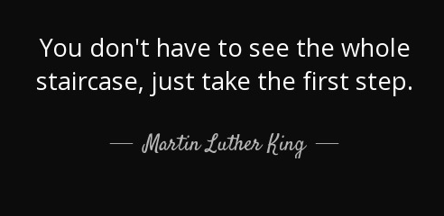

Before you start

Slide 3
Task
For this assignment, you are required to select a budget hotel and perform the following tasks.
Perform a SWOT and PESTEL analysis for chosen company (10%)
From the analysis in task 1, in your opinion, evaluate how the changes in PESTEL factors has influenced the Opportunities and Threats business. Critically comment on how the airline is addressing their Strengths to negate Threats and Weakness affecting their Opportunities. (20%)
Compare and contrast the different styles of leadership. Comment on the appropriate leadership and management style at the chosen airline. (20%)
Recommend a suitable leadership style that will help them meet their business objectives. Justify your choice using appropriate literature. (10%),
Comment on the Responsibility, Response and Obligations in their Ethics and Social Responsibilities in the processes using evidence from your research. (20%).
Reflection on your experience doing the assignment (20% of word count)

Slide 4

SWOT Analysis
QUESTION 1: Perform a SWOT and PESTEL analysis for chosen company. (20%)
Strengths
What are the internal Strategic factors that even their competitors consider to be their positives
Example:
A strong and easily recognisable brand name

Slide 5

SWOT Analysis
Weaknesses
What are the internal Strategic factors that is holding them back
Example:
An easily imitable business model

Slide 6

SWOT Analysis
Opportunities
What are the External Strategic factors that can provide new openings and advantages
Example:
new locations, partnerships

Slide 7

SWOT Analysis
Threats
What are the External Strategic factors that can be dangerous for the business
Example:
competitors

Slide 8
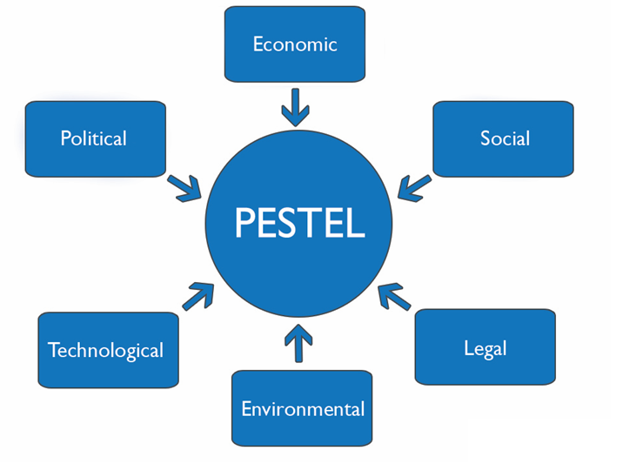
PESTEL factors

Slide 9
Presenting the ideas
SWOT Factors
Strengths
* Well-known Brand: The company has presence in over….
* Financially Strong: ….
Weaknesses
….
Same with PESTEL

Slide 10
Question 2: From the analysis in task 1, in your opinion, evaluate how the changes in PESTEL factors has influenced the opportunities and threats business. Critically comment on how the company is addressing their strengths to negate threats and weakness affecting their opportunities. (20%)
You need to show the link between SWOT and PESTEL
You will find relationship between Opportunities and Threats with PESTEL
Example
Economic opportunities
Economic threats
Technology opportunities
Social threats
This you present in paragraphs

Slide 11
Question 3: Compare and contrast the different styles of leadership. Comment on the current leadership and management style at chosen business. (20%)
You need to describe types of leadership and discuss if they are suitable for the company or not. With theory and evidence through application of theory.
For example : Describe autocratic theory and its characteristics, and apply to chosen company of if it would suit or not.
Suggested Leadership Styles
Autocratic DO NOT USE Great Man Theory, Traits Theory, Behavioural theory
Democratic
Delegative
Transactional
Transformational

Slide 12
Question 4: Recommend a suitable leadership style that will match their management style and help the chosen business grow further. Justify your choice using appropriate literature. (20%)
Recommend style(s) of leadership that you feel will be suitable for the company.
You need to say why the style is ideal for them and can be more than one style.
You can also bring in your understanding of the leadership that suit the current business environment (optional – war and peace leadership)

Slide 13
Question 5: Comment on the responsibility, response and obligations in their ethics and social responsibilities in the processes at the company using evidence from your research. (20%)
Find some CSR actions / activities and discuss them as
Responsiveness
Responsibility
Obligation

Slide 14
Q6: a reflection report on your experience in writing this report
Reflect on the knowledge you gained
What did you learn?
Anything you feel would help in your life

Slide 15
Structure
Cover page
Executive Summary
Table of Contents
Introduction (including the company profile ) -100-200 words
Question 1 to 6 – appropriate word count as indicated in brackets (600 words approx. each)
Conclusion (100-200 words)
SWOT / PESTEL can be in paragraphs or entirely bullet points
Assignment should have evidence of reading theory, and application of theory
Max word count 3000 words

Slide 16
University NAME
Context of Business
<Company> Case Study
Name
ID

Slide 17
FAQ
Number of references –at least 6
References should be Harvard referencing
Executive Summary mandatory
Table of Contents – compulsory
Headings need not be numbered
Text – normal font size – Times New Roman size 12. Calibri or Garamond accepted. No other fonts acceptable.
Layout must be clear and consistent. 1.15 spacing or 1.5 spacing fine.

