Slide 1
2
Managers and Management

Slide 2
Learning Outcomes
Tell who managers are and where they work
Define management
Describe what managers do
Explain why it’s important to study management
Describe the factors that are reshaping and redefining management

Slide 3
Who Are Managers? Where Do They Work?
Organization
A deliberate arrangement of people brought together to accomplish a specific purpose.
Common Characteristics of Organizations
Distinct purpose
People working together
A deliberate systematic structure
Notes:
Managers work in organizations. We define organizations as A deliberate arrangement of people brought together to accomplish some are deliberate arrangements of people to accomplish a specific purpose. Examples include your college or university, the United Way, your neighborhood convenience store, the Dallas Cowboys football team, fraternities and sororities, the Cleveland Clinic and Nokia.

Slide 4
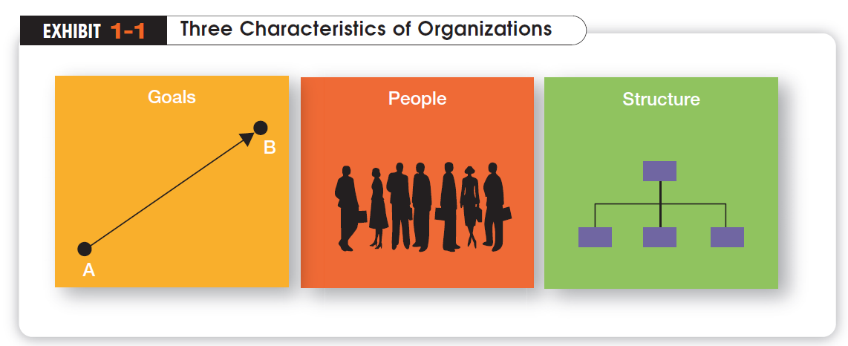

Slide 5
How Are Managers Different from Nonmanagerial Employees?
Nonmanagerial Employees
People who work directly on a job or task and have no responsibility for overseeing the work of others.
Examples, associates, team members
Managers
Individuals in organizations who direct the activities of others.
Notes:
For simplicities sake, we can divide organization members into two categories: nonmanagerial employees and managers. Nonmanagerial employees do not oversee the work of others. Managers direct and oversee the activity of the people in the organization.

Slide 6
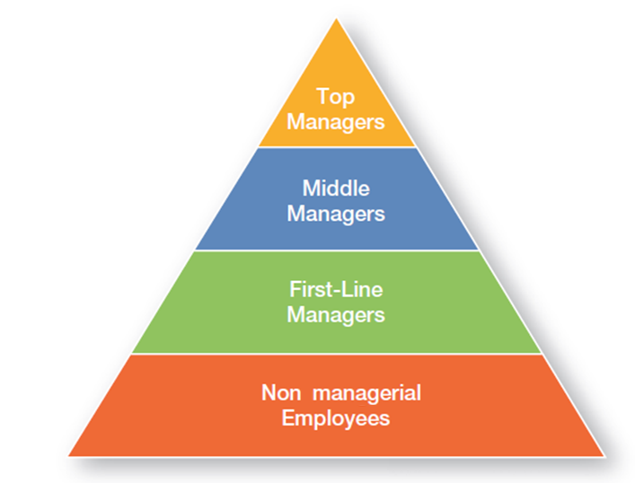
Management Levels

Slide 7
What Titles Do Managers Have?
Top Managers
Responsible for making decisions about the direction of the organization.
Examples; President, Chief Executive Officer, Vice-President
Middle Managers
Manage the activities of other managers.
Examples; District Manager, Division Manager
First-line Managers
Responsible for directing nonmanagerial employees
Examples; Supervisor, Team Leader
Notes:
Managers are usually classified as top, middle or first-line. But be aware that they can have a variety of titles.

Slide 8
What Is Management?
Management
The process of getting things done effectively and efficiently, with and through people
Effectiveness
“Doing the right things”, doing those tasks that help an organization reach its goals
Efficiency
Concerned with the means, efficient use of resources like people, money, and equipment
Notes:
Management is a process of getting things done, effectively and efficiently, with through people. A process is a set of ongoing and interrelated activities. In our definition it refers to the primary activities or functions managers perform.

Slide 9
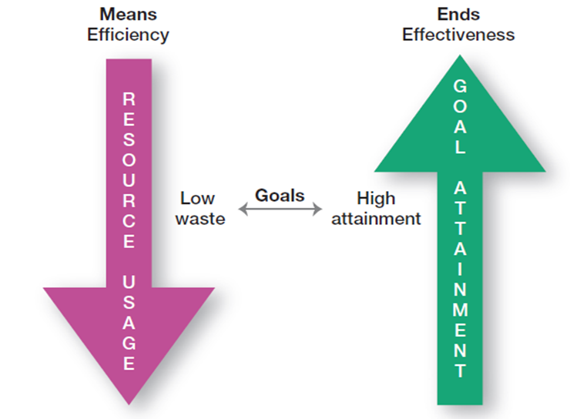
Efficiency v Effectivity

Slide 10

What Do Managers Do?
In the functions approach proposed by French industrialist Henri Fayol, all managers perform certain activities or functions
Notes:
Henri Fayol, a French industrialist in the early twentieth century, proposed that all managers perform five management activities: plan, organize, command, coordinate and control. Today these management functions have been condensed to four.

Slide 11
Four Management Functions
Planning
Defining the organizational purpose and ways to achieve it
Organizing
Arranging and structuring work to accomplish organizational goals
Leading
Directing the work activities of others
Controlling
Monitoring, comparing, and correcting work performance
Notes:
Planning includes defining goals, establishing strategy, and developing plans to coordinate activities. Organizing includes determining what tasks need to be done and by whom. Leading includes motivating, directing the activities of others, and resolving conflicts. Controlling involves monitoring, comparing, and correcting work performance.

Slide 12
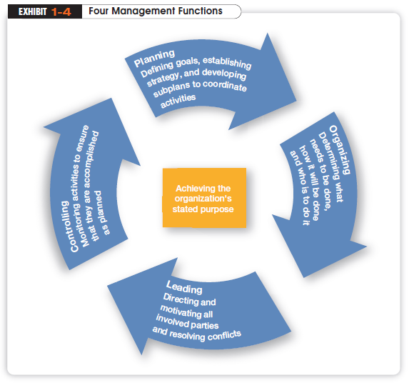

Slide 13
What Roles Do Managers Play?
Henry Mintzberg observed that a manager’s job can be described by ten roles performed by managers in three general categories
Interpersonal Roles
Figurehead, Leader, and Liaison
Informational Roles
Monitor, Disseminator and Spokesperson
Decisional roles
Entrepreneur, Disturbance Handler, Resource Allocator and Negotiator
Notes:
In the 1960s, Henry Mintzberg did an empirical study of chief executives and discovered that managers were engaged in a number of varied, un-patterned, and short-duration activities. He defined management by categorizing what managers do based on the managerial roles they perform at work.

Slide 14
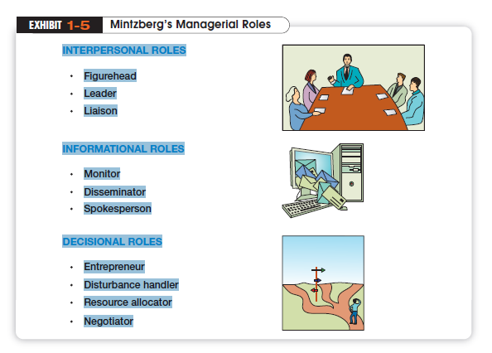

Slide 15
What Skills Do Managers Need?
Robert Katz and others describe four critical skills in managing
Conceptual Skills
Used to analyze complex situations
Interpersonal Skills
Used to communicate, motivate, mentor and delegate
Technical Skills
Based on specialized knowledge required for work
Political Skills
Used to build a power base and establish connections
Notes:
Another way to describing what managers do is by looking at the skills they need in managing. Managers must possess four critical skills in managing. Conceptual skills, Interpersonal Skills, Technical Skills and Political Skills.

Slide 16
Is The Manager’s Job Universal?
The previous discussion describe management as a generic activity. In reality, a manager’s job varies with along several dimensions
Level in the Organization
Top level managers do more planning than supervisors
Profit vs. Nonprofit
Management performance is measured on different objectives
Notes:
While the importance of managerial roles varies depending on a manager’s position within an organization, the differences are of degree and emphasis, not of function. As managers move up the organization, for example, they spend less time supervising and more time planning.
All managers, however, make decisions and plan, lead, organize, and control. But the amount of time they give to each activity is not necessarily constant. In addition, the content of the managerial activities changes with the manager’s level.
When measuring managerial performance in business, profit (the bottom line) is an unambiguous criterion. Even though not-for-profit organizations need money to survive, however, their managers do not live and die to maximize profits.
Given this difference, managers working in profit and not-for-profit organizations must perform similar functions: planning, organizing, leading, and controlling.

Slide 17

Is the Manager’s Job Universal? (cont’d)
Size of the Organization
Small businesses require an emphasis in the management role of spokesperson
National Borders
These concepts work best in English-speaking countries and may need to be modified in other global environments

Slide 18
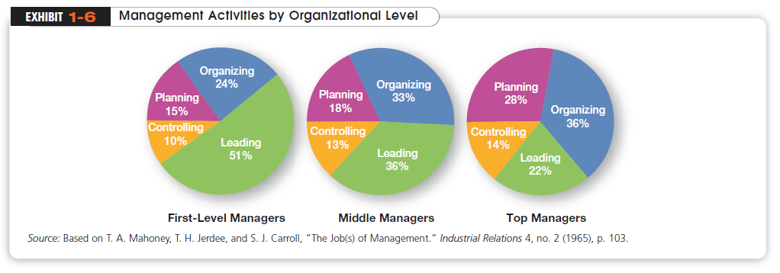

Slide 19
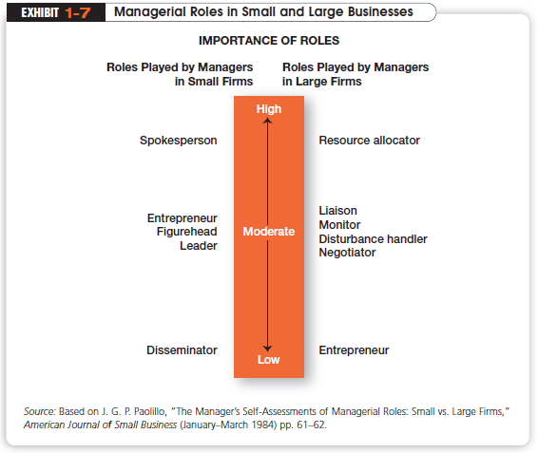

Slide 20
Why Are Customers Important to the Manager’s Job?
Without customers most organizations would cease to exist
Today we’re discovering that employee attitudes and behaviors play a big part in customer satisfaction
Managers must create a customer responsive where employees are friendly, knowledgeable, responsive g to customer needs

Slide 21

Why Is Innovation Important to the Manager’s Job?
“Nothing is more risky than not innovating”
Innovation isn’t just important for high technology companies but essential in all types of organizations

