Slide 1
4
Motivating
and Rewarding Employees

Slide 2
Learning Objectives
Define and explain motivation
Compare and contrast early theories of motivation
Compare and contrast contemporary theories of motivation
Discuss current issues in motivating employees

Slide 3
What is Motivation?
Motivation
The process by which a person’s efforts are energized, directed, and sustained toward attaining a goal
Individuals differ in motivational drive
Overall motivation varies from situation to situation
Notes:
Motivation refers to the process by which a person’s efforts are energized, directed, and
sustained toward attaining a goal.

Slide 4
Three Elements of Motivation
This definition has three key elements:
Energy - a measure of intensity or drive.
Direction - effort channeled in a direction that benefits the organization.
Persistence - when employees persist in putting forth effort to achieve those goals.
Notes:
This definition has three key elements: energy, direction,
and persistence.4
The energy element is a measure of intensity or drive. A motivated person puts forth
effort and works hard. However, the quality of the effort must be considered as well as its
intensity. High levels of effort don’t necessarily lead to favorable job performance unless
the effort is channeled in a direction that benefits the organization. Effort that’s directed
toward, and consistent with, organizational goals is the kind of effort we want from employees.
Finally, motivation includes a persistence dimension. We want employees to persist in
putting forth effort to achieve those goals.

Slide 5
What Is Maslow’s Hierarchy of Needs Theory?
Maslow was a psychologist who proposed that within every person is a hierarchy of five needs:
Physiological needs
Safety needs
Social needs
Esteem needs
Self-actualization needs
Notes:
The best-known motivation theory is probably Abraham Maslow’s hierarchy of needs
theory. Maslow was a psychologist who proposed that within every person is a hierarchy
of five needs:
Physiological needs
Safety needs
Social needs
Esteem needs
Self-actualization needs

Slide 6
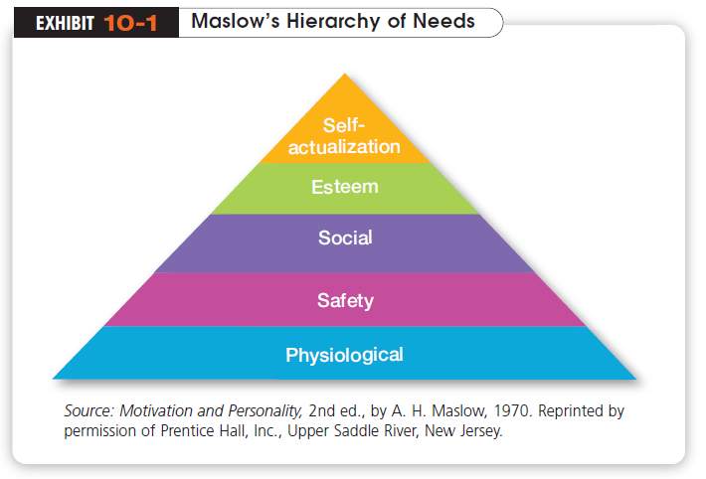
Notes:
Maslow’s need theory has received wide recognition, especially among practicing managers. Its popularity
probably can be attributed to the theory’s intuitive logic and ease of understanding.9 But Maslow provided no empirical support for his theory, and
several studies that sought to validate it could not

Slide 7
What Are McGregor’s Theory X and Theory Y?
Douglas McGregor is best known for proposing two assumptions about human nature:
Theory X
The assumption that employees dislike work, are lazy, avoid responsibility, and must be coerced to work
Theory Y
The assumption that employees are creative, enjoy work, seek responsibility, and can exercise self-direction
Notes:
Douglas McGregor is best known for proposing two assumptions about human nature: Theory X and Theory Y.12 Very simply, Theory X is a negative view of people that assumes workers have little ambition, dislike work, want to avoid responsibility, and need to be closely controlled to work effectively. Theory Y is a positive view that assumes employees enjoy work, seek out and accept responsibility, and exercise self-direction.

Slide 8
What Is Herzberg’s Two-Factor Theory?
Herzberg’s two-factor theory proposes that:
Intrinsic factors are related to job satisfaction
Extrinsic factors are associated with job dissatisfaction
Hygiene Factors
Factors that eliminate job dissatisfaction but don’t motivate.
Motivators
Factors that increase job satisfaction and motivation
Notes:
Frederick Herzberg’s two-factor theory (also called motivation-hygiene theory) proposes that
intrinsic factors are related to job satisfaction, while extrinsic factors are associated with job dissatisfaction.
Herzberg’s theory enjoyed wide popularity from the mid-1960s to the early 1980s, despite criticisms of his procedures and methodology. Although some critics said his theory was too simplistic, it has influenced how we currently design jobs.

Slide 9
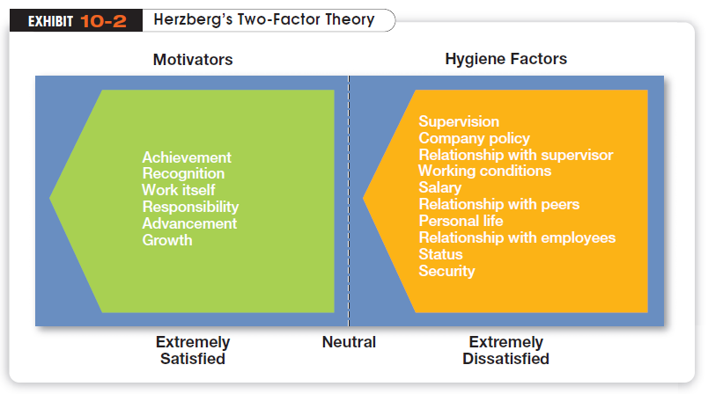
Notes:
Exhibit 10-2 shows Herzberg’s findings.

Slide 10
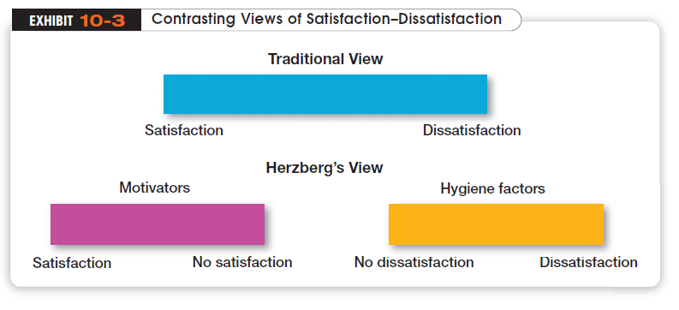
Notes:
As shown in Exhibit 10-3, Herzberg proposed that a dual continuum existed: The opposite of “satisfaction” is “no satisfaction,” and the opposite of “dissatisfaction” is “no dissatisfaction.”

Slide 11
What Is McClelland’s Three-Needs Theory?
Three acquired needs are major motives at work
Need for Achievement (nAch)
The drive to succeed and excel in relation to a set of standards
Need for Power (nPow)
The need to make others behave in a way that they would not have behaved otherwise
Need for Affiliation (nAff)
The desire for friendly and close interpersonal relationships
Notes:
David McClelland and his associates proposed the three-needs theory, which says there are three acquired (not innate) needs that are major motives in work. These three needs include the need for achievement (nAch), which is the drive to succeed and excel in relation to a set of standards; the need for power (nPow), which is the need to make others behave in a way that they would not have behaved otherwise; and the need for affiliation (nAff), which is the desire for friendly and close interpersonal relationships. Of these three needs, the need for achievement has been researched the most.

Slide 12

What Is Goal-Setting Theory?
Goal-Setting Theory
Specific goals increase performance
Difficult goals, when accepted, result in higher performance
Self-Efficacy
An individual’s belief that he or she is capable of performing a task
Notes:
There is substantial research support for goal-setting theory, which says that specific goals increase performance and that difficult goals, when accepted, result in higher performance than do easy goals.

Slide 13
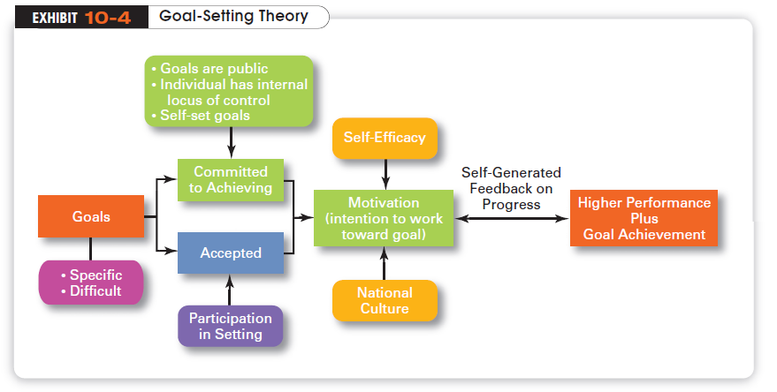
Notes:
Exhibit 10-4 summarizes the relationships among goals, motivation, and performance. Our overall conclusion is that the intention to work toward hard and specific goals is a powerful motivating force. Under the proper conditions, it can lead to higher performance. However, there is no evidence that such goals are associated with increased job satisfaction

Slide 14
How Does Job Design Influence Motivation?
Job Design
The way tasks are combined to form complete jobs
Job Characteristics Model (JCM)
A framework for analyzing and designing jobs that identifies five primary core job dimensions, their interrelationships, and their impact on outcomes
Job Enrichment
The vertical expansion of a job by adding planning and evaluation responsibilities
Notes:
We use the term job design to refer to the way tasks are combined to form complete jobs.

Slide 15
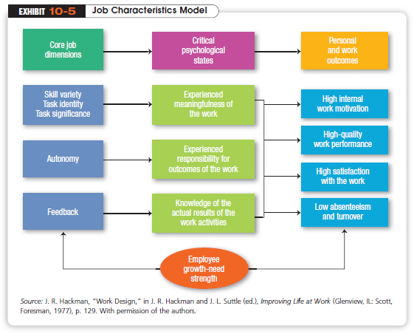
Notes:
Exhibit 10-5 presents the model. Notice how the first three dimensions—skill variety, task identity, and task significance—combine to create meaningful work.

Slide 16
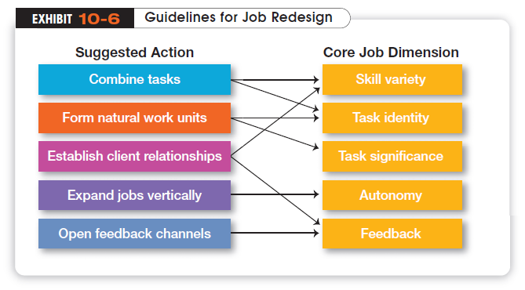
Notes:
The JCM provides significant guidance to managers for job design for both individuals and
teams. The suggestions shown in Exhibit 10-6, which are based on the JCM, specify the types
of changes in jobs that are most likely to improve in each of the five core job dimensions.

Slide 17
What Is Equity Theory?
Equity Theory
The theory that an employee compares his or her job’s input-outcomes ratio with that of relevant others and then corrects any inequity
Referent
The persons, systems, or selves against which individuals compare themselves to assess equity
Notes:
Equity theory, developed by J. Stacey Adams, proposes that employees compare what they get from a job (outcomes) in relation to what they put into it (inputs) and then compare their inputs-outcomes ratio with the inputs-outcomes ratios of relevant others

Slide 18

Equity Theory (cont.)
Distributive Justice
Perceived fairness of the amount and allocation of rewards among individuals
Procedural Justice
Perceived fairness of the process used to determine the distribution of rewards
Notes:
Originally, equity theory focused on distributive justice, which is the perceived fairness of the amount and allocation of rewards
among individuals. More recent research has focused on looking at issues of procedural justice, which is the perceived fairness of the
process used to determine the distribution of rewards

Slide 19
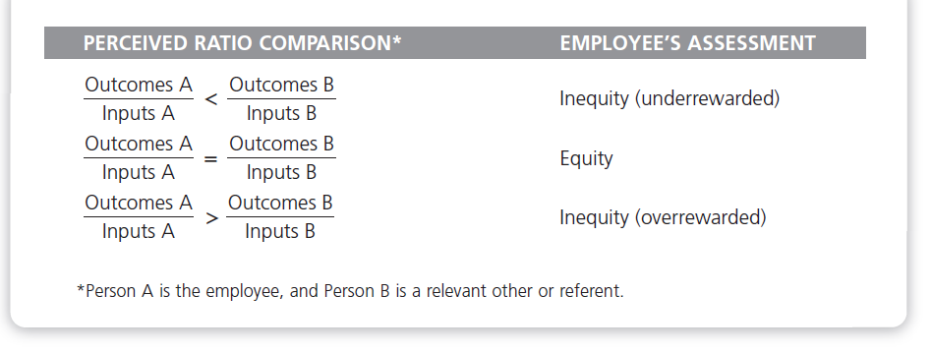

Slide 20
How Does Expectancy Theory Explain Motivation?
Expectancy Theory
An individual tends to act in a certain way, based on:
the expectation that the act will be followed by a given outcome
the attractiveness of that outcome to the individual
Notes:
The most comprehensive explanation of how employees are motivated is Victor Vroom’s expectancy theory.40 Although the theory has its critics, most research evidence supports it. Expectancy theory states that an individual tends to act in a certain way based on
the expectation that the act will be followed by a given outcome and on the attractiveness of that outcome to the individual.

Slide 21
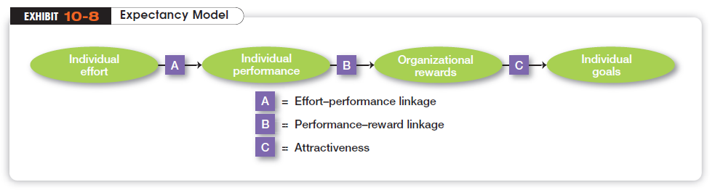
Notes:
It includes three variables or relationships (see Exhibit 10-8):
1. Expectancy or effort-performance linkage is the probability perceived by the individual
that exerting a given amount of effort will lead to a certain level of performance.
2. Instrumentality or performance-reward linkage is the degree to which the individual
believes that performing at a particular level is instrumental in attaining the desired
outcome.
3. Valence or attractiveness of reward is the importance that the individual places on the
potential outcome or reward that can be achieved on the job. Valence considers both
the goals and needs of the individual.

Slide 22
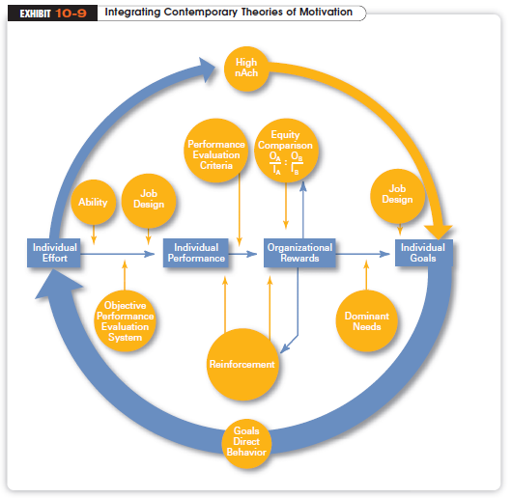
Notes:
Many of the ideas underlying the contemporary motivation theories are complementary, and you’ll understand better how to motivate people if you see how the theories fit together. Exhibit 10-9 presents a model that integrates much of what we know about motivation. Its basic foundation is the expectancy model.

Slide 23
Motivating a Diverse Workforce
Compressed Workweek
A workweek in which employees work longer hours per day but fewer days per week
Flexible Work Hours (flextime)
A scheduling system in which employees are required to work a certain number of hours per week but are free, within limits, to vary the hours of work
Notes:
To maximize motivation among today’s workforce, managers need to think in terms of flexibility. For instance, studies tell us
that men place more importance on having autonomy in their jobs than do women. In contrast, the opportunity to learn, convenient and flexible work hours, and good interpersonal relations are more important to women.

Slide 24

Motivating a Diverse Workforce (cont.)
Job Sharing
When two or more people split (share) a fulltime job
Telecommuting
A job approach in which employees work at home but are linked by technology to the workplace
Notes:
A diverse array of rewards is needed to motivate employees with such diverse needs. Many of the work/life balance
programs (see Chapter 6) that organizations have implemented are a response to the varied needs of a diverse workforce. In addition, many organizations have developed flexible work arrangements that recognize different needs. These types of programs
may become even more popular as employers look for ways to help employees cope with high fuel prices

Slide 25
Designing Appropriate Rewards Programs
Open-Book Management
An organization’s financial statements are shared with all employees
Employee Recognition Programs
Programs that consist of personal attention and expressions of interest, approval, and appreciation for a job well done
Pay-for-Performance Programs
Variable compensation plans that pay employees on the basis of some performance measurement
Notes:
A diverse array of rewards is needed to motivate employees with such diverse needs. Many of the work/life balance
programs (see Chapter 6) that organizations have implemented are a response to the varied needs of a diverse workforce. In addition, many organizations have developed flexible work arrangements that recognize different needs. These types of programs may become even more popular as employers look for ways to help employees cope with high fuel prices

Slide 26
The End

