Slide 1
Foundations
of Decision
Making
Copyright ©2011 Pearson Education, Inc. publishing as Prentice Hall

Slide 2
Learning Outcomes
Describe the decision-making process
Explain the three approaches managers can use to make decisions
Describe the types of decisions and decision-making conditions managers face
Discuss group decision making
Discuss contemporary issues in managerial decision making
Copyright ©2011 Pearson Education, Inc. publishing as Prentice Hall

Slide 3
How Do Managers Make Decisions?
Decision-Making Process
  A set of eight steps that includes identifying a problem, selecting a solution, and evaluating the effectiveness of the solution
Problem
  A discrepancy between an existing and a desired state of affairs
Decision Criteria
  Factors that are relevant in a decision
Copyright ©2011 Pearson Education, Inc. publishing as Prentice Hall
Notes:
The decision-making process begins with the identification of a problem (step 1) or,
more specifically, a discrepancy between an existing and a desired state of affairs.
Once a manager has identified a problem that needs attention, the decision criteria that will
be important in solving the problem must be identified (step 2).

Slide 4
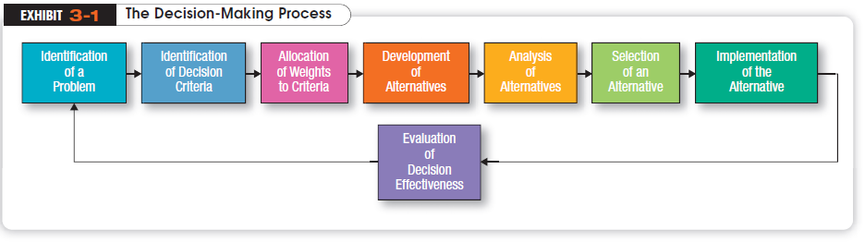
Copyright ©2011 Pearson Education, Inc. publishing as Prentice Hall
Notes:
It’s necessary, therefore, to allocate weights to
the items listed in step 2 in order to give them their relative priority in the decision (step 3).
Then the decision maker lists the alternatives that could succeed in resolving
the problem (step 4).
Once the alternatives have been identified, the decision maker must critically
analyze each one (step 5).

Slide 5
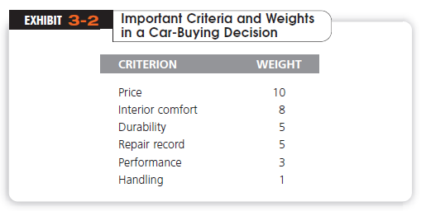
Copyright ©2011 Pearson Education, Inc. publishing as Prentice Hall
Notes:
Exhibit 3-2 lists the criteria
and weights that our manager developed for her vehicle replacement decision. Price is
the most important criterion in her decision, with performance and handling having low
weights.

Slide 6
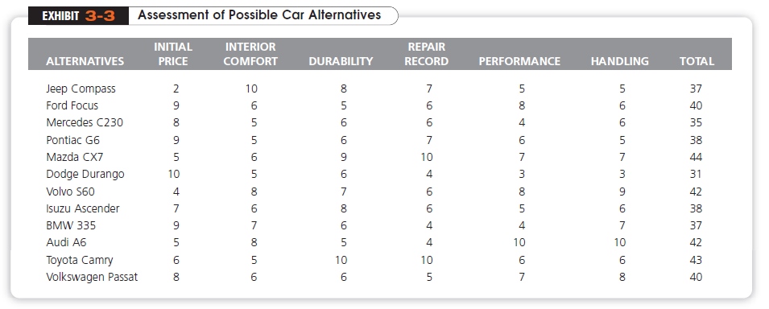
Copyright ©2011 Pearson Education, Inc. publishing as Prentice Hall
Notes:
Exhibit 3-3 is only an assessment of the 12 alternatives against the decision criteria; it
does not reflect the weighting done in step 3. If one choice had scored 10 on every criterion,
you wouldn’t need to consider the weights.
Step 6 is the critical act of choosing the best alternative from among those assessed.

Slide 7
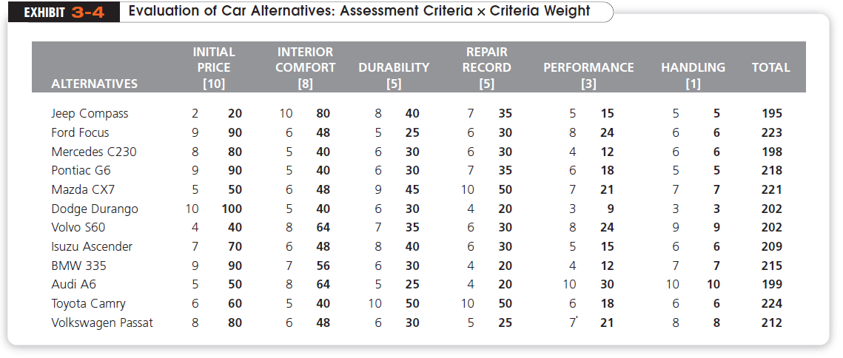
Copyright ©2011 Pearson Education, Inc. publishing as Prentice Hall
Notes:
In our vehicle example (Exhibit 3-4), the decision
maker would choose the Toyota Camry. On the basis of the criteria identified, the
weights given to the criteria, and the decision maker’s assessment of each vehicle’s
achievement on the criteria, the Toyota scored highest [224 points] and, thus, became the
best alternative.

Slide 8

Decision Implementation
  Putting a decision into action; includes conveying the decision to the persons who will be affected by it and getting their commitment to it.
Copyright ©2011 Pearson Education, Inc. publishing as Prentice Hall
Notes:
Although the choice process is completed in the previous step, the decision may still fail if
it is not implemented properly (step 7).
Decision implementation includes conveying the decision to those
affected and getting their commitment to it.
In the last step in the decision-making process (step 8) managers appraise the result
of the decision to see whether it has corrected the problem.

Slide 9
Common Errors in the Decision-Making Process
Heuristics
  “rules of thumb” to simplify decision making
  May lead to errors and biases
Overconfidence Bias
  Unrealistically positive views of one’s self
Copyright ©2011 Pearson Education, Inc. publishing as Prentice Hall

Slide 10
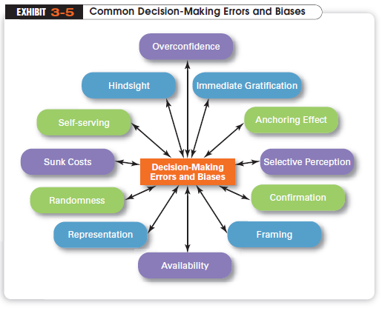
Copyright ©2011 Pearson Education, Inc. publishing as Prentice Hall
Notes:
When managers make decisions, they not only use their own particular style, but may
use “rules of thumb” or heuristics, to simplify their decision making.7 Rules of thumb can
be useful because they help make sense of complex, uncertain, and ambiguous information.
Even though managers may use rules of thumb, that doesn’t mean those rules are
reliable

Slide 11
What is the Rational Model of Decision Making?
Rational Model assumes
  that managers’ decision making will be rational logical and consistent choices to maximize value
  The problem faced would be clear and unambiguous
  the decision maker would have a clear and specific goal
  know all possible alternatives and consequences
Copyright ©2011 Pearson Education, Inc. publishing as Prentice Hall
Notes:
We assume that managers’ decision making will be rational; that is, they’ll make
logical and consistent choices to maximize value. After all, managers have all sorts of
tools and techniques to help them be rational decision makers
A rational decision maker would be fully objective and logical. The problem faced
would be clear and unambiguous, and the decision maker would have a clear and specific
goal and know all possible alternatives and consequences. Finally, making decisions
rationally would consistently lead to selecting the alternative that maximizes the likelihood
of achieving that goal

Slide 12

What is Bounded Rationality?
Managers are limited in their ability to process information
Because managers can’t analyze information on all alternatives, they satisfice
Copyright ©2011 Pearson Education, Inc. publishing as Prentice Hall
Notes:
A more realistic approach to describing how managers
make decisions is the concept of bounded rationality, which says that managers make
decisions rationally, but are limited (bounded) by their ability to process information.14
Because they can’t possibly analyze all information on all alternatives, managers
satisfice, rather than maximize. That is, they accept solutions that are “good enough.”

Slide 13
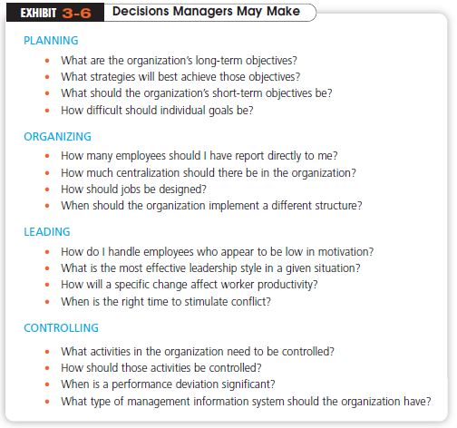
Copyright ©2011 Pearson Education, Inc. publishing as Prentice Hall

Slide 14
What Role Does Intuition Play in Managerial Decision Making?
Intuitive Decision Making
  making decisions on the basis of experience, feelings and accumulated judgment
  described as “unconscious reasoning.”
Copyright ©2011 Pearson Education, Inc. publishing as Prentice Hall
Notes:
Intuitive decision making can complement both bounded rationality and rational
decision making. First of all, a manager who has had experience with a similar type of
problem or situation often can act quickly with what appears to be limited information
because of that past experience

Slide 15
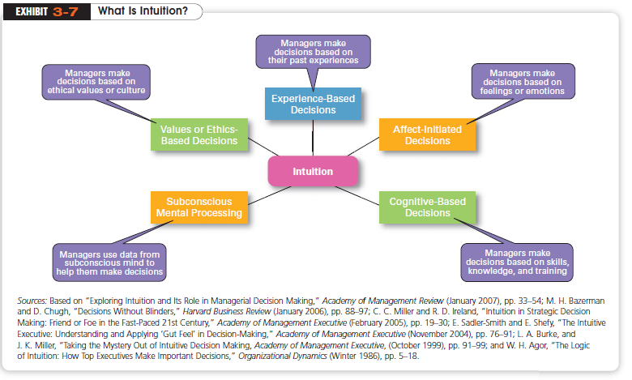
Copyright ©2011 Pearson Education, Inc. publishing as Prentice Hall

Slide 16
How Do Problems Differ?
Structured Problem
  A straightforward, familiar, and easily defined problem
Unstructured Problem
  A problem that is new or unusual for which
  information is ambiguous or incomplete.
Copyright ©2011 Pearson Education, Inc. publishing as Prentice Hall
Notes:
Some problems are straightforward. The goal of the decision maker is clear, the problem
familiar, and information about the problem easily defined and complete. Examples might
include a supplier’s tardiness with an important delivery, a customer’s wanting to return an
Internet purchase, etc.
Many situations faced by managers, however, are unstructured problems. They are new
or unusual. Information about such problems is ambiguous or incomplete.

Slide 17
What Are Programmed and Nonprogrammed Decisions?
Programmed Decisions
  A repetitive decision that can be handled using a routine approach
Nonprogrammed Decisions
  A unique and nonrecurring decision that requires a custom-made solution.
Copyright ©2011 Pearson Education, Inc. publishing as Prentice Hall
Notes:
Programmed, or routine, decision making is the most efficient way to handle structured problems. However,
when problems are unstructured, managers must rely on nonprogrammed decision making
in order to develop unique solutions.

Slide 18
Programmed Decision-Making Aids
Policy
  A general guide that establishes parameters for making decisions about recurring problems.
Procedure
  A series of interrelated sequential steps that can be used to respond to a well-structured problem (policy implementation).
Rule
  An explicit statement that tells managers what they ought or ought not to do (limits on procedural actions).
Copyright ©2011 Pearson Education, Inc. publishing as Prentice Hall

Slide 19
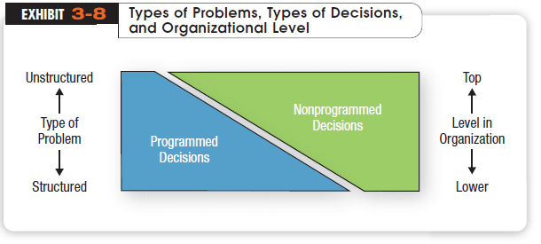
Copyright ©2011 Pearson Education, Inc. publishing as Prentice Hall
Notes:
Exhibit 3-8 describes the relationship among types of problems, types of decisions,
and level in the organization. Structured problems are responded to with programmed decision
making. Unstructured problems require nonprogrammed decision making.

Slide 20
What Decision Making Conditions Do Managers Face?
Certainty
  A situation in which a decision maker can make accurate decisions because all outcomes are known
Uncertainty
  A situation in which a decision maker has neither certainty nor reasonable probability estimates available
Risk
  A situation in which a decision maker is able to estimate the likelihood of certain outcomes
Copyright ©2011 Pearson Education, Inc. publishing as Prentice Hall

Slide 21
Group Decision Making
Advantages
  Group decisions provide more complete information
  Diversity of experiences and perspectives are higher
  Groups generate more alternatives
  Group decisions increase acceptance of a solution
Disadvantages
  Group decisions are time consuming
  May be subject to minority domination
  Subject to pressure to conform
  Responsibility is ambiguous
  Subject to Groupthink which undermines critical thinking
Copyright ©2011 Pearson Education, Inc. publishing as Prentice Hall
Notes:
Individual and group decisions have their own set of strengths. Neither is ideal for all
situations.

Slide 22

When Are Groups Most Effective?
Groups are more effective for decisions requiring
  Accuracy
  Speed
  Creativity
  Acceptance
Ideal Group Size
  5-15
Copyright ©2011 Pearson Education, Inc. publishing as Prentice Hall
Notes:
The effectiveness of group decision making is also influenced by the size of the group.
The larger the group, the greater the opportunity for heterogeneous representation

Slide 23
How Can You Improve Group Decision Making?
Brainstorming
  An idea-generating process that encourages alternatives while withholding criticism
Nominal Group Technique
  A decision-making technique in which group members are physically present but operate independently
Electronic Meeting
  Participants are linked by computer
Copyright ©2011 Pearson Education, Inc. publishing as Prentice Hall

Slide 24
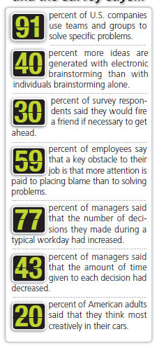
What Contemporary Decision-Making Issues Do Managers Face?
Ringisei
  Japanese consensus-forming group decisions.
Creativity
  The ability to produce novel and useful ideas
Copyright ©2011 Pearson Education, Inc. publishing as Prentice Hall

