Slide 1
7
Chapter
Managing Change and Innovation
Copyright ©2011 Pearson Education, Inc. Publishing as Prentice Hall.

Slide 2
Learning Outcomes
Define organizational change and compare and contrast views on the change process
Explain how to manage resistance to change
Describe what managers need to know about employee stress
Discuss techniques for stimulating innovation
Copyright ©2011 Pearson Education, Inc. Publishing as Prentice Hall.

Slide 3
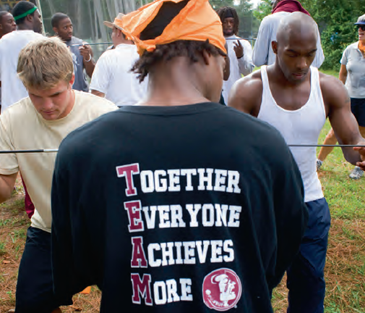
What Is Change and How Do Managers Deal with It?
Organizational Change
  Any alteration of an organization’s people, structure, or technology
Copyright ©2011 Pearson Education, Inc. Publishing as Prentice Hall.
Notes:
Change is an organizational reality. Most managers, at one point or another, will have to change some things in their workplace. We classify these changes as organizational change, which is any alteration of an organization’s people, structure or technology.

Slide 4
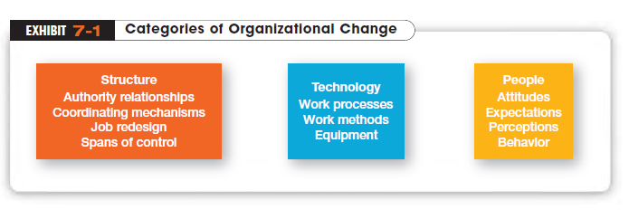
Copyright ©2011 Pearson Education, Inc. Publishing as Prentice Hall.
Notes:
Changing structure includes any alteration in authority relationships, coordination mechanisms, degree of centralization, job design, or similar organization structure variables.
Changing technology encompasses modifications in the way work is done or the methods and equipment used
Changes in people refer to changes in employee attitudes, expectations, perceptions, or behaviors

Slide 5
WHAT EXTERNAL FORCES CREATE A NEED TO CHANGE?
The external forces that create the need for organizational change come from various sources
  Marketplace
  Technology
  Government laws and regulations
  Economy
  Labor markets
Copyright ©2011 Pearson Education, Inc. Publishing as Prentice Hall.
Notes:
In Chapter 2 we pointed out that both external and internal forces constrain managers. These same forces also bring about the need for change

Slide 6

Who Initiates Organizational Change?
Change Agents
  People who act as change catalysts and assume the responsibility for managing the change process
Copyright ©2011 Pearson Education, Inc. Publishing as Prentice Hall.
Notes:
Organizational changes need a catalyst. People who act as catalysts and assume the responsibility for managing the change process are called change agents.

Slide 7
Change Metaphors
“Calm Waters” metaphor of change
  Likens organizational change to a large ship making a predictable trip across a calm sea and experiencing an occasional storm
“White-Water Rapids” metaphor of change
  Likens organizational change to a small raft navigating a raging river
Copyright ©2011 Pearson Education, Inc. Publishing as Prentice Hall.
Notes:
Until recently, the “calm waters” metaphor dominated the thinking of practicing managers and academics. The prevailing model for
handling change in such circumstances ideas, and knowledge is best illustrated in Kurt Lewin’s three-step description of the change process. (See Exhibit 7-2.)
White-water rapids is consistent with a world that’s increasingly dominated by information,

Slide 8
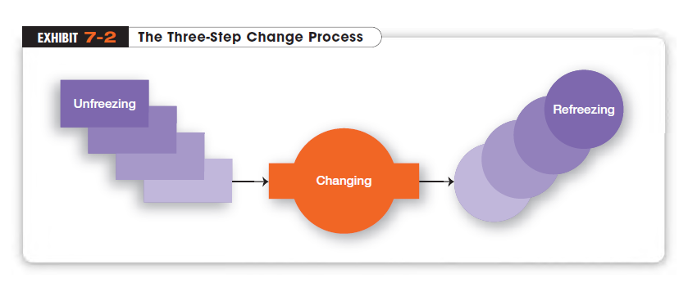
Copyright ©2011 Pearson Education, Inc. Publishing as Prentice Hall.

Slide 9
How Do Organizations Implement Planned Changes?
Organization Development (OD)
  Efforts that assist organizational members with a planned change by focusing on their attitudes and values
  Popular OD efforts in organizations rely heavily on group interactions and cooperation
Copyright ©2011 Pearson Education, Inc. Publishing as Prentice Hall.
Notes:
Often managers make a concerted effort to alter some aspect of the organization. Whatever happens—in terms of
structure or technology—ultimately affects organizational members. Efforts to assist organizational members with a planned change are referred to as organization development (OD).

Slide 10
Organizational Development Activities
Survey feedback
  A method of assessing employees’ attitudes toward and perceptions of a change
Process Consultation
  Using outside consultants to assess organizational processes such as workflow, informal intra-unit relationships, and formal communication channels
Copyright ©2011 Pearson Education, Inc. Publishing as Prentice Hall.
Notes:
Survey feedback efforts are designed to assess employee attitudes about and perceptions of the change they are encountering. Employees are generally asked to respond to a set of specific questions regarding how they view such organizational aspects as decision
making, leadership, communication effectiveness, and satisfaction with their jobs, coworkers, and management
In process consultation, outside consultants help managers to perceive, understand, and act on process elements with which they must deal. These elements might include, for example, workflow, informal relationships among unit members, and formal communications
channels.

Slide 11
OD Activities (cont.)
Team-Building
  Using activities to help work groups set goals, develop positive interpersonal relationships, and clarify the roles and responsibilities of each team member
Intergroup Development
  Activities that attempt to make several work groups more cohesive
Copyright ©2011 Pearson Education, Inc. Publishing as Prentice Hall.
Notes:
Team-building is generally an activity that helps work groups set goals, develop positive interpersonal relationships, and clarify the roles and responsibilities of each team member.
Whereas team-building focuses on helping a work group become more cohesive, intergroup development attempts to achieve the same results among different work groups. That is, intergroup development attempts to change attitudes, stereotypes, and perceptions
that one group may have toward another group

Slide 12
Why Do People Resist Organizational Change?
Why do people resist organizational change?
  Change replaces the known with uncertainty
  We do things out of habit
  Fear of losing something already possessed
Copyright ©2011 Pearson Education, Inc. Publishing as Prentice Hall.
Notes:
Why do people resist organizational change? The main reasons include uncertainty, habit, concern over personal loss, and the belief that
the change is not in the organization’s best interest

Slide 13
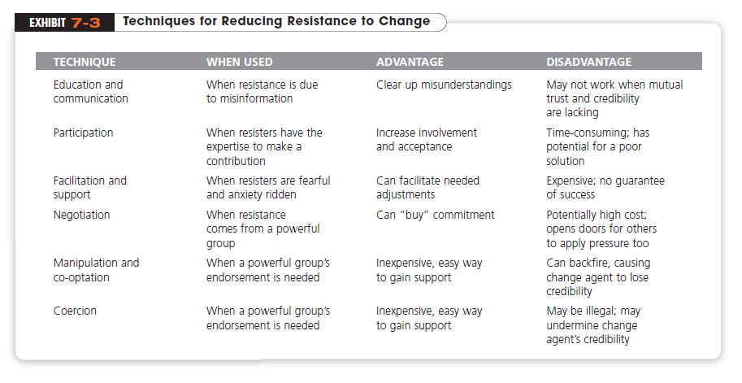
Copyright ©2011 Pearson Education, Inc. Publishing as Prentice Hall.
Notes:
When managers see resistance to change as dysfunctional, what can they do? Several strategies have been suggested in dealing with resistance to change. These approaches include education and communication, participation, facilitation and support, negotiation, manipulation
and co-optation, and coercion. These tactics are summarized here and described in Exhibit 7-3

Slide 14

What Is Stress?
Stress
  The adverse reaction people have to excessive pressure placed on them from extraordinary demands, constraints, or opportunities
Copyright ©2011 Pearson Education, Inc. Publishing as Prentice Hall.
Notes:
Stress is the adverse reaction people have to excessive pressure placed on them from extraordinary demands, constraints, or opportunities. Stress isn’t always bad. Although it’s often discussed in a negative context, stress can be positive, especially when it offers a
potential gain. For instance, functional stress allow an athlete, stage performer, or employee to perform at his or her highest level at crucial times.

Slide 15
What Causes Stress?
Stressors
  Factors that cause stress
Karoshi
  A Japanese term that refers to a sudden death caused by overworking
Role Conflicts
  Work expectations that are hard to satisfy
Copyright ©2011 Pearson Education, Inc. Publishing as Prentice Hall.
Notes:
Stress can be caused by personal factors and by job-related factors called stressors. Clearly, change of any kind—personal or job-related—has the potential to cause stress as it can involve demands, constraints, or opportunities
Role demands relate to pressures placed on an employee as a function of the particular role he or she plays in the organization. Role conflicts create expectations that may be hard to reconcile or satisfy.

Slide 16
Stressors (cont.)
Role Overload
  Having more work to accomplish than time permits
Role Ambiguity
  When role expectations are not clearly understood
Copyright ©2011 Pearson Education, Inc. Publishing as Prentice Hall.
Notes:
Role overload is experienced when the employee is expected to do more than time permits. Role ambiguity is created when role expectations are not clearly understood and the employee is not sure what he or she is to do.

Slide 17
Personal Factors
Type A Personality
  People who have a chronic sense of urgency and an excessive competitive drive
Type B Personality
  People who are relaxed and easygoing and accept change easily
Copyright ©2011 Pearson Education, Inc. Publishing as Prentice Hall.
Notes:
Evidence also indicates that employees’ personalities have an effect on how susceptible they are to stress. The most commonly
used labels for these personality traits are Type A and Type B.
Type A personality is characterized by chronic feelings of a sense of time urgency, an excessive competitive
drive, and difficulty accepting and enjoying leisure time.
The opposite of Type A is Type B personality. Type Bs never suffer from time urgency or impatience. Until quite recently, it
was believed that Type As were more likely to experience stress on and off the job

Slide 18
How Can Stress Be Reduced?
Employee Assistance Programs (EAPs)
  Programs offered by organizations to help employees overcome personal and health related problems
Wellness Programs
  Programs offered by organizations to help employees prevent health problems
Copyright ©2011 Pearson Education, Inc. Publishing as Prentice Hall.
Notes:
As mentioned earlier, not all stress is dysfunctional. Since stress can never be totally eliminated from a person’s life, managers want
to reduce the stress that leads to dysfunctional work behavior. How? Through controlling certain organizational factors to reduce
job-related stress, and to a more limited extent, offering help for personal stress

Slide 19
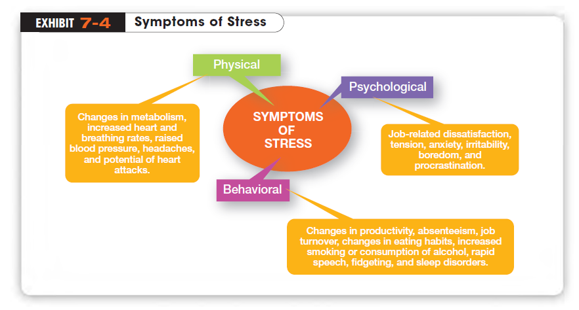
Copyright ©2011 Pearson Education, Inc. Publishing as Prentice Hall.
Notes:
As Exhibit 7-4 shows, stress symptoms can be grouped under three general categories: physical, psychological, and
behavioral. All of these can significantly affect an employee’s work.

Slide 20
How Can Managers Encourage Innovation?
Creativity
  The ability to combine ideas in a unique way or to make unusual associations between ideas
Innovation
  The process of taking a creative idea and turning it into a useful product, service, or method of operation
Copyright ©2011 Pearson Education, Inc. Publishing as Prentice Hall.
Notes:
Creativity refers to the ability to combine ideas in a unique way or to make unusual associations between ideas. A creative organization develops unique ways of working or novel solutions to problems. The outcomes of the creative process need to be turned into useful products or work methods, which is defined as innovation

Slide 21
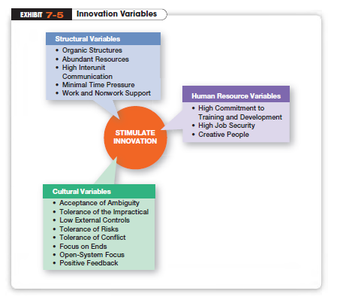
Copyright ©2011 Pearson Education, Inc. Publishing as Prentice Hall.
Notes:
The transformation process requires having the right environment to turn those inputs into innovative products or work methods. This “right” environment—that is, an environment that stimulates innovation—includes three variables: the organization’s structure, culture, and human resource practices. (See Exhibit 7-5.)

Slide 22
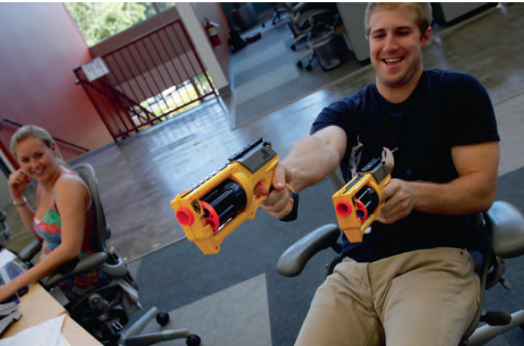
Fostering Innovation
Idea Champions
  Individuals who actively and enthusiastically support new ideas, build support for, overcome resistance to, and ensure that innovations are implemented
Copyright ©2011 Pearson Education, Inc. Publishing as Prentice Hall.
Notes:
Innovative organizations actively promote the training and development of their members so their knowledge remains current; offer their employees high job security to reduce the fear of getting fired for making mistakes; and encourage individuals to become idea champions, actively and enthusiastically supporting new ideas, building support, overcoming resistance, and ensuring that innovations are implemented.

Slide 23
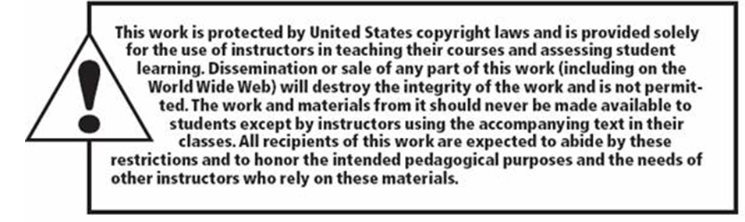
Copyright ©2011 Pearson Education, Inc. Publishing as Prentice Hall.

