Slide 1
5
Chapter
Organizational Structure and Culture

Slide 2
Learning Objectives
Describe six key elements in organizational design
Identify the contingency factors that favor the mechanistic model or the organic model
Compare and contrast traditional and contemporary organizational designs
Discuss the characteristics and importance
of organizational culture

Slide 3
What Is Organizing?
Organizing
The function of management that creates the organization’s structure
Organizational Design
When managers develop or change the organization’s structure
Work Specialization
Dividing work activities into separate job tasks; also called division of labor
Notes:
Once the organization’s goals, plans, and strategies are in place, managers must develop a structure that will best facilitate the attainment of those goals. Recall from Chapter 1 that we defined organizing as the function of management that creates the organization’s structure. When managers develop or change the organization’s structure, they’re engaging in organizational design.
Work specialization is dividing work activities into separate job tasks. Individual employees “specialize” in doing part of an activity rather than the entire activity in order to increase work output. It’s also known as division of labor.

Slide 4
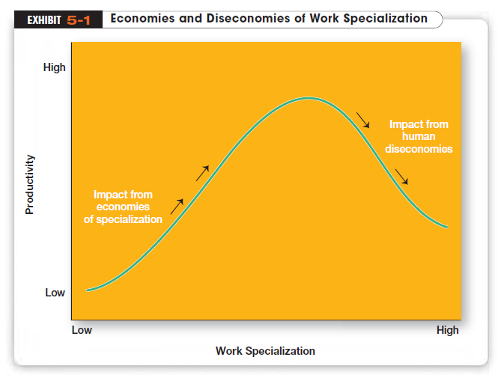
Notes:
At some point, the human diseconomies from division of labor surface as boredom, fatigue, stress, low productivity, poor quality, increased absenteeism, and high turnover exceed the economic advantages (see Exhibit 5-1)

Slide 5
What Is Departmentalization?
Departmentalization
How jobs are grouped together
Functional Departmentalization
Grouping activities by functions performed
Product Departmentalization
Grouping activities by major product areas
Customer Departmentalization
Grouping activities by customer
Notes:
How jobs are grouped together is called departmentalization. There are five common forms of departmentalization (see Exhibit 5-2) although an organization may use its own unique classification. No single method of departmentalization was advocated by the early writers. The method or methods used should reflect the grouping that would best contribute to the attainment of the goals of the organization and the individual units.

Slide 6
Departmentalization (cont.)
Geographic Departmentalization
Grouping activities on the basis of geography or territory
Process Departmentalization
Grouping activities on the basis of work or customer flow
Cross-functional Teams
Teams made up of individuals from various departments and that cross traditional departmental lines
Notes:
A recent trend is the use of cross-functional teams, which are teams made up of individuals from various departments and that cross traditional departmental lines

Slide 7
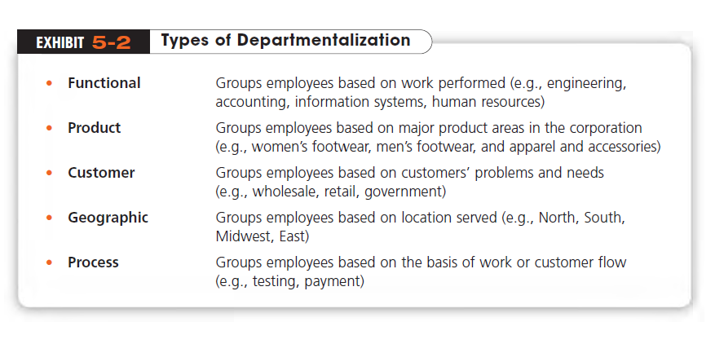

Slide 8
What Are Authority and Responsibility?
Chain of Command
The line of authority extending from upper organizational levels to lower levels, which clarifies who reports to whom
Authority
The rights inherent in a managerial position to give orders and expect the orders to be obeyed
Responsibility
An obligation to perform assigned duties
Notes:
To understand authority and responsibility, you also have to be familiar with the chain of command, the line of authority extending from upper organizational levels to lower levels, which clarifies who reports to whom
Authority refers to the rights inherent in a managerial position to give orders and expect the orders to be obeyed
When managers delegate authority, they must allocate commensurate responsibility That is, when employees are given rights, they also assume a corresponding obligation to perform

Slide 9
What are Different Types of Authority Relationships?
Line Authority
Authority that entitles a manager to direct the work of an employee
Staff Authority
Positions with some authority that have been created to support, assist, and advise those holding line authority
Chain of Command
The line of authority extending from upper organizational levels to lower levels, which clarifies who reports to whom
Notes:
Line authority entitles a manager to direct the work of an employee. It is the employer–employee authority relationship that extends from the top of the organization to the lowest echelon, according to the chain of command, as shown in Exhibit 5-3.
As organizations get larger and more complex, line managers find that they do not have the time, expertise, or resources to get their jobs done effectively. In response, they create staff authority functions to support, assist, advise, and generally reduce some of their informational burdens.

Slide 10
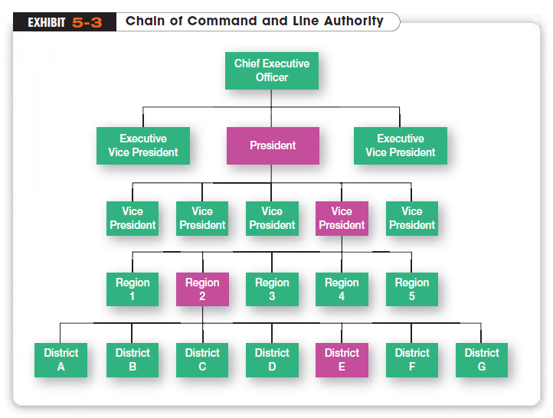

Slide 11
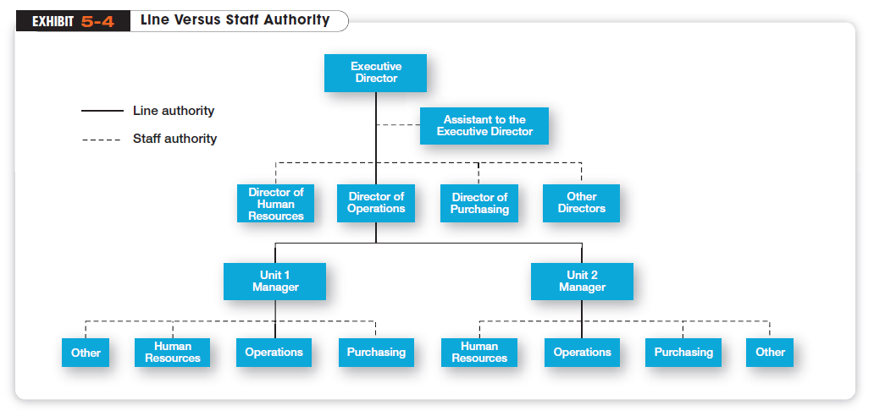
Notes:
Exhibit 5-4 illustrates line and staff authority

Slide 12
What is Power?
Authority goes with the job, but
Power
refers to an individual’s capacity to influence decisions. Authority is part of the larger concept of power
Notes:
Authority goes with the job. Power, on the other hand, refers to an individual’s capacity to influence decisions. Authority is part of the larger
concept of power. That is, the formal rights that come with an individual’s position in the organization are just one means by which an individual can affect the decision process

Slide 13
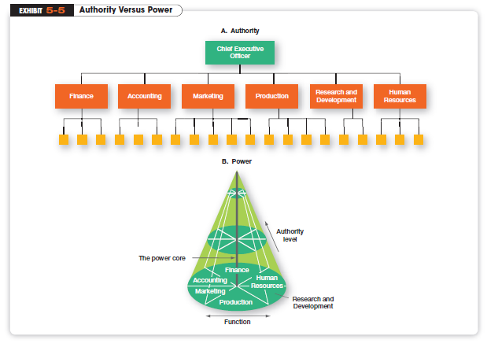
Notes:
Exhibit 5-5 visually depicts the difference between authority and power.

Slide 14
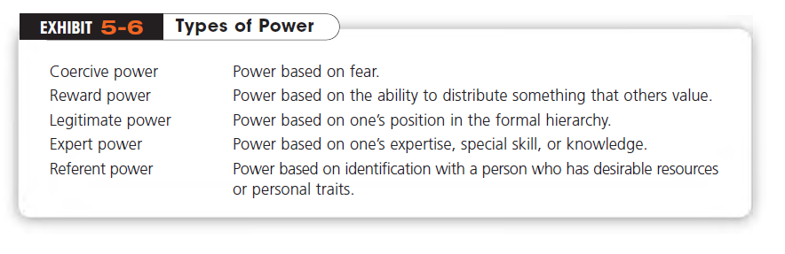
Notes:
French and Raven identified five sources, or bases, of power: coercive, reward, legitimate, expert, and referent. We summarize them in
Exhibit 5-6.

Slide 15
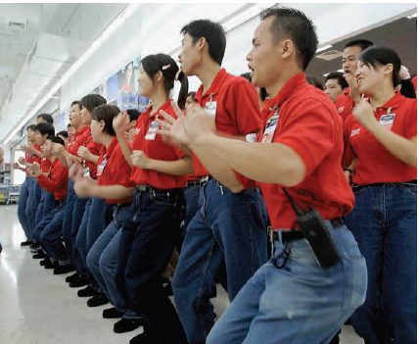
What Is Span of Control?
Span of Control
The number of employees a manager can efficiently and effectively supervise
Notes:
How many employees can a manager efficiently and effectively supervise? This question of span of control received a great deal of attention from early management writers. Although early writers came to no consensus on a specific number, most favored small spans—
typically no more than six workers—in order to maintain close control

Slide 16
What Is Formalization?
Formalization
How standardized an organization’s jobs are and the extent to which employee behavior is guided by rules and procedures
Centralization
The degree to which decision making takes place at upper levels of the organization
Decentralization
The degree to which lower-level managers provide input or actually make decisions
Notes:
Formalization refers to how standardized an organization’s jobs are and the extent to which employee behavior is guided by rules
and procedures.
Centralization is the degree to which decision making takes place at upper levels of the organization. Decentralization is the degree to which lower-level managers provide input or actually make decisions.

Slide 17
What Contingency Variables Affect Structural Choice?
Mechanistic Organization
A bureaucratic organization; a structure that’s high in specialization, formalization, and centralization
Organic Organization
A structure that’s low in specialization, formalization, and centralization
Notes:
The mechanistic organization (or bureaucracy) was the natural result of combining the six elements of structure. Adhering to the
chain-of-command principle ensured the existence of a formal hierarchy of authority, with each person controlled and supervised by one superior.
The organic organization is a highly adaptive form that is as loose and flexible as the mechanistic organization is rigid and stable. Rather than having standardized jobs and regulations, the organic organization’s loose structure allows it to change rapidly as required

Slide 18
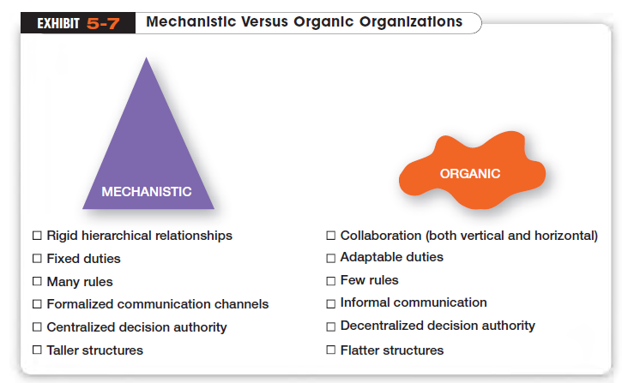

Slide 19
How Does Technology Affect Structure?
Unit Production
The production of items in units or small batches
Mass Production
Large-batch manufacturing
Process Production
Continuous flow of products being produced
Notes:
Every organization uses some form of technology to convert its inputs into outputs. Joan Woodward divided the firms into three distinct technologies that had increasing levels of complexity and sophistication. The first category, unit production, described the production of
items in units or small batches. The second category, mass production, described large-batch manufacturing. Finally, the
third and most technically complex group, process production, included continuous-process production.

Slide 20
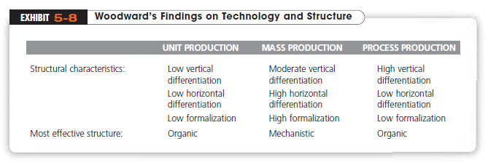

Slide 21
What is the Simple Structure?
Simple Structure
An organizational design with low departmentalization, wide spans of control, authority centralized in a single person, and little formalization
Notes:
Most companies start as entrepreneurial ventures using a simple structure, which is an organizational design with low departmentalization, wide spans of control, authority centralized in a single person, and little formalization. The simple structure is most widely used in smaller businesses and its strengths should be obvious. It’s fast, flexible, and inexpensive to maintain, and accountability is clear.

Slide 22
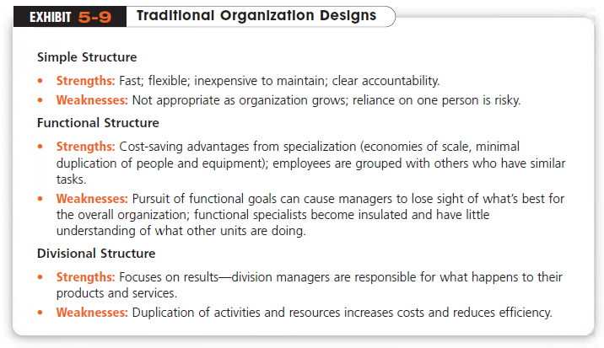
Notes:
When designing a structure, managers may choose one of the traditional organizational designs. These structures—simple, functional, and divisional—tend to be more mechanistic in nature. (See Exhibit 5-9 for a summary of the strengths and weaknesses of each.)

Slide 23
Traditional Organizational Designs
Functional Structure
An organizational design that groups similar or related occupational specialties together
Divisional Structure
An organizational structure made up of separate business units or divisions
Notes:
A functional structure is an organizational design that groups similar or related occupational specialties together.
The divisional structure is an organizational structure made up of separate business units or divisions.29 In this structure, each division
has limited autonomy, with a division manager who has authority over his or her unit and is responsible for performance.

Slide 24
Contemporary Organizational Structures
Team Structure
A structure in which the entire organization is made up of work teams
Matrix Structure
A structure in which specialists from different functional departments are assigned to work on projects led by a project manager
Project Structure
A structure in which employees continuously work on projects
Notes:
Team structure is one in which the entire organization is made up of work teams that do the organization’s work. In this structure, employee empowerment is crucial because there is no line of managerial authority from top to bottom
The matrix structure assigns specialists from different functional departments to work on projects led by a project manager. When employees finish work on an assigned project, they go back to their functional departments.
Instead of a matrix structure, many organizations are using a project structure, in which employees continuously work on projects. Unlike the matrix structure, a project structure has no formal departments where employees return at the completion of a projects

Slide 25
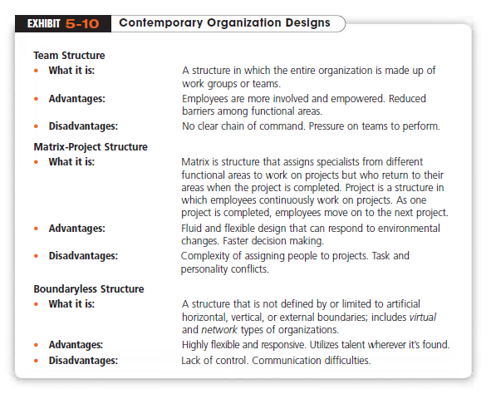

Slide 26
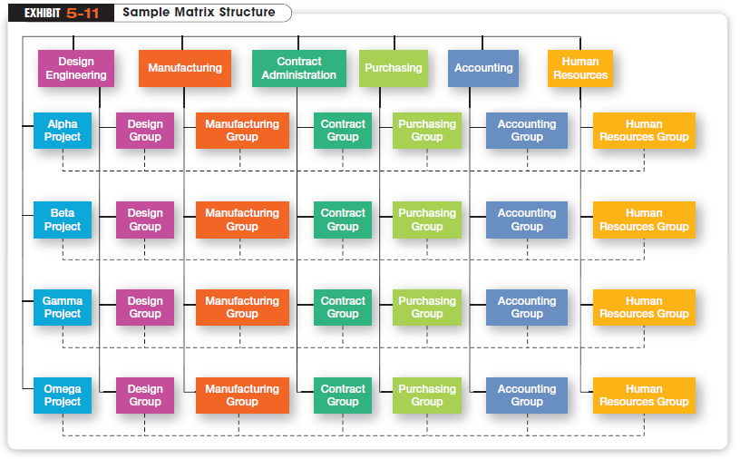

Slide 27
Contemporary Designs (cont.)
Boundaryless Organization
An organization whose design is not defined by, or limited to, boundaries imposed by a predefined structure
Virtual Organization
An organization that consists of a small core of full-time employees and outside specialists
Notes:
Another contemporary organizational design is the boundaryless organization, which is an organization whose design is not defined by, or limited to, the horizontal, vertical, or external boundaries imposed by a predefined structure.
A virtual organization consists of a small core of full-time employees and outside specialists temporarily hired as needed to work on projects

Slide 28
Contemporary Designs (cont.)
Network Organization
An organization that uses its own employees to do some work activities and networks of outside suppliers to provide other needed product components or work processes
Notes:
Another structural option for managers wanting to minimize or eliminate organizational boundaries is a network organization, which is one that uses its own employees to do some work activities and networks of outside suppliers to provide other needed product components
or work processes. This organizational form is sometimes called a modular organization by manufacturing firms

Slide 29

Today’s Organizational Challenges
Learning Organization
An organization that has developed the capacity to continuously learn, adapt, and change
Notes:
A learning organization is an organization that has developed the capacity to continuously learn, adapt, and change. The concept of a learning organization doesn’t involve a specific organizational design per se, but instead describes an organizational mind-set or philosophy that has significant design implications

Slide 30
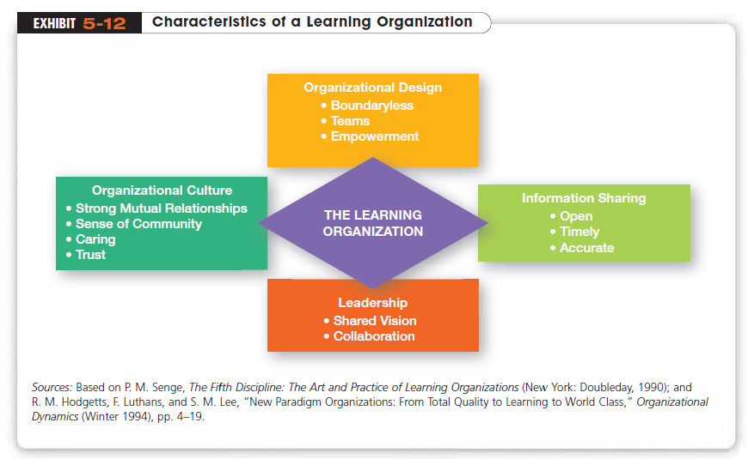

Slide 31
What is Organizational Culture?
Organizational Culture
The shared values, principles, traditions, and ways of doing things that influence the way organizational members act
Notes:
Organizational culture has been described as the shared values, principles, traditions, and ways of doing things that influence the way organizational members act. In most organizations, these shared values and practices have evolved over time and determine, to a large
extent, how “things are done around here.

Slide 32
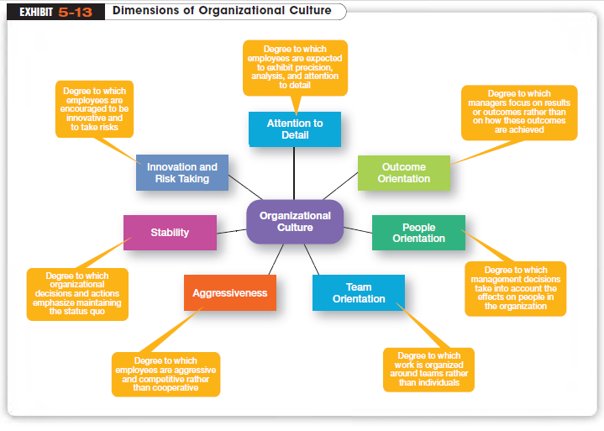

Slide 33

How Does Culture Influence Structure?
Strong Cultures
Organizational cultures in which the key values are deeply held and widely shared
Notes:
An organization’s culture may have an effect on its structure, depending on how strong, or weak, the culture is. Strong cultures—those in which the key values are deeply held and widely shared—have a greater influence on employees than do weaker cultures. The more
employees accept the organization’s key values and the greater their commitment to those values, the stronger the culture is

Slide 34
