Slide 1
ORAL PRESENTATIONS

Slide 2
A GOOD PRESENTATION:
Is obviously well-prepared in advance, e.g. notes and slides are carefully prepared and ready.
Has a clear structure prepared in advance. There is a beginning, middle and clear ending.
Is relevant to the interests and needs of the audience.
Is concise: it gets to the main points quickly and succinctly.
IN A GROUP PRESENTATION, THE FIRST PRESENTER WILL:
Get the presentation off to a good start by introducing him or
herself, and other members of the group.
Set out the main aims of the presentation.
Tell the audience how the group would prefer to deal with
questions, e.g. during the presentation, or at the end.

Slide 3
ALL PRESENTERS WILL:
Look clean and smart.
Use language appropriate to the level of ability and understanding of the audience.
Will speak clearly and with enthusiasm.
Appear confident – and will never apologize for their lack of experience in making presentations. (this is the ‘kiss of death’ for any presenter!)
Will look at the audience. Establish strong eye contact with them and will smile and look pleasant.

Slide 4
Stand well and straight – head upright and looking comfortable.
Avoid presenting unnecessary detail
Will not distract the audience from the message – by fiddling with keys, pens, coins – or anything else!
Other members of the group will not talk when another is presenting. This is very distracting as well as bad manners.
A POOR PRESENTATION IS THE CONVERSE OF ALL THE POINTS JUST LISTED.

Slide 5
THE INFORMATION YOU PRESENT
You can present information in a variety of ways, but the most popular and effective tend to be by using:
a flip-chart
an overhead projector (OHP)
or power-point presentation
Whichever medium for presentation you use:
Keep your words and images clear and simple.
Don’t crowd each sheet or slide with detail – just stick to three or four points per sheet (people tend to remember ideas that are presented in clusters of three).
Make sure that all the people in all parts of the room can read what you have written.

Slide 6
Use bullet points, rather than write large passages of text in sentences.
Make sure you present your ideas in a clear sequence.
Don’t be afraid to attempt a drawing – you don’t have to be a great artist, and you can make a joke of your efforts.
Drawings, no matter how crude, can often convey an idea better than words.
Put complicated figures & diagrams on to a handout for
the audience – don’t attempt to put these on to visual aids.

Slide 7
MEMORY

Slide 8
Improving your memory
Memory Theories and Processes
Attention and Selection
Choose what information you will remember
Encoding
Choose how you are going to remember the information
[acoustic, visual, semantic]
Storage
Choose how you will store the information -- short term and long term memory
Retrieval
Practice recalling/remembering the information you have learned
Forgetting
Review the information to avoid memory decay

Slide 9
Memory Techniques and Strategies
Putting it all together. Organizing and ordering information can significantly improve memory.
The funnel approach means learning general concepts before moving on to specific details. Ex: include previewing a chapter before reading it, studying from an outline, matrix, or concept map.
Organizing through meaning and association is done by making intentional associations between what we are learning and the environment we are in – making mental paths.
Vivid associations assist you in both storage and retrieval of new information by intentionally pairing it with something familiar.

Slide 10
Active learning – using more than one of the senses when learning new information.
Visual Memory is encoding something visually, associating concepts with visual images. This can include using diagrams, tables, outlines, charts, etc. It can be as simple as writing things out.
Talk it out. When trying to memorize something try reciting the information aloud either verbatim or in your own words.
Visualize yourself teaching the material is a great way to master the information.
Use mnemonic techniques and other memory tricks.

Slide 11
Mnemonic Techniques and Memory “Tricks”
ACRONYMS. You form acronyms by using each first letter from a group of words to form a new word. Acronyms are very common in ordinary language and in many fields. Some examples of common acronyms include NBA (National Basketball Associations), SCUBA (Self Contained Underwater Breathing Apparatus).
SENTENCES/ACROSTICS. Like acronyms, you use the first letter of each word you are trying to remember. Instead of making a new word, though, you use the letters to make a sentence. Here are some examples:
My Dear Aunt Sally (mathematical order of operations: Multiply and Divide before you Add and Subtract)
King Phil Came Over for the Genes Special (Kingdom, Phylum, Class, Order, Genus, Species)

Slide 12
RHYMES & SONGS. Rhythm, repetition, melody, and rhyme can all aid memory. You can use the same techniques to better remember information from courses. For example, even the simple addition of familiar rhythm and melody can help.
METHOD OF LOCI. This technique was used by ancient orators to remember speeches, and it combines the use of organization, visual memory, and association.
CHUNKING. It is based on the idea that short-term memory is limited in the number of things that can be contained. A common rule is that a person can remember 7 (plus or minus 2) "items" in short-term memory. In other words, people can remember between 5 and 9 things at one time.

Slide 13
PRACTICE MAKES PERFECT (or closer to it anyway): Okay, it may not be a mnemonic, but repeating Is still a great memory aid.
Linking Method – Is based solely on your visualization and imagination skills. (useful to learn list of things or names)

Slide 14
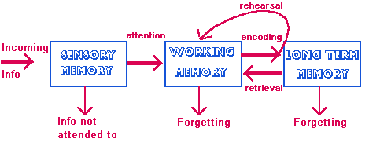
TYPES OF MEMORY

Slide 15
NOTEKING techniques

Slide 16
The Cornell Method
The Cornell method provides a systematic format for condensing and organizing notes without laborious recopying. After writing the notes in the main space, use the left-hand space to label each idea and detail with a key word or "cue”
The Outlining Method
Dash or indented outlining is usually best except for some science classes such as physics or math.
The information which is most general begins at the left with each more specific group of facts indented with spaces to the right.
The relationships between the different parts is carried out through indenting.
No numbers, letters, or Roman numerals are needed.

Slide 17
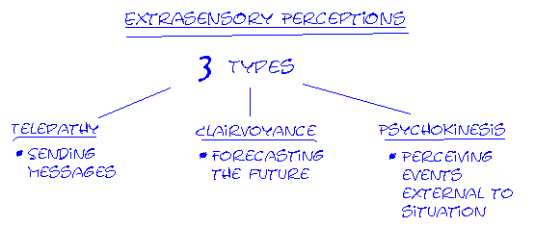

The Mapping Method
The Charting Method
If the lecture format is distinct (such as chronological), you may set up your paper by drawing columns and labeling appropriate headings in a table.

Slide 19
TIME MANAGAMENT FOR STUDY
TIME MANAGEMENT PRINCIPLES
1. Identify "Best Time" for Studying
2. Study Difficult Subjects First
3. Use Distributed Learning and Practice.
4. Make Sure the Surroundings are Conducive to Studying
5. Make Room for Entertainment and Relaxation
6. Make Sure you Have Time to Sleep and Eat Properly
7. Try to Combine Activities

