Slide 1
Ethics, Justice, and Fair Treatment in HR Management
Part 5 | Employee Relations
Chapter 14

Slide 2

After studying this chapter, you should be able to:
Explain what is meant by ethical behavior at work.
Discuss important factors that shape ethical behavior at work.
Describe at least four specific ways in which HR management can influence ethical behavior at work.
Employ fair disciplinary practices.
List at least four important factors in managing dismissals effectively.

Slide 3
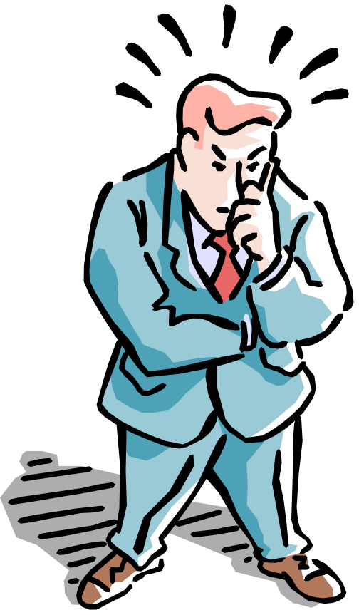
Ethics and Fair Treatment at Work
The Meaning of Ethics
  The principles of conduct governing an individual or a group.
  The standards you use to decide what your conduct should be.
  Ethical behavior depends on a person’s frame of reference.
Ethical Decisions
  Normative judgments
  Morality

Slide 4
What Is Organizational Culture?
Organizational culture
  The characteristic values, traditions, and behaviors a company’s employees share.
How is culture is revealed?
  Ceremonial events
  Written rules and spoken commands
  Office layout
  Organizational structure
  Dress codes
  Cultural symbols and behaviors
  Figureheads

Slide 5
HRM-Related Ethics Activities
Selection
  Fostering the perception of fairness in the processes of recruitment and hiring of people.
    Formal procedures
    Interpersonal treatment
    Providing explanations
    Selection tools
    Two-way communication
Training
  How to recognize ethical dilemmas.
  How to use ethical frameworks to resolve problems.
  How to use HR functions in ethical ways.

Slide 6
HRM-Related Ethics Activities (cont’d)
Performance Appraisal
  Appraisals that make it clear that the company adheres to high ethical standards by measuring and rewarding employees who follow those standards.
Reward and Disciplinary Systems
  The organization swiftly and harshly punishes unethical conduct.
Workplace Aggression and Violence
  Taking care that HR actions do not foster perceptions of inequities that translate into dysfunctional behaviors by employees.

Slide 7
Discipline Without Punishment
(Nonpunitive Discipline)
Issue an oral reminder.
Should another incident arise within six weeks, issue a formal written reminder, a copy of which is placed in the employee’s personnel file.
Give a paid, one-day “decision-making leave.”
If no further incidents occur in the next year, then purge the one-day paid suspension from the person’s file. If the behavior is repeated, the next step is dismissal.

Slide 8
Employee Privacy
Employee privacy violations upheld by courts:
  Intrusion
  Publication of private matters
  Disclosure of medical records
  Appropriation of an employee’s name or likeness
Actions triggering privacy violations:
  Background checks
  Monitoring off-duty conduct and lifestyle
  Drug testing
  Workplace searches
  Monitoring of workplace

Slide 9
Managing Dismissals
Dismissal
  Involuntary termination of an employee’s employment with the firm.
Terminate-at-Will Rule
  Without a contract, the employee can resign for any reason, at will, and the employer can similarly dismiss the employee for any reason (or no reason), at will.

Slide 10
Avoiding Wrongful Discharge Suits
Bases for Wrongful Discharge Suits
  Discharge does not comply with the law.
  Discharge does not comply with the contractual arrangement stated or implied by the firm via its employment application forms, employee manuals, or other promises.
Avoiding Wrongful Discharge Suits
  Set up employment policies and dispute resolution procedures that make employees feel treated fairly.
  Do the preparatory work that helps to avoid such suits.

Slide 11
Termination Assistance
Outplacement Counseling
  A systematic process by which a terminated employee is trained and counseled in the techniques of conducting a self-appraisal and securing a new job appropriate to his or her needs and talents.
    Does not imply that the employer takes responsibility for placing the person in a new job.
    Is part of the terminated employee’s support or severance package and is often done by specialized outside firms.

Slide 12
Interviewing Departing Employees
Exit Interview
  Its aim is to elicit information about the job or related matters that might give the employer a better insight into what is right—or wrong—about the company.
    The assumption is that because the employee is leaving, he or she will be candid.
    The quality of information gained from exit interviews is questionable.

Slide 13
The Plant Closing Law
Worker Adjustment and Retraining Notification Act (1989)
  Requires employers of 100 or more employees to give 60 days notice before closing a facility or starting a layoff of 50 people or more.
  The law does not prevent the employer from closing down, nor does it require saving jobs.
  The law is intended to give employees time to seek other work or retraining by giving them advance notice of the shutdown.

Slide 14
K E Y T E R M S
ethics
ethics code
distributive justice
procedural justice
interactional (interpersonal) justice
organizational culture
nonpunitive discipline
Electronic Communications Privacy Act (ECPA)
dismissal
wrongful discharge
unsatisfactory performance
misconduct
insubordination
termination interview
outplacement counseling
exit interviews
bumping/layoff procedures
downsizing

