Slide 1
Labor Relations and Collective Bargaining
Part 5 | Employee Relations
Chapter 15

Slide 2

After studying this chapter, you should be able to:
Give a brief history of the American labor movement.
Discuss the main features of at least three major pieces of labor legislation.
Present examples of what to expect during the union organizing drive and election.
Describe five ways to lose an NLRB election.
Illustrate with examples bargaining that is not in good faith.
Develop a grievance procedure.

Slide 3



What Do Unions Want?
Aims of Unions
Union
Security
Improved wages, hours, working conditions, and benefits

Slide 4


Union Security
Types of Union Security
Closed
Shop
Union
Shop
Agency Shop
Open
Shop
Maintenance of Membership

Slide 5
The AFL-CIO
The American Federation of Labor and Congress of Industrial Organizations (AFL-CIO)
  A voluntary federation of about 100 national and international labor unions in the United States.
Structure of the AFL-CIO
  Local unions
  National unions
  National federation
Change to Win Coalition

Slide 6
The Organizing Drive
Employer Responses to Organizing
  Can attack the union on ethical and moral grounds and cite the cost of union membership.
  Cannot make promises of benefits.
  Cannot make unilateral changes in terms and conditions of employment that were not planned to be implemented prior to the onset of union organizing activity.
  Can inform employees of their right to revoke their authorization cards.

Slide 7
The Organizing Drive (cont’d)
Union Activities During Organizing
  Unions can picket the company, subject to three constraints:
    It must file a petition for an election within 30 days after the start of picketing.
    The firm cannot already be lawfully recognizing another union.
    There cannot have been a valid NLRB election during the past 12 months.

Slide 8
NLRB Hearing Officer’s Duties
Determining if the record indicates there is enough evidence to hold an election.
  Did 30% of the employees in an appropriate bargaining unit sign the authorization cards?
Deciding what the bargaining unit will be.
  The bargaining unit is the group of employees that the union will be authorized to represent and bargain for collectively.

Slide 9
The Union Organizing Drive and Election (cont’d)
The Supervisor’s Role
  Unfair labor practices by supervisors:
    Could cause the NLRB to hold a new election after the company has won a previous election.
    Could cause the company to forfeit the second election and go directly to contract negotiation.

Slide 10
The Collective Bargaining Process
What Is Collective Bargaining?
  Both management and labor are required by law to negotiate wages, hours, and terms and conditions of employment “in good faith.”
What Is Good Faith Bargaining?
  Both parties communicate and negotiate.
  They match proposals with counterproposals in a reasonable effort to arrive at an agreement.
  Neither party can compel the other to agree to a proposal or to make any specific concessions.

Slide 11
Classes of Bargaining Items
Categories of Bargaining Items
Mandatory
Items
Voluntary
Items
Illegal
Items

Slide 12
Impasses, Mediation, and Strikes
An Impasse
  Usually occurs because one party is demanding more than the other will offer.
  Sometimes an impasse can be resolved through a third party—a disinterested person such as a mediator or arbitrator.
  If the impasse is not resolved:
    The union may call a work stoppage, or strike, to put pressure on management.
    Management may lock out employees.

Slide 13
Strikes
Economic Strike
Unfair Labor Practice Strike
Types of Strikes
Wildcat Strike
Sympathy Strike

Slide 14
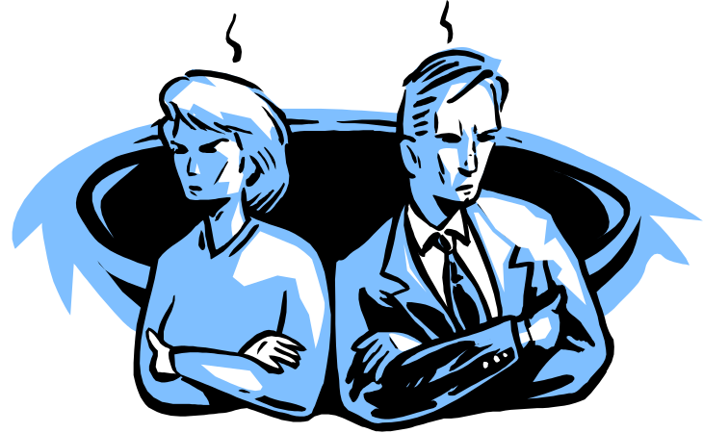
Grievances
Grievance
  Any factor involving wages, hours, or conditions of employment that is used as a complaint against the employer.
Sources of Grievances
  Discipline
  Seniority
  Job evaluations
  Work assignments
  Overtime
  Vacations
  Incentive plans
  Holiday pay
  Problem employees

Slide 15
K E Y T E R M S
closed shop
union shop
agency shop
open shop
right to work
Norris-LaGuardia Act (1932)
National Labor Relations (or Wagner) Act
National Labor Relations Board (NLRB)
Taft-Hartley Act (1947)
national emergency strikes
Landrum-Griffin Act (1959)
union salting
authorization cards
bargaining unit
decertification
collective bargaining
good faith bargaining
voluntary bargaining items
illegal bargaining items
mandatory bargaining items
impasse
mediation
fact finder
arbitration
strike
economic strike
unfair labor practice strike
wildcat strike
sympathy strike
picketing
corporate campaign
boycott
inside games
lockout
injunction
grievance

