Slide 1
HRM
Core text book:
Beardwell I. & Claydon, T (2007)
Human Resource Management: A Contemporary Perspective,
(5th edition) FT Prentice Hall

Slide 2
At the BA level, we expect you to:
Demonstrate good understanding of the concepts and theories related to the subject
Critically evaluate the theories and concepts
  Just stating the theories and ideas will not be sufficient.

Slide 3
Learner’s attitude
    Passive learners only retain and recall 14% of what they’ve heard
    Proactive learners can increase their retention to 80%
Participate, take notes, be critical, take responsibility for your learning.
Do not expect your lecturer to spoon feed you knowledge.

Slide 4
Now, let’s talk HR
Objectives:
    Understand the context and historical background of HR
    Review and evaluate the different HRM models
    Understand the role of HR through different approaches

Slide 5
What is HR?
Managing people through a strategic and coherent approach
Operates through HR Systems:
    Philosophies Company values and guiding principles
    Strategies What HRM is aiming for
    Policies How values, principles and strategies are applied
    Processes Procedures to implement HR strategic plan
    Practices Informal approaches used in managing people
    Programmes Enabling implementation of HR plan

Slide 6
Evolution of Personnel and Human Resources
Preindustrial society | Personnel | HR
Custom and practice | Operational services | Strategic input
Master/Servant | Collective approach | Individual employee approach

Slide 7
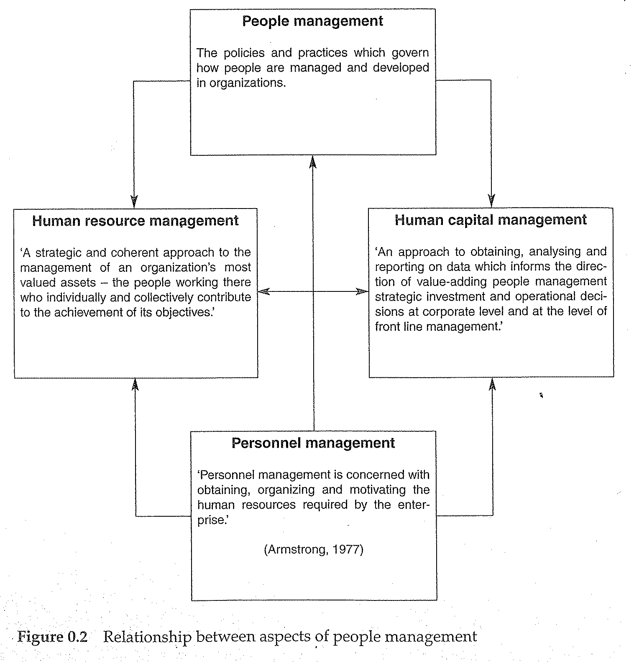
It’s all about managing people

Slide 8
Hard HR and Soft HR
Hard HR then Strategic HRM:
    Employees=cost to be minimised
    HR are deployed to achieve business goals in the same way as any other resource.
    Focus on « flexibility techniques »
    Limited investment in learning and development
Soft HR then High-commitment management:
    Employees=resource worth investing in
    Focus on high-commitment/high-involvement HR practices

Slide 9
Looking at different approaches
The human relation approach
  Started with Mayo (1933) – Hawthorne experiments
  Experiments showed that:
Also found that:
  Peer work influences workplace behaviour more than management can
  Identification of informal groups
Variable | Impact on productivity
Change in environment | NO
Interest in employee welfare | YES

Slide 10
Different HR approaches (2)
The scientific approach
    Segmenting work into a series of allocated tasks
    No need of skilled labour
    Reduces manufacturing costs by increasing efficiency and production.

Slide 11
Different approaches
New scientists
    New applications of the scientific management systems
    Re-engineering, competencies approach and information technology solution
    Systematic approach
    Cost reductions and greater control of employee behaviour
    Micromanagement
    Counter-productive to employee motivation

Slide 12
The integrated approach
The integrated approach has evolved from a long tradition of academic research and debate
Based a broad church of academic research:
    Organisational psychology
    Sociology
    Management studies
    Practitioner research
Integrated HR is situation specific.

Slide 13
The Integrated Approach to HR
Old style Personnel & HR tended to function at operational levels/ policy implementation (Legge,1993)
The modern HR professional requires an integrated strategy. Working with managers to create strategic actions.
Over 30 studies conducted in both UK and USA found a positive correlation between people management and organisational performance. Alberg (2002,p23).
Background reading:
    Alberg, R. (2002) Counting With Numbers. People Management, 10th January. CIPD.
    Legge, K. (1993) The Role of Personnel Specialist: Centrality or Marginalisation, in Clark (ed) Human Resource Management And Technical Change. London: Sage.

Slide 14
The matching model
Necessity of tight fit between HR strategy and business strategy
    Introduced the concept of strategic HRM
    Policies are inextricably linked to the « formulation and implementation of strategic corporate and/or business objectives. » (Devanna et al. 1984: 34)
    Taken from the core reference book

Slide 15
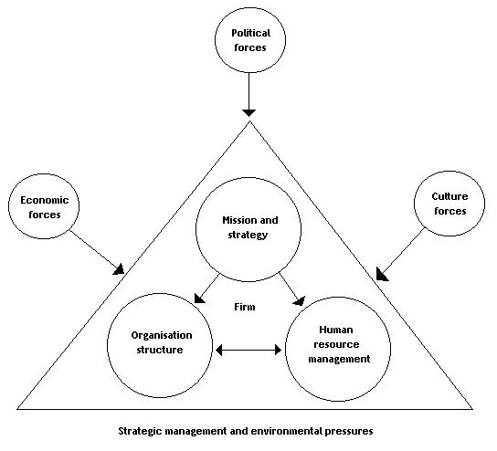
The contexte of HR according to the matching model

Slide 16
Key focus areas according to the Matching model
Price (2004: 45-46) outlines the following areas for the appropriate HR policies and systems:
    Selection of the most suitable people to meet business needs
    Performance in the pursuit of business objectives
    Appraisal monitoring perfromance and providing feedback to the organisation and its employees
    Rewards for appropriate performance
    Development of the skills and knowledge required to meet business objectives

Slide 17
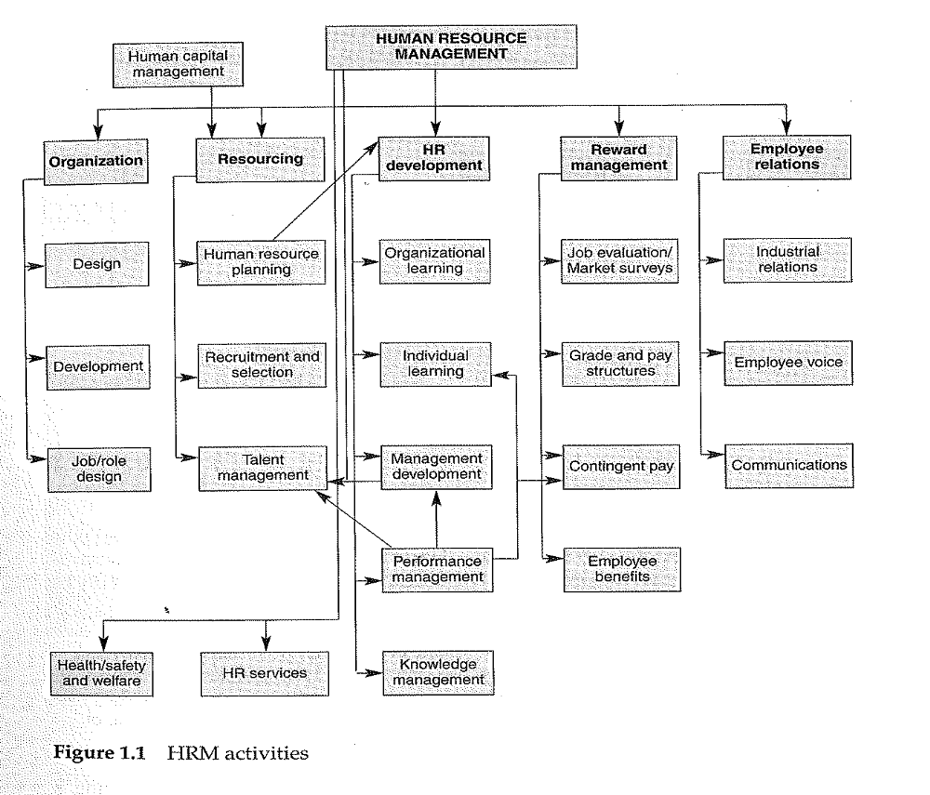
HRM activities

