Slide 1
Managing Global Human Resources

Slide 2

After studying this chapter, you should be able to:
List the HR challenges of international business.
Illustrate how intercountry differences affect HRM.
Discuss the global differences and similarities in HR practices.
Explain five ways to improve international assignments through selection.
Discuss how to train and maintain international employees.
17–<number>
<footer>© 2005 Prentice Hall Inc. All rights reserved.

Slide 3
The Management Challenges of International Business
Coordinating market, product, and production plans on a worldwide basis
Creating organization structures capable of balancing centralized home-office control with adequate local autonomy.
Extending its HR policies and systems to service its staffing needs abroad:

Slide 4
The HR Challenges of
International Business
Deployment
  Easily getting the right skills to where we need them, regardless of geographic location.
Knowledge and innovation dissemination
  Spreading state-of-the-art knowledge and practices throughout the organization regardless of where they originate.
Identifying and developing talent on a global basis
  Identifying can function effectively in a global organization and developing his or her abilities.

Slide 5
Global Staffing Issues
Selecting candidates for overseas assignment
Assignment terms and documentation
Relocation processing and vendor management
Immigration processing
Cultural and language orientation and training
Compensation administration and payroll processing
Tax administration
career planning and development
Handling of spouse and dependent matters

Slide 6
Intercountry Differences Affecting HRM
Cultural Factors
Economic Systems
Legal and Industrial Relations Factors
The European Union

Slide 7
Global Differences and Similarities in HR Practices
Personnel Selection Procedure
The Purpose of the Performance Appraisal
Training and Development Practices
The Use of Pay Incentives

Slide 8
A Global HR System
Making the global HR system more acceptable
  Remember that global systems are more accepted in truly global organizations.
  Investigate pressures to differentiate and determine their legitimacy.
  Try to work within the context of a strong corporate culture.

Slide 9
A Global HR System (cont’d)
Developing a more effective global HR system
  Form global HR networks.
  Remember that it’s more important to standardize ends and competencies than specific methods.
Implementing the global HR system
  Remember, “You can’t communicate enough.”
  Dedicate adequate resources for the global HR effort.

Slide 10
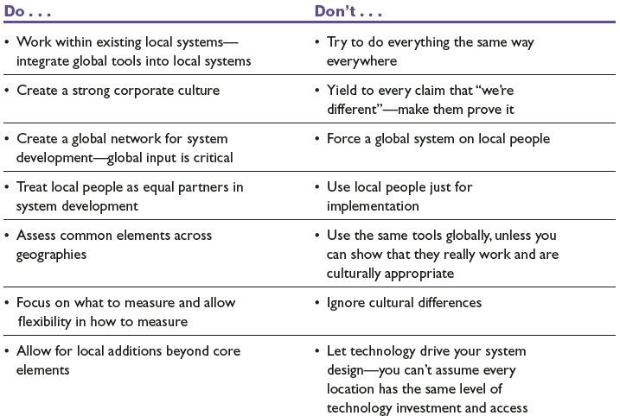
Summary of Best Practices
Source: Ann Marie Ryan et al., “Designing and Implementing Global Staffing Systems: Part 2—Best Practices,” Human Resource Management 42, no. 1 (Spring 2003), p. 93.
Table 17–1

Slide 11
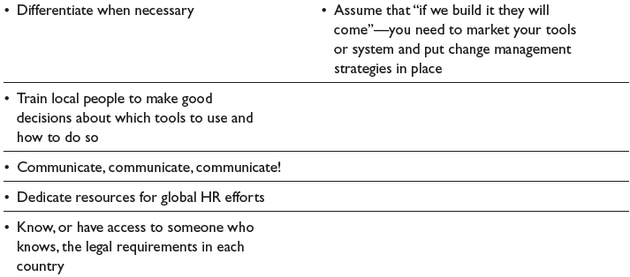
Summary of Best Practices
Source: Ann Marie Ryan et al., “Designing and Implementing Global Staffing Systems: Part 2—Best Practices,” Human Resource Management 42, no. 1 (Spring 2003), p. 93.
Table 17–1 (cont’d)

Slide 12
Staffing the Global Organization
International staffing: Home or local?
  Expatriates (expats): Noncitizens of the countries in which they are working.
  Home-country nationals: Citizens of the country in which the multinational company has its headquarters.
  Third-country nationals: Citizens of a country other than the parent or the host country.
Offshoring
  Having local employees abroad do jobs that the firm’s domestic employees previously did in-house.

Slide 13
Staffing the Global Organization (cont’d)
Offshoring
  Having local employees abroad do jobs that the firm’s domestic employees previously did in-house.
Issues in offshoring
  Having an effective supervisory and management structure in place to manage the workers.
  Screening and required training for the employees receive the that they require.
  Ensuring that compensation policies and working conditions are satisfactory.

Slide 14
Values and International Staffing Policy
Ethnocentric
  The notion that home-country attitudes, management style, knowledge, evaluation criteria, and managers are superior to anything the host country has to offer.
Polycentric
  A conscious belief that only the host-country managers can ever really understand the culture and behavior of the host-country market.
Geocentric
  The belief that the firm’s whole management staff must be scoured on a global basis, on the assumption that the best manager of a specific position anywhere may be in any of the countries in which the firm operates.

Slide 15
Why Expatriate Assignments Fail
Personality
Personal intentions
Family pressures
Inability of the spouse to adjust
Inability to cope with larger overseas responsibility.
Lack of cultural skills

Slide 16
Helping Expatriate Assignment Succeed
Providing realistic previews of what to expect
Careful screening
Improved orientation
Cultural and language training
Improved benefits packages

Slide 17
Selecting Expatriate Managers
Adaptability screening
  Assessing the assignee’s (and spouse’s) probable success in handling the foreign transfer.
  Overseas Assignment Inventory
    A test that identifies the characteristics and attitudes international assignment candidates should have.
Realistic previews
  The problems to expect in the new job as well as about the cultural benefits, problems, and idiosyncrasies of the country.

Slide 18
Five Factors Important in International Assignee Success, and Their Components
I. Job Knowledge
  and Motivation
  Managerial ability
  Organizational ability
  Imagination
  Creativity
  Administrative skills
  Alertness
  Responsibility
  Industriousness
  Initiative and energy
  High motivation
  Frankness
  Belief in mission and job
  Perseverance
III. Flexibility/Adaptability
  Resourcefulness
  Ability to deal with stress
  Flexibility
  Emotional stability
  Willingness to change
  Tolerance for ambiguity
  Adaptability
  Independence
  Dependability
  Political sensitivity
  Positive self-image
V. Family Situation
  Adaptability of spouse
  and family
  Spouse’s positive opinion
  Willingness of spouse to
  live abroad
  Stable marriage
IV. Extracultural Openness
  Variety of outside interests
  Interest in foreign cultures
  Openness
  Knowledge of local language[s]
  Outgoingness and extroversion
  Overseas experience
II. Relational Skills
  Respect
  Courtesy and fact
  Display of respect
  Kindness
  Empathy
  Non-judgmentalness
  Integrity
  Confidence
Source: Adapted from Arthur Winfred Jr., and Winston Bennett Jr., “The International Assignee: The Relative Importance of Factors Perceived to Contribute to Success,” Personnel Psychology 18 (1995), pp. 106–107.
Figure 17–1

Slide 19
Orienting and Training for
International Assignment
There is little or no systematic selection and training for assignments overseas.
Training is needed on:
  The impact of cultural differences on business outcomes.
  How attitudes (both negative and positive) are formed and how they influence behavior.
  Factual knowledge about the target country.
  Language and adjustment and adaptation skills.

Slide 20
Trends in Expatriate Training
Rotating assignments that permit overseas managers to grow professionally.
Management development centers around the world where executives hone their skills.
Classroom programs provide overseas executives with educational opportunities similar to stateside programs.
Continuing, in-country cross-cultural training
Use of returning managers as resources to cultivate the “global mind-sets” of their home-office staff.
Use of software and the Internet for cross-cultural training.

Slide 21
Compensating Expatriates
The “Balance Sheet Approach”
  Home-country groups of expenses—income taxes, housing, goods and services, and discretionary expenses—are the focus of attention.
  The employer estimates what each of these four expenses is in the expatriate’s home country, and what each will be in the host country.
  The employer then pays any differences such as additional income taxes or housing expenses.

Slide 22
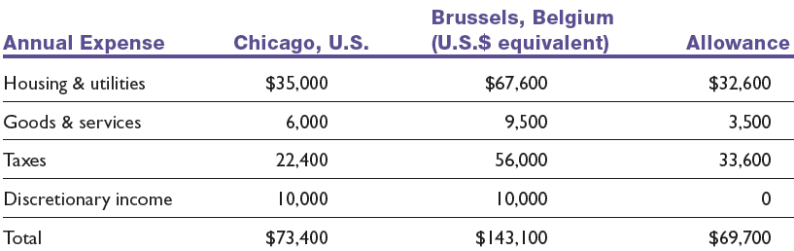
The Balance Sheet Approach
(Assumes Base Salary of $80,000)
Table 17–2

Slide 23
Incentives
Foreign service premiums
  Financial payments over and above regular base pay, and typically range between 10% and 30% of base pay.
Hardship allowances
  Payments to compensate expatriates for exceptionally hard living and working conditions at certain foreign locations.
Mobility premiums
  Lump-sum payments to reward employees for moving from one assignment to another.

Slide 24
Appraising Expatriate Managers
Challenges in appraising oversea managers
  Determining who should appraise the manager.
  Deciding on which factors to base the appraisal.
Improving the expatriate appraisal process
  Stipulate the assignment’s difficulty level, and adapt the performance criteria to the situation.
  Weigh the evaluation more toward the on-site manager’s appraisal than toward the home-site manager’s.
  If the home-office manager does the actual written appraisal, use a former expatriate from the same overseas location for advice.

Slide 25
Differences in International Labor Relations
Centralization
Union structure
Employer organization
Union recognition
Union security
Content and scope of bargaining
Grievance handling
Strikes
Worker participation

Slide 26
Terrorism, Safety, and Global HR
Taking protective measures
  Crisis management teams
Kidnapping and ransom (K&R) insurance
  Crisis situations
    Kidnapping: the employee is a hostage until the employer pays a ransom.
    Extortion: threatening bodily harm.
    Detention: holding an employee without any ransom demand.
    Threats to property or products unless the employer makes a payment.

Slide 27
Repatriation: Problems and Solutions
Problem
  Making sure that the expatriate and his or her family don’t feel that the company has left them adrift.
Solutions
  Match the expat and his or her family with a psychologist trained in repatriation issues.
  Make sure that the employee always feels that he or she is still “in the loop” with what’s happening back at the home office.
  Provide formal repatriation services.

Slide 28
Auditing the HR Function
What should HR’s functions be?
Participants then rate each of these functions to answer the question, “How important are each of these functions?”
Next, they answer the question, “How well are each of the functions performed?”
Next, compare (2) and (3) to focus on “What needs improvement?”
Then, top management needs to answer the question, “Overall, how effectively does the HR function allocate its resources?

Slide 29
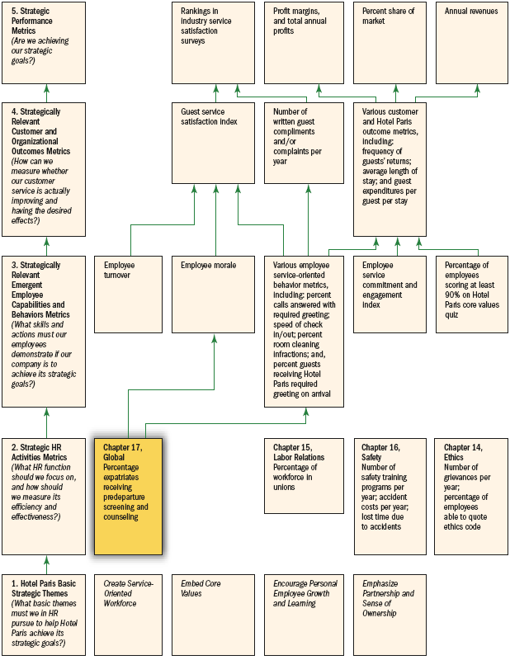
HR Scorecard for Hotel Paris International Corporation*
Note: *(An abbreviated example showing selected HR practices and outcomes aimed at implementing the competitive strategy, “To use superior guest services to differentiate the Hotel Paris properties and thus increase the length of stays and the return rate of guests and thus boost revenues and profitability”)
Figure 17–2

Slide 30
Key Terms
codetermination
expatriates (expats)
home-country nationals
third-country nationals
offshoring
ethnocentric
polycentric
geocentric
adaptability screening
foreign service premiums
hardship allowances
mobility premiums

