Slide 1
Strategic Human Resource Management in Europe
Catherine Voynnet Fourboul

Slide 2
Introduction & objectives
to understand what means International Human Resource Management, the specificity of Europe
to introduce progressively the managerial context (FDI, transnational, integration, organisation structure, HQ orientation) of Industrial Relations

Slide 3
Contents
IHRM definition
FDI & Transnationalisation
European specificity (structure, corporate governance, HQs orientation)
European Human Resource Management

Slide 4
IHRM definition

Slide 5
International Human Resource Management
Definition

Slide 6
Towards a definition of International Human Resource Management
Industrial Relations
MNC context
Issues of HRM
HRM strategies
Culture & acculturation
Comparative issues

Slide 7
Fields and types of Comparative Management Research
Enterprises / local, institutional, cultural environment
Enterprise-Specific
Location-Specific
Enterprises / local, institutional, cultural environment / international environment
Enterprises / international environment
Local / international environment
International-Environment Related
Source: Redding S. G. (1994), Comparative Management Theory: Jungle, Zoo or Fossil Bed ?, Organization studies, vol. 15, n° 3.

Slide 8
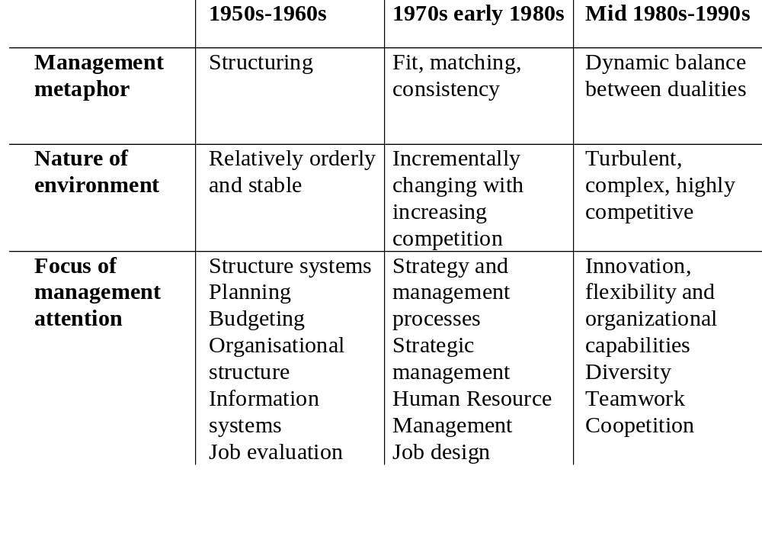
3 paradigms of Management

Slide 9
FDI & Transnationalisation

Slide 10
Global interdependence
FOMBRUN WALLY, globalizing management, 1992
Communication
Travel Trade
Capital Flows
Direct Investment
North America
Europe
Asia Pacific
Capital Flight
Widening Gap
Net World Order
Capitalist Ascendency
Spread of English
Cultural Homogeneization
Technological change
Financial integration
Regional
communities
Third world periphery
Shifting political axes
Western hegemony
INFRASTRUCTURE
SOCIOSTRUCTURE
SUPERSTRUCTURE

Slide 11
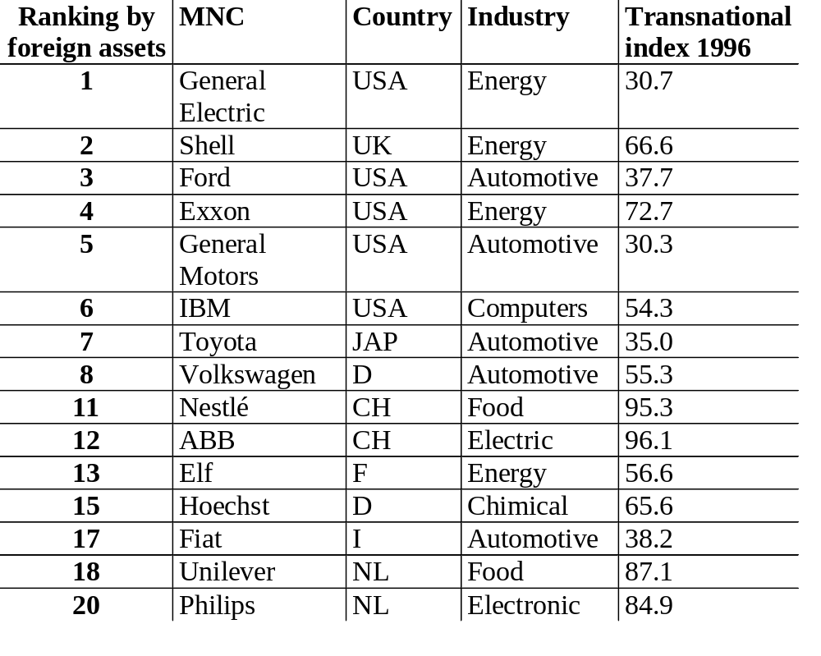
Some of the world’s top MNCs
Source : World investment report, 1996, United Nations Conference on Trade and Development

Slide 12
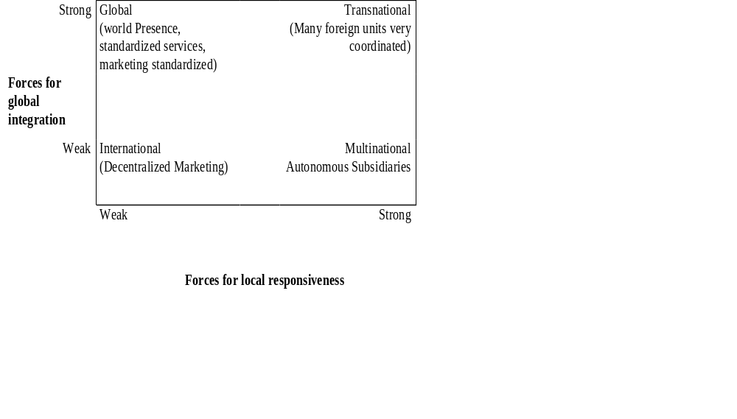
The environment of MNCs

Slide 13
Transnational Integration : definition
Increasing integration result in increased intrafirm exchanges of :
  people
  technology
  raw materials
  components
  finish goods

Slide 14
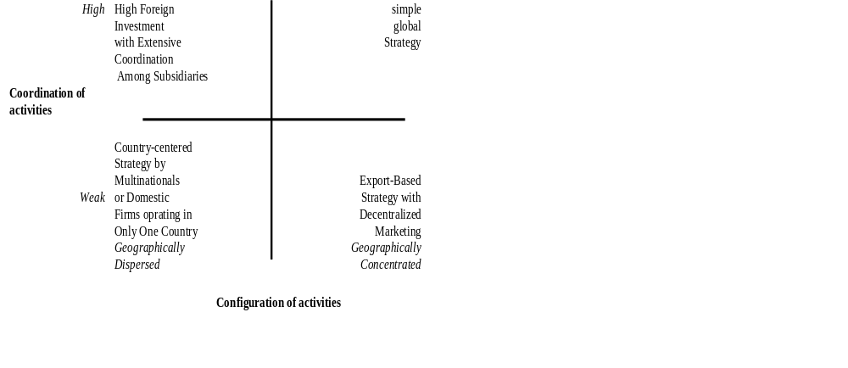
Types of international strategies
Source : Michael E. Porter, Competition in Global Industries, Harvard Business School Press, BOSTON , 1986

Slide 15
Transnational Integration : definition
not only Cross border coordination
rationalization
  standardization of product
  centralization of technological development
  vertical or horizontal integration of manufacturing
dependence of subsidiaries on the MNC system

Slide 16
Transnational Integration : definition
Increasing integration result in increased intrafirm exchanges of :
  people
  technology
  raw materials
  components
  finish goods

Slide 17
Transnational Integration : definition
Internationalization and integration are different
Transnational integration entails exploiting assets internationally through internalization within the firm, through administrative hierarchies rather than external markets

Slide 18
Degree of transnational integration
Flows of :
  parts, components and finished goods
  funds, skills and other scarce resources
  intelligence, ideas and knowledge
  people across borders

Slide 19
Degree of transnational integration
Operationalisation of a concept
  assumption : the greater the degree of intrafirm trade, the greater the degree of integration
  intrafirm flows of products correlate with flows of resources and information
International sales = parent exports + sales of overseas subsidiaries

Slide 20
Degree of transnational integration
Index of integration =
affil to affil + affil to par + par to affil
affil sales + par exports

Slide 21
HRM context

Slide 22
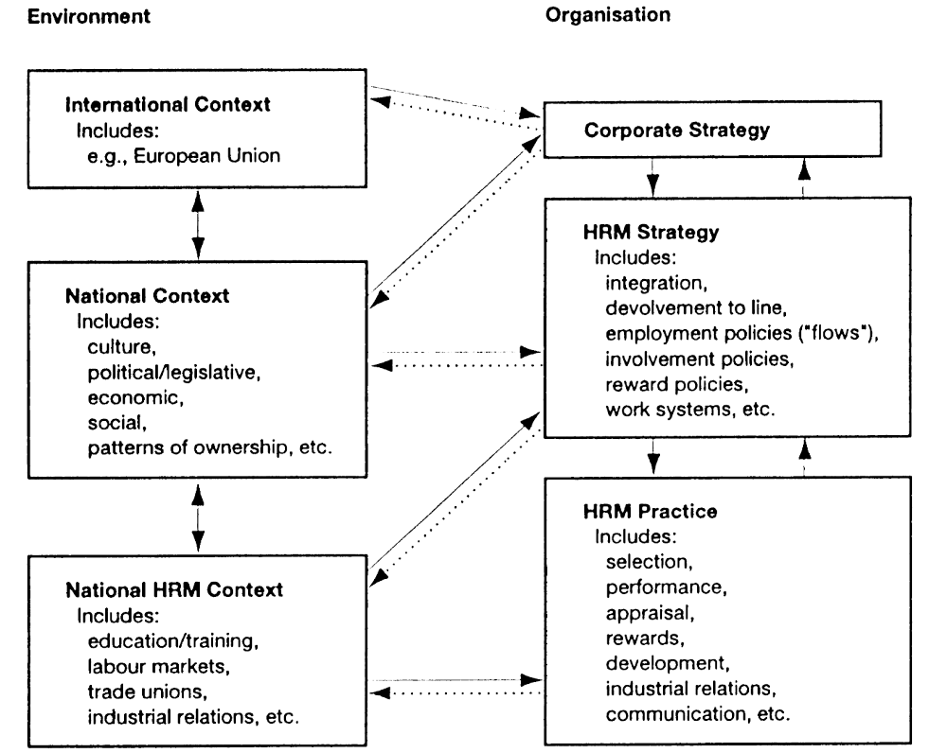
Source: Brewster C. (1995), Towards a “European” Model of Human Resource Management, Journal of International Business Studies, vol. 26, n° 1.

Slide 23
Country’s factor
National cultures impact

Slide 24
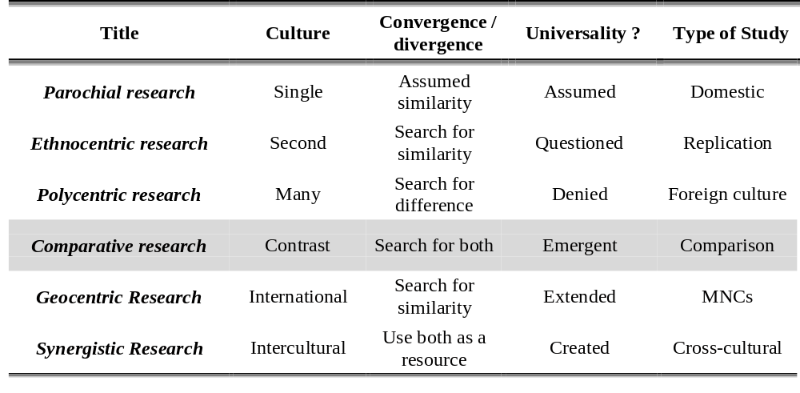
Types of research in International Management
Adapted from Adler N. J (1984), Understanding the way of understanding, in Farmer R. N. [ed.], Advances in International Comparative Management, pp. 34-35.

Slide 25
Different socialization emphases to Power Distance
Power Distance | Small | High
In the family | Children encouraged to have a will of their own Parents treated as equals | Children educates towards obedience to parents parents treated as superiors
At school | Student-centred education (initiative) Learning represents impersonal truth | Teacher-centred education (order) Learning represents personal wisdom from teacher (guru)
At the workplace | Hierarchy means an inequality of roles, established for convenience Subordinates expect to be consulted Ideal boss is resourceful democrat | Hierarchy means existential inequality Subordinates expect to be told what to do Ideal boss is benevolent autocrat (good father)

Slide 26
Different socialization emphases to collectivism and individualism
 | Collectivist societies | Individualist societies
In the family | Education towards « we » consciousness Opinions predetermined by group Obligation to family or in-group (harmony, respect, shame) | Education towards « I » consciousness Private opinion expected Obligations to self: self-interest, self-actualisation, guilt
At school | Learning is for the young only Learn how to do | Permanent education Learn how to learn
At the workplace | Value standards differ for in-groups and out-groups: particularism Other people are seen as members of some group Relationship prevail over task Moral model of employer-employee relationship | Same value standards apply to all: universalism Other people seen as potential resources Task prevails over relationship Calculative model of employer-employee relationship

Slide 27
Different socialization emphases to feminity and masculinity
 | Feminine societies | Masculine societies
In the family | Stress on relationships Solidarity Resolution of conflicts by compromise and negotiation | Stress on achievement Competition Resolution of conflict by fighting them out
At school | Average student is norm System rewards students' social adaptation Student’s failure at school is relatively minor accident | Best student are norm System rewards students' academic performance Students' failure is disaster – may lead to suicide
At the workplace | Assertiveness is ridiculed Undersell yourself Stress on life quality Intuition | Assertiveness appreciated Oversell yourself Stress on careers decisiveness

Slide 28
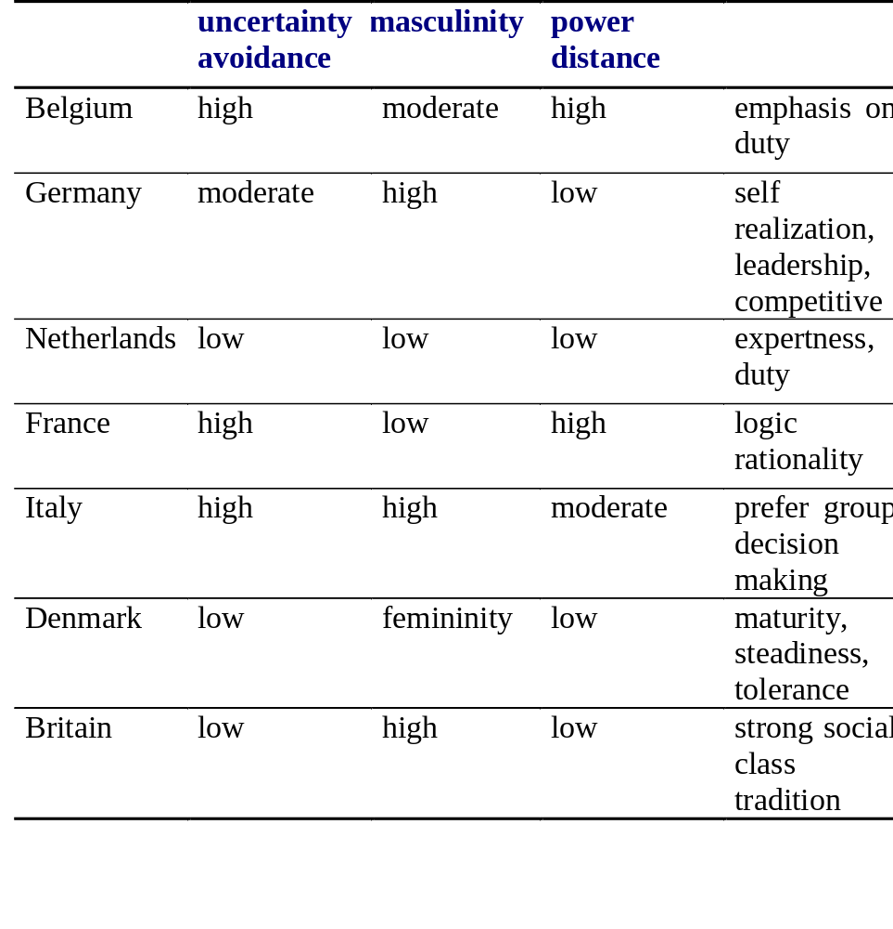
Culture specifications

Slide 29
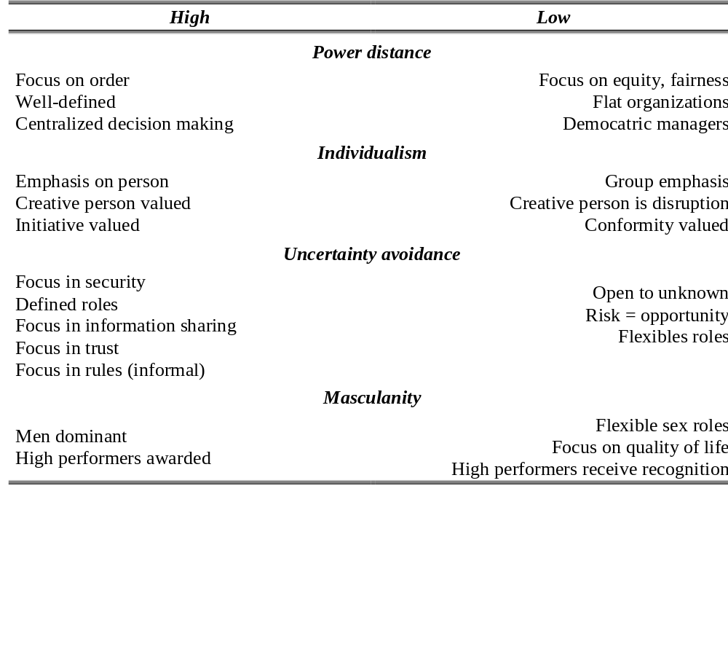
Hofstede ’s dimensions of national culture
Adapted from Hofstede G. (1993), Culture Constraints in Management Theories, Academy of Management Executive, vol. 7, n° 1.

Slide 30
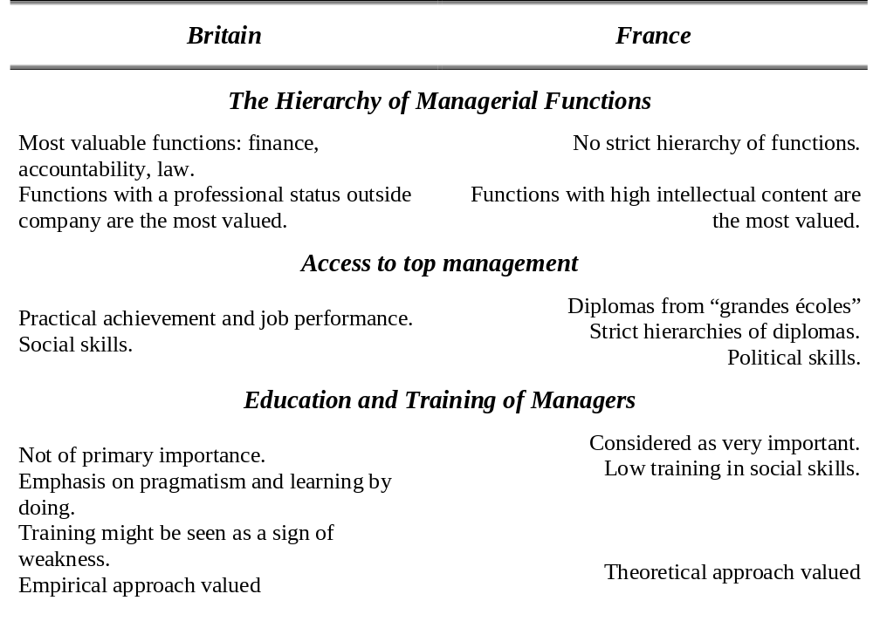
Implications of British and French management cultures
Source: Naulleau G., Criccom J. H. (1993), A comparison of French and British Management Cultures, Management Education and Development, vol. 24, pp. 14-25

Slide 31
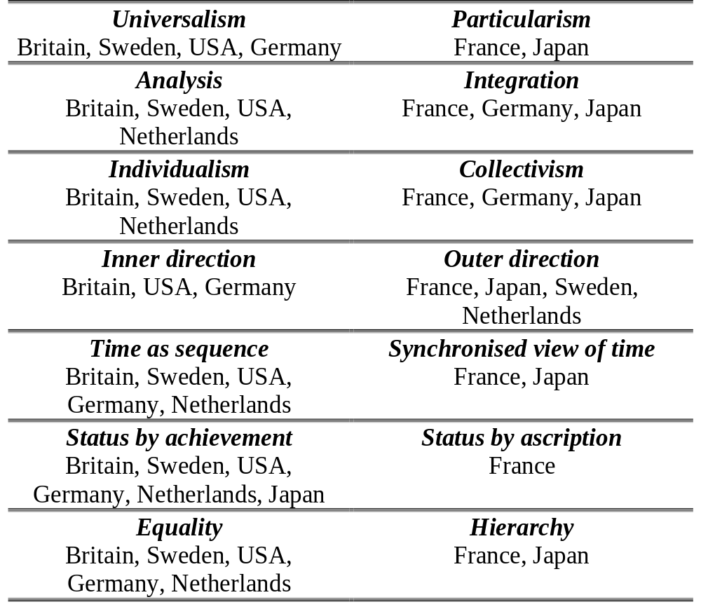
Trompenaars’ cultural dimensions
Source: Beardwell I., Holden L. (1997), Human Resource Management: A contemporary perspective, Pitman, pp. 695

Slide 32
HR practices in MNCs
Susan Schneider, 1986, HRM
HR policies developed at HQ reflect the national culture of the MNC
A menu of HR practices : planning & staffing, appraisal & compensation, selection & socialisation

Slide 33
Planning & staffing
Career management systems represent formal LT HR planning (inappropriate in Islamic countries vs determinant in Europe
France: computerized system: engineering approach
In US, concrete results = criteria for selection & promotion ≠ UK France (school & family background)
In Japan job descriptions are vague & flexible to fit uncertainty to strengthen the bond Individu/Cie ≠ US F specified : more job mobility between organizations
F values maths & science diplomas ≠ US UK ψ, HR generalists
Europeans more internationaly oriented than US

Slide 34
Appraisal and compensation
In Japanese firms: concern for integrity, morality, loyalty
MBO: appraisal and compensation systems are linked
  US practice easily transferred in D (decentralisation, less emphasis on hierarchy and formalization) but in France considered as an exercise of arbitrary power
In one Danish subsidiary, a proposal for incentives for sales people was turned down ≠ egalitarian spirit
D (1 Mercedes not enough: need for a chauffeur = status concern) ; S (monetary reward less motivating than vacation village): quality of life
Pension expected 40% of salary in Southern Europe ≠ 85% in Nordic countries

Slide 35
Selection & socialization
IBM avoid power accumulation of managers by moving them every 2 years (I’ve Been Moved) ≠ Italian: more political than instrumental oriented
Boot camp tactics of IBM to create professional armies of corporate soldiers ≠ not well accepted in Europe
Artifacts of corporate culture (US) seen in Europe as an intrusion into the private realm of the individual
US: Formal, impersonal control ≠ Europe informal, personal control

Slide 36
Corporate culture

Slide 37
Corporate Culture
“A pattern of basic assumptions – invented, discovered or developed by a given group as it learns to cope with its problems of external adaptation and internal integration – that has worked well enough to be considered valid and therefore, to be taught to new members as the correct way to perceive, think and feel in relation to those problems.” E H. Schein [1986]

Slide 38
Corporate Culture
Integrative and unifying character
Common code of information transmission
Increase convergence, co-ordination
Organisational and local national culture both influence the communication system of the company.

Slide 39
Identification with the worldwide Organization
The subtlety and complexity of a flexible multidimensional decision-making process appears difficult to achieve solely through formal organizational change.
Influence through the informal structure
Management of expatriates develop linkages throughout the MNC

Slide 40
European specificity
Structure,
Corporate governance,
HQs orientation

Slide 41
Factors of integration of European H.R.M.
Common strategic pressures
Foreign Direct Investment
Emergence of transnational organizations
Restructuring into larger units
A highly regulated labor environment
Strong identity of managers (cadres)
Cultural diversity (organ.&national level)

Slide 42
Implication for Human Resource Management
Flat, flexible Europe-wide org. Structure
Structures more customer-focused
More strategic policy-making role for the HRM function
Greater sensitivity to national cultural differences
Emergence of Euro-Managers

Slide 43
Organizational structure

Slide 44
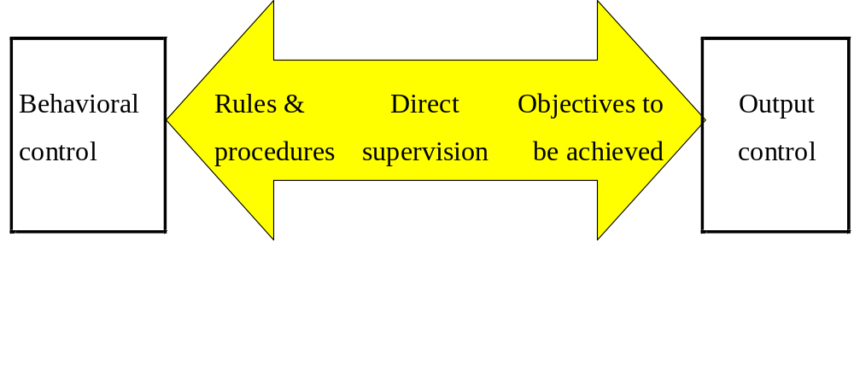
Continuum of Two Basic Types of Control

Slide 45
Seven structural Dimensions
Formulation
Specialization
Standardization
Hierarchy of authority
Complexity
Centralization
Professionalism

Slide 46
Metaphors and images
Machines
Organisms
Brains
Cultures
Political systems
Psychic prisons
Flux and transformation
Instruments of domination
Morgan G., 1986, Images of Organization

Slide 47
The bases for grouping people in the structure
Employee roles
Communication and coordination nodes and patterns of interactions
Time spans of discretion and levels of individual capability

Slide 48
Employee roles (Mintzberg)
Operating core
strategic apex
Middle line
Technostructure
Support Staff
Ideology

Slide 49
Aims of Organization Design
Shape the Org.
Establish a mechanism of governance
Shape the way people think and behave
Create an org. Identity
Provide the most appropriate combination of competencies
Ensure efficient communication, coordination

Slide 50
Scope of organizational design
Establishing the processes by which responsibility is allocated
Definition of roles
Creation of control systems
Identification of accountabilities
Delegation of decision making authority
        Source Galbraith 1977

Slide 51
Forces for coordination & departmentalization
Departmentalization forces
Equilibrium
Functional departmentalization
Matrix departmentalization
Coordination forces
Place or product departmentalization

Slide 52
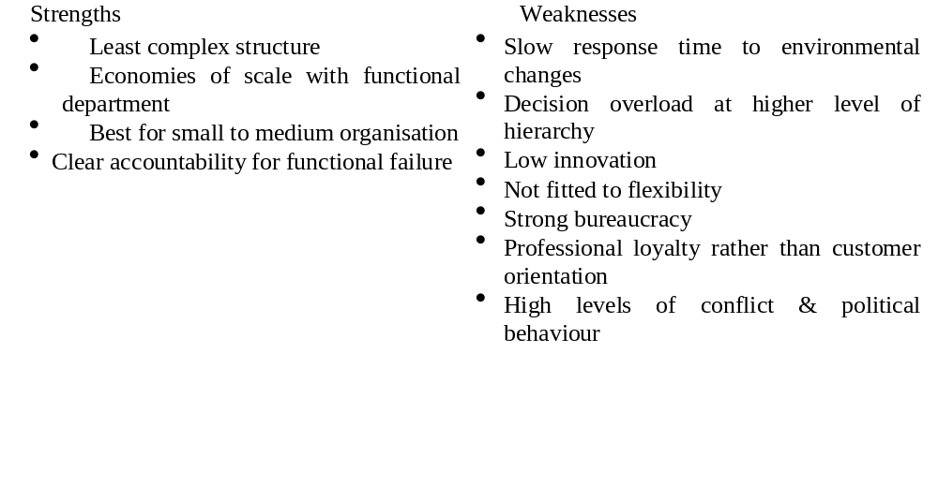
Functional structure

Slide 53
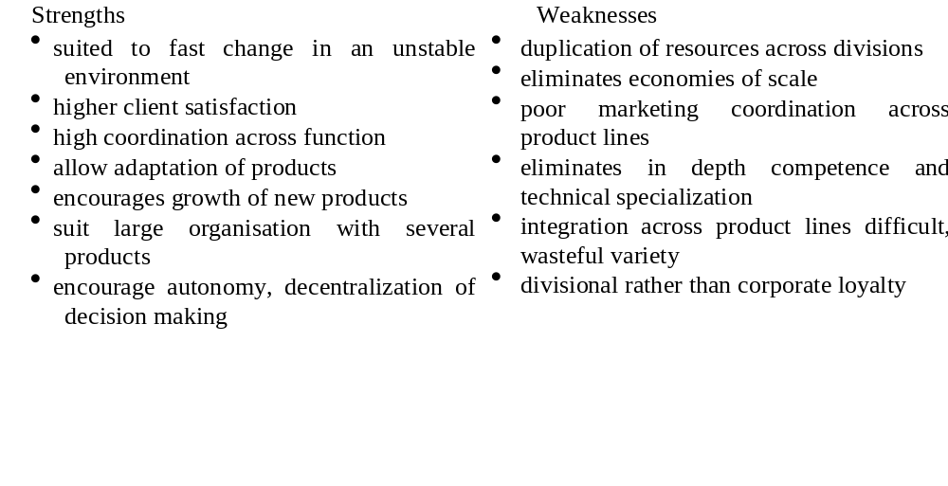
Product or divisional structure

Slide 54
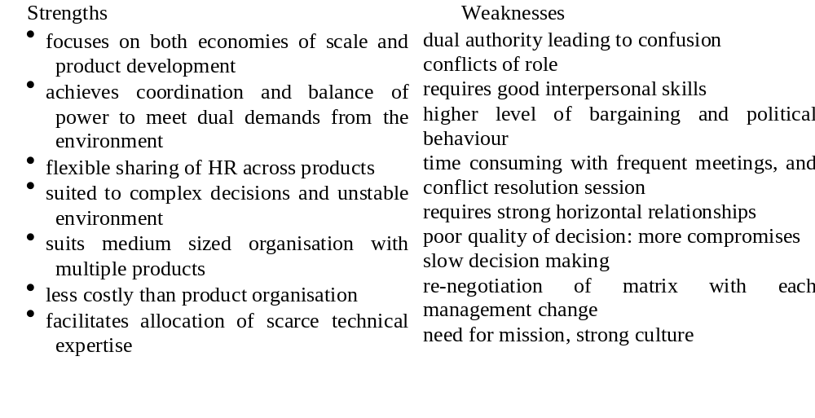
Matrix structure

Slide 55
Case study: context
A MNC in the chemical sector, 70 000 employees. 5 divisions.
The aim: organizing one division, the European fibre polymer division
Products : nylon, polyester, thread, stockings, carpet
Every corporations are autonomous CH: 2500, F:3500, D:2500, I:1200 (1 Managing director + 1 HRD/ country)
There is 1 Managing Director at the EU level but no troops.

Slide 56
Case study: plan & question
Report: Cost, no communication and no mobility among nationals HRD. HRD don’t know each other. Executives: 10 % of employees, no mobility.
Aim: to Europeanize the structure, to increase the intra sector mobility from 5 to 50 movements, to create a HR organization
Questions: How would you organize the European department with 4 executives? Imagine the possible scenarios and the advantages and drawbacks for each scenario. What action do you take? What are the limits?

Slide 57
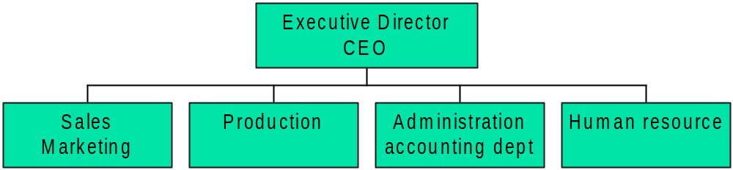
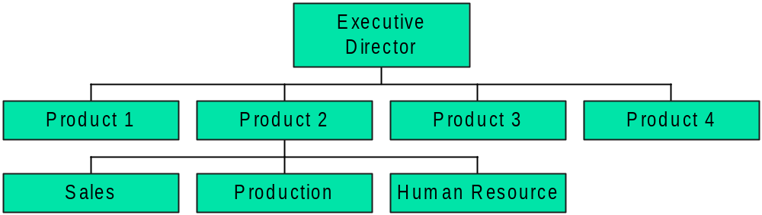
Functional Structure
Product / divisional Structure

Slide 58
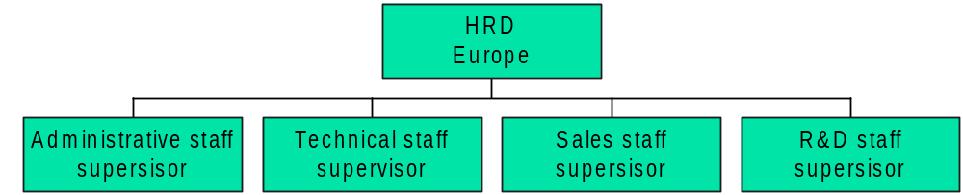
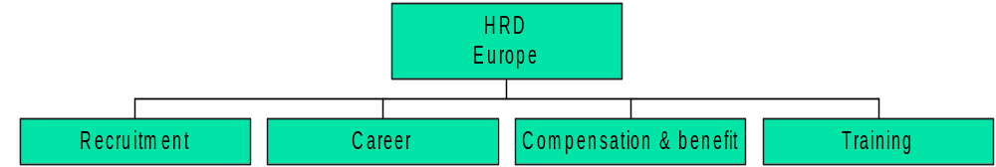
Craft Scenario: homogeneity of career path
HRM functions Scenario :

Slide 59
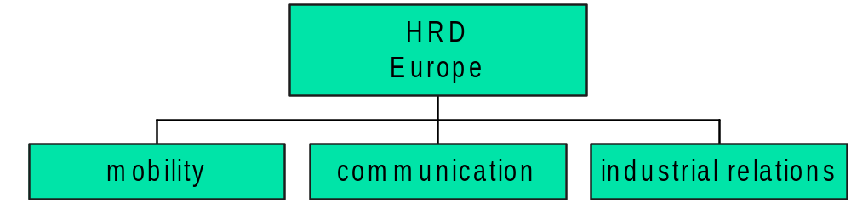
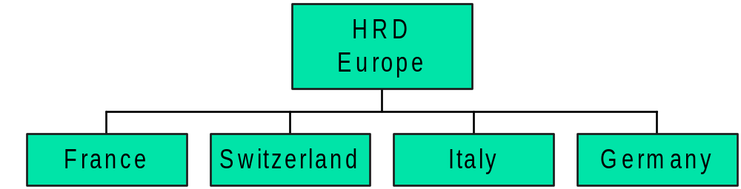
Human resources themes Scenario
Countries scenario

Slide 60
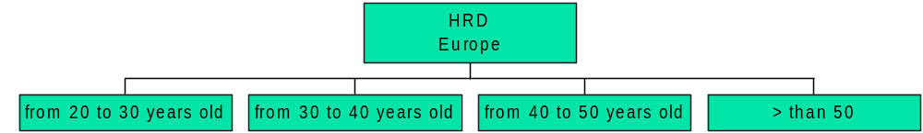
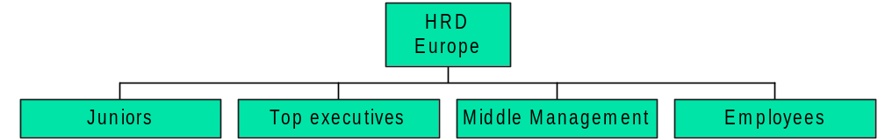
Age scenario
Layer scenario

Slide 61
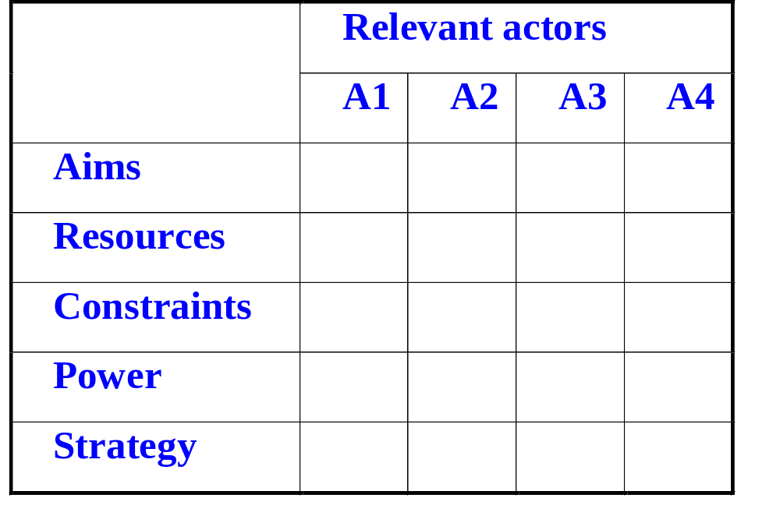
Strategic analysis framework

Slide 62
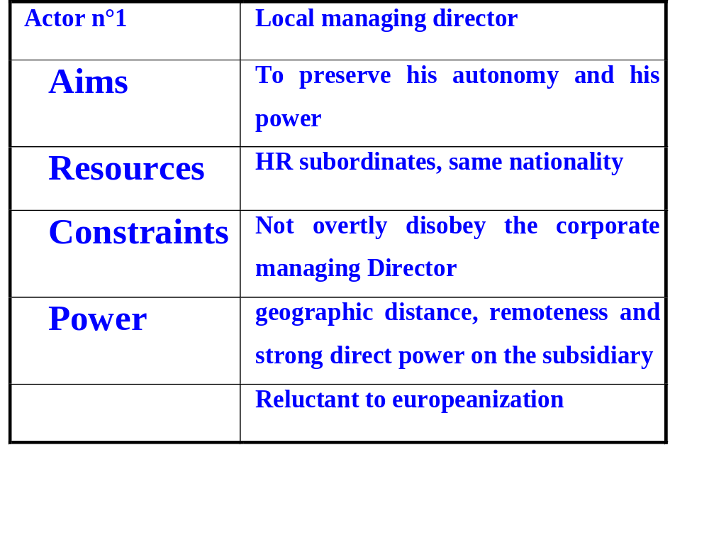
Strategic analysis: local MD

Slide 63
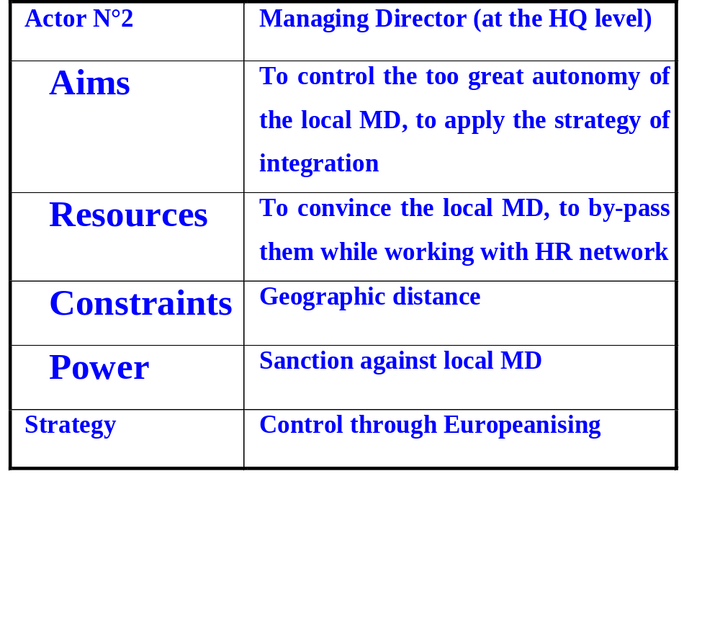
Strategic analysis: corporate managing director

Slide 64
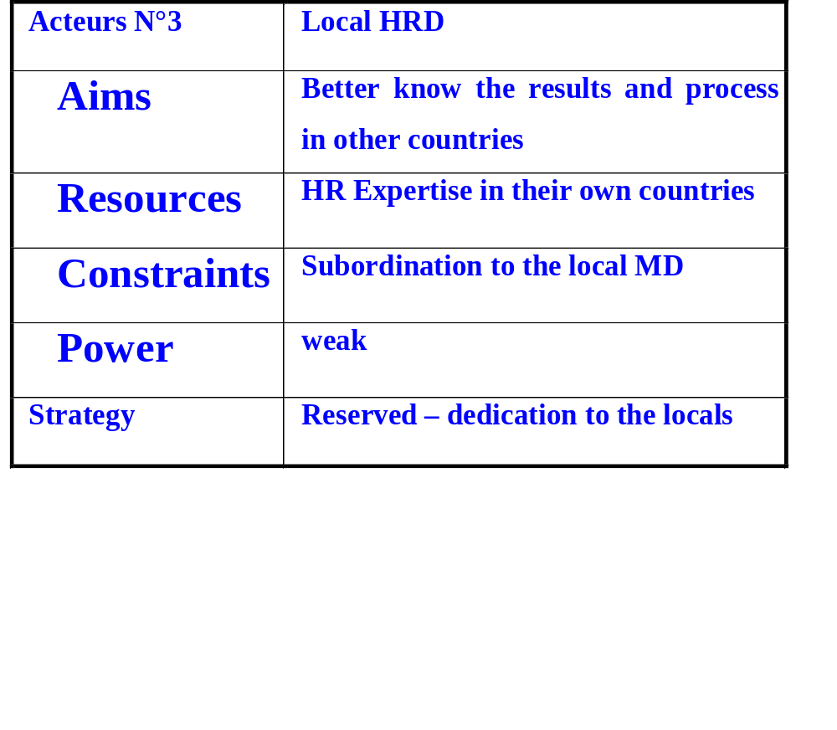
Strategic analysis: HRD

Slide 65
Implementation
Political blocks (Managing Directors of national countries
  fear to lost power
  nominate ex-nationals HRD at the European level
  Influence for a country /structure
  failure

Slide 66
National differences in organization structure
UK
Management
Technical
staff
Supervisory staff
Clerical
administrative
Staff 37%
Production workers
Maintenance
workers
Works 63%

Slide 67
National differences in organization structure
France
Management
Technical
staff
Supervisory staff
Clerical
administrative
Staff 41.6%
Production workers
Maintenance
workers
Works 58.4%

Slide 68
National differences in organization structure
Germany
Management
Technical
staff
Supervisory staff
Clerical
administrative
Staff 28.2%
Production workers
Maintenance
workers
Works 71.8%

Slide 69
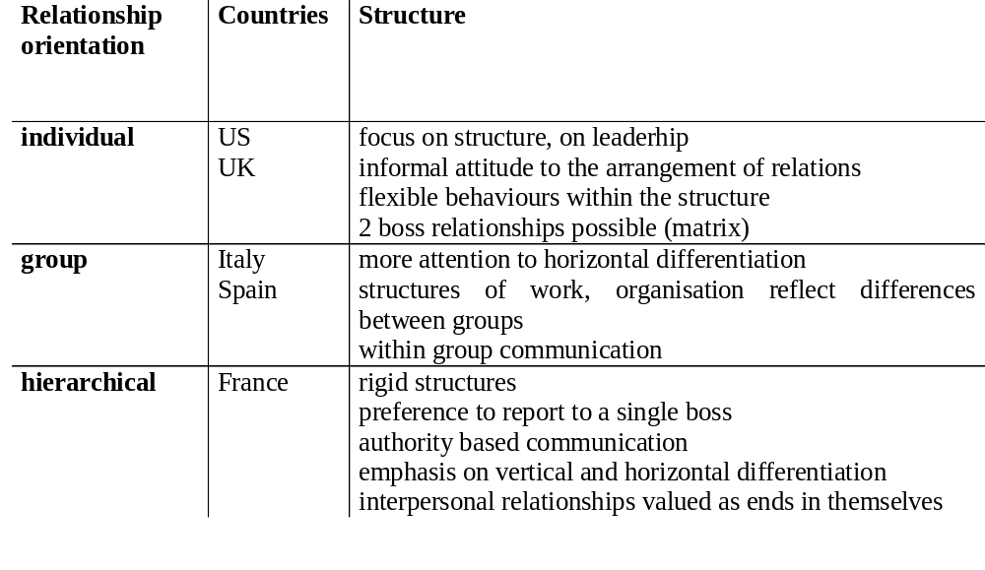
Culture and structure

Slide 70
Corporate governance

Slide 71
Corporate governance
How a MNC organization structures the 2 main bodies of corporate governance?
Proportion of insiders and outsiders on boards
unitary and dual board structure

Slide 72
Governance system
German and French companies  a two- or a unitary system of administration,
British companies  the unitary system.
dual-system
  both a supervisory and a management board with overlap in membership,
  supervisory board exert control over the management board
In the unitary system
  executive and non-executive directors sit together on one board.

Slide 73
Critics of the 2 tier structure
+ | Effective control over management
- | Members on a separate supervisory board remain too remote from the work of senior management
- | Leads to confusion in top management and slow down the decision-making process

Slide 74
The case of Germany
In Germany: size dependence
  unitary  (< 500 employees) small CIE (GmbH)
  dual  larger companies (AG or Aktiengesellschaft)
single-tier board: company managers + directors elected by shareholders.
two-tier system:
  supervisory board (Aufsichtsrat) shareholders and employee representatives.
    Bankers mainly on the supervisory boards. The composition of the supervisory board tends to be a mirror of the company's business relationships.
    other industrialists (customers or suppliers)
  The management board (Vorstand) consists solely of 3-15 top managers.

Slide 75
The German system of management: institutions
is a collegiate system where members bear collective responsibility for the company
no managing director, only a chairman who is considered primus inter pares.
The supervisory board
  the legally designated organ of control over the management board
  extensive formal powers
    appoints and dismisses top managers,
    determines their remuneration and supervises their activity.
    advises on general company policy and can specify which kind of management decisions require its prior consent.

Slide 76
The German system of management: stakeholders
    German banks (long-term perspective): do not press business enterprises for short-term returns on invested capital. ≠ British and French banks and individual shareholders (ST)
    The supervisory board:
      from control < to administration
      close community of interest between members of the two boards
    Bank representatives are valued
      they provide a broader sectoral or even macro-economic perspective, offer an unrivalled consultancy service, can mobilize capital and have good government contacts. Industrialists, in turn, serve on banks' supervisory boards.
    The supervisory board may wrest control from top management and actively participate in, or dominate, key decision-making
    Top management is on five-year contracts which have to be renewed by the board  potential power.
    Few cases (Thyssen Krupp and AEG) where the bank representatives removed the chairman of the management board because his performance was considered unsatisfactory.

Slide 77
The German system of management in small Cies
Geschäftsführung usually consists of three to four people
  the Geschäftsführer, being the owner or chairman,
  the technical director,
  the commercial director. (sales and marketing or administration)
they manage collectively
But the technical director is invariably more powerful than the commercial director, highlighting the central importance of production in the German enterprise

Slide 78
Britain
no clear division of power at the top of the enterprise hierarchy.
The board of directors:
  both executive and non-executive directors
  supreme decision-making body, but has more a counselling role: A top management meeting in Britain, in contrast with Germany, is a board meeting
  Non-executive directors may be:
    representatives of share-owners
    non-stakeholders who are present to provide expertise.
    There are no employee representatives on the board. Some of the directors are full-time employees of the company and form its top management.
  According to Horovitz (ibid.), a majority of board members ( 69 per cent in his sample) are insiders. ln a high proportion of large British companies the managing director is at the same time the chairman of the board. The actual exercise of strategic control varies from company to company. It can lie either entirely with top maÎ1age- ment, with the board merely acting in a councelling capacity and rubber- stamping their decisions (this is relatively rare), or the board can be, to varying degrees, actively involved in strategic policy making. According to the data collected by the IDE Research Group (Wilpert and Rayley, 1983: 45, Table 4.2), the board is considered more influential in relation to top management than is the case in German companies. Although there is no collegiate management in British companies and the chief executive or managing director has ultimate responsibility for the conduct of company affairs, delegation of responsibility to other mana- gers is extensive. The chief executive is elected and can be dismissed by the board.
Financial organizations, particu.larly pension funds, have in recent

Slide 79
Britain
  a majority of board members ( 70 per cent) are insiders. The managing director is often at the same time the chairman of the board.
  The actual exercise of strategic control varies from company to company. The board acts as counsellor or can be actively involved in strategic policy making.
  the board is considered more influential in relation to top management than is the case in German companies. Although there is no collegiate management in British companies and the chief executive or managing director has ultimate responsibility for the conduct of company affairs, delegation of responsibility to other managers is extensive. The chief executive is elected and can be dismissed by the board.

Slide 80
HQs attitude towards subsidiaries
Perlmutter

Slide 81
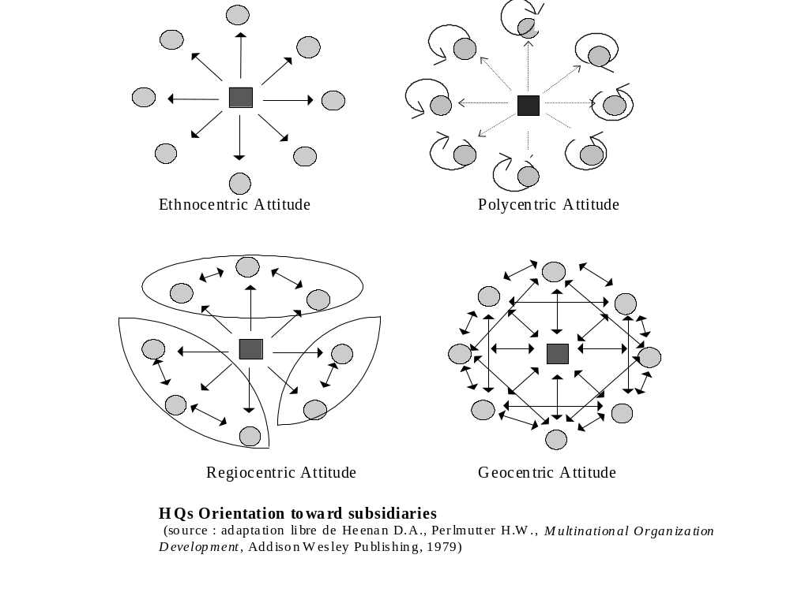

Slide 82
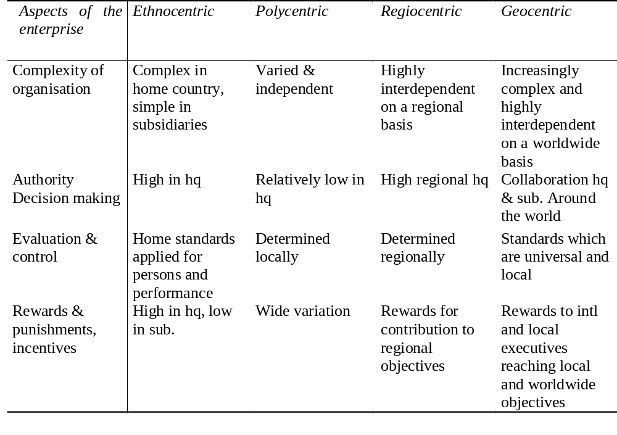
HQs orientation

Slide 83
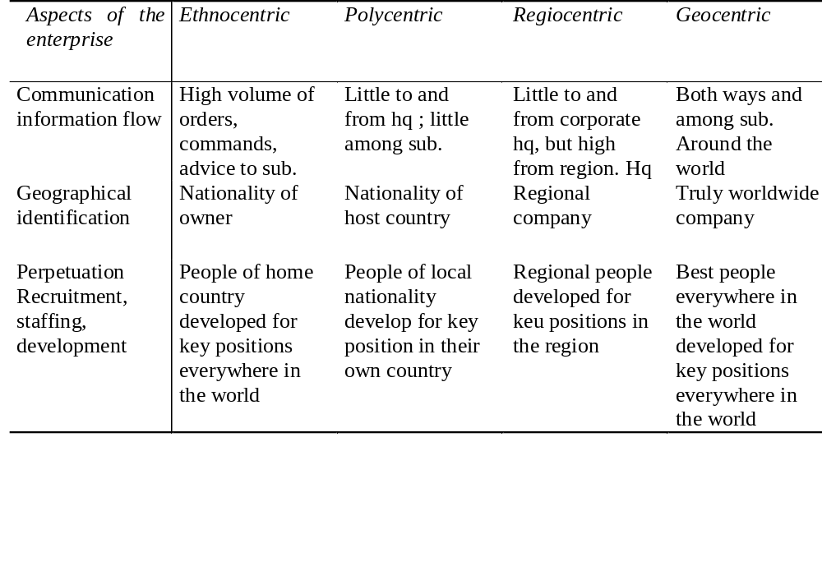
HQs orientation

Slide 84
SOURCES OF MANAGERS
Home-Country Nationals (or parent-) country nationals are the citizens of the country in which the headquarter of the multinational company is based
Host-Country Nationals Citizens of the country that is hosting a foreign subsidiary are the host-country nationals.
TCN: Third-Country Nationals = a French executive working in a German subsidiary of an American multinational company

Slide 85
Home-Country Nationals as Managers
Historically, key positions with home-country nationals. reasons:
  unavailability of host-country nationals having the required technical expertise or managerial talent
  the desire to provide the company's more promising managers with international experience
  the need for coordination and control;
  foreign image in the host country;
advantageous during the start-up phase
desire to ensure that the foreign subsidiary complies with overall company objectives and policies

Slide 86
Host-Country Nationals as Managers
in middle- and lower-level management positions in developing countries.
because of local law. But, scarcity of managers with the necessary qualifications for top jobs.
For example, Brazil requires that two-thirds of the employees in a Brazilian subsidiary be Brazilian nationals, and there are pressures on multinationals to staff upper management positions in Brazilian subsidiaries with Brazilian nationals.

Slide 87
Host-Country Nationals as Managers
Assignment of domestic North American employees on a short-term transfer or loan basis.
reasons for hiring host-country nationals :
  close to the local culture and language,
  lower costs as compared to HCN,
  improved public relations that resulted from such a practice.
  more effective in dealing with local employees and clients, greater continuity of management because they tend to stay longer in their positions than managers from other countries.
  avoidance of low morale if they don’t move into upper management positions.

Slide 88
Third-Country Nationals as Managers
greater technical expertise
only from advanced countries.
a top management position at the subsidiary is usually envisioned as the ultimate goal in her or his career development.
Advantage: salary and benefit requirements less than those of home-country nationals. a French citizen could adapt fairly readily to working in the Ivory Coast.
Drawbacks: animosities of a national character between neighboring countries-for example, India and Pakistan, Greece and Turkey.

Slide 89
What Are the Trends in International Staffing?
predictable stages of internationalization
American managers often in charge of subsidiaries – MNC with a strategy of spreading a limited product line around the globe.
from maturation to a strategy of multinational product standardization. The firms pulled together the once relatively independent subsidiaries under the umbrella of a regional headquarters office. U.S. managers: head the regional divisions
as products and policies standardized supranationally, host-country managers again replaced home-country managers as the senior staff of local subsidiaries in U.S. firms. Some even filled top managerial posts at regional division headquarters. Some host-country managers were also used to manage subsidiaries in third countries.

Slide 90
Euro managers
Euro managers are able to think European
"glocalized" in their attitudes and behavior
understand local nuances in tastes and preferences
manage people of a different cultural heritage and nationality in a flexible way
bring a diverse team together
learn at least one foreign language

Slide 91
Euro managers and firms
increasing need for managers who can work effectively in several countries and cultures.
especially true in Europe, where unification in 1992 is forcing many companies to focus several aspects of their businesses from a pan-European perspective.
Firms are facing difficulties finding Euromanagers for their European operations.
how global companies like ICI, Colgate-Palmolive, Unilever, 3M, and HoneyweIl are facing and handling the difficulties of hiring and keeping such managers .

Slide 92
IBM
Europe: an integrated market
Divergent languages and a growing skills shortage pose a particular problem for the computer industry.
  the Greeks will still use a different alphabet, the Germans will still require a double "s," and the French will still employ accents over their vowels. The problem does not end after designing separate keyboards
continentwide networks to consider, automatic translation programs to write, and manuals, help screens, operating system software.
IBM formed a Management Academy in West Berlin

Slide 93
Reasons to select the recruit
Segalla M. Sauquet A., Turati A., symbolic vs Functional Recruitment, EMJ 2001
Training in foreign languages In-house management assessment test scores Quality to handle small/middle size firm
Graduation rank | Unimportance for the French managers
Technical or specialist skills | Not a major consideration for the English, Italians, or Spanish
International work experience | More important to the French and Italian
Graduation rank | Of little importance in France
Academic background & age | Of very little importance
Culture/nationality | The English, French, and Italian place higher importance on the job candidate's cultural/national origin than the Germans and Spanish respondents

Slide 94
Symbolic recruitment
The recruit = corporate advertising - foreign faces means the company is international.
Important in Europe where the establishment of the European Market contributes to the rapid expansion of companies across borders
pressure of providing culturally sensitive services to foreign clients.
French people may find attractive to move from a local bank to an international bank. (200000 French currently live in the UK)

Slide 95
Symbolic recruitment
the Italian and French managers rely more often on symbolic rationale than their English, German and Spanish counterparts
Perhaps the French and Italian respondents believe that recruiting foreigners sends strong signals to their clients and to their own subordinate managers

Slide 96
The heterarchical MNC

Slide 97
The heterarchical MNC
Hedlund G.,the hypermodern MNC- A Heterarchy?, H.R.M., spring 1986
Near from the geocentric model but
different in strategy :
  not only exploiting competitive advantages derived from a home country
  seeking advantages originating in the global spread of the firm
different in structure :
  it defines structural properties
  then looks for strategic options

Slide 98
Heterarchy
Many centers : polyarchy
subsidiary managers play a strategic role not only for their own but for the MNC as a whole
different kinds of centers R&D, product division, marketing, purchases ; not one overriding dimension superordinate to the rest but coordination

Slide 99
Heterarchy
Favorite structure : matrix but with negotiation and different reporting
integration is achieved through normative control (cultural control)
information about the whole is contained in each part
  every member will be aware of all aspects of the firm’s operations

Slide 100
Heterarchy
Metaphor : the brain & the body
  strategy makers : the brain
  implementers : the body
  separation between thinking and acting
coalitions with other companies

Slide 101
Human Resource Management in Heterarchy
Movement between centers more common
at the core : people with a long experience
communication network not easy to imitate
hologram quality : many employee share the same info (replace each other)
the core : memory & communication
satellites : new ideas

Slide 102
Human Resource Management in Heterarchy
High rotation of personnel, travel and postings
capacity for strategic thinking and action : open communication of strategies, effective control
reward and punishment
  performance of the entire firm, shareholding

Slide 103
Personality in Heterarchy
Searching and combining elements in new ways
communicating ideas, turning them into action
several languages, knowledge of several cultures
honesty and personal integrity
willingness to take risk and to experiment

Slide 104
European Human Resource Management

Slide 105
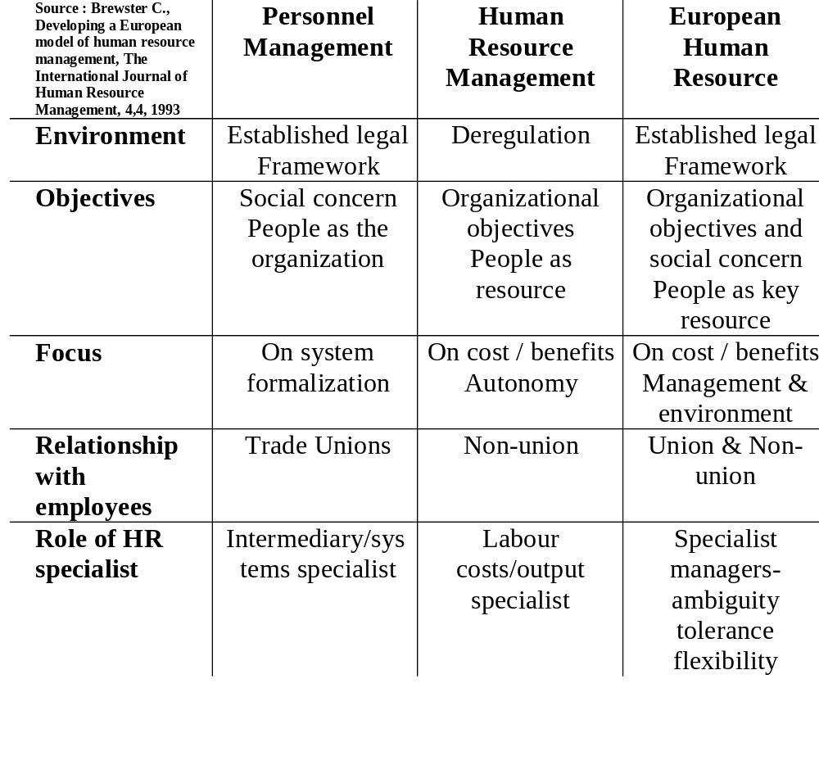
Comparing European and US HRM

Slide 106
European specificity
More restricted employer autonomy
Government intervention
Role of 'social partners'
Market processes
Emphasis on workers
Emphasis
on the group
Emphasis
on the individual
Emphasis on managers
USA

Slide 107
Reinterpretation of management agendas at the local level
Brewster, Hegewisch Lockhart - 1991
Identical questions about specific HRM tools are interpreted within the national cultural and legal context. i.e.
  Flexible working
    in Britain and Germany is linked to demographic change (reintegrate women into the labour market)
    In France , seen as a response to general changes in lifestyle
  Health and safety
    Seen in Britain as a narrow manufacturing-related issue
    Seen in Sweeden with reference to the working environment (at the forefront of the personnel management)

Slide 108
Historical role of HRM professionals
Varies considerably across European countries
  Italy, Holland: financial background  cost control ans labour savings
  Germany: legal background  focus on interpreting rules and regulations

Slide 109
Career paths vary widely
HRM specialists rarely reach the highest positions except in Scandinavia)
Greatest level of HRM experience (>5years: D, Ir, F, NL, UK)
  Coming from non-personnel functions: Dk,Ir  decentralisation
  Coming from other organizations: (most countries)

Slide 110
The German personnel function
more reactive, legalistic, concerned with training
less autonomous than many other European HRM functions.
not involved in pay negotiations but in the implementation and execution of pay policies.
The co-determination system create a climate of restraint, shared responsibility, and higher levels of trust
More activities are encoded by legislation such as rights and duties of trades unions, annual wages contracts, system of labour courts,Works Council structures

Slide 111
Role of HRM function
most European organizations with more than 200 employees determine HRM policies centrally, but share responsibility for most issues between the HRM function and the line.
In Holland and Belgium high specialized (difficulty to meet the needs of line managers)
UK Denmark more decentralized
In France  an advisory role
in Spain, Italy  low integration of HRM activities into line management.

Slide 112
Strategic role measures of the HRM function
Brewster 1993
An organizational structure which provides for the head of the HRM function to be present at the key policy-making forum
Perceived involvement in developing corporate strategy
The existence of a written personnel HRM strategy

Slide 113
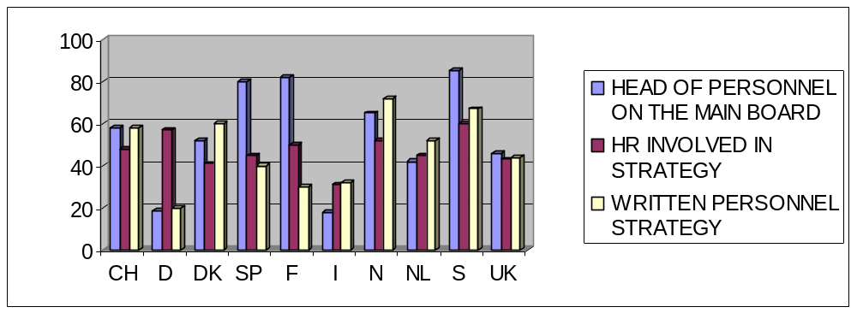
HR representation on the board and involvement in corporate strategy 1993 Brewster

Slide 114
Integration and devolvement
Degree of integration of HRM into business strategy
Degree of devolvement: the degree to which HRM practive involves and gives responsibility to line managers rather than personnel specialits

Slide 115
Mechanics (low integration and low devolvement) Specialist, but limited skills and interests of HRM practitioners. Professional personnel manager with 'higher' imperatives than the organization. Focus on the mechanical requirements of the function. Increasing isolation from strategic interests of the organization. | Guarded strategists {high integration but low devolvement} Specialists powerful figures in the organization. Close liaison with senior managers to develop strategy. Large and influential departments with centralized control of policies. Better line managers frustrated with rack of control, poor managers welcome lack of responsibility.
The wild west (low integration and high devolvement) .Individual manager free to develop his/her own employee relationship. Increased power to hire and fire, reward and develop employees. Potential for incoherence, inconsistency and strong employee reactions. | Pivotal (high integration and high devolvement) Senior personnel managers act as catalysts, facilitators and co-ordinators. Small, but powerful departments. Monitoring of and internal consulting on HRM developments. Responsibility, authority devolved to the line. Problems with resourcing high-calibre business- orientated HRM managers

Slide 116
The integration devolvement matrix Brewster Larsen 1993
Guarded strategists
Pivotal
+
Norway
Sweden
France
Switzerland
Spain
Integration
UK
Netherlands
-
Italy
Germany
Denmark
Mechanics
The wild west
-
Devolvement
+

Slide 117
Contextual determinants of European HRM
Institutional factors National business systems level of provision for social security and welfare Scope and Recency of labour legislation codification Corporate responsibility/penalization for redundancy Employment philosophy | Business structure Degree of state ownership Organizational autonomy Size of organizations level of single family stakeholders Fragmentation of industrial sectors.
National competitive advantage Factor conditions Demand Related and supporting industries Firm strategy, structure and rivalry | National culture Management styles Attitudes to authority Value differences Pay systems and distributive justice Career mobility Approaches to cultural diversity

Slide 118
Contextual determinants of European HRM
Whitley 1992
1. The nature of the firm The degree to which private managerial hierarchies co-ordinate economic activities. The degree of managerial discretion from owners. Specialization of managerial capabilities and activities within authority hierarchies. The degree to which growth is discontinuous and involves radical changes in skills and activities. The extent to which risks are managed through mutual dependence with business patterns and employees. 2. Market organization The extent of long-term c0-0perative relations between firms within and between sectors. The significance of intermediaries in the coordination of market transaction | Stability, integration and scope of business groups. Dependence of c0-0perative relations on personal ties and trust. 3. Authoritative co-ordination and control systems Integration and interdependence of economic activities. Impersonality of authority and subordination relations. Task, skill and role specialization and individualization. Differentiation of authority roles and expertise- .Decentralization of operational control and level of work group autonomy. Distance and superiority of managers. Extent of employer-employee commitment and organization-based employment system.

