Slide 1
Management & Organisational Behaviour 2e
Chapter 17
The Role of Human Resource Management in the Organisation

Slide 2
Learning Outcomes
After studying this chapter you will be able to:
Identify the historical developments and their impact on HRM
Outline the development and functions of HRM
Understand the differences between HRM and Personnel management
Evaluate ‘hard’ and ‘soft’ approaches to HRM
Understand how diversity is an issue HR practice
Consider the HRM as an international issue

Slide 3
Historical Development
The Late 15th Century
Scientific Management
Fordism
Human Relations Movement
The First World War
Between the wars
The Second World War
The Post War Years

Slide 4
Post 70s Features of HRM
The collective bargaining role
The implementer of legislation role
The bureaucratic role
The social conscience of business role.
A growing performance improvement role

Slide 5
Personnel Versus Human Resource Management
Sometimes means the same things.
HRM can mean a particular philosophy

Slide 6

Traditional HR Functions

Slide 7
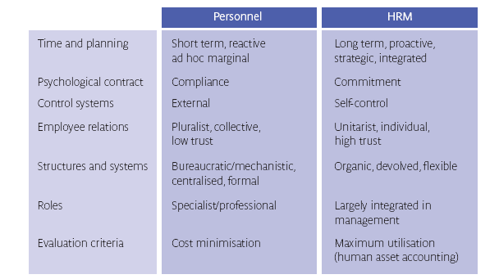
Distinguishing Between HRM and PM

Slide 8
Guest’s Model of HRM
Linked to the strategic management of an organisation.
Seeks commitment to organisational goals
Focuses on the individual needs rather than the collective workforce.
Enables organisations to devolve power and become more flexible
Emphasises people as an asset to be positively utilised by the organisation.

Slide 9
Storey’s Definition of HRM
'Human capability and commitment'. Storey argues that this is what differentiates organisations.
Strategic importance of HRM. It needs to be implemented into the organisational strategy and needs to be considered at the highest management level.
The long term importance of HRM. It needs to be integrated into the management functions and is seen to have importance consequences on the ability of the organisation to achieve its goals.
The key functions of HRM which are seen to encourage commitment rather than compliance.

Slide 10
Points of Difference between Personnel and IR Practices and HRM Practices
Dimension Personnel/IR HRM
Beliefs and assumptions
1. Contract | Careful delineation of written contracts | Aim to go 'beyond contract'
2. Rules | Importance of devising clear rules/mutuality | 'Can-do' outlook; impatience with 'rule'
3. Guide to management action | Procedures | 'Business need'
4. Behaviour referent | Norms/custom and practice | Values/mission
Managerial task vis a vis labour | Monitoring | Nurturing
6. Nature of relations | Pluralist | Unitarist
7. Conflict | Institutionalised | De-emphasised

Slide 11
Strategic aspects
Personnel /IR HRM
8. Key relations | Labour management | Customer
9. Initiatives | Piecemeal | Integrated
10.Corporate plan | Marginal to | Central to
11. Speed of decision | Slow | Fast

Slide 12
Line management
Personnel / IR HRM
12. Management role | Transactional | Transformational leadership
13. Key managers | Personnel/IR specialists | General/business/line managers
14. Communication | Indirect | Direct
15. Standardisation | High (for example 'parity' an issue) | Low (for example 'parity' not an issue)
16. Prized management skills | Negotiation | Facilitation

Slide 13
Key Levers
Personnel / IR HRM
17. Selection | Separate, marginal task | Integrated, key task
18. Pay | Job evaluation (fixed grades) | Performance related
19. Conditions | Separately negotiated | Harmonisation
20. Labour management | Collective bargaining contracts | Towards individual contracts
21. Thrust of relations with stewards | Regularised through facilities and training | Marginalised (with exception of some bargaining for change models)
22. Job categories and grades | Many | Few
23. Communication | Restricted flow | Increased flow
24. Job design | Division of labour | Teamwork
25. Conflict handling | Reach temporary truces | Manage climate and culture
26. Training and development | Controlled access to courses | Learning companies
27. Foci of attention for interventions | Personnel procedures | Wide ranging cultural, structural and personnel strategies

Slide 14
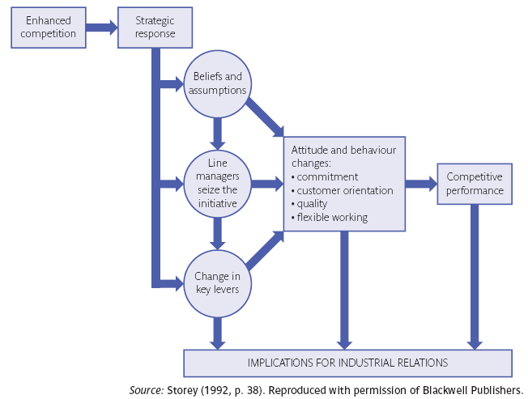
A Model of the Shift to HRM

Slide 15
Hard HRM
The 'hard' approach rooted in the manpower planning approach is concerned with aligning human resource strategy with business strategy

Slide 16
Soft HRM
The 'soft' approach is rooted in the human relations school, with concern for workers' outcomes and encourages commitment to the organisation by focussing on workers' concerns.

Slide 17
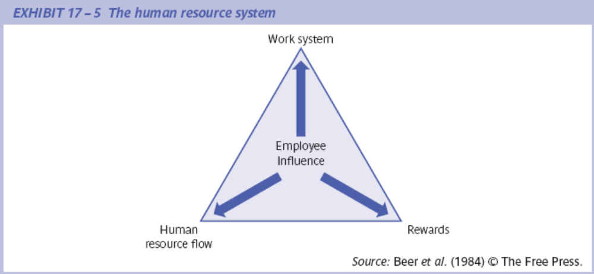
The Human Resource System

Slide 18
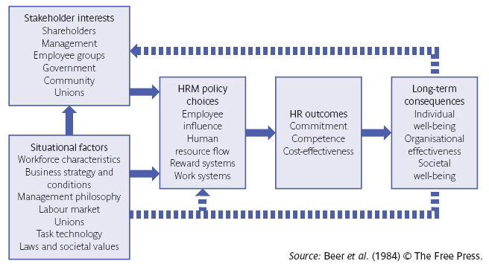
The Harvard Model of Human Resource Management

Slide 19
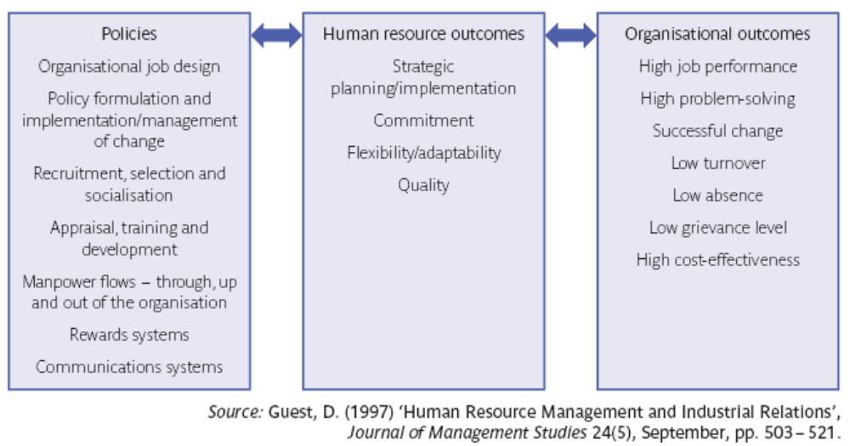
Guest’s Model of HRM

Slide 20
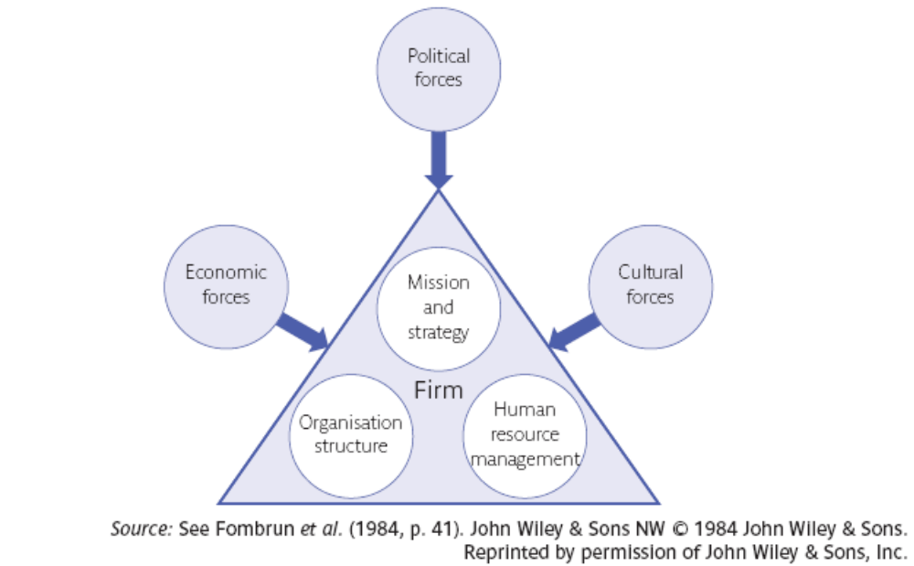
Strategic Management and Environmental Pressures

Slide 21
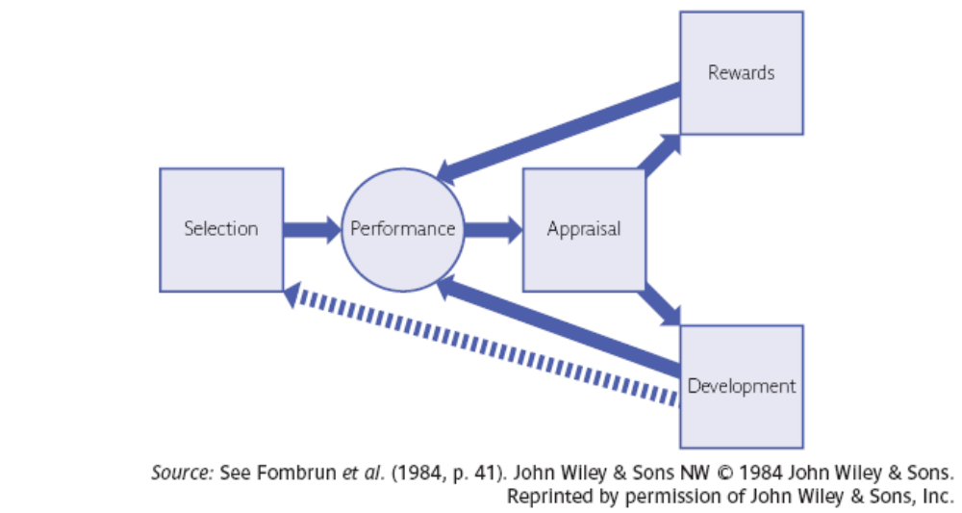
The Human Resource Cycle

Slide 22
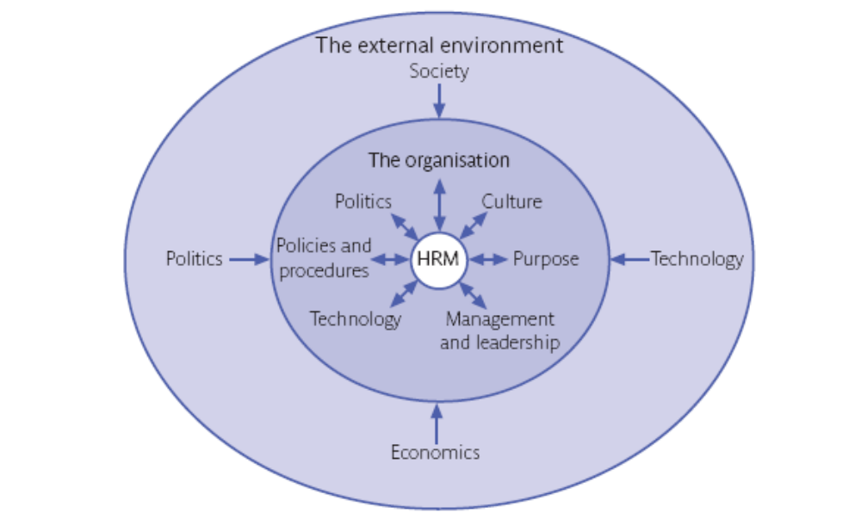
The Context of HRM

Slide 23
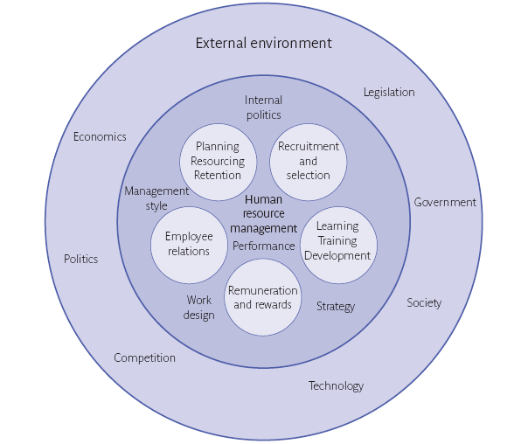
The HR Functions

Slide 24
Summary
An HR manager needs to recognise that Human Resource Management is in a constant state of change.
HR management has progressed from an ad hoc role to the professional body of the CIPD.

Slide 25
Summary continued 1
The terms Personnel management and HRM have are part of the debate that inform the role of the HR manager.
HRM is viewed as a means of moving people along to achieve organisational goals through staffing, performance, change management and administrative objectives.

Slide 26
Summary continued 2
Personnel Management has often been seen as a bridge between the employer and the employee.
"Hard" HRM characterised by the Michigan model is seen as viewing people as a resource needed to achieve organisational goals.
"Soft" HRM characterised by the Harvard model is seen as a method of developing strategies to encourage employee commitment.

Slide 27
Summary continued 3
The functions of HR include: planning and resourcing; recruitment and selection; training and development; pay and reward and employee relations.
Understanding the HR context in relation to the organisational and external context is important for an effective HR manager.

