Slide 1
Perspectives on HRM and Personnel Management
David Greenshields

Slide 2
4 Perspectives on HRM
Resource based- Individuals as key assets to be invested in and seeks to align the individual to the company goals. (unitary model)
A move away from a collective view of labour ( pluralistic) where Personnel / IR acted as the bridge between Management and labour to solve disputes
Restatement -Renaming of basic functions to increase status. Distinct PM & IR orientated, which is pluralistic in nature.
A fusion of PM and IR which is performance focused.

Slide 3
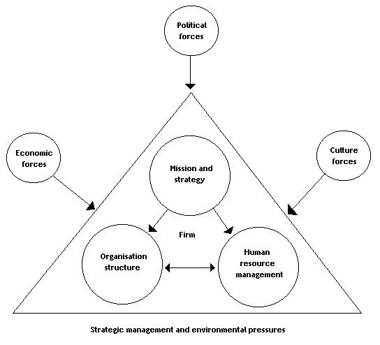
4 Perspectives on HRM cont
Strategic- It is a strategic orientated activity which both contributes and determines strategic direction of the organisation through developing competent line managers and creating the right policies and culture.
The task for HRM is to integrate HR into all levels and practices
Devanna et al 1984

Slide 4
HRM Demands…
Strategic integration- incorporating HRM into strategic plans and line managers to apply HRM in their practices
Developing high commitment -creating the right behaviours and attitudes to pursue agreed goals and for staff to identify with the enterprise
Focusing on Quality-Treating staff well, developing them as a resource in order to achieve agreed performance targets and satisfy clients
Flexibility- functional flexibility and also an adaptable organisational structure to accommodate innovation

Slide 5
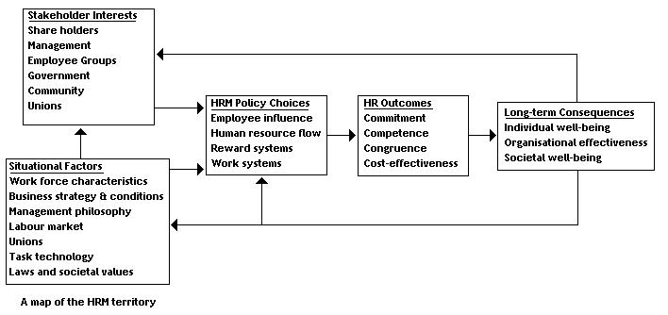
Map of HRM Territory
Beer et al 1984 Harvard Model

Slide 6
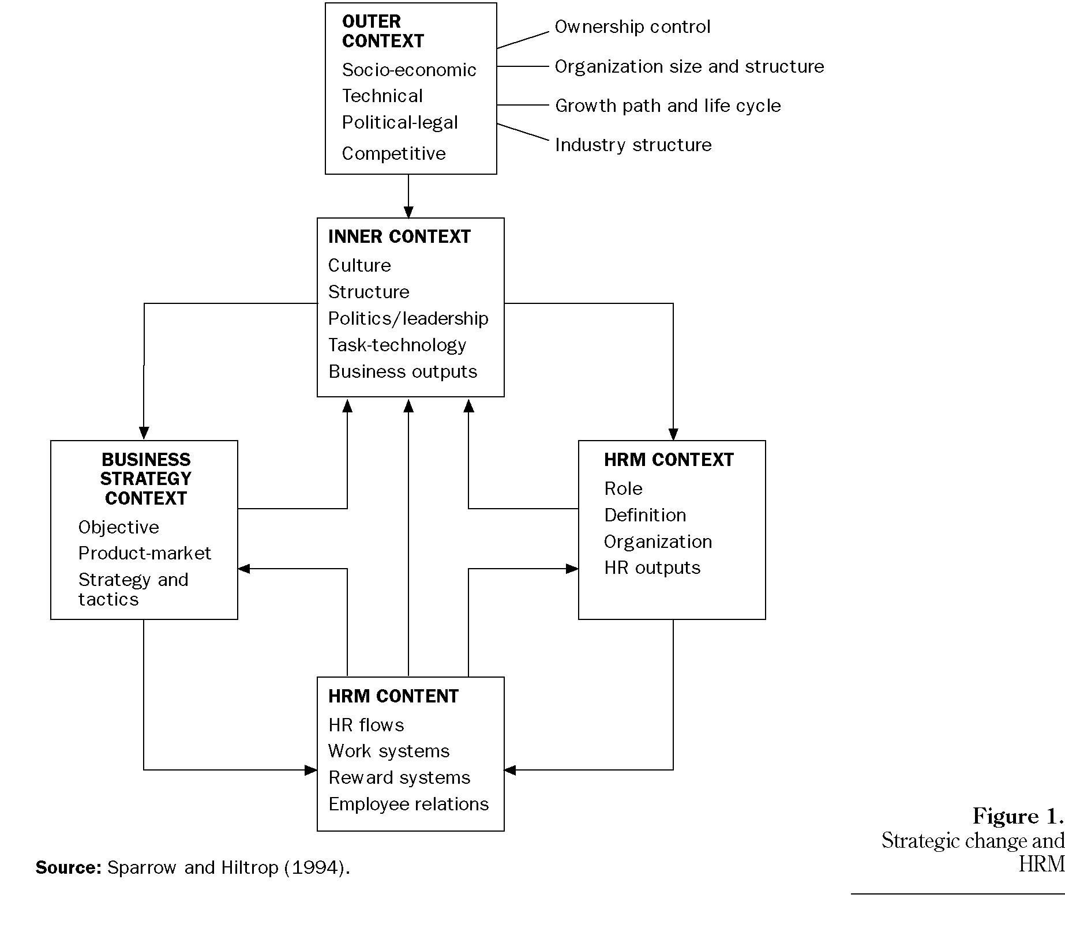
Strategic Change and HRM

