Slide 1

Chapter 1
Meeting Present and Emerging Strategic Human Resource Challenges
© 2007 by Prentice Hall
1-<number>

Slide 2
Chapter 1 Overview
Challenges Facing HR Management
Planning and Implementing Strategic HR Policies
Selecting HR Strategies to Increase Firm Performance
The HR Department and Managers:
An Important Partnership
© 2007 by Prentice Hall
1-<number>

Slide 3
Key HR Challenges for
Today’s Managers
Environmental
Rapid Change
The Internet Revolution
Workforce Diversity
Globalization
Legislation
Work/Life Balance
Skill Shortages and the Rise of the Service Sector
© 2007 by Prentice Hall
1-<number>

Slide 4
Key HR Challenges for
Today’s Managers
Organizational
Competitive Position
Decentralization
Downsizing
Organizational Restructuring
Self-Managed Work Teams
The Growth of Small Businesses
Organizational Culture
Technology
Internal Security
Outsourcing
© 2007 by Prentice Hall
1-<number>

Slide 5

Key HR Challenges for
Today’s Managers
Individual
Matching People and Organizations
Ethics and Social Responsibility
Productivity
Empowerment
Brain Drain
Job Insecurity
© 2007 by Prentice Hall
1-<number>

Slide 6
Planning and Implementing
Strategic HR Policies
The Benefits of Strategic HR Planning
Encouragement of Proactive Rather Than Reactive Behavior
Explicit Communication of Company Goals
Stimulation of Critical Thinking and Ongoing Examination of Assumptions
Identification of Gaps Between Current Situation and Future Vision
Encouragement of Line Managers’ Participation
Identification of HR Constraints and Opportunities
Creation of Common Bonds
© 2007 by Prentice Hall
1-<number>

Slide 7
Planning and Implementing
Strategic HR Policies
The Challenges of Strategic HR Planning
Maintaining a Competitive Advantage
Reinforce Overall Business Support
Avoiding Excessive Concentration on Day-to-Day Problems
Developing HR Strategies Suited to Unique Organizational Features
Coping with the Environment
Securing Management Commitment
Translating the Strategic Plan into Action
Combining Intended and Emergent Strategies
Accommodating Change
© 2007 by Prentice Hall
1-<number>

Slide 8

Planning and Implementing
Strategic HR Policies
Strategic HR Choices
Work Flows
Staffing
Employee Separations
Performance Appraisal
Training & Career Development
Compensation
Employee Rights
Employee & Labor Relations
International Management
© 2007 by Prentice Hall
1-<number>

Slide 9
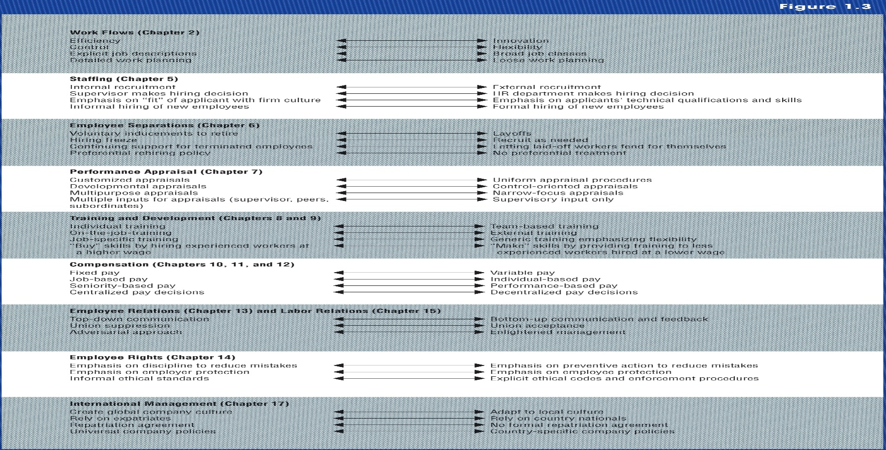
Selecting HR Strategies to Increase
Firm Performance
Fit with Organizational Strategies
© 2007 by Prentice Hall
1-<number>

Slide 10
Selecting HR Strategies to Increase
Firm Performance
Fit with Organizational Strategies
Corporate Strategies
Porter’s Business Unit Strategies
Miles and Snow’s Business Strategies
© 2007 by Prentice Hall
1-<number>

Slide 11

Selecting HR Strategies to Increase
Firm Performance
Fit with the Environment
  Degree of Uncertainty
  Volatility
  Magnitude of Change
  Complexity
© 2007 by Prentice Hall
1-<number>

Slide 12
Selecting HR Strategies to Increase
Firm Performance
Fit with Organizational Characteristics
The Production Process for Converting Inputs into Output
The Firm’s Market Posture
The Firm’s Overall Managerial Philosophy
The Firm’s Organizational Structure
The Firm’s Organizational Culture
© 2007 by Prentice Hall
1-<number>

Slide 13

Selecting HR Strategies to Increase
Firm Performance
Fit with Organizational Capabilities
    Distinctive Competencies
Choosing Consistent and Appropriate HR Tactics to Implement HR Strategies
© 2007 by Prentice Hall
1-<number>

Slide 14
HR Strategy Leads to Improved Organizational Performance
Organizational Strategies
Organizational Capabilities
HR Strategies
Organizational Characteristics
Environments
© 2007 by Prentice Hall
1-<number>

Slide 15

The HR Department and Managers:
An Important Partnership
Key Competencies Required of HR Department to Become a Full Strategic Partner
Leadership
Knowledge of Business
HR Strategic Thinking
Process Skills
HR Technologies
© 2007 by Prentice Hall
1-<number>

Slide 16

LEADERSHIP
Understand styles of leadership
Display appropriate leadership
Demonstrate leadership at all levels of performance – team, individual, unit, or organization
© 2007 by Prentice Hall
1-<number>

Slide 17
KNOWLEDGE OF BUSINESS
HR must understand…
internal / external customers
key business disciplines
business structure, vision, values,
  goals, strategies, finances
competitors, products, technology,
  and sources of competitive advantage
© 2007 by Prentice Hall
1-<number>

Slide 18

STRATEGIC THINKING
Understand strategic business planning
Apply a systematic HR planning process
Integrate HR systems to build capability and competitive advantage for the firm
Develop and integrate department strategies within corporate framework
© 2007 by Prentice Hall
1-<number>

Slide 19
PROCESS SKILLS
Know management processes
Know process skills: consulting, problem solving, evaluation, and communication
Understand organizational development
Facilitate and manage change
Manage under uncertainty and instability
© 2007 by Prentice Hall
1-<number>

Slide 20

TECHNOLOGY
Maintain HR documentation using knowledge management and technology
Build firm’s capability using info systems
Provide training in use of technology
© 2007 by Prentice Hall
1-<number>

Slide 21

Summary and Conclusions
Challenges in HRM
Plan and Implement Strategic HR Policies
Select HR Strategies That Increase Firms Performance
HR Department and Managers: The Importance of This Partnership
© 2007 by Prentice Hall
1-<number>

