Slide 1
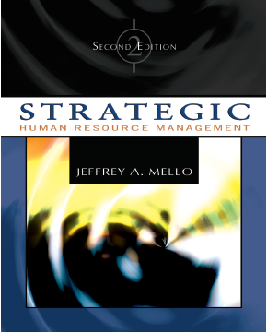
CHAPTER 4:
THE EVOLVING/ STRATEGIC ROLE OF HUMAN RESOURCE MANAGEMENT
Copyright © 2005 South-Western. All rights reserved.

Slide 2
Strategic Human Resource Management
Involves development of consistent, aligned collection of practices, programs, & policies to facilitate achievement of strategic objectives
Requires abandoning mindset & practices of “personnel management” & focusing on strategic issues rather than operational issues
Integration of all HR programs within larger framework, facilitating mission & objectives
Writing down strategy facilitates involvement & buy-in of senior executives & other employees
Copyright © 2005 South-Western. All rights reserved.
1–<number>

Slide 3
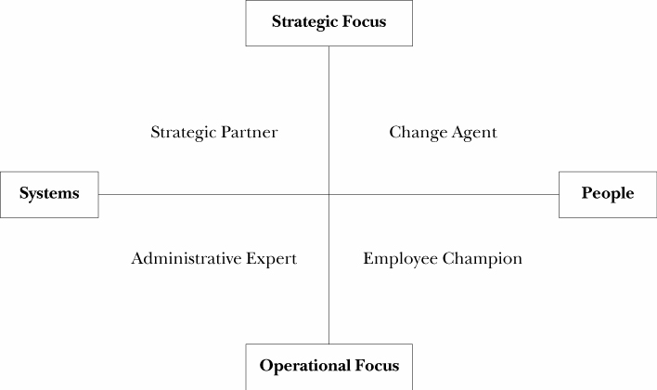
Exhibit 4-1
Possible Roles Assumed by HR Function
Copyright © 2005 South-Western. All rights reserved.
1–<number>

Slide 4
HR Roles in Knowledge-Based Economy
Human capital steward
  Creates an environment & culture in which employees voluntarily contribute skills, ideas, & energy
  Human capital is not “owned” by organization
Knowledge facilitator
  Procures necessary employee knowledge & skill sets that allow information to be acquired, developed, & disseminated
  Provides a competitive advantage
  Must be part of strategically designed employee development plan
Copyright © 2005 South-Western. All rights reserved.
1–<number>

Slide 5
HR Roles in Knowledge-Based Economy
Relationship builder
  Develops structure, work practices, & culture that allow individuals to work together
  Develops networks that focus on strategic objectives
Rapid deployment specialist
  Creates fluid & adaptable structure & systems
  Global, knowledge-based economy mandates flexibility & culture that embraces change
Copyright © 2005 South-Western. All rights reserved.
1–<number>

Slide 6
SHRM Critical Competencies
HR’s success as true strategic business partner dependent on five specific competencies:
  Strategic contribution - development of strategy
  Business knowledge - understanding nuts & bolts of organization
  Personal credibility - measurable value demonstrated in programs & policies
  HR delivery - serving internal customers through effective & efficient programs
  HR technology - using technology to improve organization’s management of people
Copyright © 2005 South-Western. All rights reserved.
1–<number>

Slide 7
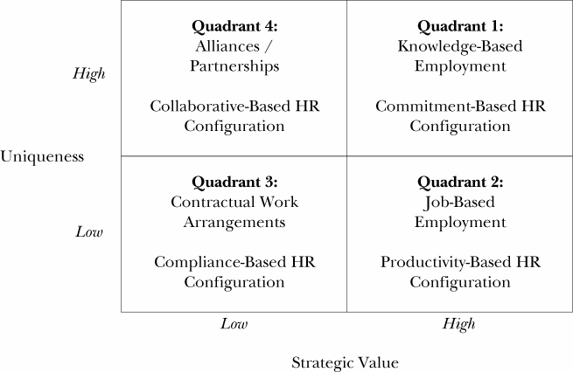
Exhibit 4-4
Lepak & Snell’s Employment Models
Copyright © 2005 South-Western. All rights reserved.
1–<number>

Slide 8
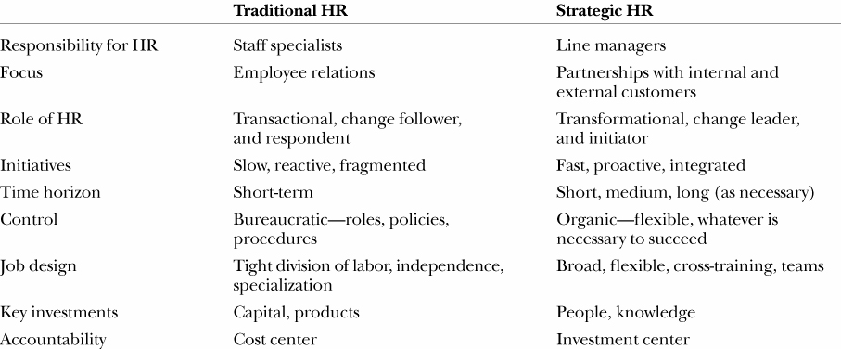
Exhibit 4-5
Traditional HR Versus Strategic HR
Copyright © 2005 South-Western. All rights reserved.
1–<number>

Slide 9
Barriers to Strategic HR
Strategic contribution
Business knowledge
Personal credibility
HR delivery
HR technology
Copyright © 2005 South-Western. All rights reserved.
1–<number>

Slide 10
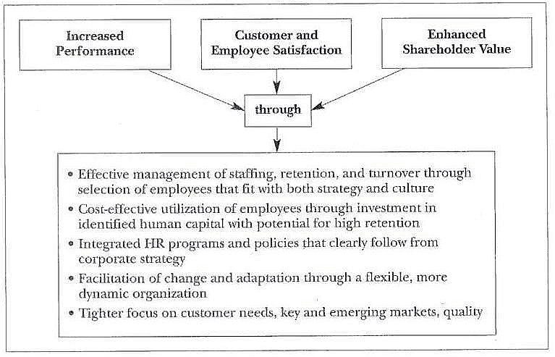
Exhibit 4-7
Outcomes of Strategic HR
Copyright © 2005 South-Western. All rights reserved.
1–<number>

Slide 11
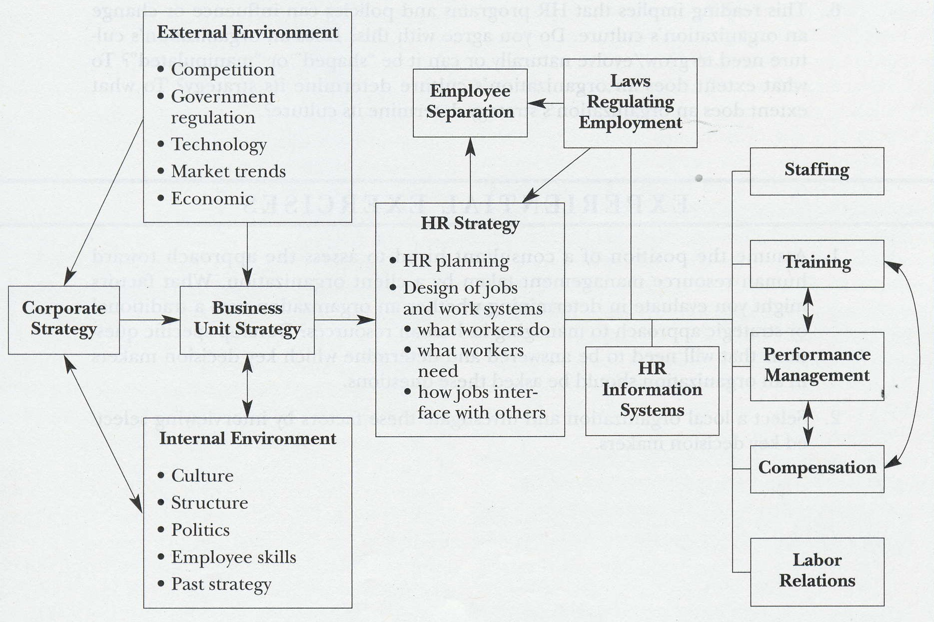
Exhibit 4-8
Model of Strategic HR Management
Copyright © 2005 South-Western. All rights reserved.
1–<number>

Slide 12
Reading 4.1
Strategic HR as Organizational Learning
Stages of knowledge management
  Generating or capturing knowledge
  Structuring & providing value to gathered knowledge
  Transferring knowledge
  Establishing mechanisms for use & reuse of knowledge for individuals & groups
Copyright © 2005 South-Western. All rights reserved.
1–<number>

Slide 13
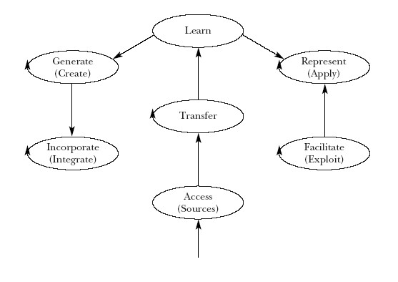
Figure 1
Knowledge Management Cycle
Copyright © 2005 South-Western. All rights reserved.
1–<number>

Slide 14
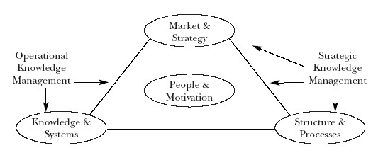
Figure 2
Knowledge Management
Copyright © 2005 South-Western. All rights reserved.
1–<number>

Slide 15
Reading 4.1
Strategic HR as Organizational Learning
Knowledge creation
  Single loop learning:
    Comparing consequences of actions with desired outcomes
    Modifying behavior
  Double loop learning:
    Goes beyond detection & correction of errors
    Entails examining actions & outcomes as well as underlying assumptions
Copyright © 2005 South-Western. All rights reserved.
1–<number>

Slide 16
Reading 4.1
Strategic HR as Organizational Learning
Without purposeful analysis of underlying assumptions & systems, organizations may become victims of ‘competency traps’
Organizational learning:
  Inherently rare
  Inimitable
  Immobile
Copyright © 2005 South-Western. All rights reserved.
1–<number>

Slide 17
Reading 4.1
Strategic HR as Organizational Learning
How HR management systems can contribute to development of organizational knowledge
  Labor markets can be exploited in order to attract & select individuals with high cognitive abilities
  Internal labor markets can contribute to development of firm specific assets
  Cross-functional & inter-organizational teams can be utilized
Copyright © 2005 South-Western. All rights reserved.
1–<number>

Slide 18
Reading 4.1
Strategic HR as Organizational Learning
How HR systems can support & enhance knowledge transfer
  Apprenticeship & mentoring
  Cross-functional teams
  Stimulate & reward information sharing
  Provide free access to information
  Job rotations
Copyright © 2005 South-Western. All rights reserved.
1–<number>

Slide 19
Reading 4.1
Knowledge Institutionalization
Walsh & Ungson’s five ‘storage bins’ in which organizational memory can reside
  Individuals (assumptions, beliefs, & cause maps)
  Culture (stories, myths, & symbols)
  Transformations (work design, processes, & routines)
  Structure (organizational design)
  Ecology (physical structure & information systems)
Institutionalized knowledge tends to be firm specific, socially complex, & causally ambiguous
Copyright © 2005 South-Western. All rights reserved.
1–<number>

Slide 20
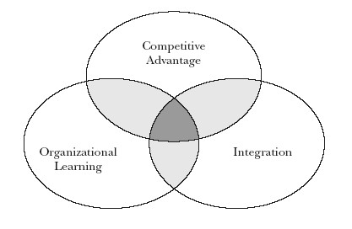
Figure 3
Alternative Orientations of Fit in SHRM
Copyright © 2005 South-Western. All rights reserved.
1–<number>

Slide 21
Reading 4.2
Understanding HRM-Performance Linkages
Scholars have often assumed two perspectives
Systems view considers overall configuration or aggregation of HRM practices
Strategic perspective examines “fit” between various HRM practices & organization’s competitive strategy
Overall set of HRM practices generally associated with firm performance & competitive advantage
Copyright © 2005 South-Western. All rights reserved.
1–<number>

Slide 22
Reading 4.2
Understanding HRM-Performance Linkages
Psychological climate:
  Experiential-based perception of what people “see” & report happening to them as they make sense of their environment
Climate:
  Critical mediating construct in exploring multilevel relationships between HRM & organizational performance
Copyright © 2005 South-Western. All rights reserved.
1–<number>

Slide 23
Reading 4.2
Understanding HRM-Performance Linkages
Two interrelated features of HRM system:
  Content
  Process
  Must be integrated effectively
Copyright © 2005 South-Western. All rights reserved.
1–<number>

Slide 24
Reading 4.2
Understanding HRM-Performance Linkages
Content
  Set of practices adopted
  Ideally driven by strategic goals & values
  No single most appropriate set of practices for particular strategic objective
  Different sets of practices may be equally effective so long as they allow particular type of climate around some strategic objective to develop
Process
  How HRM system can be designed & administered effectively by defining meta-features of overall HRM system
Copyright © 2005 South-Western. All rights reserved.
1–<number>

Slide 25
Reading 4.2
Understanding HRM-Performance Linkages
To create strong situations with unambiguous messages about appropriate behavior, HRM systems should have:
  Distinctiveness
  Consistency
  Consensus
Copyright © 2005 South-Western. All rights reserved.
1–<number>

Slide 26
Reading 4.2
Understanding HRM-Performance Linkages
Distinctiveness
  Visibility
    Degree to which practices are salient & readily observable
  Understandability
    Lack of ambiguity & ease of comprehension of practice content
  Legitimacy of authority
    Leads individuals to submit to performance expectations as formally sanctioned behaviors
  Relevance
    Whether situation is defined so that individuals see it as relevant to important goal
Copyright © 2005 South-Western. All rights reserved.
1–<number>

Slide 27
Reading 4.2
Understanding HRM-Performance Linkages
Consistency
  Instrumentality
    Unambiguous perceived cause-effect relationship between system’s desired content-focused behaviors & associated employee consequences
  Validity
    HRM practices must display consistency between what they purport to do & what they actually do
Copyright © 2005 South-Western. All rights reserved.
1–<number>

Slide 28
Reading 4.2
Understanding HRM-Performance Linkages
Consensus
  Agreement among message senders
  Fairness
    Composite of employees’ perceptions of whether practices adhere to three dimensions of justice: distributive, procedural, & interactional
Copyright © 2005 South-Western. All rights reserved.
1–<number>

Slide 29
Reading 4.3
Organization Culture Questionnaire
Topics to be included in questionnaire:
  How is performance defined, measured & rewarded?
  How are information & resources allocated & managed?
  What is operational philosophy of organization with regard to risk-taking, leadership, & concern for overall results?
  Does organization regard human resources as costs or assets?
Copyright © 2005 South-Western. All rights reserved.
1–<number>

Slide 30
Reading 4.3
Interpreting Results & Formulating Strategies
Tendency to try to identify an “ideal” culture
Not clear than any one culture will be effective for all organizations
Strategy consists of interrelated functional components that must be carefully integrated to form an effective whole:
  Selection & staffing
  Organizational & human resource development
  Rewards
Copyright © 2005 South-Western. All rights reserved.
1–<number>

Slide 31
Reading 4.3
Analyzing Dysfunctional Cultures
Which components of culture are misaligned?
What priorities should be assigned to bridging gaps between what culture is & what people feel it should be?
What resources are needed & how should they be used to change culture?
How should change effort be managed & who does what?
What role should HR strategy play in signaling, making & reinforcing necessary changes?
Copyright © 2005 South-Western. All rights reserved.
1–<number>

