Slide 1
HRM
Lesson 2 – Strategic HRM

Slide 2
Objectives
Understand the concept of Strategic Management
Become familiar with SHRM concepts and approaches
To understand the different steps in strategy management and understanding how different parties contribute
Looking at the balanced score card
Understanding management strategies in a context of change

Slide 3
What is strategic HRM?
Aligning HR strategy to business strategy
    Balances the needs of employees with the needs of the organization
    Develops philosophies, policies, programs, practices, procedures and makes tailored, as opposed to standardized, decisions to address these specific needs
    It is totally dependent on Organisational strategy
    Can be reactive or proactive
    Can be accomplished by understanding how employees and customers serve business objectives, understanding the challenges faced by the company's core customers, and assessing the company's competition, in order to deliver value to all stakeholders

Slide 4
What is a strategic plan?
The three traditional poles of a strategic plan
Senior Management
Environment
Resources
Source: Adapted from Aktouf (1996)

Slide 5
The strategic management model
Mission and goals
Management philosophies
Values
Step 1
SWOT analysis
Environmental analysis
Internal scan
External scan
Step 2
Strategic formulation
Strategic choice
Corporate
Business Functional
Step 3
Strategic implementation
Leadership
Structure
Control systems
Human resources
Step 4
Performance
evaluation
Strategy evaluation
Operating performance
Financial performance
Step 5

Slide 6
Hierarchy of strategic decision making (rational approach)
Contextual factors
Product market
Capital market
Labour market
Technology
Government policies
European Union policies
North American Free Trade
Agreement policies
Stakeholder interests
Corporate Management
Corporate-level strategy
What business are we in?
Business unit
1
Business unit
2
Business unit
3
Business-level strategy
How do we compete?
R&D
Mktg
HR
Manu-
facturing
Finance
Functional-level strategy
How do we support the business-level competitive strategy?
Human Resources Management:
philosophy, policies, programs, practices, processes,
relationships with managers, non-managers,
trade unions, customers and suppliers

Slide 7
Hierarchy of strategic decision making – 3 levels
Corporate level strategy
    Investment priorities, steering corporate resources into most attractive BU
    Initiate actions to improve combined performance of BUs
    Ways to improve synergy between BUs
    Making decision dealing with diversification

Slide 8
Business level strategy
Formulates competitive strategies
Porter’s competitive strategies:
Cost leadership, differentiation and focus
Competitive advantage
Low cost Uniqueness
Competitive Scope
Broad target
Narrow target
Low-cost leadership
e.g. Walmart
Differentiation
e.g. Tommy Hilfiger
Focused low-cost
e.g. Rent –A– Wreck
cars
Focused Differentiation
e.g. Moutain equipment co-operative
Source: adapted from Porter (1985)

Slide 9
Functional-level strategy
Strategies pertaining to major functional areas:
    R&D
    Marketing
    Manufacturing
    Finance
    HR
It is at this functional level that HRM policies and practices support the business goals.

Slide 10
Different approaches to Strategy-making policies
Classical or rational planning
The evolutionary approach
    Strategy is made through an informal evolutionary process
    Focused on market NOT management
The processual approach
    In addition to rational, considers influences of psychological, political and behavioural relationships
The systemic approach
    Strategy is shaped by social system it operates in
 No approach is perfect but it helps us understand what to consider

Slide 11
We have just looked at what was to be considered when drafting a business strategy
Let’s now look at the different approaches in formulating HR strategies

Slide 12
Strategic Management and SHRM
The best fit school
    Assesses the extent to which there is vertical integration between an organisation’s business strategy and its HRM practices and policies
    Vertical integration demonstrated through linking business goal to individual objectives, to the measurement and rewarding of attainment of business goals (performance evaluation)
    “fit” or vertical integration gained through procedures, policies and processes
    Ensures an explicit link or relationship between internal people processes and policies and the external market
    Ensures competencies are created which have a potential to be a key source of competitive advantage
    Vertical integration enables HRM to be strategic

Slide 13
Models of Best-fit school of SHRM
Life cycle model
    Selection and management of HR policies and procedures that best-fit the stage of an Organisations development or life-cycle
Stage | Focus
Start-up | Flexibility
Growth | Formality
Maturity | Cost control
Decline | Rationalisation

Slide 14
Competitive advantage model
(Porter’s – Strategic choice)
    HR policies and procedures are defined “to fit” the generic strategies of cost reduction, quality enhancement and innovation
    Organisation’s mission and vision are expressed through desired competitive strategy
    Appropriate alignment leads to a higher level of organisational performance
Configurational models
    Achieve both horizontal and vertical integration

Slide 15
Limits of the Best fit model
    Firms are never the complete author of its HRM
    Ignores employees interests in the pursuit of enhanced economic performance
    Lack of emphasis on the internal context of individual businesses within the same sector and unique characteristics which may provide its main source of competitive advantage
    Is fit good in a period of change?

Slide 16
Resource-based view of SHRM
Focus on the internal resources of the organisation rather than analysing the performance in terms of external context
HR = “strategic assets”
HR executive=strategic partner in developing and sustaining an organisation’s competitive advantage
The VRIO framework (Value, Rarity, Inimitability, Organisation)
Organisational processes and HR should reinforce one another

Slide 17
Limitations of the resource-based view
Provides more added value when the external environment is less predictable

Slide 18
Best practice SHRM
The best HR practices results in:
    enhanced organisational performance (increased productivity, quality and efficiency)
    improved employee attitude and behaviour (low level of absenteisme and turnover, higher skills level)
Universal model or High commitment model
    Best HR practices applicable to all
Integrated bundle

Slide 19
Strategy is formulated
Each functional unit develops their plan which should be SMART
What kind of solutions can SHRM bring to the organisation?

Slide 20
How can SHRM be helpful in this context?
HR can ensure adherence to the business strategy through the following actions:
    Determine the appropriate organizational structure, job designs for the company.
    Emphasize key attributes of successful candidates during recruitment and selection.
    Identify key competencies in all performance management programs.
    Ensure that all training and development programs build company bench strength.
    Design compensation and rewards systems that reward desired behaviors.
    Create employment branding initiatives that communicate desired customer experiences.

Slide 21
Strategy is formulated
Each functional unit develops their plan which should be SMART
Implementation
Then, evaluation is absolutely critical
You must evaluate the impact of the strategy on the business performance
But how can you do it?

Slide 22
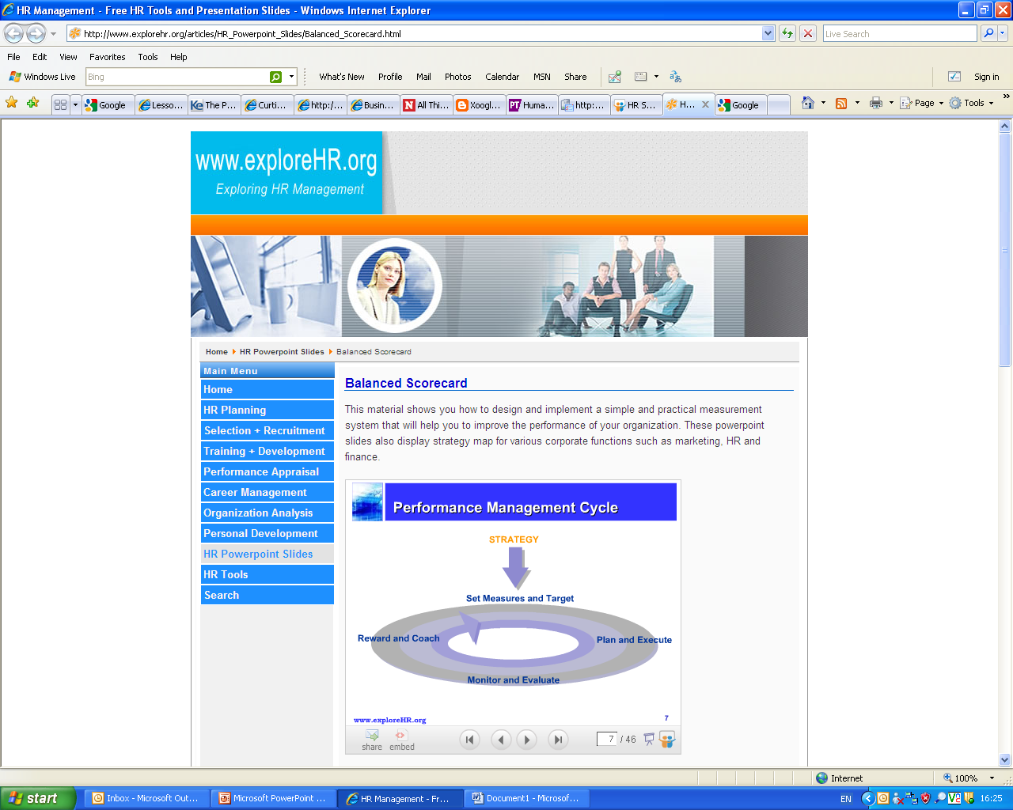

Slide 23
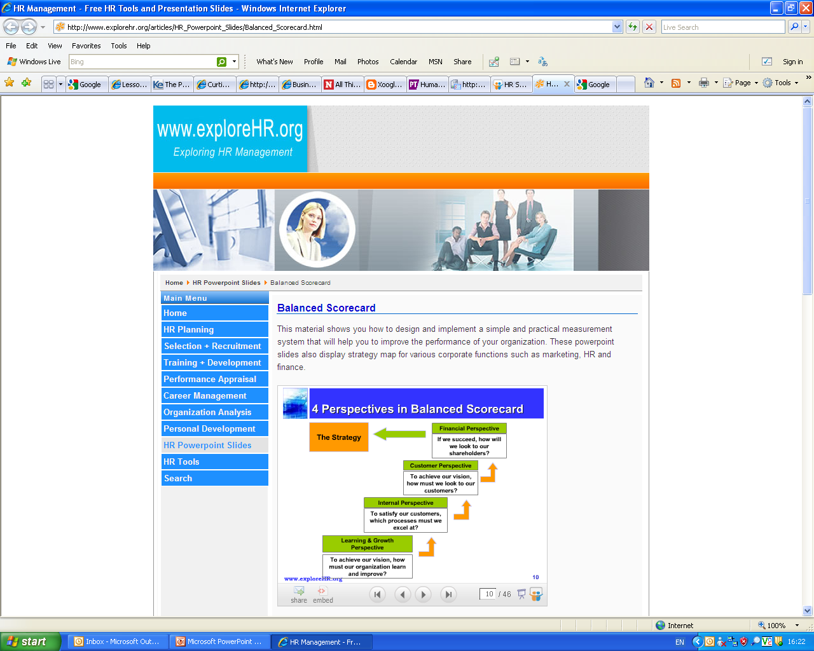
Measuring the impact of Strategy on performance
More than just a financial perspective

Slide 24
A helpful tool
The balance scorecard
    Management tool that provides stakeholders with a comprehensive measure of how the organisation is progressing towards the achievement of its strategic goals
    Identifies objectives, measures, targets and initiatives on four perspectives of business performance: financial, customer, internal business processes and learning and growth
Balances:
    Financial and non-financial measures
    Short and Long term measures
    Performance drivers with outcome measures
    Leads to strategic focus and organisational alignment

Slide 25
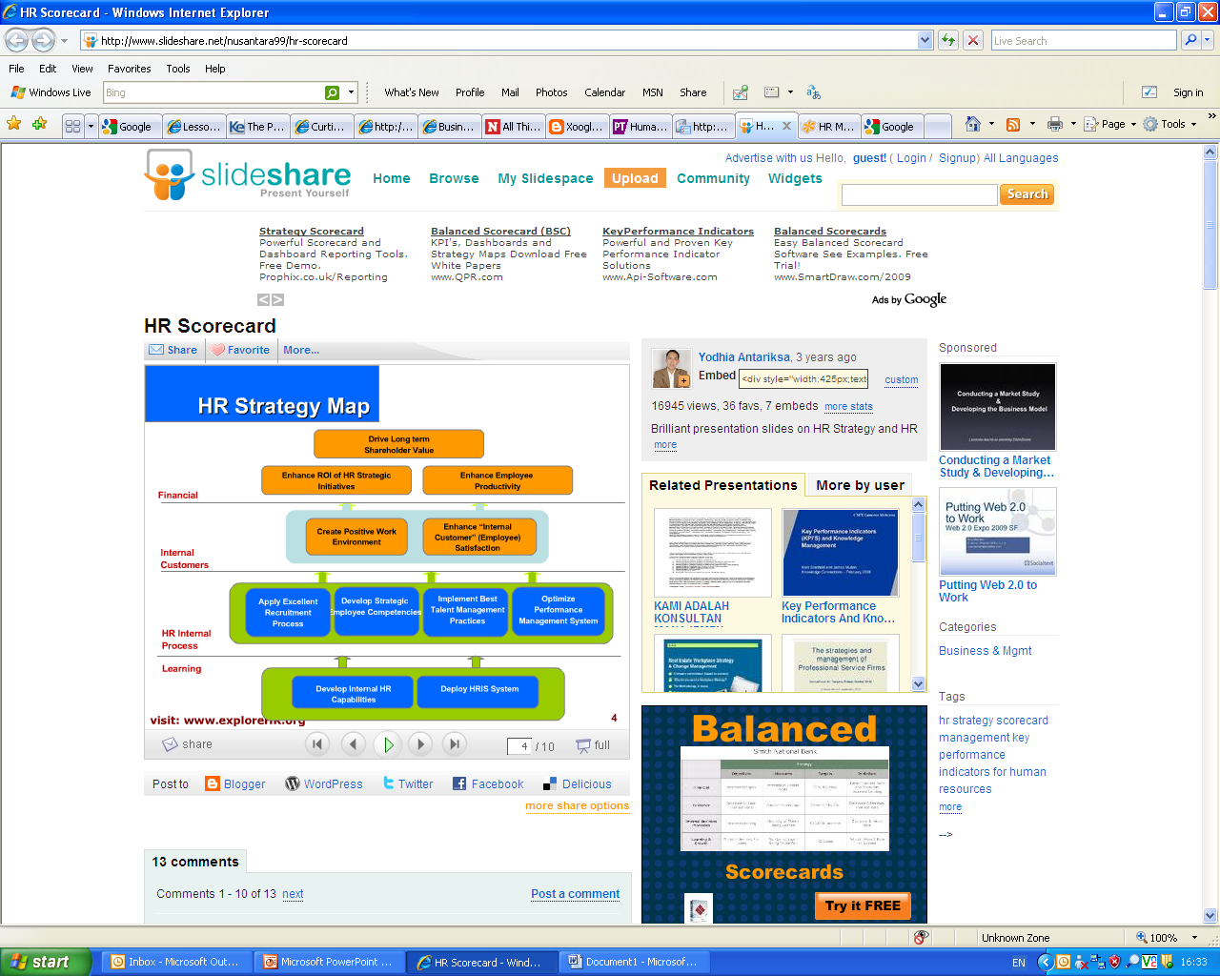
HR Strategy Map

Slide 26
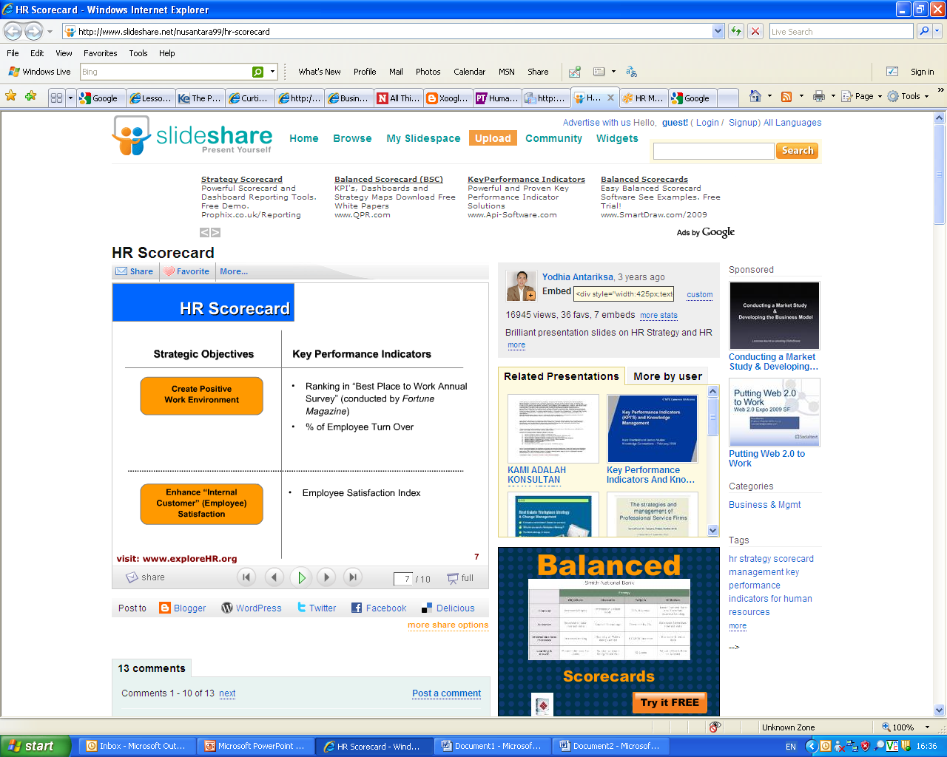
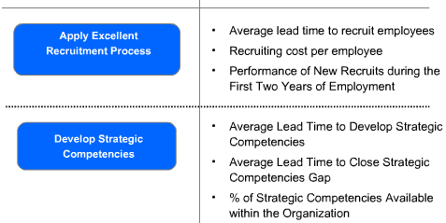

Slide 27
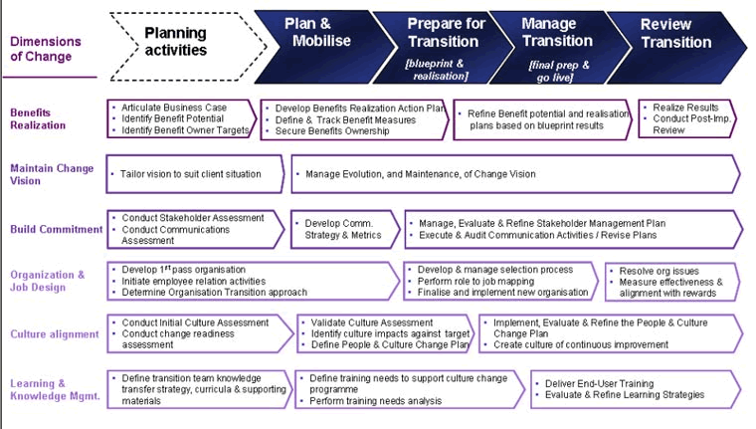
Managerial strategies and change management

