Slide 1


Human Resource
Management
TENTH EDITON
SECTION 1
Nature of
Human Resource
Management
Robert L. Mathis ⏐ John H. Jackson
Chapter 2
Strategic Human Resource Management
© 2003 Southwestern College Publishing. All rights reserved.
PowerPoint Presentation
by Charlie Cook

Slide 2
Learning Objectives
After you have read this chapter, you should be able to:
  Discuss why human resources can be a core competency for organizations.
  Define HR planning, and outline the HR planning process.
  Specify four important HR benchmarking measures.
  Identify factors to be considered in forecasting the supply and demand for human resources in an organization.
© 2002 Southwestern College Publishing. All rights reserved.
2–<number>

Slide 3
Learning Objectives (cont’d)
  Discuss several ways to manage a surplus of human resources.
  Identify what a human resource information system (HRIS) is and why it is useful when doing HR planning.
© 2002 Southwestern College Publishing. All rights reserved.
2–<number>

Slide 4
Human Resources as a Core Competency
Strategic Human Resources Management
  Organizational use of employees to gain or keep a competitive advantage against competitors.
Core Competency
  A unique capability in the organization that creates high value and that differentiates the organization from its competition.
© 2002 Southwestern College Publishing. All rights reserved.
2–<number>

Slide 5
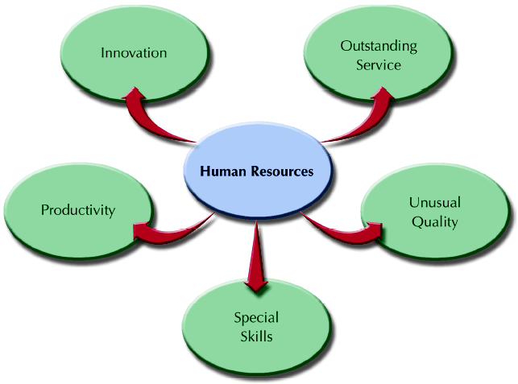
Possible HR Areas for Core Competencies
Figure 2–1
© 2002 Southwestern College Publishing. All rights reserved.
2–<number>

Slide 6
HR-Based Core Competencies
Organizational Culture
  The shared values and beliefs of the workforce
Productivity
  A measure of the quantity and quality of work done, considering the cost of the resources used.
  A ratio of the inputs and outputs that indicates the value added by an organization.
Quality Products and Services
  High quality products and services are the results of HR-enhancements to organizational performance.
© 2002 Southwestern College Publishing. All rights reserved.
2–<number>

Slide 7
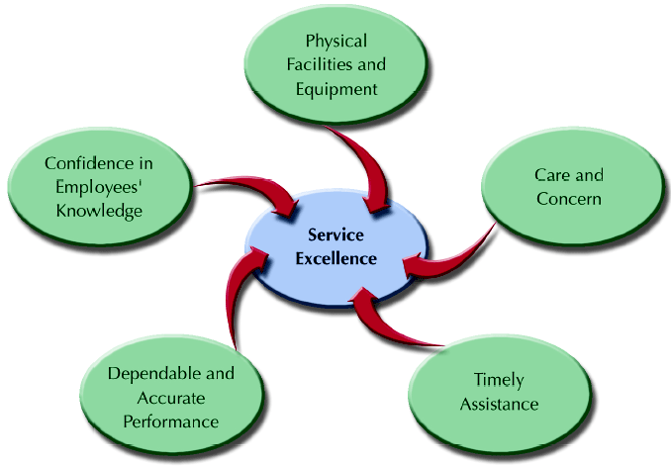
Customer Service Dimensions
Figure 2–2
© 2002 Southwestern College Publishing. All rights reserved.
2–<number>

Slide 8
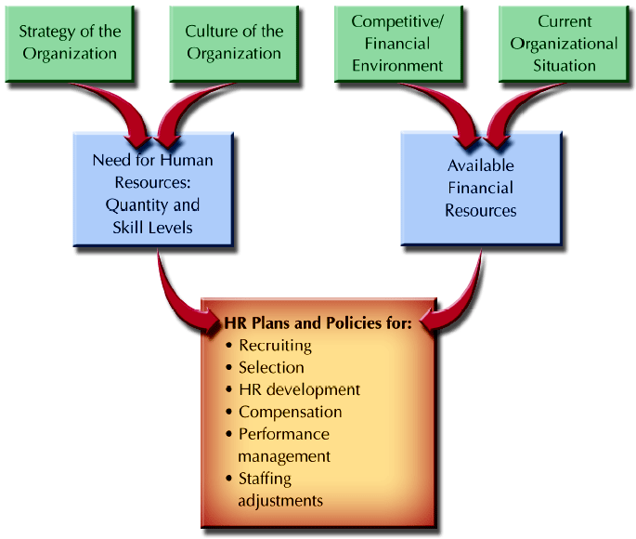
Factors That Determine HR Plans
Figure 2–3
© 2002 Southwestern College Publishing. All rights reserved.
2–<number>

Slide 9
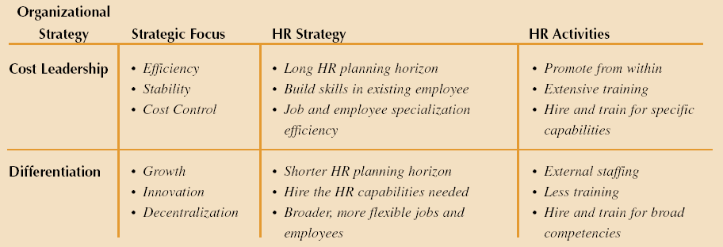
Linkage of Organizational and HR Strategies
Figure 2–4
© 2002 Southwestern College Publishing. All rights reserved.
2–<number>

Slide 10
Human Resource Planning
Human Resource (HR) Planning
  The process of analyzing and identifying the need for and availability of human resources so that the organization can meet its objectives.
HR Planning Responsibilities
  Top HR executive and subordinates gather information from other managers to use in the development of HR projections for top management to use in strategic planning and setting organizational goals
© 2002 Southwestern College Publishing. All rights reserved.
2–<number>

Slide 11
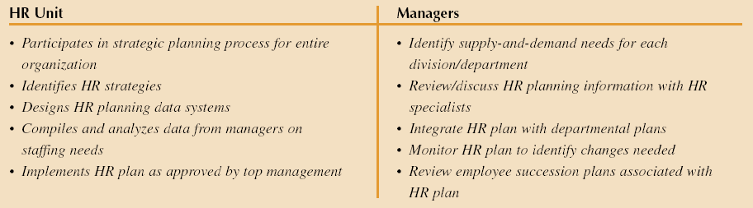
Typical Division of HR Responsibilities
in HR Planning
Figure 2–5
© 2002 Southwestern College Publishing. All rights reserved.
2–<number>

Slide 12
Human Resource Planning (cont’d)
Small Business and HR Planning Issues
  Attracting and retaining qualified outsiders
  Management succession between generations of owners
  Evolution of HR activities as business grows
  Family relationships and HR policies
© 2002 Southwestern College Publishing. All rights reserved.
2–<number>

Slide 13
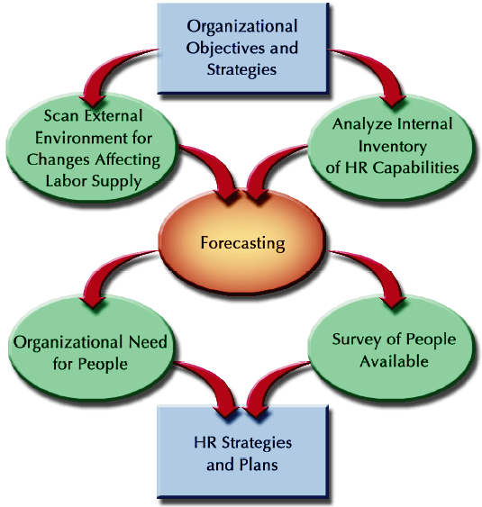
HR Planning Process
Figure 2–6
© 2002 Southwestern College Publishing. All rights reserved.
2–<number>

Slide 14
HR Planning Process
HR Strategies
  The means used to anticipate and manage the supply of and demand for human resources.
    Provide overall direction for the way in which HR activities will be developed and managed.
Overall
Strategic Plan
Human Resources Strategic Plan
HR Activities
© 2002 Southwestern College Publishing. All rights reserved.
2–<number>

Slide 15
Benefits of HR Planning
Better view of the HR dimensions of business decisions
Lower HR costs through better HR management.
More timely recruitment for anticipate HR needs
More inclusion of protected groups through planned increases in workforce diversity.
Better development of managerial talent
© 2002 Southwestern College Publishing. All rights reserved.
2–<number>

Slide 16
Scanning the External Environment
Environmental Scanning
  The process of studying the environment of the organization to pinpoint opportunities and threats.
Environment Changes Impacting HR
  Governmental regulations
  Economic conditions
  Geographic and competitive concerns
  Workforce composition
© 2002 Southwestern College Publishing. All rights reserved.
2–<number>

Slide 17
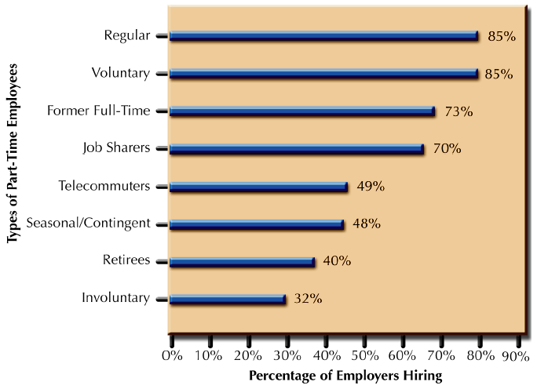
Employers’ Use of Part-Time Workers
Source: Adapted from “”Part-Time Employment,” (NY: The Conference Board, n.d.) vol. 6 #1.
Figure 2–7
© 2002 Southwestern College Publishing. All rights reserved.
2–<number>

Slide 18
Internal Assessment of the
Organizational Workforce
Auditing Jobs and Skills
  What jobs exist now?
  How many individuals are performing each job?
  How essential is each job?
  What jobs will be needed to implement future organizational strategies?
  What are the characteristics of anticipated jobs?
© 2002 Southwestern College Publishing. All rights reserved.
2–<number>

Slide 19
Internal Assessment of the
Organizational Workforce
Organizational Capabilities Inventory
  HRIS databases—sources of information about employees’ knowledge, skills, and abilities (KSAs)
  Components of an organizational capabilities inventory
    Workforce and individual demographics
    Individual employee career progression
    Individual job performance data
© 2002 Southwestern College Publishing. All rights reserved.
2–<number>

Slide 20
Forecasting HR Supply and Demand
Forecasting
  The use of information from the past and present to identify expected future conditions.
Forecasting Methods
  Judgmental
    Estimates—asking managers’ opinions, top-down or bottom-up
    Rules of thumb—using general guidelines
    Delphi technique—asking a group of experts
    Nominal groups—reaching a group consensus in open discussion
© 2002 Southwestern College Publishing. All rights reserved.
2–<number>

Slide 21
Forecasting HR Supply and Demand
Forecasting Methods (cont’d)
  Mathematical
    Statistical regression analysis—
    Simulation models
    Productivity ratios—units produced per employee
    Staffing ratios—estimates of indirect labor needs
Forecasting Periods
  Short-term—less than one year
  Intermediate—up to five years
  Long-range—more than five years
© 2002 Southwestern College Publishing. All rights reserved.
2–<number>

Slide 22
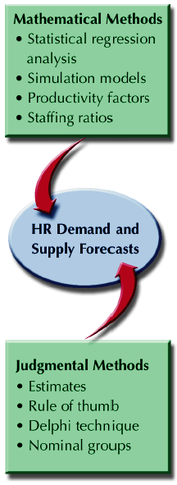
Forecasting Methods
Figure 2–8
© 2002 Southwestern College Publishing. All rights reserved.
2–<number>

Slide 23
Forecasting HR Supply and Demand
Forecasting the Demand for Human Resources
  Organization-wide estimate for total demand
  Unit breakdown for specific skill needs by number and type of employee
    Develop decision rules (“fill rates”) for positions to be filled internally and externally.
    Develop additional decision rules for positions impacted by the chain effects of internal promotions and transfers.
Forecasting the Supply for Human Resources
  External Supply
  Internal Supply
© 2002 Southwestern College Publishing. All rights reserved.
2–<number>

Slide 24
Forecasting HR Supply and Demand
Forecasting External HR Supply
  Factors affecting external
    Net migration for an area
    Individuals entering and leaving the workforce
    Individuals graduating from schools and colleges
    Changing workforce composition and patterns
    Economic forecasts
    Technological developments and shifts
    Actions of competing employers
    Government regulations and pressures
    Other factors affecting the workforce
© 2002 Southwestern College Publishing. All rights reserved.
2–<number>

Slide 25
Forecasting HR Supply and Demand
Forecasting Internal HR Supply
  Effects of promotions, lateral moves, and terminations
  Succession analysis
    Replacement charts
    Transition matrix (Markov matrix)
Exit Manager Supervisor Line Worker
Manager .15 .85 .00 .00.
Supervisor .10 .15 .70 .05
Line Worker .20 .00 .15 .65
© 2002 Southwestern College Publishing. All rights reserved.
2–<number>

Slide 26
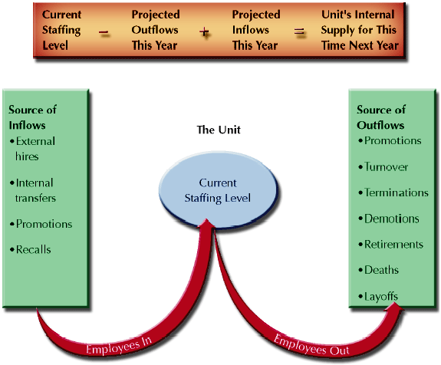
Estimating Internal Labor Supply for a Given Unit
Figure 2–9
© 2002 Southwestern College Publishing. All rights reserved.
2–<number>

Slide 27
Managing Human Resource
Surplus or Shortage
Workforce Reductions and the WARN Act
  Identifies employer requirements for layoff advance notice.
    60-day notice to employees and the local community before a layoff or facility closing involving more than 50 people.
    Does not cover part-time or seasonal workers.
    Imposes fines for not following notification procedure.
    Has hardship clauses for unanticipated closures or lack of business continuance capabilities.
© 2002 Southwestern College Publishing. All rights reserved.
2–<number>

Slide 28
Managing Human Resource
Surplus or Shortage
Workforce Realignment
  “Downsizing”, “Rightsizing”, and “Reduction in Force” (RIF) all mean reducing the number of employees in an organization.
  Causes
    Economic—weak product demand, loss of market share to competitors
    Structural—technological change, mergers and acquisitions
© 2002 Southwestern College Publishing. All rights reserved.
2–<number>

Slide 29
Managing Human Resource
Surplus or Shortage
Workforce Realignment (cont’d)
  Positive consequences
    Increase competitiveness
    Increased productivity
  Negative consequences
    Cannibalization of HR resources
    Loss of specialized skills and experience
    Loss of growth and innovation skills
  Managing survivors
    Provide explanations for actions and the future
    Involve survivors in transition/regrouping activities
© 2002 Southwestern College Publishing. All rights reserved.
2–<number>

Slide 30
Managing Human Resource
Surplus or Shortage
Downsizing approaches
  Attrition and hiring freezes
    Not replacing departing employees and not hiring new employees/
  Early retirement buyouts
    Offering incentives that encourage senior employees to leave the organization early.
  Layoffs
    Employees are placed on unpaid leave until called back to work when business conditions improve.
    Employees are selected for layoff on the basis of their seniority or performance or a combination of both.
© 2002 Southwestern College Publishing. All rights reserved.
2–<number>

Slide 31
Managing Human Resource
Surplus or Shortage
Downsizing approaches (cont’d)
  Outplacement services provided to displaced employees to give them support and assistance:
    Personal career counseling
    Resume preparation and typing services
    Interviewing workshops
    Referral assistance
    Severance payments
    Continuance of medical benefits
    Job retraining
© 2002 Southwestern College Publishing. All rights reserved.
2–<number>

Slide 32
Dealing with Downsizing
Investigate alternatives to downsizing
Involve those people necessary for success in the planning for downsizing
Develop comprehensive communications plans
Nurture the survivors
Outplacement pays off
© 2002 Southwestern College Publishing. All rights reserved.
2–<number>

Slide 33
Assessing HR Effectiveness
Diagnostic Measures of HR Effectiveness
  HR expense per employee
  Compensation as a percent of expenses
  HR department expense as a percent of total expenses
  Cost of hires
  Turnover rates
  Absenteeism rates
  Worker’s compensation per employee
© 2002 Southwestern College Publishing. All rights reserved.
2–<number>

Slide 34
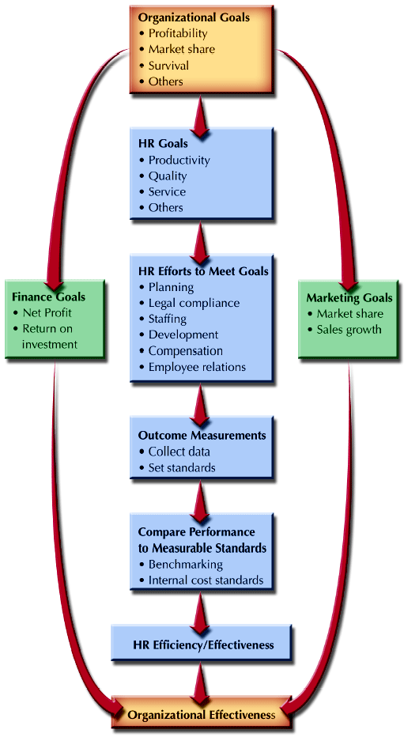
Overview of the HR Evaluation Process
Figure 2–10
© 2002 Southwestern College Publishing. All rights reserved.
2–<number>

Slide 35
Assessing HR Effectiveness
HR Audit
  A formal research effort that evaluates the current state of HR management in an organization
  Audit areas:
    Legal compliance (e.g., EEO, OSHA, ERISA, and FMLA)
    Current job specifications and descriptions
    Valid recruiting and selection process
    Formal wage and salary system • Benefits
    Employee handbook
    Absenteeism and turnover control
    Grievance resolution process
    Orientation program • Training and development
    Performance management system
© 2002 Southwestern College Publishing. All rights reserved.
2–<number>

Slide 36
Using HR Research for Assessment
HR Research
  The analysis of data from HR records to determine the effectiveness of past and present HR practices.
Primary Research
  Research method in which data are gathered first-hand for the specific project being conducted.
Secondary Research
  Research method using data already gathered by others and reported in books, articles in professional journals, or other sources.
© 2002 Southwestern College Publishing. All rights reserved.
2–<number>

Slide 37
HR Performance and Benchmarking
Benchmarking
  Comparing specific measures of performance against data on those measures in other “best practice” organizations
Common Benchmarks
  Total compensation as a percentage of net income before taxes
  Percent of management positions filled internally
  Dollar sales per employee
  Benefits as a percentage of payroll cost
© 2002 Southwestern College Publishing. All rights reserved.
2–<number>

Slide 38
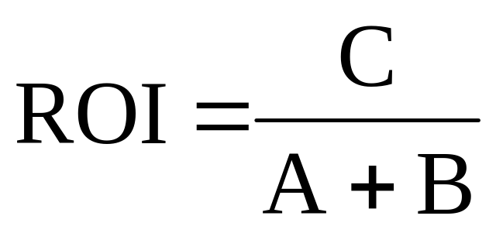
Doing the Benchmarking Analysis
Return on Investment (ROI)
  Calculation showing the value of expenditures for HR activities.
A = Operating costs for a new or enhance system for the time period
B = One-time cost of acquisition and implementation
C = Value of gains from productivity improvements for the time period
© 2002 Southwestern College Publishing. All rights reserved.
2–<number>

Slide 39
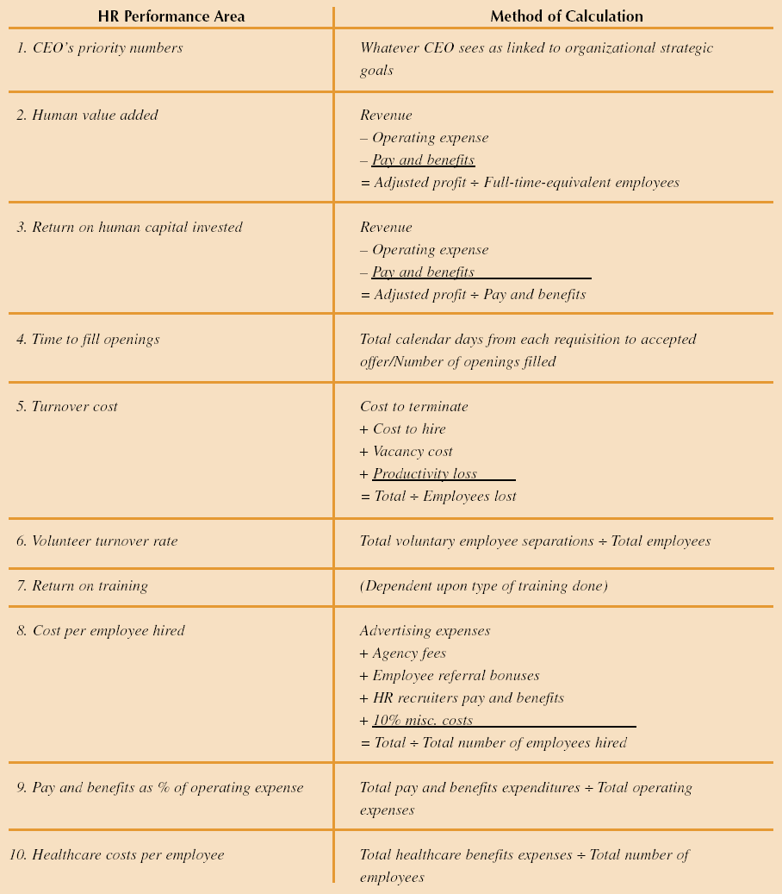
HR Business Performance Calculations
Source: Adapted from Jac Fitz-Enz, “Top 10 Calculations for Your HRIS,” HR Focus, April 1998, S-3.
Figure 2–11a
© 2002 Southwestern College Publishing. All rights reserved.
2–<number>

Slide 40
HR Business Performance Calculations
Source: Adapted from Jac Fitz-Enz, “Top 10 Calculations for Your HRIS,” HR Focus, April 1998, S-3.
Figure 2–11b
© 2002 Southwestern College Publishing. All rights reserved.
2–<number>

Slide 41
Doing the Benchmarking Analysis
Economic Value Added (EVA)
  A firm’s net operating profit after the cost of capital (minimum rate of return demanded by the shareholders) is deducted.
  Cost of capital is the benchmark for returns for all HR activities.
Utility analysis
  Analysis in which economic or other statistical models are built to identify the costs and benefits associated with specific HR activities
© 2002 Southwestern College Publishing. All rights reserved.
2–<number>

Slide 42
Human Resource Information Systems
Human resource information systems (HRIS)
  An integrated system of hardware, software, and databases designed to provide information used in HR decision making.
  Benefits of HRIS
    Administrative and operational efficiency in compiling HR data
    Availability of data for effective HR strategic planning
  Uses of HRIS
    Automation of payroll and benefit activities
    EEO/affirmative action tracking
© 2002 Southwestern College Publishing. All rights reserved.
2–<number>

Slide 43
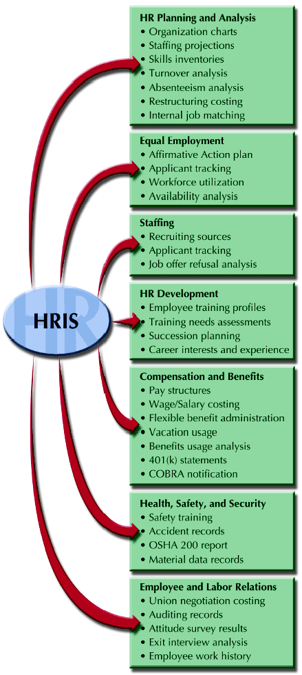
Uses of an HR Information System (HRIS)
Figure 2–12
© 2002 Southwestern College Publishing. All rights reserved.
2–<number>

Slide 44
Designing and Implementing an HRIS
HRIS Design Issues
  What information available and what is information needed?
  To what uses will the information be put?
  What output format compatibility with other systems is required?
  Who will be allowed to access to the information?
  When and how often will the information be needed?
© 2002 Southwestern College Publishing. All rights reserved.
2–<number>

Slide 45
Accessing the HRIS
Intranet
  An organizational (internal) network that operates over the Internet.
Extranet
  An Internet-linked network that allows employees access to information provided by external entities.
Web-based HRIS Uses
  Bulletin boards
  Data access
  Employee self-service
  Extended linkage
© 2002 Southwestern College Publishing. All rights reserved.
2–<number>

