Slide 1
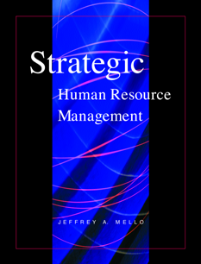
CHAPTER 3
STRATEGIC
PLANNING
PowerPoint Presentation by Charlie Cook
Copyright © 2002 South-Western. All rights reserved

Slide 2
Strategic Management
Strategic Human Resource Management
  Involves aligning initiatives involving how people are managed with the organizational mission and objectives.
Strategic Management Process
  Determining what needs to be done (how) to achieve corporate objectives over a three- to five year time span.
  Examining the organization and the competitive environment.
  Establishing a strategic (optimal) “fit” between the organization and its environment that engenders success.
  Reviewing and revising the strategic plan as necessary.
Copyright © 2002 South-Western. All rights reserved.
3–<number>

Slide 3
Models of Strategy
Industrial Organization (O/I) Model
  The external environment is the primary determinant of organizational strategy rather than the internal decisions of its managers.
  The environment presents threats and opportunities.
  All competing organizations control or have equal access to resources.
  Resources are highly mobile between firms.
  Organizational success is achieved by offering goods and services at lower costs than competitors or by differentiating products such that they bring premium prices.
Copyright © 2002 South-Western. All rights reserved.
3–<number>

Slide 4
Models of Strategy (cont’d)
Resource-Based View (RBV)
  An organization’s resources and capabilities, not external environmental conditions, should be the basis for strategic decisions.
  Competitive advantage is gained through the acquisition and value of organizational resources.
  Organizations can identify, locate and acquire key valuable resources.
  Resources are not highly mobile across organizations and once acquired are retained.
  Valuable resources are costly to imitate and non-substitutable.
Copyright © 2002 South-Western. All rights reserved.
3–<number>

Slide 5
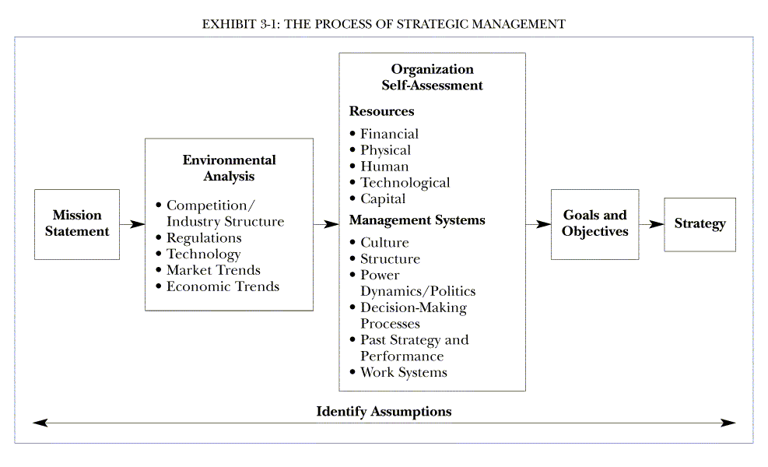
Copyright © 2002 South-Western. All rights reserved.
3–<number>

Slide 6
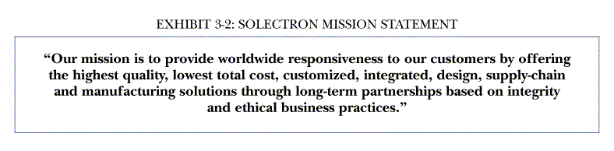
The Mission Statement
Copyright © 2002 South-Western. All rights reserved.
3–<number>

Slide 7
Corporate Strategies: Growth
Benefits
  Gaining economies of scale in operations and functions
  Enhancing competitive position vis-à-vis industry competitors
  Providing opportunities for employee professional development and advancement
HR Issues
  Planning for new hiring
  Alerting current employees
  Ensuring quality and performance standards are maintained
Internal Methods
  Penetration of existing markets
  Developing new markets
  Developing new products or services for existing or new markets
External Methods
  Acquiring other organizations
  Vertical integration
HR Issues
  Merging organizations
  Dismissing redundant employees
Copyright © 2002 South-Western. All rights reserved.
3–<number>

Slide 8
Corporate Strategies (cont’d)
Stability
  Maintaining the status quo due to limited environmental opportunities for gaining competitive advantage.
  Few employees will have opportunities for advancement.
  Critical that management identify key employees and develop specific HR retention strategies to keep them.
Turnaround or Retrenchment
  Downsizing or streamlining the organization in a cost-cutting attempt to adjust to the competitive environment.
  Few opportunities and many environmental threats.
  Important to develop HR practices to manage the “survivors.”
Copyright © 2002 South-Western. All rights reserved.
3–<number>

Slide 9
Business Unit Strategies: Cost Leadership
Increases in efficiency and cutting of costs; then passing the savings to the consumer.
Assumes price elasticity in demand for products or services is high; small change in price will cause large increase in demand.
Assumes that customers are more price sensitive than brand loyal.
HR strategy focuses on short-term performance measures of results and promoting efficiency through job specialization and cross-training.
Copyright © 2002 South-Western. All rights reserved.
3–<number>

Slide 10
Business Unit Strategies: Differentiation
Attempting to distinguish organizational products or services from other competitors or creating the perception of a difference in order to demand a premium price from consumers.
Organization offers employees incentives and compensation for creativity.
HR strategy focuses on external hiring of unique individuals and on retaining creative employees.
Copyright © 2002 South-Western. All rights reserved.
3–<number>

Slide 11
Business Unit Strategies: Focus
Business attempts to satisfy the needs of only a particular group or narrow segment of the market.
Strategic intent is to gain consumer loyalty of neglected groups of consumers.
Strategic HR issue is ensuring employee awareness of uniqueness of market segment.
  Thorough employee training and a focus on customer satisfaction are critical factors.
  Hiring members of the target segment who are empathetic to customer in the target segment.
Copyright © 2002 South-Western. All rights reserved.
3–<number>

Slide 12
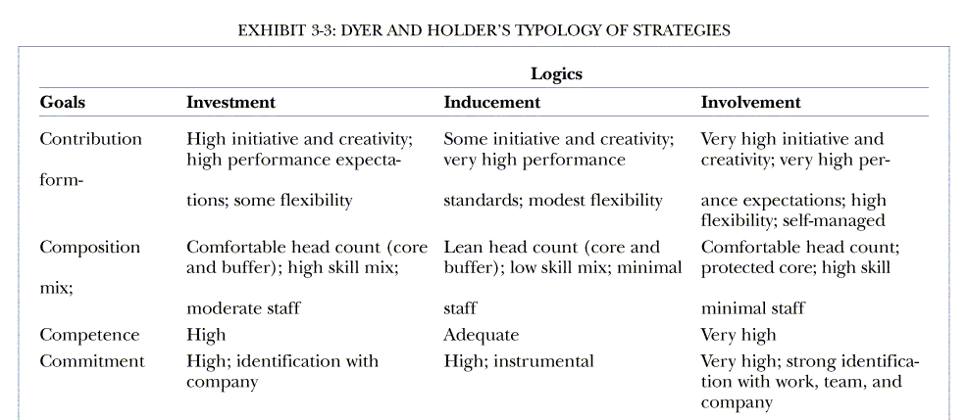
Business Unit Strategies: Logics of Control
Copyright © 2002 South-Western. All rights reserved.
3–<number>

Slide 13
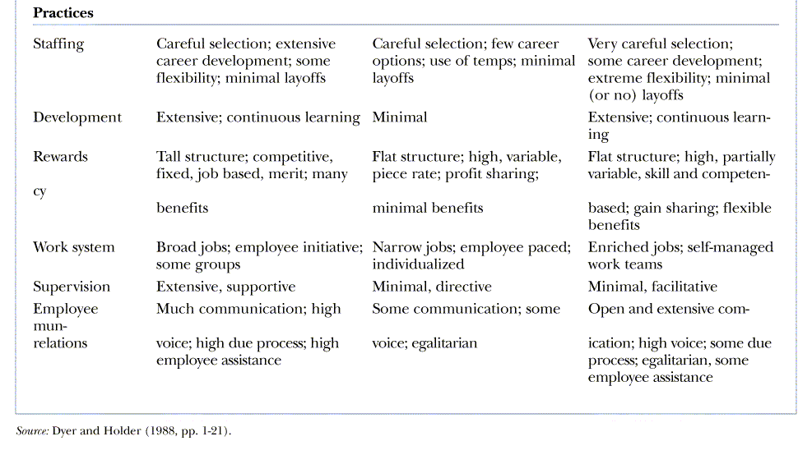
Business Unit Strategies: Logics of Control (cont’d)
EXHIBIT 3-3: DYER AND HOLDER’S TYPOLOGY OF STRATEGIES (cont’d)
Copyright © 2002 South-Western. All rights reserved.
3–<number>

Slide 14
Benefits of a Strategic Approach to HR
Facilitates the development of a high-quality workforce through its focus on the types of people and skills needed.
Facilitates cost-effective utilization of labor, particularly in service industries where labor is generally the greatest cost.
Facilitates the planning and assessment of environmental uncertainty and the adaptation of the organization to the external forces that impact the organization.
Copyright © 2002 South-Western. All rights reserved.
3–<number>

Slide 15
Reading 3.2: The Five P’s Model of SHRM
Philosophy
  Statements of how the organization values and treats employees; essentially the culture of the organization.
Policies
  Expressions of shared values and guidelines for action on employee-related business issues.
Programs
  Coordinated and strategized approaches to initiate, disseminate, and sustain strategic organizational change efforts necessitated by strategic business needs.
Copyright © 2002 South-Western. All rights reserved.
3–<number>

Slide 16
Reading 3.2: The Five P’s Model of SHRM
Practices
  HR practices that motivate behaviors that allow individuals to assume roles consistent with the organization’s strategic objectives.
Processes
  The continuum of participation by all employees in the specific activities of to facilitate the formulation and implementation of other activities.
Copyright © 2002 South-Western. All rights reserved.
3–<number>

Slide 17
Reading 3.2: Implications of SHRM
Successful SHRM efforts begin with identification of strategic needs.
Employee participation is critical to linking strategy and HR practices.
Strategic HR depends on a systematic and analytical mindset.
Corporate HR departments can have an impact on their organization’s efforts to launch strategic initiatives.
Copyright © 2002 South-Western. All rights reserved.
3–<number>

