Slide 1
The Strategic Role of
Human Resource Management

Slide 2

After studying this chapter, you should be able to:
Explain what human resource management (HR) is and how it relates to the management process.
Give at least eight examples of how managers can use HR concepts and techniques.
Illustrate the HR management responsibilities of line and staff (HR) managers.
Provide a good example that illustrates HR’s role in formulating and executing company strategy.
Write a short essay that addresses the topic: why metrics and measurement are crucial to today’s HR managers.
Outline the plan of this book.
1–<number>
<footer>© 2005 Prentice Hall Inc. All rights reserved.

Slide 3
The Manager’s Human Resource
Management Jobs
Management process
  The five basic functions of planning, organizing, staffing, leading, and controlling.
Human resource management (HRM)
  The policies and practices involved in carrying out the “people” or human resource aspects of a management position, including recruiting, screening, training, rewarding, and appraising.

Slide 4
Personnel Aspects Of A Manager’s Job
Conducting job analyses (determining the nature of each employee’s job)
Planning labor needs and recruiting job candidates
Selecting job candidates
Orienting and training new employees
Managing wages and salaries (compensating employees)
Providing incentives and benefits
Appraising performance
Communicating (interviewing, counseling, disciplining)
Training and developing managers
Building employee commitment

Slide 5
Because you do not want to do the following Personnel Mistakes
Why HR Is Important to all the Managers
Hire the wrong person for the job
Experience high turnover
Have your people not doing their best
Waste time with useless interviews
Have your company in court because of discriminatory actions
Have your company cited by safety law for unsafe practices
Have some employees think their salaries are unfair and inequitable relative to others in the organization or out side the organization
Allow a lack of training to undermine your department’s effectiveness
Commit any unfair labor practices

Slide 6

Basic HR Concepts
Getting results
  The bottom line of managing
HR creates value by engaging
in activities that produce
the employee behaviors
the company needs to
achieve its strategic
goals.

Slide 7

Line and Staff Aspects of HRM
Line manager
  A manager who is authorized to direct the work of subordinates and is responsible for accomplishing the organization’s tasks.
Staff manager
  A manager who assists and advises line managers.

Slide 8
Line Managers’ HRM Responsibilities
Placing the right person on the right job
Starting new employees in the organization (orientation)
Training employees for jobs new to them
Improving the job performance of each person
Gaining creative cooperation and developing smooth working relationships
Interpreting the firm’s policies and procedures
Controlling labor costs
Developing the abilities of each person
Creating and maintaining department morale
Protecting employees’ health and physical condition

Slide 9
Functions of the HR Manager
A line function
  The HR manager directs the activities of the people in his or her own department and in related service areas (like the plant cafeteria).
A coordinative function
  HR managers also coordinate personnel activities, a duty often referred to as functional control.
Staff (assist and advise) functions
  Assisting and advising line managers is the heart of the HR manager’s job.

Slide 10
HR and Authority
Authority
  The right to make decisions, direct others’ work, and give orders.
Implied authority
  The authority exerted by an HR manager by virtue of others’ knowledge that he or she has access to top management.
Line authority
  The authority exerted by an HR manager by directing the activities of the people in his or her own department and in service areas.

Slide 11
Employee Advocacy
HR must take responsibility for:
  Clearly defining how management should be treating employees.
  Making sure employees have the mechanisms required to contest unfair practices.
  Represent the interests of employees within the framework of its primary obligation to senior management.

Slide 12
Examples of HR Job Duties
Recruiters
  Search for qualified job applicants.
Equal employment opportunity (EEO) coordinators
  Investigate and resolve EEO grievances, examine organizational practices for potential violations, and compile and submit EEO reports.
Job analysts
  Collect and examine information about jobs to prepare job descriptions.

Slide 13
Examples of HR Job Duties (cont’d)
Compensation managers
  Develop compensation plans and handle the employee benefits program.
Training specialists
  Plan, organize, and direct training activities.
Labor relations specialists
  Advise management on all aspects of union–management relations.

Slide 14
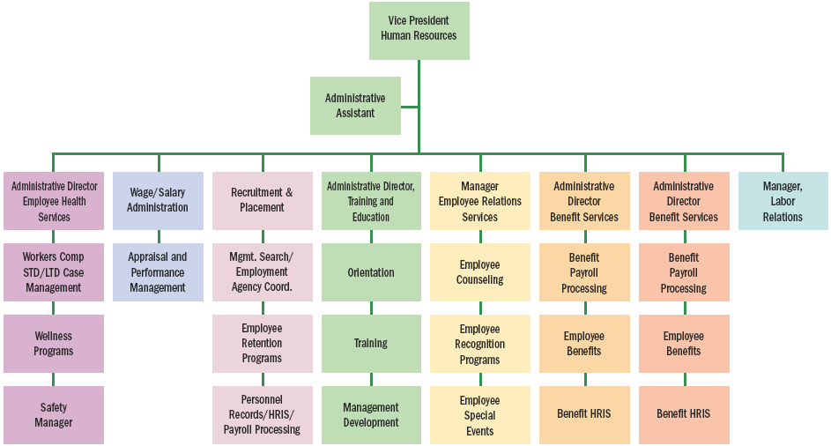
HR Department Organizational Chart (Large Company)
Source: Adapted from BNA Bulletin to Management, June 29, 2000.
Figure 1–1

Slide 15
Cooperative Line and Staff HR Management
The line manager’s responsibility is to specify the qualifications employees need to fill specific positions.
HR staff then develops sources of qualified applicants and conduct initial screening interviews
HR administers the appropriate tests and refers the best applicants to the supervisor (line manager), who interviews and selects the ones he or she wants.

Slide 16
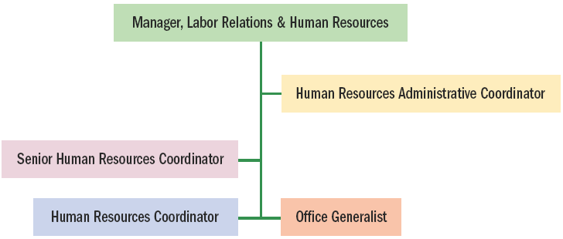
HR Organizational Chart (Small Company)
Figure 1–2

Slide 17
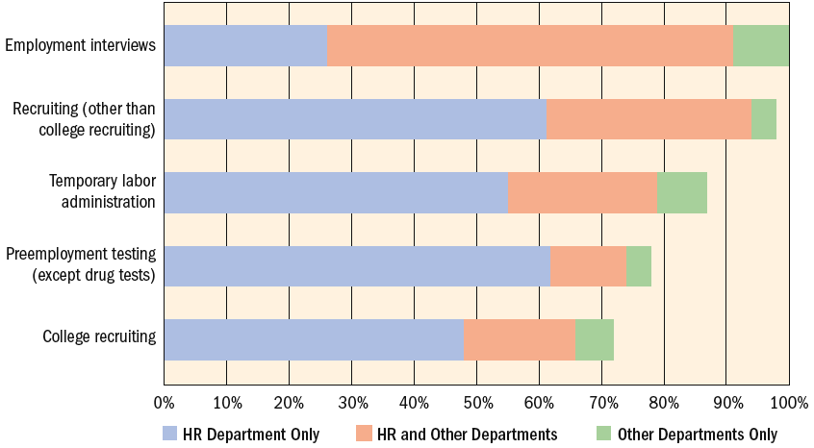
Employment and Recruiting—Who Handles It? (percentage of all employers)
Note: length of bars represents prevalence of activity among all surveyed employers.
Source: HR Department Benchmarks and Analysis,” BNA/Society for Human Resource Management, 2002.
Figure 1–3

Slide 18
The Changing Environment Of
HR Management
HR’s changing role:
“ Personnel departments”
  Took over hiring and firing from supervisors, payroll, and benefit plans administration.
  In the 1930s added “protecting the firm in its interaction with unions” responsibilities (labor relations).
  Assumed organizational responsibilities for equal employment and affirmative action.

Slide 19

A Changing HR Environment
Globalization( Toyota in Kentucky, dell in china, more competition)
Technological Advances( Carrier saves 100Million dollar using internate.
Exporting Jobs( dell has call centre in abroad)
The Nature of Work( Instrument replacing Man)
Workforce Demographics

Slide 20
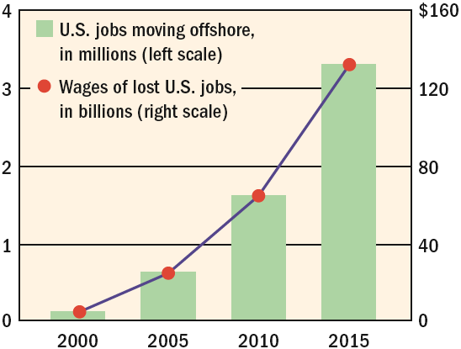
Employment Exodus:
Projected Loss of Jobs and Wages
Source: Michael Shroeder, “States Fight Exodus of Jobs,” Wall Street Journal, June 3, 2003, p. 84.
Figure 1–4

Slide 21
Measuring HR’s Contribution
Strategy
  The company’s long-term plan for how it will balance its internal strengths and weaknesses with its external opportunities and threats to maintain a competitive advantage.
    HR managers today are more involved in partnering with their top managers in both designing and implementing their companies’ strategies.
  Top management wants to see, precisely, how the HR manager’s plans will make the company more valuable.

Slide 22
HR Metrics
Absence Rate
  [(Number of days absent in month) ÷ (Average number of employees during mo.) × (number of workdays)] × 100
Cost per Hire
  (Advertising + Agency Fees + Employee Referrals + Travel cost of applicants and staff + Relocation costs + Recruiter pay and benefits) ÷ Number of Hires
Health Care Costs per Employee
  Total cost of health care ÷ Total Employees
HR Expense Factor
  HR expense ÷ Total operating expense
Sources: Robert Grossman, “Measuring Up,” HR Magazine, January 2000, pp. 29–35; Peter V. Le Blanc, Paul Mulvey, and Jude T. Rich, “Improving the Return on Human Capital: New Metrics,” Compensation and Benefits Review, January/February 2000, pp. 13–20;Thomas E. Murphy and Sourushe Zandvakili, “Data and Metrics-Driven Approach to Human Resource Practices: Using Customers, Employees, and Financial Metrics,” Human Resource Management 39, no. 1 (Spring 2000), pp. 93–105; [HR Planning, Commerce Clearing House Incorporated, July 17, 1996;] SHRM/EMA 2000 Cost Per Hire and Staffing Metrics Survey; www.shrm.org.
Figure 1–5

Slide 23
HR Metrics (cont’d)
Human Capital ROI
  Revenue − (Operating Expense − [Compensation cost + Benefit cost]) ÷ (Compensation cost + Benefit cost)
Human Capital Value Added
  Revenue − (Operating Expense − ([Compensation cost + Benefit Cost]) ÷ Total Number of FTE
Revenue Factor
  Revenue ÷ Total Number of FTE
Time to fill
  Total days elapsed to fill requisitions ÷ Number hired
Sources: Robert Grossman, “Measuring Up,” HR Magazine, January 2000, pp. 29–35; Peter V. Le Blanc, Paul Mulvey, and Jude T. Rich, “Improving the Return on Human Capital: New Metrics,” Compensation and Benefits Review, January/February 2000, pp. 13–20;Thomas E. Murphy and Sourushe Zandvakili, “Data and Metrics-Driven Approach to Human Resource Practices: Using Customers, Employees, and Financial Metrics,” Human Resource Management 39, no. 1 (Spring 2000), pp. 93–105; [HR Planning, Commerce Clearing House Incorporated, July 17, 1996;] SHRM/EMA 2000 Cost Per Hire and Staffing Metrics Survey; www.shrm.org.
Figure 1–5 (cont’d)

Slide 24
HR Metrics (cont’d)
Training Investment Factor
  Total training cost ÷ Headcount
Turnover Costs
  Cost to terminate + Cost per hire + Vacancy Cost + Learning curve loss
Turnover Rate
  [Number of separations during month ÷ Average number of employees during month] × 100
Workers’ Compensation Cost per Employee
  Total WC cost for Year ÷ Average number of employees
Sources: Robert Grossman, “Measuring Up,” HR Magazine, January 2000, pp. 29–35; Peter V. Le Blanc, Paul Mulvey, and Jude T. Rich, “Improving the Return on Human Capital: New Metrics,” Compensation and Benefits Review, January/February 2000, pp. 13–20;Thomas E. Murphy and Sourushe Zandvakili, “Data and Metrics-Driven Approach to Human Resource Practices: Using Customers, Employees, and Financial Metrics,” Human Resource Management 39, no. 1 (Spring 2000), pp. 93–105; [HR Planning, Commerce Clearing House Incorporated, July 17, 1996;] SHRM/EMA 2000 Cost Per Hire and Staffing Metrics Survey; www.shrm.org.
Figure 1–5 (cont’d)

Slide 25

Measuring HR’s Contribution
The HR Scorecard
  Shows the quantitative standards, or “metrics” the firm uses to measure HR activities.
  Measures the employee behaviors resulting from these activities.
  Measures the strategically relevant organizational outcomes of those employee behaviors.

Slide 26
Benefits of a High Performance Work System (HPWS)
Generate more job applicants
Screen candidates more effectively
Provide more and better training
Link pay more explicitly to performance
Provide a safer work environment
Produce more qualified applicants per position
More employees are hired based on validated selection tests
Provide more hours of training for new employees
Higher percentages of employees receiving regular performance appraisals.

Slide 27

The New HR Manager
New Proficiencies
  HR proficiencies
  Business proficiencies
  Leadership proficiencies
  Learning proficiencies

Slide 28

The New HR Manager (cont’d)
The Need to “Know Your Employment Law”
  Equal employment laws
  Occupational safety and health laws
  Labor laws

Slide 29
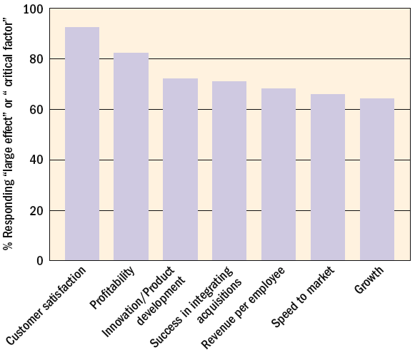
Effects CFOs Believe Human Capital
Has on Business Outcomes
Source: Steven H. Bates, “Business Partners,” HR Magazine, September 2003, p. 49
Figure 1–6

Slide 30
The New HR Manager
Ethics and HR
  Ethical lapses (e.g., Enron, Martha Stewart)
Sarbanes-Oxley Act in 2003
  Intended to curb erroneous corporate financial reporting:
    Requires CEOs and CFOs to certify their companies’ periodic financial reports.
    Prohibits personal loans to executive officers and directors.
    Requires CEOs and CFOs to reimburse their firms for bonuses and stock option profits if corporate financial statements subsequently require restating.

Slide 31

HR Professional Certification
HR is becoming more professionalized.
Society for Human Resource Management (SHRM)
  SHRM’s Human Resource Certification Institute (HRCI)
    SPHR (senior professional in HR)
    PHR (professional in HR)
    certificate

Slide 32
HR and Technology
Benefits of technological applications for HR
  Intranet-based employee portals through which employees can self-service HR transactions.
  The availability of centralized call centers staffed with HR specialists.
  Increased efficiency of HR operations.
  The development of data warehouses of HR-related information.
  The ability to outsource HR activities to specialist service providers.

Slide 33
The Plan of This Book: Basic Themes
HR management is the responsibility of every manager—not just those in the HR department.
HR managers must always stand ready to defend their plans and contributions in measurable terms.
An HR department’s performance is measured relative to achieving the company’s strategic aims.
HR managers increasingly rely on IT to help support the company’s strategic aims.
Virtually every HR-related decision managers make has legal implications.
Globalization and diversity are important HR issues today.

Slide 34
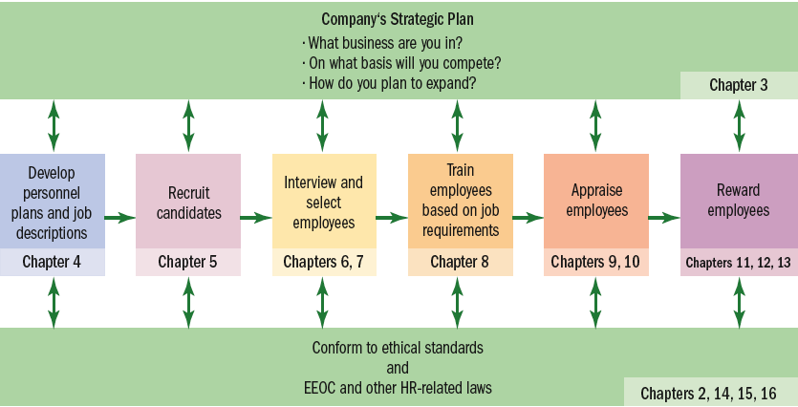
Strategy and the Basic HR Process
Figure 1–8

Slide 35
KEY TERMS
management process
human resource management (HRM)
authority
line manager
staff manager
line authority
implied authority
functional control
employee advocacy
globalization
nontraditional workers
human capital
strategy
metrics
HR Scorecard
outsourcing

