Slide 1

Chapter 3 & 4
Personnel Planning and Recruiting

Slide 2
THE HR PLANNING PROCESS: THE SYSTEMATIC REVIEW OF HUMAN RESOURCE REQUIREMENTS TO ENSURE THAT:
The Required
Number of
Employees
With The Required
Skills
Are Available When Needed
Notes:
Employment or personnel planning
The process of deciding what positions the firm will have to fill, and how to fill them. Personnel planning covers all the firm’s future positions, from maintenance clerk to CEO. However, most firms use succession planning to refer to the process of deciding how to fill the company’s most important executive jobs.

Slide 3
THE HUMAN RESOURCE PLANNING PROCESS
Strategic Planning
HR Planning
Comparison of
Requirements &
Availability
Forecasting
HR Requirements
Forecasting
HR Availability
Surplus of
Workers
Demand
=
Supply
Shortage of
Workers
Restricted Hiring,
Reduced Hours,
Early Retirement,
Layoffs
Recruitment
No Action
Selection

Slide 4
Nature of Jobs Today: From Specialized to Enlarged Jobs
Job Enlargement = same-level activities
Job Rotation = moving from one job to another
Job Enrichment = redesigning to experience more responsibility, achievement, growth and recognition
Notes:
Job enlargement means assigning workers additional same-level activities, thus increasing the number of activities they perform. Thus, the worker who previously only bolted the seat to the legs might attach the back as well. Job rotation means systematically moving workers from one job to another.
job rotation
Systematically moving workers from one job to another.
Job enrichment means redesigning jobs in a way that increases the opportunities for the worker to experience feelings of responsibility, achievement, growth, and recognition—for instance, by letting the worker plan and control his or her own work instead of having it controlled by outsiders.

Slide 5

Job Analysis in a “Jobless” World
From specialized to enlarged jobs
Why managers are “de-jobbing” their companies
“de-jobbing”: Broadening the responsibilities of the company’s jobs and encouraging employees not to limit themselves to what’s on the job description

Slide 6





Why De-Job the Jobs???
Rapid product and technological changes
Competition
Global Changes
Demographics
Notes:
Dejobbing—broadening the responsibilities of the company’s jobs, and
encouraging employees not to limit themselves to what’s on their job descriptions
—is a result of the changes taking place in business today. Organizations
need to grapple with trends like rapid product and technological change, global
competition, deregulation, political instability, demographic changes, and a shift
to a service economy. This has increased the need for firms to be responsive, flexible,
and generally more competitive. In turn, the organizational methods managers
use to accomplish this have helped weaken the meaning of job as a well-defined
and clearly delineated set of responsibilities.

Slide 7
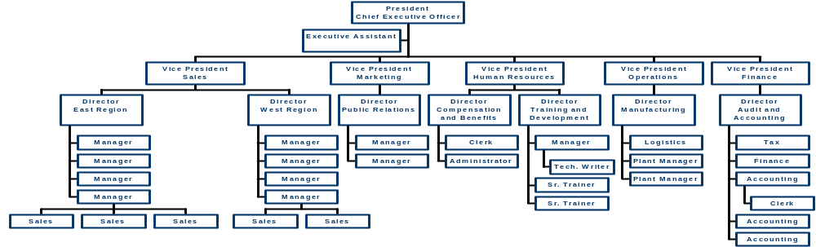
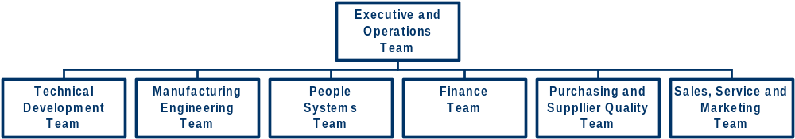
Traditional Organization Chart to Flat Organization
Notes:
Flatter Organizations Instead of traditional pyramid-shaped organizations with
seven or more management layers, flat organizations with just three or four levels
are becoming more prevalent.
Visit the Saturn site: http://www.saturnbp.com/company/employment/team_jobs/

Slide 8
How Organizations are Responding
The boundaryless organization
Re-engineering
“Broadbanding” job descriptions
Performance-based job descriptions
Empowered employees
Skills matrices
Notes:
The Boundaryless Organization In a boundaryless organization the widespread
use of teams and similar structural mechanisms reduces and makes more
permeable the boundaries that typically separate departments (like sales and production)
and hierarchical levels.
Reengineering is “The fundamental rethinking and radical redesign of business processes to achieve dramatic improvements in critical contemporary measures of performance, such as cost, quality, service, and speed.”
Work Teams Managers increasingly organize tasks around teams and processes rather than around specialized functions.

Slide 9
Flat and Boundaryless Organizations
General
Electric
WAL MART
I K E A
Procter & Gamble
Notes:
NOTE: Check out some of the links about people, success stories and values of these organizations.
GE: http://www.gecareers.com/WorkingForGE/index.cfm
IKEA: http://www.ikea-usa.com/about_ikea/about.asp
Procter & Gamble: http://www.pg.com/jobs/who_we_are/index.jhtml
Wal-Mart: http://www.walmartstores.com/

Slide 10
The Skills Matrix for One Job at British Petroleum
H | H | H | H | H | H | H
G | G | G | G | G | G | G
F | F | F | F | F | F | F
E | E | E | E | E | E | E
D | D | D | D | D | D | D
C | C | C | C | C | C | C
B | B | B | B | B | B | B
A | A | A | A | A | A | A
Technical Expertise | Business Awareness | Communi-cation & Interper-sonal | Decision Making & Initiative | Leadership & Guidance | Planning & Organiza-tional Ability | Problem Solving
The highlighted boxes indicate the minimum level of skill required for the job.
Notes:
In one firm—British Petroleum’s exploration division—the need for more efficient, faster-acting, flatter organizations and empowered employees inspired management to replace job descriptions with matrices listing skills and skill levels.
Senior managers wanted to shift employees’ attention from a job description/“that’s-not-my-job” mentality to one that would motivate them to obtain the new skills they needed to accomplish their broader responsibilities.
The solution was a skills matrix. They created skills matrices for various jobs within two groups of employees, those on a management track and those whose aims lay elsewhere (such as to stay in engineering).
HR prepared a matrix for each job or job family (such as drilling manager).
The focus then became developing the new skills needed for the employees’ broader, empowered, and often relatively undefined responsibilities.

Slide 11
Determining the Vacancy - is there one?
Alternative Options to recruitment include:-
Re-organise the work among existing staff
Use overtime
Mechanise the work
Stagger the hours
Make the job part-time
Sub-contract the work
Use temps.

Slide 12
Recruitment and Selection Defined
Definition
Recruitment involves searching for and obtaining potential job candidates in sufficient numbers and quality so that the organisation can select the most appropriate people to fill its job needs.
(Dowling and Schuler, 1990)
Selection involves predicting which candidates will make the most appropriate contribution to the organisation - now and in the future.
(Hackett, 1991)

Slide 13
The Aims of Recruitment
The overall aim is “to obtain at minimum cost the number and quality of employees required to satisfy the human resource needs of the company”.
(Armstrong, 2001:385)
The aims of recruitment are:
♠ to obtain a pool of suitable candidates for vacant posts
♠ to use and be seen to use a fair process
♠ to ensure that all recruitment activities contribute to company goals and a desirable company image
♠ to conduct recruitment activities in an efficient and cost-effective manner
(Foot and Hook, 2001)

Slide 14
Recruitment Process
There are various aspects to an employer’s recruitment strategy:
1. Determining the vacancy
2. Recruitment methods available
3. Recruitment advertising
4. Employment documentation
5. Recruitment monitoring and evaluation
6. Shortlisting
(Beardwell et al, 2001)

Slide 15
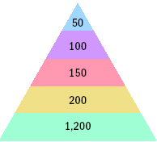
Effective Recruiting: The Yield Pyramid
New hires
Offers made (2 : 1)
Interviewed (3 : 2)
Invited (4 : 3)
Leads generated (6 : 1)
Notes:
Page 98

Slide 16

Sources
Internal
  HRIS
  Job Postings
  Intranet
  Promotions
  Transfers
  Referrals
  Re-recruitment
External
  Internet
    Job boards
    Professional orgs.
    Co. website
  Schools - The Milk Round
  Labor unions
  Job centres
  Various media
  Job fairs
  National/local press; professional journals
  Commercial employment agencies
  Head-hunters
  Onsite visits
  Internships
  Referrals
( Recommend any three methods of external recruitment that would be appropriate to use in hiring a marketing manager for a travel agency. Justify your recommendations.
Notes:
Page 99
It is often therefore safer to promote employees from within, since you’re likely to have a more accurate view of the person’s skills than you would an outsider’s. Inside candidates may also be more committed to the company. Morale may rise, to the extent that employees see promotions as rewards for loyalty and competence. Inside candidates may also require less orientation and training than outsiders.
Employees who apply for jobs and don’t get them may become discontented; telling unsuccessful applicants why they were rejected and what remedial actions they might take to be more successful in the future is thus crucial.
When all managers come up through the ranks, they may have a tendency to maintain the status quo, when a new direction is what’s required.

Slide 17
Discussion Question:
Is it a wise choice for a firm to recruit people from outside, without previous consideration to internal recruitment?

Slide 18

Ad Construction
Use AIDA guide (attention, interest, desire, and action)
Be creative - use of ad agencies might help develop and promote a companies image
Advertisement should contain:
  duties and responsibilities of the job
  abilities,experience and qualifications required.
  Basic details e.g. location, work conditions, hours
  salary, fringe benefits
  career prospects of the job - possibly.
  response required e.g. letter, phone.
  EEA statements

Slide 19
Employment Agencies
Types of agencies:
  Public agencies and non profit
  Private agencies
How to Avoid Problems With Employment Agencies
  Provide full and accurate job description
  Specify the screening tools to use
  Review data on candidates accepted or rejected by your firm and by the agency
  Develop a long-term relationships with one or more agencies
  Screen the agency
Notes:
Page 103
Instructor’s Note: Ask students -
Why turn to an agency?
Reasons include:
1. Your firm doesn’t have its own HR department and is not geared to doing recruiting
and screening.
2. Your firm has found it difficult in the past to generate a pool of qualified applicants.
3. You must fill a particular opening quickly.
4. There is a perceived need to attract a greater number of minority or female applicants.
5. You want to reach currently employed individuals, who might feel more comfortable
dealing with agencies than with competing companies.
6. You want to cut down on the time you’re devoting to interviewing.

Slide 20

Temp Agencies
Alternative staffing often used to supplement a permanent workforce
One year 100,000 people found temp work in engineering, science and management support
Some temp workers felt
  Dehumanized
  Insecure
  Worried
  Misled
  “Underemployed”
  Angry
Notes:
Page 104
Employers often supplement their permanent workforce by hiring contingent or temporary workers, often through temporary help employment agencies. Also known as part-time or just-in-time workers, the contingent workforce is big and growing. It recently accounted for about 20% of all new jobs created in the United States. Such workers are broadly defined as workers who don’t have permanent jobs.
Today’s contingent workforce isn’t limited to clerical or maintenance staff. In one year, almost 100,000 people found temporary work in engineering, science, or management support occupations, for instance. And growing numbers of firms use temporary workers as short-term chief financial officers, or even chief executive officers.
Some firms today employ so many temporary workers that they hire temporary agencies to help manage them. New York-based MasterCard, for instance, has a temporary workforce of 200 to 400 workers on any given day, and retained Manpower, Inc., a large temporary staffing agency, to coordinated the hiring, training, and paperwork of new temporary workers.
Temporary employees are examples of what HR professionals call alternative staffing – the use of nontraditional recruitment sources.
Instructor’s Notes:
Ask students what the benefits and downsides of alternative staffing are.
Contingent staffing has many benefits including: productivity, expense savings of hiring and training new employees, makes company more flexible
Downside in wage paid (20-50% higher) and loyalty. Furthermore, “people have a psychological reference point to their place of
employment. Once you put them in the contingent category, you’re saying
they’re expendable.”

Slide 21

Executive Recruiters
Headhunters
  Special employment agencies used to seek out top management and technical talent
Internet databases have shortened time required to find talent
Online executive recruiting firm
futurestep
Notes:
Page 107
Recruiters
They fill jobs in the $60,000-and-up category, although $80,000 is often the lower limit. The percentage of your firm’s positions filled by these services might be small. However, these jobs would include crucial executive and technical positions. For executive positions, headhunters may be your only source of candidates. The employer always pays their fees.
Two trends.technology and specialization.are changing the executive search business. Most recruiting firms are therefore establishing Internet-linked computerized databases the aim of which, according to one senior recruiter, is “to create a long list by pushing a button.
Executive recruiters are also becoming more specialized, and the large ones are creating new businesses aimed specifically at specialized functions or industries.

