Slide 1
Personnel Planning and Recruiting

Slide 2

After studying this chapter, you should be able to:
Explain the main techniques used in employment planning and forecasting.
List and discuss the main outside sources of candidates.
Effectively recruit job candidates.
Name and describe the main internal sources of candidates.
Develop a help wanted ad.
Explain how to recruit a more diverse workforce.
5–<number>
<footer>© 2005 Prentice Hall Inc. All rights reserved.

Slide 3
The Recruitment and Selection Process
Decide what positions you’ll have to fill through personnel planning and forecasting.
Build a pool of candidates for these jobs by recruiting internal or external candidates.
Have candidates complete application forms and perhaps undergo an initial screening interview.
Use selection techniques like tests, background investigations, and physical exams to identify viable candidates.
Decide who to make an offer to, by having the supervisor and perhaps others on the team interview the candidates.

Slide 4
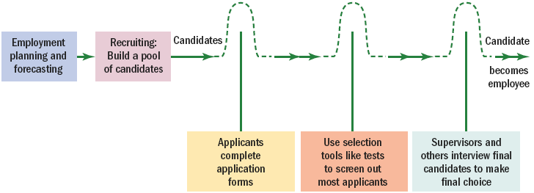
Steps in Recruitment and Selection Process
The recruitment and selection process is a series of hurdles aimed at selecting the best candidate for the job.
Figure 5–1

Slide 5
Planning and Forecasting
Employment or personnel planning
  The process of deciding what positions the firm will have to fill, and how to fill them.
Succession planning
  The process of deciding how to fill the company’s most important executive jobs.
What to forecast?
  Overall personnel needs
  The supply of inside candidates
  The supply of outside candidates

Slide 6
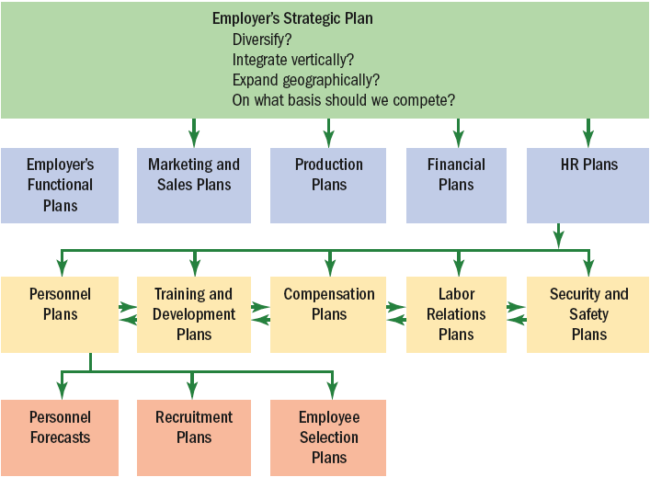
Linking Employer’s Strategy to Plans
Figure 5–2

Slide 7
Forecasting Personnel Needs
Trend analysis
  The study of a firm’s past employment needs over a period of years to predict future needs.
Ratio analysis
  A forecasting technique for determining future staff needs by using ratios between a causal factor and the number of employees needed.
  Assumes that the relationship between the causal factor and staffing needs is constant

Slide 8
The Scatter Plot
Scatter plot
  A graphical method used to help identify the relationship between two variables.
Size of Hospital Number of
(Number of Beds) Registered Nurses
200 240
300 260
400 470
500 500
600 620
700 660
800 820
900 860

Slide 9
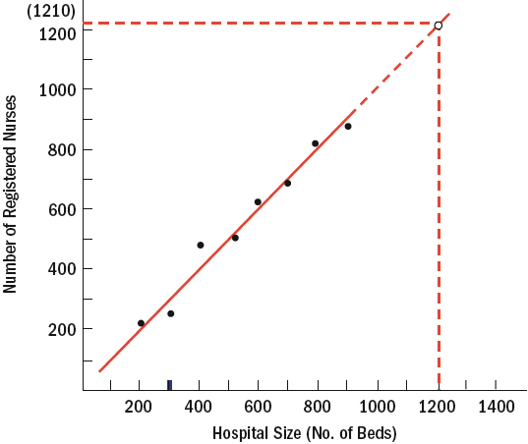
Determining the Relationship Between
Hospital Size and Number of Nurses
Figure 5–3

Slide 10
Drawbacks to Scatter Plots
They focus on projections and historical relationships, and assume that the firm’s existing structure and activities will continue into the future.
They generally do not consider the impact the company’s strategic initiatives may have on future staffing levels.
They tend to support compensation plans that reward managers for managing ever-larger staffs, and will not uncover managers who expand their staffs irrespective of strategic needs.
They tend to “bake in” the nonproductive idea that increases in staffs are inevitable.
They tend to validate and institutionalize existing planning processes and ways of doing things, even in the face of rapid change.

Slide 11
Using Computers to Forecast Personnel Requirements
Computerized forecasts
  The use software packages to determine of future staff needs by projecting sales, volume of production, and personnel required to maintain a volume of output.
    Generates figures on average staff levels required to meet product demands, as well as forecasts for direct labor, indirect staff, and exempt staff.
    Typical metrics: direct labor hours required to produce one unit of product (a measure of productivity), and three sales projections—minimum, maximum, and probable.

Slide 12
Forecasting the Supply of Inside Candidates
Qualifications inventories
  Manual or computerized records listing employees’ education, career and development interests, languages, special skills, and so on, to be used in selecting inside candidates for promotion.

Slide 13
Manual Systems and Replacement Charts
Personnel replacement charts
  Company records showing present performance and promotability of inside candidates for the most important positions.
Position replacement card
  A card prepared for each position in a company to show possible replacement candidates and their qualifications.

Slide 14
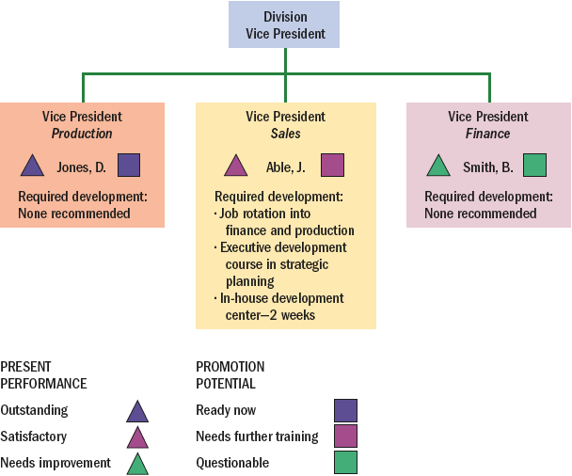
Management Replacement Chart Showing Development Needs of Future Divisional Vice President
Figure 5–4

Slide 15
Computerized Information Systems
Human Resource Information System (HRIS)
  Computerized inventory of information that can be accessed to determine employees’ background, experience, and skills that may include:
    Work experience codes
    Product or service knowledge
    Industry experience
    Formal education

Slide 16
The Matter of Privacy of HR Information
The need to ensure the security of HR information
  There is a lot of HR information to keep secure.
  Control of HR information can be established through the use of access matrices that limit users.
  Legal considerations: The Federal Privacy Act of 1974 gives employees rights regarding who has access to information about their work history and job performance.

Slide 17
Forecasting the Supply of Outside Candidates
Factors impacting the supply of outside candidates
  General economic conditions
  Expected unemployment rate
Sources of information
  Periodic forecasts in business publications
  Online economic projections
    U.S. Congressional Budget Office (CBO)
    Bureau of Labor Statistics
    U.S. Department of Labor: O*Net
    Other federal agencies

Slide 18
Effective Recruiting
External factors affecting recruiting:
  Looming undersupply of workers
  Lessening of the trend in outsourcing of jobs
  Increasingly fewer “qualified” candidates
Internal factors affecting recruiting:
  The consistency of the firm’s recruitment efforts with its strategic goals
  The available resources, types of jobs to be recruited and choice of recruiting methods
  Nonrecruitment HR issues and policies
  Line and staff coordination and cooperation

Slide 19
Effective Recruiting (cont’d)
Advantages of centralizing recruitment
  Strengthens employment brand
  Ease in applying strategic principles
  Reduces duplication of HR activiites
  Reduces the cost of new HR technologies
  Builds teams of HR experts
  Provides for better measurement of HR performance
  Allows for the sharing of applicant pools

Slide 20
Sample Acceptable Questions
Once A Conditional Offer Is Made
Do you have any responsibilities that conflict with the job vacancy?
How long have you lived at your present address?
Do you have any relatives working for this company?
Do you have any physical defects that would prevent you from performing certain jobs where, to your knowledge, vacancies exist?
Do you have adequate means of transportation to get to work?
Have you had any major illness (treated or untreated) in the past 10 years?
Have you ever been convicted of a felony or do you have a history of being a violent person? (This is a very important question to avoid a negligent hiring or retention charge.)
Educational background. (The information required here would depend on the job-related requirements of the position.)
Source: Kenneth Sovereign, Personnel Law (Upper Saddle River, NJ: Prentice Hall, 1999), p. 50.
Figure 5–5

Slide 21
Measuring Recruiting Effectiveness
What to measure and how to measure
  How many qualified applicants were attracted from each recruitment source?
    Assessing both the quantity and the quality of the applicants produced by a source.
High performance recruiting
  Applying best-practices management techniques to recruiting.
    Using a benchmarks-oriented approach to analyzing and measuring the effectiveness of recruiting efforts such as employee referrals.

Slide 22
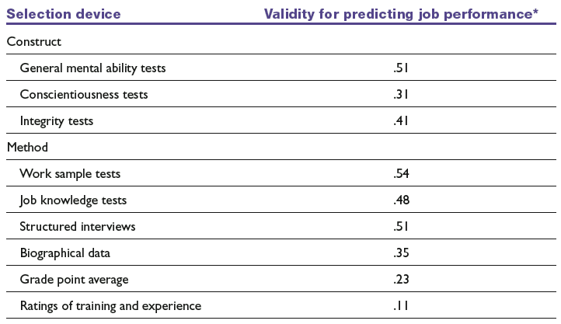
Selection Devices that Could be used to Initially Screen Applicants
Note: *Higher is better.
Source: Kevin Carlson et al., “Recruitment Evaluation: The Case for Assessing the Quality of Applicants Attracted,” Personnel Psychology 55 (2002), p. 470.
Table 5–1

Slide 23
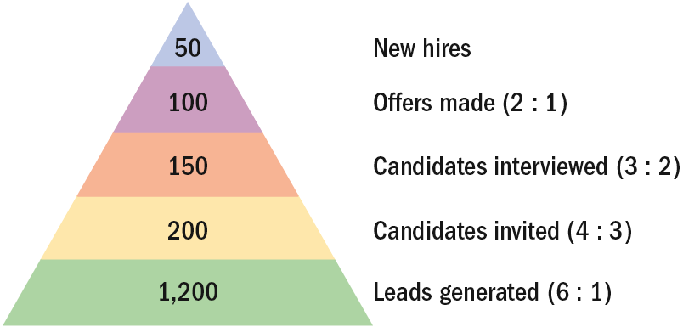
Recruiting Yield Pyramid
Recruiting yield pyramid
  The historical arithmetic relationships between recruitment leads and invitees, invitees and interviews, interviews and offers made, and offers made and offers accepted.
Figure 5–6

Slide 24
Internal Sources of Candidates: Hiring from Within
Advantages
  Foreknowledge of candidates’ strengths and weaknesses
  More accurate view of candidate’s skills
  Candidates have a stronger commitment to the company
  Increases employee morale
  Less training and orientation required
Disadvantages
  Failed applicants become discontented
  Time wasted interviewing inside candidates who will not be considered
  Inbreeding of the status quo

Slide 25
Finding Internal Candidates
Job posting
  Publicizing an open job to employees (often by literally posting it on bulletin boards) and listing its attributes.
Rehiring former employees
  Advantages:
    They are known quantities.
    They know the firm and its culture.
  Disadvantages:
    They may have less-than positive attitudes.
    Rehiring may sent the wrong message to current employees about how to get ahead.

Slide 26
Finding Internal Candidates (cont’d)
Succession planning
  The process of ensuring a suitable supply of successors for current and future senior or key jobs.
Succession planning steps:
  Identifying and analyzing key jobs.
  Creating and assessing candidates.
  Selecting those who will fill the key positions.

Slide 27
Outside Sources of Candidates
Advertising
  The Media: selection of the best medium depends on the positions for which the firm is recruiting.
    Newspapers (local and specific labor markets)
    Trade and professional journals
    Internet job sites
    Marketing programs
Constructing an effective ad
  Wording related to job interest factors should evoke the applicant’s attention, interest, desire, and action (AIDA) and create a positive impression of the firm.

Slide 28

Help Wanted Ad
Source: The Miami Herald, March 24, 2004, p. SF.
Figure 5–7

Slide 29
Outside Sources of Candidates (cont’d)
Types of employment agencies:
  Public agencies operated by federal, state, or local governments
  Agencies associated with nonprofit organizations
  Privately owned agencies

Slide 30
Outside Sources of Candidates (cont’d)
Reasons for using a private employment agency:
  When a firm doesn’t have an HR department and is not geared to doing recruiting and screening.
  The firm has found it difficult in the past to generate a pool of qualified applicants.
  The firm must fill a particular opening quickly.
  There is a perceived need to attract a greater number of minority or female applicants.
  The firm wants to reach currently employed individuals, who might feel more comfortable dealing with agencies than with competing companies.
  The firm wants to cut down on the time it’s devoting to recruiting.

Slide 31
Outside Sources of Candidates (cont’d)
Avoiding problems with employment agencies:
  Give the agency an accurate and complete job description.
  Make sure tests, application blanks, and interviews are part of the agency’s selection process.
  Periodically review data on candidates accepted or rejected by your firm, and by the agency. Check on the effectiveness and fairness of the agency’s screening process.
  Screen the agency. Check with other managers or HR people to find out which agencies have been the most effective at filling the sorts of positions needed to be filled.
  Review the Internet and a few back issues of the Sunday classified ads to discover the agencies that handle the positions to be filled.

Slide 32
Temp Agencies and Alternative Staffing
Benefits of Temps
  Paid only when working
  More productive
  No recruitment, screening, and payroll administration costs
Costs of Temps
  Fees paid to temp agencies
  Lack of commitment to firm

Slide 33
Concerns of Temp Employees
Treatment by employers in a dehumanizing, impersonal, and ultimately discouraging way.
Insecurity about their employment and pessimistic about the future.
Worry about their lack of insurance and pension benefits.
Being misled about their job assignments and in particular about whether temporary assignments were likely to become full-time positions.
Being “underemployed” (particularly those trying to return to the full-time labor market).
In general they were angry toward the corporate world and its values; participants repeatedly expressed feelings of alienation and disenchantment.

Slide 34
Guidelines for Using Temporary Employees
Do not train your contingent workers.
Do not negotiate the pay rate of your contingent workers.
Do not coach or counsel a contingent worker on his/her job performance.
Do not negotiate a contingent worker’s vacations or personal time off.
Do not routinely include contingent workers in your company’s employee functions.
Do not allow contingent workers to utilize facilities intended for employees.
Do not let managers issue company business cards, nameplates, or employee badges to contingent workers without HR and legal approval.
Do not let managers discuss harassment or discrimination issues with contingent workers.
Do not discuss job opportunities and the contingent worker’s suitability for them directly.
Do not terminate a contingent worker directly.
Source: Adapted from Bohner and Selasco, “Beware the Legal Risks of Hiring Temps,” Workforce, October 2000, p. 53.
Figure 5–8

Slide 35
Working with a Temp Agency
Invoicing. Get a sample copy of the agency’s invoice. Make sure it fits your company’s needs.
Time sheets. With temps, the time sheet is not just a verification of hours worked. Once the worker’s supervisor signs it, it’s usually an agreement to pay the agency’s fees.
Temp-to-perm policy. What is the policy if the client wants to hire one of the agency’s temps as a permanent employee?
Recruitment of and benefits for temp employees. Find out how the agency plans to recruit what sorts of benefits it pays.
Dress code. Specify the attire at each of your offices or plants.
Equal employment opportunity statement. Get a statement from the agency that it is not discriminating when filling temp orders.
Job description information. Have a procedure whereby you can ensure the agency understands the job to be filled and the sort of person you want to fill it.

Slide 36
Offshoring/Outsourcing White-Collar and Other Jobs
Specific issues in outsourcing jobs abroad
  Political and military instability
  Likelihood of cultural misunderstandings
  Customers’ security and privacy concerns
  Foreign contracts, liability, and legal concerns
  Special training of foreign employees
  Costs associated with companies supplying foreign workers

Slide 37
Outside Sources of Candidates (cont’d)
Executive recruiters (headhunters)
  Special employment agencies retained by employers to seek out top-management talent for their clients.
    Contingent-based recruiters collect a fee for their services when a successful hire is completed.
    Retained executive searchers are paid regardless of the outcome of the recruitment process.
  Internet technology and specialization trends are changing how candidates are attracted and how searches are conducted.

Slide 38
Guidelines for Choosing a Recruiter
Make sure the firm is capable of conducting a thorough search.
Meet the individual who will actually handle your assignment.
Ask how much the search firm charges.

Slide 39
Outside Sources of Candidates (cont’d)
On demand recruiting services (ODRS)
  A service that provides short-term specialized recruiting to support specific projects without the expense of retaining traditional search firms.

Slide 40
Outside Sources of Candidates (cont’d)
College recruiting
  Recruiting goals
    To determine if the candidate is worthy of further consideration
    To attract good candidates
  On-site visits
    Invitation letters
    Assigned hosts
    Information package
    Planned interviews
    Timely employment offer
    Follow-up
  Internships

Slide 41
Outside Sources of Candidates (cont’d)
Employee referrals
  Applicants who are referred to the organization by current employees
    Referring employees become stakeholders.
    Referral is a cost-effective recruitment program.
    Referral can speed up diversifying the workforce
Walk-ins
  Direct applicants who seek employment with or without encouragement from other sources.
  Courteous treatment of any applicant is a good business practice.

Slide 42
Outside Sources of Candidates (cont’d)
Recruiting via the Internet
  More firms and applicants are utilizing the Internet in the job search process.
Advantages of Internet recruiting
  Cost-effective way to publicize job openings
  More applicants attracted over a longer period
  Immediate applicant responses
  Online prescreening of applicants
  Links to other job search sites
  Automation of applicant tracking and evaluation

Slide 43

Selected Recruitment Web Sites
Source: HR Magazine, November 2003.
Figure 5–9

Slide 44

Ineffective and Effective Web Ads
Figure 5–10

Slide 45
Issues in Recruiting a More Diverse Workforce
Single parents
  Providing work schedule flexibility.
Older workers
  Revising polices that make it difficult or unattractive for older workers to remain employed.
Recruiting minorities and women
  Understanding recruitment barriers.
  Formulating recruitment plans.
  Instituting specific day-to-day programs.

Slide 46
Issues in Recruiting a More Diverse Workforce (cont’d)
Welfare-to-work
  Developing pre-training programs to overcome difficulties in hiring and assimilating persons previously on welfare.
The disabled
  Developing resources and policies to recruit and integrate disable persons into the workforce.

Slide 47
Developing and Using Application Forms
Application form
  The form that provides information on education, prior work record, and skills.
Uses of information from applications
  Judgments about the applicant’s educational and experience qualifications
  Conclusions about the applicant’s previous progress and growth
  Indications of the applicant’s employment stability
  Predictions about which candidate is likely to succeed on the job

Slide 48
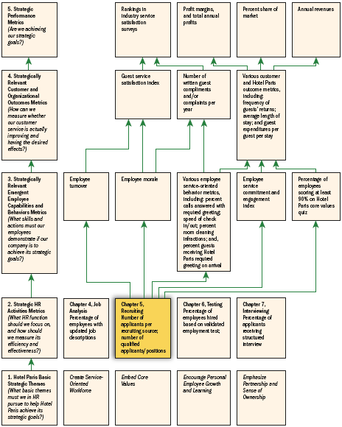
HR Scorecard for Hotel Paris International Corporation*
Note: *(An abbreviated example showing selected HR practices and outcomes aimed at implementing the competitive strategy, “To use superior guest services to differentiate the Hotel Paris properties and thus increase the length of stays and the return rate of guests and thus boost revenues and profitability”)
Figure 5–11

