Slide 2
Objectives
After studying this chapter, you should be able to:
Identify the advantages of integrating human resources planning and strategic planning.
Describe the basic approaches to human resources planning.
Explain the advantages and disadvantages of recruiting from within the organization.
Explain the advantages and disadvantages of external recruitment.
Describe how recruitment activities are integrated with diversity and equal employment opportunity initiatives.

Slide 3

Human Resources Planning
Human Resources Planning (HRP)
  Process of anticipating and making provision for the movement (flow) of people into, within, and out of an organization.
  HRP’s purpose is the the effective deployment of human resources through:
    Anticipating organizational labor supply and demand.
    Providing expanded employment opportunities for women, minorities, and the disabled.
    Guiding the development and training the workforce.

Slide 4
HRP and Strategic Planning
Strategic Analysis
  What human resources are needed and what are available?
Strategic Formulation
  What is required and necessary in support of human resources?
Strategic Implementation
  How will the human resources be allocated?
Human Resources Planning
Strategic
Planning

Slide 5
Linking the Processes of HRP and Strategic Planning
Strategic
Analysis
Establish the context:
Business goals
Company strengths/weaknesses
External opportunities/threats
Source of competitive advantage
Strategy Formulation
Clarify performance expectations and future management method:
Values, guiding principles
Business mission
Objectives and priorities
Resource allocations
Strategy Implementation
Implement processes to achieve desired results:
Business goals
Company strengths/weaknesses
External opportunities/threats
Source of competitive advantage
Identify people-related business issues
Define HR strategies, objectives, and action plans
Implement HR processes, policies, and practices
Source: Adapted from James W. Walker, “Integrating the Human Resource Function with the Business,” Human Resource Planning 14, no. 2 (1996): 59–77. Reprinted with permission.
Presentation Slide 4–1
Figure 4.1

Slide 6
Mapping an Organization’s Human Capital Architecture
Core knowledge workers
  Employees who have firm-specific skills that are directly linked to the company’s strategy.
    Example: Senior software programmer
Traditional job-based employees
  Employees with skills to perform a predefined job that are quite valuable to a company, but not unique.
    Example: Security guard

Slide 7
Mapping an Organization’s Human Capital Architecture (cont’d)
Contract labor
  Employees whose skills are of less strategic value and generally available to all firms.
    Example: General electrician
Alliance/partners
  Individuals and groups with unique skills, but those skills are not directly related to a company’s core strategy.
    Example: Independent product label designer

Slide 8
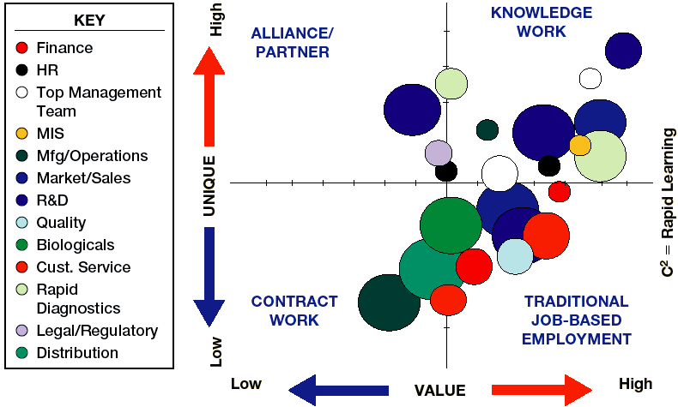
Mapping Human Capital
Presentation Slide 4–2
Figure 4.2
Source: Scott A. Snell, Cornell University.

Slide 9
Ensuring the Fit between HR and Strategy
External Fit (or External Alignment)
  Focuses on the connection between the business objectives and the major initiatives in HR.
Internal Fit (or Internal Alignment)
  Aligning HR practices with one another to establish a configuration that is mutually reinforcing.

Slide 10
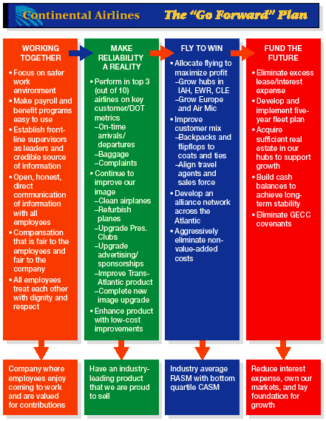
Achieving Strategic Fit At Continental Airlines
HRM 1
Source: Company document.

Slide 11
Strategic Flexibility
Organizational Capability
  Capacity of the organization to act and change in pursuit of sustainable competitive advantage.
  Coordination flexibility
    The ability to rapidly reallocate resources to new or changing needs.
  Resource flexibility
    Having human resources who can do many different things in different ways.

Slide 12
HRP and Environmental Scanning
Environmental Scanning
  The systematic monitoring of the major external forces influencing the organization.
    Economic factors: general and regional conditions
    Competitive trends: new processes, services, and innovations
    Technological changes: robotics and office automation
    Political and legislative issues: laws and administrative rulings
    Social concerns: child care and educational priorities
    Demographic trends: age, composition,and literacy

Slide 13
Scanning the Internal Environment
Cultural Audits
  Audits of the culture and quality of work life in an organization.
    How do employees spend their time?
    How do they interact with each other?
    Are employees empowered?
    What is the predominant leadership style of managers?
    How do employees advance within the organization?
Benchmarking
  The process of comparing the organization’s processes and practices with those of other companies.

Slide 14
The Top Ten Measures Of Human Capital
Your most important issues
Human capital value added
Human capital ROI
Separation cost
Voluntary separation rate
Total labor-cost/revenue percentage
Total compensation/revenue percentage
Training investment factor
Time to start
Revenue factor
HRM 2

Slide 15
Human Resource Planning Model
FORECASTING DEMAND
Considerations
Product/service demand
Technology
Financial resources
Absenteeism/turnover
Organizational growth
Management philosophy
Techniques
Trend analysis
Managerial estimates
Delphi technique
BALANCING
SUPPLY AND DEMAND
(Shortage) Recruitment
Full-time
Part-time
Recalls
Techniques
Staffing tables
Markov analysis
Skills inventories
Management inventories
Replacement charts
Succession Planning
External Considerations
Demographic changes
Education of the workforce
Labor Mobility
Government policies
Unemployment rate
(Surplus) Reductions
Layoffs
Terminations
Demotions
Retirements
FORECASTING SUPPLY
Presentation Slide 4–3
Figure 4.3

Slide 16
Forecasting Demand for Employees
Quantitative Methods
Forecasting Demand
Qualitative Methods

Slide 17
Quantitative Approach: Trend Analysis
Forecasting labor demand based on an organizational index such as sales:
  Select a business factor that best predicts human resources needs.
  Plot the business factor in relation to the number of employees to determine the labor productivity ratio.
  Compute the productivity ratio for the past five years.
  Calculate human resources demand by multiplying the business factor by the productivity ratio.
  Project human resources demand out to the target year(s).

Slide 18
Example of Trend Analysis of HR Demand
BUSINESS ÷ LABOR = HUMAN RESOURCES
FACTOR PRODUCTIVITY DEMAND
YEAR (SALES IN THOUSANDS) (SALES/EMPLOYEE) (NUMBER OF EMPLOYEES)
1997 $2,351 14.33 164
1998 $2,613 11.12 235
1999 $2,935 8.34 352
2000 $3,306 10.02 330
2001 $3,613 11.12 325
2002 $3,748 11.12 337
2003 $3,880 12.52 310
2004* $4,095 12.52 327
2005* $4,283 12.52 342
2006* $4,446 12.52 355
*Projected figures
Figure 4.4

Slide 19
Qualitative Approaches to Demand Forecasting
Management Forecasts
  The opinions (judgments) of supervisors, department managers, experts, or others knowledgeable about the organization’s future employment needs.
Delphi Technique
  An attempt to decrease the subjectivity of forecasts by soliciting and summarizing the judgments of a preselected group of individuals.
  The final forecast represents a composite group judgment.

Slide 20

Forecasting Supply of Employees: Internal Labor Supply
Staffing Tables
Markov Analysis
Skill Inventories
Replacement Charts
Succession Planning

Slide 21
Forecasting Internal Labor Supply
Staffing Tables
  Graphic representations of all organizational jobs, along with the numbers of employees currently occupying those jobs and future (monthly or yearly) employment requirements.
Markov Analysis
  A method for tracking the pattern of employee movements through various jobs.

Slide 22
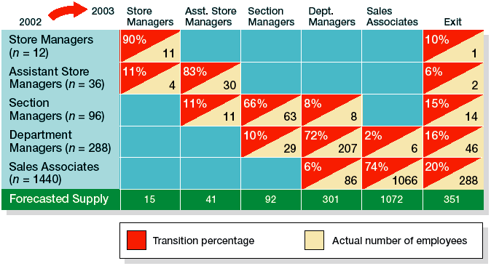
Hypothetical Markov Analysis for a Retail Company
Figure 4.5

Slide 23
Internal Demand Forecasting Tools
Skill Inventories
  Files of personnel education, experience, interests, skills, etc., that allow managers to quickly match job openings with employee backgrounds.
Replacement Charts
  Listings of current jobholders and persons who are potential replacements if an opening occurs.
Succession Planning
  The process of identifying, developing, and tracking key individuals for executive positions.

Slide 24
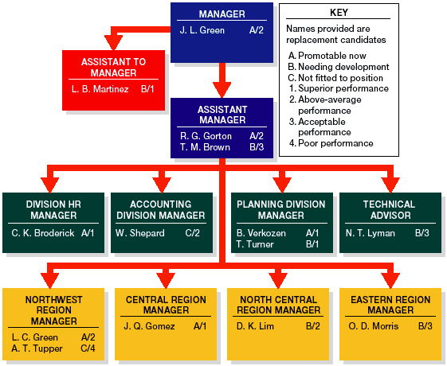
An Executive
Replacement
Chart
Figure 4.6

Slide 25
Forecasting Supply of Employees: External Labor Supply
Factors Influencing the External Labor Supply:
  Demographic changes in the population
  National and regional economics
  Education level of the workforce
  Demand for specific employee skills
  Population mobility
  Governmental policies

Slide 26
Sources of Information About External Labor Markets
U.S. Department of Labor publications
  Bureau of Labor Statistics (BLS)
    Monthly Labor Review
    Occupational Outlook Handbook
State and local planning and development agencies
Chambers of Commerce
Industry and trade group publications
State and local employment agencies

Slide 27
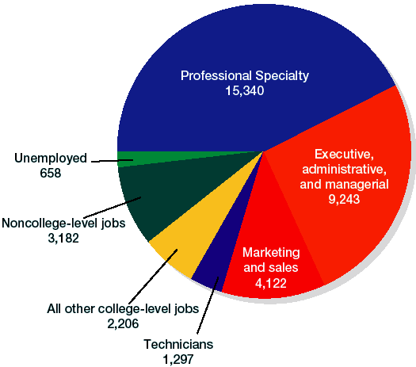
College Graduates in the Labor Force, 2000
(Thousands)
Figure 4.7

Slide 28

Labor Supply and Demand Issues
Balancing supply and demand considerations
Organizational downsizing
Making layoff decisions

Slide 29
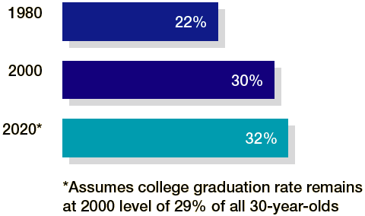
Growth Rate of Prime-Age College Educated Employees
Figure 4.8

Slide 30

Recruiting within the Organization
Benefits of a promotion-from-within policy:
  Capitalizes on past investments (recruiting, selecting, training, and developing) in current employees.
  Rewards past performance and encourages continued commitment to the organization.
  Signals to employees that similar efforts by them will lead to promotion.
  Fosters advancement of members of protected classes within an organization.

Slide 31
Recruiting within the Organization
Limitations of a promotion-from-within policy:
  Current employees may lack the knowledge, experience or skills needed for placement in the vacant/new position.
  The hazards of inbreeding of ideas and attitudes (“employee cloning”) increase when no outsiders are considered for hiring.
  The organization has exhausted its supply of viable internal candidates and must seek additional employees in the external job market.

Slide 32
Internal Methods of Locating Qualified Job Candidates
Human Resources Information Systems (HRIS)
  Database systems containing the records and qualifications of each employee that can be accessed to identify and screen candidates for an internal job opening.
Job Posting and Bidding
  Posting vacancy notices and maintaining lists of employees looking for upgraded positions.

Slide 33

Recruiting Outside the Organization
Labor Market
  Area from which applicants are to be recruited.
    Tight market: high employment, few available workers
    Loose market: low employment, many available workers
Factors determining the relevant labor market:
  Skills and knowledge required for a job
  Level of compensation offered for a job
  Reluctance of job seekers to relocate
  Ease of commuting to workplace
  Location of job (urban or nonurban)

Slide 34
Outside Sources of Recruitment
Advertisements
Unsolicited applications and resumes
Internet recruiting
Employee referrals
Executive search firms
Educational institutions
Professional organizations
Labor unions
Public employment agencies
Private employment agencies
Temporary help agencies
Employee leasing

Slide 35
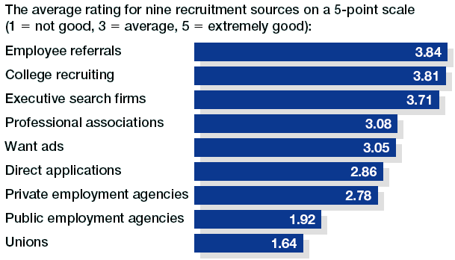
Effectiveness of Recruitment Sources
Source: David E. Terpstra, “The Search for Effective Methods.” Reprinted from HRFocus, May 1996. © 1996 American Management Association International. Reprinted by permission of American Management Association International, New York, NY. All rights reserved. http://www.amanet.org/.
Figure 4.9

Slide 36

Increasing the Effectiveness of Employee Referrals
Up the ante.
Pay for performance.
Tailor the program.
Increase visibility.
Keep the data.
Rethink your taboos.
Widen the program.
Measure the results.

Slide 37
Hot Recruiting Sites
Career Builder: http://www.careerbuilder.com
  Carries its own listings and offers links to sixteen specialized career sites.
Employment Guide: http://www.employmentguide.com
  Another leading career resource site, has thousands of job listings from hundreds of major companies.
FlipDog: http://www.flipdog.com
  Features more than 400,000 jobs and 57,000 employers in 3,700 locations.
HotJobs: http://www.hotjobs.com
  Owned by Yahoo, offers advanced management features and smart agents to streamline the recruiting process.
HRM 6

Slide 38
Hot Recruiting Sites
JOBTRAK: http://www.jobtrak.com
  A leading college recruiting site, has more than 40,000 listings and links to 750 campuses in the United States.
JobWeb: http://www.jobweb.com
  A college recruiting site run by the National Association of Colleges and Employers.
Monster.com: http://www.monster.com
  One of the oldest and largest general recruiting sites on the Internet, with more than 50,000 listings.
Net-Temps: http://www.nettemps.com
  The web’s leading site for recruiting temps
Spherion (formerly E. Span): http://www.spherion.com
  One of the largest and best-known web recruiting sites.
HRM 6

Slide 39
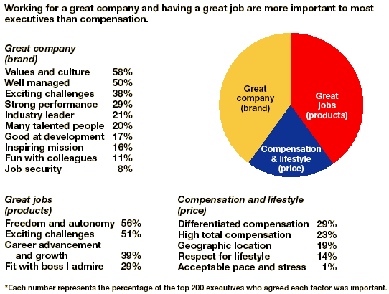
Factors That Motivate Top Talent
Source: E. G. Chambers, H. Hanafield-Jones, S. M. Hankin, and E. G. Michaels, III, “Win the War for Top Talent,” Workforce 77, no. 12 (December 1998): 50–56. Used with permission of McKinsey & Co.
Figure 4.10

Slide 40
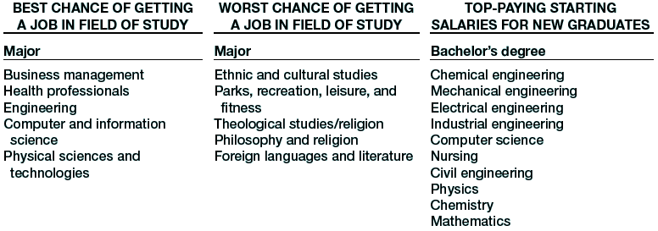
Best and Worst Majors for Job-Hunting Graduates
Source: Patrick Scheetz, Employment Research Institute, Michigan State University.
Figure 4.11

Slide 41
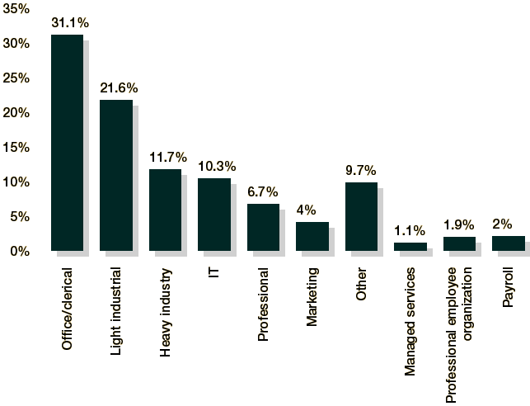
Occupational Breakdown of
Temporary Help Agency
Placements
Source: Steve Jones, “You’ve Come a Long Way, Baby: What the Staffing Industry Offers Today,” Canadian HR Reporter 14, no. 19 (November 5, 2001): 15.
Figure 4.12

Slide 42
Improving the Effectiveness of External Recruitment
Calculate Yield Ratios
Training Recruiters
External
Recruitment
Realistic Job Previews

Slide 43
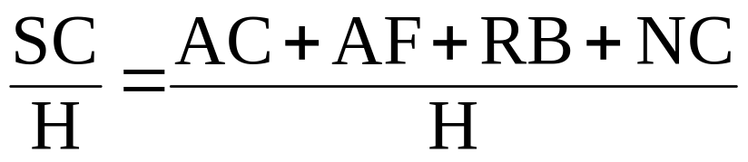
External Recruitment Considerations
Yield Ratio
  Percentage of applicants from a recruitment source that make it to the next stage of the selection process.
    100 resumes received, 50 found acceptable = 50% yield.
Cost of Recruitment (per employee hired)
SC = source cost
AC = advertising costs, total monthly expenditure (example: $28,000)
AF = agency fees, total for the month (example: $19,000)
RB = referral bonuses, total paid (example: $2,300)
NC = no-cost hires, walk-ins, nonprofit agencies, etc. (example: $0)
H = total hires (example: 119)
Cost to hire one employee = $414

Slide 44
External Recruitment Considerations
Sources of Organizational Recruiters
  Professional HR recruiters
  HR generalists
  Work team members
Requirements for Effective Recruiters
  Knowledge of the recruited job’s requirements and of the organization
  Training as an interviewer
  Personable and competent to represent the organization

Slide 45
External Recruitment Considerations
Realistic Job Previews (RJP)
  Informing applicants about all aspects of the job, including both its desirable and undesirable facets.
  Positive benefits of RJP
    Improved employee job satisfaction
    Reduced voluntary turnover
    Enhanced communication through honesty and openness
    Realistic job expectations

Slide 46

Issues in Recruiting Protected Classes
Recruitment of Women
  Growth of women in the workplace
  Increase in females in management roles
  Stereotyping and gender conflicts
Recruitment of Minorities
  Educational and societal disadvantages
  Retention in organizations
  Affirmative action

Slide 47
Top Female Executives
RANK NAME COMPANY POSITION
1 Carly Fiorina Hewlett-Packard Chairman and CEO
2 Meg Whitman eBay President and CEO
3 Oprah Winfrey Harpo Ent. Group Chairman
4 Andrea Jung Avon Chairman and CEO
5 Marce Fuller Mirant President and CEO
6 Anne Mulcahy Xerox President and CEO
7 Karen Katen Pharma Group, Pfizer EVP and President
8 Pat Woertz Chevron (Products) President
9 Betsy Holden Kraft Foods Co-CEO
10 Indra Nooyi PepsiCo President and CFO
Source: Adapted from Ann Harrington, “The Power 50,” Fortune 144, no. 7 (October 15, 2001): 195–98.
Figure 4.13

Slide 48
Issues in Recruiting Protected Classes
Recruitment of the Disabled
  Increasing numbers of disabled in the workforce
  Stereotyping of the disabled versus their superior records for dependability, attendance, motivation and performance
  Accommodations for physical and mental disabilities
Recruitment of Older People
  Increasingly returning to the workplace
  Have valued knowledge, experience, flexibility and reliability as employees

Slide 49


Slide 50
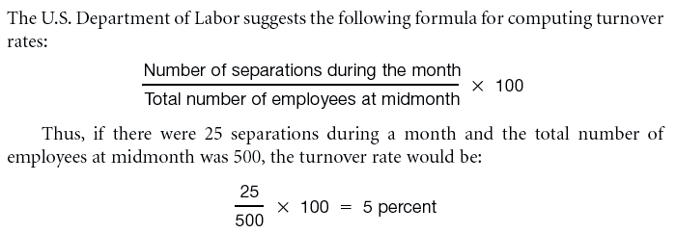
Employee Turnover Rates
Computing Turnover Rates:

Slide 51
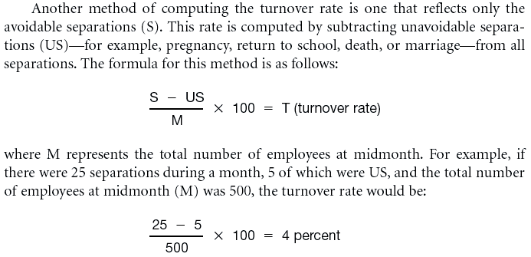
Employee Turnover Rates (cont’d)
Computing Turnover Rates (cont’d):

Slide 52
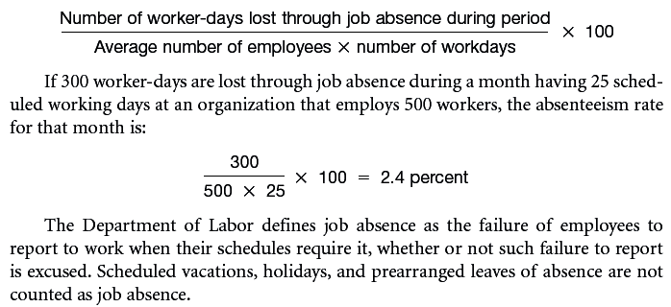
Employee Absenteeism Rates
Computing Absenteeism Rates

Slide 53
Costs Associated With The Turnover Of One Computer Programmer
(Turnover costs = Separation costs + Replacement costs + Training costs)
Separation costs
Exit interview cost for salary and benefits of both interviewer and departing employee during the exit interview = $30+$30 = $60
Administrative and record-keeping action = $30
Total separation costs = $60 + $30 = $90
Replacement costs
Advertising for job opening = $2,500
Preemployment administrative functions and record-keeping action = $100
Selection interview = $250
Employment tests = $40
Meetings to discuss candidates (salary and benefits of managers while participating in meetings )= $250
Total replacement costs = $2,500 + $100 + $250 + $40 + $250 = $3,140
Training costs
Booklets, manuals, and reports = $50
Education = $240/day for new employee’s salary and benefits x 10 days of workshops, seminars, or courses = $2,400
One-to-one coaching = ($240/day/new employee + $240/day/staff coach or job expert) x 20 days of one-to-one coaching = $9,600
Salary and benefits of new employee until he or she gets “up to par” = $240/day for salary and benefits x 20 days = $4,800
Training costs = $50 + $2,400 + $9,600 + $4,800 = $16,850
Total turnover costs= $90 + $3,140 + $16,850 = $20,080
Source: Adapted from Michael W. Mercer, Turning Your Human Resources Department into a Profit Center (New York: AMACOM, 1993). Copyright 1993 Michael W. Mercer. Reproduced with permission from Michael W. Mercer, Ph.D., Industrial Psychologist, The Mercer Group, Inc., Chicago, Ill.
HRM 5

