Slide 1
Job Design and Smart Working
Edited from CIPD Report

Slide 2
Job Design-A Definition
‘Jobs are created by people for people. Whether deliberately or by default, choices are made about which tasks to group together to form a job, the extent to which job holders should follow prescribed procedures in completing those tasks, how closely the job incumbent will be supervised, and numerous other aspects of the work. Such choices are the essence of job design, which may thus be defined as the specification of the content and methods of jobs…’ (Wall and Clegg, 1998).

Slide 3
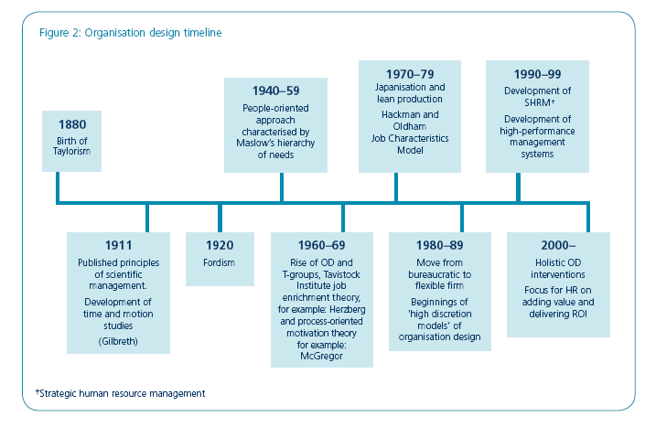
Organisation Design

Slide 4
Taylorism
The changing employment relationship
Before looking at the job enrichment school of thought seen from the mid-1960s onwards, it is useful to review the logic behind the approach that it replaced: job simplification.
Taylor (cited in CIPD 2007) found that manufacturing production could be improved by:
Detailed understanding of the tasks involved in a job
Restricting or removing any discretion that employees have over the way in which work is performed
Simplifying tasks, setting out standard operating procedures and times to complete work
Motivating employees through financial incentivisation.

Slide 5
Herzberg
The main response to this, led initially by Herzberg (cited in CIPD 2007), was a focus on job enrichment: the idea that deliberately designing jobs in a way that provides features such as challenge, recognition and skill usage might increase employee motivation and/or satisfaction.

Slide 6
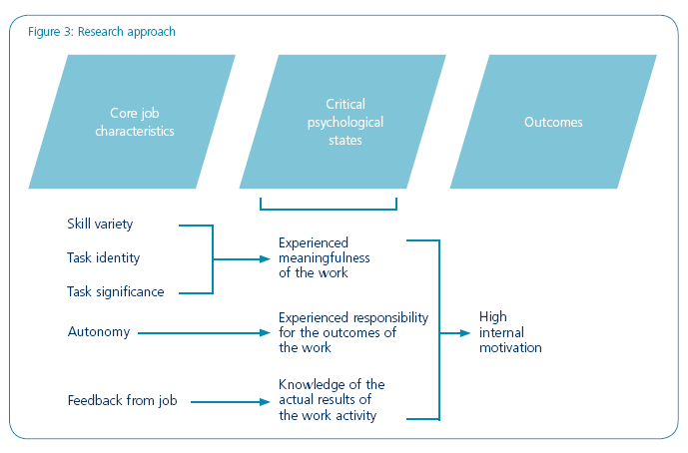
Job Characteristics Model (JCM)

Slide 7
5 core job characteristics
Developing Herzberg’s themes is Hackman and Oldham’s (1975) Job Characteristics Model (JCM). Hackman and Oldham identify five ‘core job characteristics’:
Skill variety: the degree to which a job requires an employee to perform activities that challenge his or her skills and abilities
Task identity: the degree to which the job requires completion of an identifiable piece of work
Task significance: the degree to which the job outcome has a substantial impact on others.
Autonomy: the degree to which the job gives freedom and discretion in scheduling work and determining how it is performed
Feedback: the degree to which an employee gets information about the effectiveness of their efforts – with particular emphasis on feedback directly related to the work itself rather than from a third party (for example, manager).

Slide 8
Critical psychological states
Taken together, the core job characteristics were said to produce three ‘critical psychological states’:
Meaningfulness – the employee perceiving the work as worthwhile or important
Responsibility – the belief that the employee is accountable for the outcome of his or her efforts
Knowledge – of whether or not the outcome of the employee’s work is satisfactory.

Slide 9
Outcomes
Designing jobs in a way that maximised the probability of all three of these ‘critical states’ being present was, in turn, believed to drive four positive outcomes:
High internal work motivation
High-quality work performance
High job satisfaction
Low absenteeism and voluntary staff turnover.

Slide 10
Current assessment of the model
The model works, but:
The practical effectiveness of job design theory can be significantly boosted by building in additional motivational, social and work context characteristics such as job complexity, problem-solving, friendship opportunities and work environment (Humphrey et al 2007).

Slide 11
Current thinking
Traditional organisation design theory and practice centres on a process-driven approach to designing roles and interactions within the workplace.
Contemporary thinking reflects a shifting mindset towards the constituent parts of a role and the psychological factors that drive job performance.
‘Simple changes in work methods, workflow and work layout can often generate surprisingly large improvements in job performance independently of any change in job perceptions or intrinsic motivation… what satisfies employees will not necessarily motivate them to high performance.’ (Kelly 1992)

Slide 12
Recent evolutionary steps
During the 1990s an increased emphasis on employee empowerment led to ‘high discretion’ models characterised by ‘individual job enrichment and self-managing or autonomous teamwork… high performance work systems’ (Huczynski and Buchanan 2001).
Leading academics such as Ulrich (1997) highlighted the need for HR to take a more strategic and proactive role in the development of people and organisational capability.

Slide 13
HR and OD High Performance
Ruona and Gibson (2004) have highlighted four major
themes for HR and OD:
Increased centrality of people to organisational success
Focus on whole systems and integrated solutions
Strategic alignment and impact
Capacity for change.

Slide 14
Business processes will drive the need for psychological alignment
Modern working practices such as ‘lean’, total quality management (TQM), advanced manufacturing technology (AMT) and supply-chain partnering (SCP) require a highly skilled and committed workforce to be successful. Holman et al (2003) offer four main reasons for this:
The complexity of modern working practices requires higher levels of technical skill and cognitive ability.
Techniques such as TQM require relationships within and across teams to be managed effectively.
The requirement for continuous improvement requires creative and innovative employees.
New work practices increase the level of discretion and responsibility that employees must exercise, requiring an ability and willingness to engage in discretionary behaviour.

Slide 15
High performance work practices
Three components of the effectiveness of HPWP are:
Increasing employees’ knowledge, skills and abilities
Empowering employees to act
Motivating them to do so.
Employee participation and flexible working arrangements are examples of such systems that have a direct impact on ways of working and therefore flow through to job design.

Slide 16
The physical environment
Flexible or ‘smart’ working is credited with:
Boosting productivity and profits
Increasing a company’s skills base
Freeing up travelling time & accommodation costs
Improving employees’ quality of work (and life)
Lowering absence rates
Increasing an employer’s reputation as a good company to work for – hence
Attracting talent and consequently reducing recruitment costs
Business attract more diverse candidates, for example those with childcare or other caring responsibilities.

