Slide 2
After studying this chapter, you should be able to:
Explain the main techniques used in HR planning and forecasting
Discuss the main internal sources of candidates
Discuss the main external sources of candidates
Explain how to recruit job candidates
Develop a “help wanted” ad
Discuss recruitment practices in some companies in Asia

Slide 3
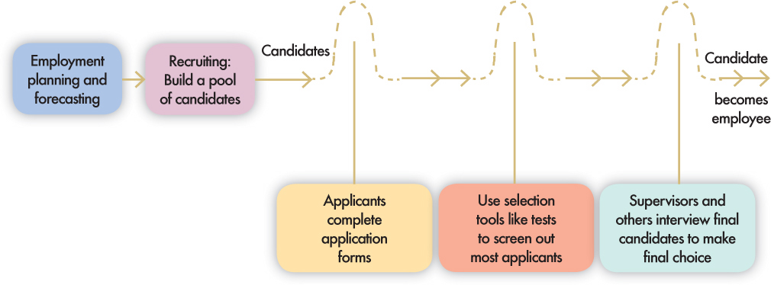
The Recruitment and Selection Process
HR Planning
The recruitment and selection process is a series of hurdles aimed at selecting the best candidate for the job.

Slide 4
The Recruitment and Selection Process – Steps
Decide what positions you’ll have to fill through personnel planning and forecasting.
Build a pool of candidates for these jobs by recruiting internal or external candidates.
Have candidates complete application forms and perhaps undergo an initial screening interview.
Use selection techniques like tests, background investigations, and physical exams to identify viable candidates.
Decide who to make an offer to, by having the supervisor and perhaps others on the team interview the candidates.

Slide 5
Planning and Forecasting
Employment or personnel planning
  The process of deciding what positions the firm will have to fill, and how to fill them.
Succession planning
  The process of deciding how to fill the company’s most important executive jobs.
What to forecast?
  Overall personnel needs
  The supply of inside candidates
  The supply of outside candidates

Slide 6
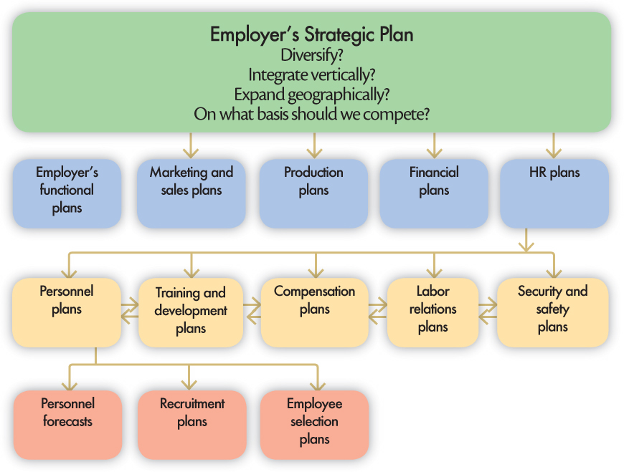
Linking Employer’s Strategy to Plans
Figure 5.2
Linking the Company’s Strategic Plan to the HR Plan

Slide 7
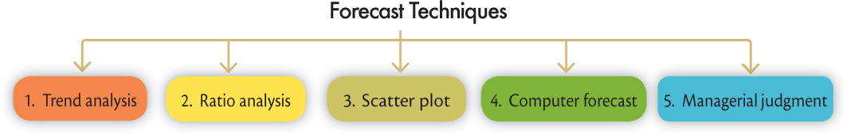
Forecasting HR Needs
First step in HR planning
  Forecast revenue
  Estimate the number of persons needed to achieve this volume
Figure 5.3
Forecast Techniques in HR Planning

Slide 8
Forecasting HR Needs
Trend analysis
  The study of a firm’s past employment needs over a period of years to predict future needs.
Ratio analysis
  A forecasting technique for determining future staff needs by using ratios between a causal factor and the number of employees needed.
  Assumes that the relationship between the causal factor and staffing needs is constant.

Slide 9
Forecasting HR Needs
Scatter plot
  A graphical method used to help identify the relationship between two variables.
Size of Hospital Number of
(Number of Beds) Registered Nurses
200 240
300 260
400 470
500 500
600 620
700 660
800 820
900 860

Slide 10
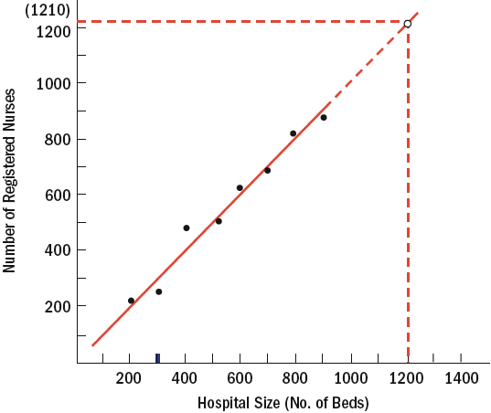
Determining the Relationship Between
Hospital Size and Number of Nurses
Forecasting HR Needs
Scatter plot

Slide 11
Forecasting HR Needs
Computerized forecasts
  The use of software packages to determine of future staff needs by projecting sales, volume of production, and personnel required to maintain a volume of output.
    Generates figures on average staff levels required to meet product demands, as well as forecasts for direct labor, indirect staff, and exempt staff.
    Typical metrics: direct labor hours required to produce one unit of product (a measure of productivity), and three sales projections—minimum, maximum, and probable.

Slide 12
Forecasting HR Needs
Managerial Judgment
  To modify forecast based on factors e.g. entering into a new market
  Difficult to take a long-term perspective when market conditions change dramatically

Slide 13
Forecasting the Supply of
Inside Candidates
Qualifications inventories
  Manual or computerized records listing employees’ education, career and development interests, languages, special skills, and so on, to be used in selecting inside candidates for promotion.

Slide 14
Forecasting the Supply of
Inside Candidates
Manual System and Replacement Chart
  Personnel replacement chart
    Company records showing present performance and promotability of inside candidates for the most important positions.
  Position replacement card
    A card prepared for each position in a company to show possible replacement candidates and their qualifications.

Slide 15
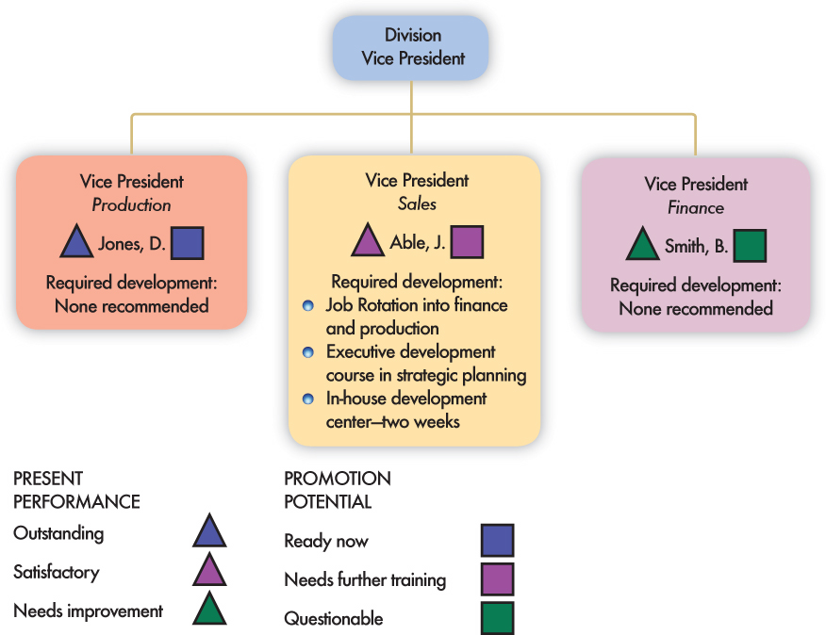
Management Replacement Chart Showing Development Needs of Future Divisional Vice President
Forecasting the Supply of
Inside Candidates
Manual System and Replacement Chart (cont’d)

Slide 16
Forecasting the Supply of
Inside Candidates
Computerized Information Systems
  Human Resource Information System (HRIS)
    Computerized inventory of information that can be accessed to determine employees’ background, experience, and skills that may include:
      Work experience codes
      Product or service knowledge
      Industry experience
      Formal education

Slide 17
Forecasting the Supply of
Inside Candidates
Matter of Privacy
  Need to ensure the security of HR information
    There is a lot of HR information to keep secure.
    Control of HR information can be established through the use of access matrices that limit users.
    Legal considerations: The Federal Privacy Act of 1974 gives employees rights regarding who has access to information about their work history and job performance.

Slide 18
Hong Kong – Privacy of
Personal Data
Office of Privacy Commissioner for Personal Data (Issued code in 2001)
  Provides guidance to data users handling personal data (prospective, current and former employees)
  Collection, holding, use, security and data access

Slide 19
Forecasting the Supply of External Candidates
Factors impacting the supply of external candidates
  General economic conditions
  Expected unemployment rate
Sources of information
  Forecast by business newspapers & publications
  Economic projections
    Government agencies
    Department of Labor or Manpower
    Department of Statistics
    Private consultants

Slide 20
Effective Recruiting
External factors affecting recruiting:
  Looming undersupply of workers
  Lessening of the trend in outsourcing of jobs
  Increasingly fewer “qualified” candidates
Internal factors affecting recruiting:
  The consistency of the firm’s recruitment efforts with its strategic goals
  The available resources, types of jobs to be recruited and choice of recruiting methods
  Non-recruitment HR issues and policies
  Line and staff coordination and cooperation

Slide 21
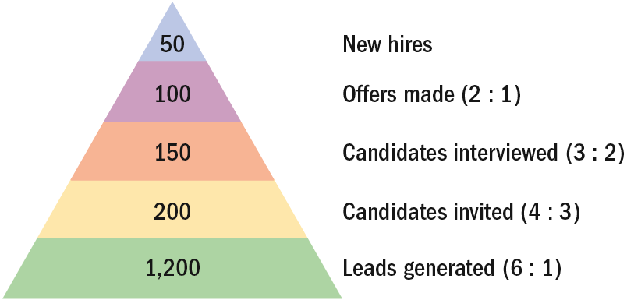
Effective Recruiting
Recruiting Yield Pyramid
  Historical arithmetic relationships between recruitment leads and invitees, interviews and offers made, and offers made and offers accepted
  Used to calculate the number of applicants they must attract to hire the required number of employees

Slide 22
Effective Recruiting
Advantages of centralizing recruitment
  Strengthens employment brand
  Ease in applying strategic principles
  Reduces duplication of HR activities
  Reduces the cost of new HR technologies
  Builds teams of HR experts
  Provides for better measurement of HR performance
  Allows for the sharing of applicant pools

Slide 23
Recruitment Assistance in Asia
Hong Kong Labor Department
  Provides services to job seekers & employers
  Tips on job hunting and interviews
Singapore Workforce Development Agency
  Provides information on job market, jobs available in specific industries
Singapore EDB
  Attract international talents

Slide 24
Internal Sources of Candidates: Hiring from Within
Advantages
  Foreknowledge of candidates’ strengths and weaknesses
  More accurate view of candidate’s skills
  Candidates have a stronger commitment to the company
  Increases employee morale
  Less training and orientation required
Disadvantages
  Failed applicants become discontented
  Time wasted interviewing inside candidates who will not be considered
  Inbreeding of the status quo

Slide 25
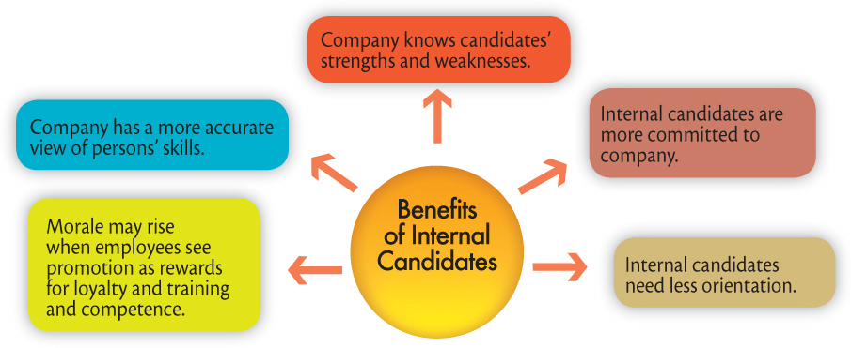
Internal Sources of Candidates:
Hiring from Within
Figure 5.7
Benefits of Internal Candidates

Slide 26
Internal Sources of Candidates:
Hiring from Within
Finding Internal Candidates
  Job posting
    Publicizing an open job to employees (often by literally posting it on bulletin boards) and listing its attributes.
    Examination of HR records for potential candidates

Slide 27
Internal Sources of Candidates:
Hiring from Within
Re-hiring former employees
  Advantages:
    They are known quantities.
    They know the firm and its culture.
  Disadvantages:
    They may have less-than positive attitudes.
    Rehiring may sent the wrong message to current employees about how to get ahead.

Slide 28
Succession Planning
Succession planning
  The process of ensuring a suitable supply of successors for current and future senior or key jobs.
Succession planning steps:
  Identifying and analyzing key jobs.
  Creating and assessing candidates.
  Selecting those who will fill the key positions.

Slide 29
Succession Planning
Step 1: Identify and analyze key jobs
Based on the company’s strategic goals, top management and the HR manager identify what the company’s future key positions will be. They then write job descriptions and specifications for these positions. For instance, if the company plans to expand abroad, it may look for talent in its international division.
Step 2: Assess candidates
After identifying future key positions, the management team assesses candidates for these jobs. It then provides them with the developmental experience they need in these positions.
Step 3: Select those who will fill the positions
Top management selects those who will fill the key positions.

Slide 30
External Sources of Candidates
Through Advertising
Through Employment Agencies

Slide 31
External Sources of Candidates
Advertising
  The Media: selection of the best medium depends on the positions for which the firm is recruiting.
    Newspapers (local and specific labor markets)
    Trade and professional journals
    Internet job sites
    Marketing programs
Constructing an effective ad
  Wording related to job interest factors should evoke the applicant’s attention, interest, desire, and action (AIDA) and create a positive impression of the company

Slide 32
External Sources of Candidates
Types of employment agencies
  Government and non-profit agencies
  Commercial agencies

Slide 33
External Sources of Candidates
Reasons for using an agency:
  When a firm doesn’t have an HR department and is not geared to doing recruiting and screening.
  The firm has found it difficult in the past to generate a pool of qualified applicants.
  The firm must fill a particular opening quickly.
  There is a perceived need to attract a greater number of minority or female applicants.

Slide 34
External Sources of Candidates
Reasons for using an agency (cont’d):
  The firm wants to reach currently employed individuals, who might feel more comfortable dealing with agencies than with competing companies.
  The firm wants to cut down on the time it’s devoting to recruiting.

Slide 35
External Sources of Candidates
Avoiding problems with employment agencies:
  Give the agency an accurate and complete job description.
  Make sure tests, application blanks, and interviews are part of the agency’s selection process.
  Periodically review data on candidates accepted or rejected by your firm, and by the agency.
  Check on the effectiveness and fairness of the agency’s screening process.

Slide 36
External Sources of Candidates
Avoiding problems with employment agencies:
  Screen the agency. Check with other managers or HR people to find out which agencies have been the most effective at filling the sorts of positions needed to be filled.
  Review the Internet and a few back issues of the Sunday classified ads to discover the agencies that handle the positions to be filled.

Slide 37
Temp Agencies and Alternative Staffing
External Sources of Candidates
Benefits of Temps
  Paid only when working
  More productive
  No recruitment, screening, and payroll administration costs
Costs of Temps
  Fees paid to temp agencies
  Lack of commitment to firm

Slide 38
External Sources of Candidates
Executive recruiters (headhunters)
  Special employment agencies retained by employers to seek out top-management talent for their clients.
    Contingent-based recruiters collect a fee for their services when a successful hire is completed.
    Retained executive searchers are paid regardless of the outcome of the recruitment process.
  Internet technology and specialization trends are changing how candidates are attracted and how searches are conducted.

Slide 39
External Sources of Candidates
Advantages of using executive recruiters:
  Able to contact qualified, currently employed candidates who are not actively looking to change jobs
  Can keep your company’s name confidential until late into the search process.
  Save top management’s time by advertising for the position and screening applicants
  Recruiter’s fee may turn out to be insignificant compared with cost of executive time saved

Slide 40
External Sources of Candidates
Disadvantages of using executive recruiters:
  Employer has to provide comprehensive explanation of what sort of candidate is required and why
  Some recruiters are salespeople, and may be more interested in persuading to the employer to hire a candidate rather than finding one who will really do the job.

Slide 41
External Sources of Candidates
Guidelines for choosing a recruiter
  Make sure the firm is capable of conducting a thorough search.
  Meet the individual who will actually handle your assignment.
  Ask how much the search firm charges.

Slide 42
External Sources of Candidates
Campus recruiting
  Recruiting goals
    To determine if the candidate is worthy of further consideration
    To attract good candidates
  Consists of:
    On-site visits
    Internships

Slide 43
External Sources of Candidates
On-site visits
  Invitation letters should be warm and friendly but businesslike.
  Assign a specific person to meet the applicant and play host.
  Prepare an information package including the applicant’s schedule as well as other information regarding the company.
  Carefully plan the interviews and keep to schedule.
  Make a timely employment offer, if any, as soon as possible.
  Frequent follow-ups may help to attract the applicant.

Slide 44
External Sources of Candidates
Problems with campus recruiting:
  Expensive and time-consuming
    Schedules must be set in advance
    Company brochures need to be printed
    Records of interviews kept
    Much time spent on campus
  Recruiters themselves may be ineffective
    Some recruiters are unprepared
    They do not effectively screen the candidates
    They must be trained before they visit the campus

Slide 45
External Sources of Candidates
Employee referral
  Applicants who are referred to the organization by current employees
    Referring employees become stakeholders.
    Referral is a cost-effective recruitment program.
    Referral can speed up diversifying the workforce

Slide 46
External Sources of Candidates
Walk-in
  Direct applicants who seek employment with or without encouragement from other sources.
  Courteous treatment of any applicant is a good business practice.

Slide 47
External Sources of Candidates
Recruiting via the Internet
  More firms and applicants are using the Internet in their job searches.
  Advantages of Internet recruiting
    Cost-effective way to publicize job openings
    More applicants attracted over a longer period
    Immediate applicant responses
    Online prescreening of applicants
    Links to other job search sites
    Automation of applicant tracking and evaluation

Slide 48

External Sources of Candidates
Recruiting via the Internet

Slide 49
Developing and Using Application Forms
Application form
  Provides information on education, prior work record, and skills
Uses of information from applications
  Judgment about the applicant’s education and experience qualifications
  Conclusion about the applicant’s previous progress and growth
  Indication of the applicant’s employment stability
  Prediction about which candidate is likely to succeed on the job

Slide 50
Developing and Using Application Forms
Employers should carefully review application forms to ensure that they comply with equal employment laws.
Questions to beware of include:
  Education
  Arrest record
  Notify in case of emergency
  Membership in organizations
  Physical handicaps
  Marital status
  Housing

Slide 51
Recruitment in China
Before economic reforms:
  Recruit according to government plan
After economic reforms:
  Open to society (market forces)
  Based on qualifications
  Recruitment fairs in major cities organized by agencies

Slide 52
Recruitment in China
Two-way Recruitment and Selection
  Policy shift away from centrally-planned allocation system to one that’s market-oriented
  Objective is to attract and retain competent employees
  Policy requires the labor bureau to assist job seekers
  Jobseekers now introduce themselves to companies by sending resumes and attending interviews.

Slide 53
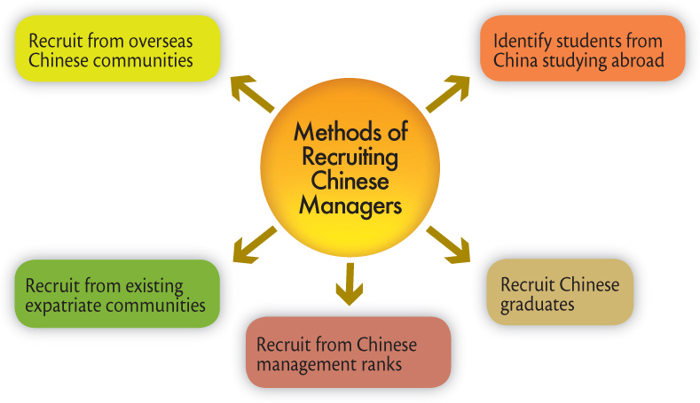
Recruitment in China
Recruiting Managers for China Operations

Slide 54
Recruitment in Hong Kong
Talents Scheme
  Working visas for skilled persons
Admission of Mainland Professionals
  Attract talents from mainland
Anti-discrimination Laws
  Gender, disability, family status
  Enforced by Equal Opportunities Commission

Slide 55
Recruitment in Indonesia
Demand for science and economic graduates
Newspaper advertising generally ineffective
Word of mouth advertising attracts good response
Networking system is strong
Priority given to Indonesians unless the skills required are absent
Recruitment of civil servants coordinated by State Employee Administrative Office with respective departments

Slide 56
Recruitment in Malaysia
Bumiputra Policy
  Proportionate racial mix
Recruitment methods
  Newspaper ads
Need more foreign skilled workers
Preference given to projects related to Multimedia Super corridor IT industry

Slide 57
Recruitment in Philippines
About 2 million overseas Filipino workers (OFW)
Overseas labor placement program was set up in 1970s as a “temporary” measure to ease unemployment
Now a permanent feature and supported by the Philippine Overseas Employment Administration (POEA) and labor attaches in embassies

Slide 58
Recruitment in Singapore
Common method – newspaper ads
  Second most common method: executive search firms, typically for senior positions
Tripartite Guidelines on Non-Discriminatory Advertisements
  Criteria which should not be in ads include: age, gender, marital status, race, and religion
Workforce Development Agency
  Help retrenched workers to find jobs in other companies or industries.

Slide 59
Recruitment in Singapore
Attracting overseas talents
  Government has encouraged employers to recruit skilled manpower from abroad.
  Immigration rules have been relaxed to allow professionals and skilled workers to become permanent residents.
  MOM’s International Manpower Division oversees a network of Contact Singapore offices around the world.

Slide 60
Recruitment in South Korea
Common methods
  Large companies tend to use the mass media
  Small firms tend to use word of mouth
Labor Standard Act
  Anti-discrimination: gender, nationality, religion, social status
Restrictions on entry of skilled foreign workers have been abolished

Slide 61
Recruitment in Thailand
Methods
  Newspaper ads are the most common method
  Family-based enterprises depend on familial relationships to fill vacancies
  Large companies use various methods, including campus recruitment, social networks and e-recruiting.
Demand for foreign-trained graduates
Government encourages overseas employment
  Popular destinations include
    Middle East, Hong Kong, Singapore, Taiwan, Israel

Slide 62
Recruitment in Vietnam
Difficult to recruit expat staff
  Considered as hardship posting
  Extra incentives needed
Local staff lack qualification and experience
Local staff need government security clearance to work for foreign companies

