Slide 1
Employee Testing and Selection

Slide 2

After studying this chapter, you should be able to:
Explain what is meant by reliability and validity.
Explain how you would go about validating a test.
Cite and illustrate our testing guidelines.
Give examples of some of the ethical and legal considerations in testing.
List eight tests you could use for employee selection, and how you would use them.
Explain the key points to remember in conducting background investigations.
6–<number>
<footer>© 2005 Prentice Hall Inc. All rights reserved.

Slide 3
Why Careful Selection is Important
The importance of selecting the right employees
  Organizational performance always depends in part on subordinates having the right skills and attributes.
  Recruiting and hiring employees is costly.
  The legal implications of incompetent hiring
    EEO laws and court decisions related to nondiscriminatory selection procedures
    The liability of negligent hiring of workers with questionable backgrounds

Slide 4
Avoiding Negligent Hiring Claims
Carefully scrutinize information supplied by the applicant on his or her employment application.
Get the applicant’s written authorization for reference checks, and carefully check references.
Save all records and information you obtain about the applicant.
Reject applicants who make false statements of material facts or who have conviction records for offenses directly related and important to the job in question.
Balance the applicant’s privacy rights with others’ “need to know,” especially when you discover damaging information.
Take immediate disciplinary action if problems arise.

Slide 5
Basic Testing Concepts
Reliability
  The consistency of scores obtained by the same person when retested with the identical or equivalent tests.
  Are the test results stable over time?
Test validity
  The accuracy with which a test, interview, and so on measures what it purports to measure or fulfills the function it was designed to fill.
  Does the test actually measure what we need for it to measure?

Slide 6

Sample Picture Card from
Thematic Apperception Test
How do you interpret this picture?
Source: Harvard University Press. Used with permission.
Figure 6–1

Slide 7
Types of Validity
Criterion validity
  A type of validity based on showing that scores on the test (predictors) are related to job performance (criterion).
    Are test scores in this class related to students’ knowledge of human resource management?
Content validity
  A test that is content valid is one that contains a fair sample of the tasks and skills actually needed for the job in question.
    Do the test questions in this course relate to human resource management topics?
    Is taking an HR course the same as doing HR?

Slide 8
How to Validate a Test
Step 1: Analyze the job
  Predictors: job specification (KSAOs)
  Criterion: quantitative and qualitative measures of job success
Step 2: Choose the tests
  Test battery or single test?
Step 3: Administer the test
  Concurrent validation
    Current employees’ scores with current performance
  Predictive validation
    Later-measured performance with prior scores
Step 4: Relate Test Scores and Criteria
  Correlation analysis
    Actual scores on the test with actual performance
Step 5: Cross-Validate and Revalidate
  Repeat Step 3 and Step 4 with a different sample of employees.

Slide 9
Testing Program Guidelines
Use tests as supplements.
Validate the tests.
Monitor your testing/selection program
Keep accurate records.
Use a certified psychologist.
Manage test conditions.
Revalidate periodically.
Table 6–1

Slide 10
Equal Employment Opportunity (EEO) Aspects of Testing
A organization must be able to prove:
  That its tests are related to success or failure on the job (validity)
  That its tests don’t unfairly discriminate against minority or nonminority subgroups (disparate impact).
EEO guidelines and laws apply to all selection devices, including interviews, applications, and references.

Slide 11
Equal Employment Opportunity (EEO) Aspects of Testing (cont’d)
Testing alternatives if a selection device has disparate impact:
  Institute a different, valid selection procedure that does not have an adverse impact.
  Show that the test is valid—in other words, that it is a valid predictor of performance on the job.
  Monitor the selection test to see if it has disparate impact.

Slide 12
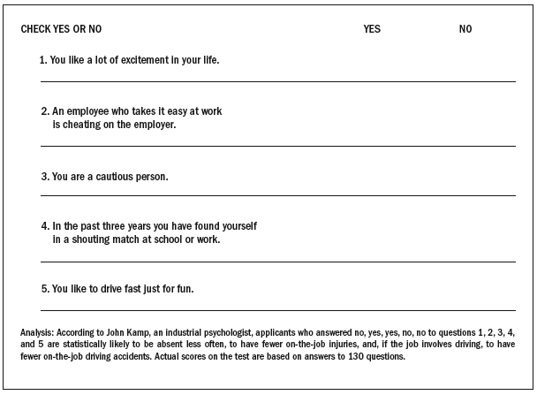
Sample Test
Source: Courtesy of NYT Permissions.
Figure 6–4

Slide 13
Test Takers’ Individual Rights and Test Security
Under the American Psychological Association’s standard for educational and psychological tests, test takers have the right:
  To privacy and information.
  To the confidentiality of test results.
  To informed consent regarding use of these results.
  To expect that only people qualified to interpret the scores will have access to them.
  To expect the test is fair to all.

Slide 14
Using Tests at Work
Major types of tests used by employers
  Basic skills tests (45%)
  Drug tests (47%)
  Psychological tests (33%)
Use of testing
  Less overall testing now but more testing is used as specific job skills and work demands increase.
    Screen out bad or dishonest employees
    Reduce turnover by personality profiling
Source of tests
  Test publishers

Slide 15
Computer-Interactive Testing
Types of tests
  Specialized work sample tests
  Numerical ability tests
  Reading comprehension tests
  Clerical comparing and checking tests
Online tests
  Telephone prescreening
  Offline computer tests
  Virtual “inbox” tests
  Online problem solving tests

Slide 16
Types of Tests
Tests of cognitive abilities
  Intelligence Tests
    Tests of general intellectual abilities that measure a range of abilities, including memory, vocabulary, verbal fluency, and numerical ability.
  Aptitude tests
    Tests that measure specific mental abilities, such as inductive and deductive reasoning, verbal comprehension, memory, and numerical ability.
Tests of motor abilities
  Tests that measure motor abilities, such as finger dexterity, manual dexterity, and reaction time.
Tests of physical abilities
  Tests that measure static strength, dynamic strength, body coordination, and stamina.

Slide 17
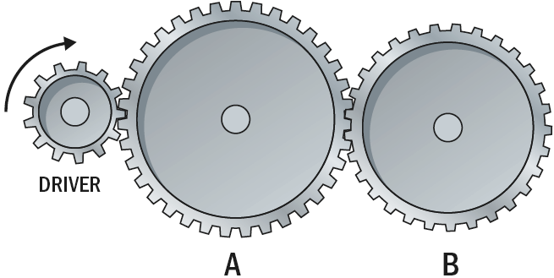
Problem from the Test of
Mechanical Comprehension
Which gear will turn the same way as the driver?
Source: Reproduced by permission. Copyright 1967, 1969 by The Psychological Corporation, New York, NY. All rights reserved. Author’s note: 1969 is the latest copyright on this test, which is still the main one used for this purpose.
Figure 6–5

Slide 18
Measuring Personality and Interests
Personality tests
  Tests that use projective techniques and trait inventories to measure basic aspects of an applicant’s personality, such as introversion, stability, and motivation.
  Disadvantage
    Personality tests—particularly the projective type—are the most difficult tests to evaluate and use.
  Advantage
    Tests have been used successfully to predict dysfunctional job behaviors and identify successful candidates for overseas assignments.

Slide 19
The “Big Five”
Extraversion
  The tendency to be sociable, assertive, active, and to experience positive effects, such as energy and zeal.
Emotional stability/neuroticism
  The tendency to exhibit poor emotional adjustment and experience negative effects, such as anxiety, insecurity, and hostility.
Openness to experience
  The disposition to be imaginative, nonconforming, unconventional, and autonomous.
Agreeableness
  The tendency to be trusting, compliant, caring, and gentle.
Conscientiousness
  Is comprised of two related facets: achievement and dependability.

Slide 20
Other Tests
Interest inventories
  Personal development and selection devices that compare the person’s current interests with those of others now in various occupations so as to determine the preferred occupation for the individual.
Achievement tests
  Test that measure what a person has already learned—“job knowledge” in areas like accounting, marketing, or personnel.
Web-Based (Online) testing
  Eliminates costly and inefficient paper-and-pencil testing processes.
  Allows for role-playing by applicants.
  Use of computer-based scoring eliminates rater bias.
  Provides immediate scoring and feedback of results to applicants.
  Can be readily customized for specific jobs.

Slide 21
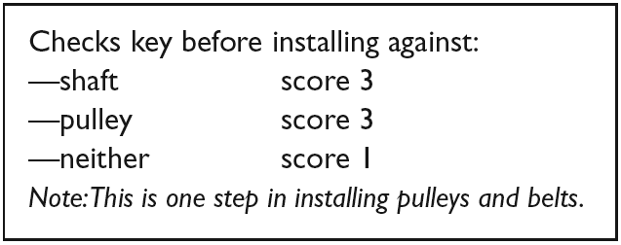
Work Samples
Work samples
  Actual job tasks are used in testing applicants’ performance.
Work sampling technique
  A testing method based on measuring an applicant’s performance on actual basic job tasks.
  Example of a Work Sampling Question

Slide 22
Work Simulations
Management assessment center
  A simulation in which management candidates are asked to perform realistic tasks in hypothetical situations and are scored on their performance.
Typical simulated exercises include:
  The in-basket
  Leaderless group discussion
  Management games
  Individual presentations
  Objective tests
  The interview

Slide 23
Work Simulations (cont’d)
Video-Based situational testing
  A situational test comprised of several video scenarios, each followed by a multiple choice question that requires the candidate to choose from among several courses of action.
  While the evidence is mixed, the results suggest that video-based situational tests can be useful for selecting employees.

Slide 24
Work Simulations (cont’d)
The miniature job training and evaluation approach
  Candidates are trained to perform a sample of the job’s tasks, and then are evaluated on their performance.
  The approach assumes that a person who demonstrates that he or she can learn and perform the sample of tasks will be able to learn and perform the job itself.

Slide 25
Background Investigations and Reference Checks
Extent of investigations and checks
  Reference checks (87%)
  Background employment checks (69%)
  Criminal records (61%)
  Driving records (56%)
  Credit checks (35%)
Reasons for investigations and checks
  To verify factual information provided by applicants.
  To uncover damaging information.

Slide 26
Reference Checking Form
(Verify that the applicant has provided permission before conducting reference checks)
Candidate Name:
Reference Name: Company Name:
Dates of Employment: (From: and To:)
Position(s) Held: Salary History:
Reason for Leaving:
Explain the reason for your call and verify the above information with the supervisor (including the reason for leaving)
1. Please describe the type of work for which the candidate was responsible.
2. How would you describe the applicant’s relationships with coworkers, subordinates (if applicable), and with superiors?
3. Did the candidate have a positive or negative work attitude? Please elaborate
4. How would you describe the quantity and quality of output generated by the former employee?
5. What were his/her strengths on the job?
6. What were his/her weaknesses on the job?
7. What is your overall assessment of the candidate?
8. Would you recommend him/her for this position? Why or why not?
9. Would this individual be eligible for rehire? Why or why not?
Other comments?
Source: Society for Human Resource Management, © 2004.
Figure 6–7

Slide 27
Background Investigations and Reference Checks (cont’d)
Sources of information for background checks:
  Former employers
  Current supervisors
  Commercial credit rating companies
  Written references

Slide 28
Background Investigations and Reference Checks (cont’d)
Reference providers’ concerns
  Fear of legal reprisal for defamation
  Not wanting to damage the applicant’s chances
  Helping to get rid an incompetent employees

Slide 29
Making Background Checks More Useful
Include on the application form a statement for applicants to sign explicitly authorizing a background check.
Use telephone references if possible.
Be persistent in obtaining information.
Ask open-ended questions to elicit more information from references.
Use references provided by the candidate as a source for other references.

Slide 30
Using Preemployment Information Services
Concerns about checking applicant histories
  Various equal employment laws discourage or prohibit the use of such information in employee screening.
  Courts view making employment decisions based on someone’s arrest record as unfairly discriminatory.
  The EEOC says a poor credit history should not by itself preclude someone from getting a job.

Slide 31
Collecting Background Information
Check all applicable state laws.
Review the impact of federal equal employment laws.
Remember the Federal Fair Credit Reporting Act.
Do not obtain information that you’re not going to use.
Remember that using arrest information will be highly suspect.
Avoid blanket policies (such as “we hire no one with a record of workers’ compensation claims”).
Use information that is specific and job related.
Keep information confidential and up to date.
Never authorize an unreasonable investigation.
Make sure you always get at least two forms of identification from the applicant.
Always require applicants to fill out a job application.
Compare the application to the résumé
Particularly for executive candidates, include background checks of such things as involvement in lawsuits, and of articles about the candidate in local or national newspapers.
Separate the tasks of (1) hiring and (2) doing the background check.
Source: Adapted from Jeffrey M. Hahn, “Pre-Employment Services: Employers Beware?” Employee Relations Law Journal 17, no. 1 (Summer 1991), pp. 45–69; and Shari Caudron, “Who are you really hiring?”, Workforce, November 2002, pp. 28–32.
Figure 6–8

Slide 32
The Polygraph and Honesty Testing
The polygraph (or lie detector)
  A device that measures physiological changes,
  The assumption is that such changes reflect changes in emotional state that accompany lying.
Employee Polygraph Protection Act of 1988.
  Prohibits employers (in most all cases) from conducting polygraph examinations of all job applicants and most employees.
  Also prohibited are other mechanical or electrical devices including psychological stress evaluators and voice stress analyzers.

Slide 33
Permitted Users of the Polygraph
Employers with contracts involving:
  National defense or security
  Nuclear-power (Department of Energy)
  Access to highly classified information
  Counterintelligence (the FBI or Department of Justice)
Other exceptions
  Hiring of private security personnel
  Hiring persons with access to drugs
  Conducting ongoing investigations involving economic loss or injury to an employer’s business.

Slide 34
Paper-and-Pencil Honesty Tests
Paper-and-pencil honesty tests
  Psychological tests designed to predict job applicants’ proneness to dishonesty and other forms of counterproductivity.
  Measure attitudes regarding things like tolerance of others who steal, acceptance of rationalizations for theft, and admission of theft-related activities.

Slide 35
Antitheft Screening Procedure
Ask blunt questions.
Listen, rather than talk.
Do a credit check.
Check all employment and personal references.
Use paper-and-pencil honesty tests and psychological tests.
Test for drugs.
Establish a search-and-seizure policy and conduct searches.

Slide 36
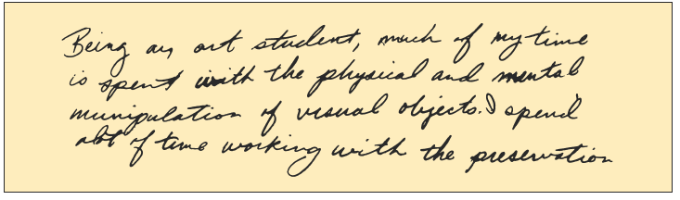
Graphology
Graphology (handwriting analysis)
  Assumes that handwriting reflects basic personality traits.
  Graphology’s validity is highly suspect.
Handwriting Exhibit Used by Graphologist
Source: Reproduced with permission from Kathryn Sackhein, Handwriting Analysis and the Employee Selection Process (New York: Quorum Books, 1990), p. 45.
Figure 6–8

Slide 37
Physical Examination
Reasons for preemployment medical examinations:
  To verify that the applicant meets the physical requirements of the position
  To discover any medical limitations you should take into account in placing the applicant.
  To establish a record and baseline of the applicant’s health for future insurance or compensation claims.
  To reduce absenteeism and accidents
  To detect communicable diseases that may be unknown to the applicant.

Slide 38
Substance Abuse Screening
Types of screening:
  Before formal hiring
  After a work accident
  Presence of obvious behavioral symptoms
  Random or periodic basis
  Transfer or promotion to new position
Types of tests
  Urinalysis
  Hair follicle testing

Slide 39
Key Terms
negligent hiring
reliability
test validity
criterion validity
content validity
expectancy chart
interest inventory
work samples
work sampling technique
management assessment center

