Slide 1
Ethics, Justice, and Fair Treatment in HR Management

Slide 2

After studying this chapter, you should be able to:
Explain what is meant by ethical behavior at work.
Discuss important factors that shape ethical behavior at work.
Describe at least four specific ways in which HR management can influence ethical behavior at work.
Employ fair disciplinary practices.
List at least four important factors in managing dismissals effectively.
14–<number>
<footer>© 2005 Prentice Hall Inc. All rights reserved.

Slide 3
Ethics and Fair Treatment at Work
Ethics
  The principles of conduct governing an individual or a group; specifically, the standards you use to decide what your conduct should be.
  Ethical behavior depends on the person’s frame of reference.

Slide 4
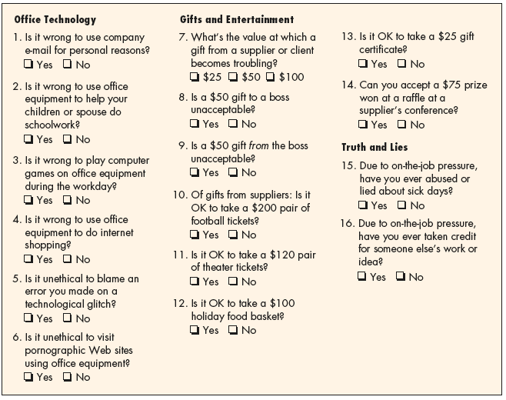
The Wall Street Journal Workplace-Ethics Quiz
Source: Wall Street Journal, October 21, 1999, pp. B1–B4; Ethics Officer Association, Belmont, MA; Ethics Leadership Group, Wilmette, IL; surveys sampled a cross-section of workers at large companies and nationwide.
Figure 14–1

Slide 5
Factors affecting ethical decisions
Normative judgments
  Judging something as good or bad, right or wrong, better or worse.
Moral standards (Morality)
  Society’s accepted standards for behaviors that have serious consequences to its well-being.
    Behaviors that cannot be established or changed by decisions of authoritative bodies.
    Behaviors that override self-interest.

Slide 6
Ethics and Fair Treatment at Work (cont’d)
Ethics and the law
  An behavior may be legal but unethical.
  An behavior may be illegal but ethical.
  An behavior may be both legal and ethical.
  An behavior may be both illegal and unethical.

Slide 7
Ethics, Fair Treatment, and Justice
Distributive justice
  The fairness and justice of a decision’s result.
Procedural justice
  The fairness of the process by which the decision was reached.
Interactional (interpersonal) justice
  The manner in which managers conduct their interpersonal dealings with employees.

Slide 8
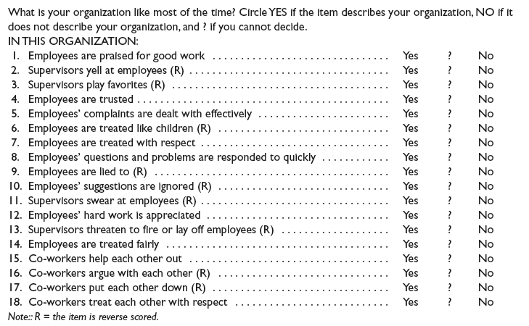
Perceptions of Fair Interpersonal Treatment Scale
Sources: Michelle A. Donovan et al., “The Perceptions of Their Interpersonal Treatment Scale: Development and Validation of a Measure of Interpersonal Treatment in the Workplace,” Journal of Applied Psychology 83, no. 5 (1998), p. 692. Copyright © 1997
by Michelle A. Donovan, Fritz Drasgow, and Liberty J. Munson at the University of Illinois at Urbana-Champaign. All rights reserved.
Figure 14–2

Slide 9
What Shapes Ethical Behavior at Work?
Individual factors
Organizational factors
The boss’s influence
Ethics policies and codes
The organization’s culture

Slide 10
Employees and Ethical Dilemmas
Questions employees should ask when faced with ethical dilemmas:
  Is the action legal?
  Is it right?
  Who will be affected?
  Does it fit the company’s values?
  How will it “feel” afterwards?
  How will it look in the newspaper?
  Will it reflect poorly on the company?

Slide 11
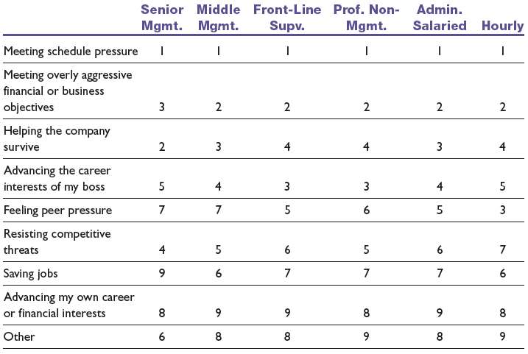
Principal Causes of Ethical Compromises
Note: 1 is high, 9 is low.
Sources: O.C. Ferrell and John Fraedrich, Business Ethics, 3rd ed. (New York: Houghton Mifflin, 1997), p. 28; adapted from Rebecca Goodell, Ethics in American Business: Policies, Programs, and Perceptions (1994), p. 54. Permission provided courtesy of the Ethics Resource Center, 1120 6th Street NW, Washington, DC: 20005.
Table 14–1

Slide 12
What Is Organizational Culture?
Organization culture
  The characteristic values, traditions, and behaviors a company’s employees share.
How is culture is revealed?
  Ceremonial events
  Written rules and spoken commands.
  Office layout
  Organizational structure
  Dress codes
  Cultural symbols and behaviors
  Figureheads

Slide 13
The Manager’s Role in Creating Culture
Clarify expectations for values to be followed.
Use signs and symbols to signal the importance of values.
Provide physical (the firm’s rewards) support for values.
Use stories to illustrate values.
Organize rites and ceremonies reinforcing values

Slide 14
HR’s Role in Fostering Ethics and Fair Treatment
Why treat employees fairly?
  “They’re not employees, they’re people”
    Management guru Peter Drucker
  Avoidance of employee litigation
  Enhanced employee commitment
  Enhanced satisfaction with the organization, with jobs, and with leaders
  Increased organizational citizenship behaviors

Slide 15
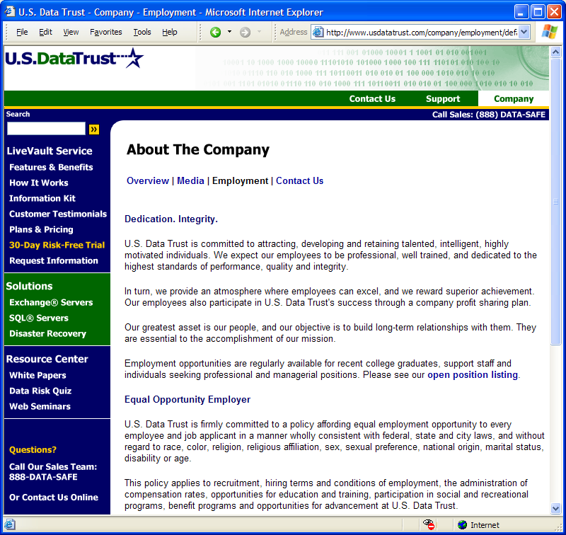
U.S.DataTrust
Source: All contents copyright
© 2002–2004 U.S. Data Trust Corporation. All rights reserved. Privacy policy. Your use of this site indicates your agreement to be bound by the Terms of Use Site Map.
Figure 14–4

Slide 16
HR Ethics Activities
Staffing and selection
  Fostering the perception of fairness in the processes of recruitment and hiring of people.
    Formal procedures
    Interpersonal treatment
    Providing explanation
Training
  How to recognize ethical dilemmas.
  How to use ethical frameworks (such as codes of conduct) to resolve problems.
  How to use HR functions (such as interviews and disciplinary practices) in ethical ways.

Slide 17
HR Ethics Activities (cont’d)
Performance appraisal
  Appraisals that make it clear the company adheres to high ethical standards by measuring and rewarding employees who follow those standards.
Reward and disciplinary systems
  The organization swiftly and harshly punishes unethical conduct.
Workplace aggression and violence
  Taking care that HR actions do not foster perceptions of inequities that translate into dysfunctional behaviors by employees.

Slide 18
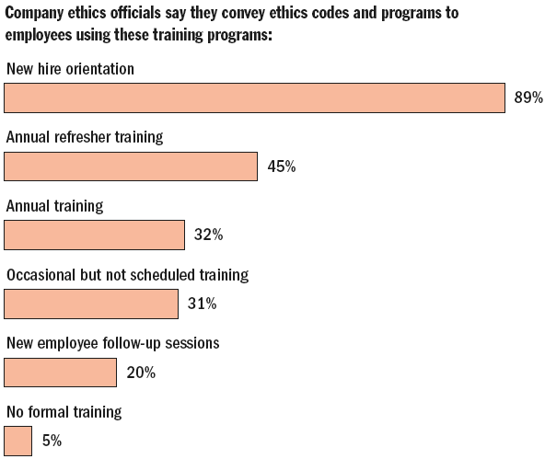
The Role of Training in Ethics
Figure 14–5

Slide 19
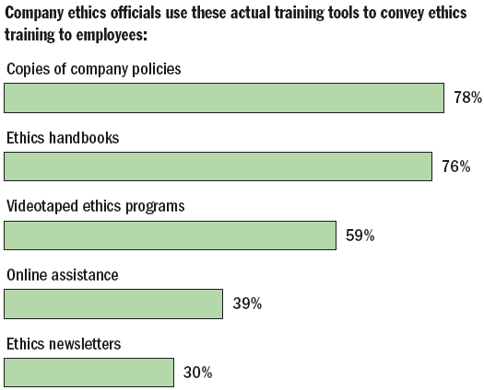
The Role of Training in Ethics (cont’d)
Figure 14–5 (cont’d)

Slide 20
Building Two-Way Communications
Perceptions of fair treatment depend on:
  Engagement—involving individuals in the decisions that affect them by asking for their input and allowing them to refute the merits of others’ ideas and assumptions
  Explanation—ensuring that everyone involved and affected understands why final decisions are made and the thinking that underlies the decisions
  Expectation clarity—making sure everyone knows up front by what standards they will be judged and the penalties for failure.

Slide 21
Employee Discipline and Privacy
Basis for a fair and just discipline process
  Clear rules and regulations
    Define workplace issues
    Inform employees
  A system of progressive penalties
    The range and severity of the penalty is a function of the offense and number of occurrences.
  An appeals process
    The right of the employee to grieve the decision helps to ensure that supervisors mete out discipline fairly and equitably.

Slide 22
Disciplining an Employee
Does the facts support the charge of employee wrongdoing?
Were the employee’s due process rights protected?
Was the employee warned of disciplinary consequences?
Was a rule violated and was it “reasonably related” to the efficient and safe operation of the work environment?
Was the matter fairly and adequately investigated before administering discipline?
Did the investigation produce substantial evidence of misconduct?
Have rules, orders, or penalties been applied evenhandedly?
Is the penalty reasonably related to the misconduct and to the employee’s past work history?
Did the employee have the right to counsel?
Did anger, hearsay, or personal impression affect the decision?

Slide 23
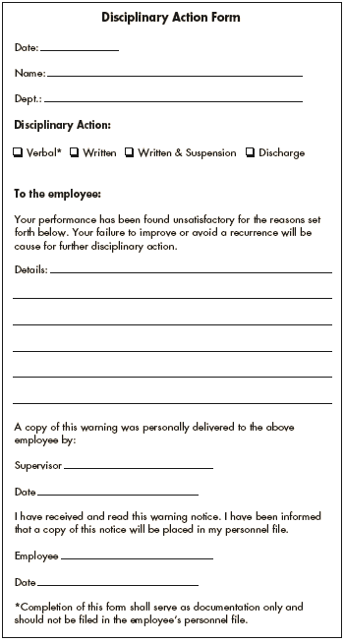
Disciplinary Action Form I
Source: Reprinted with permission of the publisher, HRNext.com. Copyright HRNext.com, 2003.
Figure 14–6

Slide 24
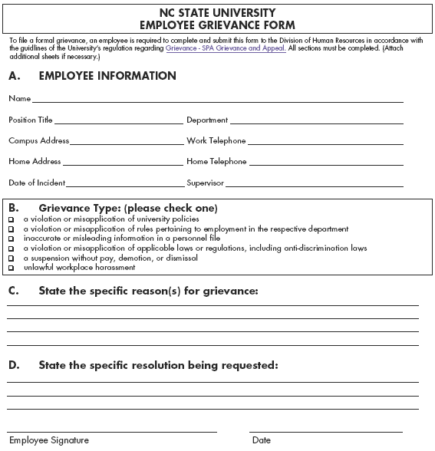
Employee Grievance Form
Source: NC State University. Used with permission.
Figure 14–6

Slide 25
Formal Disciplinary Appeals Processes
FedEx’s guaranteed fair treatment multi-step program
  Step 1: Management review
  Step 2: Officer complaint
  Step 3: Executive appeals review

Slide 26
Discipline without Punishment (Nonpunitive Discipline)
Issue an oral reminder.
Should another incident arise within six weeks, issue a formal written reminder, a copy of which is placed in the employee’s personnel file.
Give a paid, one-day “decision-making leave.”
If no further incidents occur in the next year, the purge the one-day paid suspension from the person’s file.
If the behavior is repeated, the next step is dismissal.

Slide 27
Employee Privacy
Employee privacy violations upheld by courts:
  Intrusion (locker room and bathroom surveillance)
  Publication of private matters
  Disclosure of medical records
  Appropriation of an employee’s name or likeness
Actions triggering privacy violations:
  Background checks
  Monitoring off-duty conduct and lifestyle
  Drug testing
  Workplace searches
  Monitoring of workplace

Slide 28
Employee Privacy (cont’d)
What do employers monitor about employees:
  E-mail activity
  Internet use
  Telephone calls
Employers monitor employees to:
  Improve productivity.
  Protect from computer viruses
  Detect leaks of confidential information
  Guard against liability for illegal acts and harassment suits caused by employee misuse

Slide 29
Restrictions on Workplace Monitoring
The Electronic Communications Privacy Act (ECPA)
  The “business purpose exception” permits employers to monitor communications if they can show a legitimate business reason for doing so.
  The “consent exception” allows employers to monitor communications if they have their employees’ consent to do so.
Common-law provides protections against invasion of privacy.

Slide 30
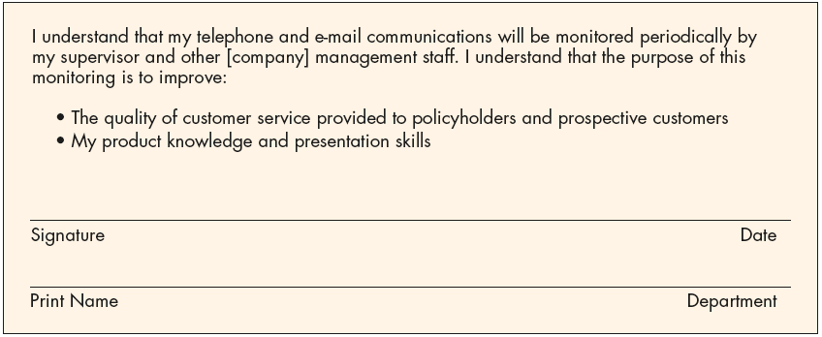
Sample Telephone Monitoring Acknowledgement Statement
Source: Reprinted with permission from Bulletin to Management (BNA Policy and Practice Series) 48, no. 14, Part II, (April 3, 1997), p. 7. Copyright 1997 by The Bureau of National Affairs, Inc.
Figure 14–8

Slide 31
Managing Dismissals
Dismissal
  Involuntary termination of an employee’s employment with the firm.
Terminate-at-will rule
  Without a contract, the employee can resign for any reason, at will, and the employer can similarly dismiss the employee for any reason (or no reason), at will.
  Limitations on “terminate-at-will”
    Violation of public
    Implied contract
    Good faith

Slide 32
Managing Dismissals (cont’d)
Limitations on terminate-at-will
  Public policy exception
    Discharge is wrongful when it was against an explicit, well-established public policy: employee fired or refusing to break the law.
  Implied contract exception
    Employer statements about future employment create a contractual obligation for the employer to continue to employ the employee.
  Covenant of good faith exception
    Suggests that employers should not fire employees without good cause.

Slide 33
Grounds for Dismissal
Unsatisfactory performance
  Persistent failure to perform assigned duties or to meet prescribed standards on the job.
Misconduct in the workplace
  Deliberate and willful violation of the employer’s rules: stealing, rowdy behavior, and insubordination.
Lack of qualifications for the job
  An employee’s inability to do the assigned work although he or she is diligent.
Changed requirements or elimination of the job.
  An employee’s inability to do the work assigned, after the nature of the job has changed.
  Elimination of the employee’s job.

Slide 34
Insubordination
Direct disregard of the boss’s authority.
Flat-out disobedience of, or refusal to obey, the boss’s orders—particularly in front of others.
Deliberate defiance of clearly stated company policies, rules, regulations, and procedures.
Public criticism of the boss. Contradicting or arguing with him or her is also negative and inappropriate.
Blatant disregard of reasonable instructions.
Contemptuous display of disrespect and, portraying these feelings while on the job.
Disregard for the chain of command, shown by going around the immediate supervisor or manager with a complaint, suggestion, or political maneuver.
Participation in (or leadership of ) an effort to undermine and remove the boss from power.

Slide 35
Managing Dismissals (cont’d)
Foster a perception of fairness in the dismissal situation by:
  Instituting a formal multi-step procedure (including warning).
  Having a supervising manager give full explanations of why and how termination decisions were made.
  Establishing a neutral appeal process also fosters fairness.

Slide 36
Avoiding Wrongful Discharge Suits
Bases for wrongful discharge suits:
  Discharge does not comply with the law.
  Discharge does not comply with the contractual arrangement stated or implied by the firm via its employment application forms, employee manuals, or other promises.
Avoiding wrongful discharge suits
  Set up employment policies and dispute resolution procedures that make employees feel treated fairly.
  Do the preparatory work that helps to avoid such suits.

Slide 37
Typical Severance Pay
Nonexempt employee—one week of pay for each year with a minimum of four weeks and maximum of two months.
Exempt employee to $90,000—two weeks for each year with a minimum of two months and a maximum of six months.
Exempt employee over $90,000 to director or VP level—two to three weeks for each year with a minimum of three months and maximum of nine months.
Director or VP to company officer—three weeks for each year with a minimum of four months and maximum of a year.
Officer—usually covered by an employment contract or Change of Control provisions and can be all the way from one year of pay to three or four years, with other perks that may be continued.
Source: www.shrm.org, downloaded March 6, 2004.
Figure 14–9

Slide 38
Steps in Avoiding Wrongful Discharge Suits
Have applicants sign the employment application and make sure it contains a clearly worded statement that employment is for no fixed term and that the employer can terminate at any time.
Review your employee manual to look for and delete statements that could prejudice your defense in a wrongful discharge case.
Have clear written rules listing infractions that may require discipline and discharge, and then make sure to follow the rules.
If a rule is broken, get the worker’s side of the story in front of witnesses, and preferably get it signed. Then make sure to check out the story, getting both sides of the issue.
Be sure to appraise employees at least annually. If an employee shows evidence of incompetence, give that person a warning and provide an opportunity to improve. All evaluations should be in writing and signed by the employee.
Keep careful confidential records of all actions such as employee appraisals, warnings or notices, memos outlining how improvement should be accomplished, and so on.

Slide 39
Steps in Avoiding Wrongful Discharge Suits (cont’d)
A final 10-step checklist would include:
  Is employee covered by any type of written agreement, including a collective bargaining agreement?
  Have any representations been made to form a contract?
  Is a defamation claim likely?
  Is there a possible discrimination allegation?
  Is there any workers’ compensation involvement?
  Have reasonable rules and regulations been communicated and enforced?
  Has employee been given an opportunity to explain any rule violations or to correct poor performance?
  Have all monies been paid within 24 hours after separation?
  Has employee been advised of his or her rights under COBRA?
  Has employee been advised of what the employer will tell a prospective employer in response to a reference inquiry?

Slide 40
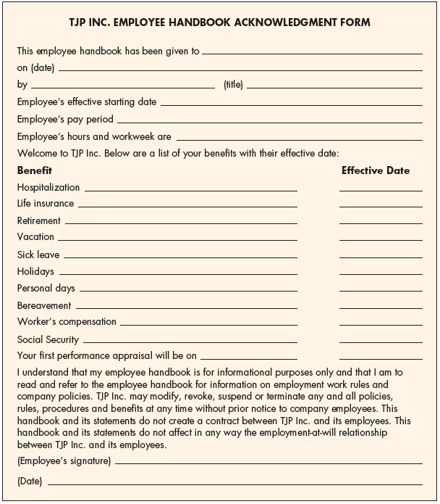
TJP Inc. Employee Handbook Acknowledgment Form
Figure 14–10

Slide 41
Personal Supervisory Liability
Avoiding personal supervisory liability:
  Be familiar with federal, state, and local statutes and know how to uphold their requirements.
  Follow company policies and procedures
  Be consistent application of the rule or regulation is important.
  Don’t administer discipline in a manner that adds to the emotional hardship on the employee.
  Do not act in anger.
  Utilize the HR department for advice regarding how to handle difficult disciplinary matters.

Slide 42
The Termination Interview
Plan the interview carefully.
  Make sure the employee keeps the appointment time.
  Never inform an employee over the phone.
  Allow 10 minutes as sufficient time for the interview.
  Use a neutral site, never your own office.
  Have employee agreements, the human resource file, and a release announcement (internal and external) prepared in advance.
  Be available at a time after the interview in case questions or problems arise.
  Have phone numbers ready for medical or security emergencies.

Slide 43
The Termination Interview (cont’d)
Get to the point.
  Do not beat around the bush by talking about the weather or making other small talk.
  As soon as the employee enters, give the person a moment to get comfortable and then inform him or her of your decision.
Describe the situation.
  Briefly explain why the person is being let go.
  Remember to describe the situation rather than attack the employee personally
  Emphasize that the decision is final and irrevocable.

Slide 44
The Termination Interview (cont’d)
Listen.
  Continue the interview until the person appears to be talking freely and reasonably calmly about the reasons for his or her termination and the support package (including severance pay).
Review all elements of the severance package.
  Describe severance payments, benefits, access to office support people, and the way references will be handled. However, under no conditions should any promises or benefits beyond those already in the support package be implied.

Slide 45
The Termination Interview (cont’d)
Identify the next step.
  The terminated employee may be disoriented and unsure what to do next.
  Explain where the employee should go next, upon leaving the interview.

Slide 46
Termination Assistance
Outplacement Counseling
  A systematic process by which a terminated employee is trained and counseled in the techniques of conducting a self-appraisal and securing a new job appropriate to his or her needs and talents.
    Outplacement does not imply that the employer takes responsibility for placing the person in a new job.
    Outplacement counseling is part of the terminated employee’s support or severance package and is often done by specialized outside firms.

Slide 47
Termination Assistance (cont’d)
Outplacement firms
  Can help the employer devise its dismissal plan regarding:
    How to break the news to dismissed employees.
    Deal with dismissed employees’ emotional reactions.
    Institute the appropriate severance pay and equal opportunity employment plans.

Slide 48
Interviewing Departing Employees
Exit Interview
  Its aim is to elicit information about the job or related matters that might give the employer a better insight into what is right—or wrong—about the company.
    The assumption is that because the employee is leaving, he or she will be candid.
    The quality of information gained from exit interviews is questionable.

Slide 49
Exit Interview Questions
How were you recruited?
Why did you join the company?
Was the job presented correctly and honestly?
Were your expectations met?
What was the workplace environment like?
What was your supervisor’s management style like?
What did you like most/least about the company?
Were there any special problem areas?
Why did you decide to leave, and how was the departure handled?

Slide 50
The Plant Closing Law
Worker Adjustment and Retraining Notification Act (1989)
  Requires employers of 100 or more employees to give 60 days’ notice before closing a facility or starting a layoff of 50 people or more.
  The law does not prevent the employer from closing down, nor does it require saving jobs.
  The law is intended to give employees time to seek other work or retraining by giving them advance notice of the shutdown.

Slide 51
The Plant Closing Law (cont’d)
Worker Adjustment and Retraining Notification Act (1989)
  Employment losses covered by the law:
    Terminations other than discharges for cause, voluntary departures, or retirement
    Layoffs exceeding six months
    Reductions of more than 50% in employee’s work hours during each month of any six-month period.
  Penalty for failing to give notice
    One day’s pay and benefits to each employee for each day’s notice that should have been given, up to 60 days.

Slide 52
Layoffs
Layoff are not terminations.
Temporary layoffs occur when:
  There is no work available for employees.
  Management expects the no-work situation to be temporary and probably short term.
  Management intends to recall the employees when work is again available.

Slide 53
Bumping/Layoff Procedures
Seniority is usually the ultimate determinant of who will work.
Seniority can give way to merit or ability, but usually only when no senior employee is qualified for a particular job.
Seniority is usually based on the date the employee joined the organization, not the date he or she took a particular job.
Companywide seniority allows an employee in one job to bump or displace an employee in another job, provided the more senior person can do the job without further training.

Slide 54
Alternatives to Layoffs
Voluntarily reducing employees’ pay to keep everyone working.
Concentrating employees’ vacations during slow periods.
Taking voluntary time off to reduce the employer’s payroll.
Taking a “rings of defense approach” by hiring temporary workers that can be let go early.
Offering buyout packages to find enough volunteers to avoid dismissing people.

Slide 55
Adjusting to Downsizings and Mergers
Guideline for implementing a reduction in force:
  Identify objectives and constraints.
  Form a downsizing team.
  Address legal issues.
  Plan post-reduction actions.
  Address security concerns.

Slide 56
Adjusting to Downsizings and Mergers (cont’d)
Guidelines for treatment of departing employees during a merger:
  Avoid the appearance of power and domination.
  Avoid win–lose behavior.
  Remain businesslike and professional.
  Maintain a positive feeling about the acquired company.
  Remember that how the organization treats the acquired group will affect those who remain.

Slide 57
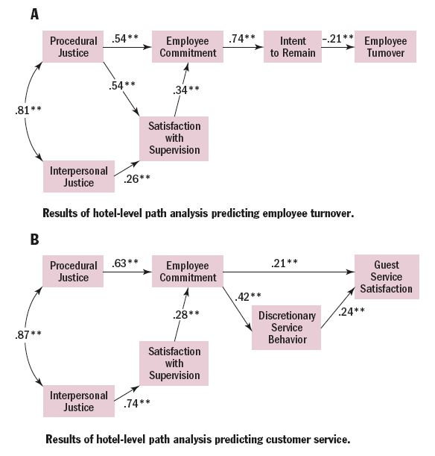
Employee Morale and Behavior Improves When Justice Prevails
Source: Tony Simons and Quinetta Roberson, " Why Managers Should Care about Fairness. The Effects of Aggregate Justice Perceptions on Organizational outcomes,” Journal of Applied Psychology 88, no. 3 (2003), p. 432.

Slide 58
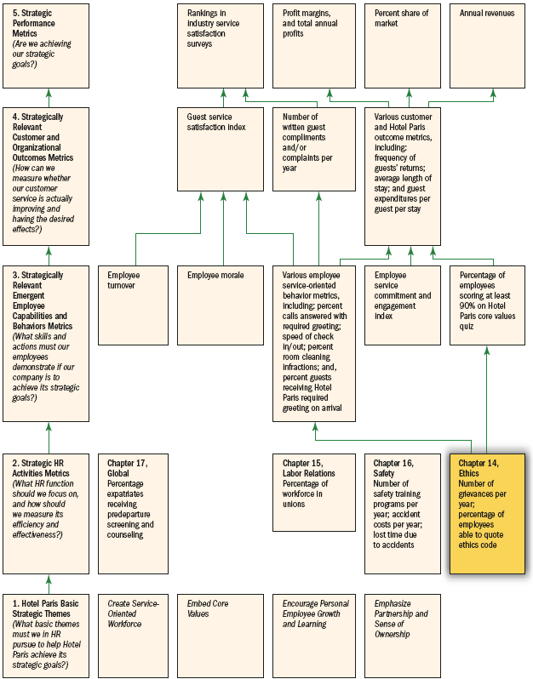
HR Scorecard for Hotel Paris International Corporation*
Note: *(An abbreviated example showing selected HR practices and outcomes aimed at implementing the competitive strategy, “To use superior guest services to differentiate the Hotel Paris properties and thus increase the length of stays and the return rate of guests and thus boost revenues and profitability”)
Figure 14–12

Slide 59
Key Terms
ethics
distributive justice
procedural justice
interactional (interpersonal) justice
organizational culture
nonpunitive discipline
Discipline without punishment
Electronic Communications Privacy Act (ECPA)
dismissal
unsatisfactory performance
misconduct
insubordination
wrongful discharge
termination interview
outplacement counseling
exit interviews
bumping/layoff procedures
downsizing

